Slide 1
IGGI Centre for Doctoral Training
Joe Cutting
IGGI PhD student, University of York

Slide 2
Not a research group
Most students belong to another group
We don’t run seminars – we have a mailing list

Slide 3
Centre for Doctoral Training
Funds 56+ PhD students across 4 universities
(York, Goldsmiths, Essex and Queen Mary)
York currently has 16 students
We’ll be recruiting another 4 this year

Slide 4
IGGI does games research
Intelligent Games
Games Intelligence

Slide 5
Intelligent games

Slide 6
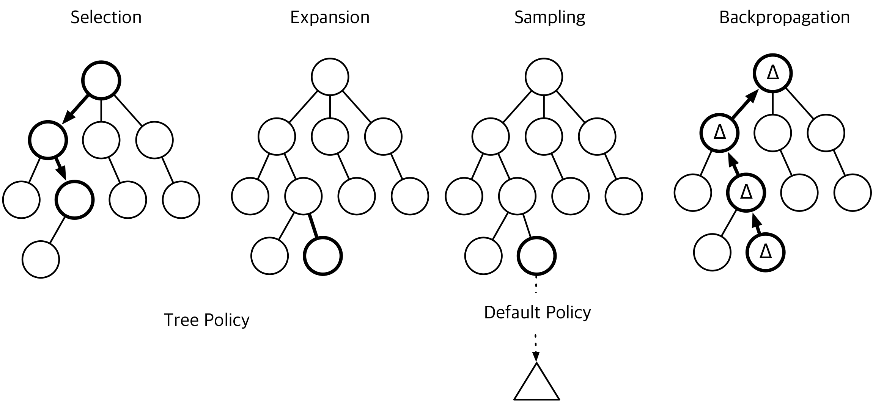
Matthew Bedder: Abstraction-Based Monte Carlo Tree Search
Daniel Hernandez: Multi-Agent Reinforcement Learning for Game AI
Adam Sattaur: Deep learning for game AI
Lizzie Viallis: SAT solvers to create a more satisfying opponents
Peter York: AI to play DOTA

Slide 7
Games intelligence?

Slide 8
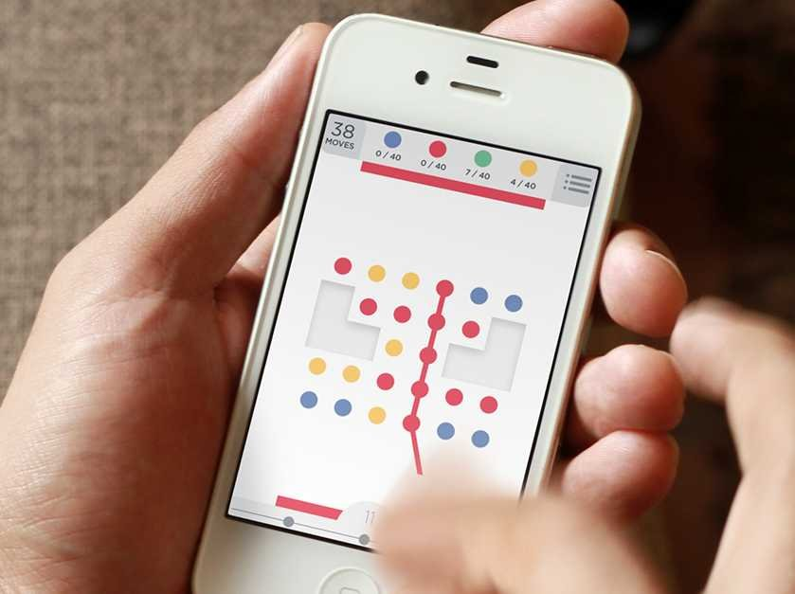
Joe Cutting: Measuring the experience of playing self-paced games
Rory Davidson: Learning and Strategy Acquisition in Digital Games
Myat Aung: Studying videogame immersion using neuroimaging methods
Sam Hughes: Emotion and immersive audio
Athansios Kokkinakis: Videogame Correlates of Real-Life Cognitive Traits

Slide 9
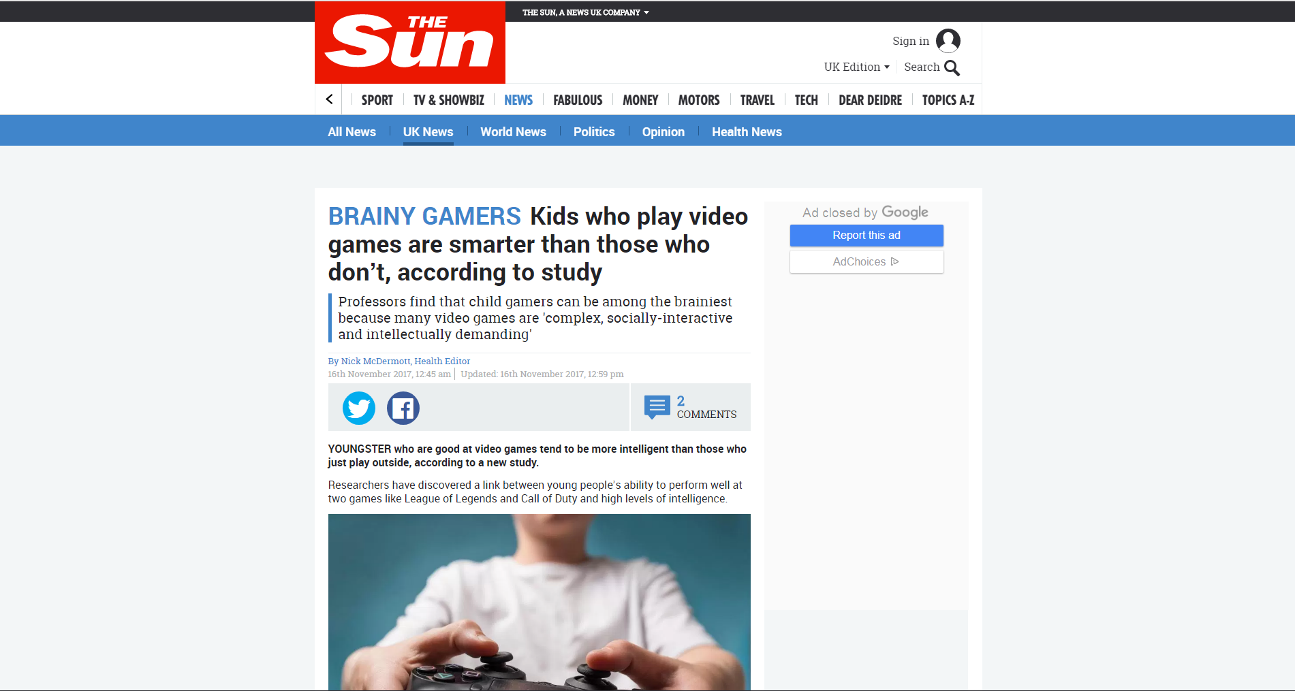

Slide 10
Game design, culture etc

Slide 11
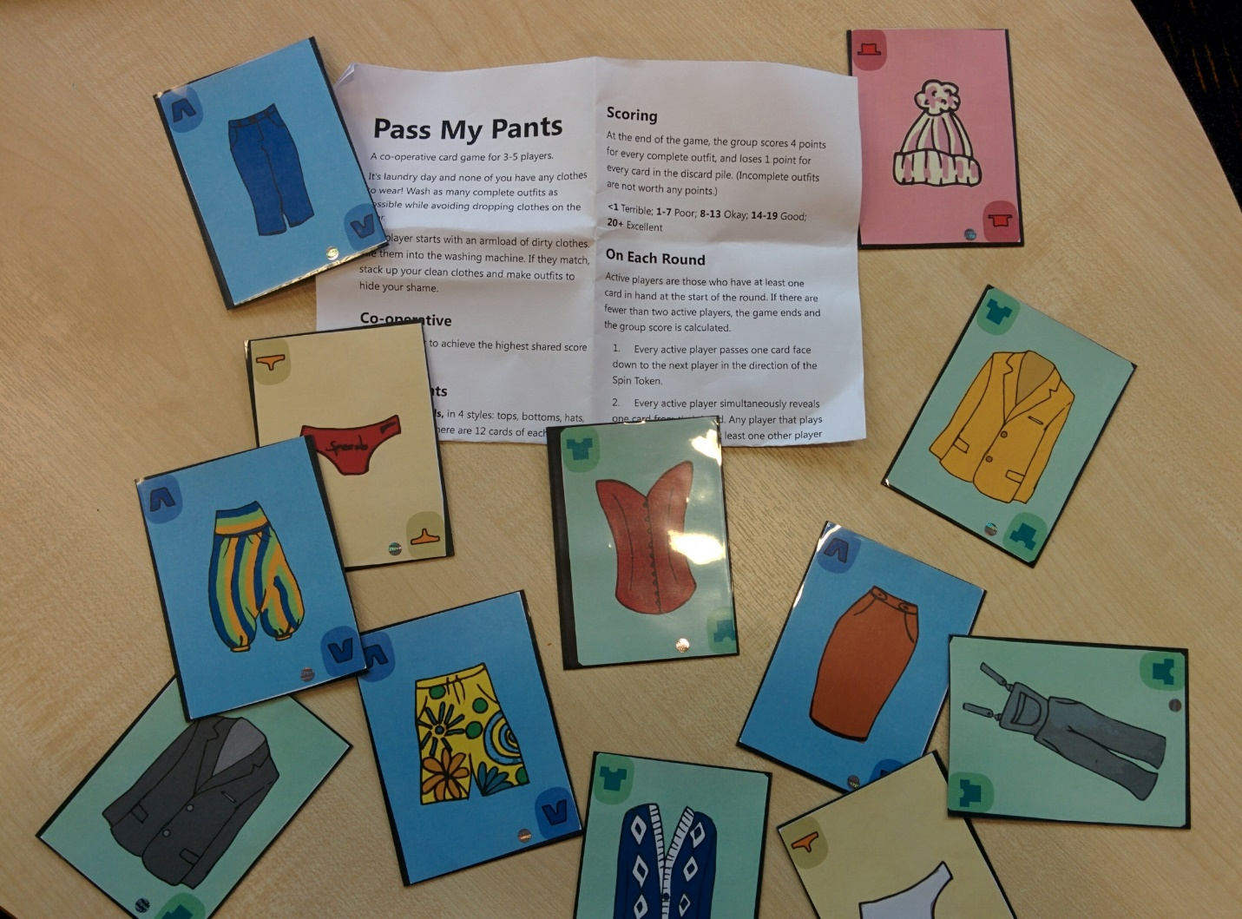
David Gundry: Games to gather linguistic data
Lisa (Sha Li): Gifting in games
Jen Beeston: Games for people with disabilities
Thryn Henderson: Vignette games
Carlos Gonzalez Diaz: Bespoke motion controllers and VR
Joseph Hesketh: Adaptive tutorials for eSports Games

Slide 12
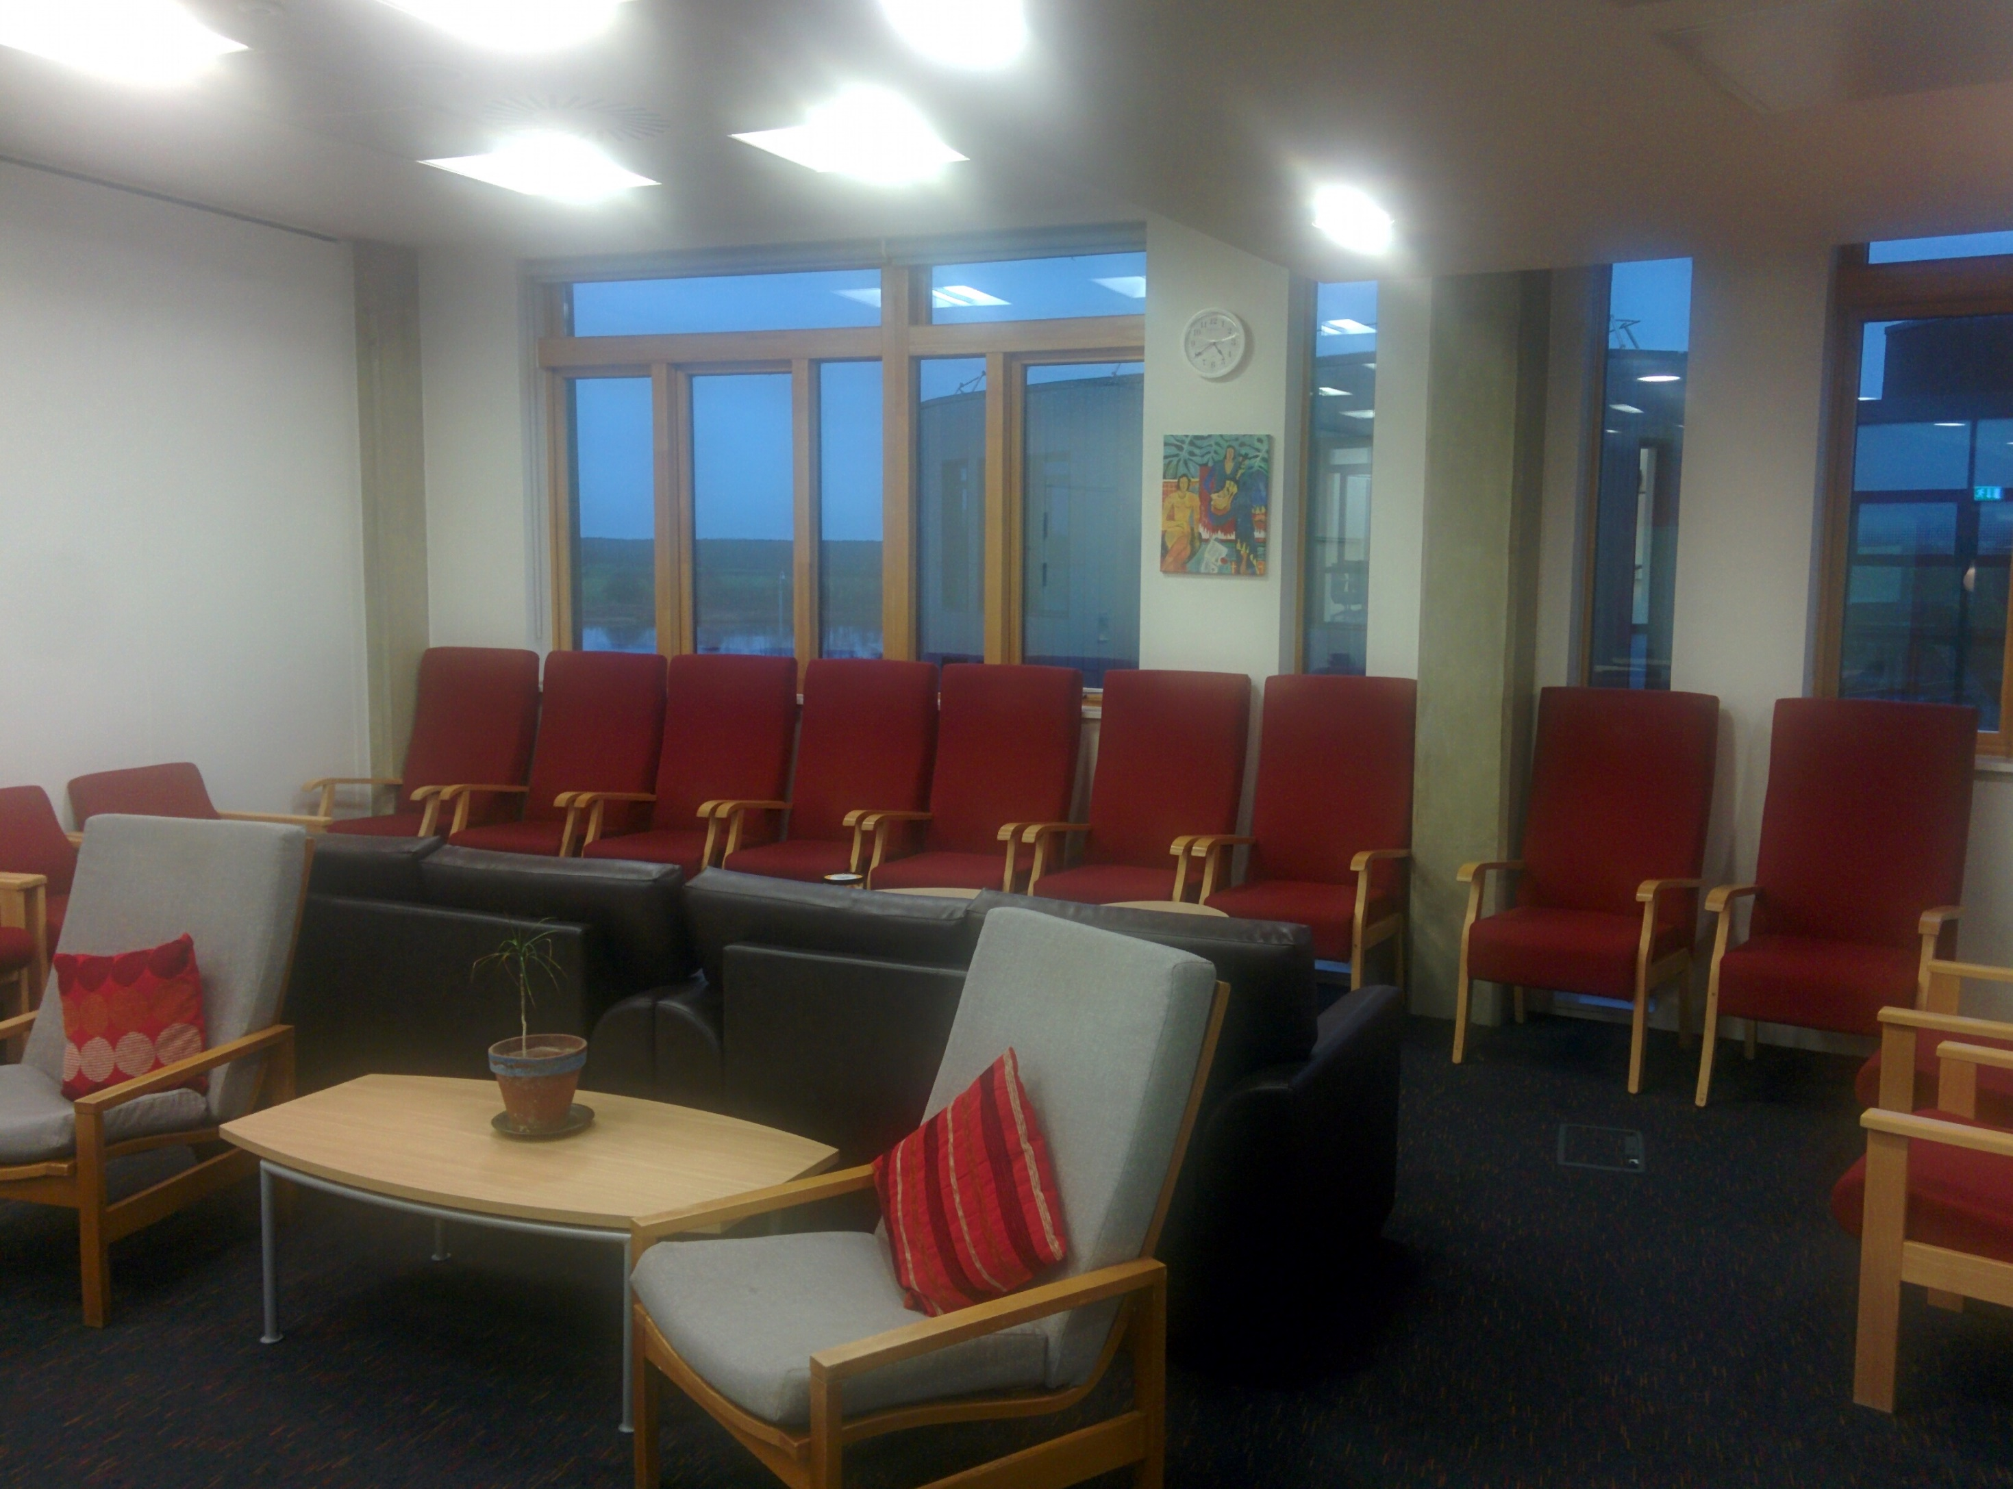
Based in YCCSA in the Ron Cooke Hub

