Slide 1

Non-Standard Computation
What is “computation”?
Computation is often described as any calculation that can be modeled or described by an algorithm.
However, computation is not tied to numbers, acronyms, punctuation, or syntax. Computation is an idea in flux.
E.g. If computation is information processing is not the whole universe a computer? Then what is or isn’t computation…?
Computation is in some sense in the eye of the beholder, and we can choose to perceive many "natural" devices as performing computations.
Notes:
At the logical extreme, if computation is defined as information processing is not the whole universe a computer? Then what is or isn’t computation?

Slide 2
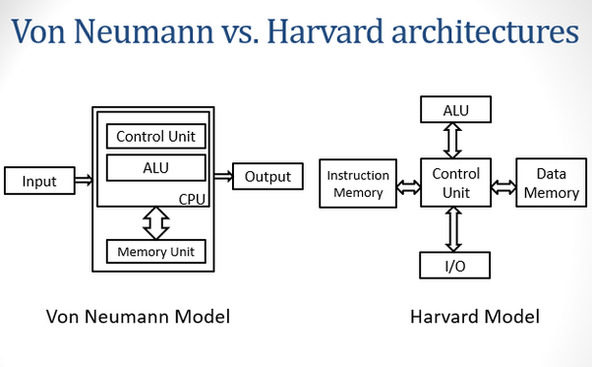

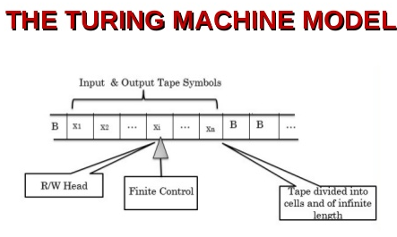
Non-Standard Computation
NSC Focus
Reality-based computing approaches that seek inspiration from the natural world (mainly biology and physics).
Exploring new computational paradigms that break the classical computational assumptions.
Examples:
Embodied in physics (non-Turing)
Non-Von Neumann & non-symbolic
Biologically-inspired
Emergent
Notes:
A Turing machine has infinite discrete memory capacity. Ordinary biologicalsystems have finite memory capacity.

Slide 3

Non-Standard Computation
NSC Research Group?

Slide 4

Non-Standard Computation
Well, sort of…

Slide 5
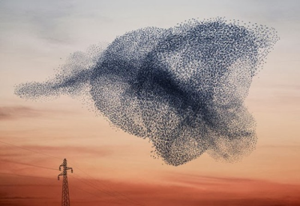
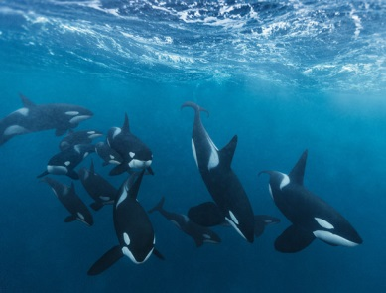
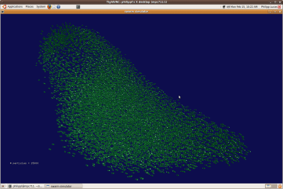
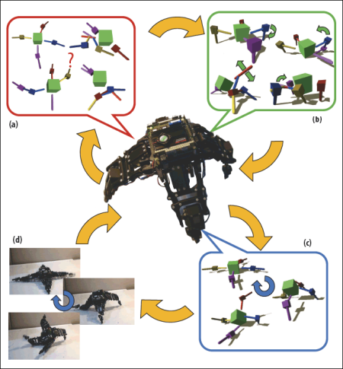

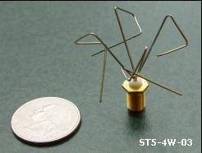
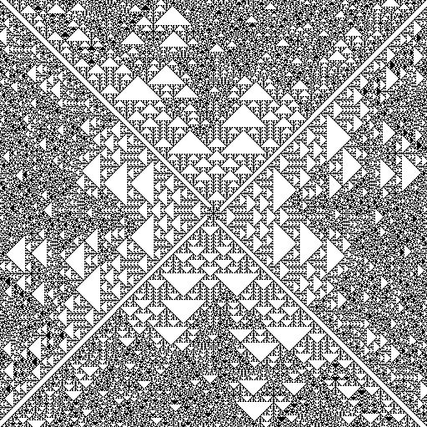
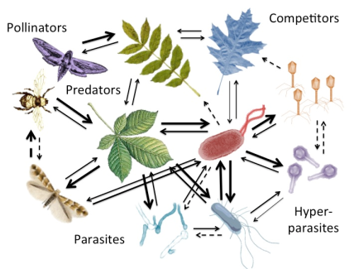
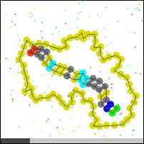
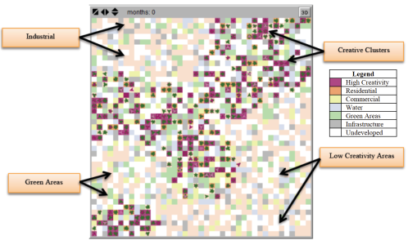
NCS Areas of Research
Bio-inspired algorithms and hardware
Artificial immune systems
Swarm robotics
Self-organising systems and social networks
Evolutionary algorithms and computation
Evolvable hardware (nanosystems/robotics/CMOS chips)
Open-ended Evolution
Coevolution
Reflective Evolution
Complex Systems
Artificial Chemistries
Agent-based modelling
Cellular Automata
Computational Modelling

Slide 6
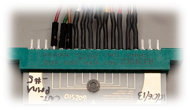
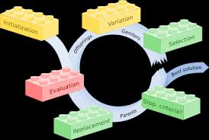
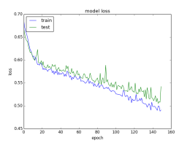
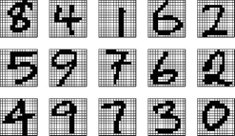
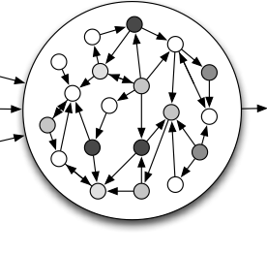
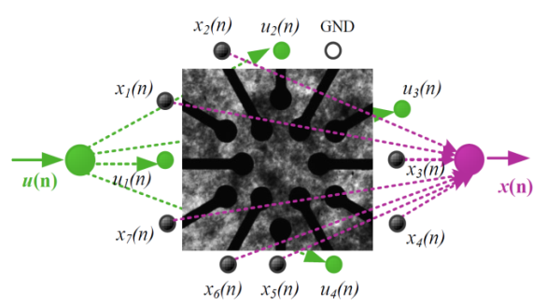








Example: Computing with Matter (in materio)
My Research
Train and exploit matter (primarily carbon nanotube composites) to perform complex tasks such as pattern recognition, classification and robot control.
Evolve physical material (inputs-outputs/stimulus) to solve task
Reservoir Computing model
(Recurrent Neural Network)
$$W$$
$$y_{Target(n)}$$
$$W_{in}$$
$$x(n)$$
$$y(n)$$
$$W_{out}$$
-
e.g. Pattern
Recognition
$$u(n)$$
$$E$$

