Slide 1

DEPARTMENT OF COMPUTER SCIENCE
The Quantum Information Group
Riccardo Laurenza
CSRSS group presentation seminar –15 Feb 2018

Slide 2
QUANTUM INFORMATION AND QUANTUM TECHNOLOGY
Nature behaves quantum mechanically at the very small scales
Quantum theory has opened to us the microscopic world of particles, atoms and photons
It can be harnessed to improve new tools for communication, measurement and computing

Slide 3
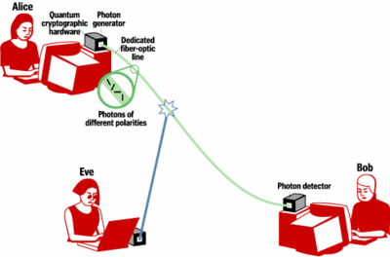
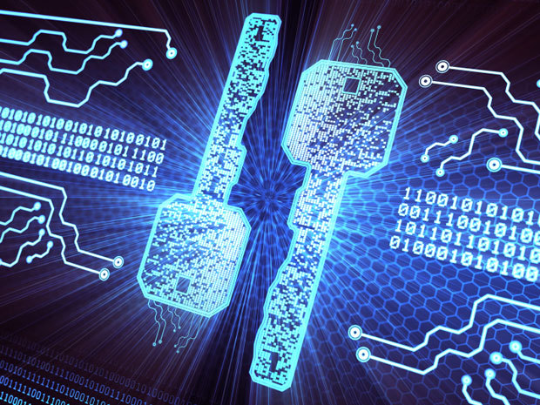
QUANTUM CRYPTOGRAPHY
Alice and Bob use qubits to establish the key. Eve cannot measure these qubits without disturbing them. She will always get caught
Quantum features allow two parties to share random numbers which nobody else can learn
Quantum secure communication systems use quantum effects to secure sensitive data transmissions, such as bank transactions.

Slide 4
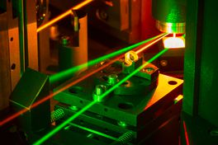
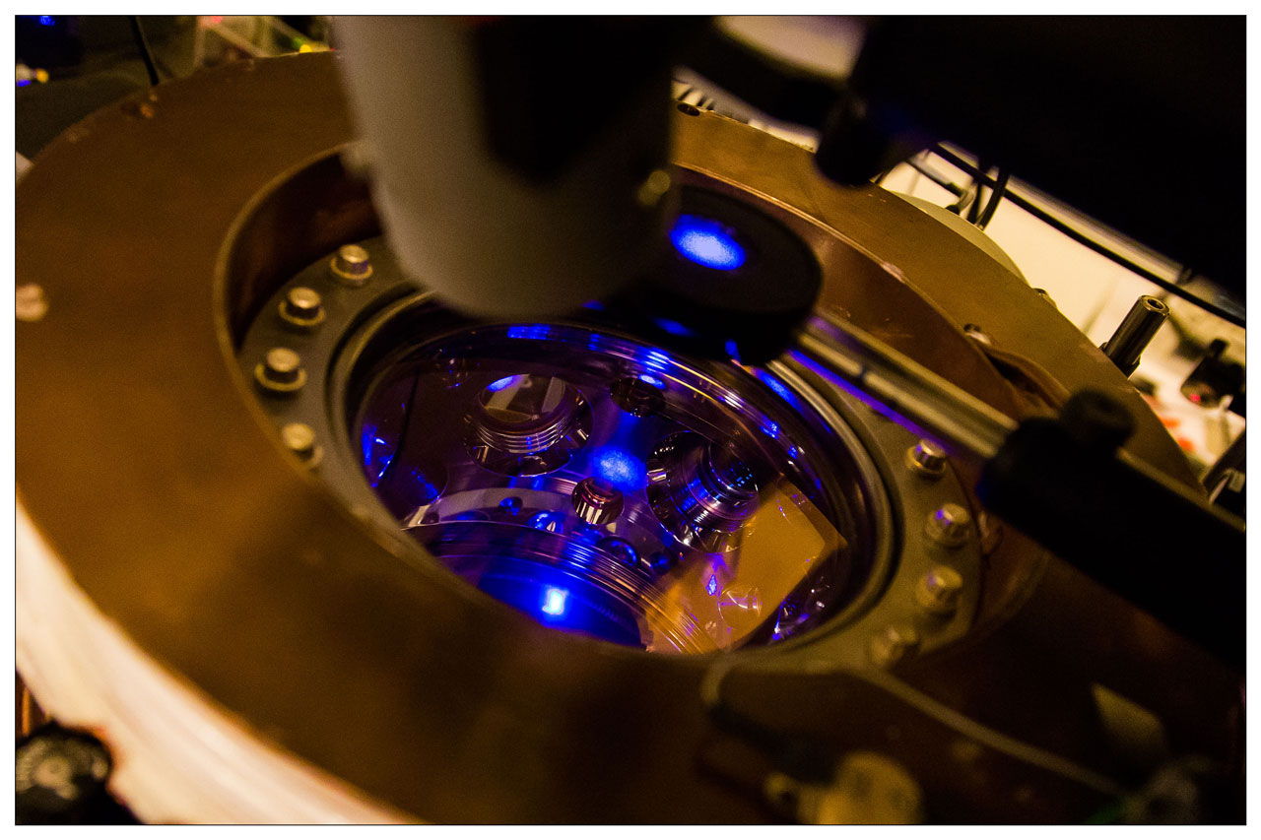
QUANTUM METROLOGY AND SENSING
Engineered quantum states can be much more sensitive to the variations of measurable quantities than classical measurement instruments
Accurate timing, enhanced imaging and sensing

Slide 5
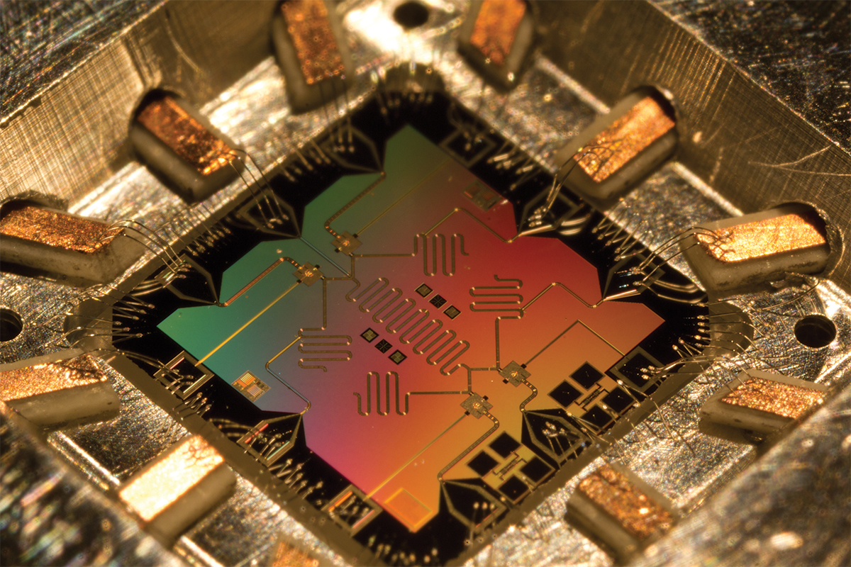
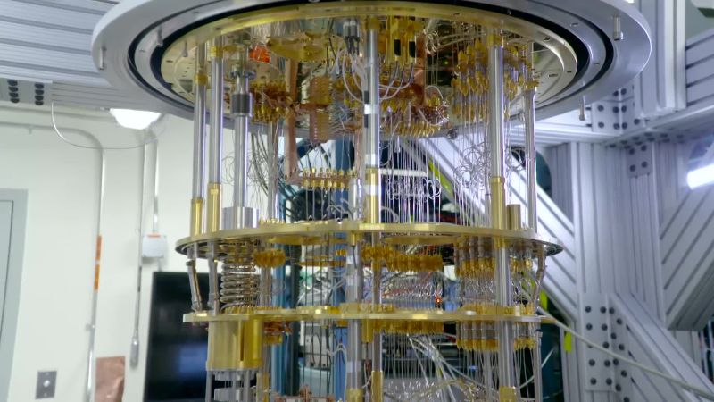
QUANTUM COMPUTING
Computers power and speed are exponentially increasing → The size of the bits has continuously decreased due to technological improvements
The bit dimension will soon reach atom’s size. Increase in the power exploiting quantum effects (state superposition and entanglement)
machine learning, image recognition, optimization, large number factorization, etc.
J. Biamonte, et al. Nature volume 549, pages 195–202 (14 September 2017)

Slide 6





UK NATIONAL QT PROGRAMME

Slide 7
UK NATIONAL QT PROGRAMME

Slide 8
THE QUANTUM HUB
UNIVERSITIES
INDUSTRIES
York (leader)
Leeds
Cambridge
Sheffield
Bristol
Strathclyde Glasgow
Heriot Watt Edinburgh
Royal Holloway London
Toshiba Group
British Telecom
NATIONAL PHYSICAL LABORATORY
ID Quantique
ADVA
Qumet
….and many more

Slide 9
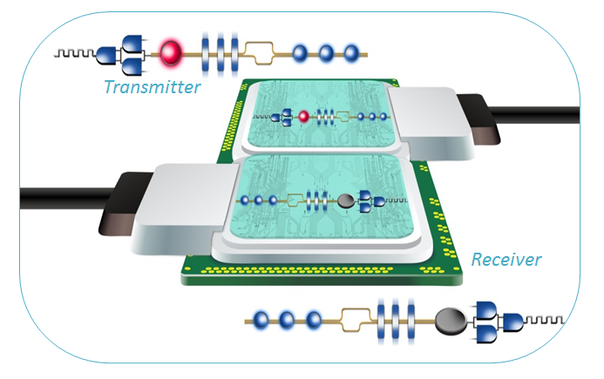
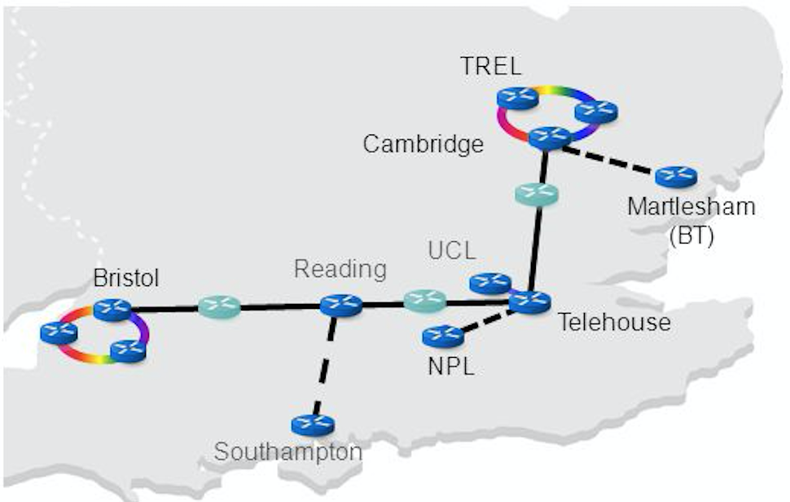
SOME OF THE MAIN GOALS
Short-range, Free-space QKD
Chip-scale QKD devices
Large scale Quantum Communications Networking
Next generation Quantum Communications
Quantum Digital Signature
Quantum Repeaters
Measurement Device Independent QKD

Slide 10
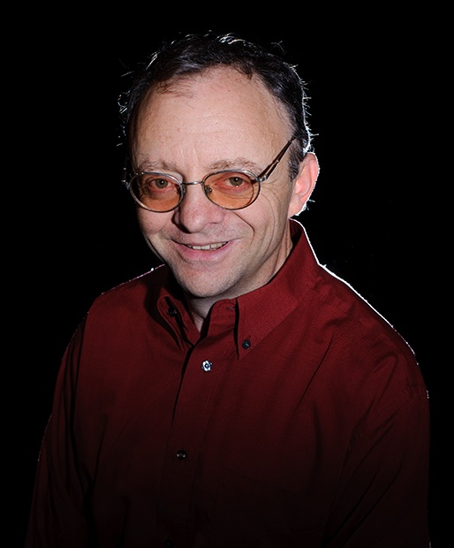
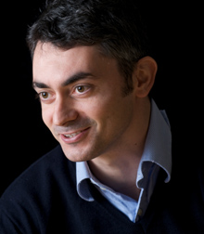
OUR RESEARCH GROUP
GROUP LEADERS
Pr. Samuel L. Braunstein
Pr. Stefano Pirandola

Slide 11
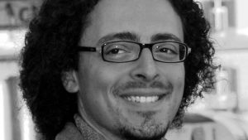
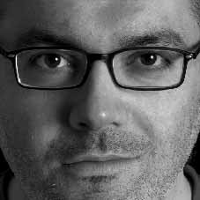
OUR RESEARCH GROUP
RESEARCH ASSOCIATES
Dr. Cosmo Lupo
Continuous variable QKD
Measurement device independent quantum cryptography
Quantum metrology
Quantum Shannon theory
Dr. Carlo Ottaviani
Continuous variable QKD
Measurement device independent quantum cryptography
Quantum optics

Slide 12
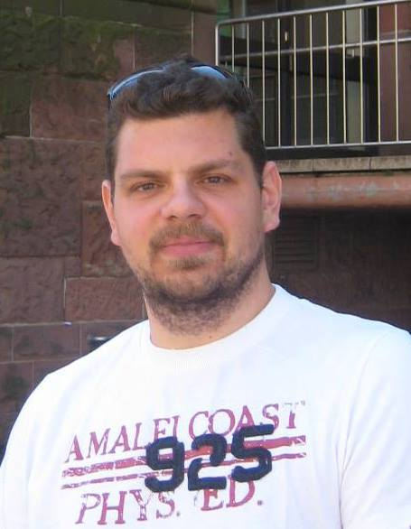
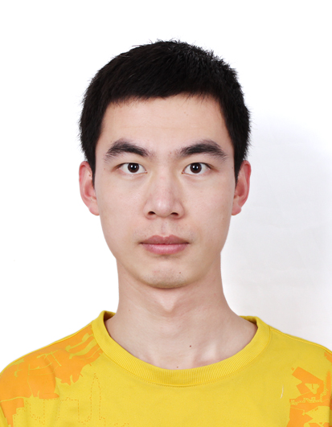
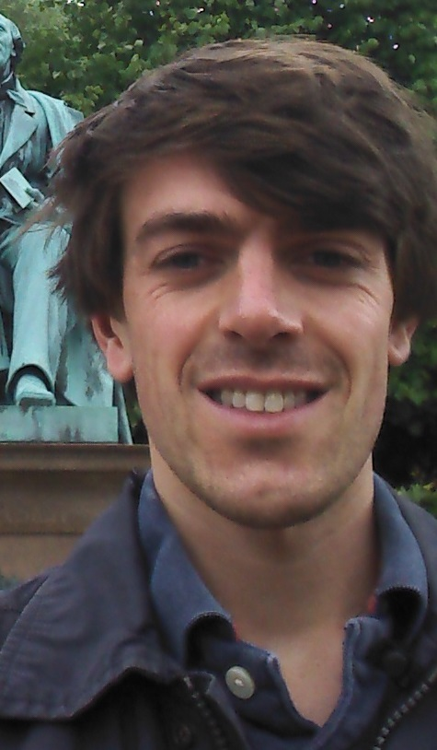
OUR RESEARCH GROUP
PhD STUDENTS
Panagiotis Papanastasiou
Zhiwei Wang
QKD with continuous variables
MDI QKD
Thermodynamics of Black Holes
Quantum Information and Black Holes
Thomas Cope
Me
Quantum communication
QKD with inefficient devices
Quantum Metrology
Quantum channel capacities
Quantum Shannon Theory
Quantum Metrology & QKD

Slide 13
OUR RESEARCH GROUP
PhD STUDENTS
Jason Pereira: Security of quantum communications against hacking, e.g. side channel attacks, continuous variable protocols.
Athena Karsa: Quantum Illumination, Quantum Radar, Quantum Sensing, Quantum Machine Learning
Kieran Wilkinson: Quantum butterfly network, Quantum communication

