Slide 1

Real-Time Systems Group
Spring 2018

Slide 2
Real-Time Systems Group
Established in 1990, it has undertaken research into all aspects of the design, implementation and analysis of real-time systems and is one of the world leading groups in this area
Research is structured around the interests of the permanent academic staff:
  Prof Neil Audsley
  Dr Iain Bate
  Prof Alan Burns
  Dr Rob Davis
  Dr Ian Gray
  Dr Leandro Soares Indrusiak
  Prof Andy Wellings (emeritus)

Slide 3
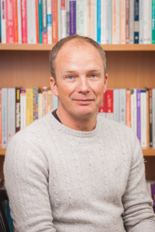
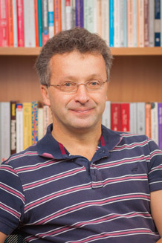
Real-Time Systems Group
Neil Audsley
  high performance embedded real-time systems, including:
    architectures – CPU, memory, interconnect
    system SW: OS, kernels, virtualisation
    timing analysis and simulation
Iain Bate
  dependable real-time systems
  wireless sensor networks
  design and certification of safety-critical systems
  scheduling and timing analysis

Slide 4

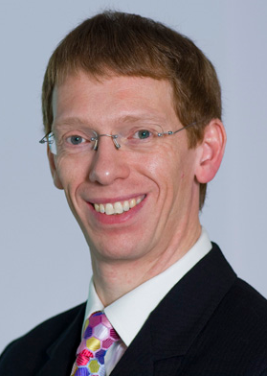
Real-Time Systems Group
Alan Burns
  scheduling theory of all sorts
  mixed criticality systems
  real-time programming languages
  Timebands – layered specifications of RTS
Rob Davis
  scheduling and schedulability analysis
    single processor, multiprocessor, networks (CAN)
  mixed criticality systems
  probabilistic real-time systems
  cache related pre-emption delays

Slide 5
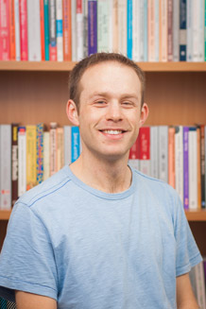
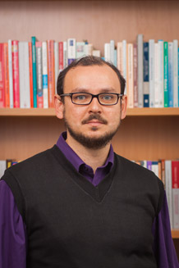
Real-Time Systems Group
Ian Gray
  real-time systems and their programming models
  embedded systems, FPGAs and reconfigurable computing
  many-core and multicore systems
  application-specific, high-performance and cloud computing
Leandro Soares Indrusiak
  static and dynamic resource allocation heuristics
    real-time constraints, energy efficiency, load balancing, mixed-criticality, thermal balance, reliability, security
  multiprocessor and distributed systems
    networks-on-chip, internet-of-things, grid/cloud
  fast and accurate analytical and simulation models
    timing, energy dissipation

Slide 6
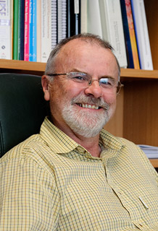
Real-Time Systems Group
Andy Wellings
  support for architecture-neutral real-time systems
  impact of multicore platforms on real-time languages (Ada, Java) and operating systems (POSIX)
  transforming Java into a production quality platform for high-integrity and real-time embedded systems
  real-time Big Data Systems

Slide 7










Real-Time Systems Group - Projects
Cloud-based Situational Analysis for Factories providing Real-Time Reconfiguration Services
cloud-based optimisation under real-time constraints
case studies: white goods manufacture, EDM, industrial processes
programmability of reconfigurable multi-core and heterogeneous hardware platforms
case studies: telecom, surveillance, HPC
STRATA
Layers for Structuring Trustworthy Ambient Systems
MCCPS
cross-layer design for fault-tolerance, time-predictability and energy-efficiency
case studies: internet-of-things, cloud
mixed-criticality scheduling of computation and communication in cyber-physical systems
case studies: wireless networks

Slide 8
Real-Time Systems Group http://www.cs.york.ac.uk/rts

