Slide 1


pulse.
CARE, CONNECTED
Pulse
Care, connected
A wearable patient-monitoring prototype for A&E
Mohammed Sherif Mostafa Issa
Maham Ali Elysha Ruddock
PULSE / HEALTHCARE HACKATHON PROTOTYPE
01
Notes:
0:00-0:20. Introduce Pulse and the team. Suggested opening: Pulse is our healthcare hackathon prototype for helping patients and staff stay connected while patients wait in A&E. Use the next six slides for the pitch, then Questions. Slide 8 is a spare editable layout. The waveform is decorative, not a measured ECG. Design source: static/styles.css, static/favicon.svg and templates/macros.html.

Slide 2
pulse.
THE PROBLEM
The waiting-room gap
A patient's condition can change while they wait
Patients need a way to share changes and ask for help.
Staff need a clear view of readings and items awaiting review.
PULSE / HEALTHCARE HACKATHON PROTOTYPE
02
Notes:
0:20-0:50. Explain the intended problem in ordinary language. Avoid claims about measured outcomes, NHS endorsement or clinically validated benefits. These are the product goals described in README.md and docs/website-overview.md.

Slide 3
pulse.
THE PATIENT JOURNEY
One journey through Pulse
01
Choose a hospital
02
Share symptoms
Search a postcode and compare the supported hospitals.
Complete and review the intake form.
03
Confirm arrival
04
Stay in contact
Staff check in the patient and assign a band.
View readings and send updates to human staff.
PULSE / HEALTHCARE HACKATHON PROTOTYPE
03
Notes:
0:50-1:25. Explain the implemented demo journey. Registration and hospital selection do not confirm physical arrival. Waiting starts after staff-confirmed check-in. Hospital counts are simulated and selection is not a booking. Source: pulse/services.py and templates/hospitals.html, intake.html, patient.html.

Slide 4
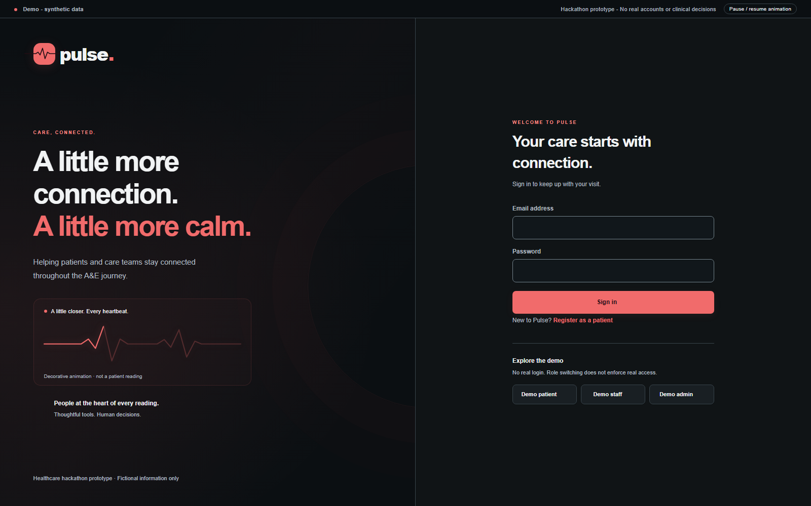
pulse.
THE WEBSITE
The Pulse website
Python Flask
HTML templates
CSS styling
Patient, staff and admin views
Human chat and visit history
PULSE / HEALTHCARE HACKATHON PROTOTYPE
04
Notes:
1:25-2:15. Mohammed: I worked on the website interface using Python Flask, HTML templates and CSS, with Codex helping me implement and review it. Patients can submit intake information and contact staff. Staff can check in a patient, assign a demo band and review new symptoms. We separated the interface from the data service so real connections can replace the demo workflow. The Oracle records view reads stored database data. The main patient workflow still uses synthetic data. Source: app.py, pulse/__init__.py, pulse/services.py, pulse/oracle.py and templates/. Screenshot: actual local login screen with fictional demo content. Demo role entry is not real authentication.

Slide 5
pulse.
THE SYSTEM
How the parts connect
01
02
03
04
Wristband
Oracle
Python Flask
Website
Sensor readings
Stored measurements
Protected data requests
Patient and staff views
AI: [add the agreed model input, output and current connection status]
PULSE / HEALTHCARE HACKATHON PROTOTYPE
05
Notes:
2:15-3:15. Handoff to Mostafa, Maham and Elysha. Each teammate should replace the AI placeholder and explain only what they have verified. This is the intended sensor-to-screen path. Website code already includes a protected read-only Oracle client, but a fresh sensor record reaching the correct patient still needs an end-to-end check. The notebook exists without a connected website inference service. No model accuracy or hardware performance claim is included. Sources: pulse/oracle.py, integration/ords_read_api.sql, AI_Training.ipynb and docs/INTEGRATION.md.

Slide 6
pulse.
CURRENT STATUS
Working demo and next steps
Working in the prototype
Next integration checks
Patient and staff workflows
Oracle records through a protected reader
Chat and symptom-review demo
Verify a fresh sensor reading on screen
Save website actions to Oracle
Connect real login and AI inference
PULSE / HEALTHCARE HACKATHON PROTOTYPE
06
Notes:
3:15-4:00. Update this slide after the team completes fresh sensor verification. Current Oracle records are stored demonstration data. Reading the database does not prove live hardware transmission. Demo workflow actions do not currently write back to Oracle. Real authentication and AI inference remain separate work. Close by inviting a short demonstration or questions. Source: pulse/oracle.py, pulse/services.py, templates/oracle.html and docs/INTEGRATION.md.

Slide 7
pulse.
Q&A
Questions?
We can walk through the prototype
PULSE / HEALTHCARE HACKATHON PROTOTYPE
07
Notes:
Two-minute Q&A. Keep the demonstration ready in another window. Clearly distinguish tested website behaviour, synthetic workflow data, stored Oracle records and any newly verified sensor connection. Let each teammate answer questions about their own hardware, database or AI work.

Slide 8
pulse.
SPARE CONTENT LAYOUT
[Your section title]
[One clear point about this part of Pulse]
[Place your hardware photo,
model chart or demo screenshot here]
[Add a short explanation]
[Add your verified result or next step]
PULSE / HEALTHCARE HACKATHON PROTOTYPE
08
Notes:
Spare editable layout. Duplicate this slide for additional hardware, database or AI content. Replace bracketed text before showing it. Keep numbers and claims backed by a teammate-verified result. Do not include private API keys, passwords or identifiable health data in images. Website palette: #101416 background, #F1F3F4 text, #B2BDC3 muted text, #F16B6B accent. Typeface: Arial for portability.

