Slide 1
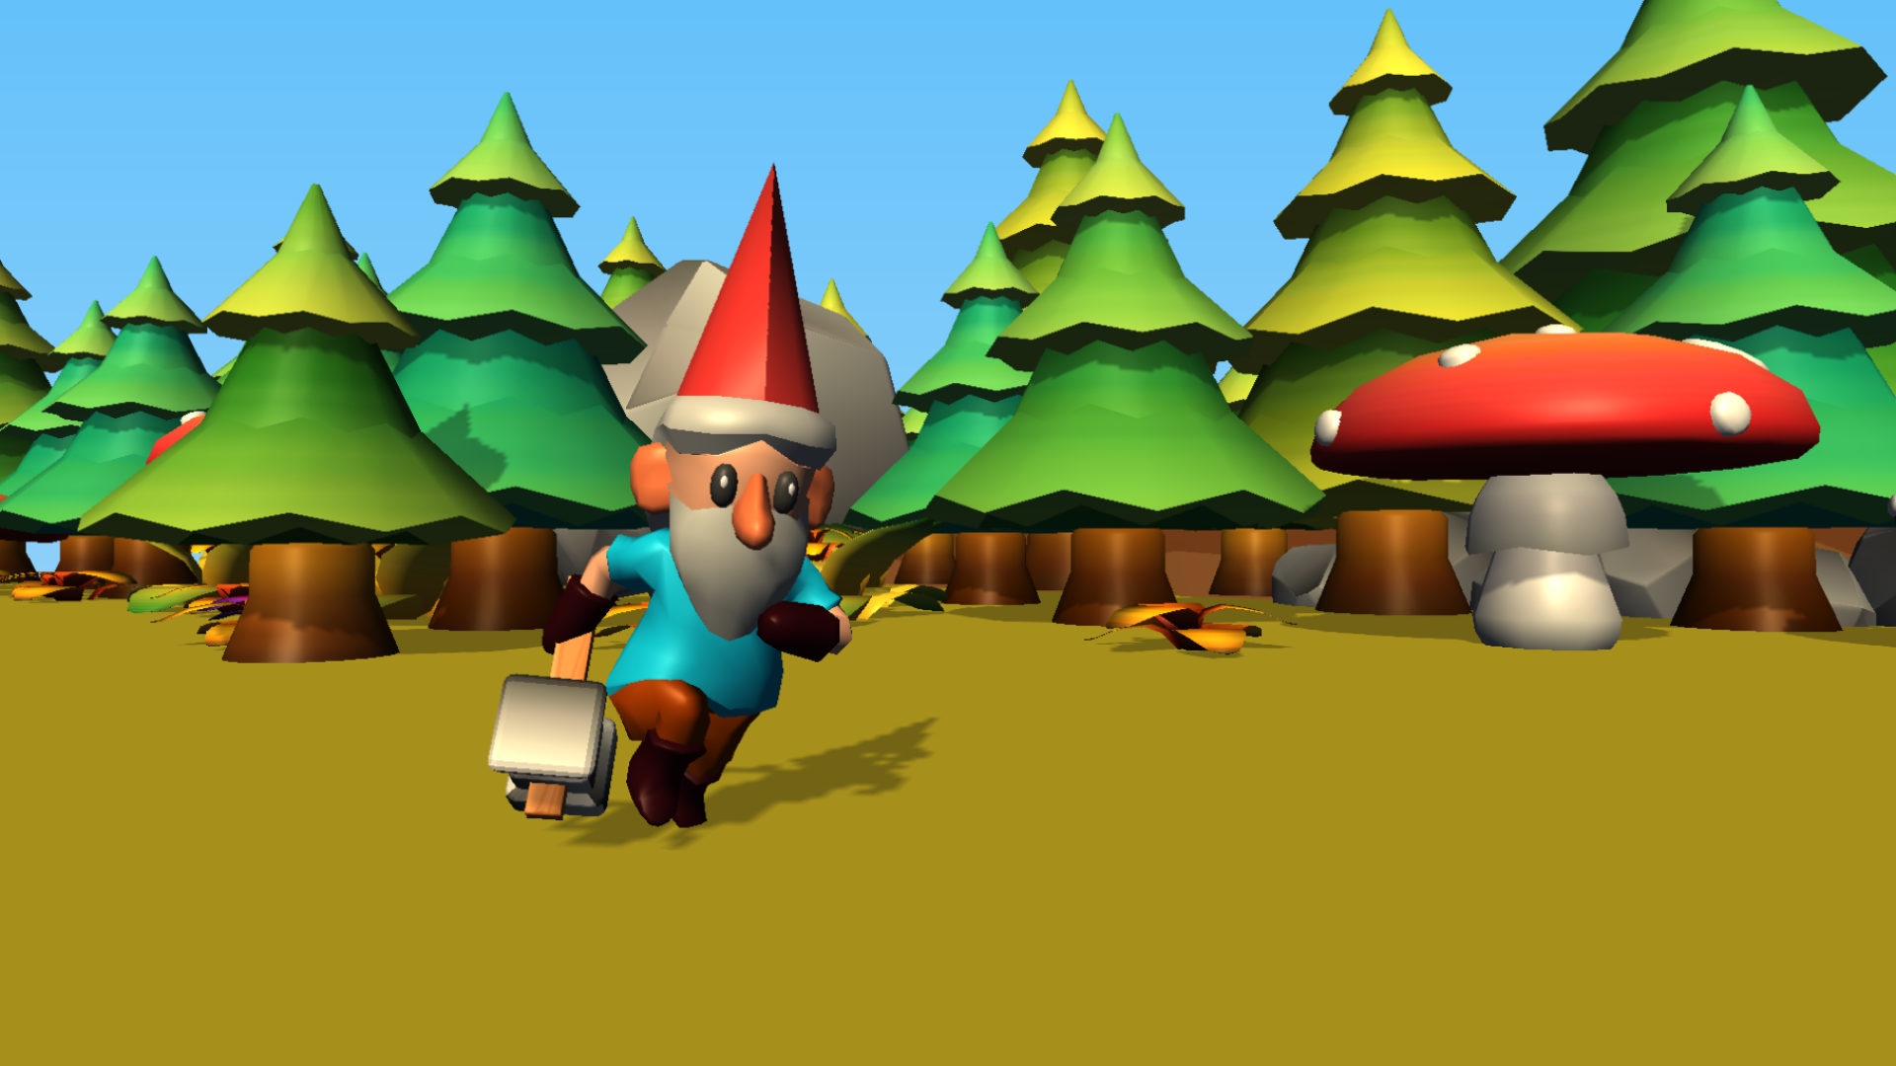

Slide 2
GNOME
and
OWL

