Slide 1



Immersive reality: Effects and uses of VR in perception
Sandra Malpica
Universidad de Zaragoza
Notes:
So today we will be talking about the effects and uses of VR in perception

Slide 2
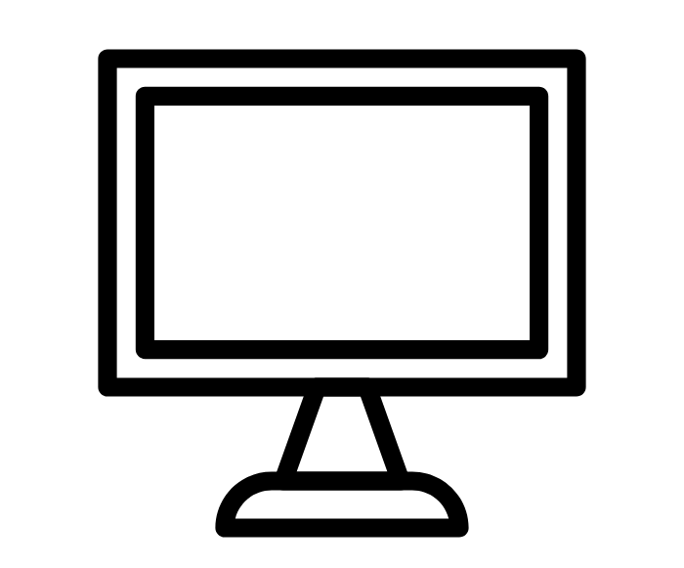



Visual Turing Test: How close are we?
Notes:
One of the questions we can ask ourselves is: how far are we from passing the visual Turing test? This question creates a myriad of subproblems itself. How do we define the optimal point we want to reach? And more importantly, how do we measure if a user perceives a difference or not? During this talk we will follow a user-centric approach, focusing on the perception of users rather than the fidelity of the display.

Slide 3

Virtual Reality
Notes:
I will also be basing my talk on VR as the title suggests. When thinking about the visual turing test, it comes natural to think of this particular display technology

Slide 4
Virtual Reality
Full control of visual stimuli
Notes:
Vr has a number of advantages when using it as a tool to study human perception. First, it gives us control of the visual stimuli we show to the users.

Slide 5
Virtual Reality
Full control of visual stimuli
Isolation
Reproducibility
Notes:
This means both an isolation from outside stimuli and increased reproducibility. The users will only see what we want them to see, and we can exactly reproduce complex environments easily.

Slide 6
Virtual Reality
Full control of visual stimuli
Isolation
Reproducibility
Immersion
Notes:
Additionally, VR’s unique immersive capabilities means that users will answer realistically if they feel present in the virtual environment.

Slide 7
Virtual Reality
Full control of visual stimuli
Isolation
Reproducibility
Immersion
Increased ecological validity
Notes:
All this together creates

Slide 8
Visual Turing Test: How close are we?
Notes:
So, going back to our first question. How close are we to pass the visual turing test and how to measure it.

Slide 9

Visual Turing Test: How close are we?
Notes:
Let’s change our display for a VR headset first.

Slide 10

Visual Turing Test: How close are we?
Notes:
Traditionally, we would say we are there when the users can’t perceive a difference between the real world and the generated environment.

Slide 11
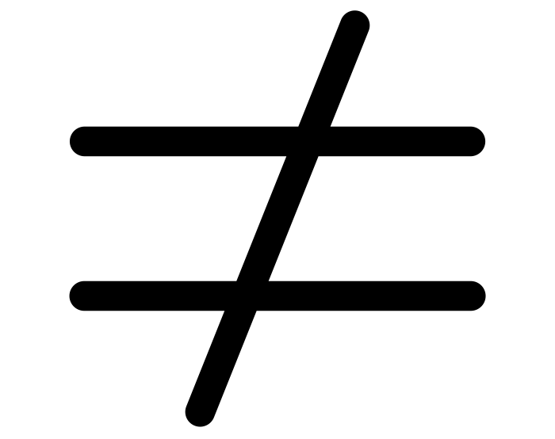
Visual Turing Test: How close are we?
Notes:
However, through this talk I will argue that we don’t need that

Slide 12
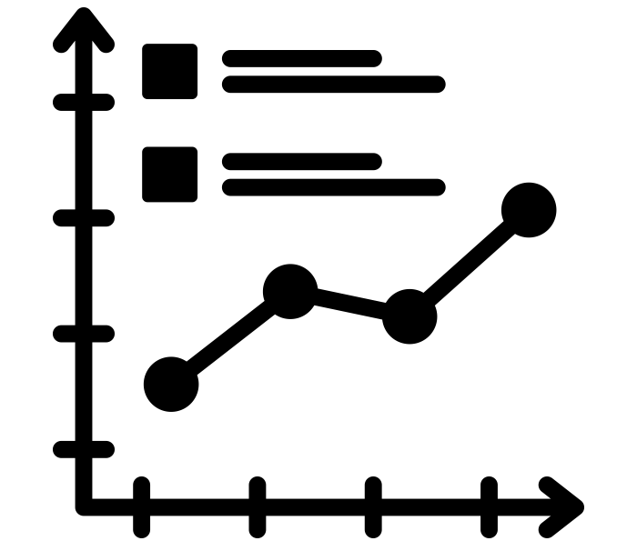
Visual Turing Test: Methodology
Self-report
Performance
Eye tracking
GSR, ECG, EEG
fMRI
Notes:
The first problem we have, is a lack of an absolute methodology to test every visual perception as a whole? What we do instead is measure isolated aspects of visual perception, or related cognitive processes. We can measure eye tracking, ask users for a self-report of perceived realism or differences, try to get biosensors involved or even an fMRI.

Slide 13

Visual Turing Test: Our perception
Flexible
Trainable
Dynamic
Efficient
Notes:
Additionally, we can consider the way our brains work to our advantage. Our perception is flexible: it can adapt to different situations. It’s trainable, we can train and improve our capacities. It’s dynamic: changing through time. It’s efficient, meaning it can achieve maximum productivity with minimum wasted effort. Our brains have evolved to learn to focus on the important information and discard the rest, keeping a good enough model of the outside world for us to act accordingly.

Slide 14
We can take advantage of the way we perceive the environment to better allocate our efforts
Notes:
This means, to our advantage, that there are shortcuts we can use, things that our brains won’t notice, that can take us close enough to the real world as to pass the visual Turing test.

Slide 15
We can take advantage of the way we perceive the environment to better allocate our efforts
How to isolate and measure high-level cognitive aspects in complex environments
The pivotal role of context and cognitive behavior in shaping visual behavior
Effects of additional sensory modalities on visual behavior

Slide 16
Measuring high-level features in complex environments
Time perception
Malpica, S., Masia, B., Herman, L., Wetzstein, G., Eagleman, D. M., Gutierrez, D., ... & Sun, Q. (2022). Larger visual changes compress time: The inverted effect of asemantic visual features on interval time perception. Plos one, 17(3), e0265591.

Slide 17
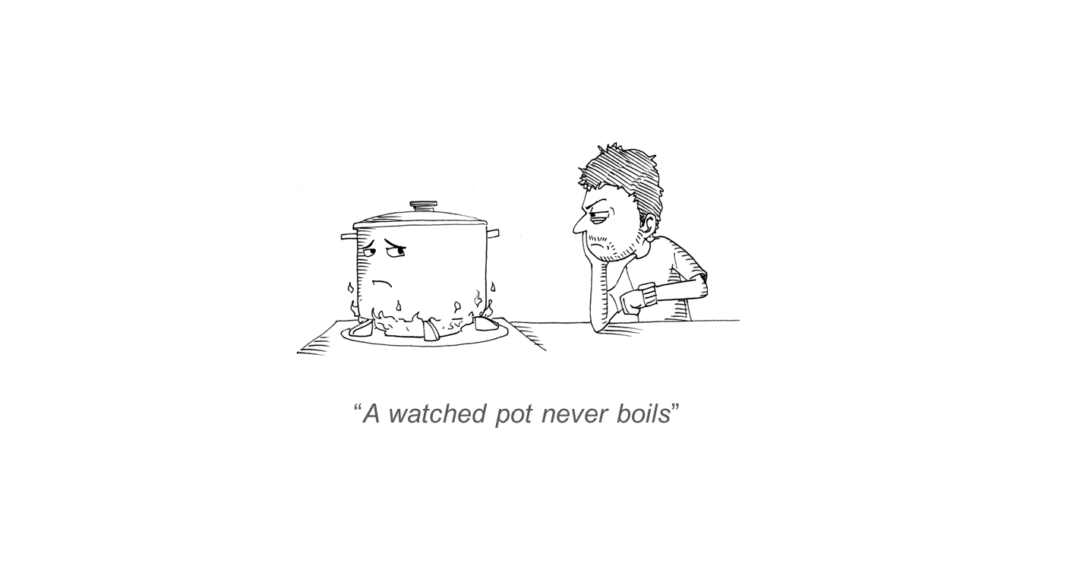
Measuring high-level features in complex environments
Notes:
We know that time perception is affected by high-level cognitive aspects like emotion, arousal and so on.

Slide 18
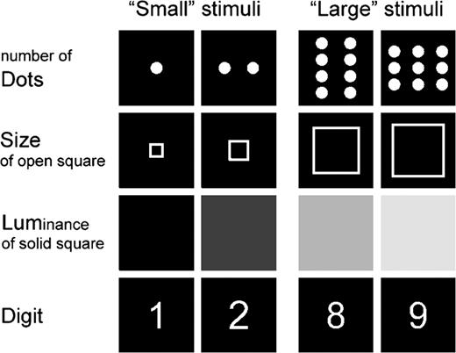
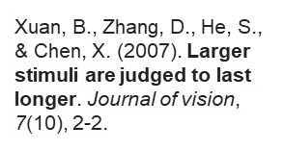
Measuring high-level features in complex environments
Notes:
On short intervals, we also know that time perception can be affected by semantic visual features, like luminance or size

Slide 19
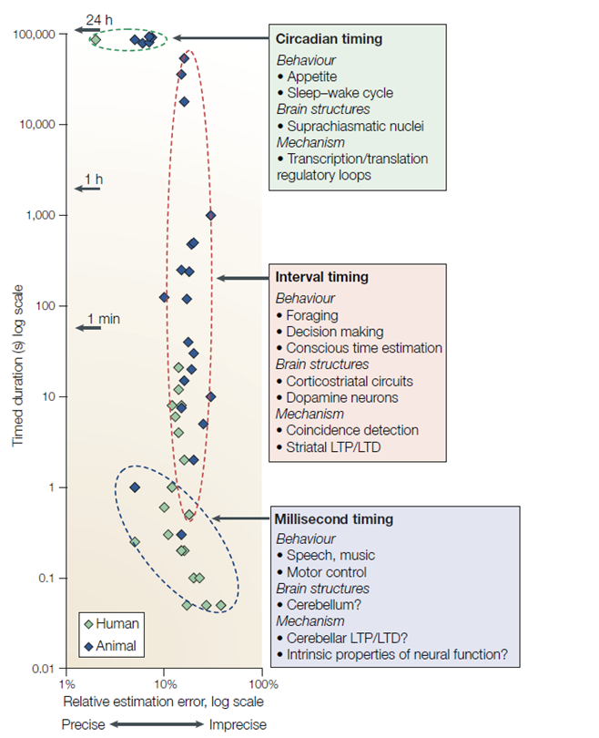
Measuring high-level features in complex environments
Notes:
All in all, time perception is a complex, multidimensional high-level cognitive aspect of our perception.

Slide 20
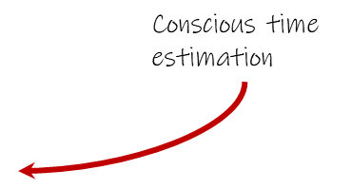
Measuring high-level features in complex environments
Notes:
We wanted to test if visual features could also affect time perception in a more complex environment at longer intervals.

Slide 21
Measuring high-level features in complex environments
Replication of millisecond experiment

Slide 22
Measuring high-level features in complex environments
Replication of millisecond experiment
Extension to longer intervals
Naive approximation

Slide 23
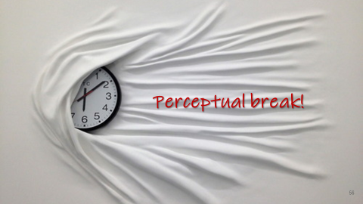
Measuring high-level features in complex environments
Replication of millisecond experiment
Extension to longer intervals
Naive approximation

Slide 24
Measuring high-level features in complex environments
Replication of millisecond experiment
Extension to longer intervals
Naive approximation
Isolation from confounding factors

Slide 25
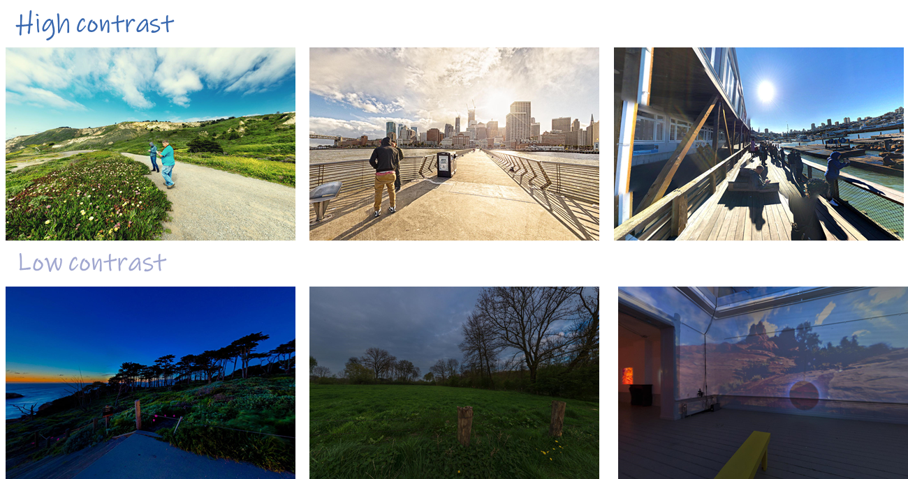
Measuring high-level features in complex environments
Replication of millisecond experiment
Extension to longer intervals
Naive approximation
Isolation from confounding factors

Slide 26
Measuring high-level features in complex environments
Replication of millisecond experiment
Extension to longer intervals
Naive approximation
Isolation from confounding factors
Control for random effects in participants

Slide 27
Measuring high-level features in complex environments
Replication of millisecond experiment
Extension to longer intervals
Naive approximation
Isolation from confounding factors
Control for random effects in participants
Robust, consistent results under varying conditions

Slide 28

Main studies - Results
100
High contrast
Low contrast
75
50
Percentage of errors
25
0
55% sampling point
Notes:
What we found was this. You can see the percentage of errors in the Y axis, the high contrast condition in a strong blue and the low contrast condition in a soft blue

Slide 29
Main studies - Results
100
High contrast
Low contrast
75
Time(30s)
50
Percentage of errors
25
0
55% sampling point
Notes:
The 55% sampling point corresponds to the point of the trial where the participant was asked the binary question: has more or less tan half of the time elapsed?

Slide 30
Main studies - Results
“Has more or less than half of the time elapsed?”
100
High contrast
Low contrast
55% sp
(16,5s)
75
Time(30s)
50
Percentage of errors
Objective half (15s)
25
0
55% sampling point
Notes:
The 55% sampling point corresponds to the point of the trial where the participant was asked the binary question: has more or less tan half of the time elapsed?
So, what are we seeing here?

Slide 31
Main studies - Results
“Has more or less than half of the time elapsed?”
100
High contrast
Low contrast
55% sp
(16,5s)
75
Time(30s)
50
Percentage of errors
Objective half (15s)
25
0
55% sampling point
Notes:
We are seeing that Participants are making more mistakes in the high contrast condition

Slide 32
Main studies - Results
“Has more or less than half of the time elapsed?”
100
High contrast
Low contrast
75
Higher bar = shorter perceived time
Underestimation
50
Percentage of errors
25
0
55% sampling point
Notes:
, this is, they are answering “less than half” more often in the high contrast condition. This is an underestimation of time in high contrast conditions

Slide 33
Main studies - Results
“Has more or less than half of the time elapsed?”
100
High contrast
Low contrast
*
75
Underestimation
50
Percentage of errors
25
0
55% sampling point
Notes:
Our analysis reveals that this difference is significant.

Slide 34
Main studies - Results
“Has more or less than half of the time elapsed?”
100
High contrast
Low contrast
*
75
Underestimation
50
Percentage of errors
25
0
45% sampling point
55% sampling point
Notes:
What happens at the other sampling point we are testing? Exactly the same.

Slide 35
Main studies - Results
“Has more or less than half of the time elapsed?”
100
High contrast
Low contrast
*
75
Time(30s)
Underestimation
45% sp
(13,5s)
50
Percentage of errors
Objective half (15s)
25
0
45% sampling point
55% sampling point
Notes:
In this case, wrong answers correspond to saying that half of the duration has already passed

Slide 36
Main studies - Results
“Has more or less than half of the time elapsed?”
100
High contrast
Low contrast
*
75
Time(30s)
Underestimation
45% sp
(13,5s)
50
Percentage of errors
Objective half (15s)
25
0
45% sampling point
55% sampling point
Notes:
We can see a higher error rate for the low contrast condition

Slide 37
Main studies - Results
Overestimation
“Has more or less than half of the time elapsed?”
100
High contrast
Low contrast
*
75
Higher bar = longer perceived time
Underestimation
50
Percentage of errors
25
0
45% sampling point
55% sampling point
Notes:
We can see a higher error rate for the low contrast condition

Slide 38
Main studies - Results
“Has more or less than half of the time elapsed?”
100
High contrast
Low contrast
Underestimation
Overestimation
*
75
Higher bar (45%sp) =
longer perceived time
Higher bar (55%sp) =
shorter perceived time
50
Percentage of errors
25
0
45% sampling point
55% sampling point

Slide 39
Main studies - Consistency
Contrast
100
Underestimation
Overestimation
75
*
50
Percentage of errors
25
0
45% sampling point
55% sampling point
Notes:
The same effect can be found for temporal frequency and field of view

Slide 40
Main studies - Consistency
Contrast Frequency
100
100
Underestimation
Underestimation
Overestimation
Overestimation
75
*
75
*
*
50
50
Percentage of errors
Percentage of errors
25
25
0
0
45% sampling point
55% sampling point
45% sampling point
55% sampling point
Notes:
The same effect can be found for temporal frequency and field of view

Slide 41
Main studies - Consistency
Contrast Frequency Field of view
100
100
100
Underestimation
Underestimation
Underestimation
Overestimation
Overestimation
Overestimation
75
*
75
75
*
*
*
50
50
50
Percentage of errors
25
25
25
0
0
0
45% sampling point
55% sampling point
45% sampling point
55% sampling point
45% sampling point
55% sampling point
Notes:
The same effect can be found for temporal frequency and field of view

Slide 42
Measuring high-level features in complex environments
Conclusions:
Start from the basics and build up
Adapt the conditions to isolate you study factor
Internal
External
Test under different conditions if possible

Slide 43
Measuring high-level features in complex environments
How time perception is affected by low level asemantic visual features
Controlled to complex environment
Replication of vision science experiment
Isolation from other high-level factors
Consistent and robust results

Slide 44
The role of context and task on visual behavior Task-dependent visual behavior
Malpica, S., Martin, D., Serrano, A., Gutierrez, D., & Masia, B. (2023).
Task-Dependent Visual Behavior in Immersive Environments:
A Comparative Study of Free Exploration, Memory and Visual Search.
IEEE transactions on visualization and computer graphics.

Slide 45

Notes:
And also on top-down mechanisms, which guide our attention towards relevant areas based on the task or goal of the viewer. For example, you may look at different parts of this image without an assigned task. But if I ask you to tell me how many cars you can see in the picture

Slide 47
The role of context and task on visual behavior
We focus our resources on different parts of the environment depending on the task we need to carry out

Slide 48
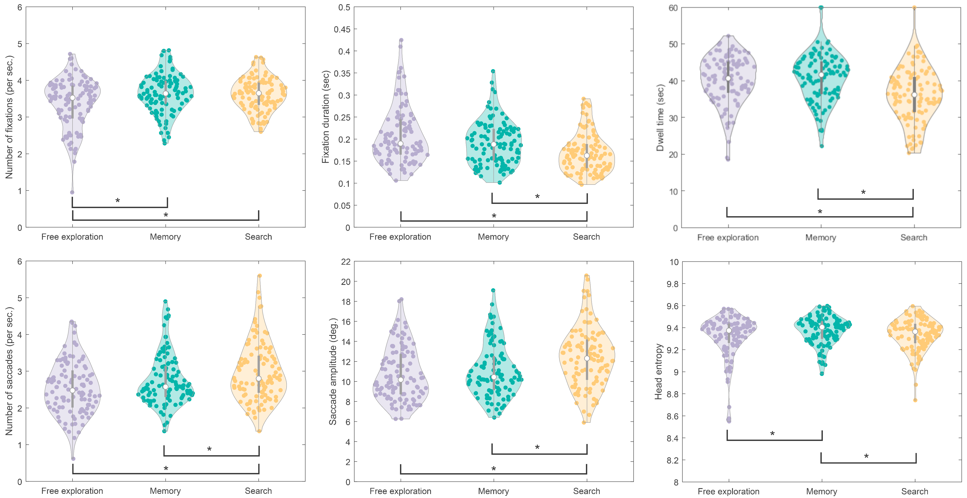
Free-viewing, memory and visual search
Number of fixations
Fixation duration
Dwell time
Number of saccades
Saccade amplitude
Head entropy
More details in our paper!

Slide 49
The role of context and task on visual behavior
Depending on the task at hand, we can focus our resources on particular aspects of the virtual environment:
Foveated rendering
Materials, textures, color and meshes

Slide 50
Additional sensory modalities can alter what we see Auditory-triggered suppression
Malpica, S., Serrano, A., Gutierrez, D., & Masia, B. (2020). Auditory stimuli degrade visual performance in virtual reality. Scientific Reports, 10.

Slide 51

Additional sensory modalities can alter what we see

Slide 52
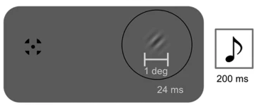
Auditory-triggered suppression
Hidaka, S., & Ide, M. (2015). Sound can suppress visual perception. Scientific reports, 5(1), 10483.

Slide 53
Main experiment - Spatial layout
Participant
Notes:
First, let’s look at the spatial layout of the experiment. This is our participant seen from above

Slide 54
Main experiment - Spatial layout
Visual targets
Notes:
We show participants different visual targets which always appear at one of three positions, as shown in the figure

Slide 55
Main experiment - Spatial layout
Visual targets
Field of view
Notes:
always inside the field of view of the participant.

Slide 56
Main experiment - Spatial layout
Visual targets
Field of view
Detection (I saw something)
Recognition (I saw this)
Notes:
Participants have to detect the visual targets (which is a binary response: “I have seen something”) and recognize the visual targets (“this is the shape I saw”)

Slide 57

Main experiment - Spatial layout
Visual targets
Field of view
Detection (I saw something)
Recognition (I saw this)
Notes:
Additionally, an audioclip can play at one of three possible locations in the back of the participants head. When a visual target an an auditory source appear at the same time we call that combination a bimodal stimulus

Slide 58

Main experiment - Spatial layout
Visual targets
Field of view
Detection (I saw something)
Recognition (I saw this)
Bimodal: visual target + audio source
Notes:
You can see a possible spatial combination of a bimodal stimulus highlighted in green

Slide 59
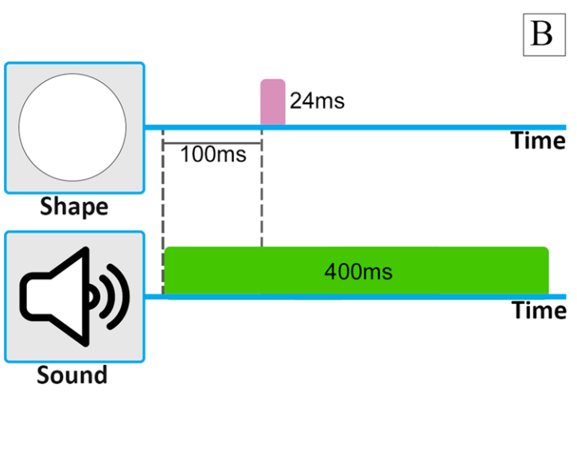
Main experiment - Temporal layout
Notes:
Moving on to the temporal profile of our experiment. We show the visual targets for 24ms

Slide 60
Main experiment - Temporal layout
Notes:
The auditory part of the bimodal stimuli is played for 400ms, starting 100ms before the visual target onset.

Slide 61
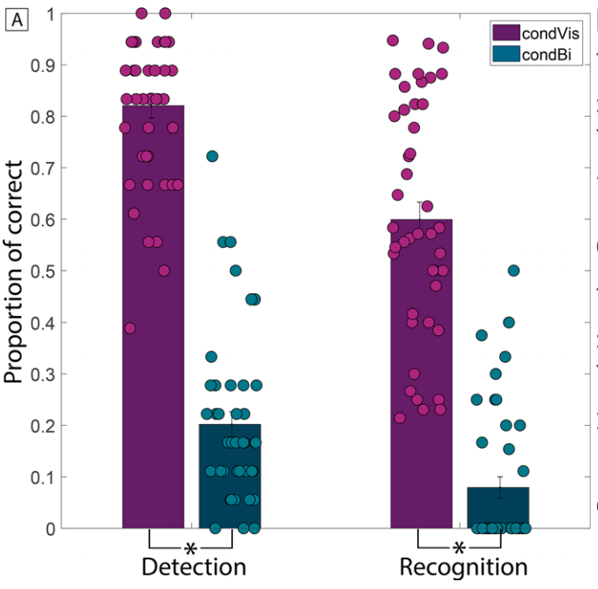
Main experiment - Results
Visual-only = Baseline
Notes:
If you have any doubts about the visibility of the visual targets, we analyzed a visual-only condition in our experiment as a baseline before assessing participant’s performance in the bimodal condition
The detection (if the visual targets were perceived) and recognition (once perceived, their shape was correctly recognized) for visual only stimuli was over 80% and 60% respectively.
The bar shows the mean rate and the points each participant’s performance.
Participants with a detection or recognition rate of visCond stimuli below 20% were rejected from the experiment and not considered in our analysis

Slide 62
Main experiment - Results
Both detection and recognition decrease in the presence of sound
Visual-only = Baseline
Bimodal = Performance decrease
Notes:
Now, if we compare visual only stimuli with bimodal stimuli we can see a drastic decrease in performance, both for detection and recognition.

Slide 63
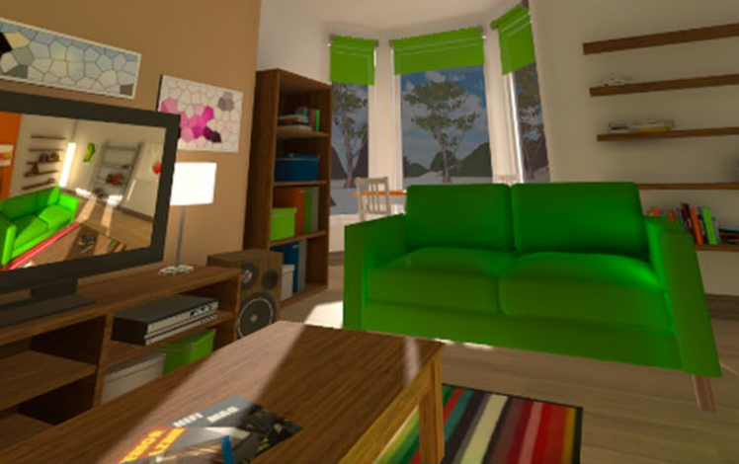
Gaze sample (non-detected bimodal stimulus)
Visual target
Notes:
As for the underlying causes, we used an eye tracker to study visual behavior.
In this figure you can see the gaze position of one of our users during a two seconds interval. We are only showing the horizontal coordinate for simplicity.
We can see that, while the target is visible (the gray column) gaze is fixated closely (you can see the target’s position in red) to the target.
The blue area around the gaze point is where the target can be visible.

Slide 64

Gaze sample (non-detected bimodal stimulus)
Visual target
Gaze position
Notes:
As for the underlying causes, we used an eye tracker to study visual behavior.
In this figure you can see the gaze position of one of our users during a two seconds interval. We are only showing the horizontal coordinate for simplicity.
We can see that, while the target is visible (the gray column) gaze is fixated closely (you can see the target’s position in red) to the target.
The blue area around the gaze point is where the target can be visible.

Slide 65
Gaze sample (non-detected bimodal stimulus)
Visual target
Gaze position
Visible area
Notes:
As for the underlying causes, we used an eye tracker to study visual behavior.
In this figure you can see the gaze position of one of our users during a two seconds interval. We are only showing the horizontal coordinate for simplicity.
We can see that, while the target is visible (the gray column) gaze is fixated closely (you can see the target’s position in red) to the target.
The blue area around the gaze point is where the target can be visible.

Slide 66
Gaze sample (non-detected bimodal stimulus)
Visual target
Gaze position
Visible area
Participants are virtually blind for a short while!
Notes:
This means that the suppression effect occurs even when gaze is fixating on the visual target, which is amazing!
We have found that we can render users virtually blind for a short period of time.
We believe that this effect may be caused by a neural inhibition mechanism, but this should be further studied with a functional magnetic resonance.
This effect could also be related to the double illusion flash, where the presence of sound briefly inhibits the perceived continuity of a visual stimuli

Slide 67
Auditory-triggered suppression
We can modulate what we perceive visually with sensory cues from other modalities (auditory and haptics at least)
The effect could be more pronounced with endogenous cues
Passing the visual Turing test may not only be a matter of perfect visual stimuli

Slide 68
Conclusions
Depending on…
What we are going to measure

Slide 69
Conclusions
Depending on…
What we are going to measure
The context and task at hand

Slide 70
Conclusions
Depending on…
What we are going to measure
The context and task at hand
The sensory modalities that we can use

Slide 71
Conclusions
Depending on…
What we are going to measure
The context and task at hand
The sensory modalities that we can use
We may already be closer than we think!

Slide 72
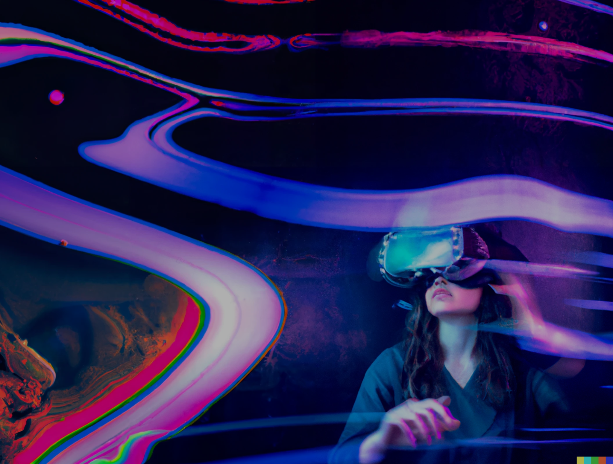

Thanks!
smalpica@unizar.es

Slide 73
What is the best methodology to measure how close we are?
Do we need to consider everything? Do our displays need to be perfect, as good as real life?
I don‘t think so. I will try to convince you about this through 3 case studies. Sometimes we don’t need to be there to perceive we are there. Our brain is flexible, and we can take advantage of the shortcuts it uses to alleviate current hardware and software limitations.
3 case studies: (1) How can we measure what we perceive? Isolating high-level cognitive aspects is hard, but we can do it. Isolating and working with a single aspect may be good enough (time-perception); (2) The pivotal role of context and cognitive behavior in shaping visual behavior (tasks). Depending on our task and context, we will pay more attention to different parts of the environment. (3) Multimodality. Using audio, haptics, etc. changes how and what we see (auditory-suppression)

