Slide 1

SMK MANUFACTURING ANALYTICS DASHBOARD
SMK Manufacturing Analytics Dashboard
End-to-End Manufacturing Analytics Solution
PREPARED BY: S.MANIKANDAN
Snowflake · SQL · Power BI · DAX · Dynamic RLS

Slide 2

SMK MANUFACTURING ANALYTICS DASHBOARD
Project Overview
The SMK Manufacturing Analytics Dashboard is an end-to-end Business Intelligence solution designed to monitor Production, Quality, Downtime, Maintenance, and Machine Performance across manufacturing plants.
GOAL
Enable data-driven decision making through centralized KPI monitoring and operational insights.
02
02

Slide 3
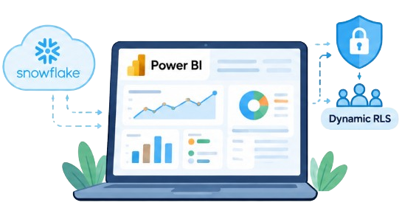
Business Problem
Fragmented reporting hides operational risk
Lack of centralized reporting
SOLUTION
Production target tracking difficulties
Power BI Analytics solution powered by Snowflake and secured with Dynamic RLS.
High defect rates
Downtime monitoring issues
Maintenance cost visibility challenges
03
03

Slide 4






Project Objectives
The solution is built around six operating objectives
Production Monitoring
Quality Monitoring
Downtime Tracking
Maintenance Analysis
Machine Performance Analysis
Secure User Access
04
Deliver a centralized analytics platform for KPI monitoring and data-driven manufacturing decisions.
04

Slide 5
TECHNOLOGY STACK
Each layer has a focused role
CATEGORY | TECHNOLOGY
Data Warehouse | Snowflake
Querying | SQL
Modeling | Star Schema
Visualization | Power BI Desktop & Service
Calculations | DAX
Security | Dynamic Row-Level Security (RLS)
05
05

Slide 6
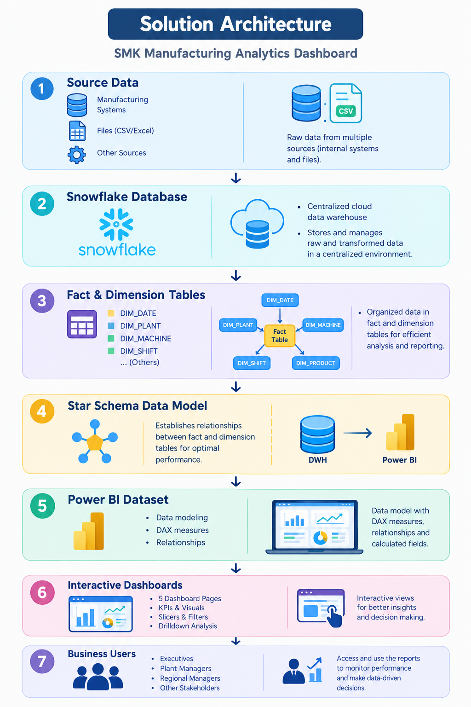
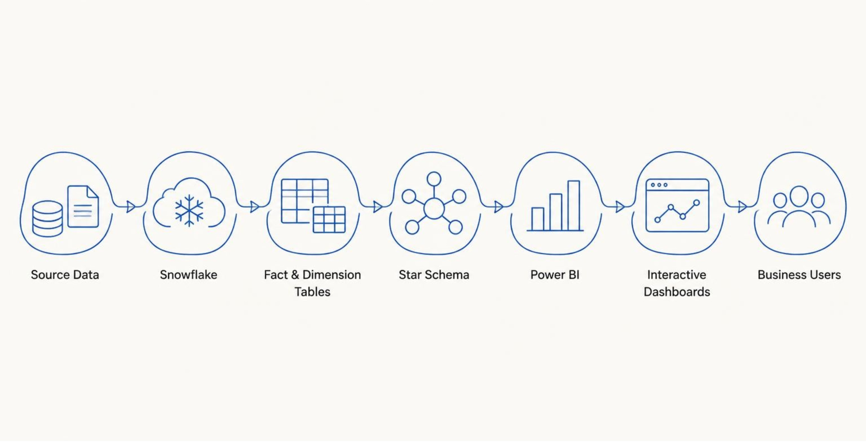
ARCHITECTURE
From source data to business decisions
06
06

Slide 7
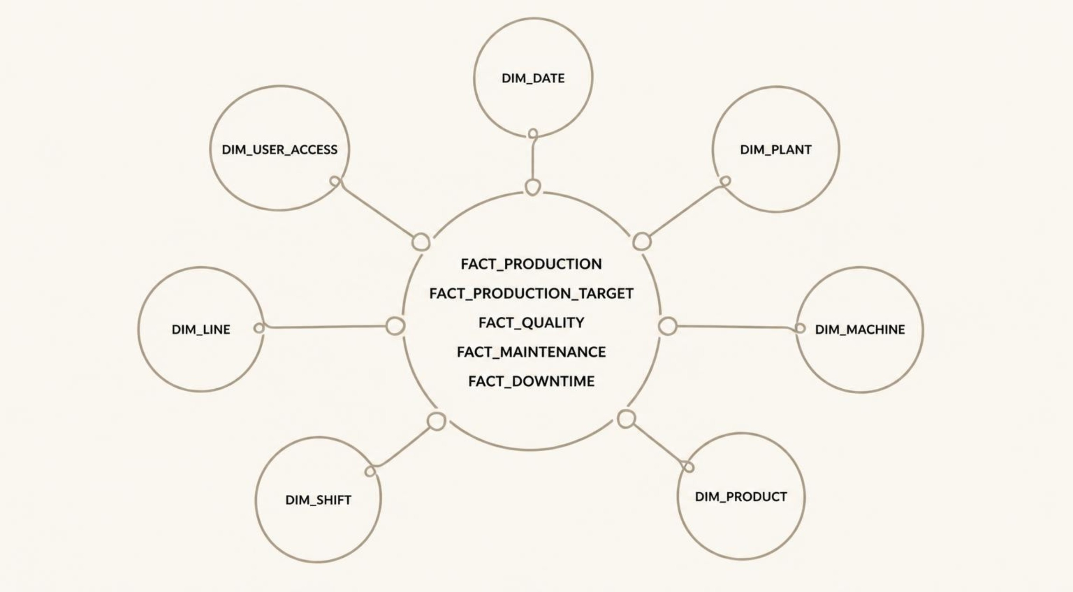
DATA MODEL OVERVIEW
The star schema keeps analysis flexible
Fact tables:
FACT_PRODUCTION
FACT_PRODUCTION_TARGET
FACT_QUALITY
FACT_MAINTENANCE
FACT_DOWNTIME
Dimension tables:
DIM_DATE
DIM_PLANT
DIM_MACHINE
DIM_PRODUCT
DIM_SHIFT
DIM_LINE
DIM_USER_ACCESS
07

Slide 8
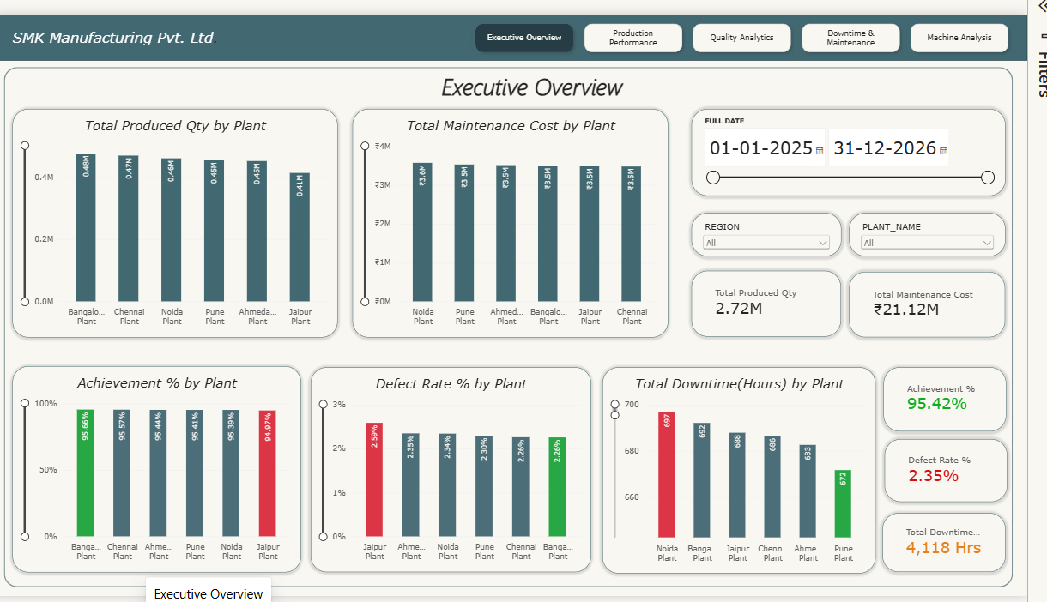
EXECUTIVE OVERVIEW
Executive overview puts the vital signals first
PRODUCTION ACHIEVEMENT %
95.42%
DEFECT RATE %
2.35%
MAINTENANCE COST
21.12 M
DOWNTIME HOURS
4,118 Hrs
Business value:
Provides a high-level manufacturing performance summary for executive decision-making.
The Executive Overview dashboard provides a consolidated view of key manufacturing KPIs including Production Achievement, Defect Rate, Maintenance Cost, and Downtime Hours.
It enables executives to monitor overall plant performance and quickly identify operational issues through a single reporting page.
08

Slide 9
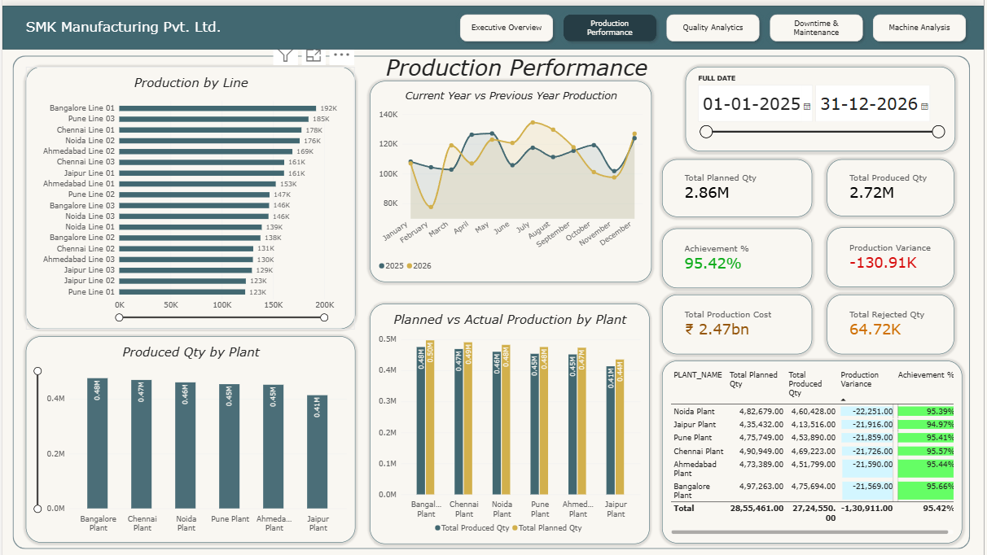
PRODUCTION
Production performance connects plan to output
Total Produced Qty
2.72 M
Total Planned Qty
2.86 M
Production Variance
-130.91 K
Achievement %
95.42 %
Produced Qty by Plant
Drilldown: Plant → Line → Year → Quarter → Month
This dashboard analyzes production targets versus actual output using KPIs such as Production Quantity, Variance, and Achievement %, with drill-down from Plant to Month level.
Planned Vs Actual Production by Plant
Drilldown: Plant → Year
09
09

Slide 10
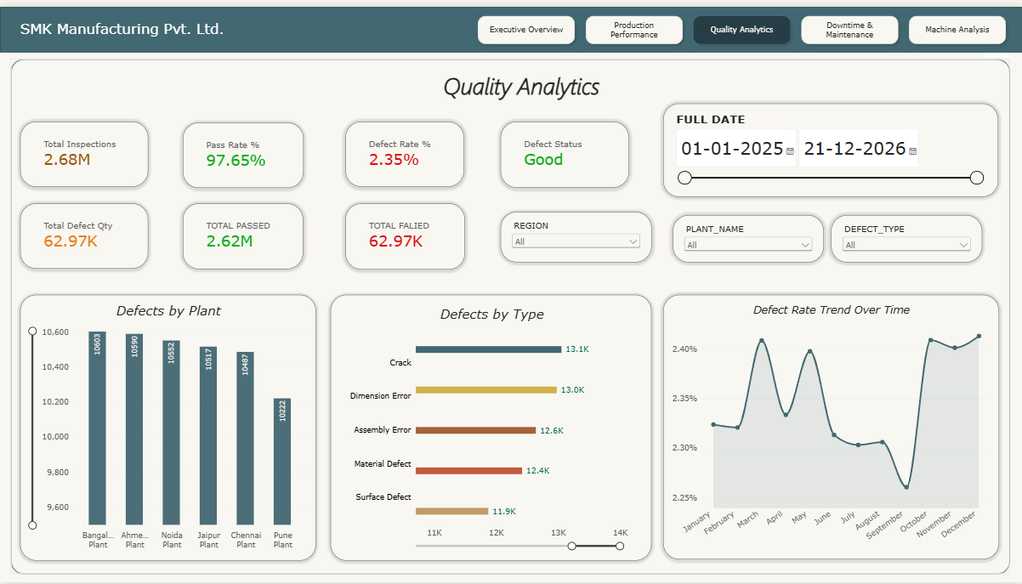
QUALITY
Quality analytics makes defects actionable
TOTAL INSPECTIONS
2.68 M
PASS RATE %
97.65%
DEFECT RATE %
2.35%
TOTAL DEFECT QTY
62.97 K
This dashboard monitors inspections, pass rates, defect rates, and defect quantities.
The drill-down functionality enables users to analyze defects from Plant to Defect Type and Year level.
Defects by Plant
Drilldown: Plant → Defect Type → Year
10
10
10

Slide 11
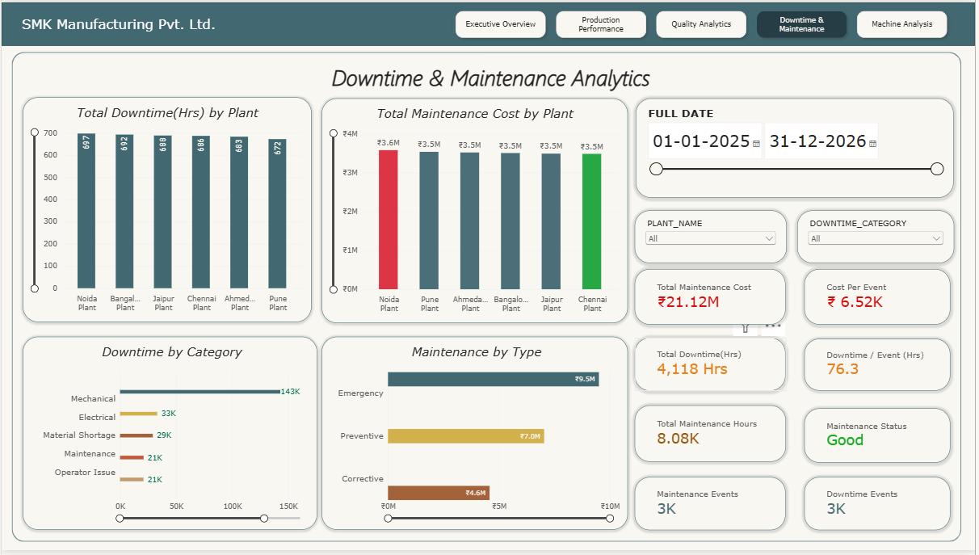
Downtime & Maintenance
Downtime & Maintenance analytics improves equipment performance
TOTAL MAINTENANCE COST
21.12 M
Cost per Event
6.52 K
Total Downtime Hours
4,118 Hrs
Downtime Events
3k
This dashboard analyzes maintenance costs, downtime hours, downtime events, and maintenance activities.
It helps identify operational disruptions, optimize maintenance planning, and improve equipment reliability.
Total Maintenance Cost by Plant
Drilldown: Plant → Machine Type → Year
Total Downtime(Hrs) by Plant
Drilldown: Plant → Year
11

Slide 12
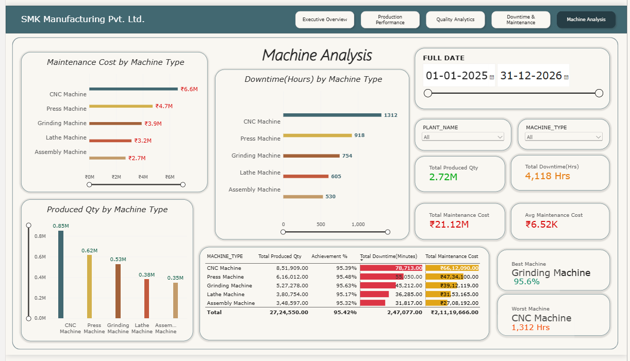
Machine
Machine analysis identifies performance leaders and bottlenecks
Best Machine
Grinding Machine
Worst Machine
CNC Machine
TOTAL MAINTENANCE COST
21.12 M
Total Downtime Hours
4,118 Hrs
• This dashboard analyzes machine-level production, downtime, and maintenance performance across manufacturing plants.
• It helps identify the best-performing machines, track downtime trends, compare maintenance costs, and improve equipment utilization.
12

Slide 13
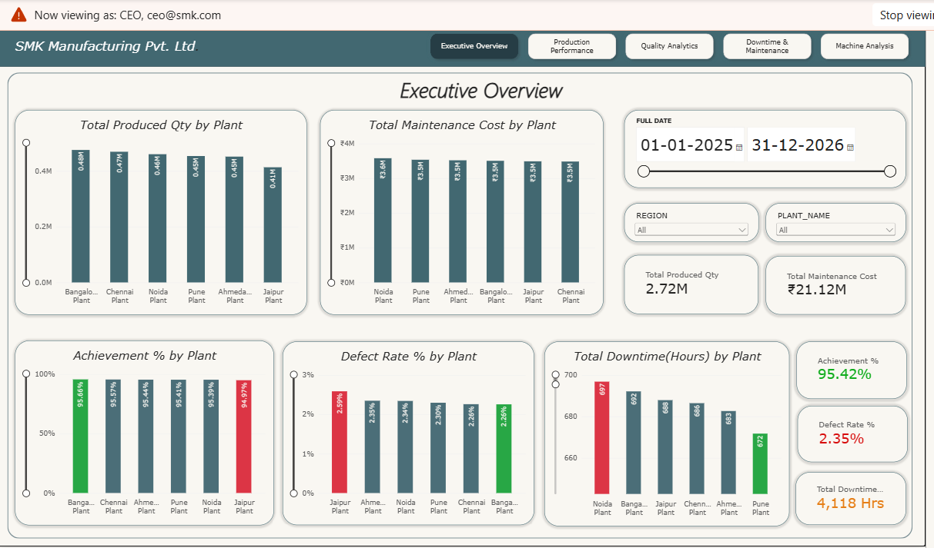
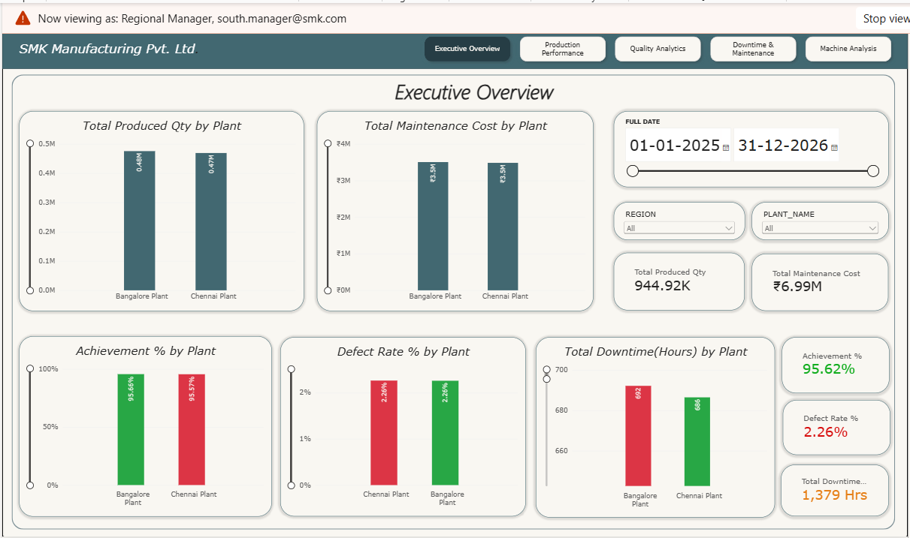
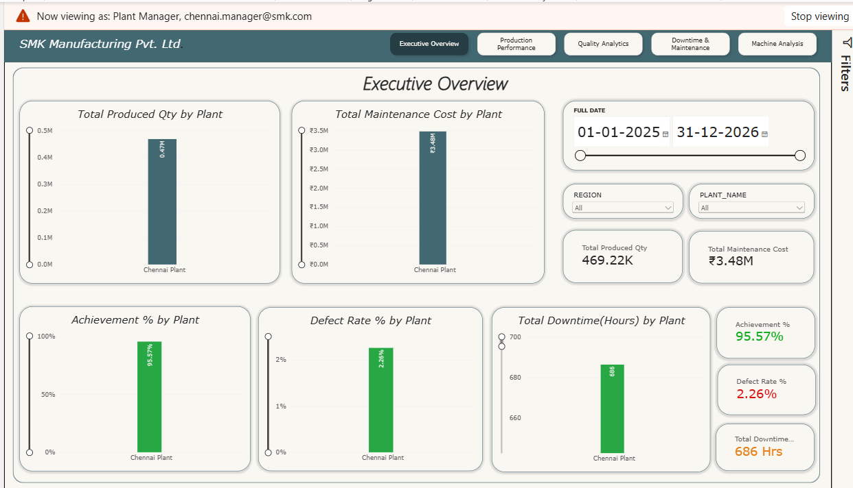
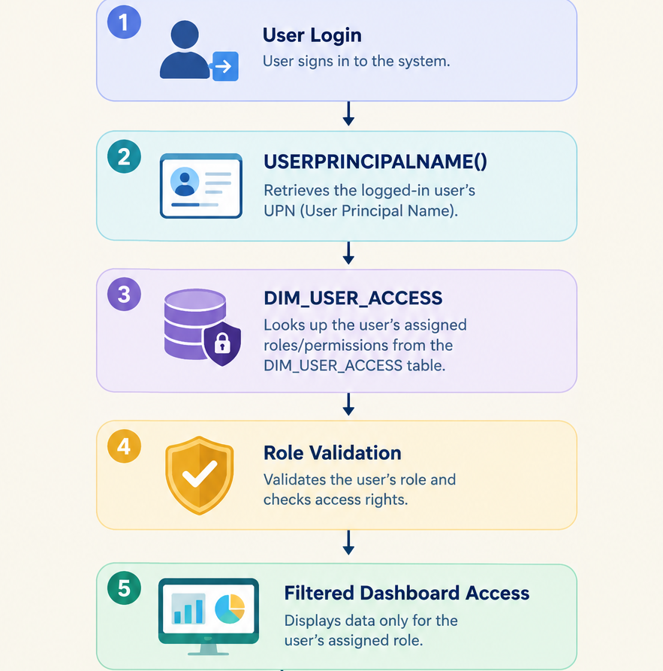
Dynamic RLS
Dynamic RLS secures data by role
Role-Based Access Control
CEO View
Regional Manager View
CEO
Access to All Plants
Regional Manager
Access to Assigned Region
Plant Manager
Access to Assigned Plant
Plant Manager View
Security Flow
• Dynamic Row-Level Security (RLS) ensures that users can access only the data relevant to their assigned role.
• Security is implemented using USERPRINCIPALNAME() and DIM_USER_ACCESS to provide personalized dashboard access.
13

Slide 14
Business Insights
Key Business Insights
Business insights transform data into decisions
• Production operations achieved 95.42% of the planned target, demonstrating strong overall manufacturing performance.
• The overall Defect Rate of 2.35% indicates effective quality control and inspection processes.
• Manufacturing plants recorded 4,118 Hours of Downtime, highlighting opportunities for operational improvement.
• Total Maintenance Cost reached ₹21.12M, enabling better maintenance planning and cost monitoring.
• Grinding Machine was identified as the best-performing machine, while CNC Machine recorded the highest downtime and requires focused maintenance attention.
•The dashboard provides centralized KPI monitoring and enables faster, data-driven decision-making across manufacturing operations.
PRODUCTION ACHIEVEMENT %
Production Variance
95.42%
-130.91 K
DEFECT RATE %
TOTAL DEFECT QTY
2.35%
62.97 K
TOTAL MAINTENANCE COST
Cost per Event
6.52 K
21.12 M
TOTAL DOWNTIME HOURS
Total Downtime Events
4,118 Hrs
3k
Best Machine
Grinding Machine
Worst Machine
CNC Machine
14

Slide 15
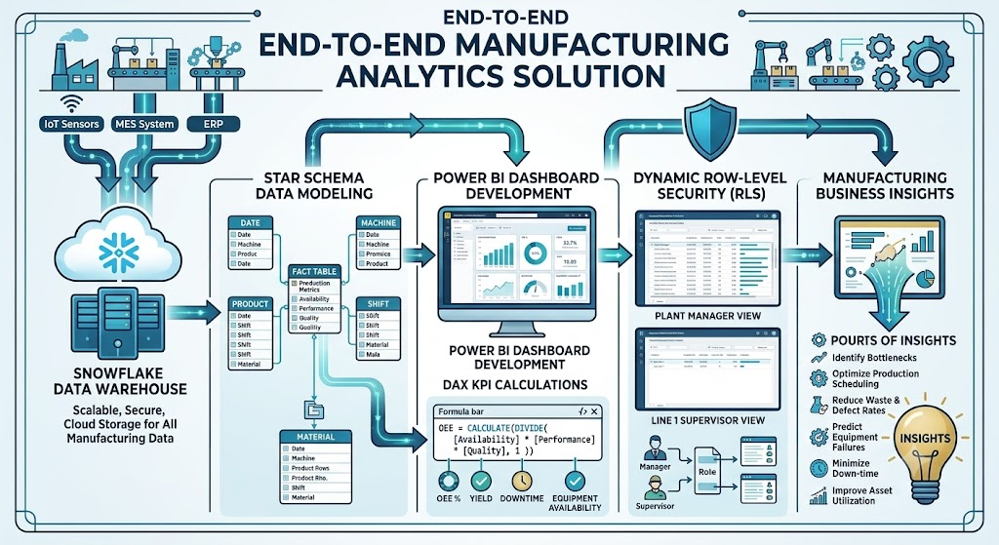
Conclusion
From data to operational excellence
Project Outcome
End-to-End Manufacturing Analytics Solution
Snowflake Data Warehouse
Star Schema Data Modeling
Power BI Dashboard Development
DAX KPI Calculations
Dynamic Row-Level Security (RLS)
Manufacturing Business Insights
Thank You
15

