Slide 1

2. Non-Primitive – Non Linear Data Structures
B-Tree Family
The B‑Tree family refers to a group of self‑balancing, multi‑way search trees designed for efficient storage and retrieval of large datasets, especially on disk. They generalize binary search trees by allowing multiple keys per node and multiple children, ensuring balanced height and minimizing costly disk I/O.
Core Concept of B‑Trees
Order (m): Maximum number of children a node can have.
Keys per node: Up to m−1 keys stored in sorted order.
Balance: All leaf nodes are at the same level.
Efficiency: Search, insertion, and deletion operations run in O(log n) time.
Use case: Optimized for databases and file systems where minimizing disk access is critical.
Operations
Search: Similar to binary search, but across multiple keys per node.
Insertion: Insert into node; if overflow occurs, split node and promote median key.
Deletion: Remove key; if underflow occurs, borrow from sibling or merge nodes.
Traversal: In‑order traversal yields sorted sequence of keys.

Slide 2
2. Non-Primitive – Non Linear Data Structures
B-Tree Family
Real‑World Applications
Databases: MySQL, Oracle, PostgreSQL use B+ Trees for indexing.
File Systems: NTFS, HFS+, and ext4 rely on B‑Tree variants for directory and metadata management.
Search Engines: Efficient indexing of large datasets.
Operating Systems: Used in virtual memory and storage subsystems.
Advantages
Balanced height: Ensures predictable performance.
Disk optimization: Reduces number of disk reads/writes.
Scalability: Handles millions of records efficiently.
Sequential access: B+ Trees allow fast range queries.
Limitations
Complex implementation: More difficult than binary or AVL trees.
Memory overhead: Internal nodes may store many pointers.
Not ideal for small datasets: Overhead outweighs benefits when data fits in memory.

Slide 3
2. Non-Primitive – Non Linear Data Structures
B-Tree Family
B‑Tree
Structure: Each node can hold multiple keys and have multiple children (up to order m).
Property: Keys in each node are sorted; children pointers divide ranges of keys.
Balance: All leaves are at the same level.
Use Case: General indexing in databases and file systems.
Operations: Search, insert, delete all run in O(log n).
B+ Tree
Structure: Internal nodes store only keys (for navigation), while all actual data is stored in leaf nodes.
Property: Leaf nodes are linked together, enabling fast sequential access.
Advantage: Excellent for range queries and ordered traversals.
Use Case: Widely used in relational databases (MySQL, Oracle) and file systems (NTFS, ext4).
B Tree*
Structure: A variant of B+ Tree.
Property: Instead of splitting immediately when a node overflows, it redistributes keys with siblings first.
Advantage: Better space utilization (about 2/3 full vs 1/2 full in B+ Trees).
Use Case: Advanced database indexing where minimizing splits is critical.

Slide 4
2. Non-Primitive – Non Linear Data Structures
B-Tree Family
B‑Link Tree
Structure: Extension of B+ Tree with extra sibling pointers at each level.
Property: Allows concurrent operations (insert, delete, search) without locking the entire tree.
Advantage: High concurrency and parallelism — multiple threads can safely access/update.
Use Case: High‑performance transactional systems, modern databases needing parallel access.
Tree Type | Data Storage | Special Feature | Best Use Case
B‑Tree | Keys + data in all nodes | Balanced, multi‑way search | General indexing
B+ Tree | Data only in leaves | Linked leaves for fast range queries | Databases, file systems
B Tree* | Data in leaves | Redistributes before splitting | Efficient space utilization
B‑Link Tree | Data in leaves | Sibling pointers for concurrency | Parallel database systems

Slide 5
2. Non-Primitive – Non Linear Data Structures
B-Tree
A B‑Tree is a self‑balancing multi‑way search tree.
Unlike a binary search tree (only 2 children per node), a B‑Tree node can have many keys and children.
It’s designed for disk storage and databases, where minimizing disk reads is critical.
All leaf nodes are at the same level, keeping the tree balanced.

Slide 6
2. Non-Primitive – Non Linear Data Structures
B-Tree
Keys and Data
Keys:
Act as separators inside nodes.
Guide the search process by dividing ranges.
Example: Node [10 | 20] means:
Values <10 go left.
Values between 10–20 go middle.
Values >20 go right.
Data (Records):
The actual information stored (like a file pointer, student record, or database row).
In a B‑Tree, both internal nodes and leaf nodes can store keys + data.
This is different from a B+ Tree, where only leaf nodes store data.

Slide 7
2. Non-Primitive – Non Linear Data Structures
B-Tree
Keys and Data
Keys vs. Data
Keys → identifiers used for searching and navigation (like student IDs, file names, or numbers).
Data → the actual record or payload linked to each key (like student details, file pointers, or database rows).
In a B‑Tree, both internal nodes and leaf nodes store keys + data.

Slide 8



2. Non-Primitive – Non Linear Data Structures
B-Tree
Example: Student Records in a B‑Tree (Order 3)
Let’s say we want to store student records by their ID.
Insert IDs: 10, 20, 5, 6, 12
Step‑by‑Step Tree
Insert 10
Insert 20
Insert 5 → overflow → split
Insert 6 → goes left
Insert 12 → goes right

Slide 9
2. Non-Primitive – Non Linear Data Structures
B-Tree
How Keys and Data Work Together
Keys (5,6,10,12,20) are the search labels.
Data (Student5, Student6, Student10, Student12, Student20) are the actual records.
Searching for ID=12:
Compare with root key 10 → go right.
Find key 12 in right child → return Data:"Student12".

Slide 10
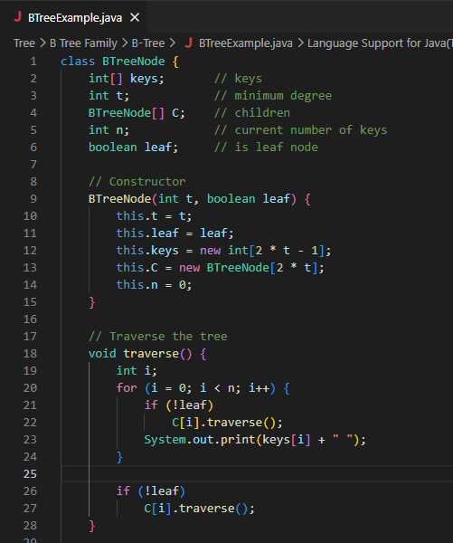
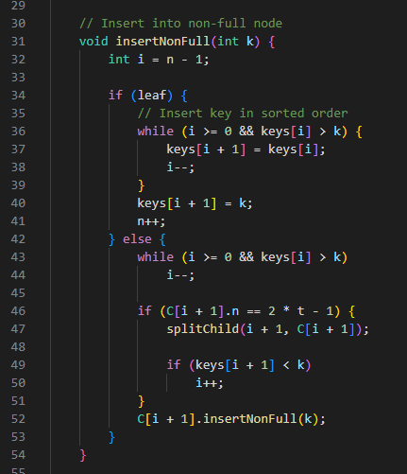
2. Non-Primitive – Non Linear Data Structures
B-Tree

Slide 11
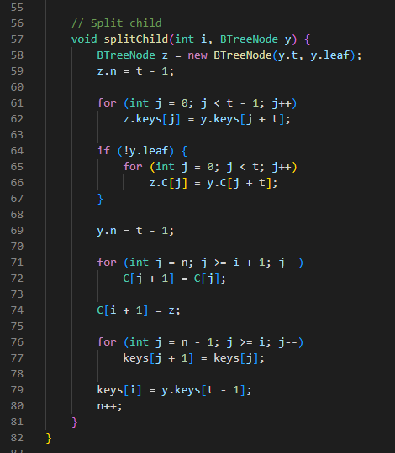
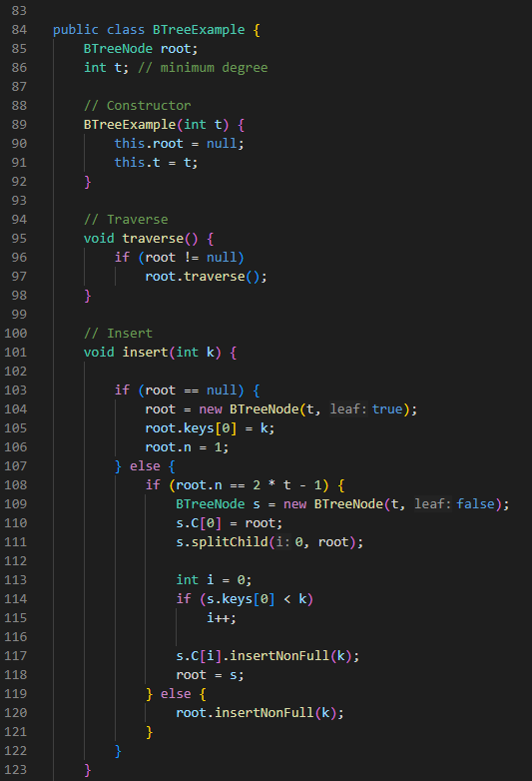
2. Non-Primitive – Non Linear Data Structures
B-Tree

Slide 12
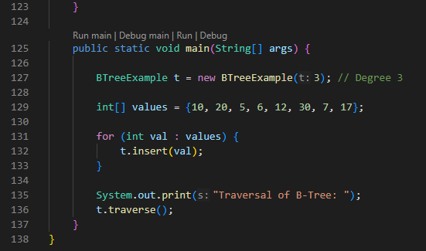
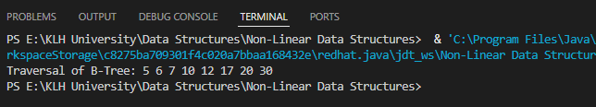

2. Non-Primitive – Non Linear Data Structures
B-Tree

Slide 13
2. Non-Primitive – Non Linear Data Structures
B-Tree
1. BTreeNode Class
Fields:
keys[] → stores the keys in sorted order.
t → minimum degree (defines the range of children).
C[] → array of child pointers.
n → current number of keys in the node.
leaf → flag to check if the node is a leaf.
Constructor:
Initializes a node with capacity 2t - 1 keys and 2t children.
2. Traverse Method
Performs an in‑order traversal of the B‑Tree.
Prints all keys in sorted order.

Slide 14
2. Non-Primitive – Non Linear Data Structures
B-Tree
3. InsertNonFull Method
Inserts a key into a node that is not full.
If it’s a leaf → inserts in sorted order.
If it’s internal → finds the correct child and inserts recursively.
If the child is full → calls splitChild() before inserting.
4. SplitChild Method
Splits a full child node into two nodes.
Promotes the middle key to the parent.
Ensures the B‑Tree properties are maintained (balanced, sorted, within degree limits).

Slide 15


2. Non-Primitive – Non Linear Data Structures
B-Tree
In main, you create a B‑Tree of minimum degree 3:
Then you insert values:
How Insert Works
Minimum degree t = 3 →
Each node can hold up to 2t–1 = 5 keys.
Each node must have at least t–1 = 2 keys (except root).

Slide 16




2. Non-Primitive – Non Linear Data Structures
B-Tree
Step‑by‑Step Insertions
Insert 10 → root created: [10]
Insert 20 → [10,20]
Insert 5 → [5,10,20]
Insert 6 → [5,6,10,20]
Insert 12 → [5,6,10,12,20] (root full now)
Insert 30 → root splits:
Insert 7 → goes left child:
Insert 17 → goes right child:

Slide 17
2. Non-Primitive – Non Linear Data Structures
B+Tree
A B+ Tree is a variant of the B‑Tree.
It is also a balanced multi‑way search tree, but with one key difference:
Internal nodes store only keys (no data).
Leaf nodes store both keys and data.
Leaf nodes are linked together like a chain, making range queries very efficient.
Keys vs. Data in a B+ Tree
Keys in Internal Nodes → act like a catalog or index. They guide you to the right leaf.
Keys + Data in Leaf Nodes → leaf nodes hold the actual records (like student details, file pointers, etc.).
Linked Leaves → leaf nodes are connected, so you can scan sequentially across them.

Slide 18




2. Non-Primitive – Non Linear Data Structures
B+Tree
Example (Order 3 B+ Tree)
Let’s insert IDs: 10, 20, 5, 6, 12
Step‑by‑Step
Insert 10
Insert 20
Insert 5 → overflow → split
Insert 6 → goes left leaf
Insert 12 → goes right leaf

Slide 19
2. Non-Primitive – Non Linear Data Structures
B+Tree
How It Differs from B‑Tree?
In B‑Tree: keys + data can be in both internal and leaf nodes.
In B+ Tree:
Internal nodes = keys only (like a catalog).
Leaf nodes = keys + data (actual records).
Leaves are linked for fast sequential access.
Properties
Balanced height → O(log n) search, insert, delete.
Range queries are very fast because leaf nodes are linked.
Better for databases where scanning ranges (like “find all IDs between 100 and 200”) is common.
A B+ Tree is like a library catalog system:
Internal nodes = catalog cards (just titles).
Leaf nodes = actual books (full records).
Linked leaves = shelves connected in order, so you can walk through them easily.

Slide 20
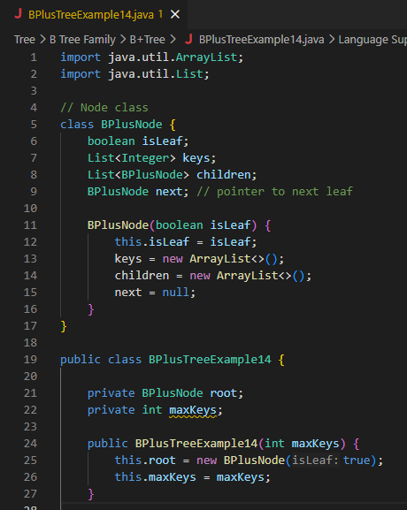
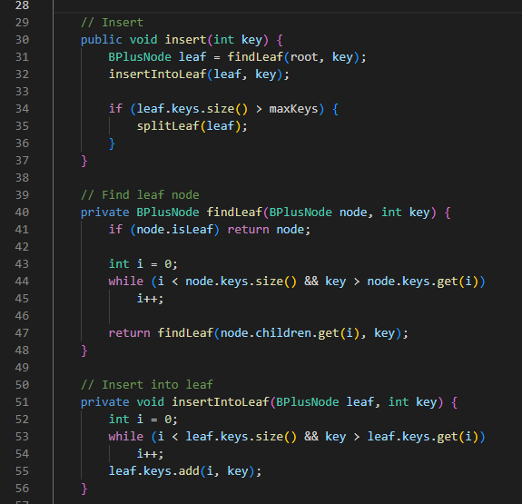
2. Non-Primitive – Non Linear Data Structures
B+Tree

Slide 21
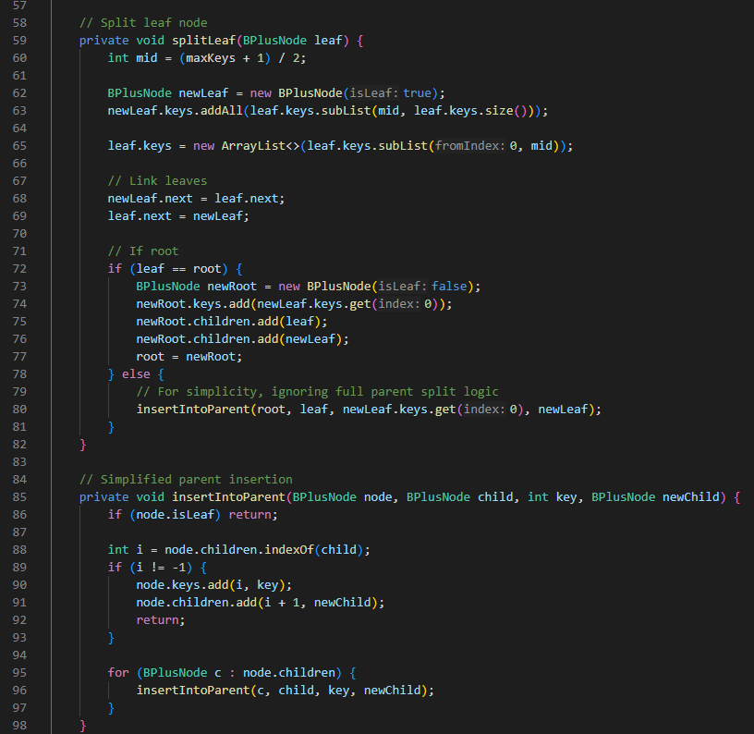
2. Non-Primitive – Non Linear Data Structures
B+Tree

Slide 22
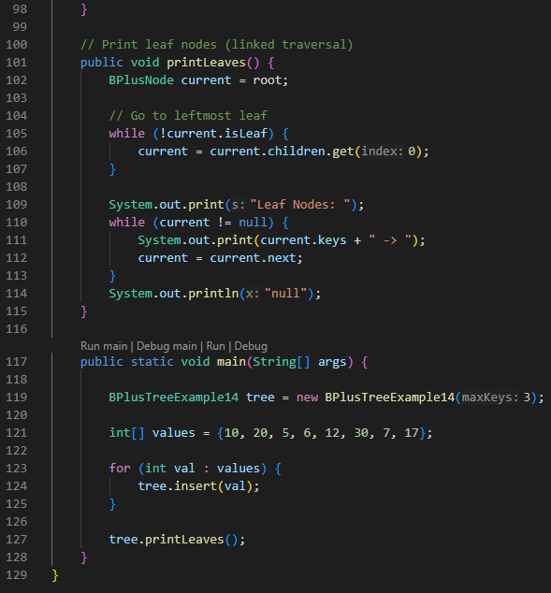
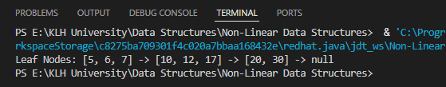
2. Non-Primitive – Non Linear Data Structures
B+Tree

Slide 23
2. Non-Primitive – Non Linear Data Structures
B+Tree
Program Structure
Class BPlusNode
keys → list of keys stored in the node.
children → child pointers (used in internal nodes).
isLeaf → whether the node is a leaf.
next → pointer to the next leaf (for linked leaf traversal).
Class BPlusTreeExample14
root → root node of the tree.
maxKeys → maximum number of keys allowed in a node before splitting.
insert(key) → inserts a new key into the tree.
splitLeaf(leaf) → splits a leaf when it overflows.
printLeaves() → prints all leaf nodes in order using the linked list of leaves.

Slide 24
2. Non-Primitive – Non Linear Data Structures
B+Tree
Program Structure
Inputs
In main, you create a B+ Tree with maxKeys = 3:
Then you insert values:
How Insert Works
Insert 10, 20, 5 → all fit in one leaf: [5,10,20].
Insert 6 → leaf overflows (>3 keys), so split:
Root: [10]
/ \
Leaf:[5,6] Leaf:[10,20]
(Leaves linked: [5,6] → [10,20])
**Insert 12** → goes into right leaf: `[10,12,20]`.
**Insert 30** → right leaf overflows, split:
Root: [10,20]
/ | \
Leaf:[5,6] Leaf:[10,12] Leaf:[20,30]
(Leaves linked: [5,6] → [10,12] → [20,30])
**Insert 7** → goes into left leaf: `[5,6,7]`.
**Insert 17** → goes into middle leaf: `[10,12,17]`.
Final structure:
Root: [10,20]
/ | \
Leaf:[5,6,7] Leaf:[10,12,17] Leaf:[20,30]

Slide 25
2. Non-Primitive – Non Linear Data Structures
B+Tree
Inputs: numbers {10,20,5,6,12,30,7,17}.
Process: each number is inserted, leaves split when full, root updated with separator keys.
Output: linked leaf traversal prints all leaf nodes in sorted order →
[5,6,7] → [10,12,17] → [20,30] → null.
This shows how the B+ Tree keeps data only in leaf nodes, links them for fast range queries, and uses internal nodes as navigation indexes.

Slide 26
2. Non-Primitive – Non Linear Data Structures
B* Tree
A B* Tree is a balanced search tree like B and B+ Trees.
It differs by using a redistribution strategy:
When a node is full, instead of splitting immediately, it borrows keys from its sibling.
Only if redistribution is not possible, the node splits.
This results in higher occupancy (~66%) compared to B+ Trees (~50%).
Keys and Data
Internal nodes: store only keys for navigation.
Leaf nodes: store both keys and data (like B+ Tree).
Linked leaves: leaf nodes are connected for fast sequential access.

Slide 27
2. Non-Primitive – Non Linear Data Structures
B* Tree
How It Works
Insertion
Insert key into the correct leaf.
If the leaf is full:
First try to redistribute keys with its sibling.
If redistribution fails, split the node.
Promote the middle key to the parent if splitting occurs.
Search
Works like B+ Tree: navigate using internal keys, then find data in leaf.
Complexity: O(log n).
Deletion
If a node has too few keys, borrow from sibling or merge.
Balance is maintained.

Slide 28
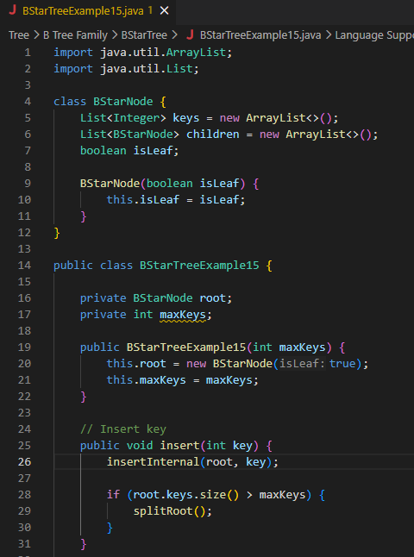
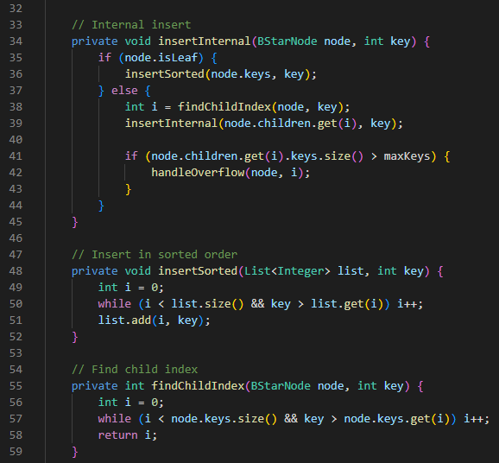
2. Non-Primitive – Non Linear Data Structures
B* Tree

Slide 29
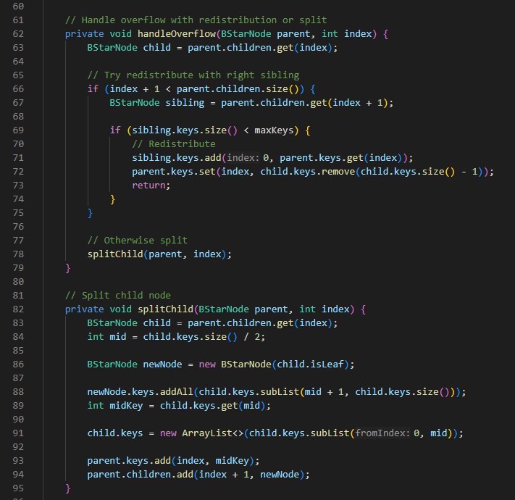
2. Non-Primitive – Non Linear Data Structures
B* Tree

Slide 30
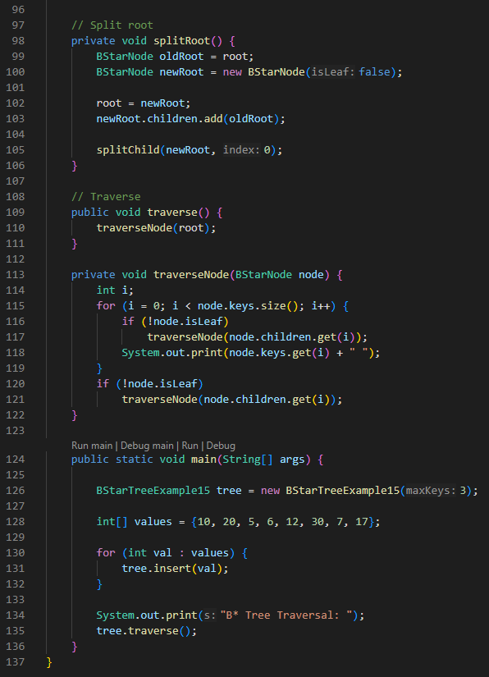
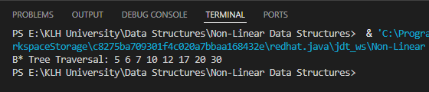
2. Non-Primitive – Non Linear Data Structures
B* Tree

Slide 31
2. Non-Primitive – Non Linear Data Structures
B* Tree
Class BStarNode
keys → list of keys stored in the node.
children → child pointers (used in internal nodes).
isLeaf → whether the node is a leaf.
Class BStarTreeExample15
root → root node of the tree.
maxKeys → maximum number of keys allowed in a node before overflow.
insert(key) → inserts a new key into the tree.
handleOverflow() → tries to redistribute keys with a sibling before splitting (this is the B* Tree’s special feature).
splitChild() → splits a child node if redistribution isn’t possible.
traverse() → prints all keys in sorted order.

Slide 32


2. Non-Primitive – Non Linear Data Structures
B* Tree
Inputs
In main, you create a B* Tree with maxKeys = 3:
Then you insert values:
How It Works Internally
Insert 10, 20, 5 → all fit in root leaf: [5,10,20].
Insert 6 → root leaf overflows (>3 keys).
Since root is leaf, it splits into two leaves:
Insert 12 → goes right leaf: [12,20].
Insert 30 → right leaf overflows.
Redistribute or split → new structure:
[10,20]
/ | \
[5,6] [12] [30]
Insert 7 → goes left leaf: [5,6,7].
Insert 17 → goes middle leaf: [12,17].
Final structure:
[10]
/ \
[5,6] [20]

Slide 33
2. Non-Primitive – Non Linear Data Structures
B* Tree
tree.traverse();
This prints all keys in sorted order:
Inputs: numbers {10,20,5,6,12,30,7,17}.
Process: each number is inserted, nodes redistribute keys with siblings before splitting (B* Tree’s unique feature).
Output: traversal prints all keys in ascending order → 5 6 7 10 12 17 20 30.
This shows how the B Tree improves space utilization* by redistributing keys before splitting, keeping nodes ~2/3 full instead of ~1/2 like B+ Trees.

Slide 34
2. Non-Primitive – Non Linear Data Structures
B Link Tree
A B‑Link Tree is a concurrent, balanced search tree.
It extends the B+ Tree by adding sibling (horizontal) links between nodes.
These links allow searches and updates to continue even if splits are happening, making it ideal for multi‑threaded database systems.
Key Features
Sibling Links: Each node has a pointer to its immediate right sibling.
Safe Concurrent Access: If a node splits while another thread is searching, the sibling link ensures the search can continue correctly.
Balanced Structure: Like B+ Trees, all data is stored in leaf nodes, and internal nodes store only keys for navigation.
Range Queries: Still efficient because leaf nodes are linked sequentially.

Slide 35
2. Non-Primitive – Non Linear Data Structures
B Link Tree
How It Works
Search
Navigate using internal keys.
If the search key is greater than the largest key in the current node, follow the sibling link to the right.
This ensures correctness even during concurrent splits.
Insertion
Insert into the correct leaf.
If the leaf overflows, split it.
The sibling link ensures that ongoing searches can still find the new key without waiting for parent updates.
Deletion
Remove the key from the leaf.
If underflow occurs, borrow or merge.
Sibling links help maintain consistency during restructuring.

Slide 36
2. Non-Primitive – Non Linear Data Structures
B Link Tree
Properties
Balanced height → O(log n) operations.
Concurrent safety → multiple threads can search/insert/delete without blocking.
Sibling links → guarantee correctness during splits and merges.
Efficient for databases with high concurrency.
Tree Type | Data Storage | Leaf Links | Sibling Links | Best Use Case
B‑Tree | Internal + Leaf | No | No | General indexing
B+ Tree | Leaf only | Yes | No | Range queries
B* Tree | Leaf only | Yes | No | Disk efficiency
B‑Link Tree | Leaf only | Yes | Yes | Concurrent DB operations

Slide 37
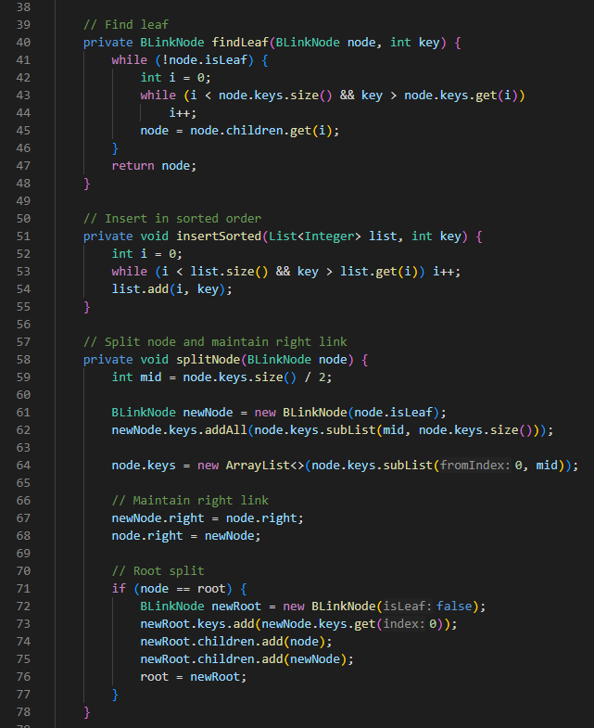
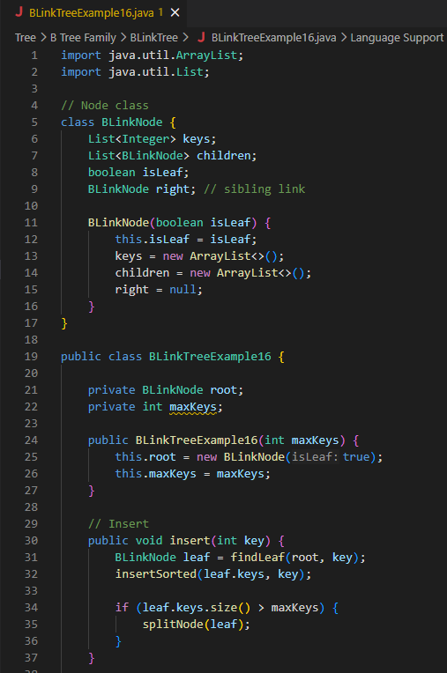
2. Non-Primitive – Non Linear Data Structures
B Link Tree

Slide 38
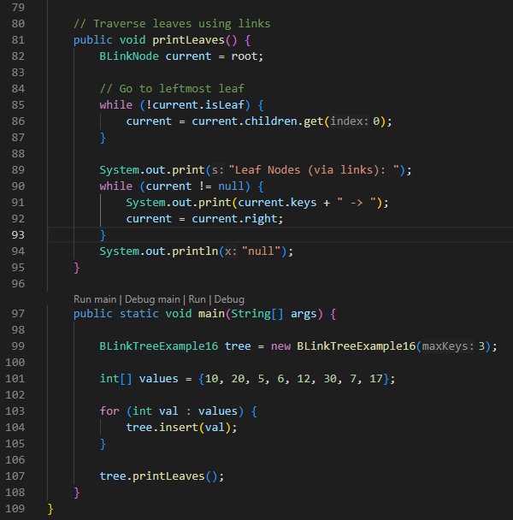
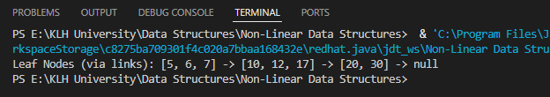
2. Non-Primitive – Non Linear Data Structures
B Link Tree

Slide 39
2. Non-Primitive – Non Linear Data Structures
B Link Tree
Class BLinkNode
keys → list of keys stored in the node.
children → child pointers (used in internal nodes).
isLeaf → whether the node is a leaf.
right → sibling link pointing to the next node (this is the special feature of B‑Link Trees).
Class BLinkTreeExample16
root → root node of the tree.
maxKeys → maximum number of keys allowed in a node before splitting.
insert(key) → inserts a new key into the tree.
splitNode(node) → splits a node when it overflows and maintains the right sibling link.
printLeaves() → prints all leaf nodes in order using the sibling links.

Slide 40

2. Non-Primitive – Non Linear Data Structures
B Link Tree
Inputs
In main, you create a B‑Link Tree with maxKeys = 3:
Then you insert values:
How It Works Internally
Insert 10, 20, 5 → all fit in root leaf: [5,10,20].
Insert 6 → root leaf overflows (>3 keys).
Root splits into two leaves:
Insert 12 → goes into right leaf: [10,12,20].
Insert 30 → right leaf overflows, split:
[10,20]
/ | \
[5,6] [10,12] [20,30]
- Right links: [5,6] → [10,12] → [20,30].
**Insert 7** → goes into left leaf: `[5,6,7]`.
**Insert 17** → goes into middle leaf: `[10,12,17]`.
Final structure:
[10,20]
/ | \
[5,6,7] → [10,12,17] → [20,30]
[10]
/ \
[5,6] [10,20]
tree.printLeaves();

Slide 41
2. Non-Primitive – Non Linear Data Structures
B Link Tree
Inputs: numbers {10,20,5,6,12,30,7,17}.
Process: each number is inserted, nodes split when full, and right sibling links are maintained.
Output: traversal prints leaf nodes in sorted order using links →
[5,6,7] → [10,12,17] → [20,30] → null.
This demonstrates the B‑Link Tree’s special feature: sibling links that make searches and updates safe even during concurrent splits.

Slide 42
2. Non-Primitive – Non Linear Data Structures
Trie Tree
A Trie (or Prefix Tree) is a tree‑based data structure used to store strings efficiently by sharing common prefixes. It is widely used in applications like autocomplete, spell checking, and IP routing because it allows fast prefix searches in O(L) time, where L is the length of the string.
A Trie Tree (pronounced “try” or “tree”) is a prefix tree.
Each node represents a character.
The path from the root to a node represents a prefix of one or more strings.
A special flag marks the end of a word.
Key Properties
Root node → empty, no character.
Edges → represent characters.
Nodes → store children references (often 26 for lowercase English letters).
End marker → indicates a complete word.
Shared prefixes → reduce duplication and save memory.

Slide 43
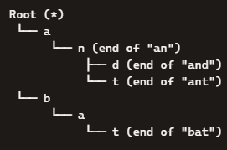
2. Non-Primitive – Non Linear Data Structures
Trie Tree
Example
Suppose we insert words: "and", "ant", "an", "bat"
Trie structure:
"an" ends at node n.
"and" extends to d.
"ant" extends to t.
"bat" is stored separately under b.

Slide 44
2. Non-Primitive – Non Linear Data Structures
Trie Tree
Operations
Insertion
Traverse character by character.
Create new nodes if path doesn’t exist.
Mark end of word.
Search
Follow path for each character.
If path exists and end marker is set → word found.
Prefix Search (Autocomplete)
Traverse prefix characters.
Collect all words under that node.
Deletion
Remove end marker.
If node has no children, prune it.

Slide 45
2. Non-Primitive – Non Linear Data Structures
Trie Tree
A Trie Tree is best when you need prefix‑based searching (like autocomplete).
It stores words by characters along paths, sharing common prefixes.
Operations run in O(L) where L = length of the word, independent of the number of words stored.
Trade‑off: fast search but higher memory usage compared to hash tables.

Slide 46
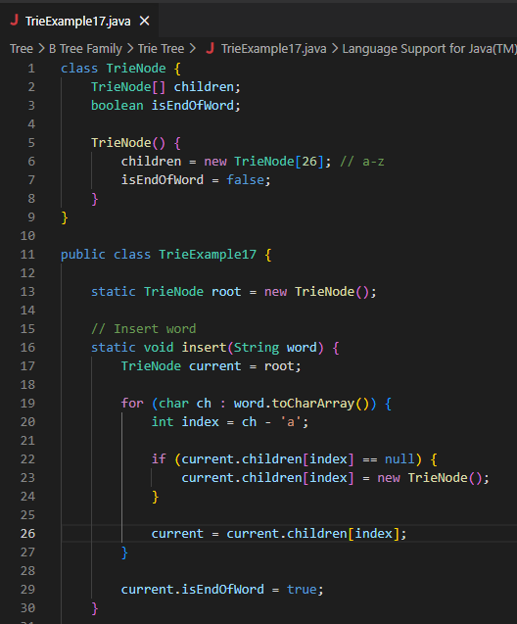
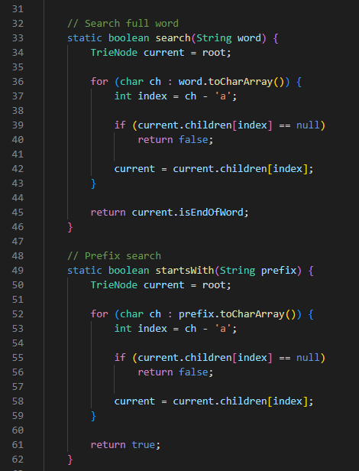
2. Non-Primitive – Non Linear Data Structures
Trie Tree

Slide 47
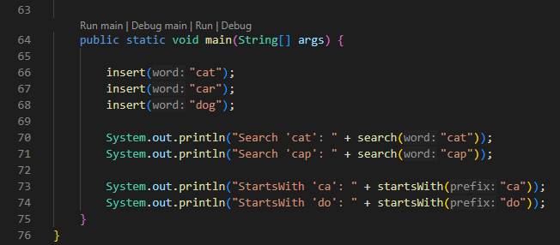
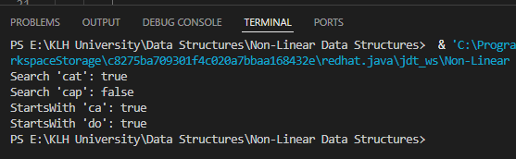
2. Non-Primitive – Non Linear Data Structures
Trie Tree

Slide 48
2. Non-Primitive – Non Linear Data Structures
Trie Tree
Class TrieNode
children → an array of 26 slots (for letters a–z). Each slot can point to another TrieNode.
isEndOfWord → a boolean flag marking whether a word ends at this node.
Class TrieExample17
root → the root of the Trie (empty node).
insert(word) → adds a word into the Trie character by character.
search(word) → checks if a full word exists in the Trie.
startsWith(prefix) → checks if any word in the Trie starts with the given prefix.

Slide 49


2. Non-Primitive – Non Linear Data Structures
Trie Tree
In main, three words are inserted:
Then the program performs searches:

Slide 50
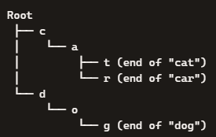

2. Non-Primitive – Non Linear Data Structures
Trie Tree
How Inputs Are Processed
Insert "cat"
Root → c → a → t.
Mark t as end of word.
Insert "car"
Root → c → a → r.
Shares prefix ca with "cat".
Mark r as end of word.
Insert "dog"
Root → d → o → g.
Separate branch from "cat"/"car".
Mark g as end of word.
Trie structure after inserts:
Outputs
Now the searches:
search("cat") → true (word exists).
search("cap") → false (prefix exists, but no word ends at "p").
startsWith("ca") → true (both "cat" and "car" start with "ca").
startsWith("do") → true ("dog" starts with "do").
Program output:
Inputs: words "cat", "car", "dog".
Processing: each word is inserted character by character, sharing prefixes where possible.
Outputs: search confirms if full words exist, while prefix search checks if any word starts with the given prefix.
This shows how a Trie efficiently stores and searches words by their prefixes.

