Slide 1

Data Structures
A logical or mathematical model for organizing data in memory, along with operations that can be performed on it.
Purpose: To manage large amounts of data efficiently, reduce complexity, and improve performance in applications like databases, operating systems, and AI systems
Why Data Structures are Important?
Without proper organization, data becomes hard to use.
Data structures help in:
Faster searching (e.g., Binary Search in arrays)
Efficient memory usage
Better performance of programs
Solving complex problems easily
Every data structure supports operations like:
Insert → Add data
Delete → Remove data
Update → Modify data
Search → Find data
Traverse → Access all elements

Slide 2
Data Structures
Operations on Data Structures
Query Operations: Retrieve information (e.g., search, find maximum/minimum).
Modification Operations: Update data (e.g., insert, delete, sort).
Real-Life Applications
Databases: Organize records for fast retrieval.
Operating Systems: Manage memory, files, and processes.
Computer Graphics: Represent geometric shapes and models.
Artificial Intelligence
Advantages
Efficiency: Faster storage and retrieval.
Flexibility: Easy modification and manipulation.
Reusability: Can be applied across multiple programs.
Maintainability: Makes code easier to understand and update

Slide 3
Types of Data Structures
Data structures are mainly classified based on how data is organized and accessed.
1. Primitive Data Structures
Primitive Data Structures are the most basic building blocks in programming—simple data types like integers, floats, characters, and boolean that represent single values and cannot be broken down further. They are directly supported by programming languages and serve as the foundation for building more complex data structures.
These are the basic, built-in data types provided by programming languages.
Type | Description | Examples
Integer | Stores whole numbers (positive, negative, zero). | int x = 10;
Float / Double | Represents real numbers with decimal points. | float y = 3.14;
Character | Represents a single symbol or letter. | 'a', '@', '1'
Boolean | Stores logical values (true/false). | bool flag = true;
String (language-dependent) | Sequence of characters; sometimes treated as primitive. | "Hello"
Pointer (in some languages) | Stores memory address of another variable. | int* ptr;

Slide 4
Types of Data Structures
Primitive Data Structures
Applications
Integers: Counting, indexing arrays, loop control.
Floats: Scientific calculations, graphics, financial computations.
Characters: Text processing, encoding symbols.
Booleans: Decision-making in conditional statements.
Pointers: Memory management, dynamic data structures (like linked lists).
Advantages
Simplicity: Easy to use and understand.
Efficiency: Directly supported by hardware and compilers.
Foundation: Essential for building non-primitive structures (arrays, lists, trees).

Slide 5
Types of Data Structures
2. Non-Primitive Data Structures
These are complex data structures formed using primitive types.
They are further divided into:
Linear
Non-Linear

Slide 6
Types of Data Structures
2. Non-Primitive Data Structures
Linear Data Structures
Linear Data Structures are data structures where elements are arranged sequentially, one after another, with each element having a unique predecessor and successor. Common examples include arrays, linked lists, stacks, and queues. They are widely used because they preserve order and allow efficient traversal and manipulation.
Characteristics
Sequential Organization: Each element has a predecessor (except the first) and a successor (except the last).
Order Preservation: Elements are accessed in the order they were inserted.
Fixed or Dynamic Size: Arrays are fixed, while linked lists, stacks, and queues can grow/shrink.
Efficient Access: Arrays allow constant-time access by index; linked lists allow dynamic memory usage.

Slide 7
Types of Data Structures
2. Non-Primitive Data Structures
Linear Data Structures
Type | Description | Order Rule | Example Use Cases
Array | Fixed-size collection of elements stored in contiguous memory. | Indexed (0,1,2…) | Storing student marks, matrices.
Linked List | Dynamic collection of nodes, each pointing to the next. | Sequential links | Implementing dynamic memory structures.
Stack | Follows LIFO (Last-In-First-Out). | Last element added is first removed. | Undo operations, expression evaluation.
Queue | Follows FIFO (First-In-First-Out). | First element added is first removed. | Task scheduling, printer queues.
Deque | Double-ended queue allowing insertion/deletion at both ends. | Flexible order | Browser history, job scheduling.

Slide 8
Types of Data Structures
2. Non-Primitive Data Structures
Linear Data Structures
Real-Life Applications
Arrays: Used in databases, image processing, and matrix operations.
Linked Lists: Useful in dynamic memory allocation and implementing file systems.
Stacks: Applied in recursion, parsing expressions, and backtracking algorithms.
Queues: Essential in operating systems for process scheduling and handling requests.
Advantages
Simplicity: Easy to implement and understand.
Predictability: Operations follow a clear order (FIFO or LIFO).
Efficiency: Good for sequential data processing.
Limitations
Fixed Size in Arrays: Can lead to wasted memory or overflow.
Traversal Overhead in Linked Lists: Accessing elements requires sequential traversal.
Restricted Access in Stacks/Queues: Only specific ends can be accessed.

Slide 9
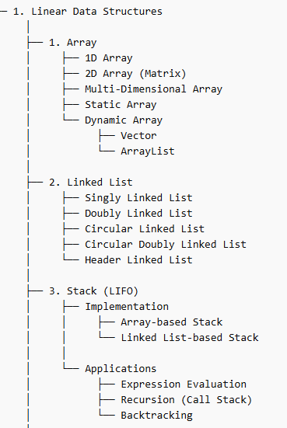
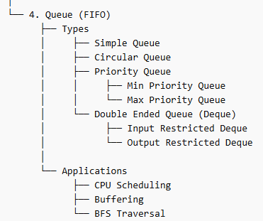
Types of Data Structures
Data structures are mainly classified based on how data is organized and accessed.
2. Non-Primitive – Linear Data Structures

Slide 10
Types of Data Structures
2. Non-Primitive – Non Linear Data Structures
Non-Linear Data Structures are data structures where elements are not stored sequentially; instead, they are organized hierarchically or in networks, allowing multiple relationships between elements. Common examples include trees, graphs, heaps, and tries, which are essential for modeling complex real-world systems like file directories, social networks, and routing maps.
Characteristics
Hierarchical or Networked Organization: Elements can branch out or connect in multiple directions.
Complex Traversal: Cannot be traversed in a single run like linear structures.
Efficient for Specialized Operations: Searching, shortest path, hierarchical queries.
Real-Life Applications
Trees: File directories, decision trees in AI, database indexing.
Graphs: Social media connections, road maps, recommendation systems.
Heaps: Task scheduling in operating systems, implementing priority queues.
Tries: Fast dictionary lookups, search engines, predictive text.

Slide 11
Types of Data Structures
2. Non-Primitive – Non Linear Data Structures
Advantages
Models Complex Relationships: Ideal for hierarchical or networked data.
Optimized Performance: Faster search and retrieval in certain contexts (e.g., binary search trees).
Flexibility: Can represent diverse real-world structures.
Limitations
Complex Implementation: More difficult to code and manage than linear structures.
Traversal Overhead: Requires specialized algorithms (DFS, BFS).
Memory Usage: Can consume more memory due to pointers and links.

Slide 12
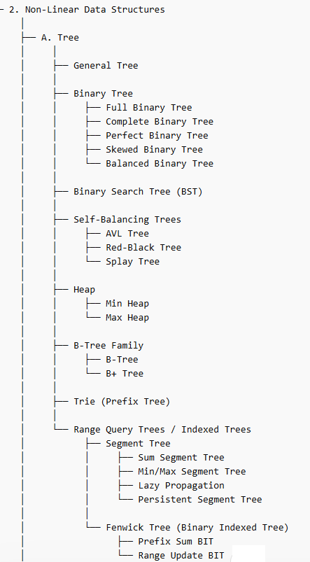
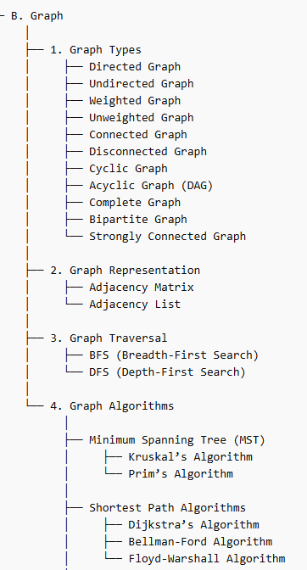
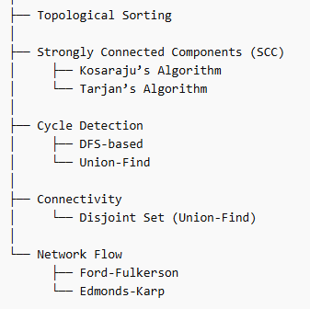
Types of Data Structures
2. Non-Primitive – Non Linear Data Structures

Slide 13
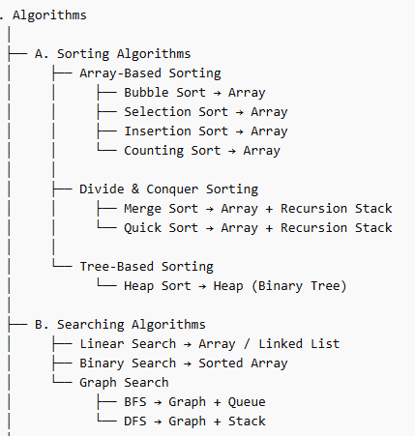
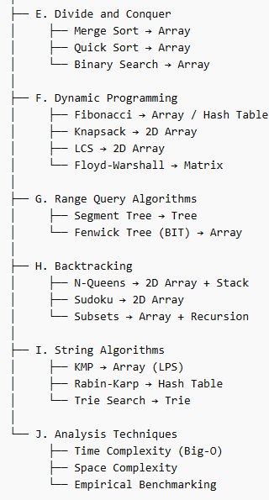
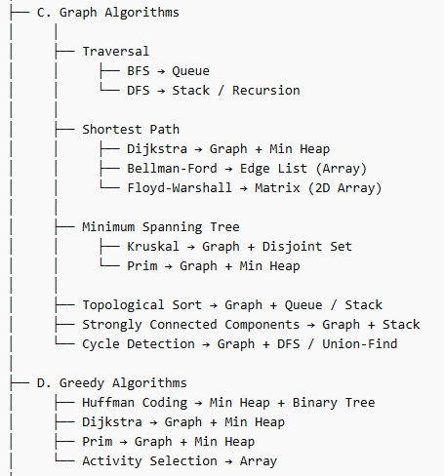
Types of Data Structures
2. Non-Primitive – Non Linear Data Structures

Slide 14
Types of Data Structures
2. Non-Primitive – Non Linear Data Structures

Slide 15
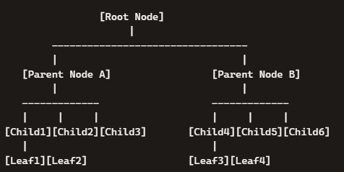
2. Non-Primitive – Non Linear Data Structures
General Tree
A General Tree is a non-linear hierarchical data structure where:
Each node can have zero, one, or many children.
There is no fixed limit on the number of children.

Slide 16
2. Non-Primitive – Non Linear Data Structures
General Tree
Root Node → The very top node (only one). It has no parent.
Parent Node → Nodes directly under the root (A and B). They have children.
Child Node → Immediate successors of a parent (Child1–Child6).
Leaf Node → Nodes with no children (Leaf1–Leaf4).
Siblings → Nodes sharing the same parent (Child1, Child2, Child3 are siblings under Parent A).
Path → A sequence of nodes from root to a target node. Example: Root → Parent A → Child1 → Leaf1.
Degree of Node → Number of children a node has. Parent A has degree 3 (Child1–Child3).
Degree of Tree → Maximum degree among all nodes. Here, the highest is 3.
Level → Distance from the root:
Root = Level 1
Parent Nodes (A, B) = Level 2
Child Nodes (Child1–Child6) = Level 3
Leaf Nodes (Leaf1–Leaf4) = Level 4
Depth → Number of edges from root to a node. Example: Leaf1 has depth 4 (Root → A → Child1 → Leaf1).
Height → Longest path from root to a leaf. In this diagram, the height is 4.

Slide 17
2. Non-Primitive – Non Linear Data Structures
General Tree
Degree of a Node
The degree of a node is the number of children that node has.
Example:
Parent Node A has 3 children (Child1, Child2, Child3). → Degree of Node A = 3
Parent Node B has 3 children (Child4, Child5, Child6). → Degree of Node B = 3
Child1 has 2 children (Leaf1, Leaf2). → Degree of Child1 = 2
Child2, Child3, Child4, Child5, Child6 each have 0 children. → Degree of those nodes = 0
Degree of a Tree
The degree of a tree is the maximum degree among all nodes in the tree.
In the diagram:
Node A has degree 3
Node B has degree 3
Child1 has degree 2
Others have degree 0
The highest degree is 3, so: Degree of Tree=3
Degree of Node → Number of children that specific node has.
Degree of Tree → The largest degree value among all nodes.
In the diagram, since the maximum children any node has is 3, the degree of the tree = 3.

Slide 18
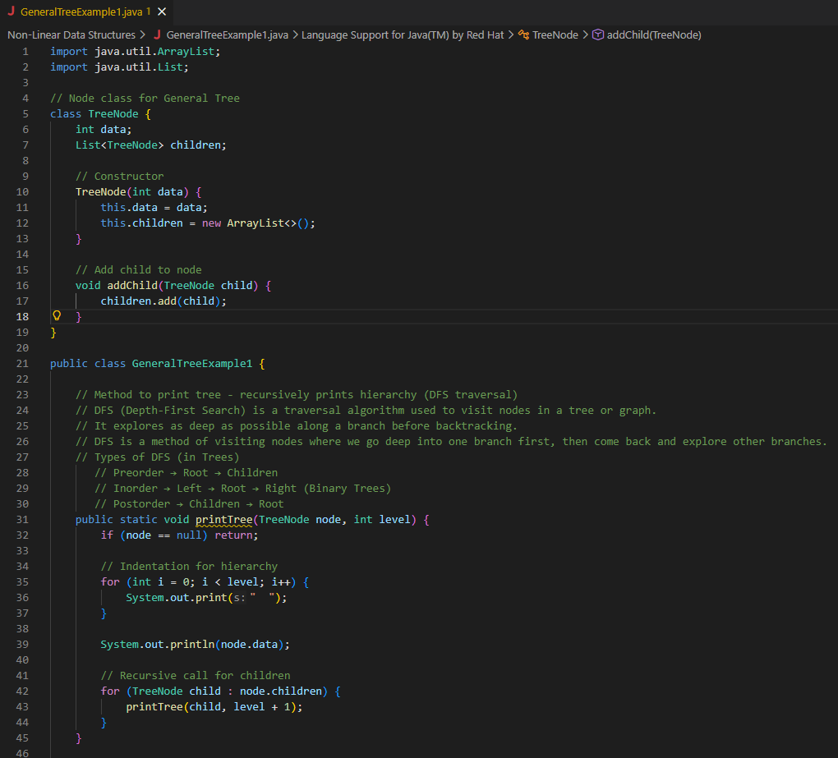
2. Non-Primitive – Non Linear Data Structures
General Tree

Slide 19
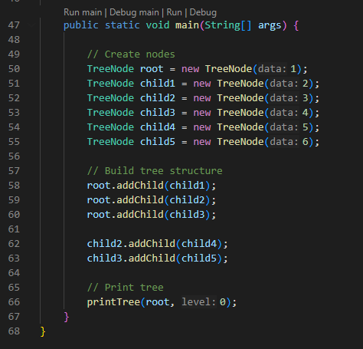
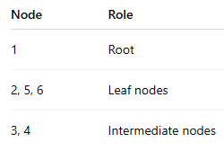
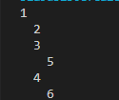
2. Non-Primitive – Non Linear Data Structures
General Tree

Slide 20
2. Non-Primitive – Non Linear Data Structures
General Tree
TreeNode Class
Each node stores:
data → the value.
children → a list of child nodes (can be many, not just 2).
addChild() → adds a new child to the node.
printTree Method
Prints the tree hierarchy using DFS (Depth-First Search).
Indentation (level) shows the depth of each node.
Recursively visits each child before moving to the next sibling.
main method
Builds a tree like as shown in the output
Root = 1
Children = 2, 3, 4
Node 3 has child 5
Node 4 has child 6
Calls printTree(root, 0) → prints the hierarchy.
When you run the program, it prints: This shows the tree structure with indentation representing levels.

Slide 21
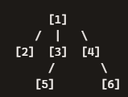
2. Non-Primitive – Non Linear Data Structures
General Tree
This program demonstrates:
General Tree structure (nodes can have multiple children).
DFS traversal to print hierarchy.
How recursion naturally fits tree operations.
In short: It builds a general tree with root 1, adds children, and prints the hierarchy using DFS.
Root node = 1
Children of 1 → 2, 3, 4
Node 3 has a child → 5
Node 4 has a child → 6
So the tree expands outward from node 1, with multiple children allowed (unlike a binary tree which limits to 2).
This program demonstrates a General Tree, where each node can have any number of children. The printTree() method uses DFS traversal to print the hierarchy with indentation, which is why the output looks like a structured outline.

Slide 22
2. Non-Primitive – Non Linear Data Structures
Binary Tree
A Binary Tree is a type of non-linear hierarchical data structure where:
Each node can have at most two children.
These children are referred to as the left child and the right child.
The structure is recursive: each child can itself be the root of another binary tree.
Structure and Terminology
Root Node → The topmost node with no parent.
Parent Node → Any node that has children.
Child Node → Immediate successors of a parent (left or right).
Leaf Node → Nodes with no children.
Subtree → A smaller tree formed from a child node and its descendants.
Characteristics
Maximum Degree: Each node has a degree of at most 2.
Ordered Structure: Children are distinguished as left and right.
Recursive Nature: Each child node can itself be the root of a binary subtree.
A Binary Tree is a special case of a general tree where each node can branch into two directions only (left and right). This restriction makes binary trees extremely useful for searching, sorting, and hierarchical representation in computer science.

Slide 23
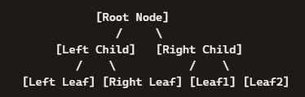
2. Non-Primitive – Non Linear Data Structures
Binary Tree
Root Node → The topmost node with no parent.
Left Child / Right Child → The two possible branches from the root.
Leaf Nodes → Nodes with no children (end points).
Hierarchy → Each node can have at most two children, forming a branching structure.
Key Properties
Every node has at most two children.
The tree grows downward, with each level representing a new generation of nodes.
Traversal can be done in multiple ways — Inorder, Preorder, and Postorder — depending on the order of visiting nodes.

Slide 24
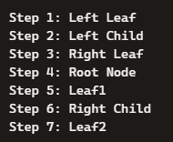
2. Non-Primitive – Non Linear Data Structures
Binary Tree
Inorder Traversal (Left → Root → Right)
You first visit the left subtree, then the root, then the right subtree.
Used in Binary Search Trees to get nodes in sorted order.

Slide 25
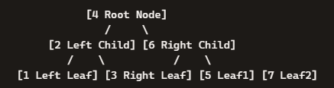
2. Non-Primitive – Non Linear Data Structures
Binary Tree
Inorder Traversal (Left → Root → Right)
Visiting Order: 1 → 2 → 3 → 4 → 5 → 6 → 7
Visit left subtree first, then root, then right subtree.

Slide 26
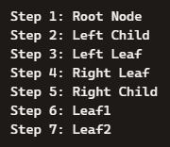
2. Non-Primitive – Non Linear Data Structures
Binary Tree
2. Preorder Traversal (Root → Left → Right)
You first visit the left subtree, then the root, then the right subtree.
Used in Binary Search Trees to get nodes in sorted order.

Slide 27
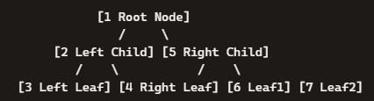
2. Non-Primitive – Non Linear Data Structures
Binary Tree
2. Preorder Traversal (Root → Left → Right)
Visiting Order: 1 → 2 → 3 → 4 → 5 → 6 → 7
Visit root first, then left subtree, then right subtree.

Slide 28
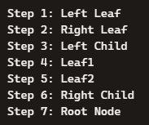
2. Non-Primitive – Non Linear Data Structures
Binary Tree
3. Postorder Traversal (Left → Right → Root)
You visit all children first, then the parent.
Used to delete a tree or evaluate postfix expressions.

Slide 29
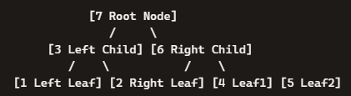
2. Non-Primitive – Non Linear Data Structures
Binary Tree
3. Postorder Traversal (Left → Right → Root)
Visiting Order: 1 → 2 → 3 → 4 → 5 → 6 → 7
Visit all children first, then the parent (root last).

Slide 30
2. Non-Primitive – Non Linear Data Structures
BFS (Breadth-First) vs DFS (Depth-First)
Breadth-First Search (BFS) explores a tree or graph level by level, while Depth-First Search (DFS) explores as far down one branch as possible before backtracking. BFS uses a queue (FIFO), and DFS uses a stack (LIFO) or recursion.
BFS → Best when you need the shortest path or level-order exploration.
DFS → Best when you need to explore deeply, detect cycles, or solve backtracking problems.
Feature | BFS (Breadth-First) | DFS (Depth-First)
Traversal Style | Level by level | Branch by branch
Data Structure | Queue (FIFO) | Stack (LIFO) / Recursion
Best For | Shortest path, closer nodes | Exploring deep paths, connectivity
Time Complexity | O(V + E) | O(V + E)
Space Complexity | O(V) (queue storage) | O(V) (stack/recursion)
Applications | Shortest path, bipartite check | Cycle detection, topological sort
(V = number of vertices, E = number of edges)

Slide 31
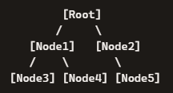
2. Non-Primitive – Non Linear Data Structures
BFS (Breadth-First) vs DFS (Depth-First)
BFS in Binary Trees
In a binary tree, BFS is called Level Order Traversal.
It visits nodes level by level from top to bottom, left to right.
Example:
BFS Order → Root → Node1 → Node2 → Node3 → Node4 → Node5
Applications:
Printing tree level by level.
Finding the shortest path in unweighted trees.
Used in Heaps (complete binary trees).

Slide 32
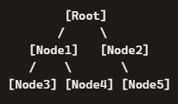
2. Non-Primitive – Non Linear Data Structures
BFS (Breadth-First) vs DFS (Depth-First)
DFS in Binary Trees
DFS corresponds to the three depth-first traversals:
Inorder (Left → Root → Right) → Produces sorted order in Binary Search Trees.
Preorder (Root → Left → Right) → Useful for copying or reconstructing trees.
Postorder (Left → Right → Root) → Useful for deleting trees or evaluating postfix expressions.
Inorder → Node3 → Node1 → Node4 → Root → Node2 → Node5
Preorder → Root → Node1 → Node3 → Node4 → Node2 → Node5
Postorder → Node3 → Node4 → Node1 → Node5 → Node2 → Root

Slide 33
2. Non-Primitive – Non Linear Data Structures
BFS (Breadth-First) vs DFS (Depth-First)
BFS → Level Order Traversal (breadth-first).
DFS → Inorder, Preorder, Postorder (depth-first).
Both are fundamental for searching, sorting, and processing binary trees.

Slide 34
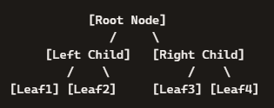

2. Non-Primitive – Non Linear Data Structures
Full Binary Tree
A Full Binary Tree is a special type of binary tree where:
Every node has either 0 or 2 children.
No node has only one child.
All internal nodes (non-leaf nodes) are completely filled with two branches.
Explanation:
The Root Node has two children.
Each Child Node also has two children.
Leaf Nodes have no children.
No node has just one child — that’s what makes it full.
Characteristics
Every internal node has exactly two children.
Leaf nodes may appear at different levels.
Height (h) and number of nodes (n) are related by:

Slide 35
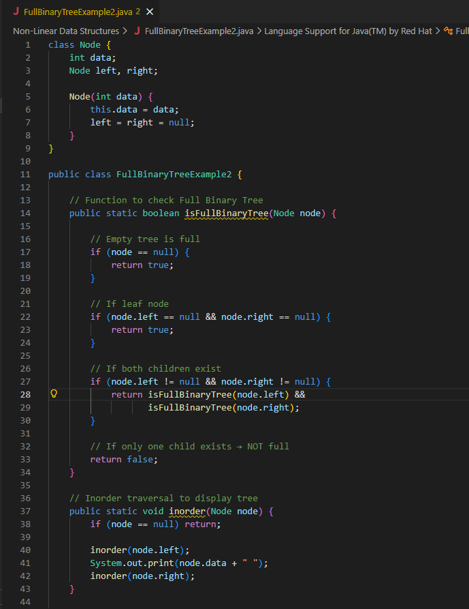
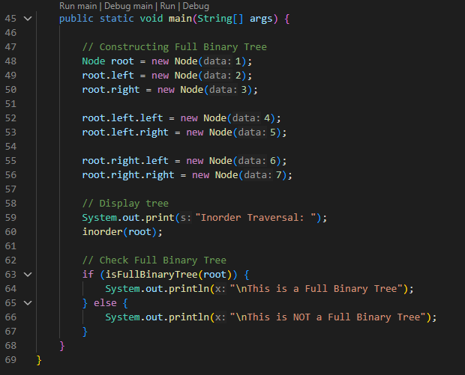
2. Non-Primitive – Non Linear Data Structures
Full Binary Tree

Slide 36
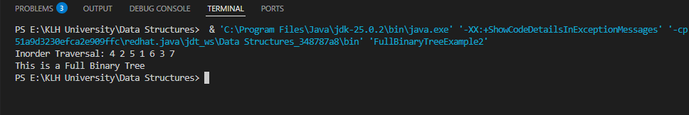
2. Non-Primitive – Non Linear Data Structures
Full Binary Tree

Slide 37
2. Non-Primitive – Non Linear Data Structures
Full Binary Tree
This Java program checks whether a given binary tree is a Full Binary Tree — meaning every node has either 0 or 2 children, never just one.
Node Class
Defines the structure of a tree node.
Each node stores:
data → the value.
left and right → pointers to child nodes.
isFullBinaryTree() Method
Recursively checks each node:
If the node is empty → considered full.
If it’s a leaf node (no children) → full.
If it has both children → check both subtrees.
If it has only one child → not full.
So, it ensures every node has either two children or none.

Slide 38
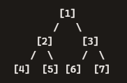
2. Non-Primitive – Non Linear Data Structures
Full Binary Tree
inorder() Method
Performs inorder traversal (Left → Root → Right).
Prints nodes in sorted order for a binary tree.
main() Method
Builds this tree:
Every node has either two children or none, so it’s Full.
Prints:
Inorder Traversal: 4 2 5 1 6 3 7
This is a Full Binary Tree
This program:
Builds a binary tree.
Traverses it in inorder.
Checks whether it’s a Full Binary Tree using recursion.
In short: it verifies that every node has either 0 or 2 children, confirming the tree’s completeness in structure.

Slide 39
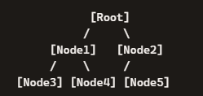
2. Non-Primitive – Non Linear Data Structures
Complete Binary Tree
A Complete Binary Tree is a binary tree where:
All levels are completely filled,
Except possibly the last level, which is filled from left to right without gaps.
No node in the last level can have a right child unless it already has a left child.
Level 1 (Root) → The root is filled.
Level 2 → Both children of the root (Node1 and Node2) are present → fully filled.
Level 3 → Nodes are added from left to right:
Node1 has two children (Node3, Node4).
Node2 has one child (Node5).
Notice: Node2’s left child exists, but the right child is missing. This is allowed because filling happens left to right.

Slide 40
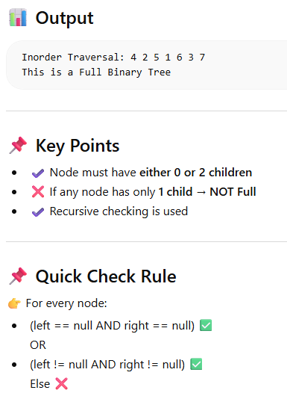
2. Non-Primitive – Non Linear Data Structures
Full Binary Tree

Slide 41
2. Non-Primitive – Non Linear Data Structures
Complete Binary Tree
Key Rule
In a Complete Binary Tree, the last level doesn’t need to be completely filled, but it must not have gaps when filled from left to right.
That’s why Node5 is placed as the left child of Node2. If Node2 had only a right child and no left child, it would not be complete.
Characteristics
Balanced filling: Nodes are added level by level, left to right.
Height efficiency: Keeps the tree compact.
Relation to arrays: A complete binary tree can be easily represented in an array (index-based storage).
Real-Life Applications
Heaps (Min-Heap / Max-Heap) → Priority queues rely on complete binary trees.
Efficient storage → Array representation avoids wasted space.
Scheduling & resource allocation → Balanced structure ensures fairness.

Slide 42
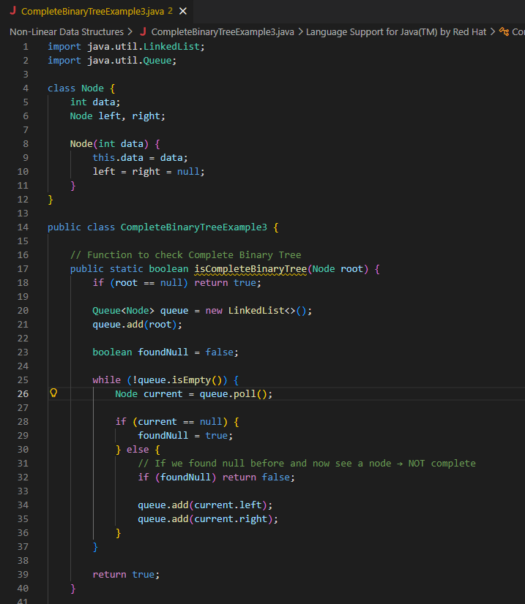
2. Non-Primitive – Non Linear Data Structures
Complete Binary Tree

Slide 43
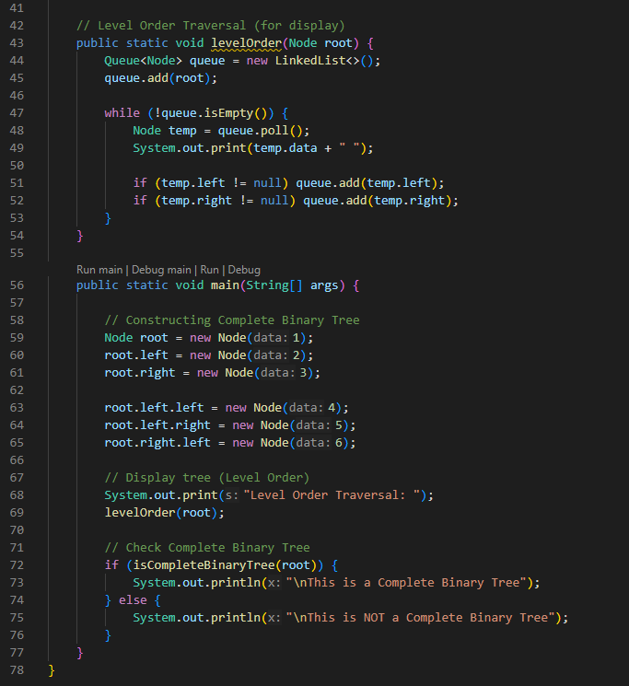
2. Non-Primitive – Non Linear Data Structures
Complete Binary Tree

Slide 44
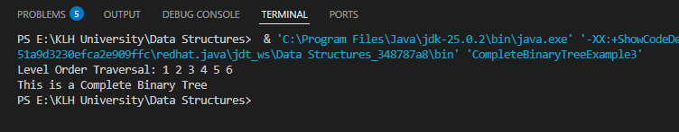
2. Non-Primitive – Non Linear Data Structures
Complete Binary Tree

Slide 45
2. Non-Primitive – Non Linear Data Structures
Complete Binary Tree
This program checks whether a given binary tree is a Complete Binary Tree — meaning all levels are fully filled except possibly the last, which is filled from left to right without gaps.
Node Class
Defines a node with:
data → value stored in the node.
left and right → pointers to child nodes.
isCompleteBinaryTree() Method
Uses a queue for level-order traversal (Breadth-First Search).
Visits nodes level by level:
If a null child is found, mark foundNull = true.
If later a non-null node appears after a null → tree is not complete.
This ensures all nodes are filled left to right without gaps.
levelOrder() Method
Prints nodes level by level (top to bottom, left to right).
Helps visualize the tree structure.

Slide 46
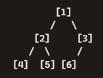
2. Non-Primitive – Non Linear Data Structures
Complete Binary Tree
main() Method
Builds this tree:
Level order traversal prints: 1 2 3 4 5 6
Checks completeness → True, because:
All levels are filled except the last.
The last level is filled left to right.
Output
Level Order Traversal: 1 2 3 4 5 6
This is a Complete Binary Tree
This program:
Builds a binary tree.
Prints it level by level.
Checks if it’s complete using a queue-based traversal.
It ensures there are no gaps in the tree’s structure — every level is filled properly from left to right.

Slide 47
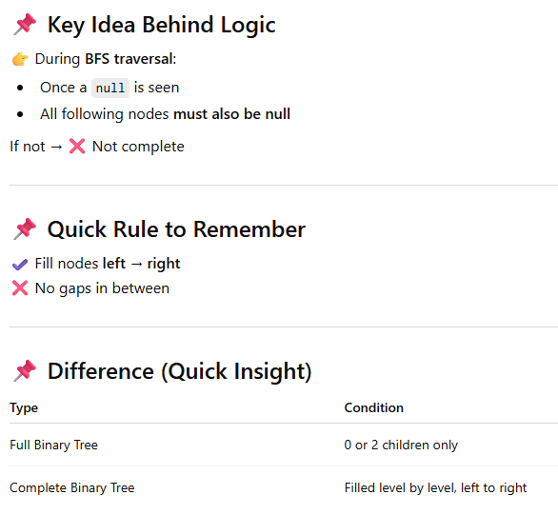
2. Non-Primitive – Non Linear Data Structures
Complete Binary Tree

Slide 48
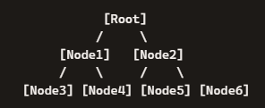
2. Non-Primitive – Non Linear Data Structures
Perfect Binary Tree
A Perfect Binary Tree is the most “balanced” form of a binary tree.
A Perfect Binary Tree is a binary tree in which:
All internal nodes have exactly two children.
All leaf nodes are at the same level.
The tree is completely filled — no gaps at any level.
Explanation:
The Root has two children.
Each child (Node1, Node2) also has two children.
All leaves (Node3, Node4, Node5, Node6) are at the same depth.
No node is missing a child, and no leaf is higher or lower than another.

Slide 49

2. Non-Primitive – Non Linear Data Structures
Perfect Binary Tree
Characteristics
Height (h) and number of nodes (n) are related by:
Every level is fully filled.
Symmetry is guaranteed.
Real-Life Applications
Balanced Search Trees → Ensures efficient searching and insertion.
Heap Structures → Priority queues often rely on perfect or complete trees.
Networking & Routing → Balanced branching for equal distribution.
A Perfect Binary Tree is both full (every internal node has 2 children) and complete (all levels filled). It’s the ideal structure for maximum efficiency in searching and balancing operations.

Slide 50
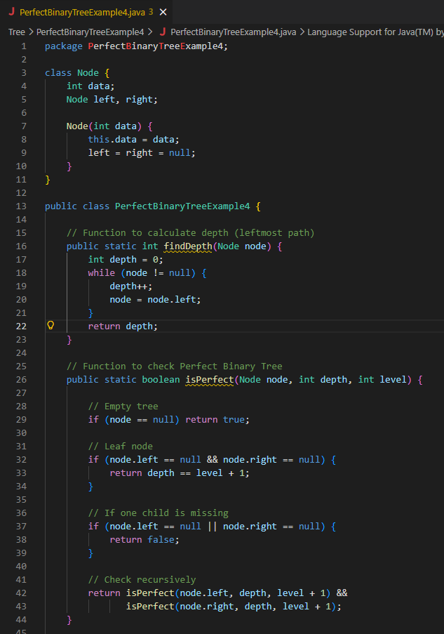
2. Non-Primitive – Non Linear Data Structures
Perfect Binary Tree

Slide 51
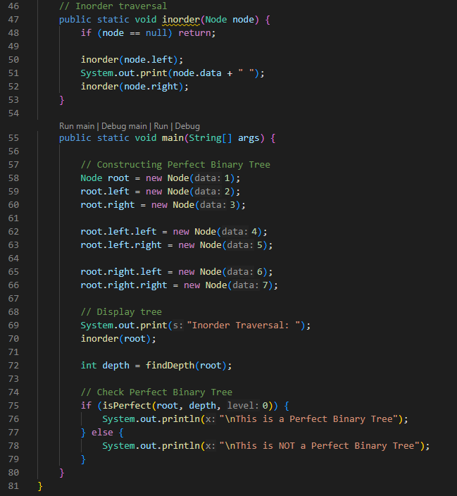
2. Non-Primitive – Non Linear Data Structures
Perfect Binary Tree

Slide 52
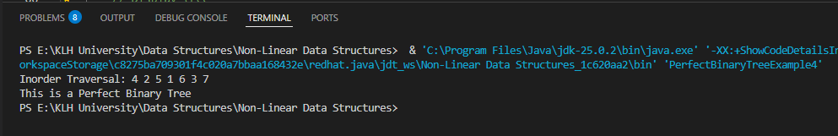
2. Non-Primitive – Non Linear Data Structures
Perfect Binary Tree

Slide 53
2. Non-Primitive – Non Linear Data Structures
Perfect Binary Tree
This program checks whether a given binary tree is a Perfect Binary Tree — meaning all internal nodes have exactly two children and all leaf nodes are at the same level.
Node Class
Defines a tree node with:
data → value stored.
left and right → child references.
findDepth() Method
Calculates the depth of the tree by following the leftmost path.
This depth is used as the expected level for all leaf nodes.
isPerfect() Method
Checks recursively:
If node is a leaf → must be at the same depth as all other leaves.
If node has only one child → not perfect.
If node has two children → check both subtrees.

Slide 54
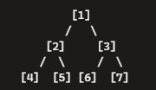
2. Non-Primitive – Non Linear Data Structures
Perfect Binary Tree
inorder() Method
Performs inorder traversal (Left → Root → Right).
Prints nodes in sorted order.
main() Method
Builds this tree:
All internal nodes have two children.
All leaf nodes (4, 5, 6, 7) are at the same level.
Inorder traversal prints: 4 2 5 1 6 3 7
Program confirms: This is a Perfect Binary Tree
This program:
Builds a binary tree.
Prints it in inorder.
Checks if it’s Perfect by ensuring:
Every internal node has 2 children.
All leaves are at the same depth.
In short: It verifies the strictest form of balance and completeness in a binary tree.

Slide 55
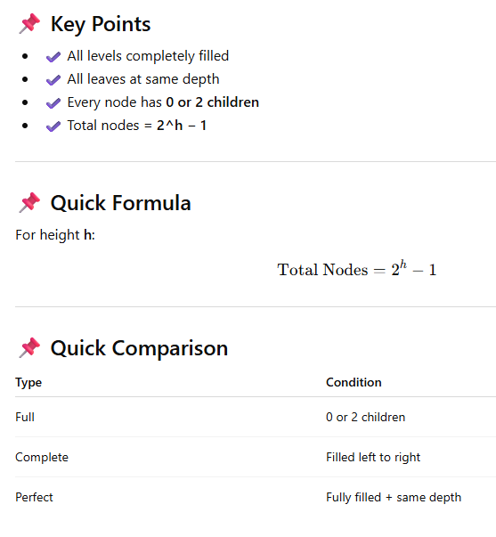
2. Non-Primitive – Non Linear Data Structures
Perfect Binary Tree

Slide 56
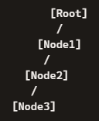
2. Non-Primitive – Non Linear Data Structures
Skewed Binary Tree
A Skewed Binary Tree is a special type of binary tree where all nodes have only one child — meaning the tree grows in a straight line rather than branching evenly.
A Skewed Binary Tree is a binary tree in which every parent node has only one child.
The child can be either always on the left side or always on the right side.
Left-Skewed Binary Tree
Every node has only a left child, so the tree grows downward to the left like a chain.

Slide 57
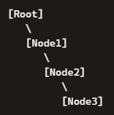
2. Non-Primitive – Non Linear Data Structures
Skewed Binary Tree
Right-Skewed Binary Tree
Every node has only a right child, so the tree grows downward to the right like a chain.

Slide 58
2. Non-Primitive – Non Linear Data Structures
Skewed Binary Tree
Both Left and Right Skewed Binary Trees are degenerate forms of binary trees.
They behave almost like a linked list because there’s only one path.
Searching in such trees is inefficient compared to balanced trees.

Slide 59
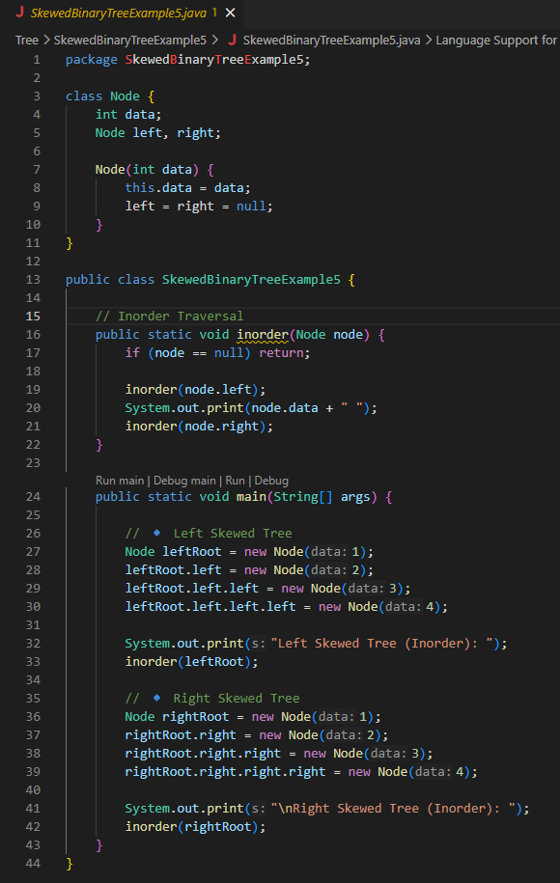
2. Non-Primitive – Non Linear Data Structures
Skewed Binary Tree

Slide 60
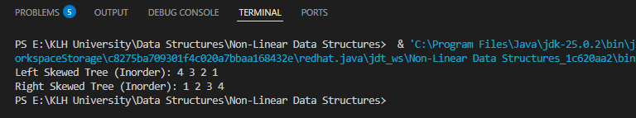
2. Non-Primitive – Non Linear Data Structures
Skewed Binary Tree

Slide 61
2. Non-Primitive – Non Linear Data Structures
Skewed Binary Tree
This program demonstrates Skewed Binary Trees — a special type of binary tree where every node has only one child (either always left or always right).
Node Class
Defines a tree node with:
data → value stored.
left and right → child references.
inorder() Method
Performs inorder traversal (Left → Root → Right).
For skewed trees, this essentially prints values in a straight sequence.

Slide 62

2. Non-Primitive – Non Linear Data Structures
Skewed Binary Tree
main() Method
Left Skewed Tree Construction:
Creates a root node with value 1.
Attaches a left child 2.
Attaches another left child 3.
Attaches another left child 4.
Inorder Traversal of Left Skewed Tree:
Inorder = Left → Root → Right.
Traversal order: 4 → 3 → 2 → 1.
Prints: Left Skewed Tree (Inorder): 4 3 2 1

Slide 63

2. Non-Primitive – Non Linear Data Structures
Skewed Binary Tree
main() Method
Right Skewed Tree Construction:
Creates a root node with value 1.
Attaches a right child 2.
Attaches another right child 3.
Attaches another right child 4.
So the structure looks like:
Inorder Traversal of Right Skewed Tree:
Inorder = Left → Root → Right.
Traversal order: 1 → 2 → 3 → 4.
Prints: Right Skewed Tree (Inorder): 1 2 3 4

Slide 64
2. Non-Primitive – Non Linear Data Structures
Skewed Binary Tree
main() Method
Final Output:
When you run the program, the console shows:
Left Skewed Tree (Inorder): 4 3 2 1
Right Skewed Tree (Inorder): 1 2 3 4
The main method builds two skewed binary trees (one left-skewed, one right-skewed) and demonstrates how inorder traversal behaves differently:
Left-skewed → prints values in descending order.
Right-skewed → prints values in ascending order.

Slide 65
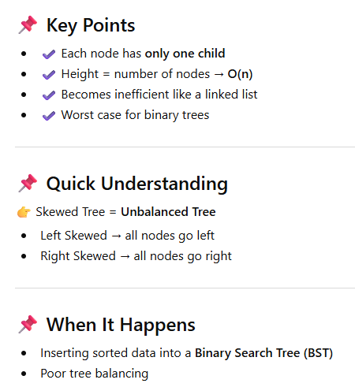
2. Non-Primitive – Non Linear Data Structures
Skewed Binary Tree

Slide 66
2. Non-Primitive – Non Linear Data Structures
Balanced Binary Tree
A Balanced Binary Tree is a binary tree where the height difference between the left and right subtrees of any node is at most 1. This ensures the tree stays compact and efficient for searching, inserting, and deleting operations.
A binary tree is balanced if, for every node: height(left subtree) − height(right subtree) ≤ 1
This prevents the tree from degenerating into a skewed structure (like a linked list).

Slide 67
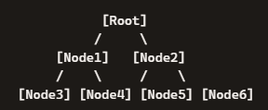
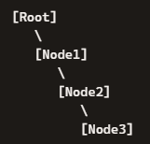
2. Non-Primitive – Non Linear Data Structures
Balanced Binary Tree
Balanced Binary Tree (height difference ≤ 1):
Both left and right subtrees are nearly equal in height.
Unbalanced Binary Tree (skewed):
Right side is much deeper than the left, making it inefficient.

Slide 68
2. Non-Primitive – Non Linear Data Structures
Balanced Binary Tree
For every node in the tree:
height(left subtree) − height(right subtree) ≤1
If this holds true everywhere, the tree is balanced.
If any node breaks this rule, the tree becomes unbalanced.

Slide 69
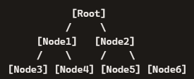
2. Non-Primitive – Non Linear Data Structures
Balanced Binary Tree
Why It’s Balanced
Height Difference Rule: For every node, the difference in height between its left and right subtrees is ≤ 1.
In this diagram:
The Root has two subtrees of equal height (both have 2 levels).
Node1’s left and right children (Node3, Node4) are at the same depth.
Node2’s left and right children (Node5, Node6) are also at the same depth.
Since no branch is significantly deeper than another, the tree is balanced.

Slide 70

2. Non-Primitive – Non Linear Data Structures
Balanced Binary Tree
Height of a Subtree
The height of a subtree = the number of edges from that node down to its deepest leaf.
Example:
Height of subtree rooted at B = 1 (B → leaf).
Height of subtree rooted at C = 1 (C → leaf).
Height difference = |1 – 1| = 0 → Balanced.

Slide 71
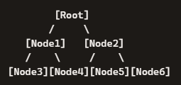
2. Non-Primitive – Non Linear Data Structures
Balanced Binary Tree
Balanced Binary Tree
Left subtree height = 2
Right subtree height = 2
Difference = |2 – 2| = 0 → Balanced.

Slide 72

2. Non-Primitive – Non Linear Data Structures
Balanced Binary Tree
Unbalanced Binary Tree
Left subtree height = 3
Right subtree height = 0
Difference = |3 – 0| = 3 → Not Balanced.

Slide 73
2. Non-Primitive – Non Linear Data Structures
Balanced Binary Tree
Characteristics
Height is minimized → operations are faster.
Time complexity for search, insert, delete:
Balanced Tree → O(log n)
Skewed Tree → O(n)
Examples of balanced trees:
AVL Tree (strictly balanced).
Red-Black Tree (loosely balanced).
B-Trees (used in databases).
Real-Life Applications
Databases → B-Trees and B+ Trees for indexing.
Compilers → Expression parsing with balanced trees.
File systems → Directory structures often rely on balanced trees.
A Balanced Binary Tree ensures efficiency by keeping the height small. It avoids the inefficiency of skewed trees and guarantees faster operations in practice.

Slide 74

2. Non-Primitive – Non Linear Data Structures
Balanced Binary Tree

Slide 75

2. Non-Primitive – Non Linear Data Structures
Balanced Binary Tree

Slide 76

2. Non-Primitive – Non Linear Data Structures
Balanced Binary Tree

Slide 77
2. Non-Primitive – Non Linear Data Structures
Balanced Binary Tree
This program checks whether a given binary tree is a Balanced Binary Tree — meaning the height difference between the left and right subtrees of every node is at most 1.
Node Class
Defines a tree node with:
data → value stored.
left and right → child references.
checkHeight() Method
Recursively calculates the height of left and right subtrees.
If any subtree is unbalanced, returns -1.
If the difference in heights > 1 → not balanced.
Otherwise, returns the height of the current node.
isBalanced() Method
Wrapper function.
If checkHeight() returns -1 → tree is not balanced.
Otherwise → tree is balanced.

Slide 78

2. Non-Primitive – Non Linear Data Structures
Balanced Binary Tree
inorder() Method
Performs inorder traversal (Left → Root → Right).
Prints nodes in sorted order.
main() Method
Builds this tree:
Inorder traversal prints: 4 2 5 1 3
Checks balance:
Left subtree height = 2
Right subtree height = 1
Difference = 1 → Balanced.

Slide 79
2. Non-Primitive – Non Linear Data Structures
Balanced Binary Tree
Output:
Inorder Traversal: 4 2 5 1 3
This is a Balanced Binary Tree
This program:
Builds a binary tree.
Prints it in inorder.
Checks if it’s Balanced by ensuring no node has left/right subtree height difference greater than 1.
It verifies that the tree is compact and efficient, avoiding skewed structures.

Slide 80

2. Non-Primitive – Non Linear Data Structures
Balanced Binary Tree

Slide 81
2. Non-Primitive – Non Linear Data Structures
Binary Tree - Differences
Big-O Notation
Big-O describes the upper bound of how long an algorithm takes (or how much space it uses) relative to input size n.
It ignores constants and focuses on growth rate as n increases.
O(log n)
Logarithmic time: Operations take time proportional to the logarithm of the number of nodes.
Example: Searching in a Balanced Binary Tree.
Why? Each step cuts the problem in half:
Root → Left or Right → Next level → … until found.
With n nodes, height ≈ log⁡2n.
Efficiency: Very fast, even for large trees.
If n=1,000,000, log⁡2n≈20. Only ~20 steps needed!
O(n)
Linear time: Operations take time proportional to the number of nodes.
Example: Searching in a Skewed Binary Tree (like a linked list).
Why? You may need to check every node one by one.
Efficiency: Much slower.
If n=1,000,000, you might need up to 1,000,000 steps.

Slide 82
2. Non-Primitive – Non Linear Data Structures
Binary Tree - Differences
Balanced Binary Trees keep operations efficient (O(log n)).
Skewed Binary Trees degrade into inefficient linked lists (O(n)).
Complexity | Meaning | Binary Tree Example | Steps for n=1,000,000
O(log n) | Logarithmic growth | Balanced Binary Tree search | ~20 steps
O(n) | Linear growth | Skewed Binary Tree search | ~1,000,000 steps

Slide 83
2. Non-Primitive – Non Linear Data Structures
Binary Tree - Differences
Type | Rule | Efficiency | Example Use Case
Complete | All levels filled, last filled left to right | O(log n) | Heaps, priority queues
Perfect | All internal nodes have 2 children, leaves at same level | O(log n) | Balanced search trees
Skewed | Every node has only one child | O(n) | Degenerate BST (like linked list)
Balanced | Height difference ≤ 1 for all nodes | O(log n) | AVL, Red-Black, B-Trees

Slide 84

2. Non-Primitive – Non Linear Data Structures
Binary Tree - Differences

Slide 85
2. Non-Primitive – Non Linear Data Structures
Binary Search Tree (BST)
A Binary Search Tree (BST) is a special type of binary tree where each node’s left child contains values smaller than the node, and the right child contains values larger than the node. This ordering property makes searching, insertion, and deletion efficient — typically O(log n) in balanced trees, but O(n) in skewed ones.
Core Properties of BST
Node Rule:
Left subtree → values strictly less than the node.
Right subtree → values strictly greater than the node.
No duplicates: Each value must be unique to maintain order.
Recursive definition: Every subtree of a BST is itself a BST.

Slide 86



2. Non-Primitive – Non Linear Data Structures
Binary Search Tree (BST)
Left of 10 → all values < 10 (5, 3, 7).
Right of 10 → all values > 10 (15, 20).
A Binary Search Tree (BST) has the rule:
Left child < Parent < Right child.
Now, the recursive definition says:
If you take any node in the BST and look at its children, the subtree rooted at that node must also follow the BST rules.
In other words, every smaller piece of the tree is itself a BST.
Subtree rooted at 10:
Left = values < 10 → {5, 3, 7}
Right = values > 10 → {15, 20}
BST property holds.
Each subtree is itself a valid BST.
Subtree rooted at 5:
Left = values < 5 → {3}
Right = values > 5 → {7}
BST property holds.
Subtree rooted at 15:
Left = none
Right = values > 15 → {20}
BST property holds.

Slide 87

2. Non-Primitive – Non Linear Data Structures
Binary Search Tree (BST)

Slide 88

2. Non-Primitive – Non Linear Data Structures
Binary Search Tree (BST)

Slide 89

2. Non-Primitive – Non Linear Data Structures
Binary Search Tree (BST)

Slide 90
2. Non-Primitive – Non Linear Data Structures
Binary Search Tree (BST)
Node Class
Represents a single node in the tree.
Each node stores:
data → the value.
left → pointer to left child.
right → pointer to right child.
Insert Method
Inserts a new value into the BST.
Rule:
If smaller → go left.
If larger → go right.
Uses recursion to find the correct spot.
Search Method
Searches for a value (key) in the BST.
Recursively checks:
If equal → found.
If smaller → search left.
If larger → search right.

Slide 91
2. Non-Primitive – Non Linear Data Structures
Binary Search Tree (BST)
Inorder Traversal
Traverses the tree inorder (Left → Root → Right).
In a BST, inorder traversal always prints values in sorted order.
Main Method
Builds a BST with values {50, 30, 70, 20, 40, 60, 80}.
Prints the tree in sorted order using inorder traversal → 20 30 40 50 60 70 80.
Searches for 40 → found, so it prints: 40 found in BST
This program demonstrates the three core operations of a BST:
Insert → Add nodes while maintaining BST property.
Search → Efficient lookup using recursion.
Inorder Traversal → Sorted output of all values.
It’s a classic example showing why BSTs are powerful: they keep data ordered and allow fast search/insert operations.

