Slide 1

2. Non-Primitive – Non Linear Data Structures
Self-Balancing Trees
Self-balancing trees are special types of binary search trees (BSTs) that automatically adjust their structure during insertions and deletions to keep the tree’s height small, ensuring efficient operations like search, insert, and delete in O(log n) time. They prevent the tree from degenerating into a skewed linked-list-like structure.
In a normal BST, inserting sorted data can make the tree skewed (height = n), leading to O(n) operations.
A self-balancing tree uses rotations or restructuring to keep the height close to log₂(n).
This guarantees efficiency even with arbitrary insertions and deletions.
How They Work
Rotations: Rearranging nodes while preserving BST property.
Example: Left rotation, right rotation.
Rebalancing: After insertion/deletion, check balance rules → apply rotations if violated.
Guarantee: Height ≈ log₂(n), so operations are efficient.
Why They Matter
Efficiency: Search, insert, delete all in O(log n).
Reliability: Prevents worst-case scenarios of skewed trees.
Applications:
Databases (B-Trees, B+ Trees).
Compilers (expression parsing).
Libraries (TreeMap in Java, map/set in C++).

Slide 2
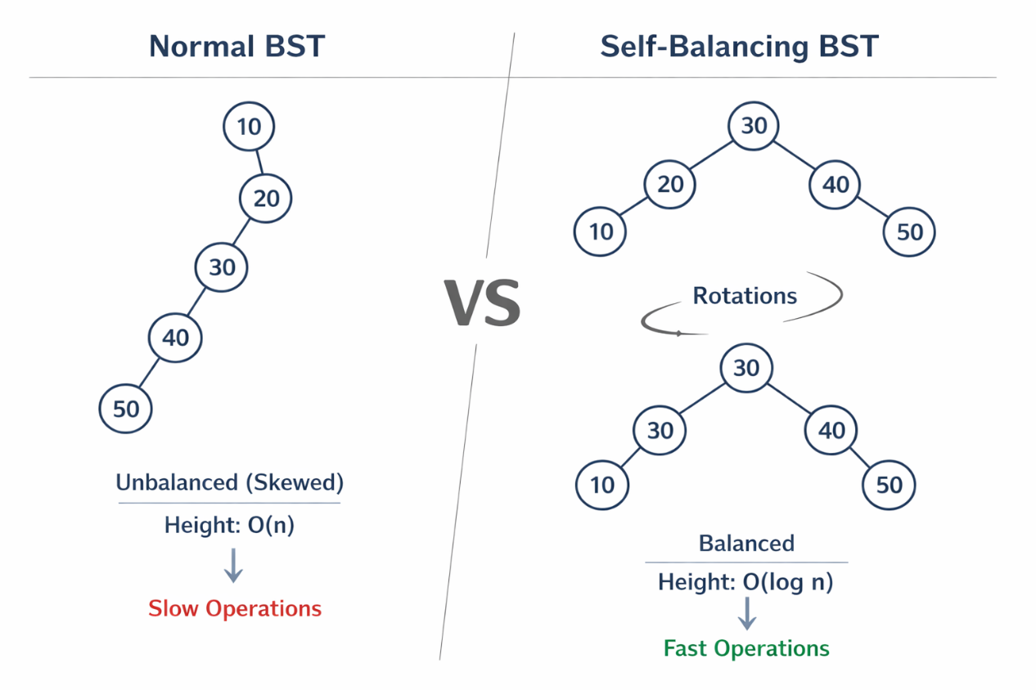
2. Non-Primitive – Non Linear Data Structures
Self-Balancing Trees
Self-balancing trees are BSTs that automatically restructure themselves to stay efficient. They are the backbone of many real-world systems like databases, compilers, and programming language libraries.
It shows how a normal BST can become skewed
versus
How a self‑balancing BST restructures itself with rotations to stay efficient.

Slide 3
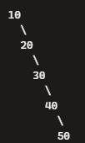
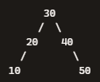
2. Non-Primitive – Non Linear Data Structures
Self-Balancing Trees
On the left side (Normal BST):
This is unbalanced (skewed). Height ≈ n, so operations are slow (O(n)).
On the right side (Self-Balancing BST):
➝ After rotations, the tree becomes balanced. Height ≈ log n, so operations are fast (O(log n)).

Slide 4


2. Non-Primitive – Non Linear Data Structures
Self-Balancing Trees
What “After Rotations” Means
When you insert or delete nodes in a self‑balancing binary search tree, the tree may temporarily become uneven — one side taller than the other. To fix this, the tree performs rotations, which are small rearrangements of nodes that restore balance while keeping the BST order intact.
Example
Suppose you insert nodes in this order: 10, 20, 30.
A normal BST becomes skewed:
Height = 3 → inefficient.
A self‑balancing tree (like an AVL tree) detects imbalance and performs a left rotation around 10:
Now height ≈ log₂(3) ≈ 1.6 → efficient.

Slide 5
2. Non-Primitive – Non Linear Data Structures
Self-Balancing Trees
Why Height ≈ log n
In a balanced tree, each level roughly doubles the number of nodes.
So the number of levels (height) grows logarithmically with the number of nodes.
That’s why operations like search, insert, and delete take O(log n) time — they only need to traverse a few levels, not every node.
“After rotations” means the tree automatically rearranges itself to stay balanced. This keeps its height small (≈ log n), making all operations fast and predictable.

Slide 6
2. Non-Primitive – Non Linear Data Structures
Self-Balancing Trees – AVL Tree
An AVL Tree is one of the earliest and most widely used self‑balancing binary search trees (BSTs). It was invented by Adelson‑Velsky and Landis in 1962 — hence the name AVL.
An AVL tree automatically keeps itself balanced after every insertion or deletion. It does this by ensuring that the height difference (balance factor) between the left and right subtrees of any node is at most 1.
Balance Factor=Height(left subtree)−Height(right subtree)
If the balance factor is −1, 0, or +1, the tree is balanced.
If it becomes less than −1 or greater than +1, the tree performs rotations to restore balance.

Slide 7
2. Non-Primitive – Non Linear Data Structures
Self-Balancing Trees – AVL Tree
Rotations Used for Balancing
When imbalance occurs, the tree performs one of four types of rotations:
These rotations rearrange nodes while keeping the BST property intact.
Type | When It Happens | Example Pattern | Fix
Right Rotation (LL) | Left subtree too heavy | Inserted into left of left child | Rotate right
Left Rotation (RR) | Right subtree too heavy | Inserted into right of right child | Rotate left
Left‑Right Rotation (LR) | Left subtree’s right child causes imbalance | Rotate left on child, then right on parent
Right‑Left Rotation (RL) | Right subtree’s left child causes imbalance | Rotate right on child, then left on parent

Slide 8


2. Non-Primitive – Non Linear Data Structures
Self-Balancing Trees – AVL Tree
Rotations Used for Balancing
1. Right Rotation (LL Case)
When: The imbalance happens because a node was inserted into the left child’s left subtree.
Fix: Perform a right rotation.
Example:
After Right Rotation around 30:

Slide 9


2. Non-Primitive – Non Linear Data Structures
Self-Balancing Trees – AVL Tree
Rotations Used for Balancing
2. Left Rotation (RR Case)
When: The imbalance happens because a node was inserted into the right child’s right subtree.
Fix: Perform a left rotation.
Example:
After Left Rotation around 10:

Slide 10



2. Non-Primitive – Non Linear Data Structures
Self-Balancing Trees – AVL Tree
Rotations Used for Balancing
3. Left‑Right Rotation (LR Case)
When: The imbalance happens because a node was inserted into the left child’s right subtree.
Fix: First left rotation on the child, then right rotation on the parent.
Example:
Step 1: Left rotation on 10:
Step 2: Right rotation on 30:

Slide 11



2. Non-Primitive – Non Linear Data Structures
Self-Balancing Trees – AVL Tree
Rotations Used for Balancing
4. Right‑Left Rotation (RL Case)
When: The imbalance happens because a node was inserted into the right child’s left subtree.
Fix: First right rotation on the child, then left rotation on the parent.
Example:
Step 1: Right rotation on 30:
Step 2: Left rotation on 10:

Slide 12
2. Non-Primitive – Non Linear Data Structures
Self-Balancing Trees – AVL Tree
Rotations Used for Balancing
LL → Right Rotation
RR → Left Rotation
LR → Left then Right Rotation
RL → Right then Left Rotation
These rotations are the “self‑balancing” mechanism of AVL trees, ensuring the height difference never exceeds 1, keeping operations efficient.

Slide 13


2. Non-Primitive – Non Linear Data Structures
Self-Balancing Trees – AVL Tree
Example:
Insert nodes in order: 10, 20, 30
Normal BST becomes skewed:
→ Unbalanced (Right‑Right case)
2. AVL tree performs a left rotation around 10:
→ Balanced again.

Slide 14
2. Non-Primitive – Non Linear Data Structures
Self-Balancing Trees – AVL Tree
Time Complexity
Operation | Complexity
Search | O(log n)
Insert | O(log n)
Delete | O(log n)
Because the height is always ≈ log₂(n), operations remain efficient.
Applications
Database indexing
Memory management
File systems
Compiler symbol tables
An AVL Tree is a self‑balancing BST that maintains near‑perfect balance using rotations. It guarantees fast and predictable performance for all operations — a cornerstone of efficient data structures.

Slide 15
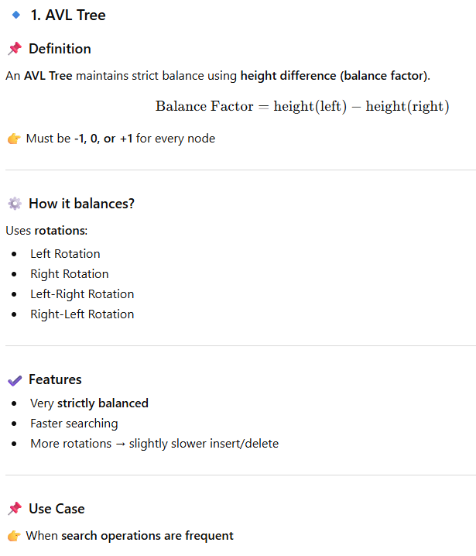
2. Non-Primitive – Non Linear Data Structures
Self-Balancing Trees – AVL Tree

Slide 16

2. Non-Primitive – Non Linear Data Structures
Self-Balancing Trees – AVL Tree

Slide 17
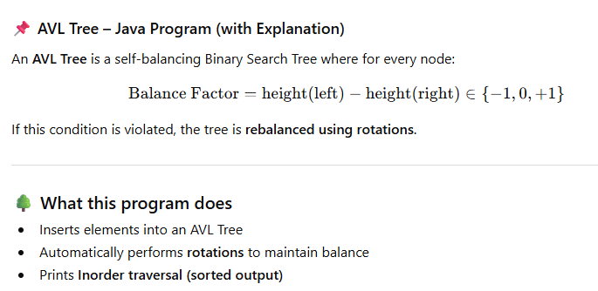
2. Non-Primitive – Non Linear Data Structures
Self-Balancing Trees – AVL Tree

Slide 18
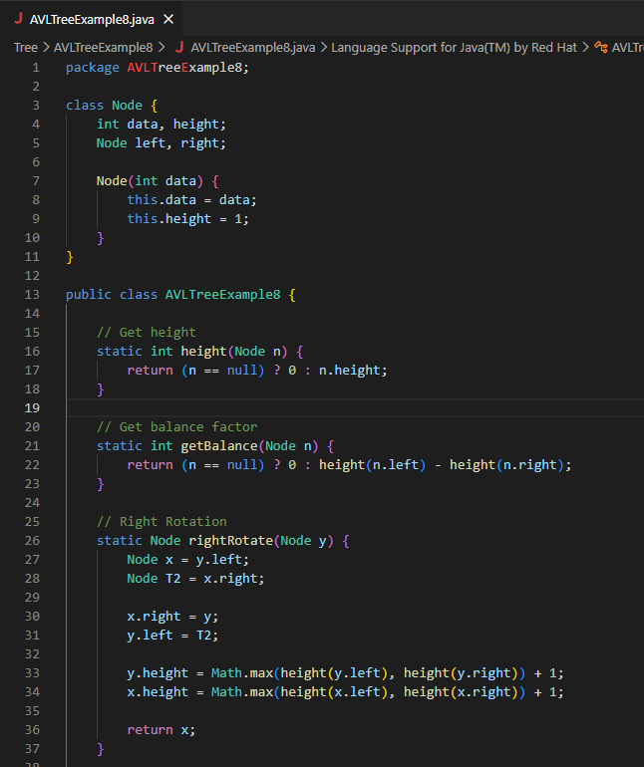
2. Non-Primitive – Non Linear Data Structures
Self-Balancing Trees – AVL Tree

Slide 19
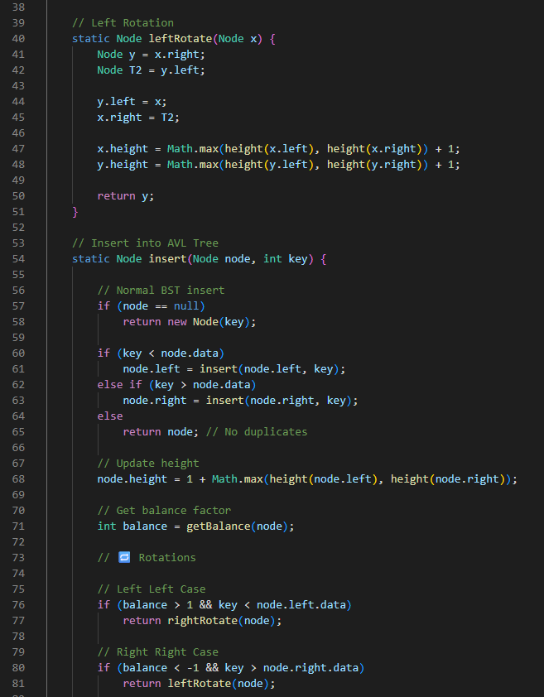
2. Non-Primitive – Non Linear Data Structures
Self-Balancing Trees – AVL Tree

Slide 20
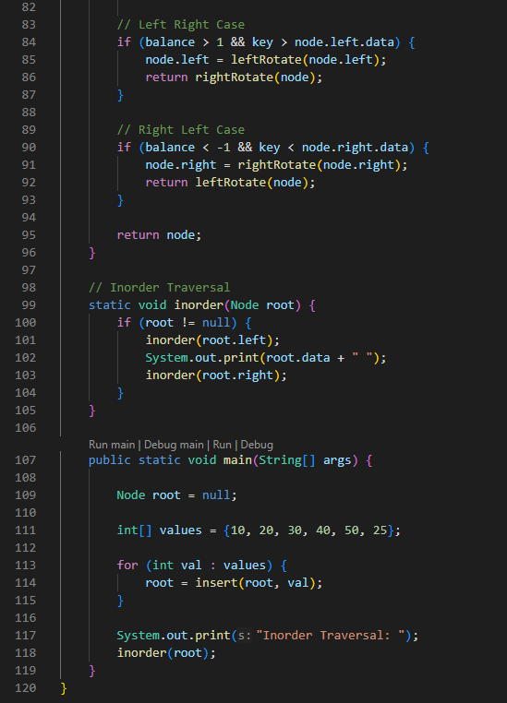
2. Non-Primitive – Non Linear Data Structures
Self-Balancing Trees – AVL Tree

Slide 21
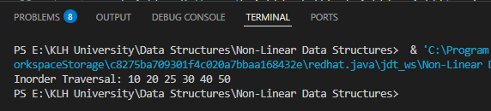
2. Non-Primitive – Non Linear Data Structures
Self-Balancing Trees – AVL Tree

Slide 22
2. Non-Primitive – Non Linear Data Structures
Self-Balancing Trees – AVL Tree
Node Class
Each node stores:
data → the value.
height → height of the node (used for balance factor).
left and right → child references.
Helper Functions
height(Node n) → returns the height of a node.
getBalance(Node n) → calculates balance factor = height(left) − height(right).
If balance factor ∈ {−1, 0, +1} → balanced.
Otherwise → imbalance → rotations needed.
Rotations
rightRotate(Node y) → fixes Left‑Left imbalance.
leftRotate(Node x) → fixes Right‑Right imbalance.
Combination (LR, RL) → handled by performing two rotations (left+right or right+left).
These rotations rearrange nodes while preserving BST order.

Slide 23
2. Non-Primitive – Non Linear Data Structures
Self-Balancing Trees – AVL Tree
Insert Method
Insert like a normal BST.
Update height.
Check balance factor.
If imbalance → fix with appropriate rotation.
Traversal
Inorder traversal prints nodes in sorted order.
main() Method
Inserts values {10, 20, 30, 40, 50, 25} one by one.
The AVL tree rebalances itself after each insertion.
Final tree is balanced, not skewed.
Inorder traversal prints: 10 20 25 30 40 50
This program:
Implements an AVL Tree with rotations.
Inserts nodes while keeping the tree balanced.
Prints the tree in sorted order using inorder traversal.
In short: It demonstrates how AVL trees self‑balance automatically to guarantee efficient operations.

Slide 24
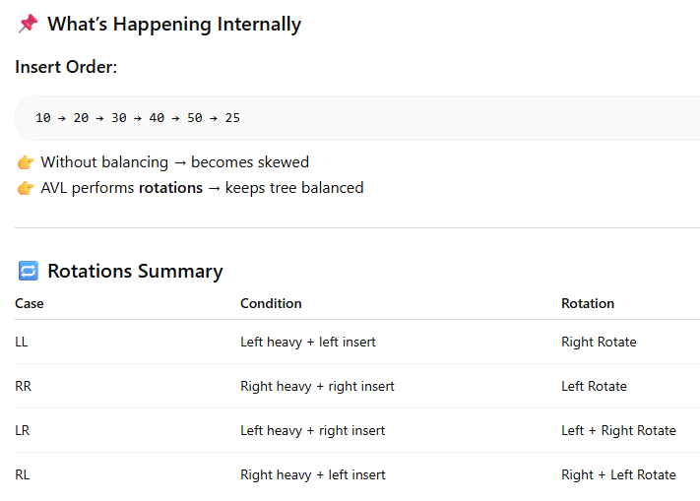

2. Non-Primitive – Non Linear Data Structures
Self-Balancing Trees – AVL Tree

Slide 25
2. Non-Primitive – Non Linear Data Structures
Self-Balancing Trees – Red Black Tree
A Red‑Black Tree is a type of self‑balancing binary search tree (BST) that uses node colors (red or black) and strict rules to keep the tree balanced, ensuring search, insert, and delete operations always run in O(log n) time. It is widely used in programming libraries and databases because it guarantees efficiency even under worst‑case insertion orders.
Core Properties of a Red‑Black Tree
To maintain balance, every Red‑Black Tree follows these rules:
Node Color: Each node is either red or black.
Root Property: The root is always black.
Red Node Property: A red node cannot have a red child (no two reds in a row).
Black Height Property: Every path from a node to its descendant leaves must contain the same number of black nodes.
Leaf Property: All leaves (NULL or NIL nodes) are considered black.
These rules ensure that the longest path from root to leaf is never more than twice as long as the shortest path, keeping the tree balanced.

Slide 26
2. Non-Primitive – Non Linear Data Structures
Self-Balancing Trees – Red Black Tree
Operations
Insertion:
Insert like a normal BST.
Color the new node red.
If rules are violated (e.g., two consecutive reds), fix using rotations and recoloring.
Case 1: If the “uncle” node is red → recolor parent and uncle black, grandparent red.
Case 2: If the uncle is black → perform rotations (left or right) and recolor.
Deletion:
Remove node using BST rules.
If a black node is deleted, a “double black” issue may arise.
Fix using rotations and recoloring based on sibling’s color.
Searching: Same as BST — traverse left or right depending on the key.

Slide 27
2. Non-Primitive – Non Linear Data Structures
Self-Balancing Trees – Red Black Tree
Applications
Java Collections (TreeMap, TreeSet)
C++ STL (map, set)
Linux kernel scheduling
Databases and file systems
A Red‑Black Tree is a BST that balances itself using coloring rules and rotations. It’s less rigid than AVL trees, making it faster for frequent insertions/deletions, and is widely used in real‑world systems where predictable performance is critical.

Slide 28


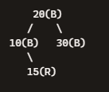
2. Non-Primitive – Non Linear Data Structures
Self-Balancing Trees – Red Black Tree
Example Red‑Black Tree
Imagine we insert the numbers: 10, 20, 30, 15.
Step 1: Insert 10
Root is always black.
Step 2: Insert 20
20 is red by default.
No violation (red child of black root is fine).
Step 3: Insert 30
30 is red.
Now 20(R) → 30(R) violates the “no two reds in a row” rule.
Fix with a left rotation around 10 and recoloring
Step 4: Insert 15
Insert 15 as red under 10.
Now 10(R) → 15(R) violates the red rule.
Fix with a right‑left rotation (rotate right on 20’s left child, then left on 20).
After recoloring, the tree becomes balanced:

Slide 29
2. Non-Primitive – Non Linear Data Structures
Self-Balancing Trees – Red Black Tree
Explanation of the Rules in Action
Root is black → 20 is black.
No two reds in a row → 15 is red, but its parent (10) is black, so rule is satisfied.
Same black height → Every path from root to leaf has the same number of black nodes.
Path 20 → 10 → NIL has 2 black nodes.
Path 20 → 30 → NIL has 2 black nodes.
Path 20 → 10 → 15 → NIL has 2 black nodes.
Because all rules are satisfied, the tree is balanced.
Key Observations
Colors prevent long chains of red nodes.
Rotations keep the tree balanced.
Black height property ensures all paths have the same number of black nodes.
Height ≈ log₂(n), so operations are efficient.
A Red‑Black Tree is a BST that uses coloring + rotations to stay balanced. It’s less strict than AVL trees but faster for frequent insertions/deletions, which is why it’s used in Java’s TreeMap, C++ STL map/set, and even the Linux kernel.

Slide 30
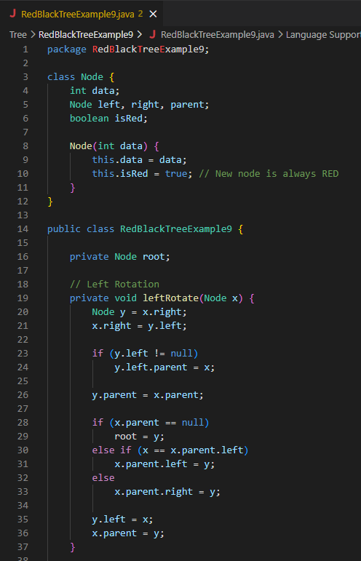
2. Non-Primitive – Non Linear Data Structures
Self-Balancing Trees – Red Black Tree

Slide 31
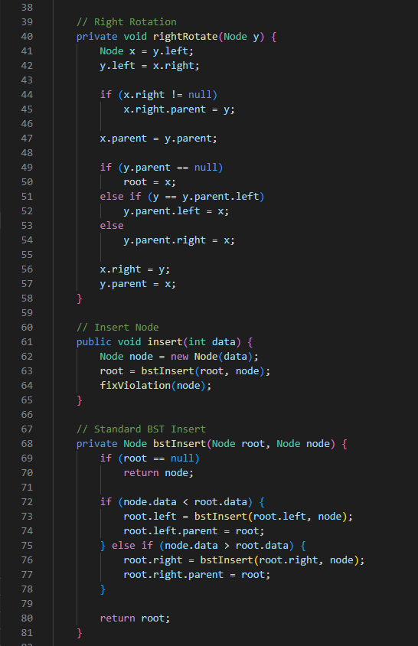
2. Non-Primitive – Non Linear Data Structures
Self-Balancing Trees – Red Black Tree

Slide 32
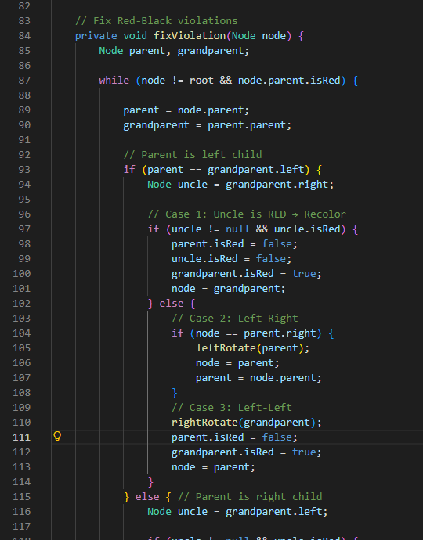
2. Non-Primitive – Non Linear Data Structures
Self-Balancing Trees – Red Black Tree

Slide 33
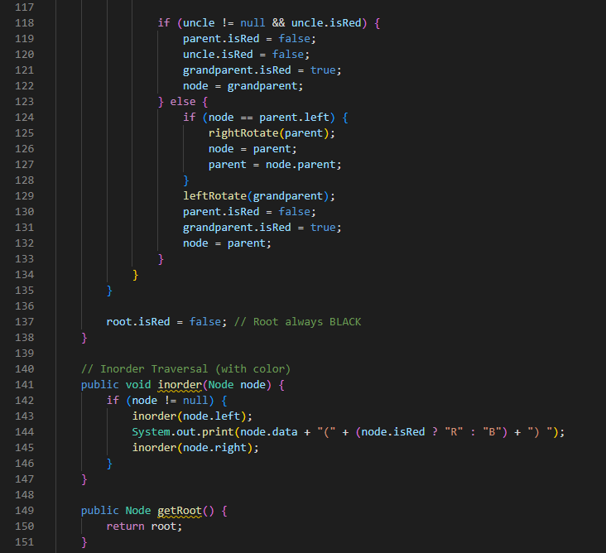
2. Non-Primitive – Non Linear Data Structures
Self-Balancing Trees – Red Black Tree

Slide 34
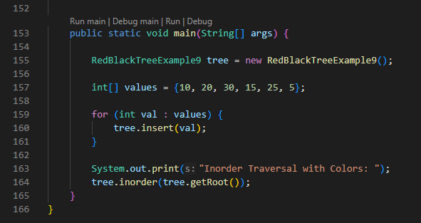
2. Non-Primitive – Non Linear Data Structures
Self-Balancing Trees – Red Black Tree

Slide 35

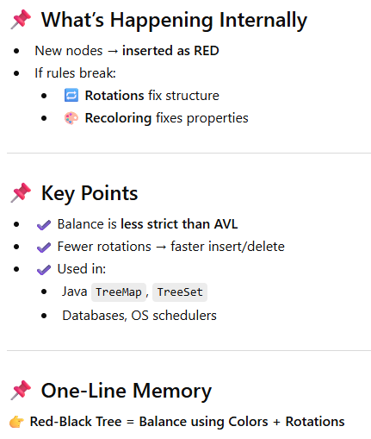
2. Non-Primitive – Non Linear Data Structures
Self-Balancing Trees – Red Black Tree

Slide 36
2. Non-Primitive – Non Linear Data Structures
Self-Balancing Trees – Red Black Tree
Node Class
Each node stores:
data → the value.
left, right, parent → references to other nodes.
isRed → color flag (new nodes start as red).
Rotations
leftRotate(Node x) and rightRotate(Node y)
Rearrange nodes to fix imbalance while preserving BST order.
Used when Red‑Black rules are violated.
Insertion
First inserts like a normal BST.
Then calls fixViolation() to restore Red‑Black properties.

Slide 37
2. Non-Primitive – Non Linear Data Structures
Self-Balancing Trees – Red Black Tree
fixViolation() Method
This is the heart of the Red‑Black Tree:
Checks if the newly inserted node violates rules (e.g., two consecutive reds).
Uses three cases:
Uncle is red → recolor parent and uncle black, grandparent red.
Uncle is black + zig‑zag shape (LR or RL) → rotate parent, then rotate grandparent.
Uncle is black + straight line (LL or RR) → rotate grandparent, recolor.
Finally ensures the root is always black.
Traversal
Performs inorder traversal (Left → Root → Right).
Prints each node’s value along with its color (R or B).
main() Method
Inserts values {10, 20, 30, 15, 25, 5} one by one.
After each insertion, the tree rebalances itself using rotations and recoloring.
Finally prints the inorder traversal with node colors, e.g.: 5(B) 10(B) 15(R) 20(B) 25(R) 30(B)
(Exact colors may vary depending on rotations, but the Red‑Black rules are always satisfied.)

Slide 38
2. Non-Primitive – Non Linear Data Structures
Self-Balancing Trees – Red Black Tree
This program:
Implements a Red‑Black Tree.
Inserts nodes while maintaining balance using rotations + recoloring.
Prints the final tree in sorted order with colors.
It demonstrates how Red‑Black Trees self‑balance automatically, ensuring efficient search, insert, and delete operations.

Slide 39
2. Non-Primitive – Non Linear Data Structures
Self-Balancing Trees – Splay Tree
A Splay Tree is a self‑adjusting binary search tree that moves the most recently accessed node to the root using rotations, making frequently used elements quicker to access. It doesn’t guarantee strict balance like AVL or Red‑Black Trees, but it provides amortized O(log n) performance for search, insert, and delete operations.
Every time you search, insert, or delete a node, the tree performs a process called splaying.
Splaying = a sequence of rotations that brings the accessed node to the root.
This means recently accessed nodes stay near the root, reducing access time if they’re used again soon.
Operations
Search: Perform normal BST search, then splay the found node to the root.
Insert: Insert like a BST, then splay the new node to the root.
Delete: Splay the node to be deleted to the root, remove it, and reconnect subtrees.

Slide 40
2. Non-Primitive – Non Linear Data Structures
Self-Balancing Trees – Splay Tree
Types of Rotations in Splaying
There are six rotation patterns depending on the node’s position relative to its parent and grandparent:
Zig: Node is left child of root → single right rotation.
Zag: Node is right child of root → single left rotation.
Zig‑Zig: Node and parent are both left children → two right rotations.
Zag‑Zag: Node and parent are both right children → two left rotations.
Zig‑Zag: Node is right child of left parent → left rotation on parent, then right rotation on grandparent.
Zag‑Zig: Node is left child of right parent → right rotation on parent, then left rotation on grandparent.
Performance
Amortized complexity: O(log n) for search, insert, delete.
Worst case: O(n) for a single operation (if tree becomes skewed).
But because splaying keeps frequently accessed nodes near the root, the average performance is excellent.
Applications
Caching systems → frequently accessed items stay near the root.
Data compression algorithms.
Network routing → quick access to recently used paths.

Slide 41
2. Non-Primitive – Non Linear Data Structures
Self-Balancing Trees – Splay Tree
A Splay Tree is a BST that self‑adjusts dynamically: every access reshapes the tree so that frequently used nodes are faster to reach. It’s simple, efficient in practice, and great for workloads with repeated access patterns — but it doesn’t guarantee strict balance, so worst‑case performance can degrade.

Slide 42


2. Non-Primitive – Non Linear Data Structures
Self-Balancing Trees – Splay Tree
Step‑by‑step diagrammatic explanation of how a Splay Tree works when you access a node (say, searching for 30).
Initial Tree (before splaying)
Suppose we inserted values 10, 20, 30 into a normal BST:
This is skewed (like a linked list).
Step 1: Search for 30
We find 30 at the bottom.
Now the tree performs splaying to bring 30 to the root.
Step 2: Zig‑Zig Rotation (Right‑Right case)
Node 30 and its parent 20 are both right children.
Perform two left rotations:
Rotate left around 10.
Rotate left around 20
Final Tree (after splaying)
Now 30 is at the root.

Slide 43


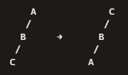

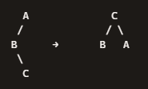
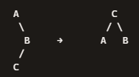
2. Non-Primitive – Non Linear Data Structures
Self-Balancing Trees – Splay Tree
1. Zig (Right Rotation)
Node is the left child of the root.
Single right rotation brings it up.
2. Zag (Left Rotation)
Node is the right child of the root.
Single left rotation brings it up.
3. Zig‑Zig (Double Right Rotation)
Node and parent are both left children.
Two right rotations bring node to root.
4. Zag‑Zag (Double Left Rotation)
Node and parent are both right children.
Two left rotations bring node to root.
5. Zig‑Zag (Left then Right Rotation)
Node is the right child of a left parent.
First left rotation on parent, then right rotation on grandparent.
6. Zag‑Zig (Right then Left Rotation)
Node is the left child of a right parent.
First right rotation on parent, then left rotation on grandparent.

Slide 44
2. Non-Primitive – Non Linear Data Structures
Self-Balancing Trees – Splay Tree
Zig/Zag → single rotations (node is child of root).
Zig‑Zig/Zag‑Zag → double rotations (node and parent on same side).
Zig‑Zag/Zag‑Zig → mixed rotations (node and parent on opposite sides).
Together, these six cases are the mechanism that makes splay trees self‑adjusting, keeping frequently accessed nodes near the root.
Splaying moves the accessed node to the root.
Frequently accessed nodes stay near the root, making repeated access faster.
Even though a single operation can take O(n) in the worst case, the amortized cost over many operations is O(log n).

Slide 45
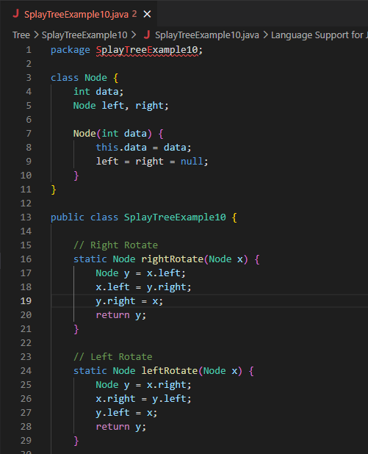
2. Non-Primitive – Non Linear Data Structures
Self-Balancing Trees – Splay Tree

Slide 46
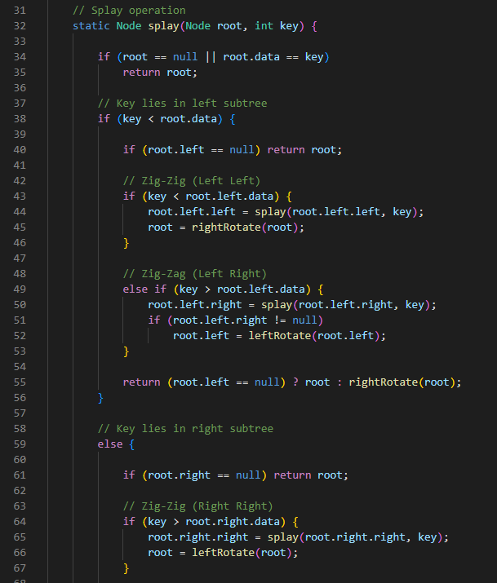
2. Non-Primitive – Non Linear Data Structures
Self-Balancing Trees – Splay Tree

Slide 47
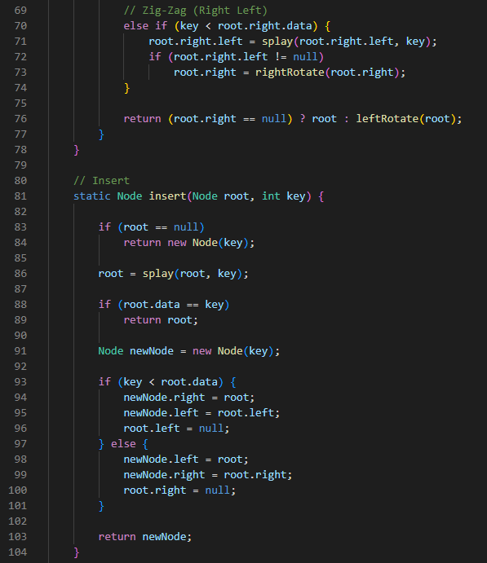
2. Non-Primitive – Non Linear Data Structures
Self-Balancing Trees – Splay Tree

Slide 48
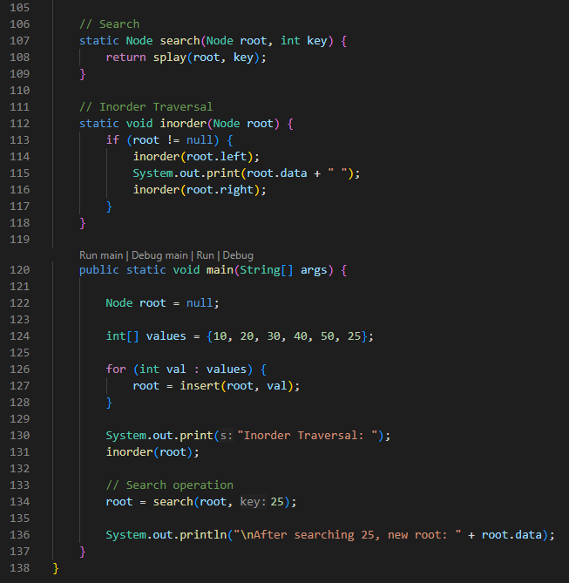
2. Non-Primitive – Non Linear Data Structures
Self-Balancing Trees – Splay Tree

Slide 49
2. Non-Primitive – Non Linear Data Structures
Self-Balancing Trees – Splay Tree

Slide 50
2. Non-Primitive – Non Linear Data Structures
Self-Balancing Trees – Splay Tree
Node Class
Each node stores:
data → the value.
left, right → child references.
Rotations
Right rotation moves a left child up.
Left rotation moves a right child up.
These are the basic operations used during splaying to restructure the tree.

Slide 51
2. Non-Primitive – Non Linear Data Structures
Self-Balancing Trees – Splay Tree
Splay Operation
This is the heart of the program.
What it does:
Searches for key in the tree.
While searching, it performs rotations to bring the accessed node (or the last accessed node if not found) to the root.
Cases handled:
Zig‑Zig (Left‑Left) → two right rotations.
Zig‑Zag (Left‑Right) → left rotation on child, then right rotation on parent.
Zag‑Zag (Right‑Right) → two left rotations.
Zag‑Zig (Right‑Left) → right rotation on child, then left rotation on parent.
After splaying, the accessed node becomes the new root.

Slide 52
2. Non-Primitive – Non Linear Data Structures
Self-Balancing Trees – Splay Tree
Insert Operation
Steps:
If tree is empty → create new node.
Splay the tree with the given key (to bring closest node to root).
If key already exists → do nothing.
Otherwise, create a new node and attach it appropriately:
If key < root.data → new node becomes root, old root becomes its right child.
If key > root.data → new node becomes root, old root becomes its left child.
This ensures the new node is always at the root after insertion.
Search Operation
Performs splay on the key.
If found, that node becomes the root.
If not found, the last accessed node becomes the root.
This keeps frequently accessed nodes near the top.

Slide 53
2. Non-Primitive – Non Linear Data Structures
Self-Balancing Trees – Splay Tree
Inorder Traversal
Prints nodes in sorted order (Left → Root → Right).
main() Method
What happens here:
Inserts {10, 20, 30, 40, 50, 25} one by one.
Each insertion splays the new node to the root.
Prints inorder traversal → sorted sequence:
10 20 25 30 40 50
Searches for 25.
Splay operation moves 25 to the root.
Output:
After searching 25, new root: 25

Slide 54
2. Non-Primitive – Non Linear Data Structures
Self-Balancing Trees – Splay Tree
This program:
Implements a Splay Tree.
Keeps recently accessed nodes near the root.
Demonstrates self‑adjusting behavior through rotations.
Ensures efficient average performance (amortized O(log n)) for search, insert, and delete.

Slide 55
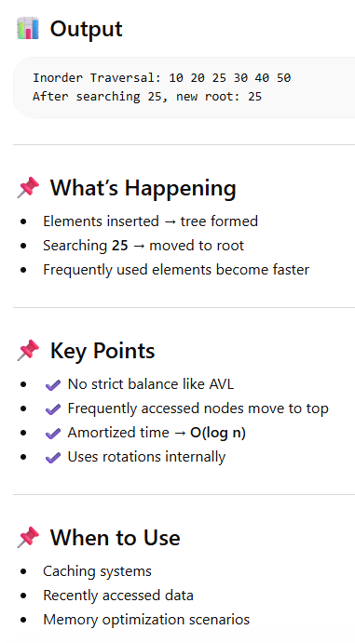

2. Non-Primitive – Non Linear Data Structures
Self-Balancing Trees – Splay Tree

Slide 56
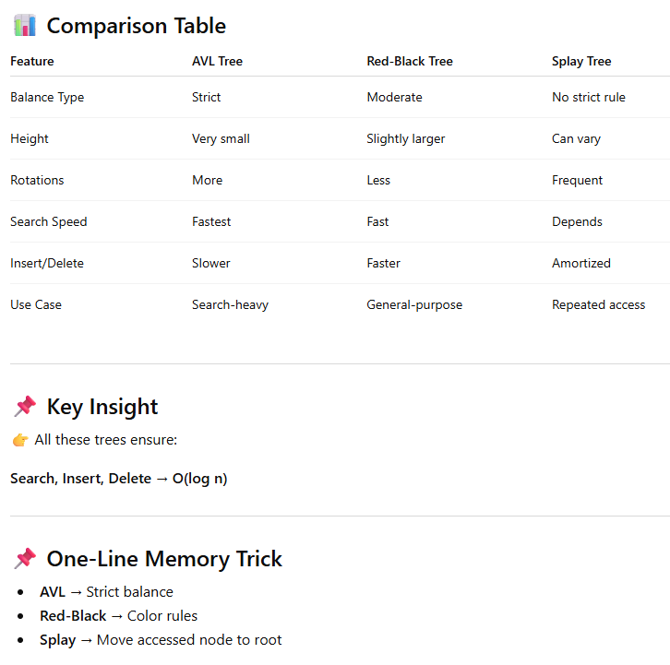
2. Non-Primitive – Non Linear Data Structures
Self-Balancing Trees – Splay Tree

Slide 57
2. Non-Primitive – Non Linear Data Structures
Heap
A Heap is a specialized non-primitive data structure that is a complete binary tree used to efficiently manage priority-based tasks. It comes in two main forms: Min-Heap (smallest element at root) and Max-Heap (largest element at root), making it ideal for priority queues, heap sort, and graph algorithms.
Heap: A complete binary tree where all levels are filled except possibly the last, and nodes are aligned to the left.
Heap Property:
Min-Heap: Parent ≤ Children (root is smallest).
Max-Heap: Parent ≥ Children (root is largest).
Core Operations
Heapify: Converts a binary tree into a heap by enforcing heap property.
Insertion: Add element at the end, then adjust using heapify.
Deletion: Remove root, replace with last element, then heapify.
Peek: Retrieve min (Min-Heap) or max (Max-Heap) without removal.
Heap Sort: Sorting algorithm using heap structure for efficient O(n log n) sorting

Slide 58
2. Non-Primitive – Non Linear Data Structures
Heap
Applications
Priority Queues: Task scheduling in operating systems.
Heap Sort: Efficient sorting algorithm.
Graph Algorithms: Dijkstra’s shortest path, Prim’s minimum spanning tree.
Event Simulation: Managing events in chronological order.
Order Statistics: Finding k-th largest/smallest elements quickly.
Advantages
Efficient Access: Constant-time access to min/max element.
Predictable Complexity: Insert/Delete in O(log n).
Memory Efficient: Implemented using arrays.
Versatile: Supports multiple variations (binomial, Fibonacci heaps).
Limitations
Not for Searching: Unlike Binary Search Trees, heaps don’t support efficient arbitrary searches.
Structure Restriction: Must remain a complete binary tree, limiting flexibility.
Complexity in Variants: Advanced heaps (Fibonacci, binomial) are harder to implement.

Slide 59
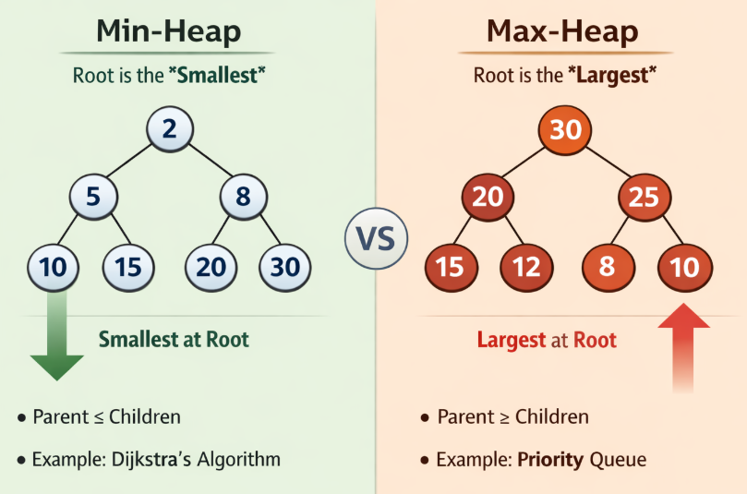
2. Non-Primitive – Non Linear Data Structures
Heap
Heaps are non-linear, tree-based structures optimized for priority management. If you need fast access to the smallest or largest element, heaps are the go-to choice, especially in priority queues, sorting, and graph algorithms.
On the left (Min-Heap): The root is the smallest element, and every parent is less than or equal to its children.
On the right (Max-Heap): The root is the largest element, and every parent is greater than or equal to its children.

Slide 60
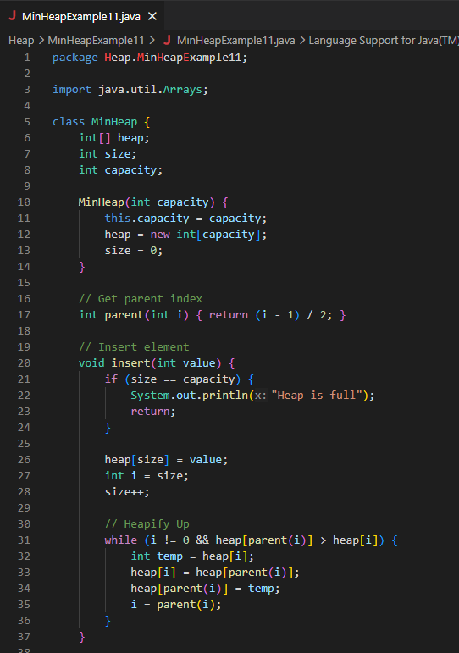
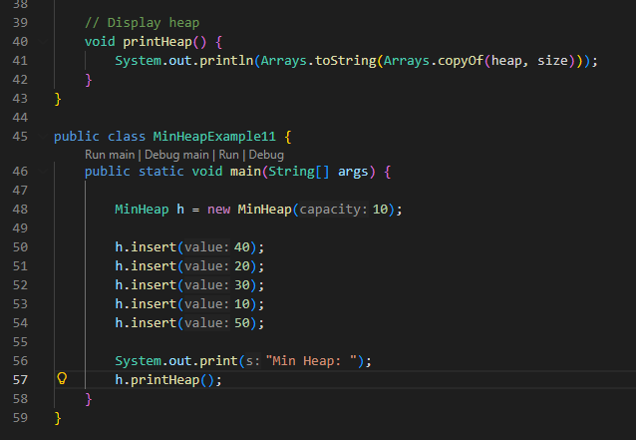
2. Non-Primitive – Non Linear Data Structures
Min Heap

Slide 61
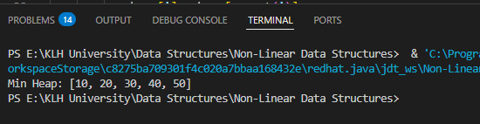
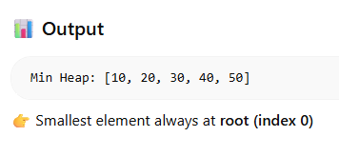
2. Non-Primitive – Non Linear Data Structures
Min Heap

Slide 62
2. Non-Primitive – Non Linear Data Structures
Min Heap
This class defines the heap structure and its operations.
Fields:
int[] heap: Array to store heap elements.
int size: Current number of elements.
int capacity: Maximum number of elements allowed.
Constructor:
Initializes an empty heap with the given capacity.

Slide 63

2. Non-Primitive – Non Linear Data Structures
Min Heap
Core Methods
1. parent(int i)
Returns the index of the parent node for a given child index:
2. insert(int value)
Adds a new element to the heap and ensures the Min-Heap property (parent ≤ children).
Steps:
Check if heap is full.
Place the new value at the end.
Perform Heapify Up:
Compare the inserted element with its parent.
If the parent is greater, swap them.
Repeat until the heap property is restored.
This ensures the smallest element “bubbles up” to the root.

Slide 64
2. Non-Primitive – Non Linear Data Structures
Min Heap
Core Methods
3. printHeap()
Displays the current heap elements as an array.
Main Method
Execution Flow:
Creates a heap with capacity 10.
Inserts elements one by one.
Each insertion reorders the heap to maintain the Min-Heap property.
Prints the final heap array:
Min Heap: [10, 20, 30, 40, 50]
Here, 10 becomes the root (smallest element), and the rest are arranged to satisfy the heap property.

Slide 65
2. Non-Primitive – Non Linear Data Structures
Min Heap
This program:
Implements a Min-Heap using an array.
Demonstrates heapify-up during insertion.
Shows how the smallest element always stays at the root.

Slide 66



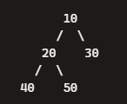


2. Non-Primitive – Non Linear Data Structures
Min Heap
Initial State
Heap is empty:
Insert 40
Heap becomes:
No parent to compare — stays as root.
Insert 20
Insert at next position → [40, 20]
Compare with parent (40).
Since 20 < 40 → swap.
Insert 10
Insert → [20, 40, 30, 10]
Parent of 10 is 40 → 10 < 40 → swap → [20, 10, 30, 40]
Now parent of 10 is 20 → 10 < 20 → swap again.
Insert 50
Insert → [10, 20, 30, 40, 50]
Parent of 50 is 20 → 50 > 20 → no swap.
Final Min-Heap:
Heap Structure (Tree View)
Each parent is smaller than its children
— satisfying the Min-Heap property.
Final Heap Array: [10, 20, 30, 40, 50]
Final Heap Tree: Root is 10, the smallest element, satisfying the Min-Heap property.

Slide 67
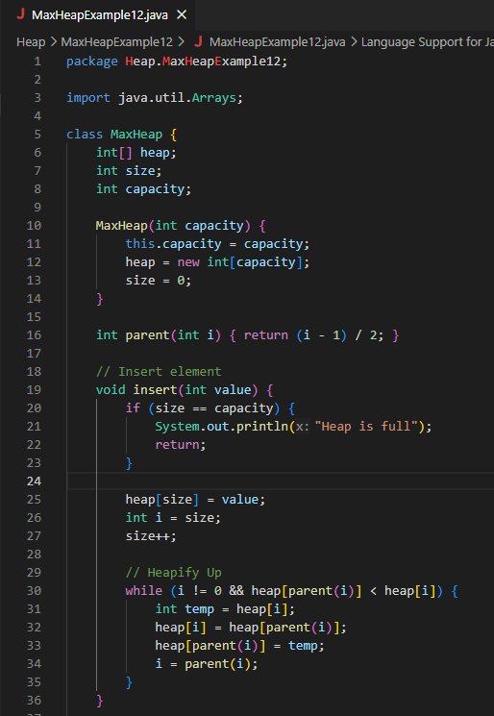
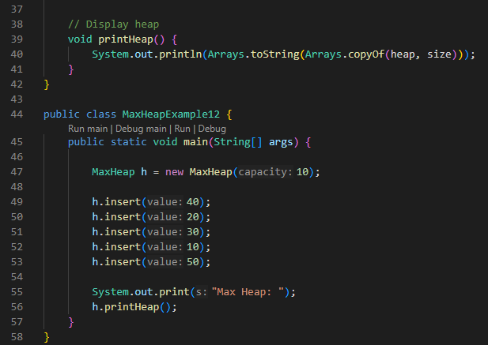
2. Non-Primitive – Non Linear Data Structures
Max Heap

Slide 68
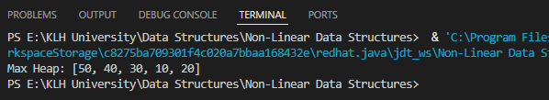
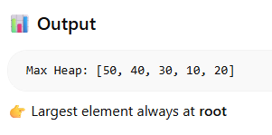
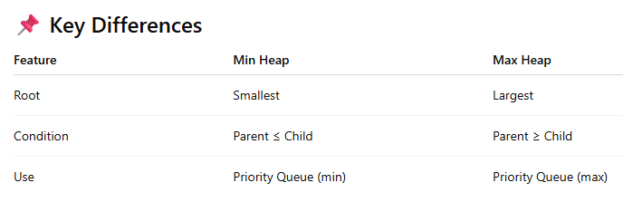
2. Non-Primitive – Non Linear Data Structures
Max Heap

Slide 69
2. Non-Primitive – Non Linear Data Structures
Max Heap
Defines the heap structure and operations.
Fields:
int[] heap: Array to store heap elements.
int size: Current number of elements.
int capacity: Maximum allowed elements.
Constructor:
Initializes an empty heap with the given capacity.

Slide 70

2. Non-Primitive – Non Linear Data Structures
Max Heap
Core Methods
1. parent(int i)
Returns the index of the parent node:
2. insert(int value)
Adds a new element and maintains the Max-Heap property (parent ≥ children).
Steps:
Check if heap is full.
Place new value at the end.
Perform Heapify Up:
Compare with parent.
If parent < child, swap.
Repeat until heap property is restored.
This ensures the largest element “bubbles up” to the root.
3. printHeap()
Displays the heap array up to current size.

Slide 71
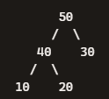
2. Non-Primitive – Non Linear Data Structures
Max Heap
Main Method
Execution Flow:
Create a heap with capacity 10.
Insert elements one by one.
Each insertion reorders the heap to maintain Max-Heap property.
Print final heap array.
Output
Max Heap: [50, 40, 30, 10, 20]
Here, 50 becomes the root (largest element), and every parent is greater than or equal to its children.
Final Heap Tree Structure
This program:
Implements a Max-Heap using an array.
Demonstrates heapify-up during insertion.
Ensures the largest element stays at the root.

