Slide 1

2. Non-Primitive – Non Linear Data Structures
Range Query Trees – Fenwick Tree (Binary Indexed Tree)
A Fenwick Tree (also called a Binary Indexed Tree, BIT) is a compact data structure that efficiently supports prefix sums and point updates in O(log n) time. It’s simpler and lighter than a segment tree, making it ideal for range query problems where you frequently update single elements and query cumulative sums.
What is a Fenwick Tree?
A Fenwick Tree (BIT) is a data structure that helps you:
Update a single element in O(log n).
Query prefix sums (sum of first i elements) in O(log n).
It’s essentially an array that cleverly stores partial sums using binary indexing.

Slide 2
2. Non-Primitive – Non Linear Data Structures
Range Query Trees – Fenwick Tree (Binary Indexed Tree)
Key Differences vs Segment Tree
Fenwick Tree:
Easier to implement.
Uses less memory.
Best for prefix sums and point updates.
Segment Tree:
More flexible (supports min, max, gcd, range updates with lazy propagation).
Slightly heavier in memory and implementation.

Slide 3
2. Non-Primitive – Non Linear Data Structures
Range Query Trees – Fenwick Tree (Binary Indexed Tree)
Comparison with Segment Tree
The Fenwick Tree is a compact and efficient alternative to Segment Trees when you mainly need prefix sums and range sums with updates. It’s widely used in competitive programming and scenarios like frequency tables, cumulative sums, and dynamic statistics.
Feature | Fenwick Tree | Segment Tree
Structure | Array-based | Tree-based
Query Complexity | O(log n) | O(log n)
Update Complexity | O(log n) | O(log n)
Memory Usage | O(n) | O(4n)
Ease of Implementation | Easier | More complex
Best Use Case | Prefix sums, cumulative frequencies | Range queries (sum, min, max, etc.)

Slide 4
2. Non-Primitive – Non Linear Data Structures
Range Query Trees – Fenwick Tree (Binary Indexed Tree) - Prefix Sum
Prefix Sum Concept
A prefix sum is the sum of elements from index 1 up to index i.
Example: Array [1, 2, 3, 4, 5]
Prefix(3) = 1 + 2 + 3 = 6
Prefix(5) = 1 + 2 + 3 + 4 + 5 = 15
Naively, computing prefix sums takes O(n).
With a Fenwick Tree, it takes O(log n).

Slide 5

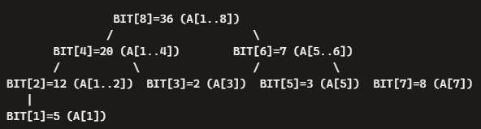
2. Non-Primitive – Non Linear Data Structures
Range Query Trees – Fenwick Tree (Binary Indexed Tree) - Prefix Sum
Example Array
Fenwick Tree Values
Each BIT index stores the sum of a block of elements, determined by the last set bit of the index:
BIT[1] = A[1] = 5
BIT[2] = A[1..2] = 5+7 = 12
BIT[3] = A[3] = 2
BIT[4] = A[1..4] = 5+7+2+6 = 20
BIT[5] = A[5] = 3
BIT[6] = A[5..6] = 3+4 = 7
BIT[7] = A[7] = 8
BIT[8] = A[1..8] = 5+7+2+6+3+4+8+1 = 36
Query Example: Prefix(6)
To compute sum of A[1..6]:
BIT[6] = 7 (covers A[5..6])
BIT[4] = 20 (covers A[1..4])
Add → 7 + 20 = 27
Check with actual array: 5+7+2+6+3+4 = 27
Each BIT node stores a partial sum of a range.
Queries combine only a few nodes to get the full prefix sum.
Updates adjust only the nodes that cover the updated index.

Slide 6
2. Non-Primitive – Non Linear Data Structures
Range Query Trees – Fenwick Tree (Binary Indexed Tree) - Prefix Sum
Prefix Sum Concept
How It’s Stored ?
The original array [5,7,2,6,3,4,8,1] is stored in its own array.
The Fenwick Tree values [5,12,2,20,3,7,8,36] are stored in a separate BIT array.
Each BIT entry is formed by summing a block of elements from the input array, determined by the binary indexing rule.
Key takeaway:
Input array stores raw values.
BIT array stores partial sums.
Together, they allow fast prefix queries and updates.
Index | Array Value | BIT Value | BIT Covers (Range of Array)
1 | 5 | 5 | A[1]
2 | 7 | 12 | A[1..2]
3 | 2 | 2 | A[3]
4 | 6 | 20 | A[1..4]
5 | 3 | 3 | A[5]
6 | 4 | 7 | A[5..6]
7 | 8 | 8 | A[7]
8 | 1 | 36 | A[1..8]

Slide 7
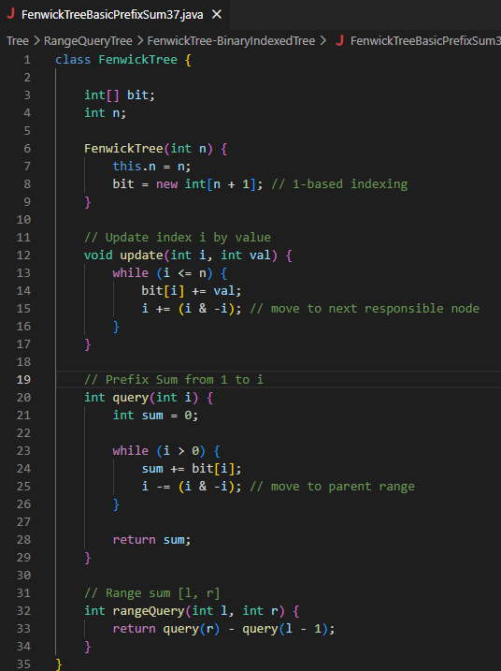
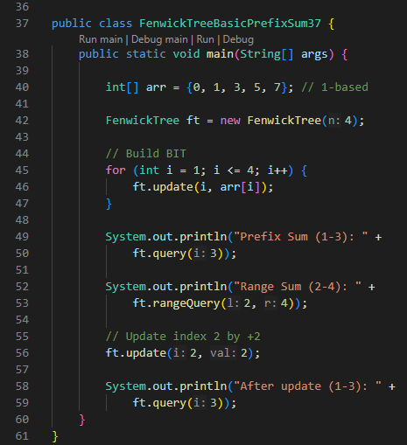
2. Non-Primitive – Non Linear Data Structures
Range Query Trees – Fenwick Tree (Binary Indexed Tree) - Prefix Sum

Slide 8
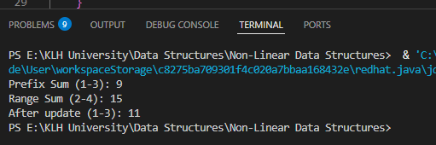
2. Non-Primitive – Non Linear Data Structures
Range Query Trees – Fenwick Tree (Binary Indexed Tree) - Prefix Sum

Slide 9

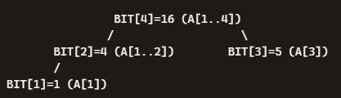

2. Non-Primitive – Non Linear Data Structures
Range Query Trees – Fenwick Tree (Binary Indexed Tree) - Prefix Sum
The program uses a 1‑based array:
arr[0] is just a dummy zero for convenience
Building the BIT
The program calls update(i, arr[i]) for each index i=1..4.
This fills the BIT array step by step.
BIT Values After Build
BIT[1] = A[1] = 1
BIT[2] = A[1..2] = 1+3 = 4
BIT[3] = A[3] = 5
BIT[4] = A[1..4] = 1+3+5+7 = 16
So the BIT array is:
Tree‑Style Diagram with Values

Slide 10
2. Non-Primitive – Non Linear Data Structures
Range Query Trees – Fenwick Tree (Binary Indexed Tree) - Prefix Sum
Queries in the Program
Prefix Sum (1–3)
ft.query(3):
Start at BIT[3] = 5 → covers A[3].
Move to BIT[2] = 4 → covers A[1..2].
Add them: 5 + 4 = 9.
Matches array sum: 1+3+5 = 9.
2. Range Sum (2–4)
ft.rangeQuery(2,4) = query(4) − query(1).
query(4) = BIT[4] = 16.
query(1) = BIT[1] = 1.
Difference = 16 − 1 = 15.
Matches array sum: 3+5+7 = 15.

Slide 11

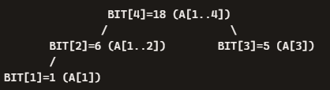

2. Non-Primitive – Non Linear Data Structures
Range Query Trees – Fenwick Tree (Binary Indexed Tree) - Prefix Sum
Queries in the Program
3. Update Index 2 by +2
Array [1, 3, 5, 7]. becomes [1, 5, 5, 7].
BIT updates propagate:
BIT[2] = 4 → 6
BIT[4] = 16 → 18
New BIT array:
4. After Update: Prefix Sum (1–3)
ft.query(3):
BIT[3] = 5
BIT[2] = 6
Add → 11
Matches new array sum: 1+5+5 = 11.
after adding +2 at index 2
Start at BIT[3] = 5 → covers A[3].
Move to BIT[2] = 6 → covers A[1..2].
Add them: 5 + 6 = 11.

Slide 12
2. Non-Primitive – Non Linear Data Structures
Range Query Trees – Fenwick Tree (Binary Indexed Tree) - Prefix Sum
Class: FenwickTree
This class defines the Fenwick Tree (Binary Indexed Tree) structure.
Fields:
int[] bit; → the BIT array that stores partial sums.
int n; → the size of the array (number of elements).
Constructor:
FenwickTree(int n) → initializes the BIT array of size n+1 (because BIT uses 1‑based indexing).
Methods
update(int i, int val)
Adds val to element at index i.
Propagates the change to all BIT nodes that cover index i.
Uses i += (i & -i) to move to the next responsible node.
query(int i)
Computes the prefix sum from index 1 to i.
Traverses BIT nodes backwards using i -= (i & -i).
Adds up the relevant partial sums.
rangeQuery(int l, int r)
Computes sum of elements in range [l, r].
Uses the formula: query(r) - query(l-1).

Slide 13
2. Non-Primitive – Non Linear Data Structures
Range Query Trees – Fenwick Tree (Binary Indexed Tree) - Prefix Sum
The class defines the Fenwick Tree structure.
The methods handle updates, prefix sums, and range queries.
The main builds the tree, runs queries, performs an update, and shows how the BIT values change.
Output comes directly from combining BIT nodes according to the query rules.

Slide 14
2. Non-Primitive – Non Linear Data Structures
Range Query Trees – Fenwick Tree (Binary Indexed Tree) - Frequency Count
A Fenwick Tree (Binary Indexed Tree) can be used not only for prefix sums but also for efficient frequency counting — it stores cumulative frequencies and allows you to quickly find how many elements fall within a given range, or even locate the k‑th element by frequency.
Instead of storing sums of array values, the BIT stores frequency counts (how many times each element appears).
Each update increases the frequency of a value.
Queries compute cumulative frequencies (like “how many elements ≤ x?”).

Slide 15
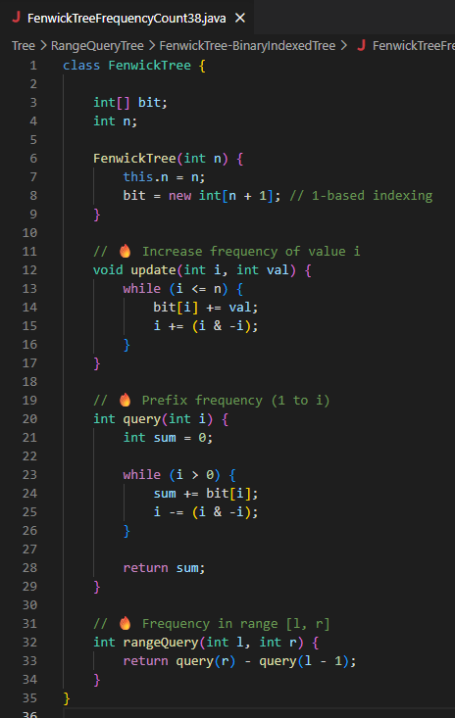
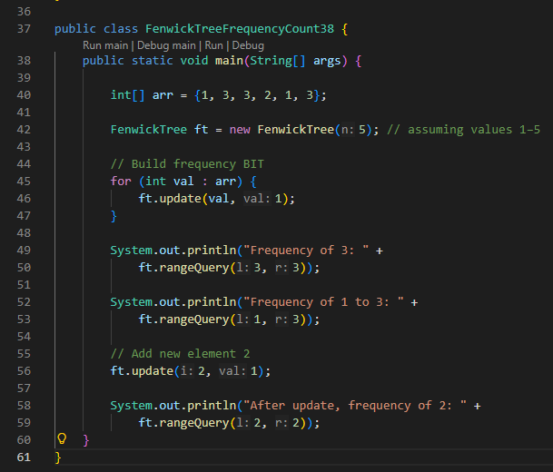
2. Non-Primitive – Non Linear Data Structures
Range Query Trees – Fenwick Tree (Binary Indexed Tree) - Frequency Count

Slide 16
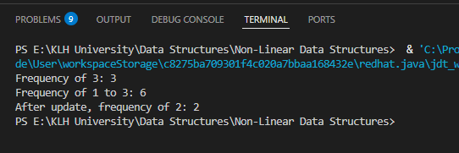
2. Non-Primitive – Non Linear Data Structures
Range Query Trees – Fenwick Tree (Binary Indexed Tree) - Frequency Count

Slide 17


2. Non-Primitive – Non Linear Data Structures
Range Query Trees – Fenwick Tree (Binary Indexed Tree) - Frequency Count
This means we are inserting these values into the frequency table. We assume values are in the range 1–5.
Building the Frequency BIT
We call update(val, 1) for each element in the array.
That means we increase the frequency of each value by 1.
Frequency Table After Build
Value 1 → appears 2 times
Value 2 → appears 1 time
Value 3 → appears 3 times
Value 4 → appears 0 times
Value 5 → appears 0 times
So the raw frequency counts are:

Slide 18
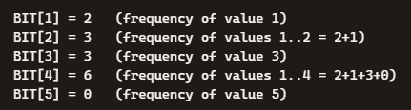

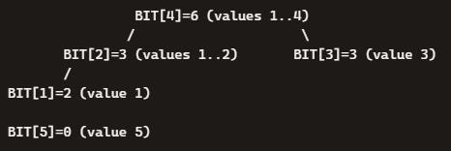
2. Non-Primitive – Non Linear Data Structures
Range Query Trees – Fenwick Tree (Binary Indexed Tree) - Frequency Count
This means we are inserting these values into the frequency table. We assume values are in the range 1–5.
BIT Array Values
The BIT array stores cumulative frequencies. After all updates, the BIT looks like this:
So the BIT array is:
Here’s what each entry means:
BIT[1] = 2 → frequency of value 1
BIT[2] = 3 → cumulative frequency of values 1..2 (2 ones + 1 two)
BIT[3] = 3 → frequency of value 3
BIT[4] = 6 → cumulative frequency of values 1..4 (all 6 elements so far)
BIT[5] = 0 → frequency of value 5
BIT[4] = frequency(1) + frequency(2) + frequency(3) + frequency(4)
= 2 + 1 + 3 + 0 = 6
That’s why BIT[4] = 6.

Slide 19


2. Non-Primitive – Non Linear Data Structures
Range Query Trees – Fenwick Tree (Binary Indexed Tree) - Frequency Count
Queries in the Program
Frequency of 3
Output: Frequency of 3: 3
Frequency of 1 to 3
Output: Frequency of 1 to 3: 6
After update(2,1) (adding another “2”):
BIT[2] becomes 4, BIT[4] becomes 7
Now frequency of 2 = 2
Look at BIT[3] and BIT[2].
Result = 3 → there are 3 threes.
Look at BIT[4] (total 6 numbers up to 4).
That’s all 6 numbers → 2 ones + 1 two + 3 threes.
Update BIT[2] and BIT[4].
BIT[2] becomes 4, BIT[4] becomes 7.
Now there are 2 twos.

Slide 20

2. Non-Primitive – Non Linear Data Structures
Range Query Trees – Fenwick Tree (Binary Indexed Tree) - Frequency Count
Queries in the Program
Update Step: Add New Element 2
We call ft.update(2,1) → increases frequency of value 2 by 1.
Propagation
BIT[2] increases from 3 → 4
BIT[4] increases from 6 → 7
New BIT array:

Slide 21
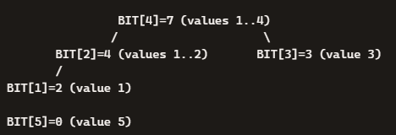

2. Non-Primitive – Non Linear Data Structures
Range Query Trees – Fenwick Tree (Binary Indexed Tree) - Frequency Count
Queries in the Program
Query After Update
Frequency of 2
Output: After update, frequency of 2: 2
The array holds the raw values [1,3,3,2,1,3].
The BIT array holds cumulative frequencies [2,3,3,6,0] (then [2,4,3,7,0] after update).
Queries combine BIT nodes to quickly compute frequencies in ranges.
Updates propagate through the BIT so it always reflects the latest counts.

Slide 22
2. Non-Primitive – Non Linear Data Structures
Range Query Trees – Fenwick Tree (Binary Indexed Tree) - Frequency Count
Class: FenwickTree
This class is the blueprint for the Fenwick Tree (Binary Indexed Tree).
It defines:
Data storage: an array called bit that holds grouped counts.
Size: n, the maximum value we want to track.
Think of it as the “machine” that knows how to store and update frequencies.
Methods
update(i, val)
Purpose: Increase the count of number i by val.
Example: If you add another “2” into your data, you call update(2,1).
Behind the scenes: It doesn’t just change one slot; it updates all the grouped totals that include i.
Analogy: If you add one candy to jar #2, you also update the bigger jars that summarize jars 1–2 and jars 1–4.
query(i)
Purpose: Find out how many numbers are ≤ i.
Example: query(3) tells you how many numbers are 1, 2, or 3.
Behind the scenes: It walks backwards through the grouped totals, adding them up.
Analogy: If you want to know how many candies are in jars 1–3, you check jar #3 and jar #2, then add them.

Slide 23
2. Non-Primitive – Non Linear Data Structures
Range Query Trees – Fenwick Tree (Binary Indexed Tree) - Frequency Count
rangeQuery(l, r)
Purpose: Find out how many numbers are between l and r.
Example: rangeQuery(2,4) tells you how many numbers are 2, 3, or 4.
Behind the scenes: It uses two queries: total up to r minus total up to l-1.
Analogy: If you want to know how many candies are in jars 2–4, you count jars 1–4 and subtract jars 1.
main()
The main program is the script that feeds numbers into the machine, asks questions, and shows the answers.

Slide 24
2. Non-Primitive – Non Linear Data Structures
Range Query Trees – Fenwick Tree (Binary Indexed Tree) – Update Types - Point Update + Range Query
What This Means
Point Update → You change the value at a single position (like “add +2 at index 5”).
Range Query → You ask for the sum (or frequency count) of values between two positions [l, r].
So the Fenwick Tree here is designed to:
Update one element quickly.
Answer range queries quickly.

Slide 25
2. Non-Primitive – Non Linear Data Structures
Range Query Trees – Fenwick Tree (Binary Indexed Tree) – Update Types - Point Update + Range Query
How It Works?
1. Point Update
Suppose you have an array [1, 2, 3, 4, 5].
If you add +2 at index 3, the array becomes [1, 2, 5, 4, 5].
The Fenwick Tree updates only the nodes that are responsible for index 3.
This takes O(log n) time, much faster than recalculating everything.
Range Query
To get the sum of values between [l, r], you use:
rangeQuery(l, r) = prefixSum(r) – prefixSum(l-1)
Example: sum of [2..4] in [1,2,5,4,5].
prefixSum(4) = 1+2+5+4 = 12
prefixSum(1) = 1
rangeQuery(2,4) = 12 – 1 = 11
When you update one index, only a few nodes change.
When you query a range, you combine a few nodes to get the answer.
Point Update: Change one element → BIT updates only relevant nodes.
Range Query: Use prefix sums to get [l..r] quickly.
Both operations run in O(log n) time, making Fenwick Trees very efficient for problems where you need fast updates and fast queries.

Slide 26
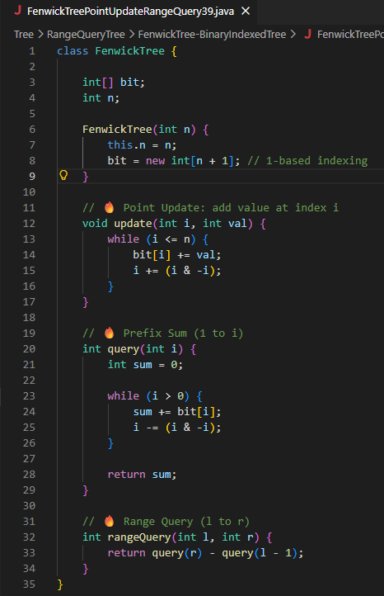
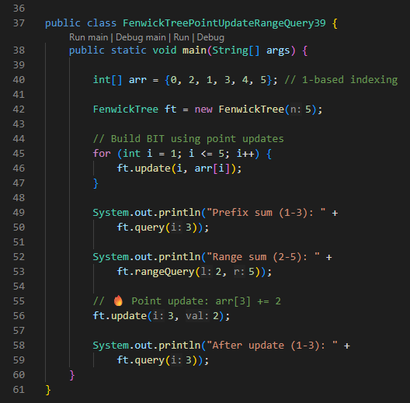
2. Non-Primitive – Non Linear Data Structures
Range Query Trees – Fenwick Tree (Binary Indexed Tree) – Update Types - Point Update + Range Query

Slide 27
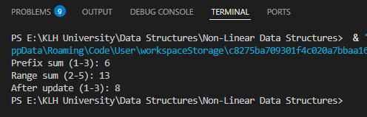
2. Non-Primitive – Non Linear Data Structures
Range Query Trees – Fenwick Tree (Binary Indexed Tree) – Update Types - Point Update + Range Query

Slide 28
2. Non-Primitive – Non Linear Data Structures
Range Query Trees – Fenwick Tree (Binary Indexed Tree) – Update Types - Point Update + Range Query
Class: FenwickTree
This class defines the data structure.
It has an internal array (bit) that stores partial sums.
It knows the size (n) of the data it’s managing.
Think of it as the “engine” that powers updates and queries.
Methods
update(i, val) – Point Update
Purpose: Add a value at a single index.
Example: If you add +2 at index 3, it updates the BIT so that all sums covering index 3 are adjusted.
Analogy: If you add 2 candies to jar #3, you also update the bigger jars that summarize jars 1–3 and jars 1–4.
query(i) – Prefix Sum
Purpose: Find the sum of values from index 1 up to index i.
Example: query(3) gives the sum of elements at positions 1, 2, and 3.
Analogy: If you want to know how many candies are in jars 1–3, you check the grouped totals and add them up.
rangeQuery(l, r) – Range Sum
Purpose: Find the sum of values between l and r.
Formula: query(r) – query(l-1).
Example: rangeQuery(2,5) gives the sum of elements at positions 2, 3, 4, and 5.
Analogy: To count candies in jars 2–5, you count jars 1–5 and subtract jars 1.

Slide 29


2. Non-Primitive – Non Linear Data Structures
Range Query Trees – Fenwick Tree (Binary Indexed Tree) – Update Types - Point Update + Range Query
Main Program
This is where the program runs step by step:
Input Array
Create Fenwick Tree
Sets up the structure for 5 elements.
Build the Tree
For each element in the array, call update(i, arr[i]).
This fills the BIT with partial sums.
Query 1: Prefix Sum (1–3)
query(3) → sum of arr[1..3] = 2+1+3 = 6.
Output: Prefix sum (1-3): 6.
(The 0 at the start is just a dummy so indexing starts at 1.)

Slide 30
2. Non-Primitive – Non Linear Data Structures
Range Query Trees – Fenwick Tree (Binary Indexed Tree) – Update Types - Point Update + Range Query
Main Program
Query 2: Range Sum (2–5)
rangeQuery(2,5) → sum of arr[2..5] = 1+3+4+5 = 13.
Output: Range sum (2-5): 13.
Point Update: arr[3] += 2
arr[3] changes from 3 → 5.
BIT updates to reflect this change.
Query 3: After Update Prefix Sum (1–3)
query(3) → sum of arr[1..3] = 2+1+5 = 8.
Output: After update (1-3): 8.

Slide 31
2. Non-Primitive – Non Linear Data Structures
Range Query Trees – Fenwick Tree (Binary Indexed Tree) – Update Types - Range Update + Point Query
Range Update → Instead of changing just one element, you add a value to an entire range [l..r].
Example: “Add +2 to every element between index 2 and 5.”
Point Query → Instead of asking for a sum over a range, you ask for the value at a single index after all updates.
Example: “What is the final value at index 4?”
So the tree is designed to apply updates to ranges efficiently and then retrieve the value at a single point.
How It Works
Normally, a Fenwick Tree is used for point updates + range queries.
To flip it (range update + point query), we use a trick:
Range Update [l..r] by +val
Do update(l, +val) → add val starting at l.
Do update(r+1, -val) → subtract val starting after r.
This way, the effect of +val is applied to all indices between l and r.
Point Query at index i
Just call query(i).
Because of the way updates were applied, query(i) gives the net effect of all range updates at that index.

Slide 32


2. Non-Primitive – Non Linear Data Structures
Range Query Trees – Fenwick Tree (Binary Indexed Tree) – Update Types - Range Update + Point Query
Array (initially all zeros, size 5):
Step 1: Range Update [2..4] by +3
update(2, +3)
update(5, -3)
Now the BIT encodes: “+3 for indices ≥2, and -3 for indices ≥5.”
Step 2: Point Queries
query(1) = 0 → index 1 unchanged
query(2) = 3 → index 2 got +3
query(3) = 3 → index 3 got +3
query(4) = 3 → index 4 got +3
query(5) = 0 → index 5 canceled out by -3
Final array values:
Range Update + Point Query is the “dual” of the usual Fenwick Tree usage.
Instead of storing sums directly, the BIT stores difference markers (start +val, end+1 −val).
Point queries then accumulate these markers to give the final value at that index.
Both operations are efficient: O(log n).

Slide 33
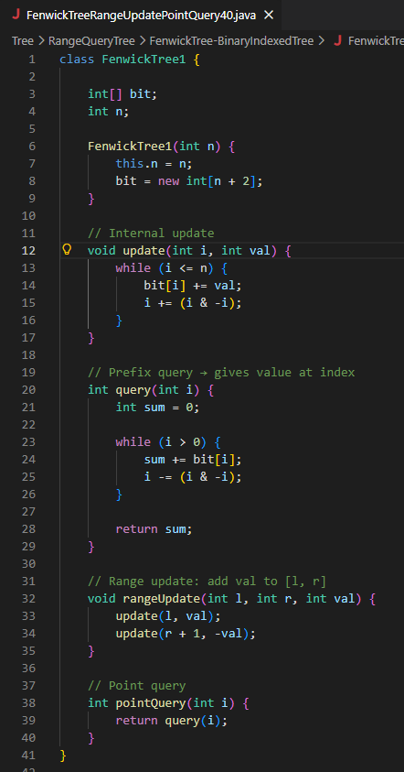
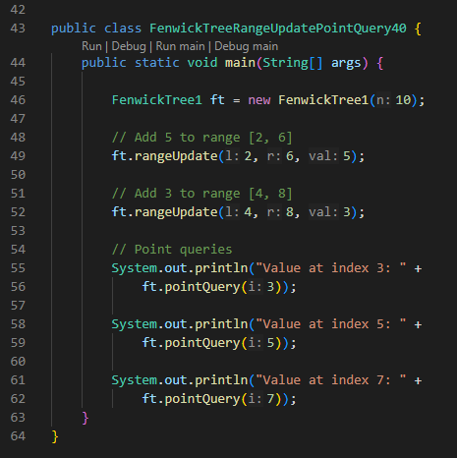
2. Non-Primitive – Non Linear Data Structures
Range Query Trees – Fenwick Tree (Binary Indexed Tree) – Update Types - Range Update + Point Query

Slide 34
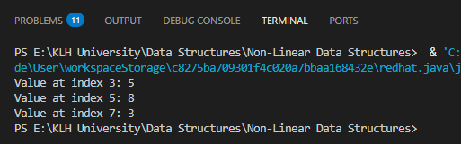
2. Non-Primitive – Non Linear Data Structures
Range Query Trees – Fenwick Tree (Binary Indexed Tree) – Update Types - Range Update + Point Query

Slide 35


2. Non-Primitive – Non Linear Data Structures
Range Query Trees – Fenwick Tree (Binary Indexed Tree) – Update Types - Range Update + Point Query
Program Explanation
This version of the Fenwick Tree is set up for Range Update + Point Query:
Range Update → add a value to all elements between [l..r].
Point Query → ask for the final value at a single index after all updates.
Step 1: Initial Setup
We create a Fenwick Tree of size 10. Initially, all values are 0.
Step 2: First Range Update [2..6] by +5
This means: add 5 to every index from 2 to 6.
Resulting values:

Slide 36

2. Non-Primitive – Non Linear Data Structures
Range Query Trees – Fenwick Tree (Binary Indexed Tree) – Update Types - Range Update + Point Query
Program Explanation
Step 3: Second Range Update [4..8] by +3
This means: add 3 to every index from 4 to 8.
Resulting values:
Explanation:
Index 4,5,6 already had 5 → now they become 8 (5+3).
Index 7,8 were 0 → now they become 3.

Slide 37


2. Non-Primitive – Non Linear Data Structures
Range Query Trees – Fenwick Tree (Binary Indexed Tree) – Update Types - Range Update + Point Query
Program Explanation
Step 4: Point Queries
Now the program asks for specific values:
Value at index 3
From the array: 5
Output: Value at index 3: 5
Value at index 5
From the array: 8
Output: Value at index 5: 8
Value at index 7
From the array: 3
Output: Value at index 7: 3
After both updates, the array looks like:

Slide 38
2. Non-Primitive – Non Linear Data Structures
Range Query Trees – Fenwick Tree (Binary Indexed Tree) – Update Types - Range Update + Range Query
Range Update → You add a value to every element in a range [l..r].
Example: “Add +2 to all elements between index 2 and 5.”
Range Query → You ask for the sum of values in a range [l..r].
Example: “What is the total of elements between index 3 and 7?”
So this setup allows you to update multiple elements at once and then query sums over ranges efficiently.
How It Works?
A normal Fenwick Tree supports:
Point Update + Range Query.
To support Range Update + Range Query, we use a trick with two Fenwick Trees:
BIT1 → stores the effect of updates directly.
BIT2 → stores correction factors so that range sums come out correctly.

Slide 39



2. Non-Primitive – Non Linear Data Structures
Range Query Trees – Fenwick Tree (Binary Indexed Tree) – Update Types - Range Update + Range Query
Example
Suppose we have an array of size 5, initially all zeros:
Step 1: Range Update [2..4] by +3
Array becomes:
Step 2: Range Update [3..5] by +2
Array becomes:
Step 3: Range Query [2..5]
Sum = 3 + 5 + 5 + 2 = 15
Range Update + Range Query is the most powerful Fenwick Tree usage.
It requires two BITs working together.
Updates and queries both run in O(log n) time.
This lets you efficiently handle problems where you frequently add values to ranges and ask for sums over ranges.

Slide 40
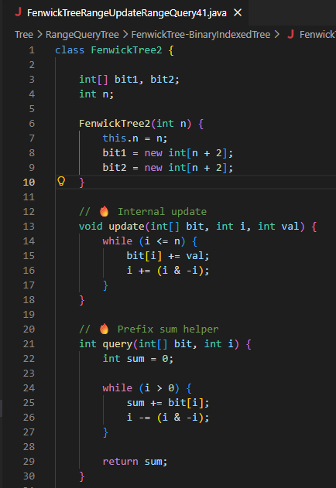
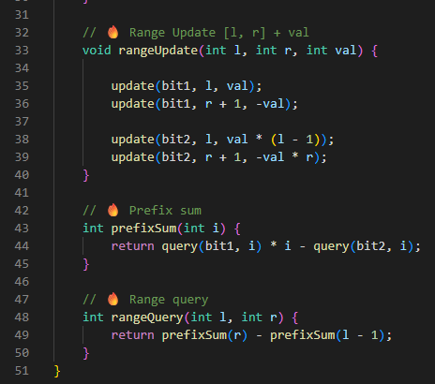
2. Non-Primitive – Non Linear Data Structures
Range Query Trees – Fenwick Tree (Binary Indexed Tree) – Update Types - Range Update + Range Query

Slide 41
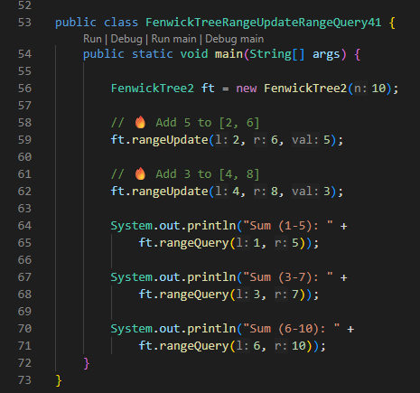
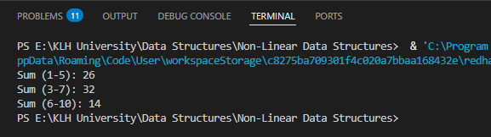
2. Non-Primitive – Non Linear Data Structures
Range Query Trees – Fenwick Tree (Binary Indexed Tree) – Update Types - Range Update + Range Query

Slide 42



2. Non-Primitive – Non Linear Data Structures
Range Query Trees – Fenwick Tree (Binary Indexed Tree) – Update Types - Range Update + Range Query
This version of the Fenwick Tree uses two internal trees (bit1 and bit2) to support:
Range Update → add a value to all elements in [l..r].
Range Query → ask for the sum of values in [l..r].
Step 1: Initial Setup
We create a Fenwick Tree of size 10. Initially, all values are 0:
Step 2: First Range Update [2..6] by +5
This means: add 5 to every index between 2 and 6.
Resulting values:
Step 3: Second Range Update [4..8] by +3
This means: add 3 to every index between 4 and 8.
Resulting values:
Explanation:
Indices 4,5,6 already had 5 → now they become 8 (5+3).
Indices 7,8 were 0 → now they become 3.

Slide 43

2. Non-Primitive – Non Linear Data Structures
Range Query Trees – Fenwick Tree (Binary Indexed Tree) – Update Types - Range Update + Range Query
Step 4: Range Queries
Now the program asks for sums:
Sum (1–5)
Values = 0+5+5+8+8 = 26
Output: Sum (1-5): 26
Sum (3–7)
Values = 5+8+8+3+3 = 27
Output: Sum (3-7): 27
Sum (6–10)
Values = 8+3+3+0+0 = 14
Output: Sum (6-10): 14
bit1 tracks where updates start and stop.
bit2 stores correction factors so that when you query, you get the right totals.
Together, they allow both range updates and range queries in O(log n) time.
Outputs

Slide 44
2. Non-Primitive – Non Linear Data Structures
Range Query Trees – Fenwick Tree (Binary Indexed Tree) – Update Types - Range Update + Range Query
Class: FenwickTree2
This class defines a Fenwick Tree structure that can handle range updates and range queries.
It has two internal arrays: bit1 and bit2.
These two arrays work together to make sure both updates and queries are correct.
Methods
update(bit, i, val)
Internal helper that adds val at position i in the chosen BIT array.
It propagates changes to higher indices so grouped totals stay correct.
query(bit, i)
Internal helper that calculates the prefix sum up to index i from the chosen BIT array.
Used to build the final prefix sums.
rangeUpdate(l, r, val)
Adds val to every element between indices l and r.
It updates both bit1 and bit2 using a clever trick so that later queries reflect the change.

Slide 45
2. Non-Primitive – Non Linear Data Structures
Range Query Trees – Fenwick Tree (Binary Indexed Tree) – Update Types - Range Update + Range Query
Methods
prefixSum(i)
Calculates the sum of elements from index 1 up to i.
Uses both BIT arrays together: query(bit1,i)*i - query(bit2,i).
rangeQuery(l, r)
Calculates the sum of elements between indices l and r.
Formula: prefixSum(r) - prefixSum(l-1).

Slide 46
2. Non-Primitive – Non Linear Data Structures
Range Query Trees – Fenwick Tree (Binary Indexed Tree) – Update Types - Range Update + Range Query
Main Method
This is where the program runs:
Creates a Fenwick Tree of size 10.
Performs two range updates:
Add 5 to indices [2..6].
Add 3 to indices [4..8].
Runs three range queries:
Sum of indices [1..5] → 26
Sum of indices [3..7] → 27
Sum of indices [6..10] → 14
Prints these results.

Slide 47
2. Non-Primitive – Non Linear Data Structures
Range Query Trees – Fenwick Tree (Binary Indexed Tree) – Variants – 2D Fenwick Tree
What is a 2D Fenwick Tree?
A normal Fenwick Tree works on a 1D array: it supports fast updates and queries on ranges of numbers.
A 2D Fenwick Tree extends this idea to a grid (matrix).
It allows you to:
Update a single cell in the matrix.
Query the sum of values inside a rectangular sub‑matrix.
So instead of working with a line of numbers, it works with a table of numbers.
How It Works
The structure is a 2D array bit[x][y].
Each cell in the BIT stores the sum of a block of the original matrix.
The block size is determined by the binary representation of the indices (just like in 1D BIT, but now in two dimensions).

Slide 48
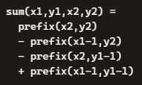
2. Non-Primitive – Non Linear Data Structures
Range Query Trees – Fenwick Tree (Binary Indexed Tree) – Variants – 2D Fenwick Tree
Operations
Point Update (x,y,val)
Add val to cell (x,y).
Propagate the change to all BIT cells that cover (x,y).
Complexity: O(log n * log m).
Prefix Sum Query (x,y)
Get the sum of all cells in the rectangle (1,1) to (x,y).
Complexity: O(log n * log m).
Range Sum Query (x1,y1,x2,y2)
Use inclusion–exclusion with prefix sums:

Slide 49

2. Non-Primitive – Non Linear Data Structures
Range Query Trees – Fenwick Tree (Binary Indexed Tree) – Variants – 2D Fenwick Tree
Example
Suppose we have a 4×4 matrix:
If we update cell (2,3) by +2, the BIT updates all blocks that include (2,3).
If we query the sum of rectangle (2,2) to (3,3), the answer is:
Why Use It?
Useful in problems involving 2D grids (like images, maps, or game boards).
Much faster than recalculating sums directly.
Common in competitive programming and advanced algorithmic tasks.
A 2D Fenwick Tree is the 2D extension of the BIT.
It supports point updates and range queries on rectangles in O(log n * log m) time.
It’s efficient for matrix problems where you need to frequently update cells and query sub‑matrix sums.

Slide 50
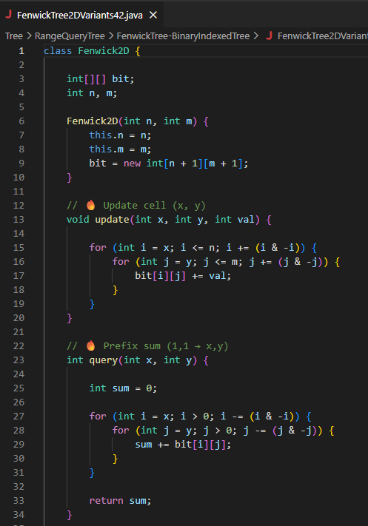
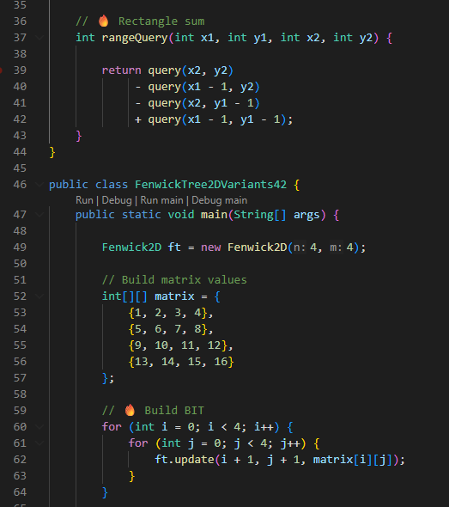
2. Non-Primitive – Non Linear Data Structures
Range Query Trees – Fenwick Tree (Binary Indexed Tree) – Variants – 2D Fenwick Tree

Slide 51
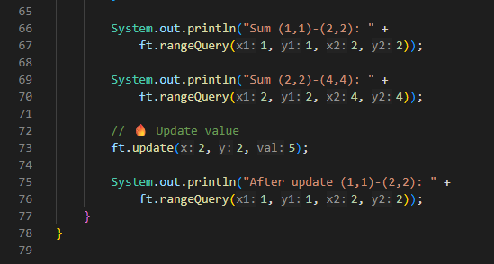
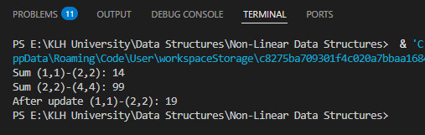
2. Non-Primitive – Non Linear Data Structures
Range Query Trees – Fenwick Tree (Binary Indexed Tree) – Variants – 2D Fenwick Tree

Slide 52

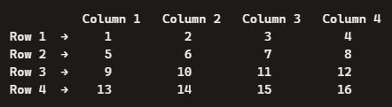
2. Non-Primitive – Non Linear Data Structures
Range Query Trees – Fenwick Tree (Binary Indexed Tree) – Variants – 2D Fenwick Tree
Class: Fenwick2D
This class defines a 2D Fenwick Tree (Binary Indexed Tree) that works on a grid (matrix).
bit → a 2D array storing partial sums.
update(x,y,val) → adds a value to cell (x,y) and propagates it to all relevant blocks.
query(x,y) → gives the sum of the rectangle from (1,1) to (x,y).
rangeQuery(x1,y1,x2,y2) → gives the sum of any rectangular sub‑matrix using inclusion–exclusion.
Step 1: Input Matrix
The program starts with a 4×4 matrix:

Slide 53


2. Non-Primitive – Non Linear Data Structures
Range Query Trees – Fenwick Tree (Binary Indexed Tree) – Variants – 2D Fenwick Tree
Step 2: Building the BIT
The program loops through each cell (i,j) and calls update(i+1,j+1,matrix[i][j]).
This fills the BIT with cumulative sums so queries can be answered quickly.
Step 3: Queries
Sum (1,1)–(2,2) Sub‑matrix:
Sum = 1+2+5+6 = 14
Output: Sum (1,1)-(2,2): 14
Sum (2,2)–(4,4)
Sub‑matrix:
Sum = 6+7+8+10+11+12+14+15+16 = 99
Output: Sum (2,2)-(4,4): 99

Slide 54


2. Non-Primitive – Non Linear Data Structures
Range Query Trees – Fenwick Tree (Binary Indexed Tree) – Variants – 2D Fenwick Tree
Step 4: Update
The program then does:
ft.update(2,2,5);
This adds +5 to cell (2,2) (which originally had 6).
So the matrix becomes:
Step 5: Query After Update
Sum (1,1)–(2,2) again:
Sum = 1+2+5+11 = 19
Output: After update (1,1)-(2,2): 19

Slide 55
2. Non-Primitive – Non Linear Data Structures
Range Query Trees – Fenwick Tree (Binary Indexed Tree) – Variants – 2D Fenwick Tree
Final Outputs
The program prints:
Sum (1,1)-(2,2): 14
Sum (2,2)-(4,4): 99
After update (1,1)-(2,2): 19

Slide 56
2. Non-Primitive – Non Linear Data Structures
Range Query Trees – Fenwick Tree (Binary Indexed Tree) – Binary Index Manipulation
Binary index manipulation in a Fenwick Tree (BIT) is the key trick that makes updates and queries efficient: it uses the lowest set bit (i & -i) of an index to decide how far to move in the tree. This determines parent–child relationships and which ranges each node covers.
A Fenwick Tree is stored in an array, but it represents a tree implicitly.
Each index i in the BIT array stores the sum of a range of elements in the original array.
The range size is determined by the rightmost set bit of i (binary index manipulation).

Slide 57
2. Non-Primitive – Non Linear Data Structures
Range Query Trees – Fenwick Tree (Binary Indexed Tree) – Binary Index Manipulation
Binary Index Manipulation Rules
Lowest Set Bit (LSB)
Formula: i & -i
Meaning: the value of the rightmost 1 in the binary representation of i.
Example:
i = 6 (binary 110) → i & -i = 2
i = 12 (binary 1100) → i & -i = 4
Update Operation
When updating index i, you add the value to BIT[i].
Then move to the next responsible node: i += (i & -i).
This jumps to the parent node that covers a larger range.
Query Operation
When querying prefix sum up to i, you add BIT[i].
Then move to the parent node: i -= (i & -i).
This jumps backwards to smaller ranges until you reach 0.

Slide 58
2. Non-Primitive – Non Linear Data Structures
Range Query Trees – Fenwick Tree (Binary Indexed Tree) – Binary Index Manipulation
Binary Index Manipulation Rules
Example
Suppose we have an array of size 8.
BIT[1] stores sum of element 1.
BIT[2] stores sum of elements [1..2].
BIT[4] stores sum of elements [1..4].
BIT[8] stores sum of elements [1..8].
Why? Because:
1 & -1 = 1 → covers 1 element.
2 & -2 = 2 → covers 2 elements.
4 & -4 = 4 → covers 4 elements.
8 & -8 = 8 → covers 8 elements.
So each index covers a block of size equal to its lowest set bit.

Slide 59
2. Non-Primitive – Non Linear Data Structures
Range Query Trees – Fenwick Tree (Binary Indexed Tree) – Binary Index Manipulation
Parent–Child Relationships
Parent of i = i - (i & -i)
Child of i = i + (i & -i)
Example:
Index 6 (binary 110) → LSB = 2
Parent = 6 - 2 = 4
Child = 6 + 2 = 8
This shows how the BIT navigates between nodes.
Binary index manipulation (i & -i) is the heart of Fenwick Tree operations.
It tells you how big a block each node covers, and how to move between nodes during updates and queries.
That’s why both updates and queries run in O(log n) time.

Slide 60
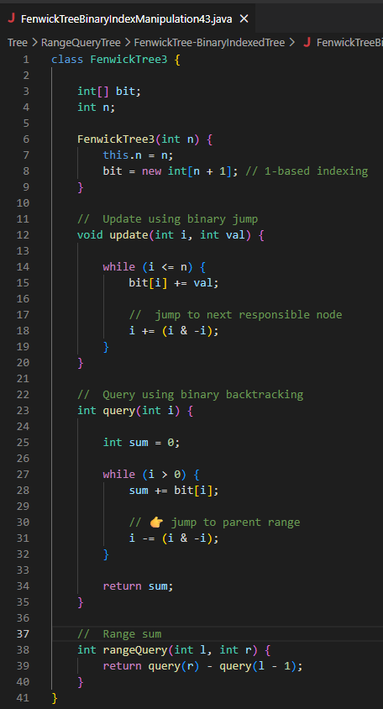
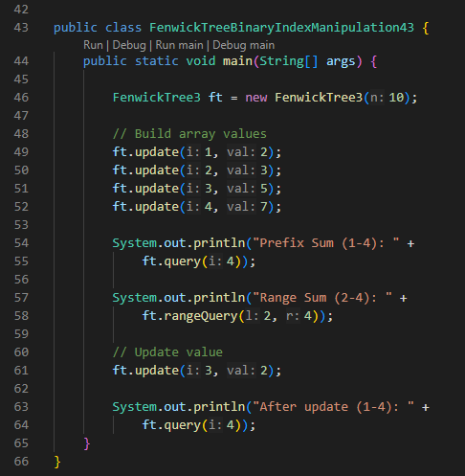
2. Non-Primitive – Non Linear Data Structures
Range Query Trees – Fenwick Tree (Binary Indexed Tree) – Binary Index Manipulation

Slide 61
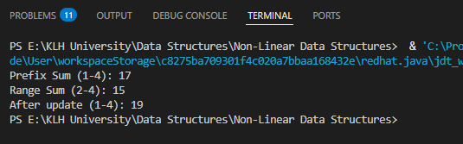
2. Non-Primitive – Non Linear Data Structures
Range Query Trees – Fenwick Tree (Binary Indexed Tree) – Binary Index Manipulation

Slide 62


2. Non-Primitive – Non Linear Data Structures
Range Query Trees – Fenwick Tree (Binary Indexed Tree) – Binary Index Manipulation
Class: FenwickTree3
This class defines a Fenwick Tree (Binary Indexed Tree) using binary index manipulation (i & -i) to move between nodes.
bit[] → internal array storing partial sums.
update(i,val) → adds val at index i and propagates forward (i += (i & -i)).
query(i) → computes prefix sum up to i by backtracking (i -= (i & -i)).
rangeQuery(l,r) → computes sum of [l..r] using query(r) - query(l-1).
The program builds values into the Fenwick Tree:
So the logical array becomes:

Slide 63
2. Non-Primitive – Non Linear Data Structures
Range Query Trees – Fenwick Tree (Binary Indexed Tree) – Binary Index Manipulation
Step 2: Queries
Prefix Sum (1–4)
query(4) = 2+3+5+7 = 17
Output: Prefix Sum (1-4): 17
Range Sum (2–4)
rangeQuery(2,4) = query(4) – query(1)
query(4)=17, query(1)=2 → 17–2 = 15
Output: Range Sum (2-4): 15

Slide 64


2. Non-Primitive – Non Linear Data Structures
Range Query Trees – Fenwick Tree (Binary Indexed Tree) – Binary Index Manipulation
Step 3: Update
ft.update(3, 2);
This adds +2 at index 3.
So arr[3] changes from 5 → 7.
New array:
Step 4: Query After Update
Prefix Sum (1–4)
query(4) = 2+3+7+7 = 19
Output: After update (1-4): 19
Final Outputs

Slide 65
2. Non-Primitive – Non Linear Data Structures
Range Query Trees – Sparse Table – Range Minimum Query (RMQ)
A Sparse Table is a non-linear data structure designed for fast range queries like Range Minimum Query (RMQ): it preprocesses an array in O(nlog⁡n) time and answers queries in O(1) time, but it only works on static arrays (no updates). This makes it ideal when you need to repeatedly query minimums (or maximums) over ranges without modifying the data.
Non-Linear Data Structures – Range Query Trees
1. Range Query Trees
These are hierarchical structures (like Segment Trees, Fenwick Trees, Sparse Tables) that allow efficient queries over subranges of an array.
They are non-linear because they organize data in tree-like or layered structures rather than sequentially.

Slide 66
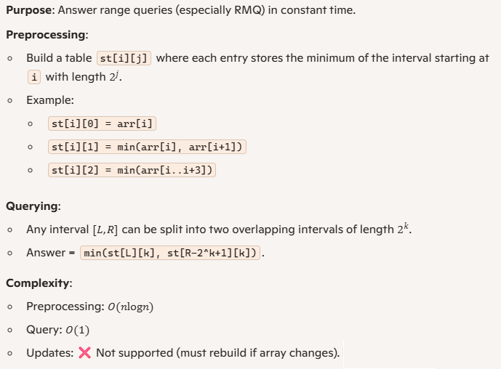
2. Non-Primitive – Non Linear Data Structures
Range Query Trees – Sparse Table – Range Minimum Query (RMQ)
Sparse Table

Slide 67

2. Non-Primitive – Non Linear Data Structures
Range Query Trees – Sparse Table – Range Minimum Query (RMQ)
Range Minimum Query (RMQ)
Definition: Given an array and a range [L,R], find the minimum element in that subarray.
Example:
Use Cases:
Competitive programming (fast queries on static arrays).
Applications in LCA (Lowest Common Ancestor) problems, string matching, and range analysis

Slide 68
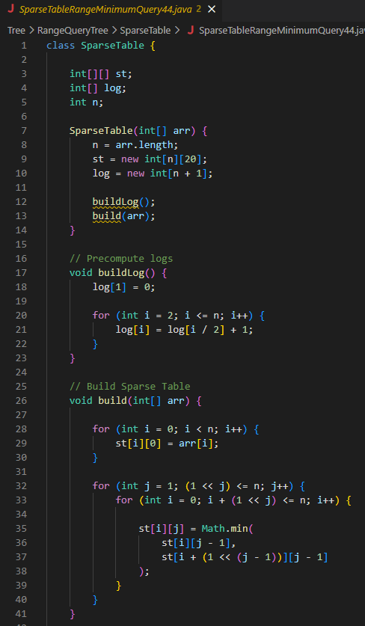
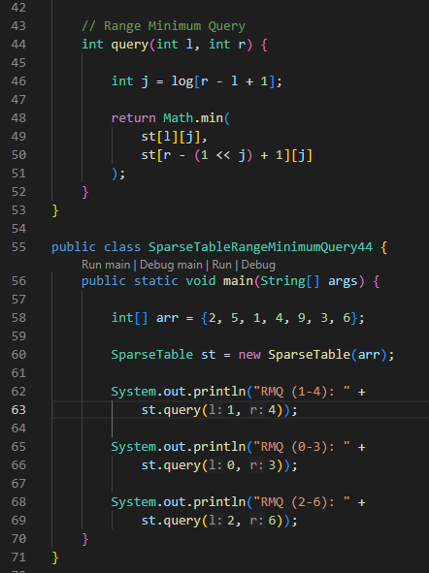
2. Non-Primitive – Non Linear Data Structures
Range Query Trees – Sparse Table – Range Minimum Query (RMQ)

Slide 69
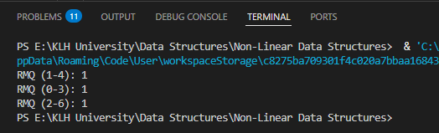
2. Non-Primitive – Non Linear Data Structures
Range Query Trees – Sparse Table – Range Minimum Query (RMQ)

Slide 70

2. Non-Primitive – Non Linear Data Structures
Range Query Trees – Sparse Table – Range Minimum Query (RMQ)
Inputs
The program takes an integer array as input.
Example:
This array is passed to the SparseTable constructor, which builds the data structure for answering Range Minimum Queries (RMQ).
Processing
The program builds a Sparse Table in two main steps:
Precompute Logs (buildLog)
Creates an array log[] where log[i] stores ⌊log⁡2(i)⌋.
This helps quickly determine the largest power of 2 that fits in a query range.
Example: log[7] = 2 because 22=4≤7.
Build Sparse Table (build)
Initializes st[i][0] = arr[i] (intervals of length 1).
Then fills higher powers of 2:
st[i][1] = min of 2 elements starting at i.
st[i][2] = min of 4 elements starting at i.
And so on.
This preprocessing takes O(nlog⁡n).
Query (query(l, r))
To answer RMQ, it finds the largest interval length 2j that fits inside [l,r].
Splits the range into two overlapping intervals of length 2j.
Returns the minimum of those two precomputed values.
Query time is O(1).

Slide 71

2. Non-Primitive – Non Linear Data Structures
Range Query Trees – Sparse Table – Range Minimum Query (RMQ)
Outputs
The program prints the results of RMQ queries:
RMQ(1,4) → minimum of arr[1..4] = min(5,1,4,9) = 1
RMQ(0,3) → minimum of arr[0..3] = min(2,5,1,4) = 1
RMQ(2,6) → minimum of arr[2..6] = min(1,4,9,3,6) = 1
So the output is:

Slide 72
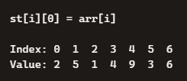
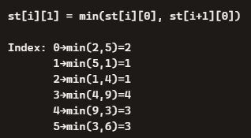
2. Non-Primitive – Non Linear Data Structures
Range Query Trees – Sparse Table – Range Minimum Query (RMQ)
Building the Sparse Table
We construct st[i][j] where:
i = starting index
j = interval length 2^{j}
Step 1: Intervals of length 1 (2⁰)
Directly copy the array:
Step 2: Intervals of length 2 (2¹)
Take min of consecutive pairs:

Slide 73
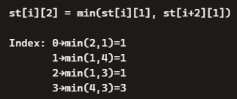

2. Non-Primitive – Non Linear Data Structures
Range Query Trees – Sparse Table – Range Minimum Query (RMQ)
Step 3: Intervals of length 4 (2²)
Take min of two blocks of length 2:
Step 4: Intervals of length 8 (2³)
Not possible here since array length = 7.
Query Examples
Query RMQ(1,4)
Range length = 4 → largest power of 2 ≤ 4 is 2²=4. Split into one block of length 4:
Answer = 1

Slide 74

2. Non-Primitive – Non Linear Data Structures
Range Query Trees – Sparse Table – Range Minimum Query (RMQ)
Query RMQ(2,6)
Range length = 5 → largest power of 2 ≤ 5 is 2²=4.
Split into two overlapping blocks of length 4:
Interval Length | Example Values Stored
1 (2^0) | [2, 5, 1, 4, 9, 3, 6]
2 (2^1) | [2, 1, 1, 4, 3, 3]
4 (2^2) | [1, 1, 1, 3]

Slide 75
2. Non-Primitive – Non Linear Data Structures
Range Query Trees – Sparse Table – Range Maximum Query (RMQ)
A Sparse Table for Range Maximum Query (RMQ) is a non-linear data structure that preprocesses an array in O(nlog⁡n) time and answers maximum queries over any subarray in O(1) time, but it only works for static arrays (no updates). It is ideal when you need repeated maximum lookups on immutable data.
Range Query Trees
Hierarchical structures (Segment Trees, Fenwick Trees, Sparse Tables).
Allow efficient queries over subranges of an array.
Non-linear because they organize data in tree-like or layered structures.

Slide 76


2. Non-Primitive – Non Linear Data Structures
Range Query Trees – Sparse Table – Range Maximum Query (RMQ)
Sparse Table
Purpose: Precompute answers for overlapping intervals of power-of-two lengths.
Construction:
st[i][0] = arr[i] (base case).
For j>0:
Querying:
Complexity:
Preprocessing: O(nlog⁡n)
Query: O(1)
Updates: ❌ Not supported.

Slide 77

2. Non-Primitive – Non Linear Data Structures
Range Query Trees – Sparse Table – Range Maximum Query (RMQ)
Range Maximum Query (RMQ)
Definition: Find the maximum element in a subarray [L,R].
Example:
Use Cases:
Competitive programming (fast queries on static arrays).
Applications in LCA (Lowest Common Ancestor), string matching, and range analysis.

Slide 78
2. Non-Primitive – Non Linear Data Structures
Range Query Trees – Sparse Table – Range Maximum Query (RMQ)
Comparison of Range Query Structures
Structure | Preprocessing | Query Time | Updates | Best Use Case
Naive Loop | None | O(n) | Yes | Small arrays, few queries
Segment Tree | O(n) | O(log⁡n) | Yes | Dynamic arrays with updates
Sparse Table | O(nlog⁡n) | O(1) | No | Static arrays, many queries

Slide 79
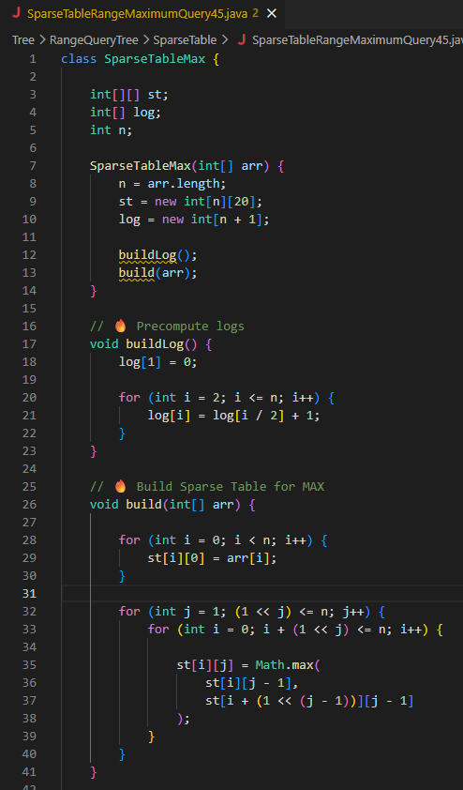
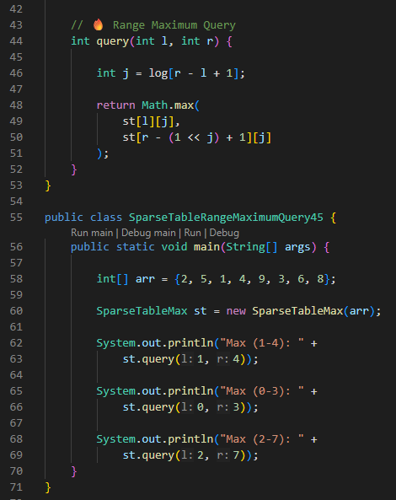
2. Non-Primitive – Non Linear Data Structures
Range Query Trees – Sparse Table – Range Maximum Query (RMQ)

Slide 80
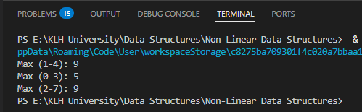
2. Non-Primitive – Non Linear Data Structures
Range Query Trees – Sparse Table – Range Maximum Query (RMQ)

Slide 81


2. Non-Primitive – Non Linear Data Structures
Range Query Trees – Sparse Table – Range Maximum Query (RMQ)
The program takes an integer array as input.
This array is passed to the SparseTableMax constructor, which builds the data structure for answering Range Maximum Queries (RMQ).
Outputs
The program prints the results of RMQ queries:
RMQ(1,4) → maximum of arr[1..4] = max(5,1,4,9) = 9
RMQ(0,3) → maximum of arr[0..3] = max(2,5,1,4) = 5
RMQ(2,7) → maximum of arr[2..7] = max(1,4,9,3,6,8) = 9
So the output is:

Slide 82
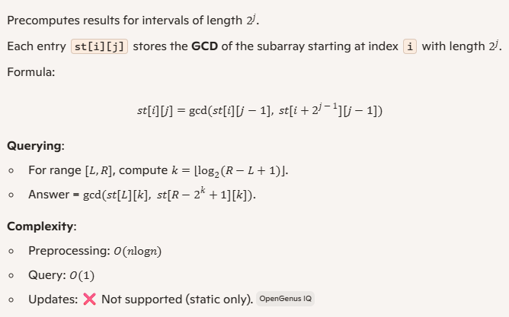
2. Non-Primitive – Non Linear Data Structures
Range Query Trees – Sparse Table – GCD
A Sparse Table for GCD is a non-linear range query data structure that preprocesses an array in O(nlog⁡n) and answers Range GCD queries in O(1). It is efficient for static arrays where updates are not required.
Range Query Trees
Organize data hierarchically for efficient subarray queries.
Examples: Segment Trees, Fenwick Trees, Sparse Tables.
Non-linear because they store overlapping intervals in tree-like structures.
Sparse Table

Slide 83
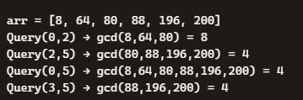
2. Non-Primitive – Non Linear Data Structures
Range Query Trees – Sparse Table – GCD
Range GCD Query
Definition: Find the greatest common divisor of all elements in a subarray [L,R].
Example:
Use Cases:
Number theory problems.
Cryptography and modular arithmetic.
Signal/image processing where divisibility patterns matter.

Slide 84
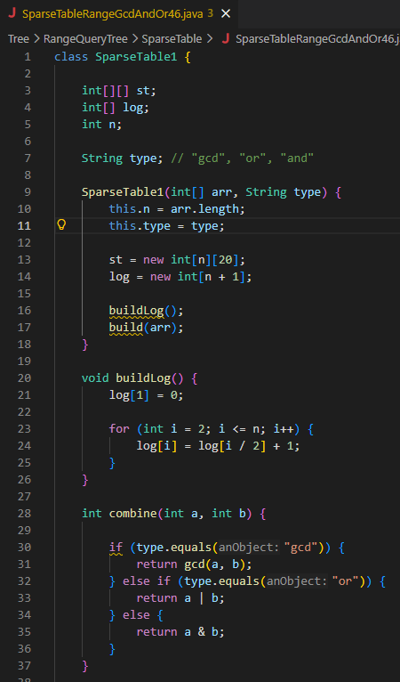
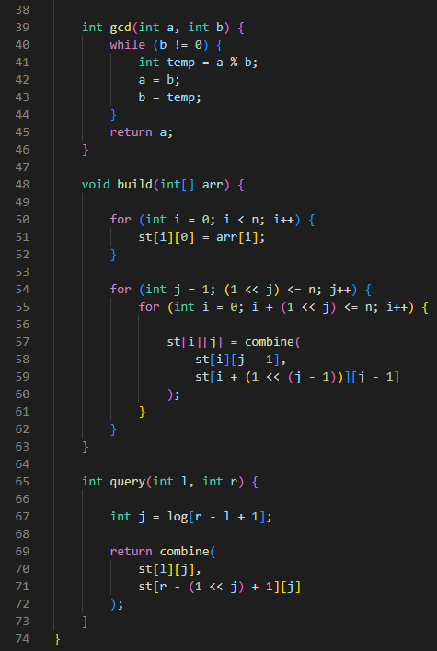
2. Non-Primitive – Non Linear Data Structures
Range Query Trees – Sparse Table – GCD

Slide 85
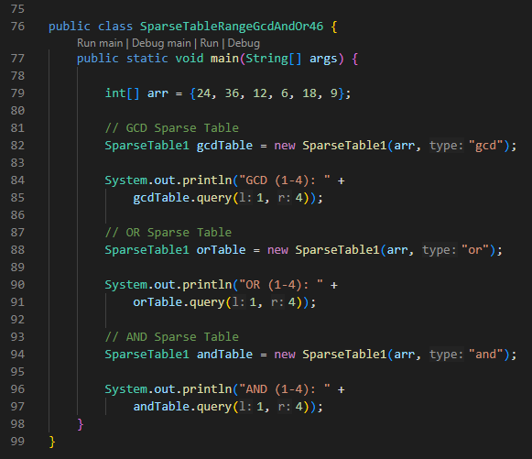
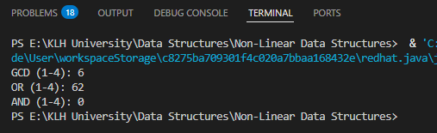
2. Non-Primitive – Non Linear Data Structures
Range Query Trees – Sparse Table – GCD

Slide 86

2. Non-Primitive – Non Linear Data Structures
Range Query Trees – Sparse Table – GCD
Inputs
Array of integers
This is the dataset on which range queries will be performed.
Operation type ("gcd", "or", "and")
"gcd" → Range Greatest Common Divisor
"or" → Range Bitwise OR
"and" → Range Bitwise AND
So the same Sparse Table logic is reused for different operations depending on the type.

Slide 87
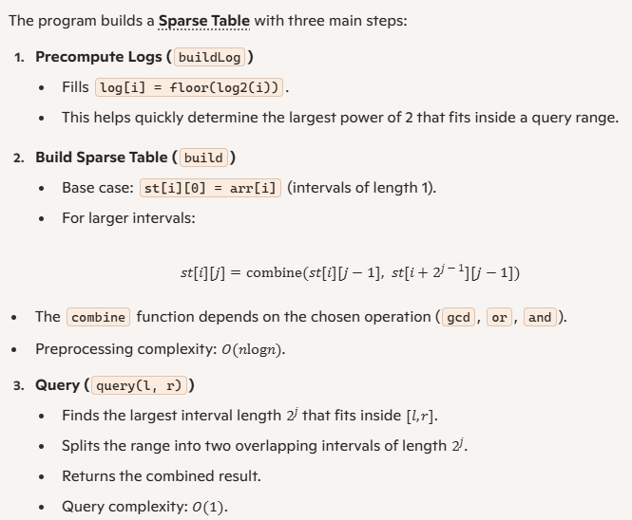
2. Non-Primitive – Non Linear Data Structures
Range Query Trees – Sparse Table – GCD
Processing

Slide 88


2. Non-Primitive – Non Linear Data Structures
Range Query Trees – Sparse Table – GCD
Outputs
The program runs three queries on the range [1,4] (indices inclusive):
GCD Table
Subarray: {36, 12, 6, 18}
GCD = 6
Output:
OR Table
Subarray: {36, 12, 6, 18}
Bitwise OR = 36 | 12 | 6 | 18 = 62
Output:
AND Table
Subarray: {36, 12, 6, 18}
Bitwise AND = 36 & 12 & 6 & 18 = 0
Output:

Slide 89
2. Non-Primitive – Non Linear Data Structures
Range Query Trees – Sparse Table – Properties - Static
1. Static Nature
Sparse Table is static, meaning once built, the underlying array cannot be updated efficiently.
Preprocessing is done in O(nlog⁡n), and queries are answered in O(1).
But if you change even one element in the array, you would need to rebuild the entire table.
This makes it ideal for immutable datasets where queries are frequent but updates are rare or nonexistent.
2. Associative Operations
Works only with idempotent and associative functions like:
Minimum (RMQ)
Maximum
GCD
Bitwise AND / OR
These operations allow overlapping intervals to be combined consistently.
3. Preprocessing vs Query Trade-off
Preprocessing: O(nlog⁡n) time and memory.
Query: O(1).
This trade-off is beneficial when the number of queries is very large compared to the preprocessing cost.

Slide 90
2. Non-Primitive – Non Linear Data Structures
Range Query Trees – Sparse Table – Properties - Static
4. Memory Usage
Requires O(nlog⁡n) space.
Each element is stored multiple times (for intervals of length 1, 2, 4, …).
More memory-heavy than Segment Trees (O(n)).
Structure | Preprocessing | Query Time | Updates | Best Use Case
Segment Tree | O(n) | O(log⁡n) | ✅ Yes | Dynamic arrays with updates
Fenwick Tree | O(n) | O(log⁡n) | ✅ Yes | Prefix sums, frequency tables
Sparse Table | O(nlog⁡n) | O(1) | ❌ No | Static arrays, many queries

Slide 91
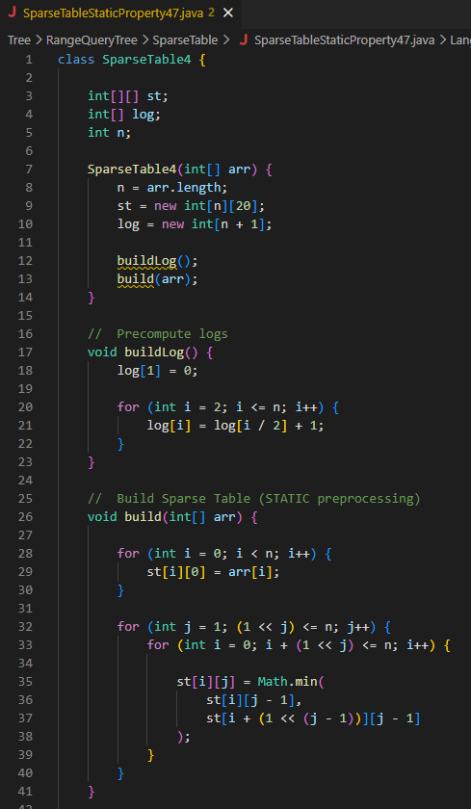
2. Non-Primitive – Non Linear Data Structures
Range Query Trees – Sparse Table – Properties - Static

Slide 92
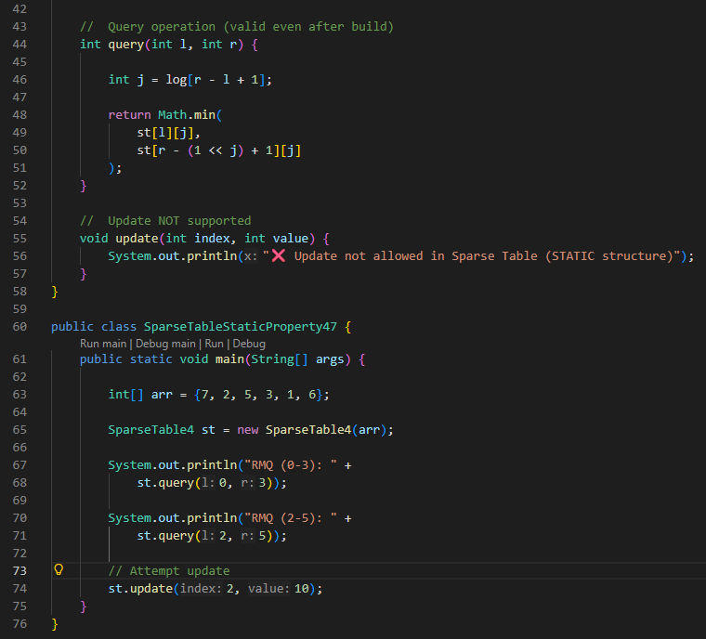
2. Non-Primitive – Non Linear Data Structures
Range Query Trees – Sparse Table – Properties - Static

Slide 93

2. Non-Primitive – Non Linear Data Structures
Range Query Trees – Sparse Table – Properties - Static

Slide 94

2. Non-Primitive – Non Linear Data Structures
Range Query Trees – Sparse Table – Properties - Static
Inputs
The program takes an integer array:
This array is passed to the SparseTable4 constructor.
The goal is to answer Range Minimum Queries (RMQ) efficiently.

Slide 95

2. Non-Primitive – Non Linear Data Structures
Range Query Trees – Sparse Table – Properties - Static
Processing

Slide 96


2. Non-Primitive – Non Linear Data Structures
Range Query Trees – Sparse Table – Properties - Static
Processing

Slide 97


2. Non-Primitive – Non Linear Data Structures
Range Query Trees – Sparse Table – Properties - Static
Outputs
The program runs two queries and one update attempt:
RMQ(0,3) → minimum of arr[0..3] = min(7,2,5,3) = 2
Output:
RMQ(2,5) → minimum of arr[2..5] = min(5,3,1,6) = 1
Output:
Update attempt → prints:

Slide 98
2. Non-Primitive – Non Linear Data Structures
Range Query Trees – Sparse Table – Idempotent Functions
Idempotent Functions
A function f is idempotent if applying it multiple times doesn’t change the result beyond the first application.
Formally: f(f(x,y),z) = f(x,y,z)
In the context of Sparse Tables, this means overlapping intervals can be combined without affecting correctness.
Examples of Idempotent Functions
Minimum: min⁡(min⁡(a,b),c)=min⁡(a,b,c)
Maximum: max⁡(max⁡(a,b),c)=max⁡(a,b,c)
GCD: gcd⁡(gcd⁡(a,b),c)=gcd⁡(a,b,c)
Bitwise AND / OR:
(a&b)&c=a&b&c
(a∣b)∣c=a∣b∣c
These are all idempotent and associative, which is why Sparse Tables can use them.

Slide 99
2. Non-Primitive – Non Linear Data Structures
Range Query Trees – Sparse Table – Idempotent Functions
Why Idempotence Matters in Sparse Table
Sparse Table answers queries by splitting a range [L,R] into two overlapping intervals of length 2^{k}.
If the function is idempotent, combining overlapping results still gives the correct answer.
Example:
Query [2,7] → split into intervals of length 4: [2,5] and [4,7].
Even though they overlap at index 4–5, idempotence ensures correctness.
Properties of Sparse Table with Idempotent Functions
Static: Works only on immutable arrays (updates not supported).
Preprocessing: O(nlog⁡n).
Query: O(1).
Memory: O(nlog⁡n).
Operations supported: Only idempotent ones (min, max, gcd, AND, OR).
Not supported: Non-idempotent operations like sum or XOR (because overlapping intervals would double-count).

Slide 100


2. Non-Primitive – Non Linear Data Structures
Range Query Trees – Sparse Table – Idempotent Functions

Slide 101


2. Non-Primitive – Non Linear Data Structures
Range Query Trees – Sparse Table – Idempotent Functions

Slide 102

2. Non-Primitive – Non Linear Data Structures
Range Query Trees – Sparse Table – Idempotent Functions
Inputs
Array of integers
This is the dataset on which range queries will be performed.
Operation type ("min", "max", "and", "gcd")
"min" → Range Minimum Query
"max" → Range Maximum Query
"and" → Range Bitwise AND
"gcd" → Range Greatest Common Divisor
So the same Sparse Table framework is reused for different idempotent functions.

Slide 103

2. Non-Primitive – Non Linear Data Structures
Range Query Trees – Sparse Table – Idempotent Functions
Processing

Slide 104



2. Non-Primitive – Non Linear Data Structures
Range Query Trees – Sparse Table – Idempotent Functions
Outputs
The program runs three queries:
MIN (1–4)
Subarray: {2, 8, 1, 3}
Minimum = 1
Output:
MAX (0–3)
Subarray: {5, 2, 8, 1}
Maximum = 8
Output:
AND (0–2)
Subarray: {5, 2, 8}
Bitwise AND = 5 & 2 & 8 = 0
Output:

Slide 105
2. Non-Primitive – Non Linear Data Structures
Range Query Trees – Sparse Table – Preprocessing O(n log n)
Range Query Trees – Sparse Table – Preprocessing
1. Sparse Table Basics
Sparse Table is a static range query structure.
It precomputes answers for intervals of length 2j.
Once built, queries are answered in O(1).
But building the table requires preprocessing.

Slide 106

2. Non-Primitive – Non Linear Data Structures
Range Query Trees – Sparse Table – Preprocessing O(n log n)
Range Query Trees – Sparse Table – Preprocessing
2. Preprocessing Complexity

Slide 107

2. Non-Primitive – Non Linear Data Structures
Range Query Trees – Sparse Table – Preprocessing O(n log n)
Range Query Trees – Sparse Table – Preprocessing
3. Why O(n log n)?

Slide 108
2. Non-Primitive – Non Linear Data Structures
Range Query Trees – Sparse Table – Preprocessing O(n log n)
Range Query Trees – Sparse Table – Preprocessing
Properties of Preprocessing
Static: Once built, queries are fast but updates are not supported.
Memory: O(nlog⁡n) space to store all intervals.
Query: O(1) because only two precomputed intervals are combined.
Trade-off: Heavy preprocessing upfront, but lightning-fast queries later.
Structure | Preprocessing | Query Time | Updates | Best Use Case
Segment Tree | O(n) | O(log⁡n) | ✅ Yes | Dynamic arrays
Fenwick Tree | O(n) | O(log⁡n) | ✅ Yes | Prefix sums
Sparse Table | O(nlog⁡n) | O(1) | ❌ No | Static arrays, many queries

Slide 109


2. Non-Primitive – Non Linear Data Structures
Range Query Trees – Sparse Table – Preprocessing O(n log n)

Slide 110

2. Non-Primitive – Non Linear Data Structures
Range Query Trees – Sparse Table – Preprocessing O(n log n)

Slide 111
2. Non-Primitive – Non Linear Data Structures
Range Query Trees – Sparse Table – Preprocessing O(n log n)
Inputs
The program takes an integer array:
This array is passed to the SparseTable6 constructor.
The goal is to answer Range Minimum Queries (RMQ) efficiently.

Slide 112

2. Non-Primitive – Non Linear Data Structures
Range Query Trees – Sparse Table – Preprocessing O(n log n)
Processing

Slide 113



2. Non-Primitive – Non Linear Data Structures
Range Query Trees – Sparse Table – Preprocessing O(n log n)
Outputs
The program runs three queries:
RMQ(1,4) → minimum of arr[1..4] = min(2,8,3,1) = 1
Output:
RMQ(0,5) → minimum of arr[0..5] = min(6,2,8,3,1,7) = 1
Output:
RMQ(2,3) → minimum of arr[2..3] = min(8,3) = 3
Output:

Slide 114

2. Non-Primitive – Non Linear Data Structures
Range Query Trees – Sparse Table – Variants – 2D Sparse Table
A 2D Sparse Table is a variant of the Sparse Table designed for matrices, allowing fast range queries (like minimum, maximum, or GCD) over subrectangles in constant time after heavy preprocessing. It is static, meaning updates are not supported, but queries are extremely efficient.

Slide 115

2. Non-Primitive – Non Linear Data Structures
Range Query Trees – Sparse Table – Variants – 2D Sparse Table

Slide 116

2. Non-Primitive – Non Linear Data Structures
Range Query Trees – Sparse Table – Variants – 2D Sparse Table

Slide 117

2. Non-Primitive – Non Linear Data Structures
Range Query Trees – Sparse Table – Variants – 2D Sparse Table
4. Example
Matrix:
Queries:
Min(0,0 → 3,3) → minimum of entire matrix = 1
Min(1,1 → 2,2) → submatrix = {2,9,4,7} → minimum = 2

Slide 118

2. Non-Primitive – Non Linear Data Structures
Range Query Trees – Sparse Table – Variants – 2D Sparse Table
Variant | Preprocessing | Query Time | Updates | Best Use Case
1D Sparse Table | O(nlog⁡n) | O(1) | ❌ No | Static arrays
2D Sparse Table | O(nmlog⁡nlog⁡m) | O(1) | ❌ No | Static matrices
Segment Tree 2D | O(nm) | O(log⁡nlog⁡m) | ✅ Yes | Dynamic matrices

Slide 119


2. Non-Primitive – Non Linear Data Structures
Range Query Trees – Sparse Table – Variants – 2D Sparse Table

Slide 120

2. Non-Primitive – Non Linear Data Structures
Range Query Trees – Sparse Table – Variants – 2D Sparse Table

Slide 121


2. Non-Primitive – Non Linear Data Structures
Range Query Trees – Sparse Table – Variants – 2D Sparse Table

Slide 122

2. Non-Primitive – Non Linear Data Structures
Range Query Trees – Sparse Table – Variants – 2D Sparse Table
Inputs
The program takes a 2D integer matrix:
This matrix is passed to the SparseTable2D constructor.
The goal is to answer 2D Range Minimum Queries efficiently.

Slide 123

2. Non-Primitive – Non Linear Data Structures
Range Query Trees – Sparse Table – Variants – 2D Sparse Table
Processing

Slide 124




2. Non-Primitive – Non Linear Data Structures
Range Query Trees – Sparse Table – Variants – 2D Sparse Table
Outputs
The program runs two queries:
1. Min(0,0 → 2,2)
Submatrix = entire 3×3 matrix
Minimum = 1
Output:
2. Min(0,1 → 2,2)
Submatrix =
Minimum = 2
Output:

Slide 125

2. Non-Primitive – Non Linear Data Structures
Range Query Trees – Sparse Table – Variants – Disjoint Sparse Table
A Disjoint Sparse Table is a variant of the Sparse Table that supports a wider range of operations (like sum, min, max, gcd) in O(1) query time with O(nlog⁡n) preprocessing, by storing precomputed results in disjoint blocks rather than overlapping intervals. It is still static (no updates), but more flexible than the classic Sparse Table.

Slide 126

2. Non-Primitive – Non Linear Data Structures
Range Query Trees – Sparse Table – Variants – Disjoint Sparse Table

Slide 127

2. Non-Primitive – Non Linear Data Structures
Range Query Trees – Sparse Table – Variants – Disjoint Sparse Table

Slide 128
2. Non-Primitive – Non Linear Data Structures
Range Query Trees – Sparse Table – Variants – Disjoint Sparse Table
Variant | Pre-processing | Query Time | Updates | Supported Ops
Classic Sparse Table | O(nlog⁡n) | O(1) | ❌ No | Idempotent (min, max, gcd, AND, OR)
Disjoint Sparse Table | O(nlog⁡n) | O(1) | ❌ No | Any associative (sum, min, max, gcd, XOR)
Segment Tree | O(n) | O(log⁡n) | ✅ Yes | Any associative

Slide 129


2. Non-Primitive – Non Linear Data Structures
Range Query Trees – Sparse Table – Variants – Disjoint Sparse Table

Slide 130


2. Non-Primitive – Non Linear Data Structures
Range Query Trees – Sparse Table – Variants – Disjoint Sparse Table

Slide 131

2. Non-Primitive – Non Linear Data Structures
Range Query Trees – Sparse Table – Variants – Disjoint Sparse Table
Inputs
The program takes an integer array:
This array is passed to the DisjointSparseTable constructor.
The goal is to answer range sum queries efficiently using the Disjoint Sparse Table.

Slide 132

2. Non-Primitive – Non Linear Data Structures
Range Query Trees – Sparse Table – Variants – Disjoint Sparse Table
Processing

Slide 133

2. Non-Primitive – Non Linear Data Structures
Range Query Trees – Sparse Table – Variants – Disjoint Sparse Table
Processing

Slide 134


2. Non-Primitive – Non Linear Data Structures
Range Query Trees – Sparse Table – Variants – Disjoint Sparse Table
Outputs
The program runs three queries:
Sum(1–4)
Subarray: {2, 3, 4, 5}
Sum = 14
Output:
Sum(0–5)
Subarray: {1, 2, 3, 4, 5, 6}
Sum = 21
Output:
Sum(2–3)
Subarray: {3, 4}
Sum = 7
Output:

Slide 135


2. Non-Primitive – Non Linear Data Structures
Range Query Trees – Sparse Table – Variants – Precompute Powers of 2

Slide 136

2. Non-Primitive – Non Linear Data Structures
Range Query Trees – Sparse Table – Variants – Precompute Powers of 2

Slide 137

2. Non-Primitive – Non Linear Data Structures
Range Query Trees – Sparse Table – Variants – Precompute Powers of 2

Slide 138
2. Non-Primitive – Non Linear Data Structures
Range Query Trees – Sparse Table – Variants – Precompute Powers of 2
Variant | Preprocessing | Query Time | Updates | Notes
Classic Sparse Table | O(nlog⁡n) | O(1) | ❌ No | Computes logs/powers on the fly
Precompute Powers of 2 | O(nlog⁡n) | O(1) | ❌ No | Faster queries due to precomputed logs/powers

Slide 139


2. Non-Primitive – Non Linear Data Structures
Range Query Trees – Sparse Table – Variants – Precompute Powers of 2

Slide 140

2. Non-Primitive – Non Linear Data Structures
Range Query Trees – Sparse Table – Variants – Precompute Powers of 2

Slide 141

2. Non-Primitive – Non Linear Data Structures
Range Query Trees – Sparse Table – Variants – Precompute Powers of 2
Inputs
The program takes an integer array:
This array is passed to the SparseTable4 constructor.
The goal is to answer Range Minimum Queries (RMQ) efficiently.

Slide 142

2. Non-Primitive – Non Linear Data Structures
Range Query Trees – Sparse Table – Variants – Precompute Powers of 2
Processing

Slide 143



2. Non-Primitive – Non Linear Data Structures
Range Query Trees – Sparse Table – Variants – Precompute Powers of 2
Outputs
The program runs three queries:
RMQ(1,4) → minimum of arr[1..4] = min(2,5,3,1) = 1
Output:
RMQ(0,5) → minimum of arr[0..5] = min(7,2,5,3,1,6) = 1
Output:
RMQ(2,3) → minimum of arr[2..3] = min(5,3) = 3
Output:

