Slide 1

2. Non-Primitive – Non Linear Data Structures
Range Query Trees – Range Tree – Dimensions – 1D Range Tree
A 1D Range Tree is essentially a balanced binary search tree built on a set of points along a single dimension, designed to efficiently answer range queries (finding all points within an interval). It supports queries in O(log⁡n+k) time, where n is the number of points and k is the number of reported results.
What is a Range Tree?
Range queries: Retrieve all points that lie within a given interval (e.g., all values between 10 and 30).
Range tree: A hierarchical data structure that organizes points to answer these queries efficiently.
Dimensions: A range tree can be extended to multiple dimensions (2D, 3D, etc.), but the simplest case is 1D.
1D Range Tree – Structure
Balanced BST: A 1D range tree is a balanced binary search tree (like AVL or Red-Black Tree).
Leaves: Store the actual data points.
Internal nodes: Each node stores the largest value in its left subtree, which helps in efficient traversal.
Construction: Built in O(nlog⁡n) time for n points.

Slide 2
2. Non-Primitive – Non Linear Data Structures
Range Query Trees – Range Tree – Dimensions – 1D Range Tree
Querying in 1D Range Tree
Process:
Compare query interval with node ranges.
Traverse left or right depending on overlap.
Collect points that fall within the interval.
Complexity: O(log⁡n+k), where:
log⁡n is the search overhead.
k is the number of points reported

Slide 3
2. Non-Primitive – Non Linear Data Structures
Range Query Trees – Range Tree – Dimensions – 1D Range Tree
Concept | Definition | Complexity | Use Case
1D Range Tree | Balanced BST storing points in one dimension | Query: O(log⁡n+k), Space: O(n) | Interval queries on a line
2D Range Tree | Recursive BST: first on x, then y | Query: O(log^{⁡2}n+k), Space: O(nlog⁡n) | Rectangular queries in a plane
Segment Tree | Tree storing aggregate info over ranges | Query: O(log⁡n), Space: O(n) | Range sums, min/max
Fenwick Tree | Binary Indexed Tree for prefix sums | Query: O(log⁡n), Space: O(n) | Dynamic cumulative frequency
1D Range Tree = BST: It’s essentially a binary search tree with extra stored info for efficient range queries.
Trade-off: Faster queries than naive search, but higher space usage compared to simpler structures.
Extension: In higher dimensions, each node stores an associated range tree for the remaining dimensions.

Slide 4
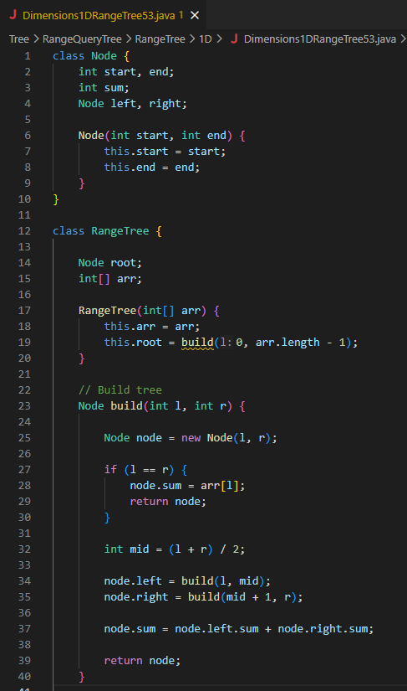
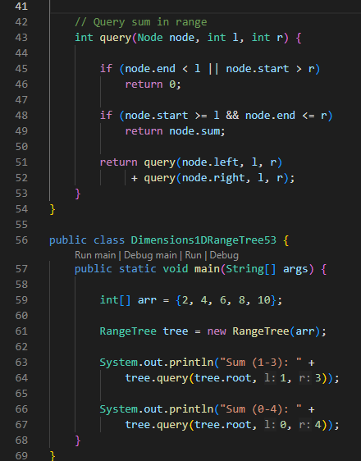
2. Non-Primitive – Non Linear Data Structures
Range Query Trees – Range Tree – Dimensions – 1D Range Tree

Slide 5
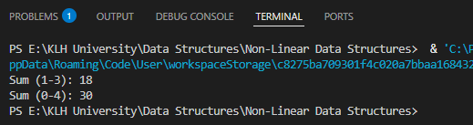
2. Non-Primitive – Non Linear Data Structures
Range Query Trees – Range Tree – Dimensions – 1D Range Tree

Slide 6
2. Non-Primitive – Non Linear Data Structures
Range Query Trees – Range Tree – Dimensions – 1D Range Tree
Inputs
Array arr: {2, 4, 6, 8, 10}
This is the dataset we want to query sums over.
Queries:
tree.query(tree.root, 1, 3) → sum of elements from index 1 to 3.
tree.query(tree.root, 0, 4) → sum of elements from index 0 to 4.

Slide 7
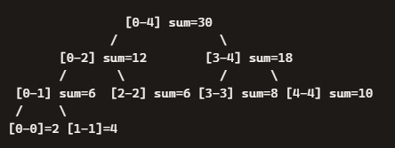
2. Non-Primitive – Non Linear Data Structures
Range Query Trees – Range Tree – Dimensions – 1D Range Tree
Processing – Building the Tree
The program builds a segment tree (called RangeTree here).
Recursive Build (build(l, r)):
Each node represents a segment [l, r] of the array.
If l == r → leaf node, stores arr[l].
Otherwise:
Split into two halves: [l, mid] and [mid+1, r].
Recursively build left and right children.
Store sum = left.sum + right.sum.
So the tree structure for {2,4,6,8,10} looks like:

Slide 8
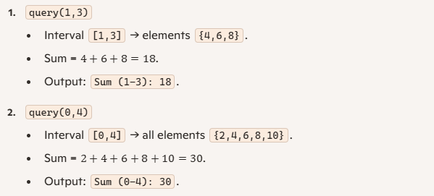
2. Non-Primitive – Non Linear Data Structures
Range Query Trees – Range Tree – Dimensions – 1D Range Tree
Querying
The query(node, l, r) function finds the sum of values in the interval [l, r].
Case 1: No overlap → return 0.
Case 2: Full overlap → return node.sum.
Case 3: Partial overlap → recurse into left and right children, add results.
Outputs

Slide 9
2. Non-Primitive – Non Linear Data Structures
Range Query Trees – Range Tree – Dimensions – 2D Range Tree
A 2D Range Tree is a multi-level binary search tree that efficiently answers rectangular range queries in the plane. It organizes points first by their x-coordinates, and at each node stores a secondary tree on y-coordinates, enabling queries in O(log⁡²n+k) time with O(nlog⁡n) space.
What is a 2D Range Tree?
Range queries: Retrieve all points within a rectangular region [x₁,x₂]×[y₁,y₂].
Range tree: A recursive structure where each level indexes one dimension.
2D case: First level is a balanced BST on x-coordinates. Each node stores an associated 1D range tree on y-coordinates for points in its subtree.
Structure of a 2D Range Tree
Primary tree (X-axis):
Balanced BST built on x-coordinates.
Each node splits points into left (≤ median x) and right (> median x).
Secondary tree (Y-axis):
At each node, build a 1D range tree on y-coordinates of points in that node’s subtree.
Enables efficient filtering by y-range once x-range is narrowed.

Slide 10
2. Non-Primitive – Non Linear Data Structures
Range Query Trees – Range Tree – Dimensions – 2D Range Tree
Querying in 2D Range Tree
Input: Rectangle [x₁,x₂]×[y₁,y₂].
Process:
Search primary tree to find nodes covering [x₁,x₂].
For each relevant node, query its secondary y-tree for [y₁,y₂].
Collect all points satisfying both conditions.
Complexity: O(log^{⁡2}n+k), where:
log⁡²n is search overhead.
k is number of reported points.

Slide 11
2. Non-Primitive – Non Linear Data Structures
Range Query Trees – Range Tree – Dimensions – 2D Range Tree
Concept | Definition | Query Complexity | Space Complexity | Use Case
1D Range Tree | BST on one dimension | O(log⁡n+k) | O(n) | Interval queries on a line
2D Range Tree | BST on x, with y-tree at each node | O(log⁡²n+k) | O(nlog⁡n) | Rectangular queries in plane
Segment Tree | Tree storing aggregates | O(log⁡n) | O(n) | Range sums/min/max
Fenwick Tree | Binary Indexed Tree | O(log⁡n) | O(n) | Prefix sums, frequency counts

Slide 12
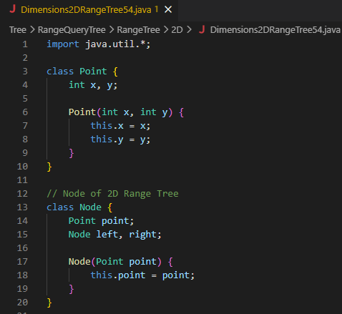
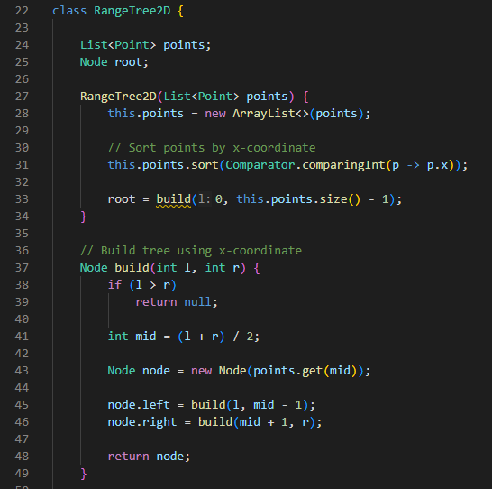
2. Non-Primitive – Non Linear Data Structures
Range Query Trees – Range Tree – Dimensions – 2D Range Tree

Slide 13
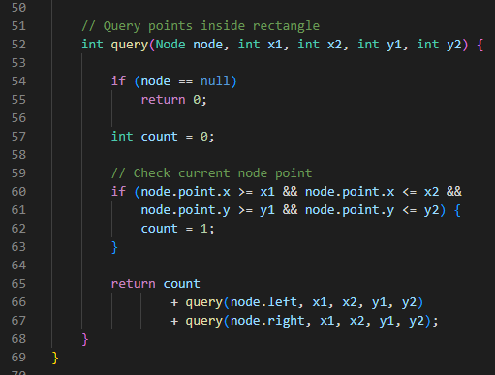
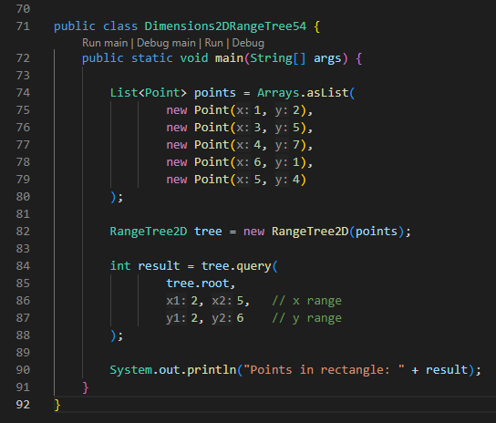
2. Non-Primitive – Non Linear Data Structures
Range Query Trees – Range Tree – Dimensions – 2D Range Tree

Slide 14
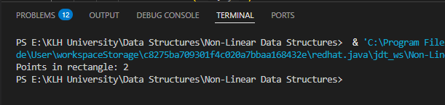
2. Non-Primitive – Non Linear Data Structures
Range Query Trees – Range Tree – Dimensions – 2D Range Tree

Slide 15

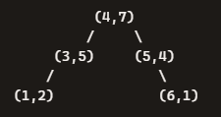
2. Non-Primitive – Non Linear Data Structures
Range Query Trees – Range Tree – Dimensions – 2D Range Tree
Inputs
Points list:
Query rectangle:
X range: [2, 5]
Y range: [2, 6]
So the query is asking: How many points lie inside the rectangle defined by x between 2 and 5, and y between 2 and 6?
Processing – Building the Tree
Sorting:
Points are sorted by x-coordinate:
→ (1,2), (3,5), (4,7), (5,4), (6,1)
Tree construction (build(l, r)):
Recursively pick the middle point as the node.
Left subtree = points left of mid.
Right subtree = points right of mid.
This creates a balanced BST on x-coordinates.
Example structure (simplified):

Slide 16

2. Non-Primitive – Non Linear Data Structures
Range Query Trees – Range Tree – Dimensions – 2D Range Tree
Querying
The query(node, x1, x2, y1, y2) function:
Checks if the current node’s point lies inside the rectangle.
If yes → count = 1.
Recursively checks left and right children.
Adds up counts.
Outputs
Query rectangle: x ∈ [2,5], y ∈ [2,6].
Points inside:
(3,5) ✅ (x=3, y=5)
(5,4) ✅ (x=5, y=4)
Other points are outside either x or y range.
So total count = 2.
Output:

Slide 17
2. Non-Primitive – Non Linear Data Structures
Range Query Trees – Range Tree – Dimensions – KD Range Tree
A KD Range Tree (or KD-tree) is a space-partitioning data structure that organizes points in k-dimensional space by recursively splitting along coordinate axes. It is widely used for efficient multidimensional range queries and nearest-neighbor searches, with average query time around O(log⁡n+k).
What is a KD Range Tree?
KD-tree: A binary tree where each node represents a point in k-dimensional space.
Splitting rule: At each level, the dataset is split by a hyperplane perpendicular to one coordinate axis.
Recursive structure: The splitting axis cycles through dimensions (x, y, z, …).
Purpose: Efficiently answer range queries (points inside a multidimensional box) and nearest-neighbor searches.
Construction of KD Range Tree
Choose axis: At depth d, split along axis dmod k.
Find median: Select the median point along that axis.
Partition points: Left child = points left of median, right child = points right of median.
Repeat recursively until each node has 1 point or a small subset.
This ensures the tree is balanced, with depth about log⁡n.

Slide 18
2. Non-Primitive – Non Linear Data Structures
Range Query Trees – Range Tree – Dimensions – KD Range Tree
Querying in KD Range Tree
Range query: Given a hyper-rectangle [x₁,x₂]×[y₁,y₂]×…, traverse the tree:
If the splitting hyperplane lies outside the query range, prune that branch.
If inside, recurse into both children.
Collect points that lie within the query box.
Complexity: O(log⁡n+k) average, but worst-case can be O(n) if query covers most of the space.
Structure | Split Rule | Query Complexity | Space Complexity | Use Case
1D Range Tree | Balanced BST on one axis | O(log⁡n+k) | O(n) | Interval queries
2D Range Tree | BST on x, y-tree at each node | O(log⁡2n+k) | O(nlog⁡n) | Rectangular queries
KD Range Tree | Axis-aligned hyperplane splits | O(log⁡n+k) avg | O(n) | Multidimensional queries, nearest neighbors

Slide 19
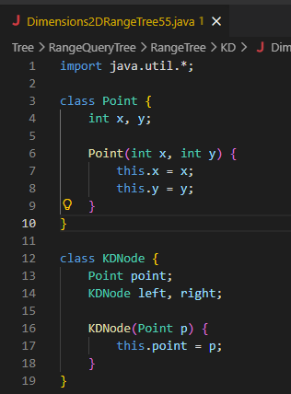
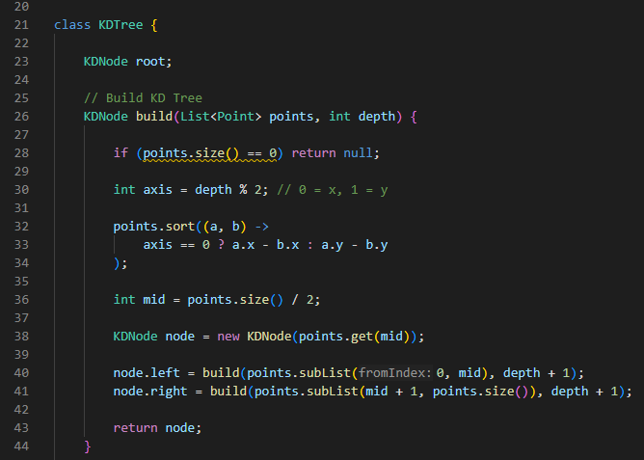
2. Non-Primitive – Non Linear Data Structures
Range Query Trees – Range Tree – Dimensions – KD Range Tree

Slide 20
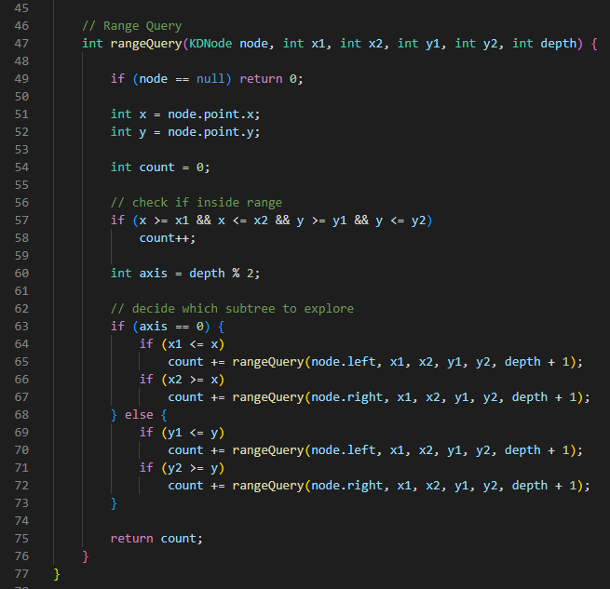
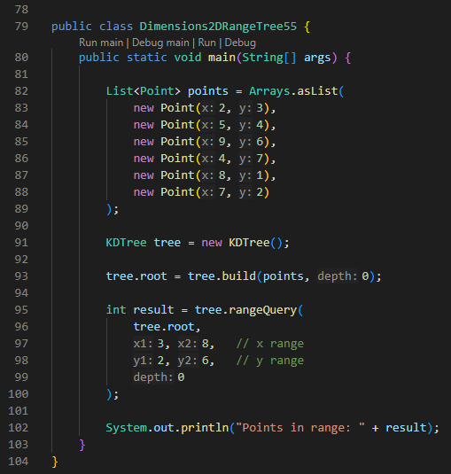
2. Non-Primitive – Non Linear Data Structures
Range Query Trees – Range Tree – Dimensions – KD Range Tree

Slide 21
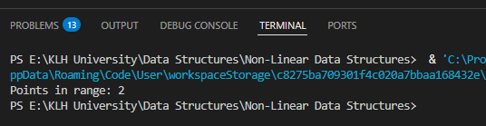
2. Non-Primitive – Non Linear Data Structures
Range Query Trees – Range Tree – Dimensions – KD Range Tree

Slide 22

2. Non-Primitive – Non Linear Data Structures
Range Query Trees – Range Tree – Dimensions – KD Range Tree
Inputs
Points list:
Query rectangle:
X range: [3, 8]
Y range: [2, 6]
So the query is asking: How many points lie inside the rectangle defined by x between 3 and 8, and y between 2 and 6?

Slide 23
2. Non-Primitive – Non Linear Data Structures
Range Query Trees – Range Tree – Dimensions – KD Range Tree
Processing – Building the KD-tree
Recursive build (build(points, depth)):
At each depth, choose an axis:
Depth % 2 = 0 → split by x.
Depth % 2 = 1 → split by y.
Sort points by that axis.
Pick the median as the node.
Recursively build left and right subtrees.
This produces a balanced KD-tree where each level alternates between x and y splits.

Slide 24
2. Non-Primitive – Non Linear Data Structures
Range Query Trees – Range Tree – Dimensions – KD Range Tree
Querying
The rangeQuery(node, x1, x2, y1, y2, depth) function:
Checks if the current node’s point lies inside the rectangle.
If yes → count++.
Decides which subtree(s) to explore based on the splitting axis:
If splitting by x:
Explore left if x1 <= node.x.
Explore right if x2 >= node.x.
If splitting by y:
Explore left if y1 <= node.y.
Explore right if y2 >= node.y.
This pruning avoids searching irrelevant branches.

Slide 25

2. Non-Primitive – Non Linear Data Structures
Range Query Trees – Range Tree – Dimensions – KD Range Tree
Outputs
Query rectangle: x ∈ [3,8], y ∈ [2,6].
Points inside:
(5,4)
(7,2)
Other points are outside either x or y range.
So total count = 2.
Output:

Slide 26
2. Non-Primitive – Non Linear Data Structures
Range Query Trees – Range Tree – Optimization – Fractional Cascading
Fractional Cascading is an optimization technique for Range Trees that reduces query time by avoiding repeated binary searches across multiple sorted lists. It improves multidimensional range queries from O(log⁡^{d}n+k) to O(log⁡^{d−1}n+k), making Range Trees significantly faster in practice.
Range Trees and the Bottleneck
Range Trees: Used for orthogonal range searching in d-dimensions.
Query complexity without optimization:
O(log⁡^{d}n+k), where n = number of points, k = number of reported results.
Problem: At each level of the tree, we perform a binary search in an associated sorted list (e.g., y-coordinates at nodes in a 2D tree). This repetition costs extra log⁡n factors.
Fractional Cascading – The Idea
Repeated search problem: We need to search for the same key across multiple sorted lists.
Naïve approach: Perform binary search independently in each list → costly.
Fractional Cascading:
Merge lists by duplicating every other element from one list into the previous list.
Add bridges (pointers) between elements in adjacent lists.
After one binary search in the first list, subsequent searches in other lists can be done in constant time by following these bridges.

Slide 27
2. Non-Primitive – Non Linear Data Structures
Range Query Trees – Range Tree – Optimization – Fractional Cascading
How It Works in Range Trees
Build layered range tree: At each node, store a sorted list of points by the secondary coordinate (e.g., y).
Apply fractional cascading: Link these lists across levels with bridges.
Query process:
Perform one binary search at the top level.
Use bridges to cascade results down to child lists in O(1) per level.
Resulting complexity:
Query time improves to O(log⁡^{d−1}n+k).
Space complexity remains O(nlog⁡^{d−1}n).
Structure | Query Time | Space | Notes
Range Tree | O(log⁡^{d}n+k) | O(nlog⁡^{d−1}n) | Multiple binary searches per level
Range Tree + Fractional Cascading | O(log⁡^{d−1}n+k) | O(nlog⁡^{d−1}n) | One binary search + constant-time cascades
KD-tree | Avg O(log⁡n+k), worst O(n) | O(n) | Simpler, but weaker worst-case guarantees

Slide 28
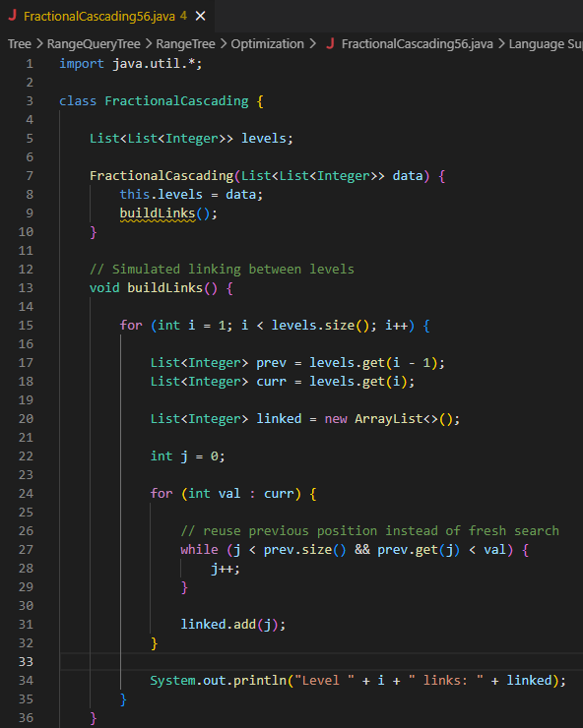
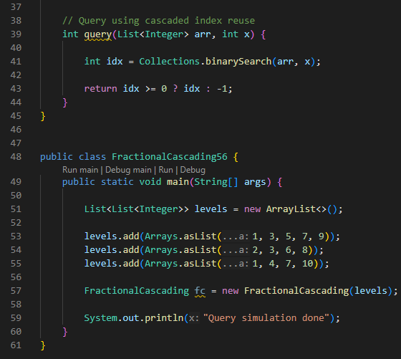
2. Non-Primitive – Non Linear Data Structures
Range Query Trees – Range Tree – Optimization – Fractional Cascading

Slide 29
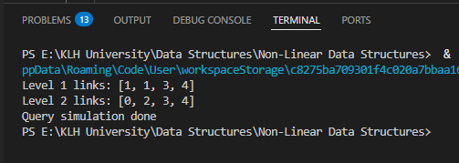
2. Non-Primitive – Non Linear Data Structures
Range Query Trees – Range Tree – Optimization – Fractional Cascading

Slide 30

2. Non-Primitive – Non Linear Data Structures
Range Query Trees – Range Tree – Optimization – Fractional Cascading
This program is a simulation of fractional cascading — it shows how links between multiple sorted lists can reduce repeated binary searches when answering range queries.
Inputs
Levels of sorted lists:
These represent different “layers” of data (like y-coordinate lists stored at nodes in a range tree).

Slide 31
2. Non-Primitive – Non Linear Data Structures
Range Query Trees – Range Tree – Optimization – Fractional Cascading
Processing
Build links (buildLinks):
For each level after the first, it compares elements of the current list with the previous list.
It records the index position in the previous list where each current element would fit.
This simulates the bridge pointers of fractional cascading.
Example:
For Level 1 [2,3,6,8] against Level 0 [1,3,5,7,9]:
2 fits after index 1 → link = 1
3 fits at index 1 → link = 1
6 fits after index 3 → link = 3
8 fits after index 4 → link = 4
→ Output: Level 1 links: [1, 1, 3, 4]
Query (query):
Performs a binary search in one list for a given value x.
In a full fractional cascading setup, you’d only do this once, then reuse the linked indices to cascade down other lists in constant time.
Here, it just demonstrates the binary search part.

Slide 32


2. Non-Primitive – Non Linear Data Structures
Range Query Trees – Range Tree – Optimization – Fractional Cascading
Outputs
During construction, it prints the link arrays for each level:
Finally, it prints:
(No actual query results are shown in main, but the query method is available to test searching with cascading.)

Slide 33
2. Non-Primitive – Non Linear Data Structures
Range Query Trees – Range Tree – Types - Static
A Static Range Tree is a type of range tree built once from a fixed set of points and never updated. It is optimized for fast queries, not for dynamic insertions or deletions, making it ideal when the dataset is immutable.
What is a Static Range Tree?
Range tree: A multi-level binary search tree used for efficient multidimensional range queries.
Static variant: Constructed from a fixed dataset; no updates allowed.
Key property: Since the structure doesn’t change, it can be heavily optimized for query speed.
Construction
Process:
Build a balanced BST on the first dimension (e.g., x-coordinates).
At each node, store an associated range tree for the remaining dimensions (e.g., y-coordinates).
Continue recursively until all dimensions are covered.
Time complexity: O(nlog^{⁡d−1}n) for n points in d-dimensions.
Space complexity: O(nlog⁡^{d−1}n).

Slide 34
2. Non-Primitive – Non Linear Data Structures
Range Query Trees – Range Tree – Types - Static
Querying
Input: A query rectangle (or hyper-rectangle in higher dimensions).
Process:
Traverse the primary tree to find nodes overlapping the query interval.
Use associated secondary trees to filter points in other dimensions.
Complexity:
Without optimization: O(log⁡^{d}n+k).
With fractional cascading: O(log⁡^{d−1}n+k).
k = number of reported points.

Slide 35
2. Non-Primitive – Non Linear Data Structures
Range Query Trees – Range Tree – Types - Static
Type | Updates Allowed | Query Time | Space | Best Use Case
Static Range Tree | ❌ No | O(log⁡^{d}n+k) (or O(log^{⁡d−1}n+k) with cascading) | O(nlog⁡^{d−1}n) | Immutable datasets
Dynamic Range Tree | ✅ Yes (insert/delete) | Slower due to rebalancing | Higher | Databases with frequent updates
KD-tree | ✅ Yes | Avg O(log⁡n+k), worst O(n) | O(n) | Nearest neighbor + range queries
Segment Tree | ✅ Yes | O(log⁡n) | O(n) | 1D range sums/min/max

Slide 36
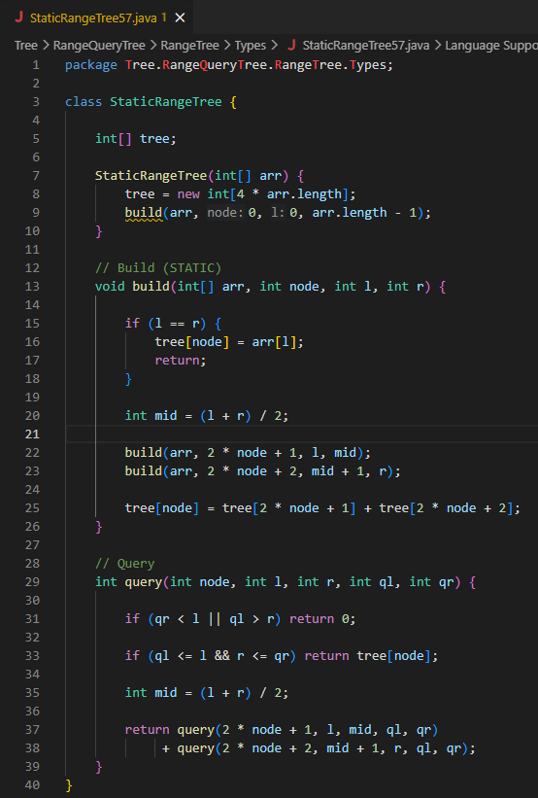
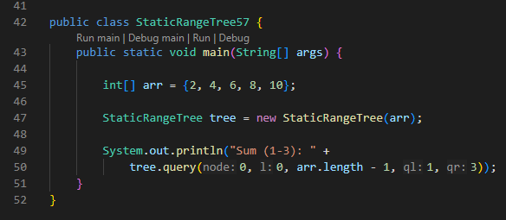
2. Non-Primitive – Non Linear Data Structures
Range Query Trees – Range Tree – Types - Static

Slide 37
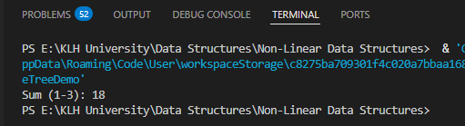
2. Non-Primitive – Non Linear Data Structures
Range Query Trees – Range Tree – Types - Static

Slide 38


2. Non-Primitive – Non Linear Data Structures
Range Query Trees – Range Tree – Types - Static
This program is implementing a Static Range Tree (in practice, a segment tree) for efficient range sum queries on a fixed array
Inputs
Array:
Query:
→ asking for the sum of elements from index 1 to 3.

Slide 39
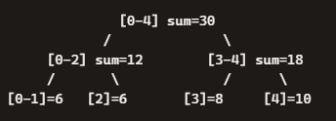
2. Non-Primitive – Non Linear Data Structures
Range Query Trees – Range Tree – Types - Static
Processing
Build phase (build):
Constructs a segment tree from the array.
Each node represents a range [l, r].
If l == r → leaf node stores arr[l].
Otherwise:
Recursively build left child [l, mid] and right child [mid+1, r].
Store sum of children in the current node.
The tree array (tree[]) is sized 4 * n to safely hold all nodes.
Example structure for {2,4,6,8,10}:
Query phase (query):
Checks overlap between query range [ql, qr] and node range [l, r].
No overlap → return 0.
Full overlap → return node’s stored sum.
Partial overlap → recurse into children and add results.

Slide 40

2. Non-Primitive – Non Linear Data Structures
Range Query Trees – Range Tree – Types - Static
Outputs
Query: Sum (1-3) → elements {4,6,8}.
Computation: 4+6+8=18.
Output:
Input: Fixed array {2,4,6,8,10}.
Processing: Build a static segment tree (no updates allowed).
Query: Efficiently compute sum over [1,3].
Output: 18.

Slide 41
2. Non-Primitive – Non Linear Data Structures
Range Query Trees – Range Tree – Types - Dynamic
A Dynamic Range Tree is a type of range tree that supports not only queries but also updates (insertions and deletions of points). Unlike a Static Range Tree, which is built once and fixed, the dynamic version maintains balance and auxiliary structures to handle changes in the dataset while still answering range queries efficiently.
What is a Dynamic Range Tree?
Range tree: A hierarchical structure for multidimensional range queries.
Dynamic variant: Allows the dataset to grow or shrink over time.
Key property: Supports both queries and updates (insert/delete).
Construction
Similar to static range trees:
Build a balanced BST on the first dimension.
At each node, store an associated range tree for the remaining dimensions.
Dynamic twist:
When a point is inserted or deleted, the tree must update both the primary BST and the associated secondary trees.
Balancing operations (like rotations in AVL/Red-Black trees) may be required to maintain efficiency.

Slide 42
2. Non-Primitive – Non Linear Data Structures
Range Query Trees – Range Tree – Types - Dynamic
Querying
Input: A query rectangle (e.g., [x₁,x₂]×[y₁,y₂]).
Process: Same as static trees — traverse primary tree, then query secondary trees.
Complexity:
Query: O(log⁡^{d}n+k) (or O(log⁡^{d−1}n+k) with fractional cascading).
Update (insert/delete): O(log⁡^{d}n).
Type | Updates Allowed | Query Time | Update Time | Space | Best Use Case
Static Range Tree | ❌ No | O(log⁡^{d}n+k) | N/A | O(nlog⁡^{d−1}n) | Immutable datasets
Dynamic Range Tree | ✅ Yes | O(log⁡^{d}n+k) | O(log⁡^{d}n) | O(nlog⁡^{d−1}n) | Databases with frequent updates
KD-tree | ✅ Yes | Avg O(log⁡n+k), worst O(n) | O(log⁡n) | O(n) | Nearest neighbor + dynamic queries

Slide 43
2. Non-Primitive – Non Linear Data Structures
Range Query Trees – Range Tree – Types - Dynamic
Dynamic = Flexibility: Can handle insertions and deletions without rebuilding.
Trade-off: Updates add complexity; queries may be slightly slower than static trees.
Applications:
Dynamic databases (e.g., user records, geographic data that changes).
Real-time systems where points are added/removed continuously.
Example Use Cases
GIS systems: Adding/removing locations dynamically.
Stock market data: Points (time, price) updated continuously.
Interactive applications: User-driven datasets where queries and updates coexist.

Slide 44
2. Non-Primitive – Non Linear Data Structures
Range Query Trees – Range Tree – Types - Dynamic
Dynamic = Flexibility: Can handle insertions and deletions without rebuilding.
Trade-off: Updates add complexity; queries may be slightly slower than static trees.
Applications:
Dynamic databases (e.g., user records, geographic data that changes).
Real-time systems where points are added/removed continuously.
Example Use Cases
GIS systems: Adding/removing locations dynamically.
Stock market data: Points (time, price) updated continuously.
Interactive applications: User-driven datasets where queries and updates coexist.

Slide 45
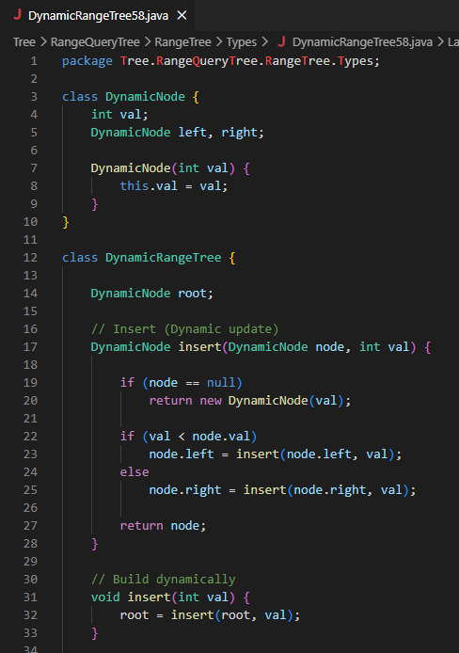
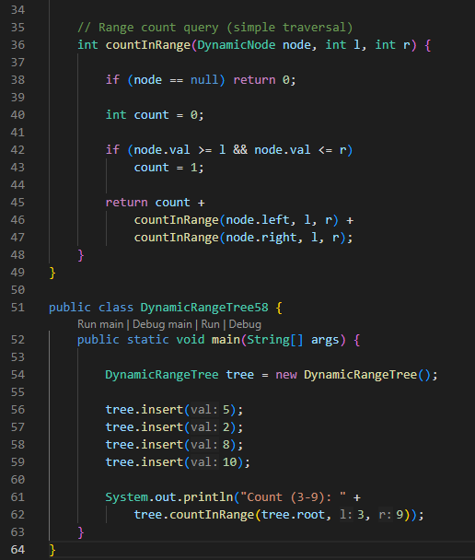
2. Non-Primitive – Non Linear Data Structures
Range Query Trees – Range Tree – Types - Dynamic

Slide 46
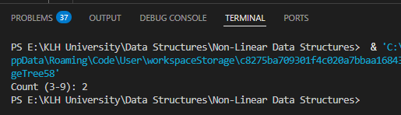
2. Non-Primitive – Non Linear Data Structures
Range Query Trees – Range Tree – Types - Dynamic

Slide 47
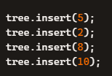
2. Non-Primitive – Non Linear Data Structures
Range Query Trees – Range Tree – Types - Dynamic
This program is a Dynamic Range Tree implementation in Java — essentially a binary search tree that supports dynamic updates (insertions) and range queries.
Inputs
The program inserts values into the tree:
Then it performs a query:
→ asking: How many values lie between 3 and 9 (inclusive)?

Slide 48

2. Non-Primitive – Non Linear Data Structures
Range Query Trees – Range Tree – Types - Dynamic
Processing
Insertion (insert):
Standard binary search tree insertion.
If the tree is empty → create a new node.
If val < node.val → go left.
Else → go right.
This builds a BST dynamically as values are added.
After inserting {5,2,8,10}, the tree looks like:
Range Query (countInRange):
Traverses the tree recursively.
For each node:
If node.val is within [l, r] → count = 1.
Recursively check left and right children.
Adds up counts from all subtrees.

Slide 49

2. Non-Primitive – Non Linear Data Structures
Range Query Trees – Range Tree – Types - Dynamic
Outputs
Query range: [3,9].
Values in tree: {5,2,8,10}.
Values within [3,9]: {5,8}.
Count = 2.
Output:

Slide 50
2. Non-Primitive – Non Linear Data Structures
Range Query Trees – Range Tree – Multi-Dimensional Searching
Multi-dimensional searching with Range Trees means efficiently retrieving all points inside a rectangular (or hyper-rectangular) region across several dimensions. A Range Tree is built recursively: the first level indexes one dimension, and each node stores a secondary tree for the remaining dimensions. This allows queries in O(log⁡^{d}n+k) time, or O(log⁡^{d−1}n+k) with fractional cascading.
How Multi-Dimensional Range Trees Work
Range queries: Retrieve all points inside a given interval or box.
Recursive structure:
Level 1: Balanced BST on the first coordinate (e.g., x).
Each node: Stores a secondary range tree on the remaining coordinates (e.g., y, z).
Continue until all dimensions are covered.
Querying:
Traverse the primary tree to find nodes overlapping the query interval.
Use associated secondary trees to filter points in other dimensions.
Collect results that satisfy all dimensions.

Slide 51
2. Non-Primitive – Non Linear Data Structures
Range Query Trees – Range Tree – Multi-Dimensional Searching
Complexity
Construction: O(nlog⁡^{d−1}n) for n points in d-dimensions.
Query:
Without optimization: O(log⁡^{d}n+k).
With fractional cascading: O(log⁡^{d−1}n+k).
Space: O(nlog⁡^{d−1}n).
Structure | Query Time | Update Support | Space | Best Use Case
1D Range Tree | O(log⁡n+k) | Static/Dynamic | O(n) | Interval queries
2D Range Tree | O(log⁡²n+k) | Static/Dynamic | O(nlog⁡n) | Rectangular queries in plane
KD-tree | Avg O(log⁡n+k), worst O(n) | Dynamic | O(n) | Nearest neighbor + range queries
Multi-Dimensional Range Tree | O(log^{⁡d}n+k) | Static/Dynamic | O(nlog⁡^{d−1}n) | High-dimensional queries

Slide 52
2. Non-Primitive – Non Linear Data Structures
Range Query Trees – Range Tree – Multi-Dimensional Searching
Multi-dimensional searching: Each dimension adds a level of recursion, making queries efficient across multiple attributes.
Trade-off: Higher dimensions increase space and query complexity, but still outperform naïve search.
Optimization: Fractional cascading reduces repeated binary searches, saving a logarithmic factor.
Applications:
Databases: Multi-attribute queries (e.g., age, salary, location).
GIS systems: Spatial queries in 2D/3D.
Computational geometry: Efficient point retrieval in multidimensional datasets.

Slide 53
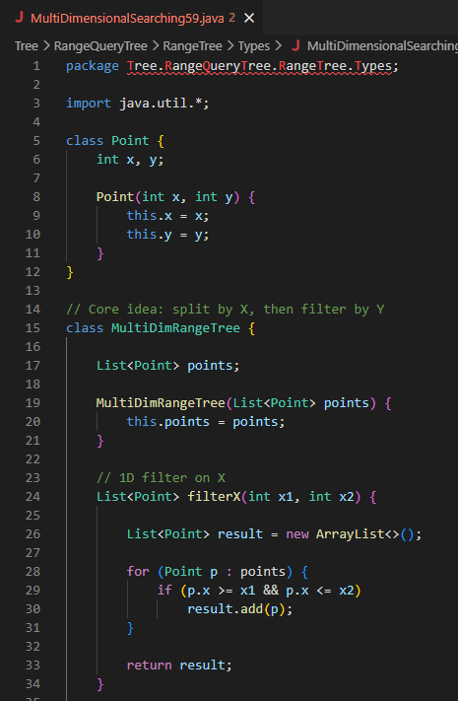
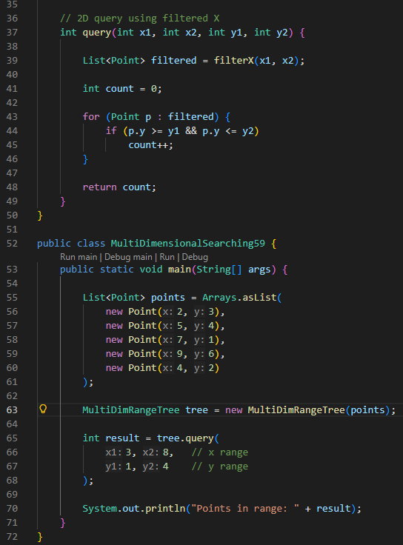
2. Non-Primitive – Non Linear Data Structures
Range Query Trees – Range Tree – Multi-Dimensional Searching

Slide 54
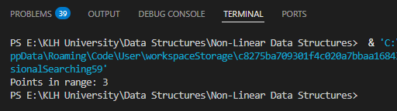
2. Non-Primitive – Non Linear Data Structures
Range Query Trees – Range Tree – Multi-Dimensional Searching

Slide 55



2. Non-Primitive – Non Linear Data Structures
Range Query Trees – Range Tree – Multi-Dimensional Searching
Inputs
Points dataset:
Query rectangle:
So the query asks: How many points lie inside the rectangle bounded by x between 3 and 8 and y between 1 and 4?
Processing
Filter by X (filterX):
Iterates through all points.
Keeps only those with x between 3 and 8.
Result after filtering:
Filter by Y (query):
From the filtered list, check if y is between 1 and 4.
Count how many points satisfy this condition.
Results:
(5,4) ✅ y=4 is within [1,4]
(7,1) ✅ y=1 is within [1,4]
(4,2) ✅ y=2 is within [1,4]
→ All three points qualify.

Slide 56

2. Non-Primitive – Non Linear Data Structures
Range Query Trees – Range Tree – Multi-Dimensional Searching
Outputs
Count of points inside rectangle = 3.
Program prints:
Input: A set of 2D points + query rectangle.
Processing:
Step 1: Filter points by x-range.
Step 2: Filter remaining points by y-range.
Output: Number of points inside rectangle → 3.

