Slide 1
2024
DATABASE SOLUTIONS Roadmap

Slide 2
DB Solutions – Near Term Work
Last Update: 2024-01-30
Establish DB Instance Security MVP
Completed Early
Establish DB Environment MVP State (DEV)
Socialize MVP with associated IT groups
Evaluate DB Environment Baseline State (DEV)
Inventory / Categorize / Group DB Environment (DEV)
Identify junk / legacy standards.
Create / implement new standards
**CRITICAL**
MANY knock-on effects
Evaluate DB Environment (Azure)
Socialize evaluation findings, proposed MVP, and standardization with associated IT groups
Establish DB Security Request Process (Basic)
Establish DB Environment MVP State (Azure)
Retrofit Full SDLC Solutions to conform to cohesive standards (Azure)
Evaluate Full SDLC Solution 1 Baseline State
Standardize Full SDLC Solution (where possible)
Notes:
DB Instance Security MVP – AD Group standard created, implemented (SEE SUBSEQUENT SLIDES)
Socialize MVP with associated IT groups – HOW TO MAKE THIS STICK?
Is there a SharePoint or Confluence page where we can publish MVPs and Standards, etc.?
3. Standards – should probably be 2 tasks; identify old, then create / implement new.
This is currently underway, but unstructured and frequently sidetracked with ad-hoc requests / priority shifts that oftentimes reinforce or add to standards that are lacking.
Identification happens organically (see Jira / Rogue1 replication), tracking over time is difficult. Expect to be ongoing.
4. DB Security Request Process – HOW TO MAKE THIS STICK?
I have already created a comprehensive diagram outlining how these requests should flow in JSM. (SEE SUBSEQUENT SLIDES)
Perception is that this subject area is poorly understood outside of our group.
Some of this can be mitigated by granting us the ability to manage AD / Entra objects that access the database layer for starters.
This is a good example of a place where standards are (woefully) lacking, yet requests come in regularly from all angles.
Propose that I develop “lines in the sand” proposal that satisfies Cyber insight requirement.
i.e. Cyber should have policy oversight / approval at the SOLUTION scope, in collaboration with the solution owners to approve general access to a solution (e.g. “Cobra”, or “SAP”, or “Jira”, etc.)
Once within the database layer, they’re out of their depth and should hand the ball to us.
At this point, having already obtained Cyber’s approval, we work with the solution owners to determine HOW to provision access (– what type, where within the solution, etc.)
Example: Jira / Rogue1 replication. Cyber should not be proposing (1) “create a view”, and (2) “provide oversight to the views”.
The justification given for this was “I know how SQL works” when they do not understand that instance level access differs from database level access and that database access can be further refined.
The justification given for this was “I know how views work” when in fact they do not understand that users are not able to create new views or change existing views by default.
Nevertheless, Cyber will be granted the appropriate level of access to spot-check the DDL layer of the Jira database replica in Rogue1.
5. AZURE – Good example of changing the tires on the car while it’s speeding down the highway.
Current environment lacks standards, has many misconfigurations, and environment management responsibility is unclear / ineffective.
We would like to expand our level of influence over the environment so that we can effectively manage it. - HOW TO IMPLEMENT WITHOUT “STEPPING ON TOES”?
While our access is restricted, our ability to produce solutions and comprehensively manage the environment is at risk.
6. Evaluate Full SDLC Solutions (group 1) – NERVE scope definition ongoing (Jeff Lis on paternity leave).

Slide 3
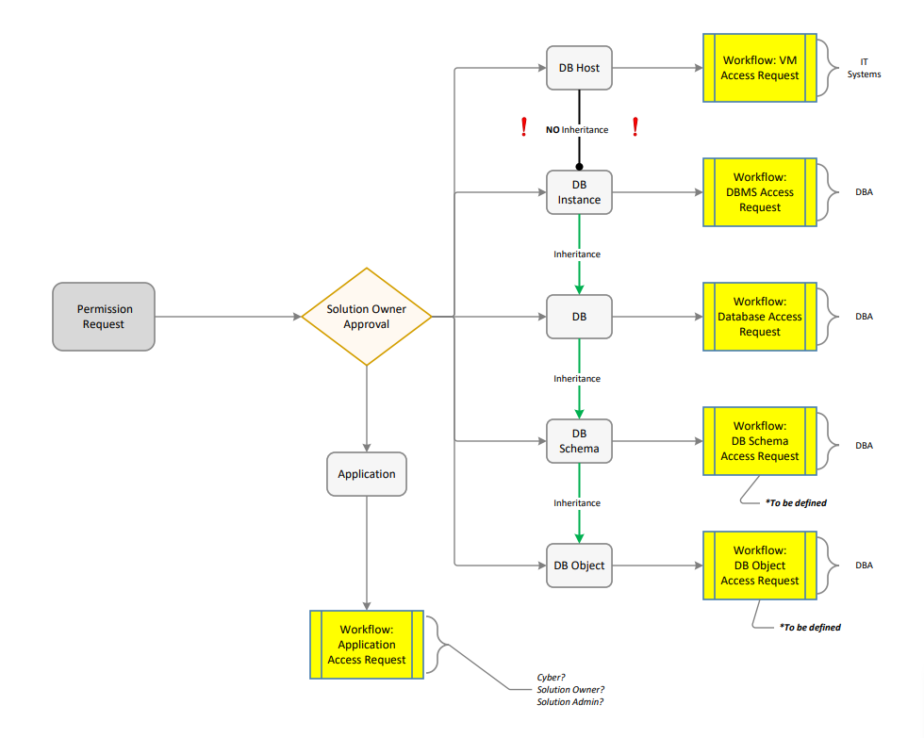
Notes:
Outline of BASIC workflow for Solution Access / Permission Request.
This openly acknowledges that all solution owners are not typically aware of deep level permission schemes for each component within the solution they own. As a result, I’ve only completed mapping out the instance and database workflows.
Solutions have many interrelated components, all of which are the responsibility of one person or function.
That person (or function) should approve or deny access to the SOLUTION, and from there, downstream requests for permissions should be invoked accordingly as illustrated in this diagram.
This requires multiple workflows, potentially at the Application layer, the Host / Server layer, and the “Database” layer – which is actually the Instance layer, Database layer, Schema layer, Object layer, and so on and so on.

Slide 4
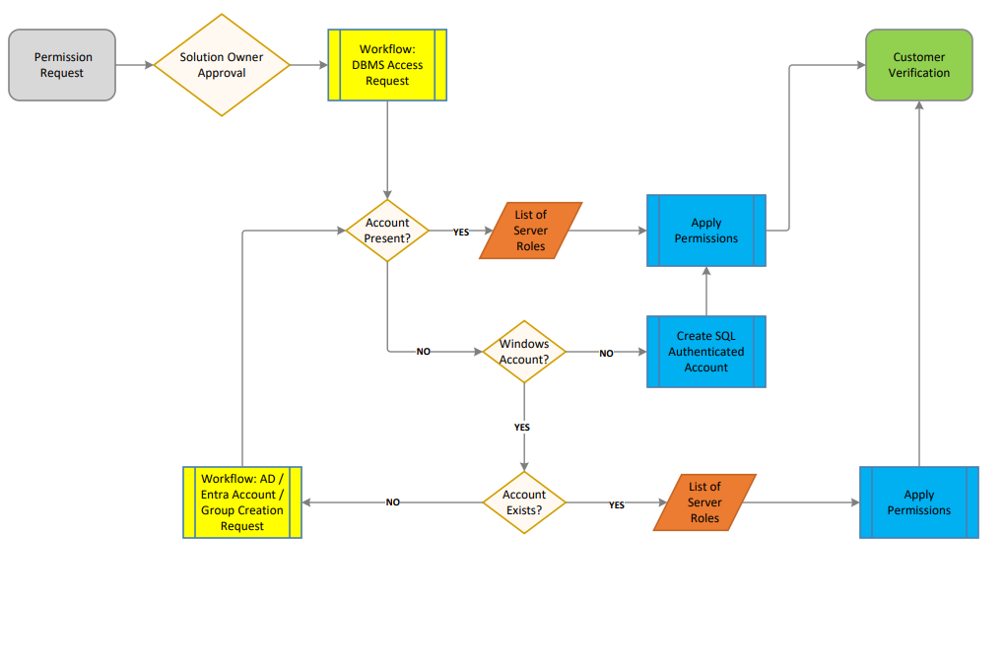
Notes:
This is an instance layer workflow

Slide 5
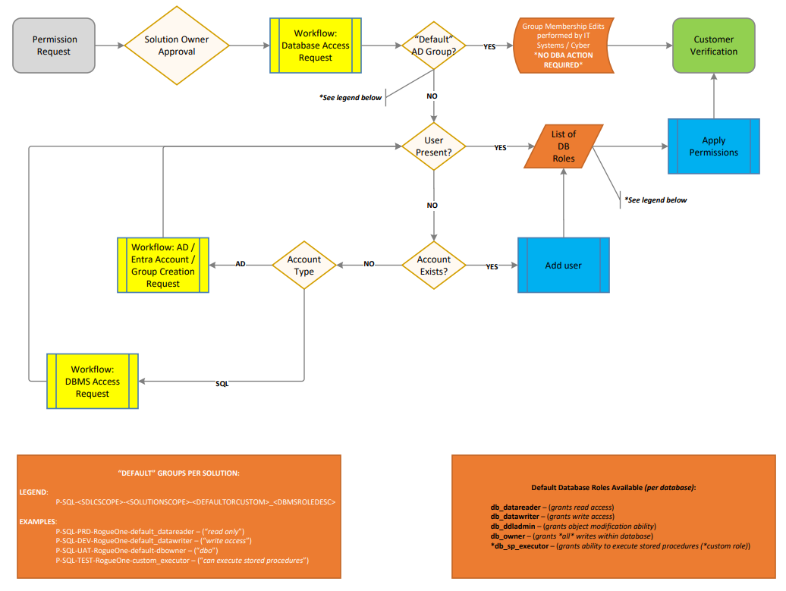
Notes:
This is a database layer workflow, illustrating the 2 standards we’ve created.

Slide 6
Notes:
Possessing subject matter expertise in all the disciplines listed has been a key differentiator for me, relative to my peers in the industry throughout my career.

Slide 7
Notes:
General brainstorming used to inform slide deck

