Slide 1
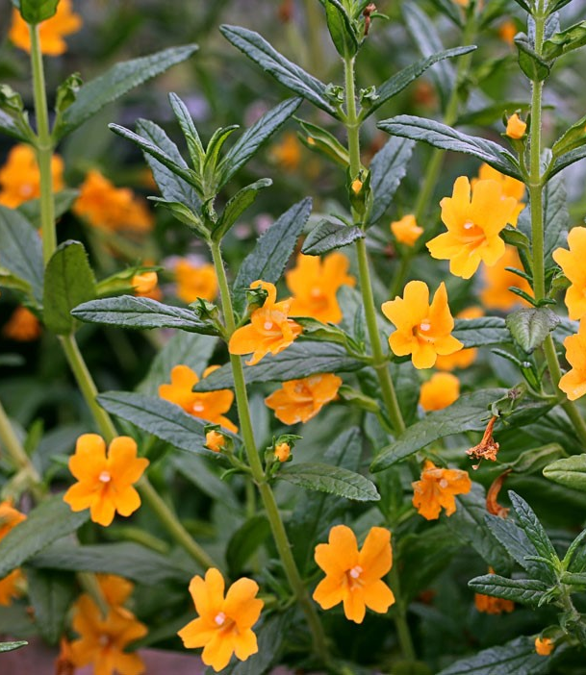
A Failed Analysis of Diplacus aurantiacus Microbiomes Across California
Bioinformatics Final Presentation
Sean McFarlan

Slide 2
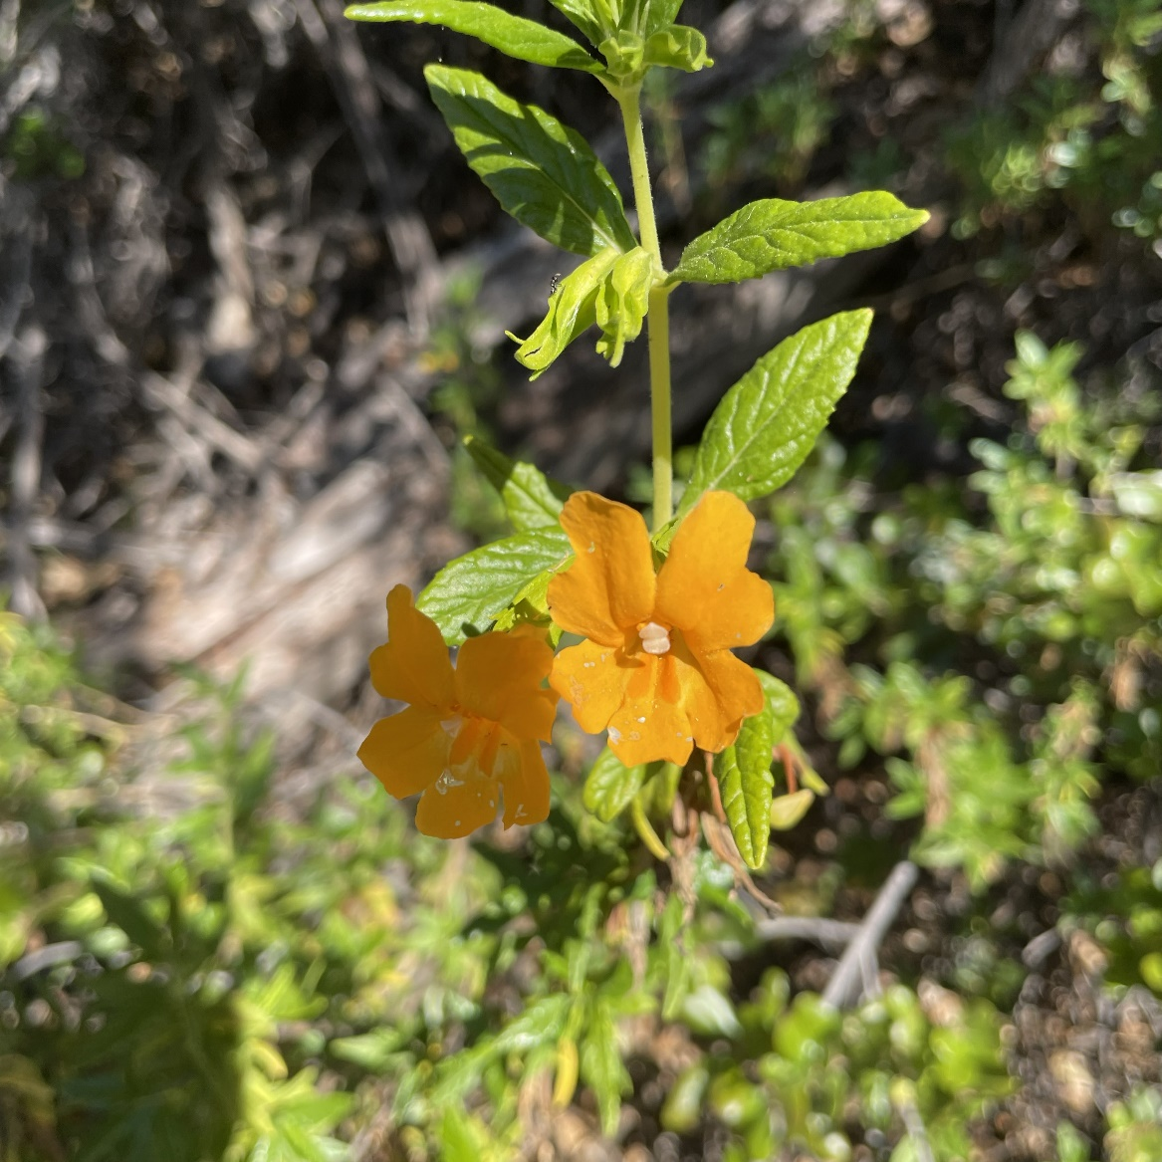
Study Species
The orange bush monkeyflower OR the sticky monkeyflower
Diplacus aurantiacus
Perennial, bushy wildflower with large orange flowers and herbaceous to woody stems.
All over Western North America.

Slide 3
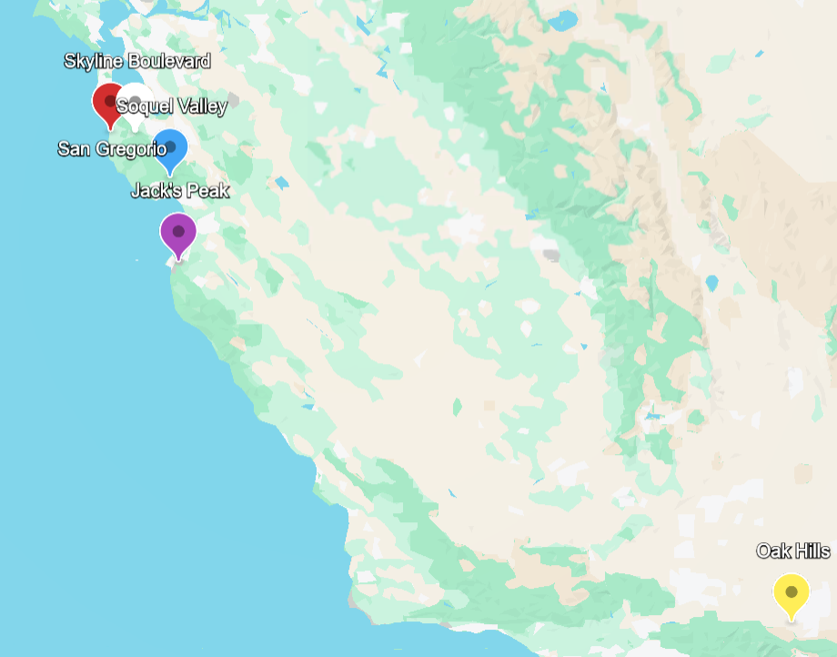
Study Region: Monterrey and Southern California
Mostly sampled around Monterrey
But then Oak Hills…?
Interesting out-group

Slide 4

Collection Methods
Not sure how samples were collected….
Only metadata: rough locational info.
Plant condition?
Conditions at each sample site?
Oh well, we ball.

Slide 5
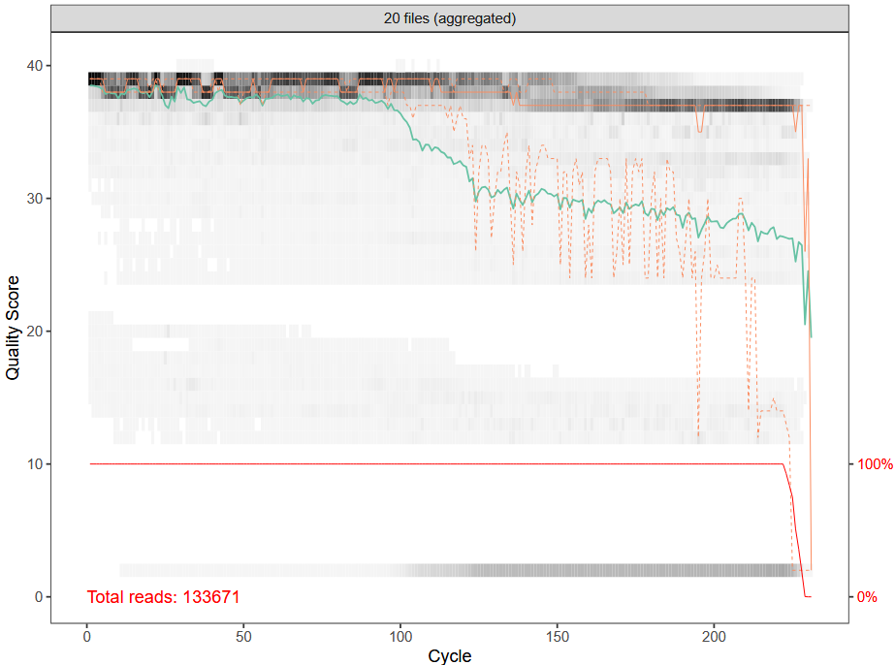
Starting
Forward Read Quality Profile
1. Combine .gz files into one collection.
2. Assess read quality.
dada2: plotQualityProfile (Galaxy Version 1.38.0+galaxy0)
~125bp of good read
(on forward)

Slide 6
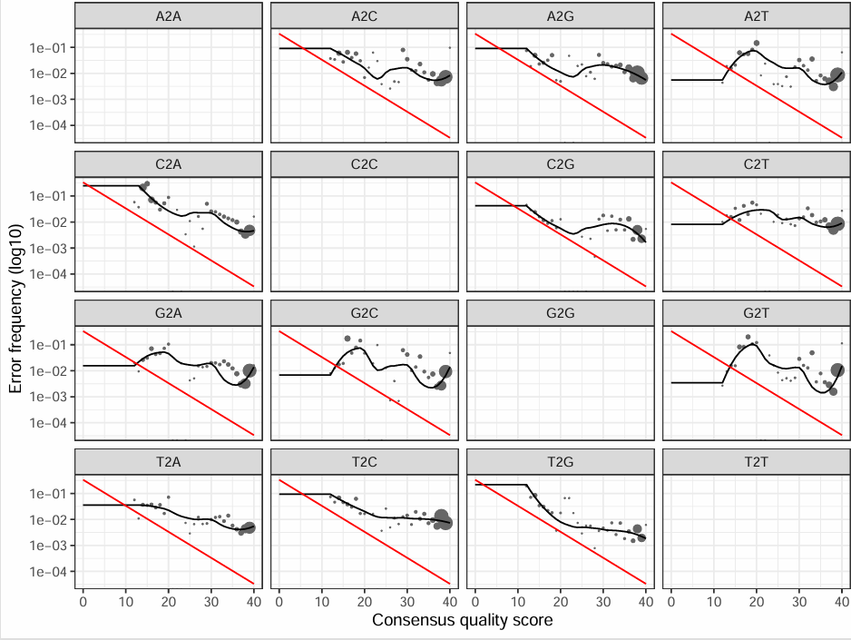
Trimming
learnErrors Forward Plot
3. Trim low-quality data.
dada2: filterAndTrim (Galaxy Version 1.38.0+galaxy0)
Truncate: 125bp F, 175bp R
Split output into forward and reverse collections.
Unzip collection (Galaxy Version 1.0.0)
4. Assess sequencing error rate.
dada2: learnErrors (Galaxy Version 1.38.0+galaxy0)
Tag forward and reverse read sets.
5. Remove suspected errors.
dada2: dada (Galaxy Version 1.38.0+galaxy0)

Slide 7
Compile and Clean
6. Recombine cleaned up reads.
dada2: mergePairs (Galaxy Version 1.38.0+galaxy0)
7. Compile sequences into one table.
dada2: makeSequenceTable (Galaxy Version 1.38.0+galaxy0)
8. Clean up PCR errors.
dada2: removeBimeraDenovo (Galaxy Version 1.38.0+galaxy0)

Slide 8
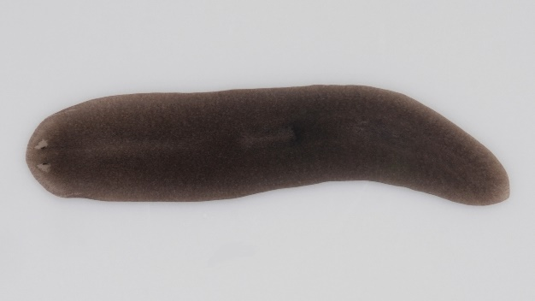
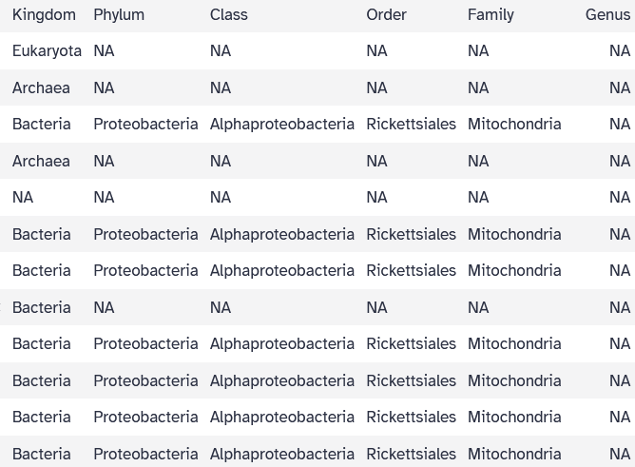
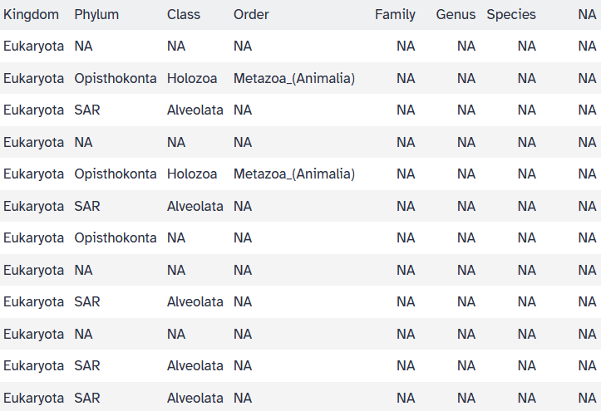
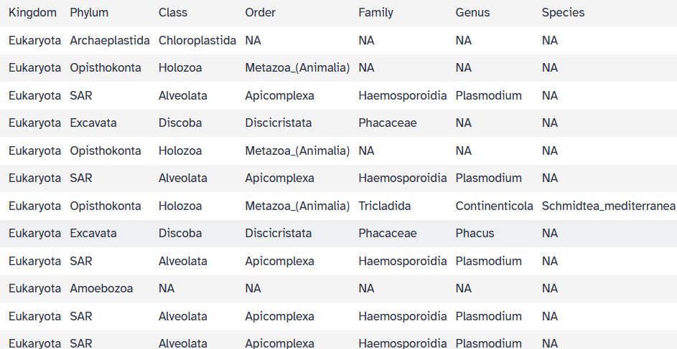
Getting Creative With Assign Taxonomy
9. Make best guesses on sequence taxonomy of origin
dada2: assignTaxonomy and addSpecies (Galaxy Version 1.38.0+galaxy0)
Schmidtea mediterranea, of Tunisia
Silva 138 Reference Set
Silva Eukaryote 18S Ref. Set
Silva Eukaryote 18S Ref. Set, Lower Bootstrap Threshold

Slide 9
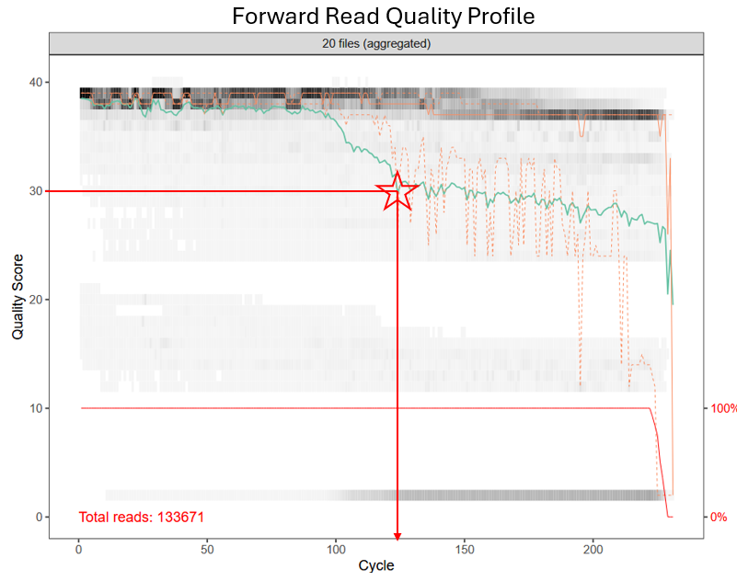
So What Happened…?
A flatworm from Tunisia booked a flight to southern California.
Reducing bootstrap values that aggressively opened interpretation up too much.
Think back….
It’s possible I cut too much information here.
It’s also possible this data is a little wacky.

Slide 10
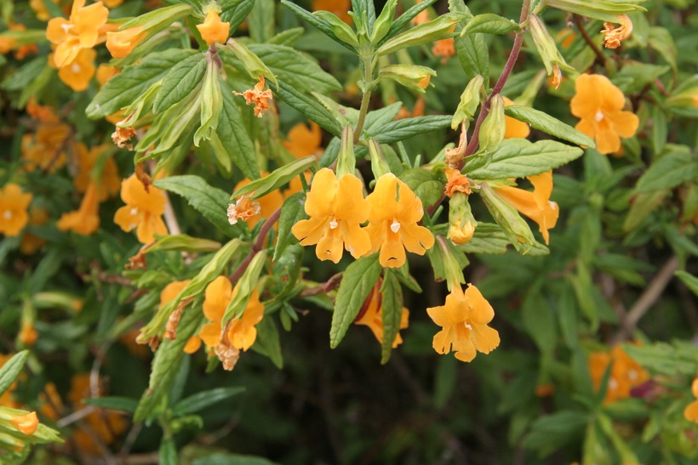
Conclusions…
An interesting set of mysterious DNA sequences from southern and coastal California.
What do I have here?
I’m not really sure….
Remedies…?
Maybe should have cut less in my filter+trim stage?
And turn back? I think not.
Maybe should have requested a different data set?
Probably not, most likely something I broke.

