Slide 1
Us Urban rail
Growth over two centuries

Slide 2
approach
The dataset contains information about urban transit systems including:
Cities - Geospatial and historical beginning of urban transit system
Stations - Historical data on build start and opening
Lines - Geospatial
Stations - Correlation with Lines and historical data
Our initial analysis showed that the data could be used to track the expansion over time. Our Research Question: How does the expansion of Urban Rail Infrastucture system infrastructure correspond with changes in U.S. metropolitan areas over time?

Slide 3
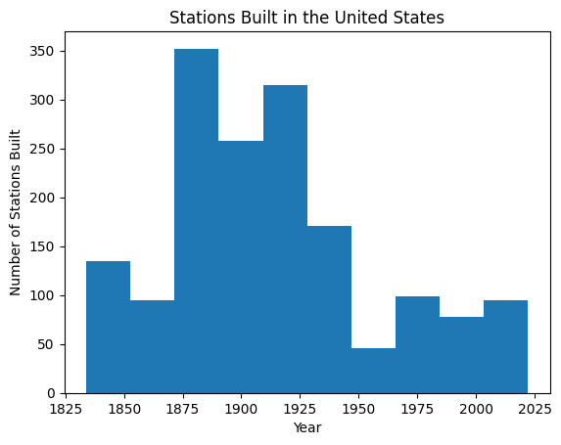
Stations built in the united states 1832-present

Slide 4
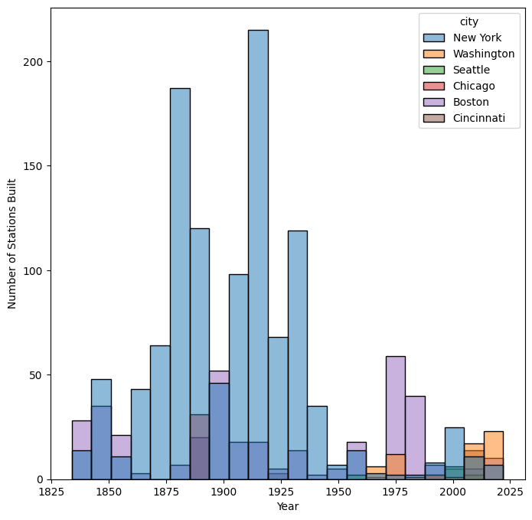
Stations built in the united states 1832-present

Slide 5
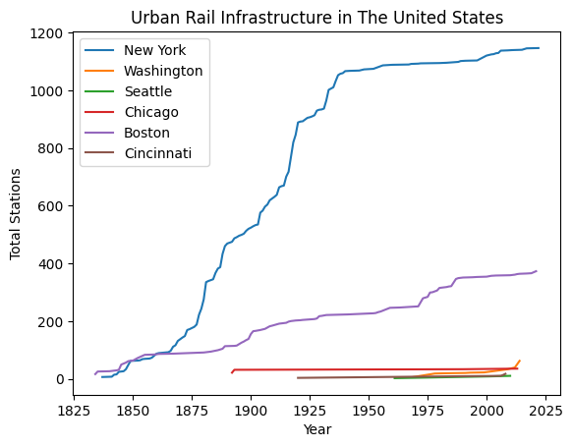
Growth over time by city

Slide 6
Growth over time by city
Web presentation

Slide 7
Conclusions/findings
Urban rail stations grew rapidly between 1850 and 1930
After 1930, the demands for stations declined significantly
The the drop in rail infrastructure investment could correspond to the expansion of car ownership and the US Interstate highway system.
Future Implemention/Analysis Potential:
Incorporate US Census data to see if there's a correlation between US population and urban rail system.
Incorporating the effect on urban rail systems on GDP

