Slide 1
Interest rate prediction
Via analysis of past investment trends
Authors: hung, n. ; angerame, s. ; Mcleaish s.

Slide 2
hypothesis
H₀ : The amount being requested, the customer FICO score, and the length of the loan will have no effect on the interest rate being offered.
H₁ : The amount being requested, the customer FICO score, and the length of the loan will have a correlation to the interest rate being offered.
Notes:
Null and alternative

Slide 3
Testing h₀
The data was first scaled, then a linear regression model was fit with a training split of 0.2
The FICO score coefficient is about -0.0877, with a 95% confidence interval from approximately -0.090 to -0.085, and a p-value effectively zero. This indicates a strong and statistically significant negative correlation: as the average FICO score increases, the interest rate tends to decrease.
The loan length coefficient is approximately 0.1372, with a narrow 95% confidence interval from about 0.128 to 0.146. The p-value is zero, indicating a very strong positive correlation.
The amount requested coefficient is very small but positive (around 0.0001). The associated p-value is effectively zero, indicating a highly significant positive correlation. This means that as the requested amount increases, the interest rate tends to increase slightly.

Slide 4
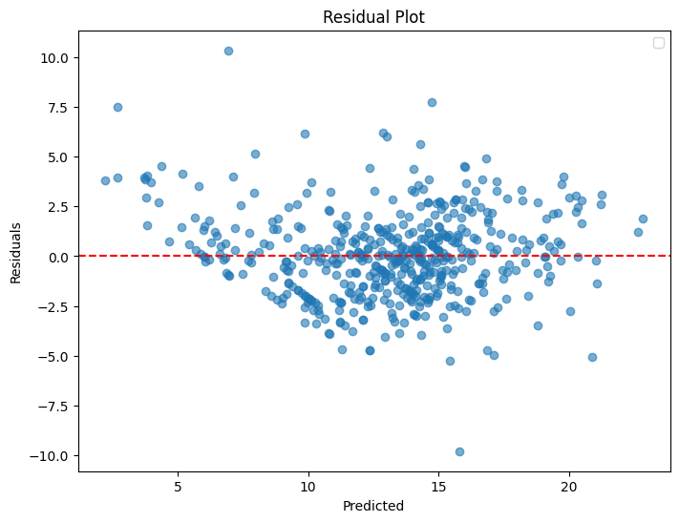
Visualizing the test
The residuals are the differences between the actual values and the predicted values from the model. By analyzing residuals, we check if the model is overfitting. Randomly distributed residuals around zero indicate a good model fit without overfitting.
We conclude that our model is an adequate fit to the test data.

Slide 5
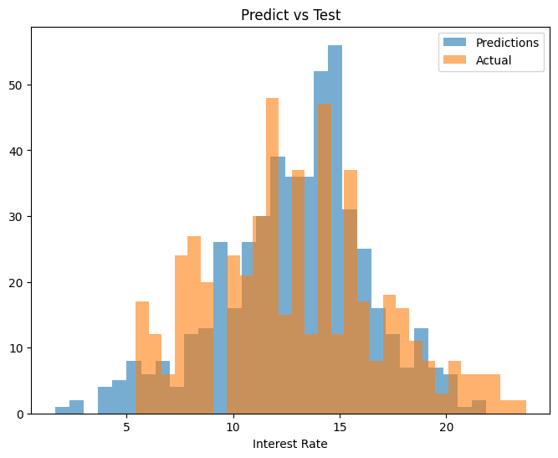
Visualizing the test (CONT.)
Overlaying the predictions of our model with the test data shows a similar distribution, consistent with the results of our OLS regression.

Slide 6
Findings
We reject the null hypothesis and conclude there is a statistically significant correlation between the amount being requested, the customer FICO score, and the length of the loan will have a correlation to the interest rate being offered.
These independent variables can be used to make a predictive analysis of probable interest rates for future loan offers.

