Slide 1
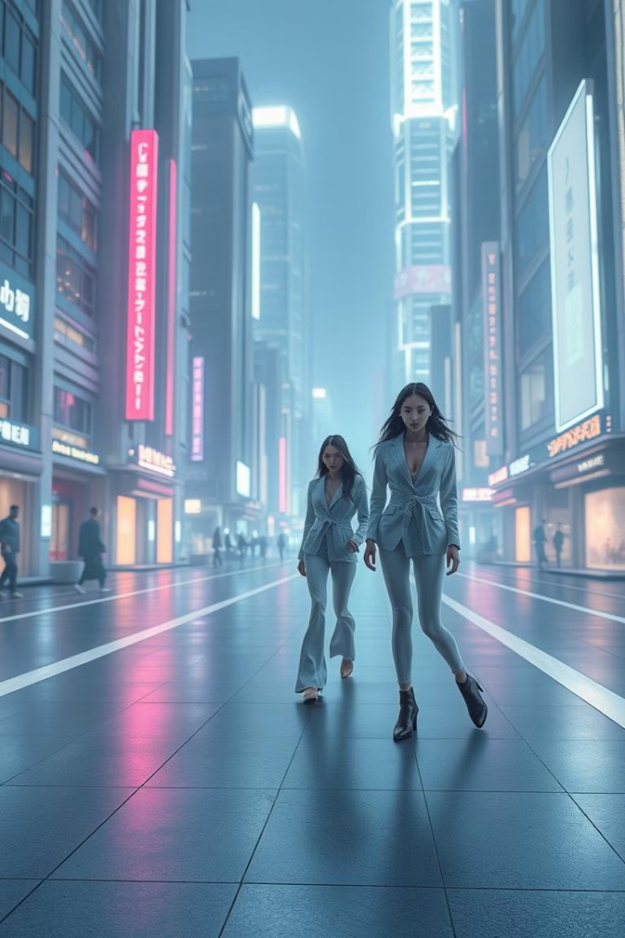
CoutureAI: Clothing Image Generator
This presentation covers the use of Stable Diffusion for clothing image generation.
We'll explore CoutureAI's architecture, workflow, challenges, and applications.

Slide 2
Overview of Stable Diffusion
Generative Model
Diffusion Process
Stable Diffusion is a deep learning generative model.
The process involves adding noise to an image and then reversing it.
It's used for creating detailed images from text descriptions.
This creates new images based on the input prompt.

Slide 3
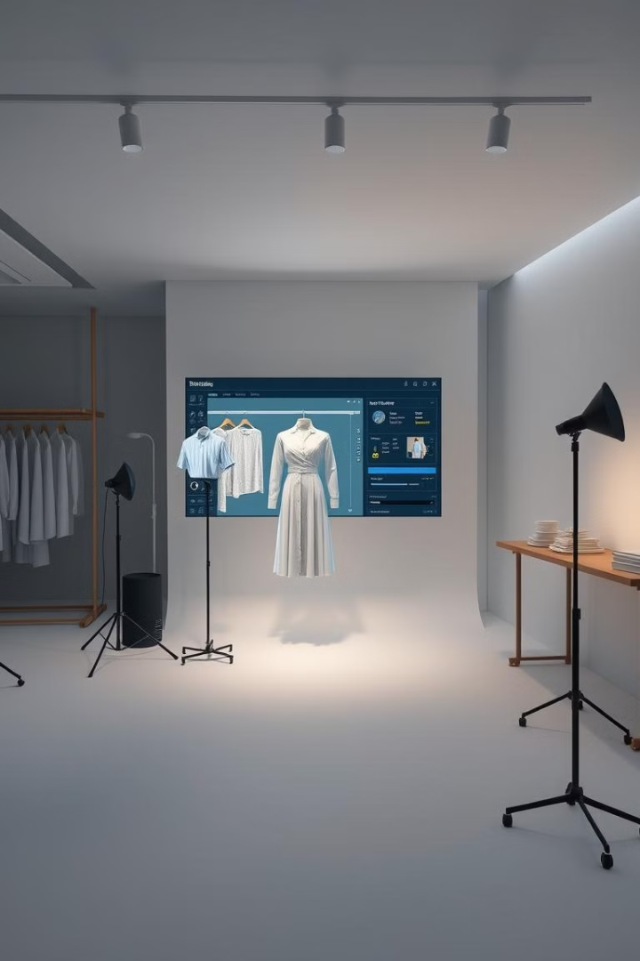
Applying Stable Diffusion to Clothing Generation
1
Dataset Training
2
Textual Inversion
Train Stable Diffusion on a large dataset of clothing images.
Use textual inversion to embed new clothing styles into the model.
3
Refinement Process
Refine the generated images for high quality and detail.

Slide 4

Key Challenges and Considerations
Fabric Detail
Style Consistency
Computational Resources
Generating realistic fabric textures can be challenging.
Maintaining style consistency across different poses is essential.
Training and inference require significant computational power.

Slide 5




Architecture and Workflow of CoutureAI
Input Text
Stable Diffusion
Refinement
Start with a text description of the desired clothing.
Process the text using Stable Diffusion to generate a base image.
Refine the image using post-processing techniques.

Slide 6
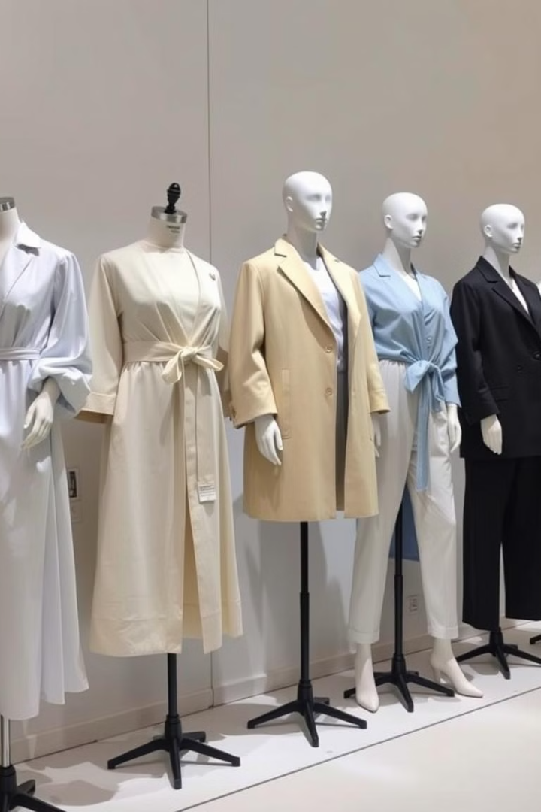



Generating Diverse Clothing Designs
Dresses
Shirts
Pants
Generate various dress styles, from casual to formal.
Create different shirt designs, including patterns and colors.
Produce diverse pant styles, such as jeans, trousers and leggings.

Slide 7
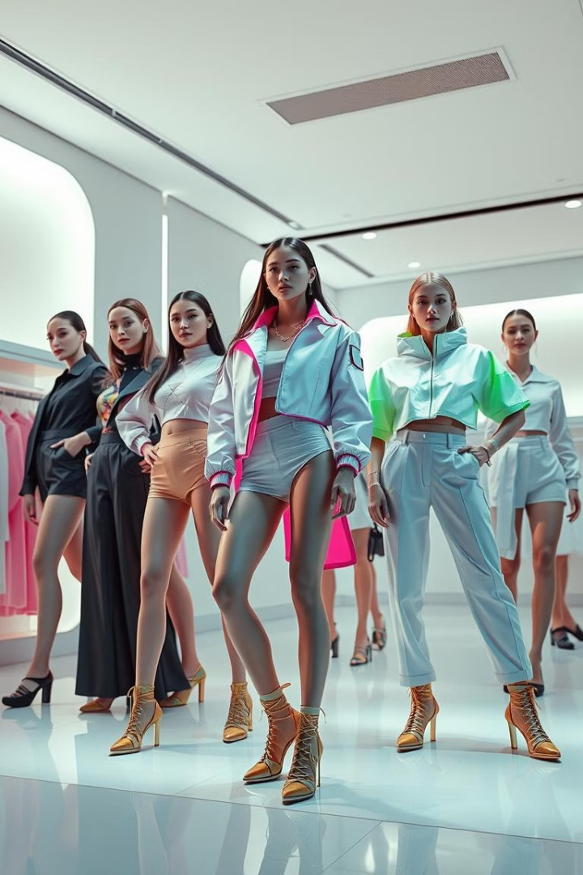
Real-world Applications and Use Cases
1
E-commerce
Virtual try-on experiences for online shopping.
2
Fashion Design
Rapid prototyping of new clothing designs.
3
Gaming
Generating clothing for virtual avatars.

Slide 8



Future Developments and Roadmap
Style Transfer
2
Implement advanced style transfer capabilities.
Improved Detail
1
Enhance fabric and texture quality.
3D Generation
3
Enable 3D clothing model generation.

