Slide 1

Urbanization in Bulgaria 2015-2018
Why more of the Bulgarian population is going to biggest cities
Bulgaria is divided into 27 provinces – the biggest cities actually
In my project I have observations only on them
The main question is – “Are more people relocating in bigger cities in Bulgaria?”

Slide 2
Data sets and methodology
The data sets which I use are taken from the NSI (National Statistical Institute of Bulgaria – nsi.bg)
I use two features – GDP (income) and population for current provinces for years 2015, 2016, 2017, 2018
I will make average of the income of each provinces for all the years
Then I will make all analysis based on it

Slide 3
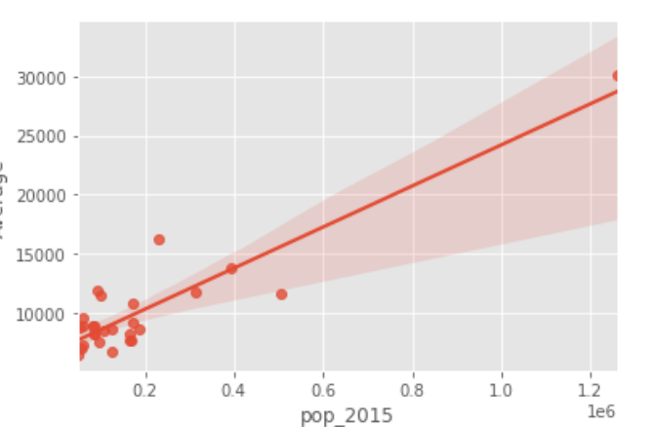
Is there correlation between population and GDP?
Yes – there is positive for 2015, based on average GDP

Slide 4
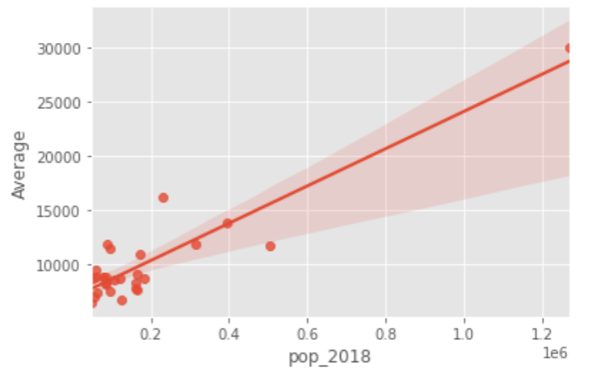
Is there correlation between population and GDP?
Yes – there is positive, even for year 2018 based on average GDP

Slide 5
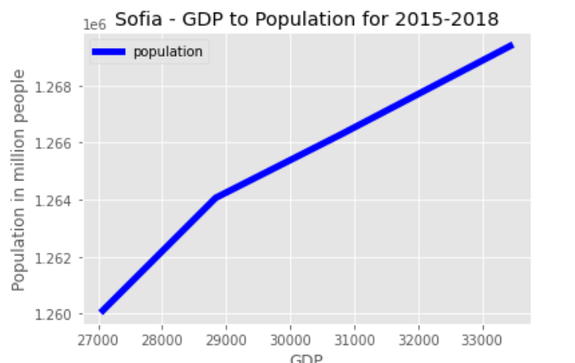
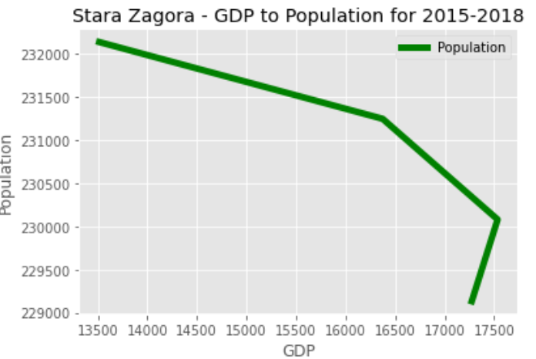
Provinces with highest GDP, also have increasing population
1. Sofia
2. Stara zagora

Slide 6
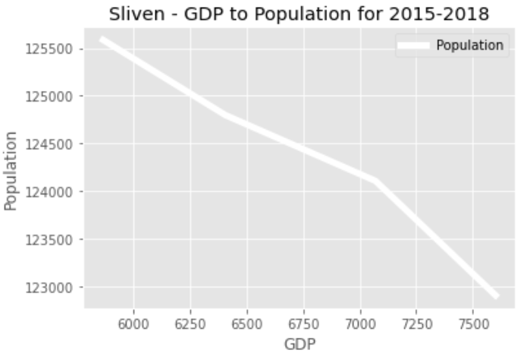
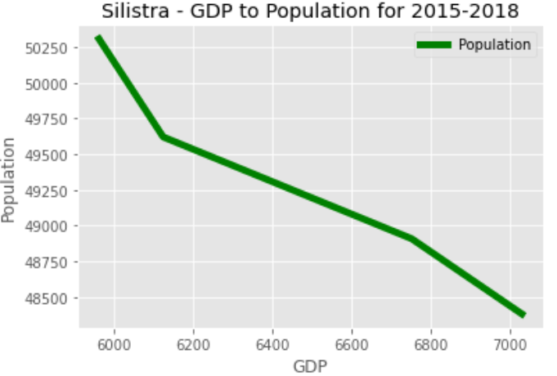
Provinces with lowest GDP, also have decreasing population
26. Sliven
27. Silistra

Slide 7
Conclusion
When the GDP of province goes up and the population goes up.
I know my work is poor, but I am watching this problem since very long time.
In conclusion I could say that Bulgaria is one of the top countries in the world leading by urbanization factor.

