Slide 1
Artificial Model Building
(searching for dispersed signals in the LHC search results)
Wolfgang Waltenberger (ÖAW and Uni Vienna), August 2019

Slide 2
Disclaimer
What I wish to present here, is a proof of principle, no more.
(But hey, I will show running code, that mostly doesn’t crash!)
The bigger philosophy behind this goes as follows:
We have all these hundreds of wonderful LHC results (simplified models results, to be more concrete). Not to mention non-LHC data.
Let’s maximally combine results and data-mine and machine-learn the sh*t out of them!

Slide 3
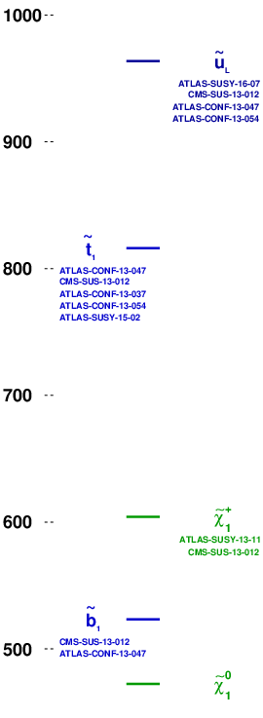
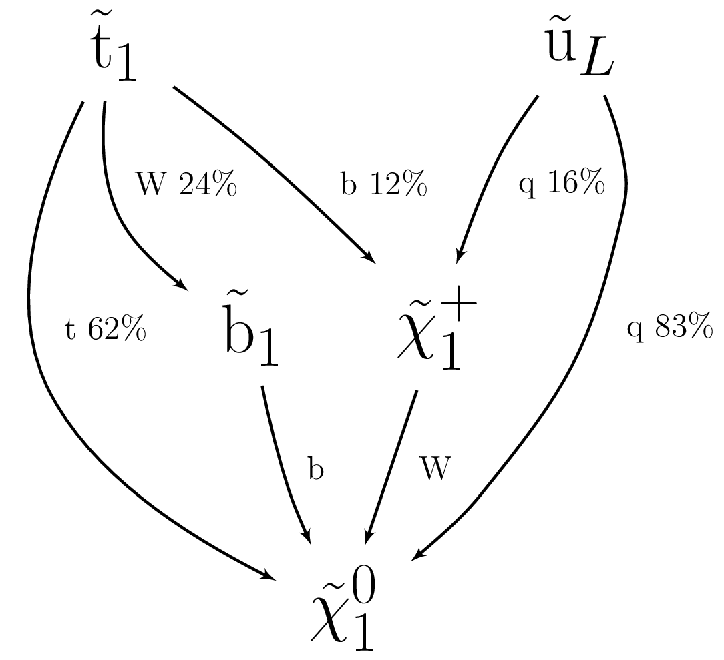
This – I shall claim – is an interesting BSM model
Z=3.25

Slide 4
This – I shall claim – is an interesting BSM model
Dark matter candidate +/- compatible with the WIMP miracle
Spectrum +/- compatible with natural SUSY
(stop < 1 TeV, can accomodate a gluino < 2.5 TeV)

Slide 5
This – I shall claim – is an interesting BSM model
Dark matter candidate +/- compatible with the WIMP miracle
Spectrum +/- compatible with natural SUSY
(stop < 1 TeV, can accomodate a gluino < 2.5 TeV)
42 SMS results of the SModelS database apply.
None can exclude the model.
With r:= σ(theory)/σ(upper limit),
the highest r values are
CMS-SUS-16-032:T2bb r=0.56, rexp=N/A
CMS-SUS-16-036:T2bb r=0.49, rexp=0.29
CMS-SUS-16-033:T2bb r=0.35, rexp=0.34

Slide 6
This – I shall claim – is an interesting BSM model
Dark matter candidate +/- compatible with the WIMP miracle
Spectrum +/- compatible with natural SUSY
(stop < 1 TeV, can accomodate a gluino < 2.5 TeV)
42 SMS results of the SModelS database apply.
None can exclude the model.
With r:= σ(theory)/σ(upper limit),
the highest r values are
CMS-SUS-16-032:T2bb r=0.56, rexp=N/A
CMS-SUS-16-036:T2bb r=0.49, rexp=0.29
CMS-SUS-16-033:T2bb r=0.35, rexp=0.34
Consider that we combine the respective topologies and analyses listed on the left, and treat it as a single BSM model with an overall signal strength μ as the only free parameter. Testing for compatibility with the Standard Model results in a test statistic Z (significance) of 3.25.

Slide 7
This – I shall claim – is an interesting BSM model
Where does the significance Z come from?
`- ATLAS-SUSY-2015-02:SR1 (EM, T2tt)
nobs: 12, nbg: 5.5 +/- 0.72, Z~2.6
`- ATLAS-SUSY-2016-07:2j_Meff_1200 (EM, T2)
nobs: 611, nbg: 526.0 +/- 31.0, Z~2.2
`- ATLAS-CONF-2013-037:SRtN3 (EM, T2tt)
nobs: 7, nbg: 5.0 +/- 2.0, Z~0.6
`- ATLAS-CONF-2013-047:A Medium (EM, T2*)
nobs: 135, nbg: 122.0 +/- 18.0, Z~0.6
`- ATLAS-CONF-2013-054:8j50 flavor 0 b-jets (EM, T2*)
nobs: 40, nbg: 35.0 +/- 4.0, Z~0.7
`- ATLAS-SUSY-2013-11:WWc-DF (EM, TChiWW)
nobs: 11, nbg: 9.0 +/- 2.2, Z~0.5
`- CMS-SUS-13-012:3NJet6_1000HT1250_600MHTinf (EM, many)
nobs: 32, nbg: 22.8 +/- 5.2, Z~1.3
(In that run we didn’t produce “likelihoods from limits” → only efficiency-map based results)

Slide 8
How was this model constructed?

Slide 9
How was this model constructed?
Two new components on top of SModelS:
An analysis combiner algorithm that finds the optimal “legal” combination of analysis results.
In this talk, “optimal” means “maximizing the significance Z while evading all exclusions”. Other criteria can however be employed (finding BSM models that are interesting in a different way).
Different choices of what are “legal” combinations are possible. In this talk I am using “aggressive” combination: signal regions must be clearly distinct. Control regions are ignored.
A “model builder” that randomly constructs BSM models in a Metropolis-Hastings-like fashion.
The walker starts from the Standard Model
It may randomly introduce and “kill” BSM particles.
It may randomly change masses of particles.
It may randomly change branching ratios.
The cross section is computed as if it were a SUSY model. However, the walker may randomly change particle-specific signal strength modifiers that are applied to the computed cross sections.
A neural network the learns to predict the “score” of the combiner, and then uses the gradient of the score instead of a random step may speed things up.

Slide 10

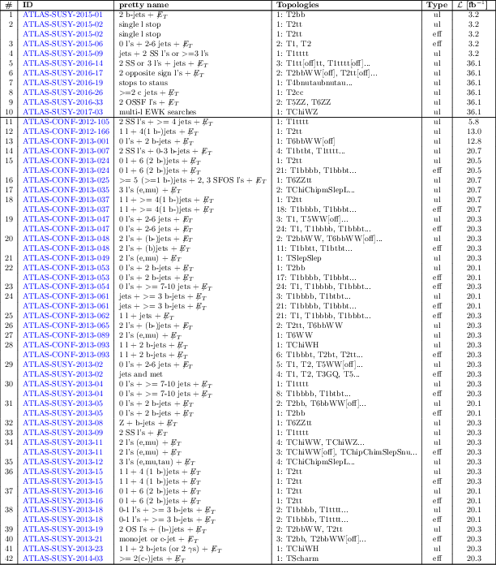
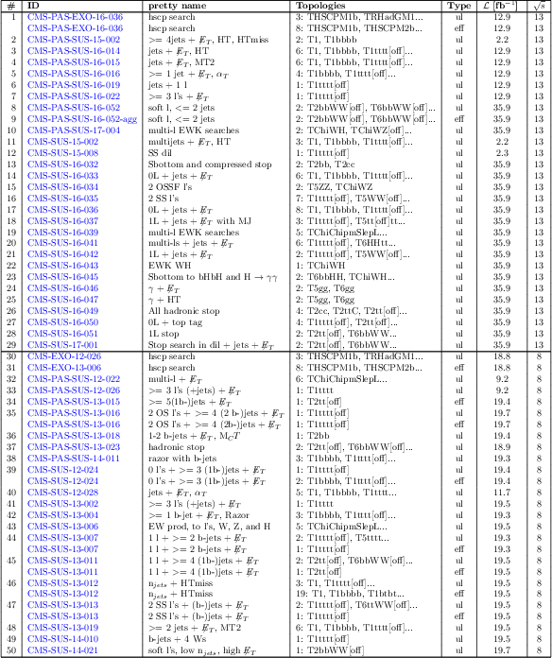
SModelS database
The current database consists of almost 50 CMS and almost 50 ATLAS results.
https://smodels.github.io/docs/ListOfAnalyses

Slide 11
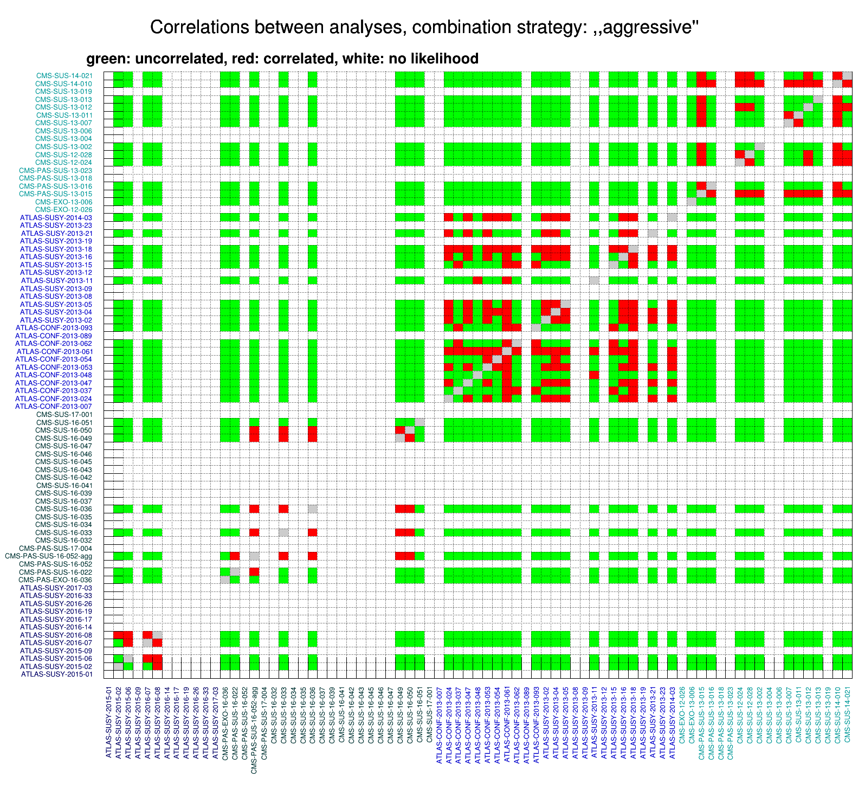
Combination of analyses
Joint likelihoods for
combining analyses
many pairs of analyses can be treated as approximately uncorrelated in the
“aggressive combination” scheme
(the green blocks, think e.g. of a 8 TeV ATLAS result and a
13 TeV CMS result)
Started a Les Houches
project to systematically study correlations between analyses:
https://phystev.cnrs.fr/wiki/2019:groups:tools:correlations

Slide 12
Combination of analyses
The Z score
finds optimal combinations of analyses, combinability given by matrix in slide before
if a result can be added to a combination, it has to be added.
will implement different criteria for what is considered “optimal”. In this talk, optimal means, it finds the combination that maximally falsifies the standard model hypothesis in a likelihood ratio test.
So we optimize for the test statistic of the hypothesis test, where the standard model is the null hypothesis and the BSM model is the alternative hypothesis with an overall signal strength multiplier as the only free parameter. That way Neyman-Pearson Lemma holds, at least in principle, as μ=0 gives the Standard Model. Since I search for models that maximize T, I do not compute a p value, as it would be misleading. One should refrain from giving the test statistic a probabilistic meaning. In the next iteration I will want to replace it with a Bayes factor.
All models have to evade all exclusions of all results in the SModelS database (though I relaxed the requirement a bit since strictly speaking we are “allowed” to violate one out of twenty 95% exclusions).

Slide 13
CMS analyses with no digital SMS results
CMS analyses with no (simple) way to construct an approximate likehood
Houston, we have a problem!
CMS-PAS-SUS-18-006
CMS-PAS-SUS-19-005
CMS-PAS-SUS-18-005
CMS-PAS-SUS-18-005
CMS-SUS-17-011
CMS-SUS-17-006
CMS-SUS-16-017
CMS-SUS-16-048
CMS-SUS-16-008
CMS-SUS-16-003
CMS-SUS-15-012
CMS-SUS-15-004
CMS-SUS-15-011
CMS-SUS-15-005
CMS-SUS-15-006
CMS-SUS-15-003
CMS-SUS-17-003
CMS-SUS-17-012
CMS-PAS-SUS-17-002
CMS-PAS-SUS-17-004
CMS-SUS-16-032
CMS-SUS-16-034
CMS-SUS-16-035
CMS-SUS-16-037
CMS-SUS-16-039
CMS-SUS-16-041
CMS-SUS-16-042
CMS-SUS-16-043
CMS-SUS-16-045
CMS-SUS-16-046
CMS-SUS-16-047
CMS-SUS-17-001
CMS-EXO-12-026
CMS-PAS-SUS-13-018
CMS-PAS-SUS-13-023
CMS-SUS-13-004
CMS-SUS-13-006
CMS-SUS-13-019
(The fix would be utterly simple. Just put the root files online, as was done in the past)
(once we have expected upper limits, we are in the business. give us efficiency maps and we can go to the moon)

Slide 14
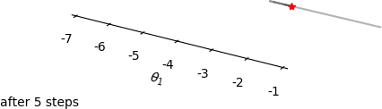
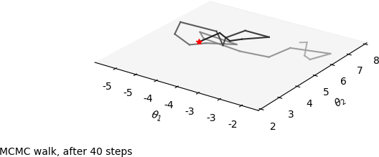
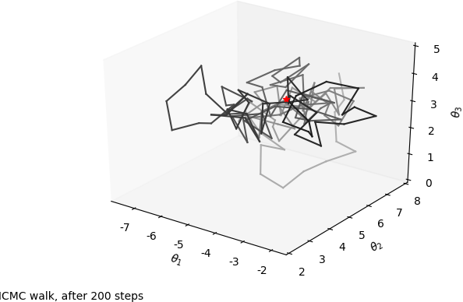
Second new SModelS ingredient:
model builder
currently a Metropolis-Hastings-type random walk in the space of all models that can be described with semantically correct SLHA files (actually currently only a subset).
in the future will want to try a neural network that learns “Z”. Should be faster, as long was we want only central values, and not complete distributions.
We begin with the standard model, all BSM particles being “frozen out”
(put to high masses). We then take
random steps in model space.
Possible random steps:
    freezing a particle out
    unfreezing a particle
    changing a particle’s mass
    changing a particle’s branchings
    changing a particle’s signal strength
    modifier
    (we use the NLO SUSY cross sections for defaults)
All models need to obey all (relaxed)
SModelS exclusions. So both antagonists
(the “excluder” and the “excess finder”)
experience the same biasses
from the incomplete SModelS database.
We can punish the algorithm for
introducing new particles.
http://www.hephy.at/user/wwaltenberger/models/mcmc.webm

Slide 15


Ach, come on – it’s just a game!
Loosely speaking, we can think of it as a game, in the game-theoretical sense. Played between the algorithm that tries to exclude the model (“excluder”, “experimentalist”), and the algorithm that tries to build a model that maximally violates the Standard Model hypothesis (“builder”, “theorist”).
r_{i}: predicted signal strength / experimental upper limit, for the result (combination) “i”
(Ok, ok, I guess one could also think of it as “optimization with constraints”.
But that sounds so much less cool.)

Slide 16
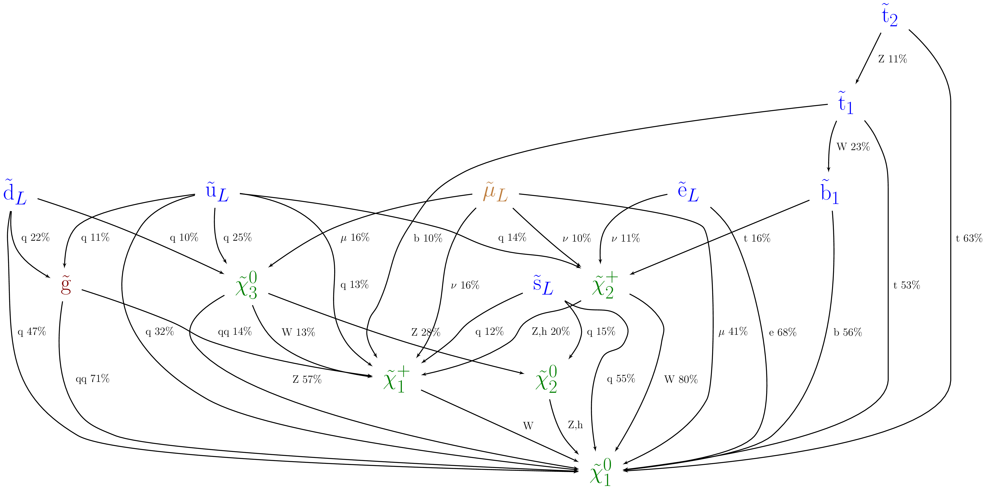
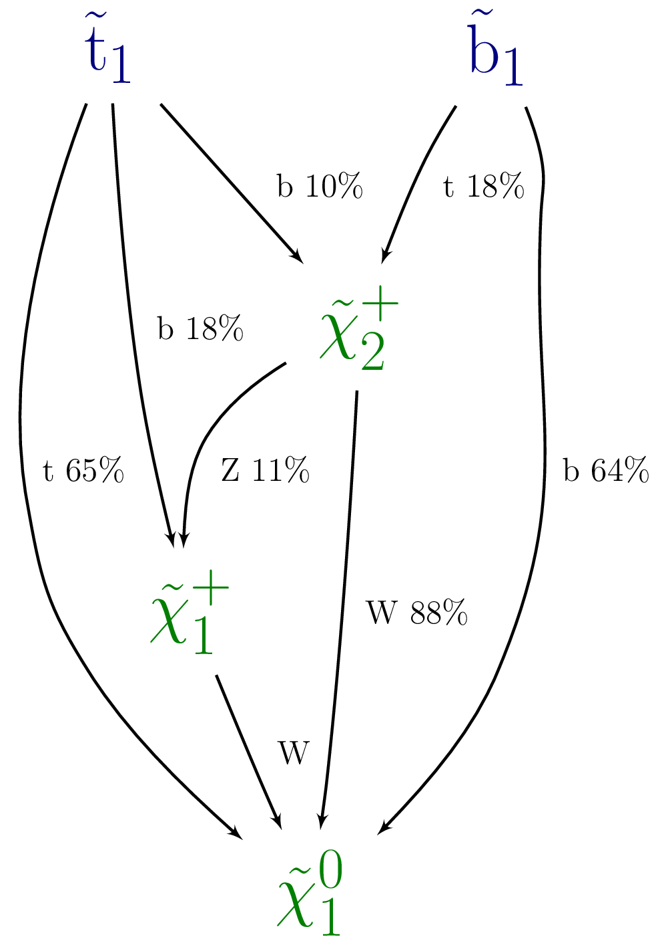
Trimming
After having found models of interest, we trim them. First we try to take out particles and see if that significantly reduces the score. Decays are next.

Slide 17
To repeat: this is what the algorithm found after O(100) steps
Z=3.25
CMS-SUS-16-032:T2bb r=0.56, r_{exp}=N/A
CMS-SUS-16-036:T2bb r=0.49, r_{exp}=0.29
CMS-SUS-16-033:T2bb r=0.35, r_{exp}=0.34
(And no, I have no idea if the model was still interesting, were we to
fully recast all analyses)

Slide 18
To repeat: this is what the algorithm found after O(100) steps
Z=3.25
Proof-of-concept only
Many aspects are still buggy / wrong / crude / ….
CMS-SUS-16-032:T2bb r=0.56, r_{exp}=N/A
CMS-SUS-16-036:T2bb r=0.49, r_{exp}=0.29
CMS-SUS-16-033:T2bb r=0.35, r_{exp}=0.34
(And no, I have no idea if the model was still interesting, were we to
fully recast all analyses)

Slide 19
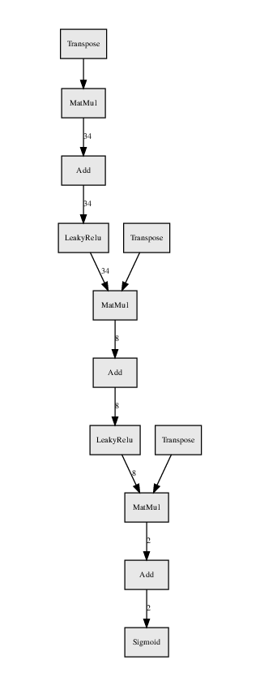
To Do
Try learning different criteria, e.g. most “spectacular” signatures that miraculously evade all SMS constraints.
Train a neural network that predicts the objective function (e.g. the significance Z for the builder, r_{max} for the excluder) → differentiable function, should make for much faster convergence (as long as we only want central values)
Add the most recent results (CMS, what shall we do?)
Allow also for displaced signatures (widths as free parameters?computed widths?) [SModelS 2.0.0]
Constraints from measurements may be added via likelihoods on Wilson coefficients.
Compute the distribution of the test statistic T under the Standard Model assumption.
SModelS actually gives much more detailed feedback than just a single test statistic. Make use of it.
Long term vision: to have a full, real sample of a posterior in model space.
Can we / should we move from SLHA files to arbitrary Lagrangians (described eg as UFO or Sarah files)?

Slide 20
Epilogue
The model shown was obtained before we had our experimental “likelihoods from limits” code in place. After adding these likelihoods, a few CMS results (CMS-SUS-16-051, CMS-SUS-16-033) pretty much ruined the Z score. Here is the best model obtained so far after having added these likelihoods:

Slide 21
Backup

Slide 22
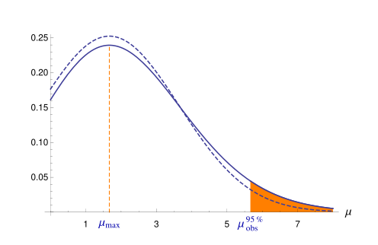
Likelihoods from limits
When we have observed and expected upper limits, we compute an approximate truncated Gaussian likelihood from it (procedure taken from arXiv:1202.3415)
ArXiv:1202.3415

Slide 23
Communication of Likelihoods
CMS has introduced the simplified likelihoods (thanks a lot!),
CMS-NOTE-2017-001
The authors of that paper have addressed a conceptual problem
when dealing with “deeply Poissonian regions (very small expected counts) in version 2 of the formalism,
“The Simplified likelihood framework”
ATLAS has only recently published their alternative to CMS’es simplified likelihoods,
ATL-PHYS-PUB-2019-029
SModelS has implemented CMS’es simplified likelihoods, will implement ATLAS’es histogram-factory based approach in the future.

Slide 24
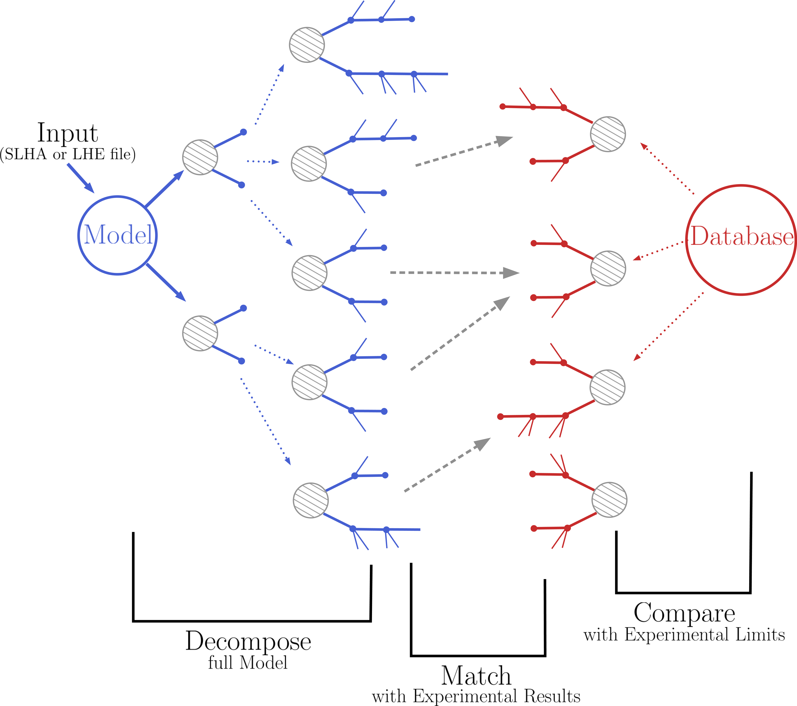
Recap: the Idea behind
SModelS
SModelS confronts theories beyond the Standard Model (BSM) with LHC search results by decomposing full models into their simplified models topologies, and comparing the cross section predictions of these individual topologies with a database of SMS results.
Simplified
model
Speed
Full
simulation
Constraining power

Slide 25
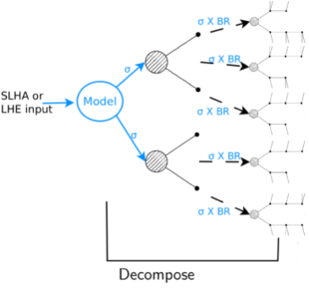
Recap: How SModelS works
1) Decomposition of a fundamental model
Input: SLHA file (mass spectrum, BRs) or LHE file (parton level)
Currently the model must have a Z₂ symmetry
The decomposition produces a set of simplified model topologies (dubbed “elements”)

Slide 26
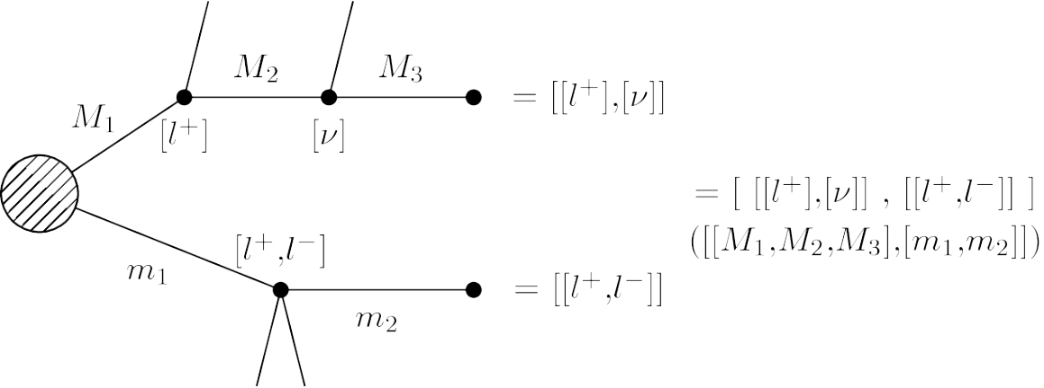
Recap: How SModelS works
2) Description of the topology in the SModelS formalism
We (currently) ignore spin, color, etc of the BSM particles
It is model independent, there is no reference
to the original model
Each topology is described by:
Topology shape + final states
BSM masses
σ x BR

Slide 27
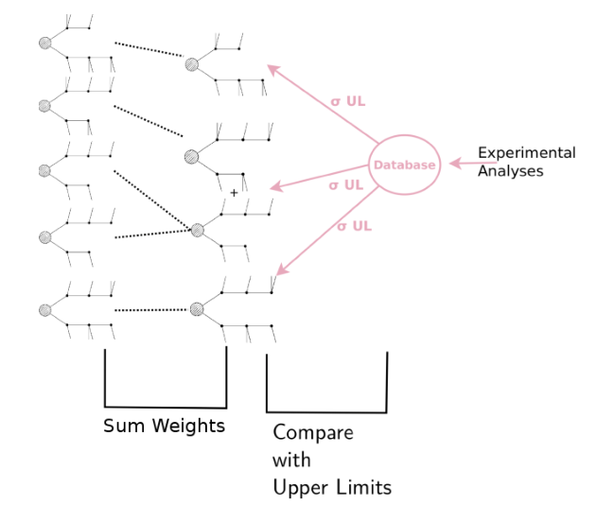
Recap: How SModelS works
3) Comparison of predicted signal strengths
with experimental result:
Upper Limit Results:
Predicted signal strength = σ x BR
Experimental result: σ_{UL}
Efficiency Map Results:
Predicted signal strength = ∑ σ x BR x ε
Experimental result: σ_{UL}=N_{UL}/ L from N_{observed}, expected(BG), error(BG)
r = predicted / σ_{UL}
Model is excluded if most constraining analysis has r > 1

