Slide 1
Artificial Model Building
Wolfgang Waltenberger (ÖAW and Uni Vienna), June 2019
2

Slide 2
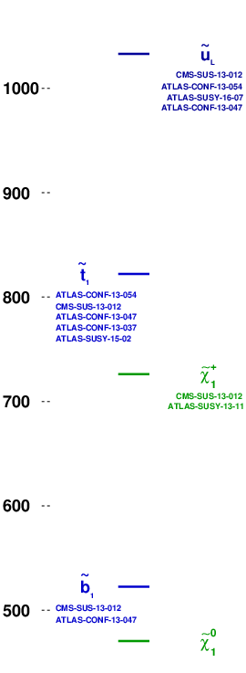
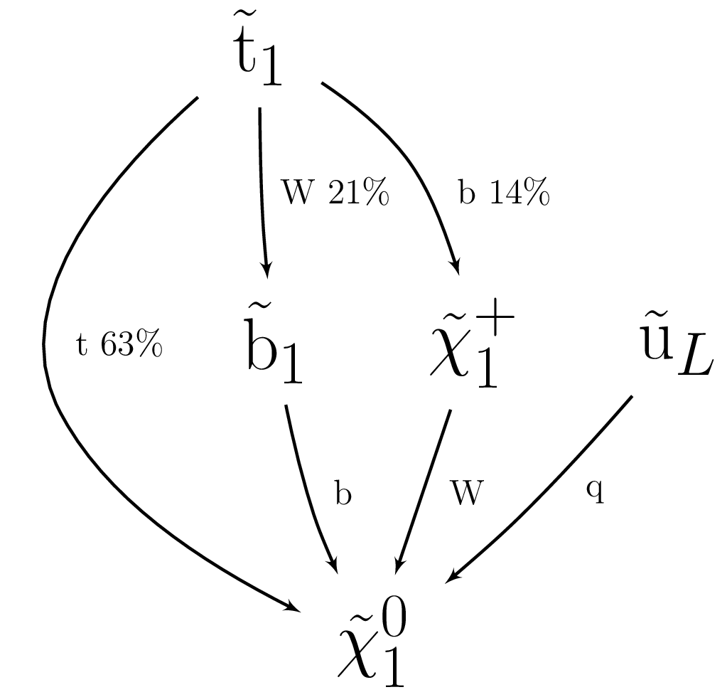
This – I shall claim – is an interesting BSM model
Z=3.23

Slide 3
This – I shall claim – is an interesting BSM model
Dark matter candidate +/- compatible with the WIMP miracle
Spectrum +/- compatible with natural SUSY
(stop < 1 TeV, can accomodate a gluino < 2.5 TeV)

Slide 4
This – I shall claim – is an interesting BSM model
Dark matter candidate +/- compatible with the WIMP miracle
Spectrum +/- compatible with natural SUSY
(stop < 1 TeV, can accomodate a gluino < 2.5 TeV)
39 SMS results of the SModelS database apply.
None can exclude the model.
With r:= σ(theory)/σ(upper limit),
the highest r values are
CMS-SUS-16-032:T2bb r=0.83, r_{exp}=N/A
CMS-SUS-16-036:T2bb r=0.71, r_{exp}=0.42
CMS-SUS-16-033:T2bb r=0.50, r_{exp}=0.49

Slide 5
This – I shall claim – is an interesting BSM model
Dark matter candidate +/- compatible with the WIMP miracle
Spectrum +/- compatible with natural SUSY
(stop < 1 TeV, can accomodate a gluino < 2.5 TeV)
39 SMS results of the SModelS database apply.
None can exclude the model.
With r:= σ(theory)/σ(upper limit),
the highest r values are
CMS-SUS-16-032:T2bb r=0.83, r_{exp}=N/A
CMS-SUS-16-036:T2bb r=0.71, r_{exp}=0.42
CMS-SUS-16-033:T2bb r=0.50, r_{exp}=0.49
Consider that we combine the respective topologies and analyses listed on the left, and treat it as a single BSM model with an overall signal strength μ as the only free parameter. Testing for compatibility with the Standard Model results in a test statistic Z (significance) of 3.23.

Slide 6
How was this model constructed?

Slide 7
How was this model constructed?
Two new components on top of SModelS:
An analysis combiner algorithm that find the optimal “legal” combination of analysis results.
In this talk, “optimal” means “maximizing the significance Z”. Other criteria can
however be employed (finding BSM models that are interesting in a different way).
Different choices of what are “legal” combinations are possible. In this talk I am using “aggresive” combination: signal regions must be clearly distinct. Control regions are ignored.
A “random walker” that randomly constructs BSM models in a Metropolis-like fashion.
The walker may randomly introduce and “kill” BSM particles.
It may randomly change masses of particles.
It may randomly change branching ratios.
The cross section is computed as if it were a SUSY model. However, the walker may randomly change particle-specific signal strength modifiers that are applied to the computed cross sections.

Slide 8

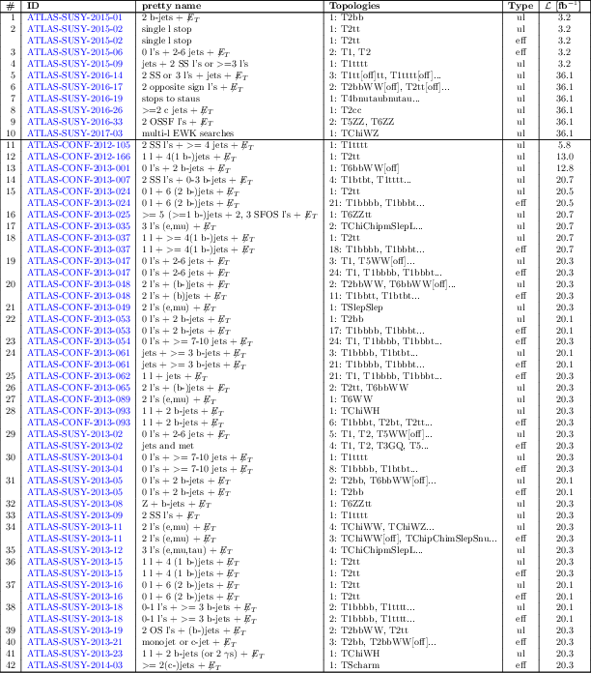
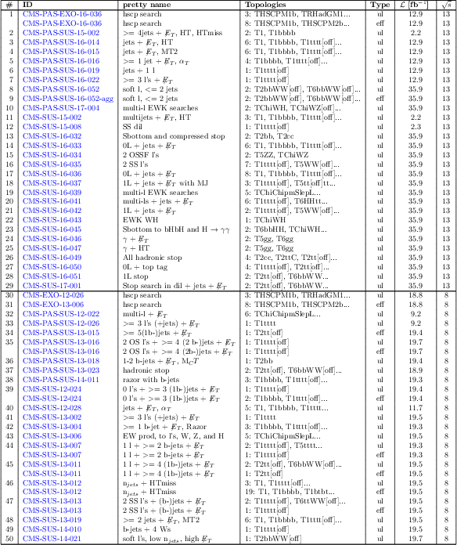
SModelS database
The current database consists of almost 50 CMS and almost 50 ATLAS results.
https://smodels.github.io/docs/ListOfAnalyses

Slide 9
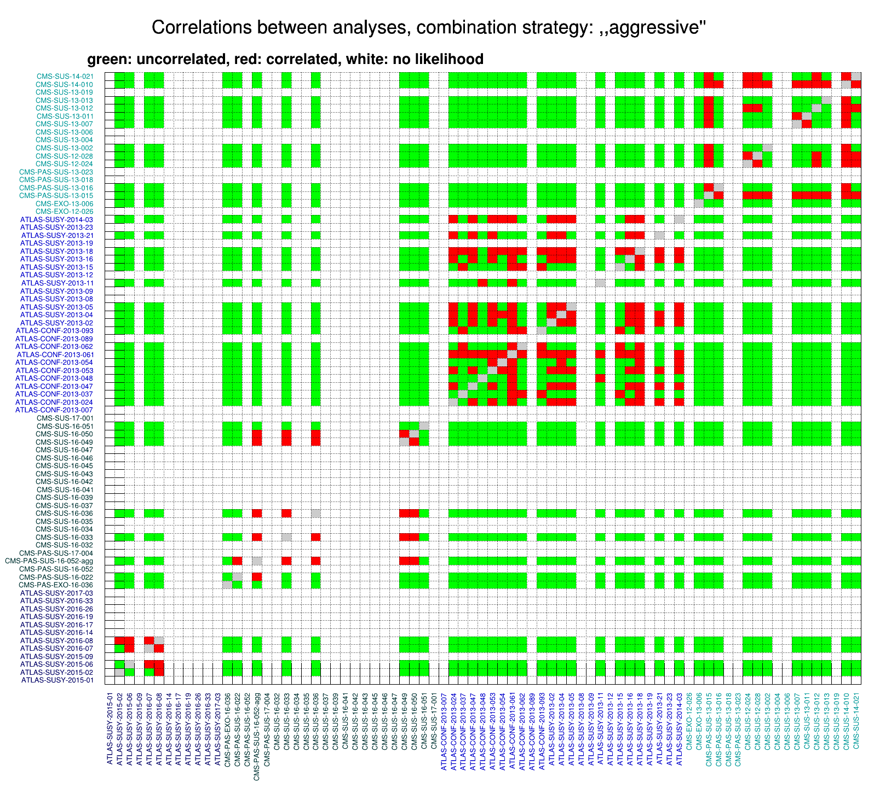
Combination of analyses
Joint likelihoods for
combining analyses
many pairs of analyses can be treated as approximately uncorrelated
(the green blocks, think e.g. of a 8 TeV ATLAS result and a
13 TeV CMS result)

Slide 10

Combination of analyses
The Z score
finds optimal combinations of analyses, combinability given by matrix in slide before
if a result can be added to a combination, it has to be added.
will implement different criteria for what is considered “optimal”. In this talk, optimal means, it finds the combination that maximally falsifies the standard model hypothesis in a likelihood ratio test.
So we optimize for the test statistic of the hypothesis test, where the standard model is the null hypothesis and the BSM model is the alternative hypothesis with an overall signal strength multiplier as the only free parameter. That way Neyman-Pearson Lemma holds, at least in principle, as μ=0 gives the Standard Model. Since I search for models that maximize T, I do not compute a p value, as it would be misleading. I will refrain from giving the test statistic a probabilistic meaning (at least for now).
All models have to evade all exclusions of all results in the SModelS database (though I relaxed the requirement a bit since strictly speaking we are “allowed” to violate one out of twenty exclusions).

Slide 11
CMS analyses with no digital SMS results
CMS analyses with no (simple) way to construct an approximate likehood
Houston, we have a problem!
CMS-PAS-SUS-18-006
CMS-PAS-SUS-19-005
CMS-PAS-SUS-18-005
CMS-PAS-SUS-18-005
CMS-SUS-17-011
CMS-SUS-16-017
CMS-SUS-16-048
CMS-SUS-16-008
CMS-SUS-16-003
CMS-SUS-15-012
CMS-SUS-15-004
CMS-SUS-15-011
CMS-SUS-15-005
CMS-SUS-15-006
CMS-SUS-15-003
CMS-SUS-17-003
CMS-SUS-17-012
CMS-PAS-SUS-17-002
CMS-PAS-SUS-17-004
CMS-SUS-16-032
CMS-SUS-16-034
CMS-SUS-16-035
CMS-SUS-16-037
CMS-SUS-16-039
CMS-SUS-16-041
CMS-SUS-16-042
CMS-SUS-16-043
CMS-SUS-16-045
CMS-SUS-16-046
CMS-SUS-16-047
CMS-SUS-17-001
CMS-EXO-12-026
CMS-PAS-SUS-13-018
CMS-PAS-SUS-13-023
CMS-SUS-13-004
CMS-SUS-13-006
CMS-SUS-13-019
(The fix would be utterly simple. Just put the root files online, as was done in the past)
(once we have expected upper limits, we are in the business. give us efficiency maps and we can go to the moon)

Slide 12
Artificial model building
Second new SModelS ingredient: model builder
currently a Metropolis-Hastings-type random walk in the space of all models that can be described with semantically correct SLHA files (actually currently only a subset).
in the future will want to try a neural network that learns “Z”. Should be faster, as long was we want only central values, and not complete distributions.
We begin with the standard model, all BSM particles being “frozen out” (put to high masses). We then take random steps in model space.
Possible random steps:
    freezing a particle out
    unfreezing a particle
    changing a particle’s mass
    changing a particle’s branchings
    changing a particle’s signal strength modifier
All models need to obey all (relaxed)
SModelS exclusions.

Slide 13
Future
Try learning different criteria, e.g. most “spectacular” signatures that miraculously evade all SMS constraints.
Train a neural network that predicts the objective function (i.e. the significance Z) → differentiable function, should make for much faster convergence (as long as we only want central values)
Add the most recent results
(CMS, what shall we do?)
Allow also for displaced
signatures
Constraints from measurements
may be added via likelihoods
on Wilson coeffients.

Slide 14
Backup

Slide 15
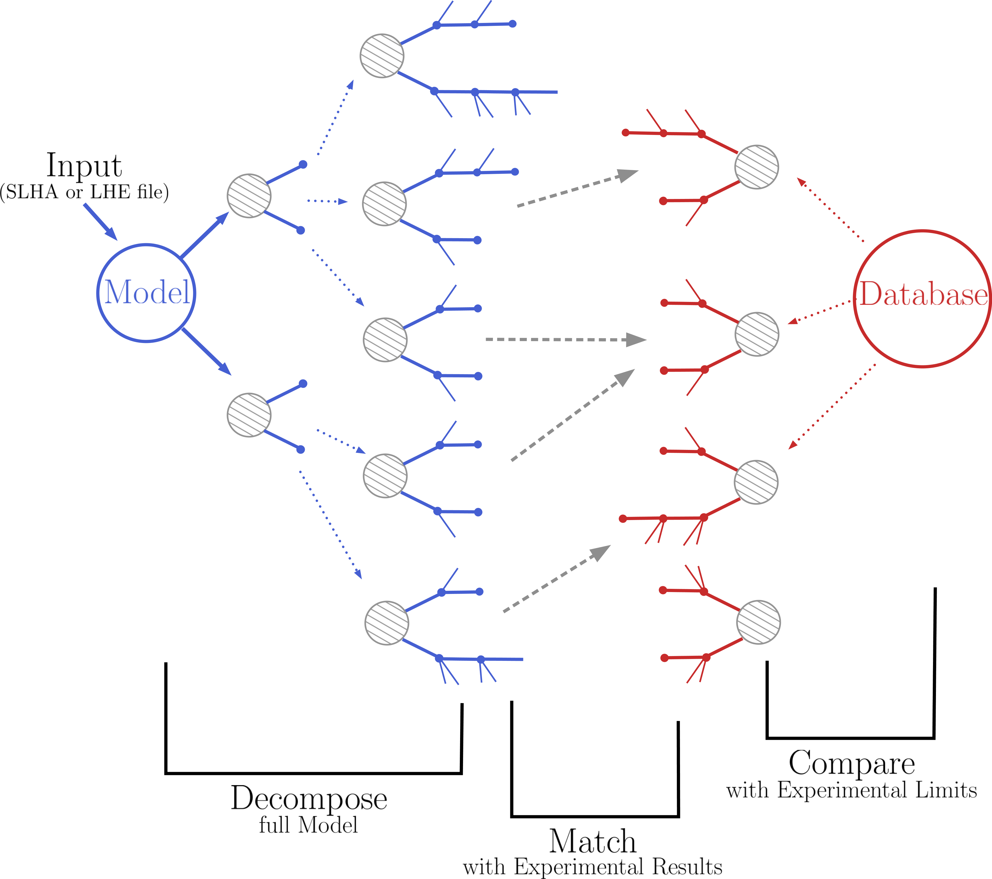
Recap: the Idea behind
SModelS
SModelS confronts theories beyond the Standard Model (BSM) with LHC search results by decomposing full models into their simplified models topologies, and comparing the cross section predictions of these individual topologies with a database of SMS results.
Simplified
model
Speed
Full
simulation
Constraining power

Slide 16
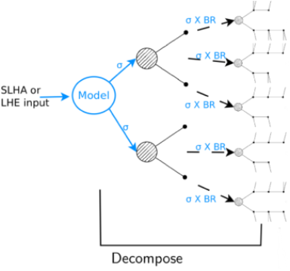
Recap: How SModelS works
1) Decomposition of a fundamental model
Input: SLHA file (mass spectrum, BRs) or LHE file (parton level)
Currently the model must have a Z₂ symmetry
The decomposition produces a set of simplified model topologies (dubbed “elements”)

Slide 17
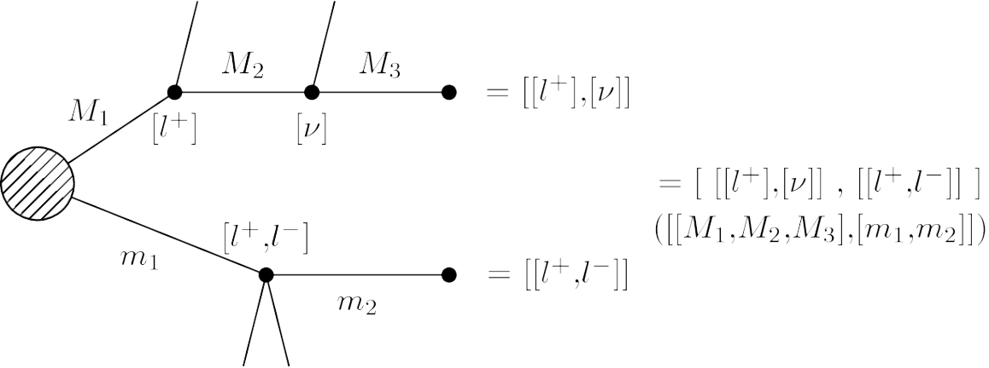
Recap: How SModelS works
2) Description of the topology in the SModelS formalism
We (currently) ignore spin, color, etc of the BSM particles
It is model independent, there is no reference
to the original model
Each topology is described by:
Topology shape + final states
BSM masses
σ x BR

Slide 18
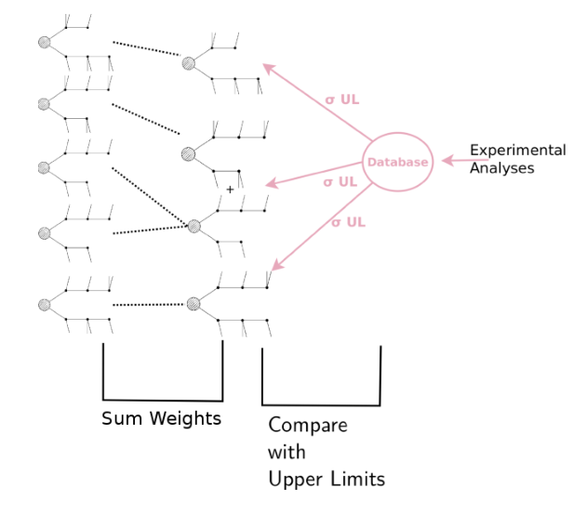
Recap: How SModelS works
3) Comparison of predicted signal strengths
with experimental result:
Upper Limit Results:
Predicted signal strength = σ x BR
Experimental result: σ_{UL}
Efficiency Map Results:
Predicted signal strength = ∑ σ x BR x ε
Experimental result: σ_{UL}=N_{UL}/ L from N_{observed}, expected(BG), error(BG)
r = predicted / σ_{UL}
Model is excluded if most constraining analysis has r > 1

