Slide 1
The 246 keV LZ nuclear recoil event
and the LHC
October 2026

Slide 2
Caveat: I am absolutely not an expert, most of the material here I researched for the first time for this talk, likely made errors. Tell me if you think I misunderstood something.
But one question I will be raising will be this:
What if we have SUSY but with zero or almost zero ewkino mixing?
(This is me giving up a potential nice story climax
in order to make things easier to digest)

Slide 3
So what’s the challenge for model builders?
Need to explain the event with high recoil energy but make sure you do not predict many low-recoil events (cause there arent any)
“Endothermic, boosted, q-dependent, exothermic”
Endothermic: we have an X1 N → X2 N process, with dm(X2,X1) approx 400 keV. Higgsinos might fit the bill.
Boosted: we are seeing boosted DM particles, not thermal ones
boost needs to be larger than LMC boost, what could boost them so much (Mukul might know)
Q-dependent: make the scattering process vastly q-dependent (pseudo-scalars as mediators?)
Exothermic: we have an X2 N → X1 N process
(what populates X2? Mukul might know)

Slide 4
So what’s the challenge for model builders?
Need to explain the event with high recoil energy but make sure you do not predict many low-recoil events (cause there arent any)
[plus get the solar neutrino flux right]
For discussions re LC interplay, allow me to very broadly group into three categories:
A. electroweak multiplets (e.g. higgsinos)
For the endothermic, exothermic explanations we need X2, X1 with small mass gaps: (SUSY) electroweak multiplets to the rescue
B. DM + mediators (such as pseudoscalars)
For e.g. DM singlets, production via mediators, some mediators (e.g. pseudoscalars) would have an appropriate q-dependency
C. exotics
For e.g. the boosted DM explanation: hic sunt dracones, anything goes

Slide 5
A. Electroweak multiplets, e.g. higgsinos
SUSY-type model with (almost purely) higgsino DM models.
LHC implication: (most likely) higgsino searches
Current status: most interesting! Allow me to zoom in on this later

Slide 6
B. DM plus mediators
DM particles in the 100 – 1000 GeV range, mediators in the 500 – 5000 GeV range.
Mediator could be axion-like, pseudoscalar (interaction needs strong q-dependence)
LHC implication: typical DM searches plus typical mediator searches, like resonance searches
Current LHC status: I am not aware of significant excesses in the resonance
searches (but in SModelS we dont yet have much meta statistics on this)

Slide 7
C. boosted DM and other more exotics
LHC implications: could be anything, really. Monojets, sure.
Could be very low masses because relativistic.

Slide 8
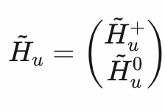
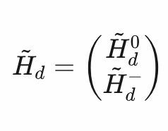
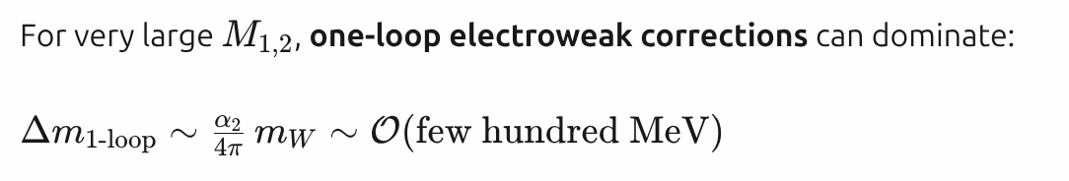
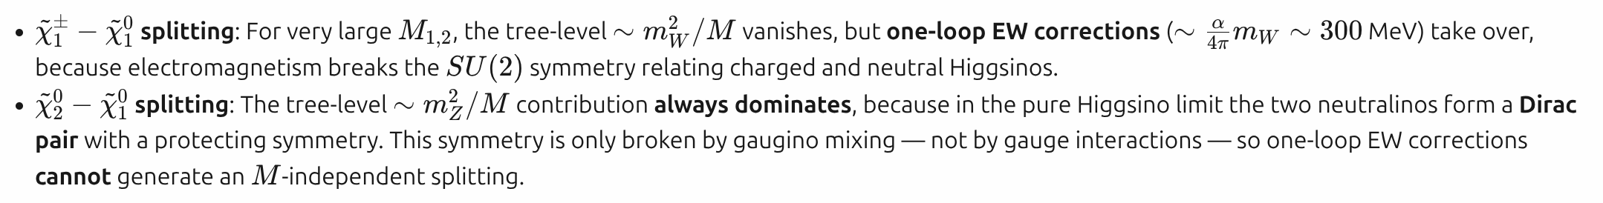
Recap: higgsinos!
In SUSY we have two higgsino doublets (b/c we need two higgs doublets b/c holomorphism of superpotential b/c anomaly cancellation)
Generally, the higgsinos mix with the Winos and Binos to form the neutralinos and charginos
Let’s now assume that the LSP (“N1”) is an (almost) pure higgsino. In this case, N1, N2, C1 are approximately mass degenerate.

Slide 9
higgsinos!
Summary: for a pure higgsino case we should
*) get an N2 that is basically mass degenerate with N1 (a 500 keV mass gap is basically mass degenerate here)
*) a C1 that is O(hundreds MeV) mass degenerate with N2, N1
N2 is then detector-stable, C1 becomes a long-lived particle (millimeters to meters of flightpath)
In typical SUSY at the LHC production of N1-N1 is negligible, N2-N1, C1-N1 and C1-C1 however are large.
N2-N1 should create “dark matter signatures” (monojets), C1-N1 and C1-C1 should create LLP and HSCP type signatures.
The other ewkinos (N3,N4,C2) would then be wino and bino-like, and at any other masses.

Slide 10
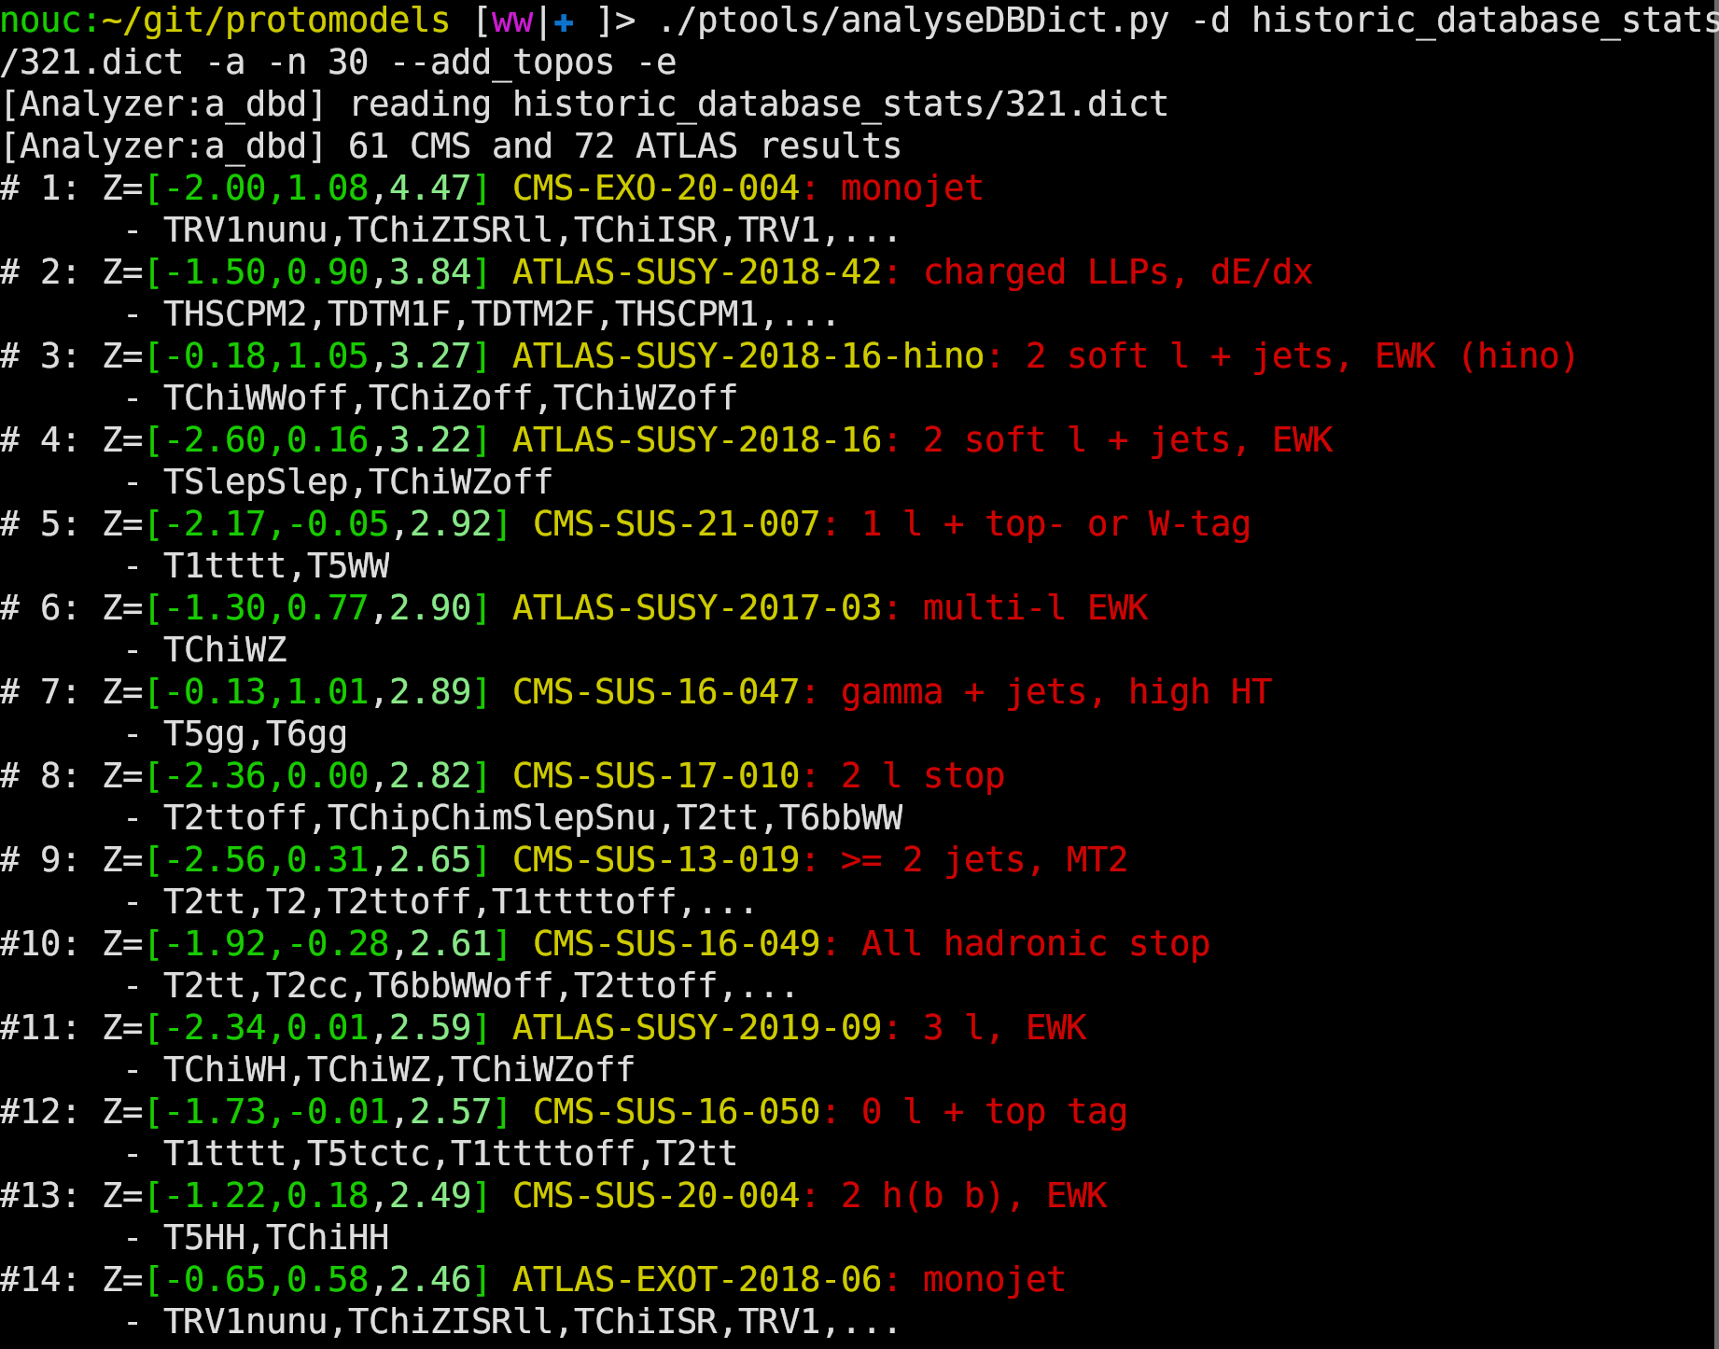
Biggest excesses we have in the SModelS database
Total number of analyses: 131 (or 163 if we count superseded)
N2-N1?
C1-N1?
C*-N*?
But: Many observations per analysis, complicated statistical models, complicated physics models

Slide 11
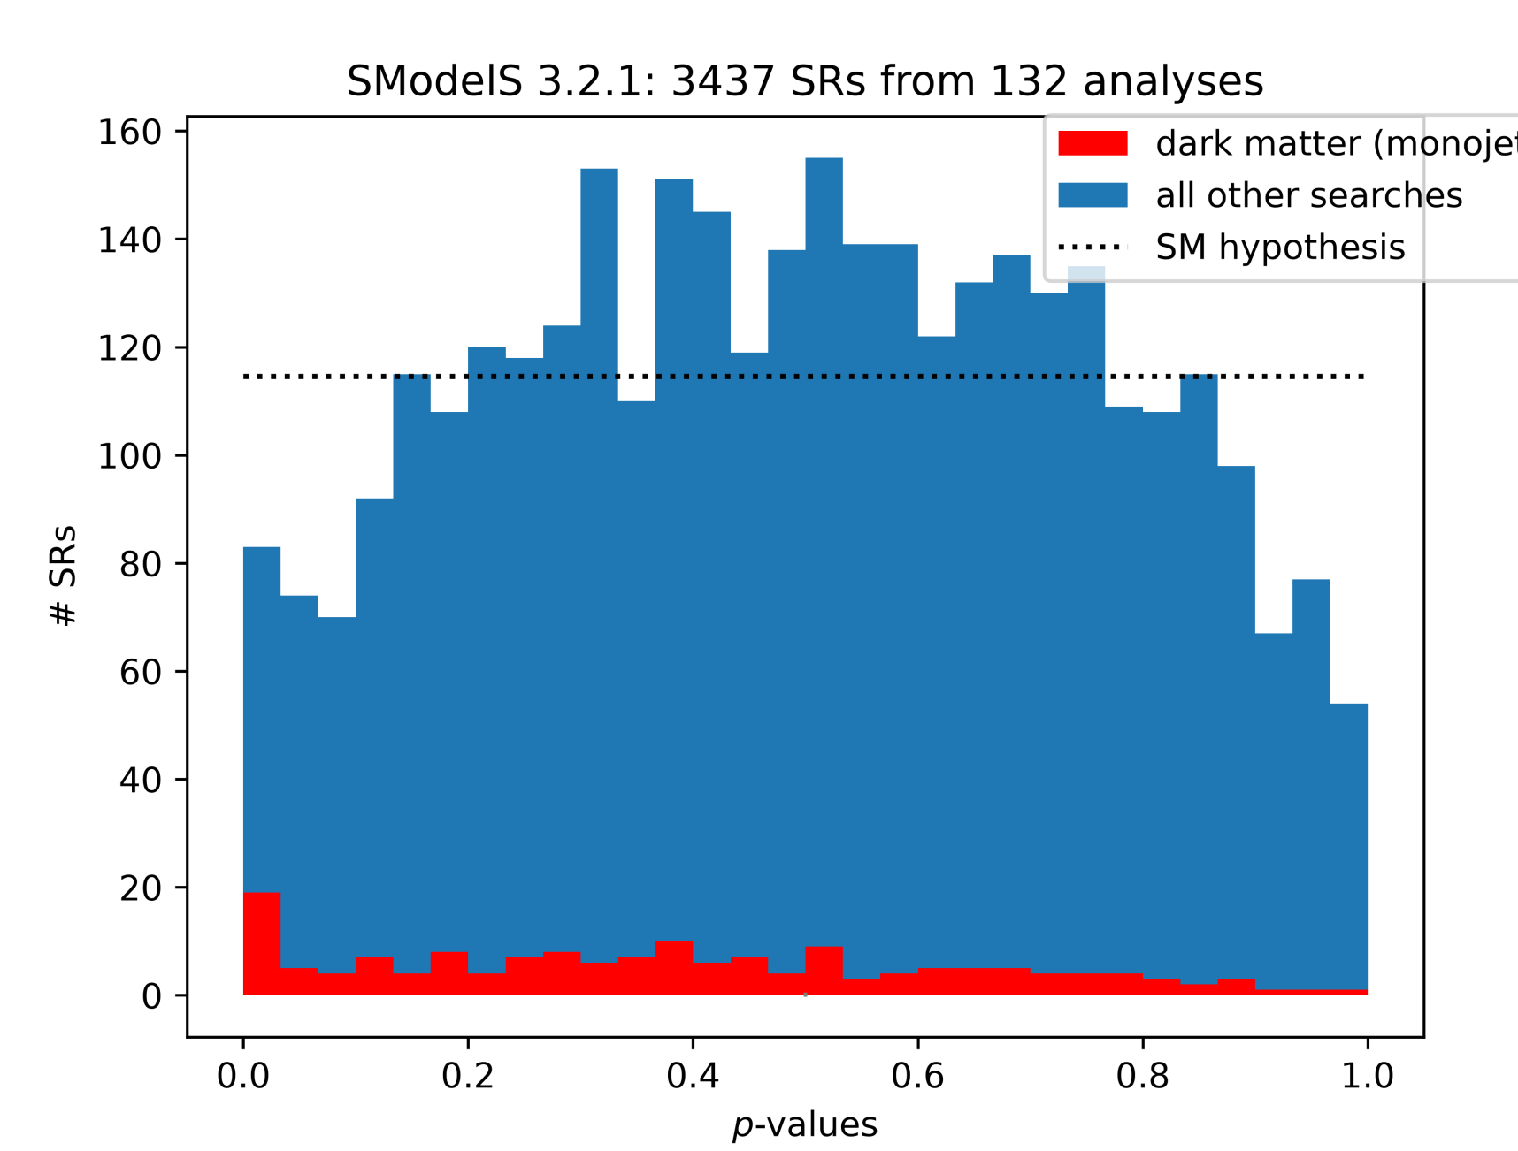
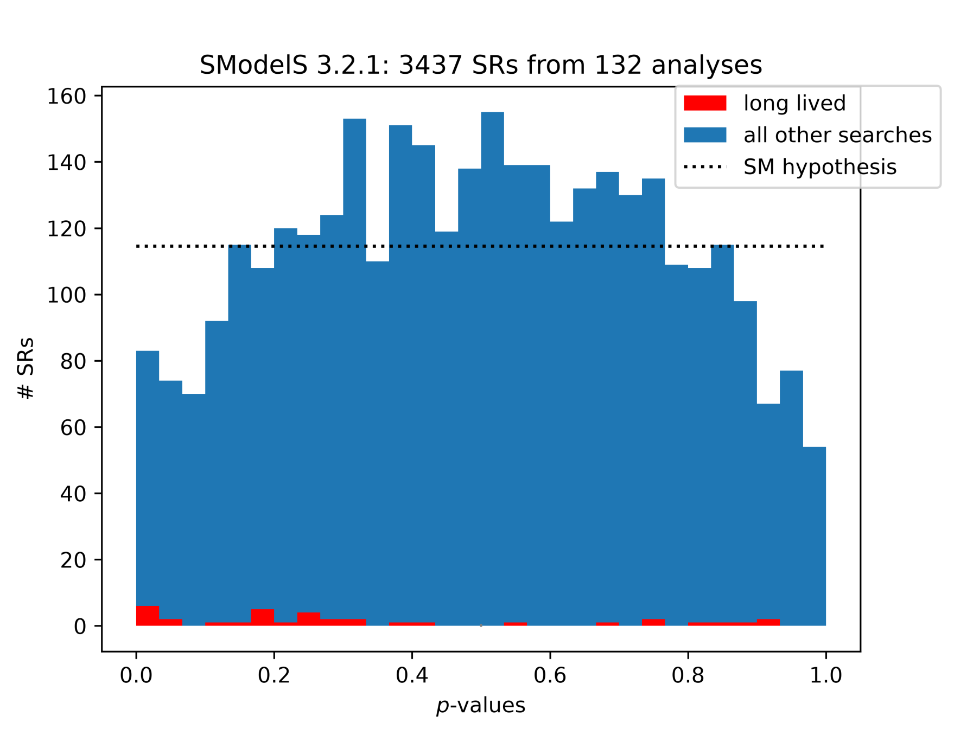
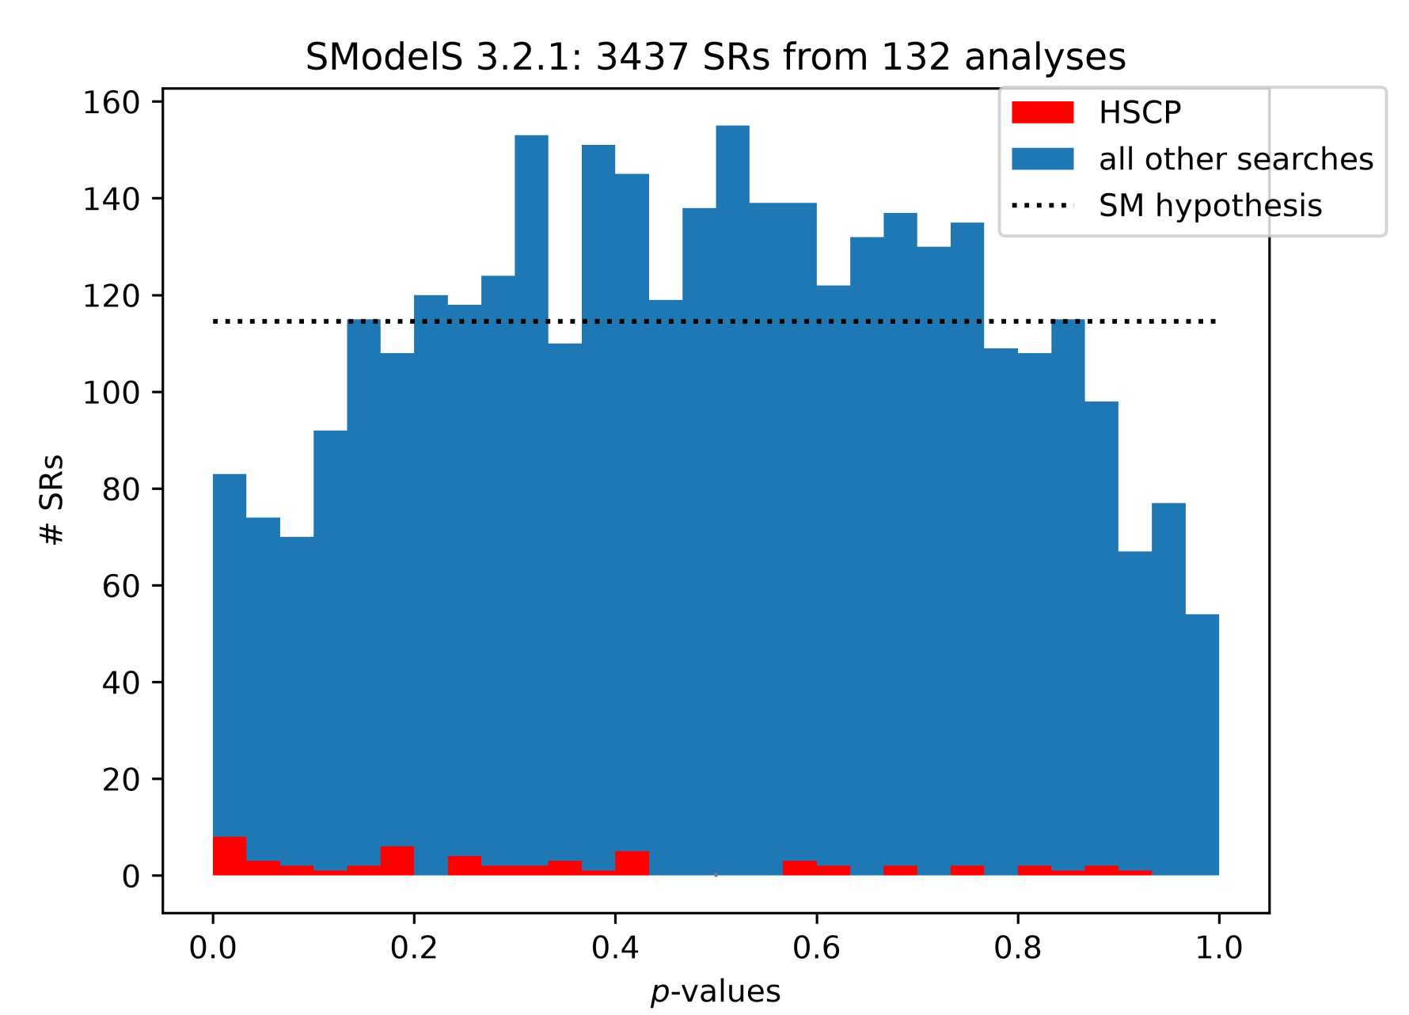
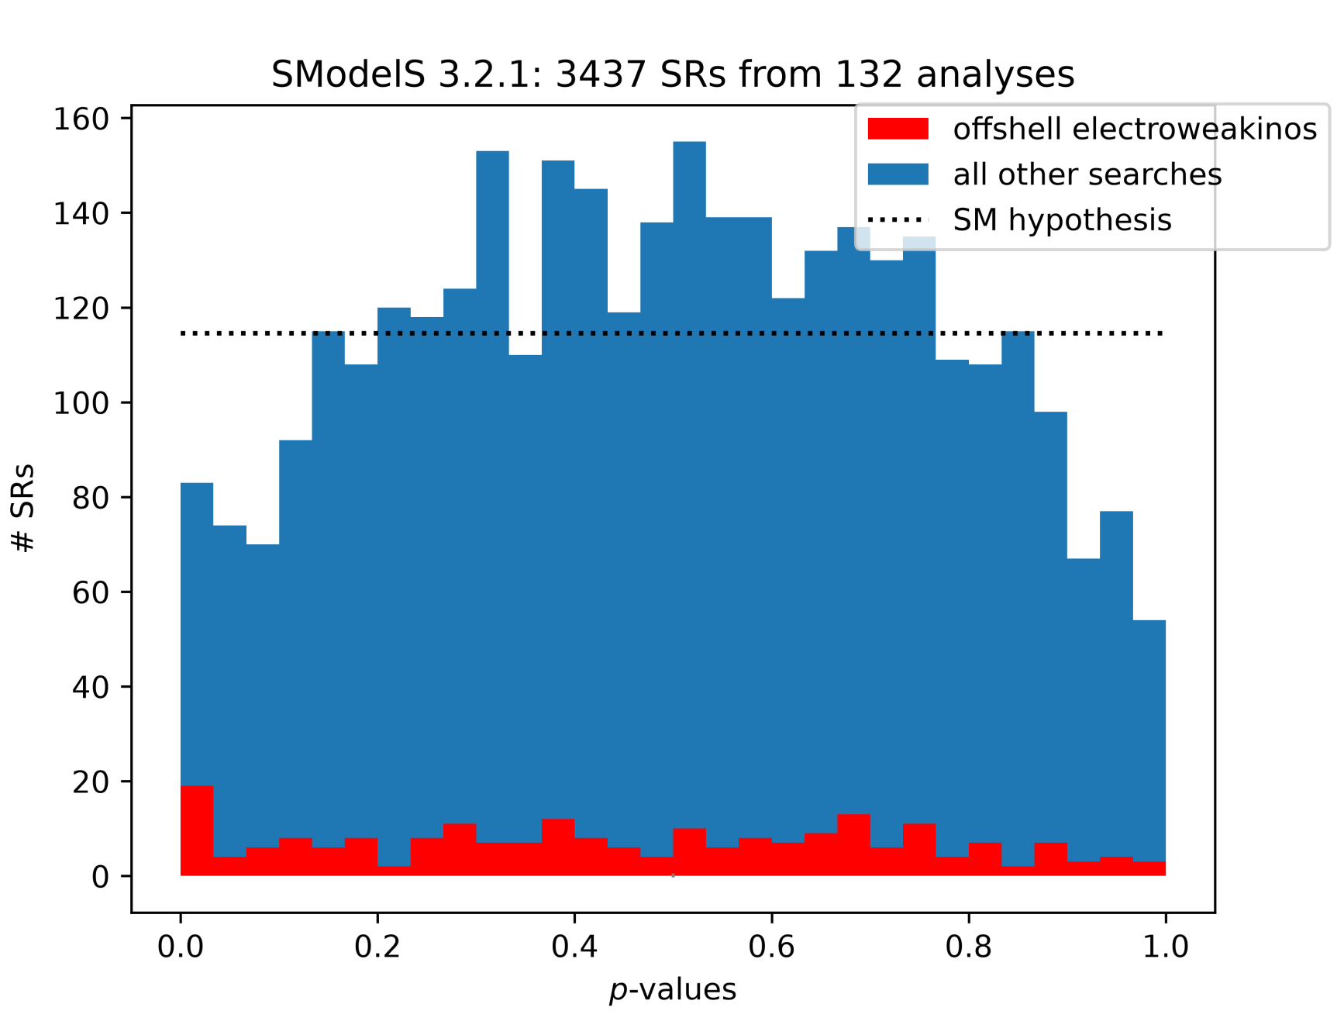
Biggest excesses we have in the SModelS database
Long-lived particles (C1-N1)
Monojet signatures (N2-N1)
Within the MSSM: contradiction/tension between offshell electroweakinos and rest
Within e.g. the NMSSM: all fine
Heavy stable charged
particles (C1-N1)
Offshell electroweakinos
(C2, N3)

Slide 12
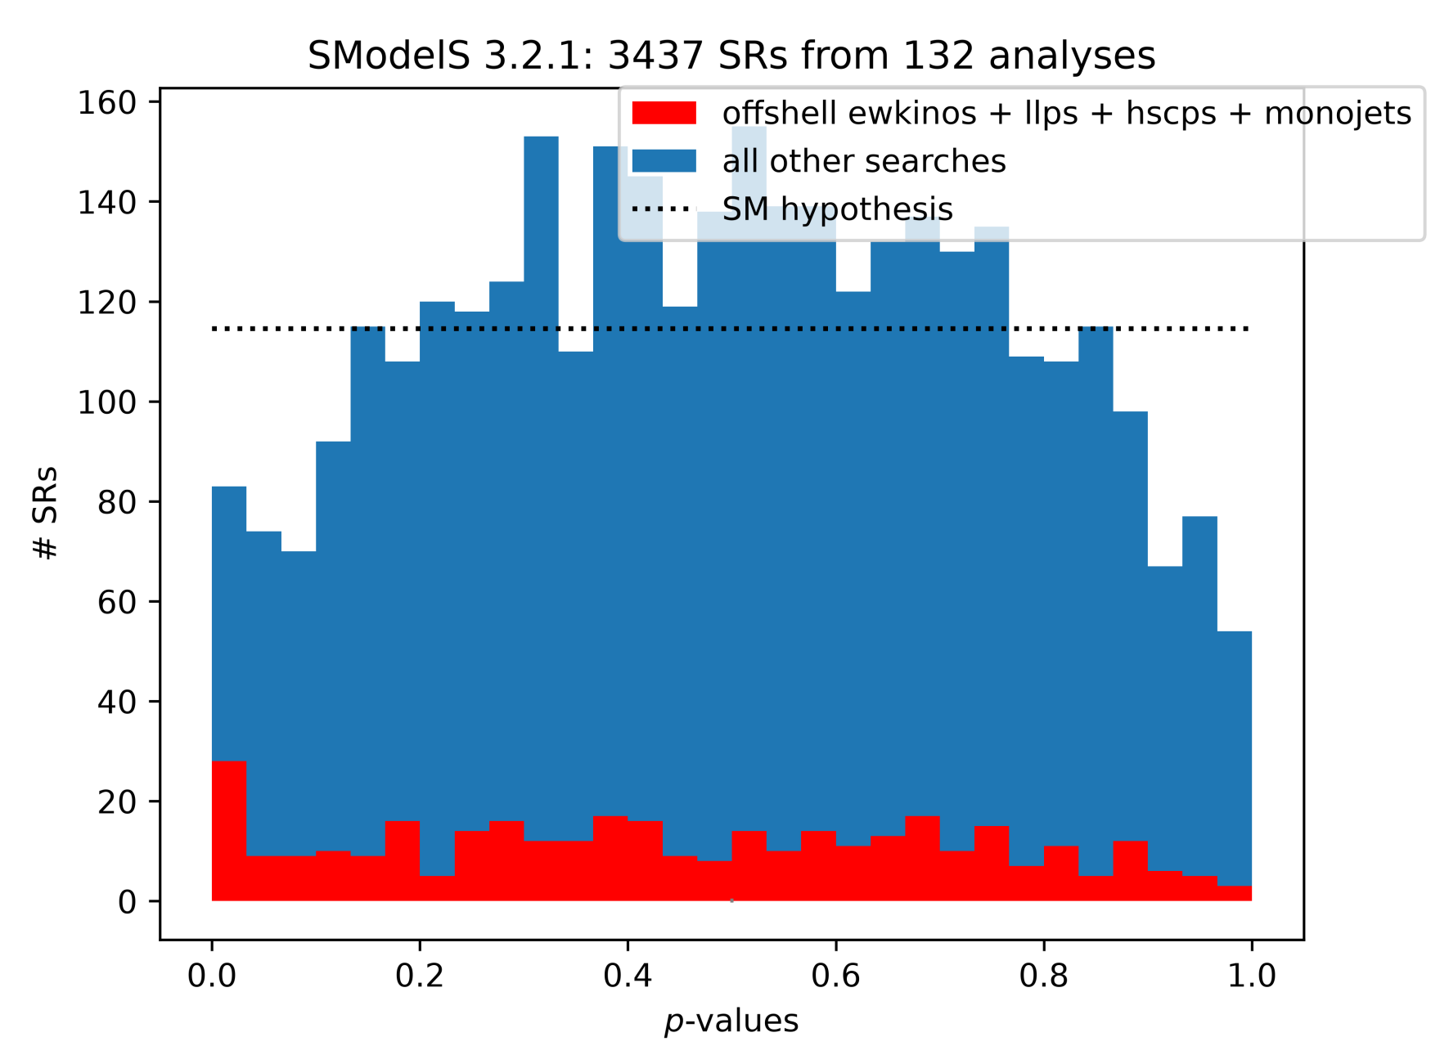
Biggest excesses we have in the SModelS database
For all the rest, we obtain an absurdly good agreement with the SM hypothesis

Slide 13
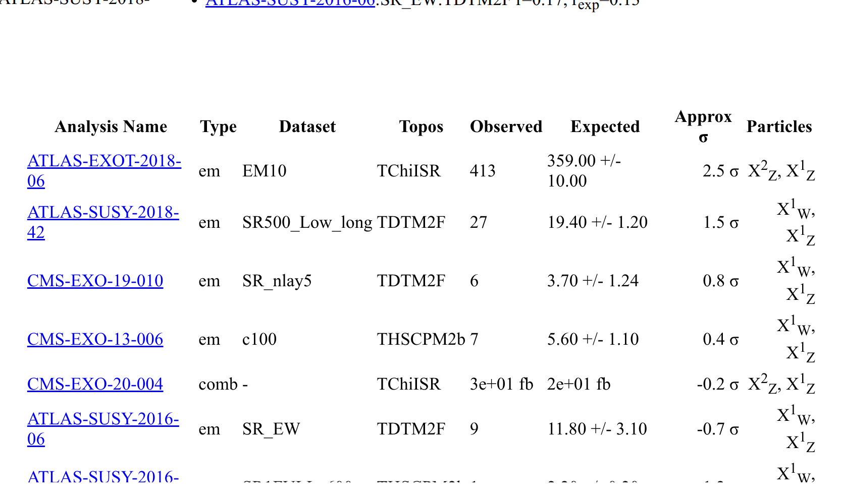
Wildly guessing, without our automated model building code running
(because we need a few extra features for that kind of scenario):
For pure (MSSM) higgsinos our excesses would want masses very roughly around 500 GeV

Slide 14
TODO:
Given that we need N1 to be almost purely higgsino,
we can determine the LHC cross sections as functions
of the LSP mass, and thus pin down the masses
TODO:
Where we have higgsinos, we should also have extra higgses. Need to add them next!
TODO:
If we want to explain the soft dileptons at dm approx 20 GeV, we cannot have pure higgsinos anymore.
Is there a sweet spot?

Slide 15
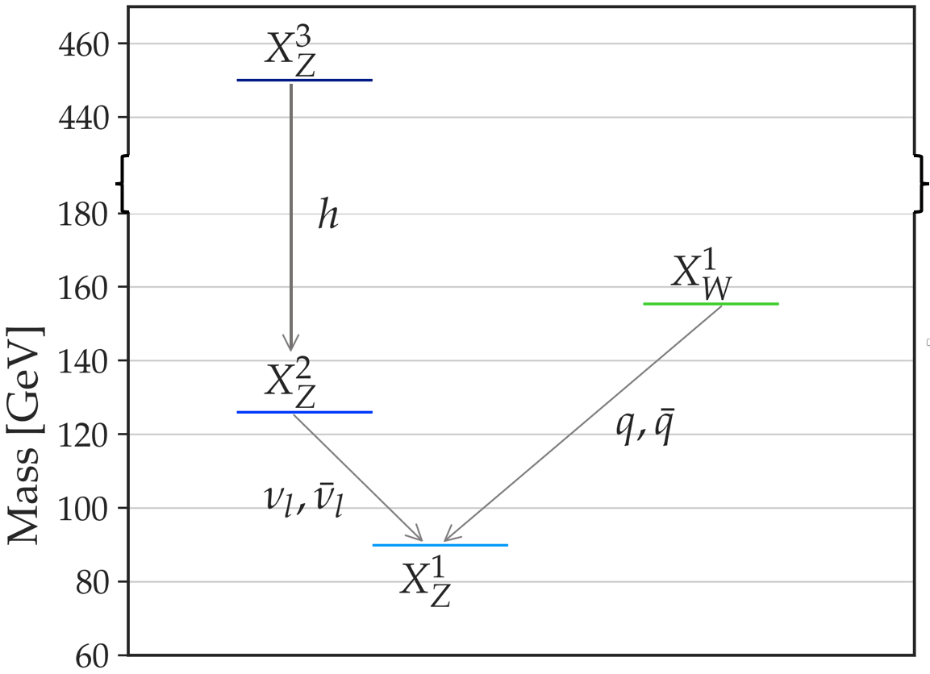
Here is such a prototype model, a “protomodel”
(We introduced this notion of a “protomodel”. It’s an incomplete BSM model, driven by data, not by theory considerations. LHC production cross sections are free parameters, BSM particle spins are left unspecified)
X^{i}Z = “neutralino-like”
X^{i}W = “chargino-like”
These were typical masses for wino-like neutralinos, for higgsino-like neutralinos: 500 GeV

Slide 16
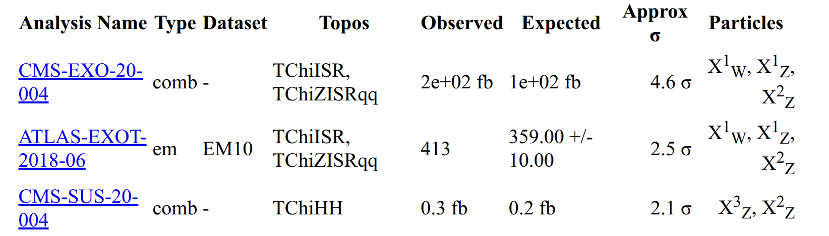
*) It contextualizes three of the biggest excesses we are
seeing in the databases, that are considered mutually independent.
*) we can thus approximately combine the likelihoods of these three analyses – by multiplying them.
*) Another result exists, but is correlated, so we cannot add it in that fashion (but it would also exhibit an excess)
“local 5.8 sigma” (if ndf=1) – with a GIGANTIC look elsewhere effect!

Slide 17
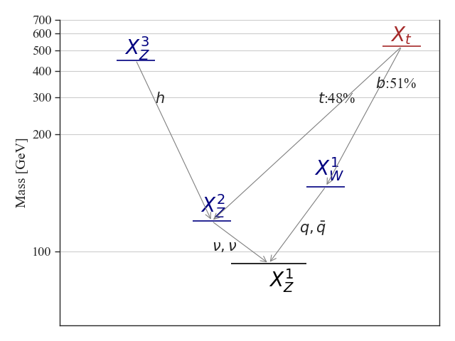
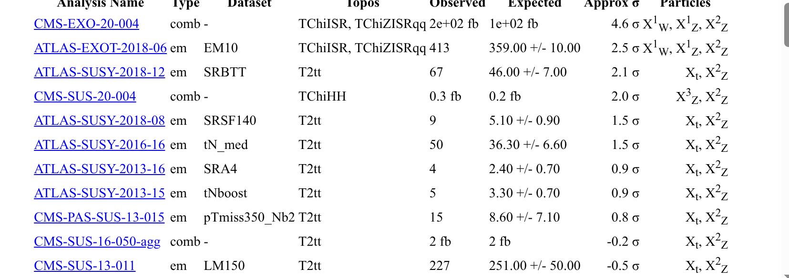
Here is another such protomodel

Slide 18
But let’s focus on the
simpler protomodel
Do we consider these excesses to be mutually compatible?

Slide 19
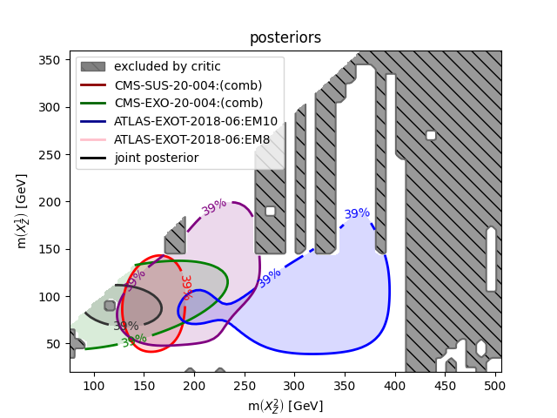
Combining Likelihoods
Likelihoods as
functions of particle
masses

Slide 20
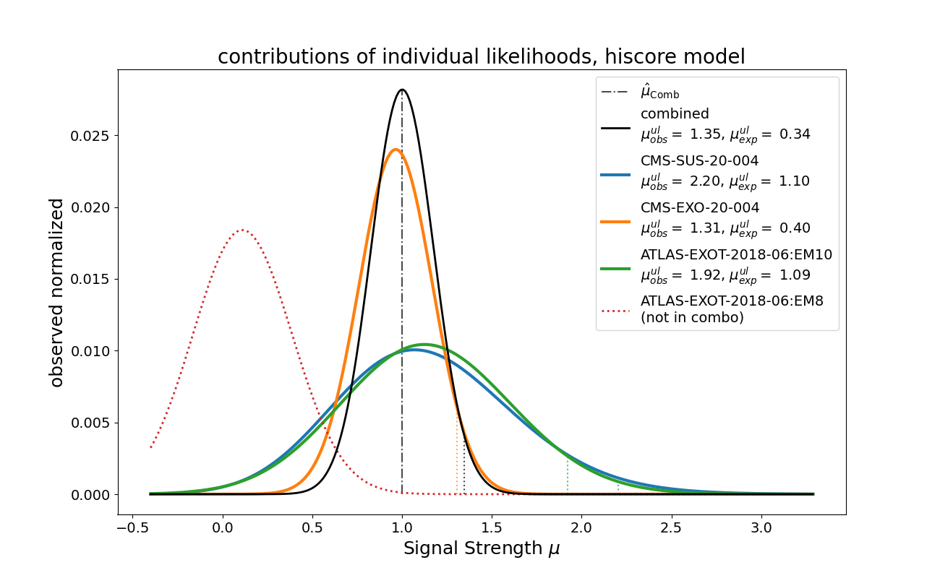
Combining Likelihoods
Likelihoods as
functions of an overall signal strength multiplier
Taking this model with mu as the only free parameter, we could formulate a likelihood ratio test:

Slide 21
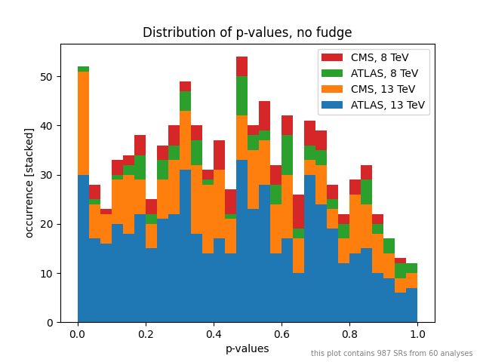
Now that we have a protomodel, what about the meta-statistics plots that I showed you earlier? We have a new hypothesis, so we can compute the p-values for that!
For the SM hypothesis:

Slide 22
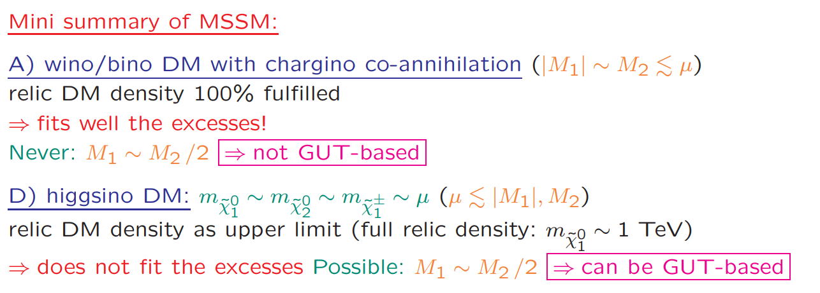
Other pheno groups
S. Heinemeyer, SUSY2026

Slide 23
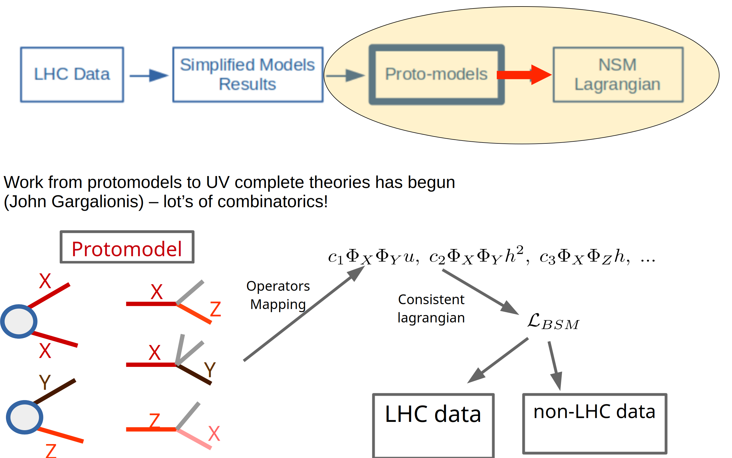
NSM Lagrangian from the proto-models, work in progress
Work in progress. Lots of combinatorics:
we cannot differentiate between light quark flavors. Observed particles might be degenerate.
From particles to fields.
Singlets versus doublets versus multiplets. From broken to unbroken Lagrangians.

Slide 24
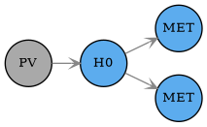
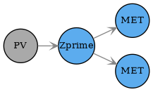
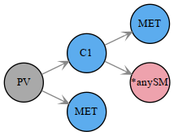
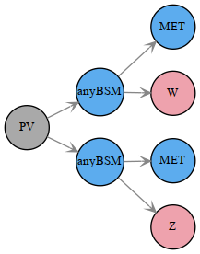
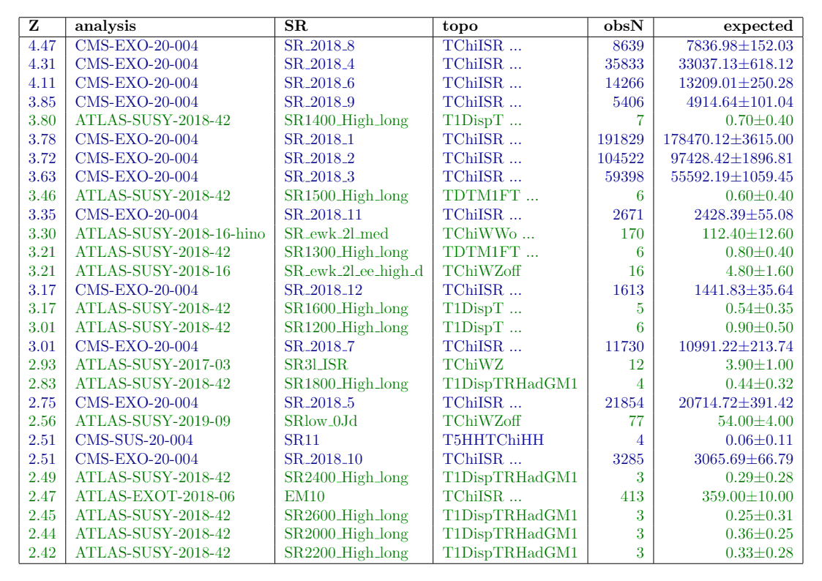
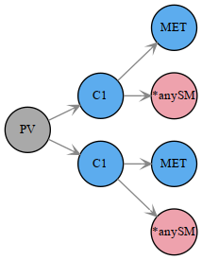

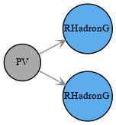
Naively: (without assuming conservatism) we would expect
<= 960 * Φ(2.40) ≈ 8 SRs.
We have 28 SRs with Z > 2.40, 4 SRs with Z < - 2.40
List Of SRs with Z > 2.40
TRS1
TRV1
TDTM2F
TChiWZ(off)
TDTM1F
*) CMS-EXO-20-004 is yes overrepresented
(simplified likelihood fit possible culprit?)
*) “small mass gap + MET” topologies are dominant

Slide 25
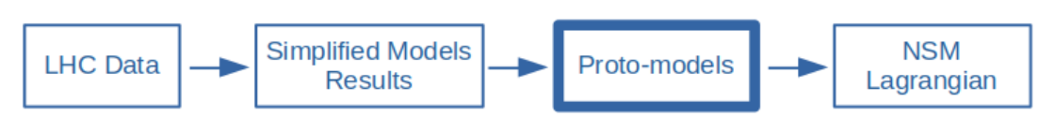
ProtoModels → Next Standard Model
Work from protomodels to UV complete theories has begun
(John Gargalionis, PostDoc in Valencia) – lot’s of combinatorics!
Protomodel
X
X
Operators Mapping
Z
Consistent lagrangian
X
X
Y
Y
Z
LHC data
non-LHC data
X₀
Z
...
...
dark matter observables, low energy observables, ...

