Slide 1

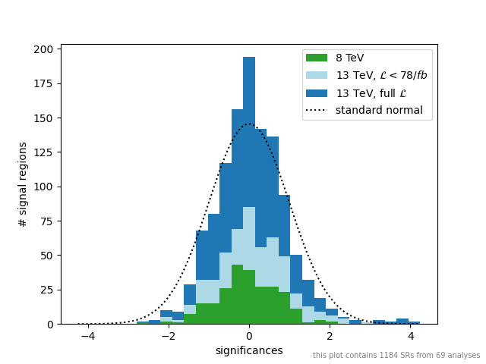
Experimental Data and
Wolfgang Waltenberger (ÖAW and Uni Wien)
for the SModelS collaboration
Invisibles Data Days, May 2024

Slide 2
In SModelS v3.0.0 – to be released ~ next week, we will have the results of a total of 160 publications in our database (if we count really everything). They are all ATLAS and CMS searches for new (particle) physics.
For (only) 69 of them do we have enough information to construct at least a simplified statistical model. Usually, a single result has multiple “signal regions”.
The plot above presents significances with respect to the Standard Model hypothesis,
of all signal regions within these 69 publications.
If all is done correctly, and no new physics is in the data, the distribution should follow a standard normal. New physics would manifest itself as an overabundance of positive values.

Slide 3
And What Do We Do With
The Information Contained
In These Statistical Models?

Slide 4

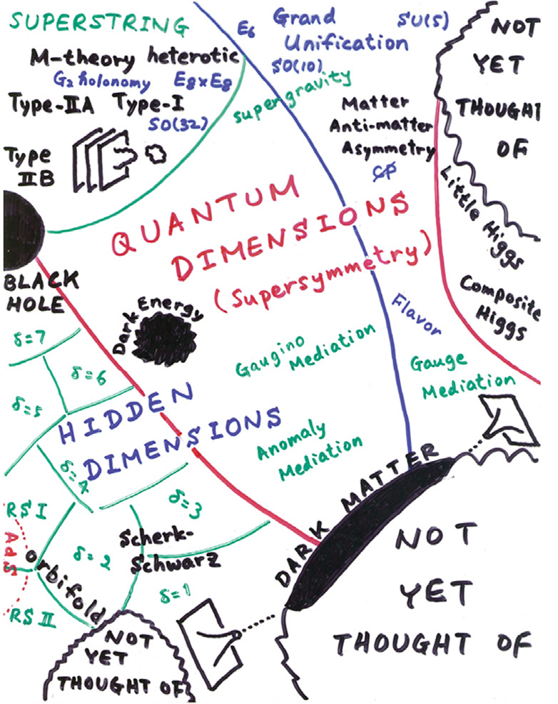
A Next Standard Model
from this ...
… we wish to infer this:
i.e. identify the One True Point [*] (a.k.a. the Next Standard Model) in Hitoshi Murayama’s landscape of theories
[*] obviously in reality we would actually want a posterior density, not one point

Slide 5
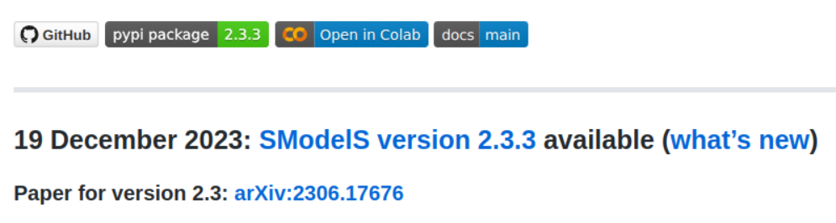
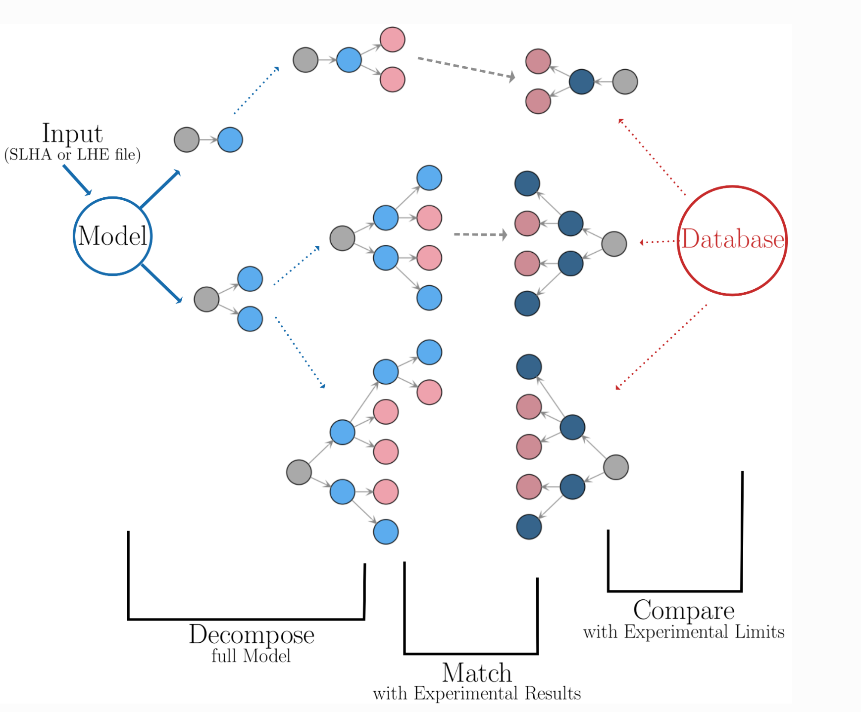
SModelS
https://smodels.github.io
a tool to quickly compare a theory
against a database of experimental results
decomposes theory into its
“simplified model spectrum”
No expensive Monte Carlo event generation required!
Database contains results from
> 100 CMS and ATLAS publications

Slide 6
Our Inverse Problem
To connect our observations with contender theories for the Next Standard Model,
In addition to lots of other information, we need statistical models (in one way or another)
we can either start by:
postulating a theory, then fit its parameters
(“top-down”)
or:
try to build our model directly from data
(“bottom-up”)

Slide 7


Top-down versus bottom-up
Top-
Down:
Start here: You have a
great idea for a new model.
You write down the
model’s Lagrangian
You calculate all observables.
Comparing with data you
compute p(data|theory).
From this you compute
a test statistic T.
T
is “good”?
Come up with a better idea.
no
yes
Congratulations! Fly to Stockholm.
Claim your prize.

Slide 8

Top-down versus bottom-up
Only now do you think about symmetries, gauge groups, etc that
may underlie all observations. Construct your Lagrangian.
From the descriptions you try and construct precursor theories to the NSM
that describe everything you really know about
TeV-scale (and below) physics
Bottom-Up:
Start here: You describe your experimental findings in a language
amenable to theoretical physics, e.g. simplified models for on-shell
effects (“searches”), effective field theories for off-shell
effects (“measurements”).

Slide 9
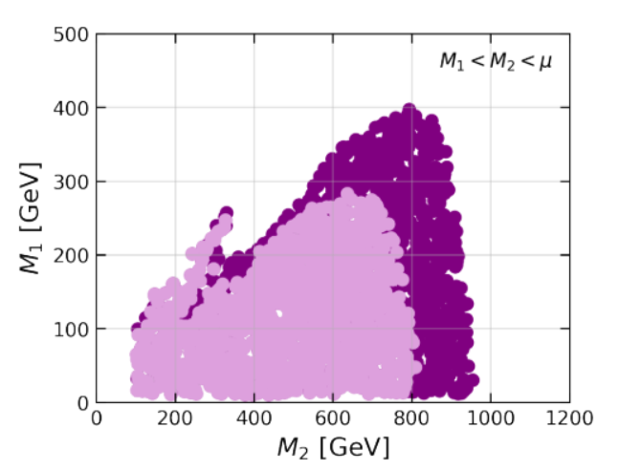
Top-down: example
“Global LHC constraints on electroweakinos with SModelS v2.3”
Model: MSSM, but looking at its charginos and neutralinos only
Excluded
Model points
gain in exclusion reach by combining (CMS and ATLAS)
results
https://arxiv.org/abs/2312.16635

Slide 10
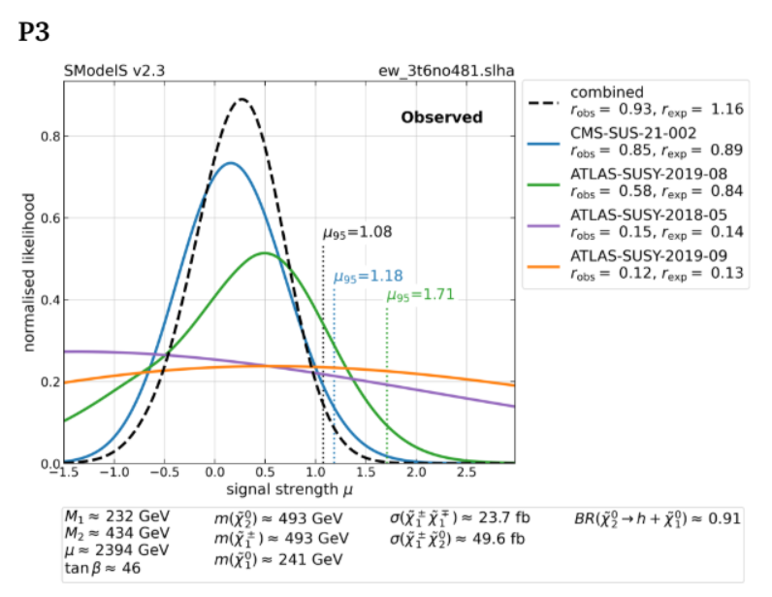
Top-down: example
Combination at work, for one model point. Likelihoods here are functions of a single parameter (the overall “signal strength”). Combining several likelihoods (colored lines)
results in a narrower combined likelihood (dashed line).
https://arxiv.org/abs/2312.16635

Slide 11
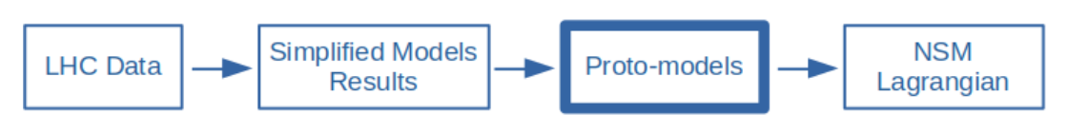
Bottom-up: Protomodels
“Likelihood-based automated model building” (in a wider sense of the words)

Slide 12
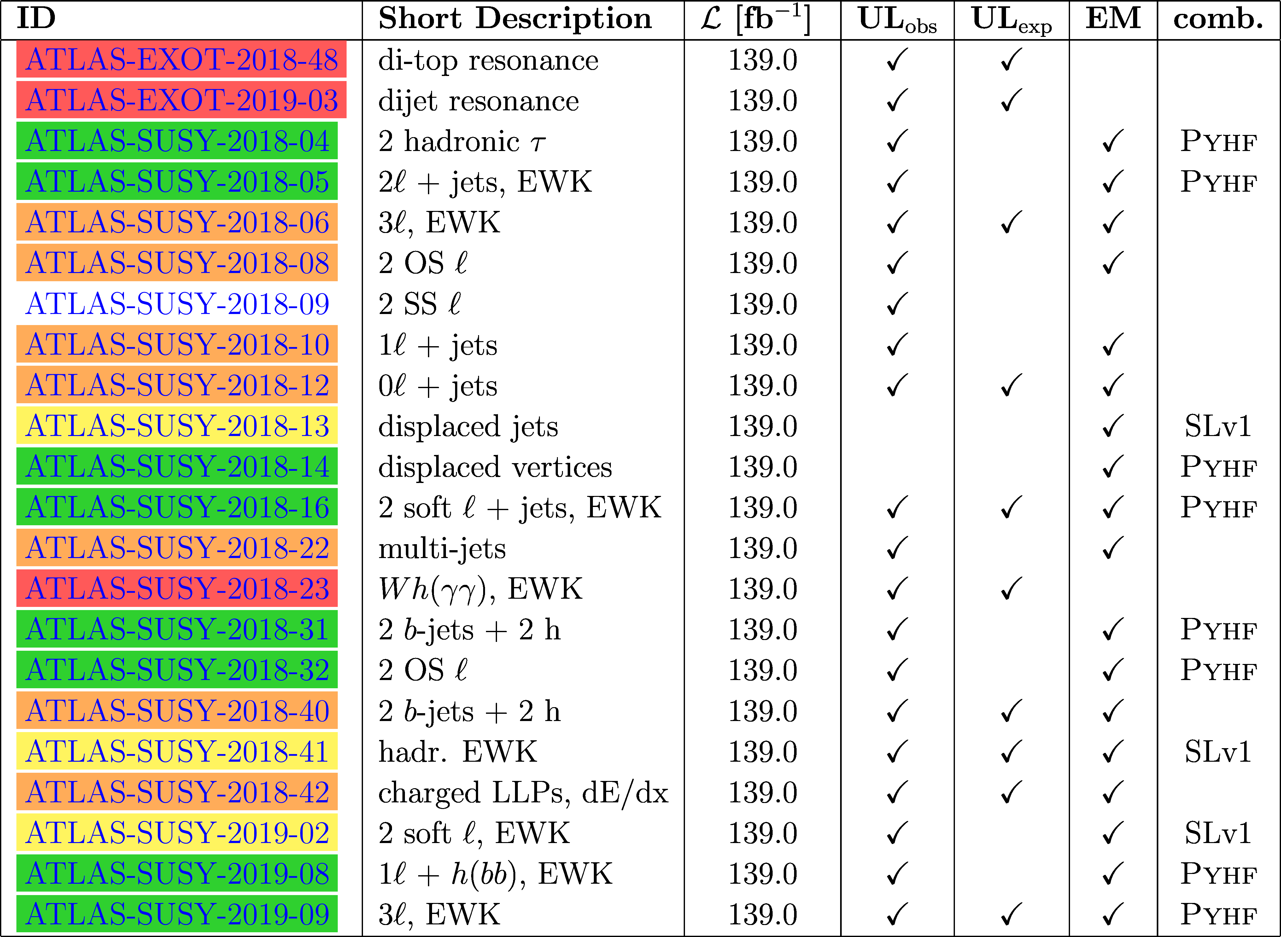
Statistical Models in the
SModelS Database
ATLAS, Run-2, Full Lumi only:
Type of statistical model

Slide 13

Statistical Models
Only exclusions for particular models
If only “exclusion lines” are given, without upper limits, we can do nothing
Observed 95% CL upper limits on production cross sections only:
cannot construct likelihood, binary decision “excluded” / “not-excluded” only (“critic”)
Expected and observed 95% CL upper limits
can construct an approximate likelihood with truncated Gaussian,
cannot combine topologies, very crude approximation
Signal Efficiency “maps” for “simplified models”
can construct a likelihood as Gaussian (for the nuisances) * Poissonian
(for yields), can work per SR, and combine topologies in each SR [*]
Efficiency maps + correlation matrices
can combine signal regions via multivariate Gaussian * Poissonians
Efficiency maps + full likelihoods
full realism, correct statistical model
Efficiency maps + full likelihoods + naming convention
+ knowledge about “data overlaps”
can combine publications at full realism
better
Likelihoods
Combos
[*] if efficiency maps are not supplied, we can try to produce them with recasting frameworks

Slide 14
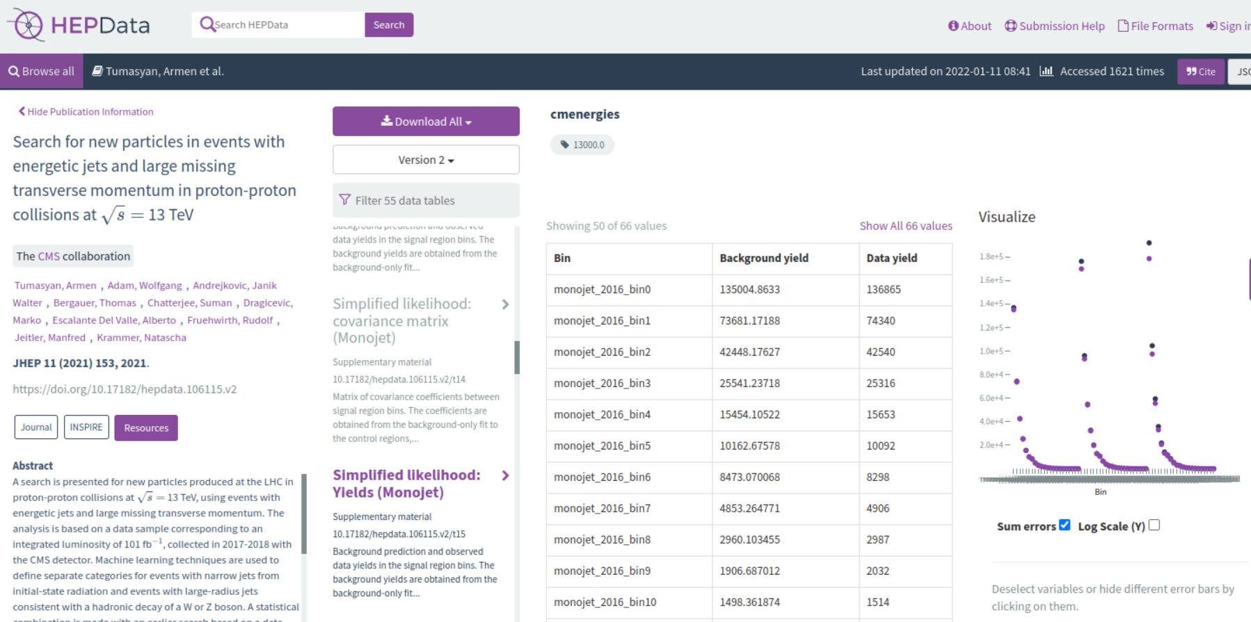
HEPData
(CMS monojet search)

Slide 15
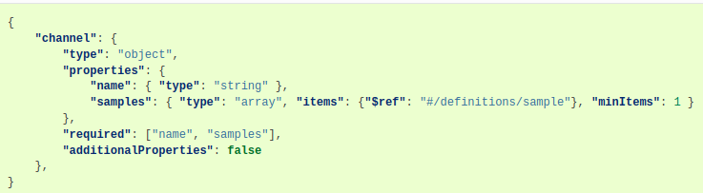
Serialized Statistical Models
(Lukas is of course the authority here but) pyhf serializes the models into json
files:
Posterior distributions on nuisance parameters (such as jet energy scales, pdf uncertainties, reconstruction ineffciencies, etc etc) are described via “auxiliary measurements” –> keeping things frequentist (if we wish)!
Statistics Standardization comittee formed: HS3
https://github.com/hep-statistics-serialization-standard/hep-statistics-serialization-standard
These “closed world” approaches are general enough for users!

Slide 16
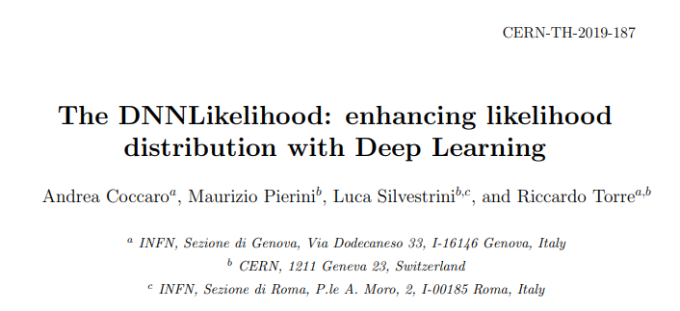
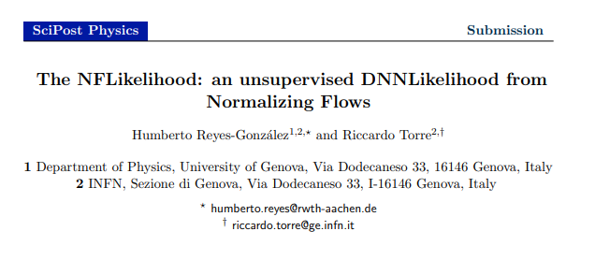
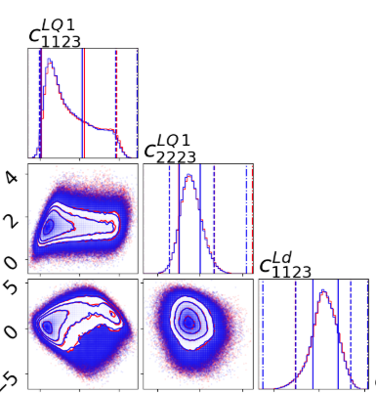
In “User Space”: Machine Learning Surrogate Models
If speed and/or memory footprint become an issue, users can always also
machine-learn surrogate models.
If only likelihood is needed: simple, fully
connected neural networks (Bayesian neural networks
for adding errors on the estimates), e.g.:
If full statistical model including toys is needed as well: generative network such as normalizing flows. e.g:

Slide 17
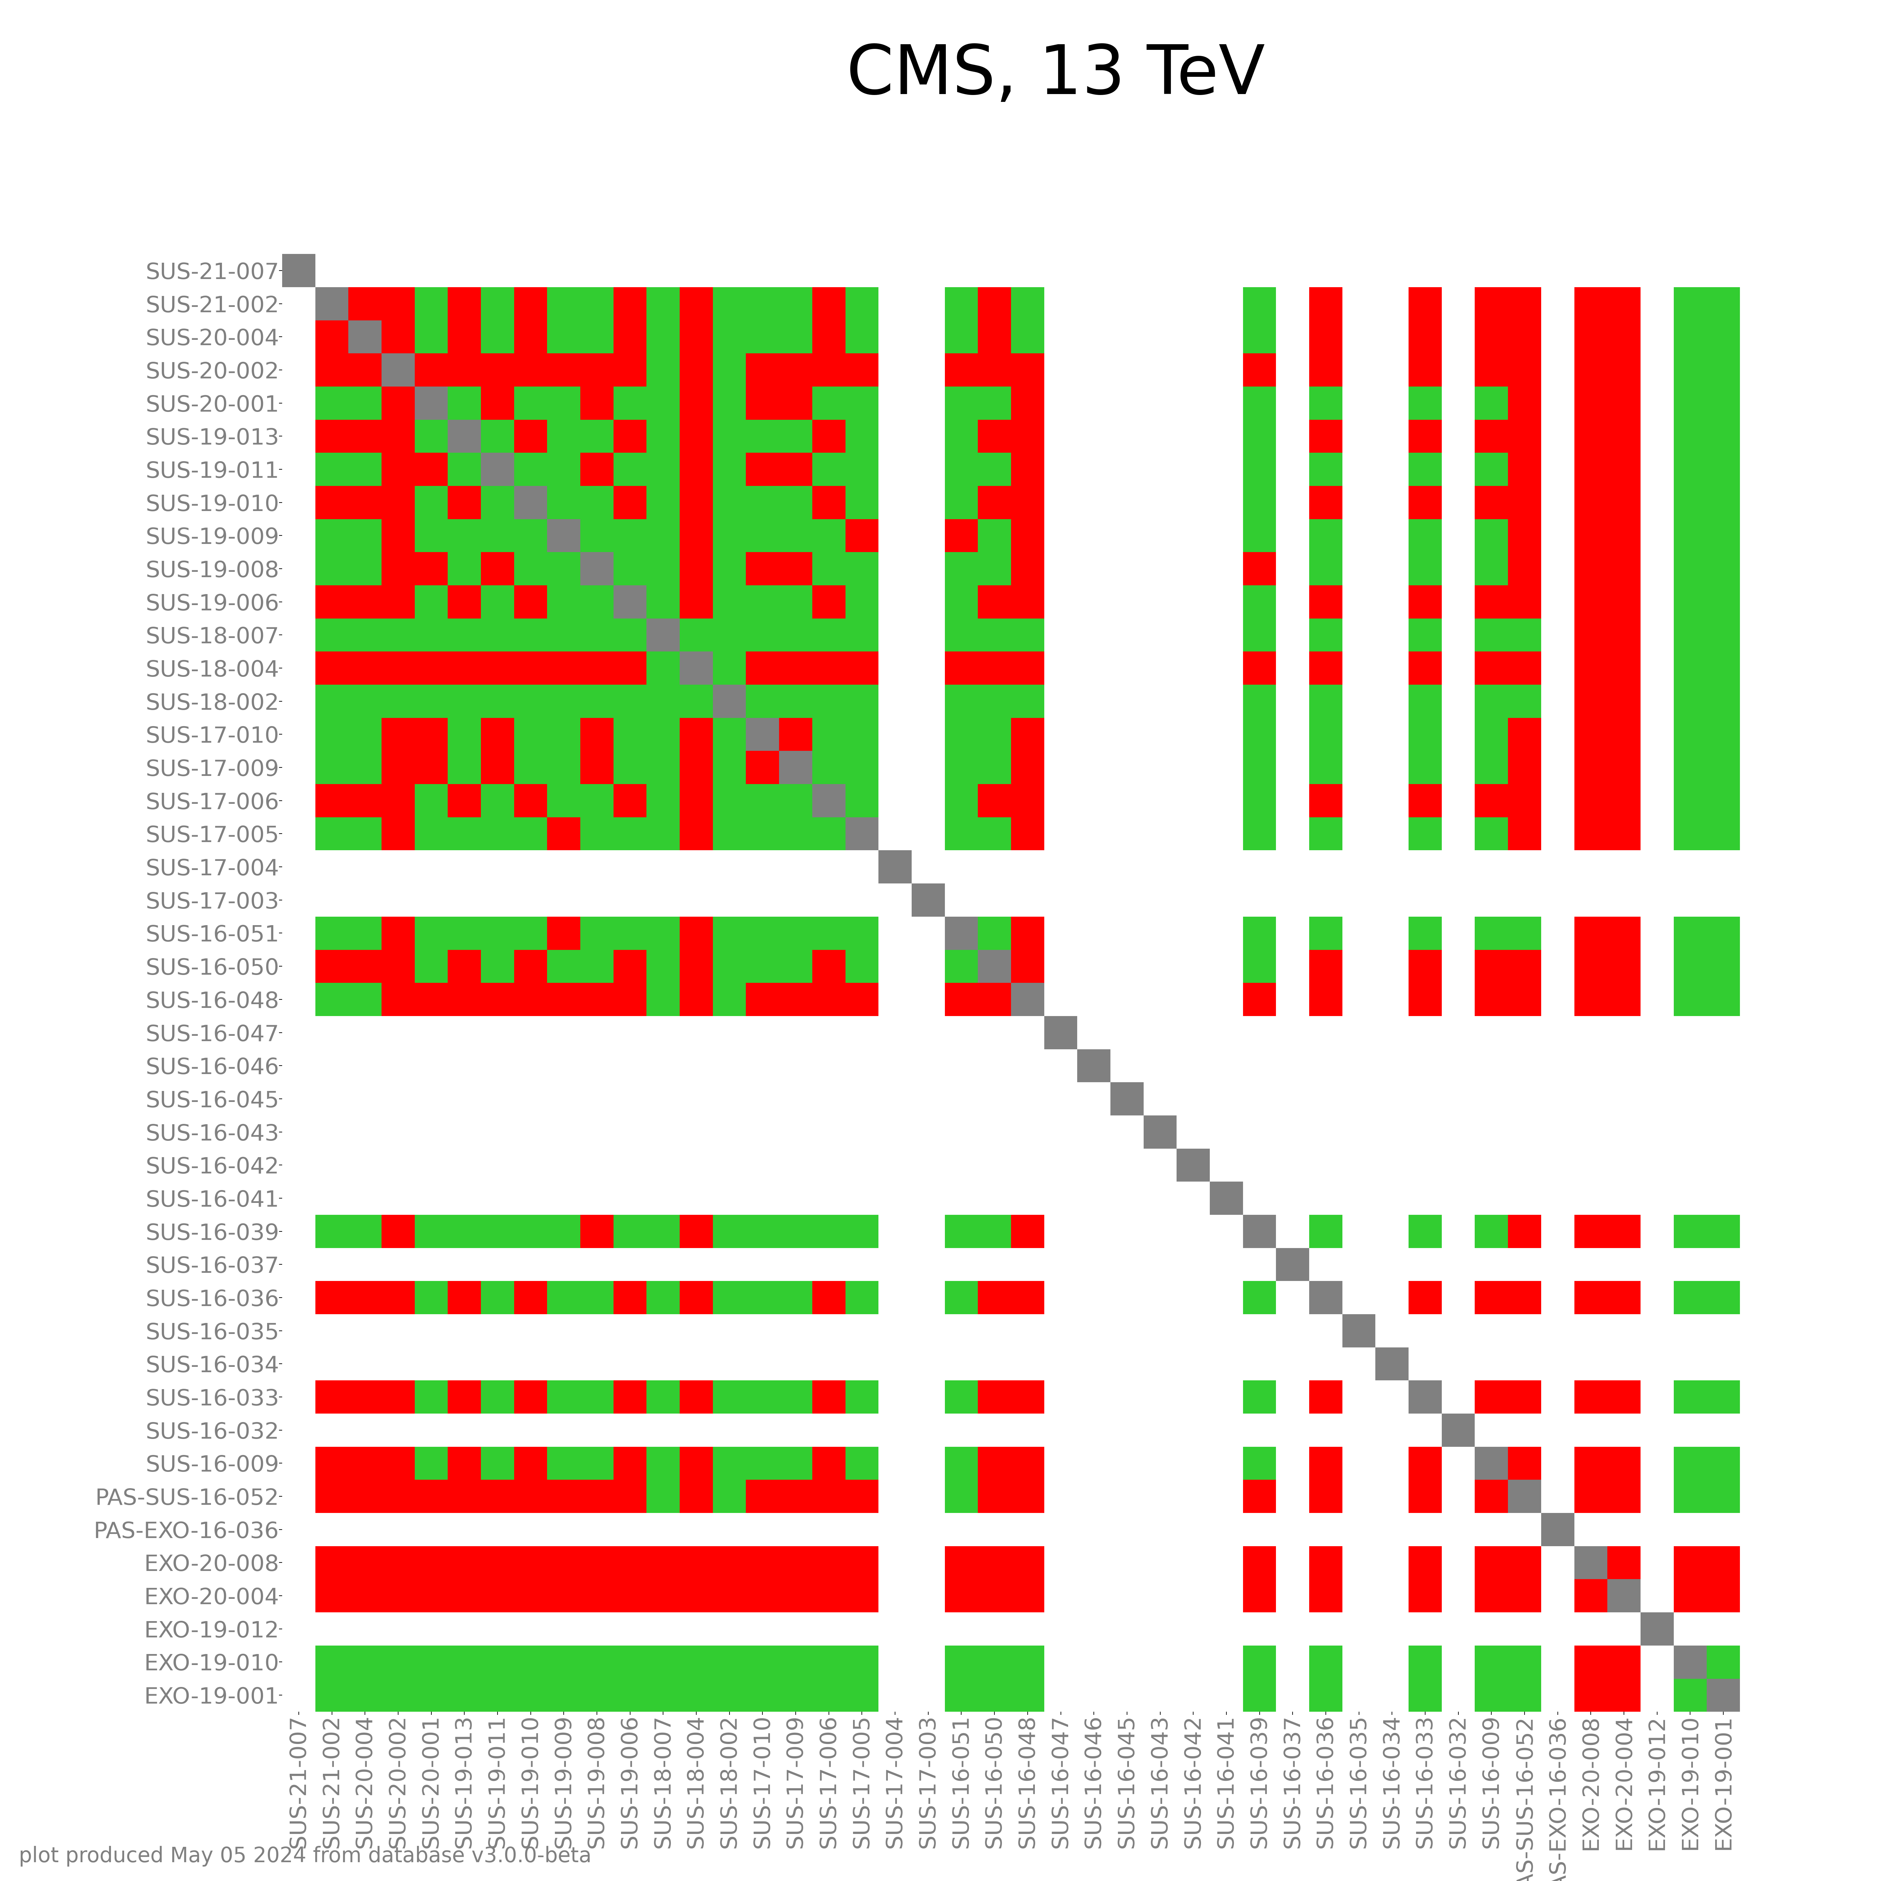
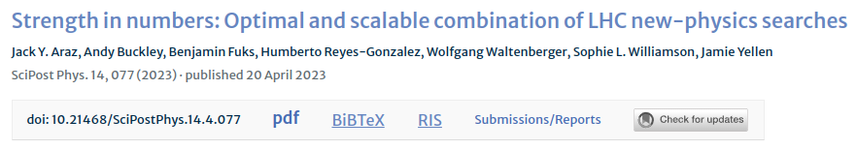
Combinability Matrix, and “recasts”
We keep track of which pairs of analyses have no overlaps in what LHC collision events enter the signal regions. In the “pheno community”, we combine only if no overlap.
Currently most reliable source for the combinations matrix: analysis recast frameworks: generating events, track which signal regions are populated by which events
Requires detailed documentation about
the analysis
Experimental collaborations could in principle produce this information as well
(and better)

Slide 18
Reproducing an Analysis
In order to facilitate reproduction of an entire analysis – to e.g. apply it to a new model, or to study analysis overap (previous slide), the analysis needs to be documented in great detail:
Cutflow tables of the analysis cuts, reconstruction object efficiencies, machine-learning models (e.g. as onnx files) need to be given in digitized form, for e.g. recasts, studies of analysis overlaps.
Implementation in a simple framework / language: e.g. SimpleAnalysis or Analysis Description Language (ADL)
For Monte Carlo samples used in publication: generator datacards, etc
Upper limit plots, signal efficiency maps (of simplified models) in digitized form
Statistical models in reusable digitized form

Slide 19
Experimental Results →
Protomodels
the test statistic
Particle
spectra
A hiscore
protomodel
potential
dispersed
signals
Random modifications
an MCMC-like walk
https://smodels.github.io/protomodels/videos

Slide 20
ProtoModels → Next Standard Model
Work from protomodels to UV complete theories has begun
(John Gargalionis, PostDoc in Valencia) – lot’s of combinatorics!
Protomodel
X
X
Operators Mapping
Z
Consistent lagrangian
X
X
Y
Y
Z
LHC data
non-LHC data
X₀
Z
...
...
dark matter observables, low energy observables, ...

Slide 21
Summary
Ideally, all important aspects of a physics result get published: cutflow tables, reconstruction object efficiencies, machine learned models, generator datacards, for SModelS: efficiency maps and: serialized statistical models!
HEPdata is the collider physics results platform of choice
DOIs for all digital objects
Global fits are still an indispensible tool to obtain a “big picture” (see also gambit’s talk)
The SModelS collaboration recently started to automate model building based on the statistical models

Slide 23
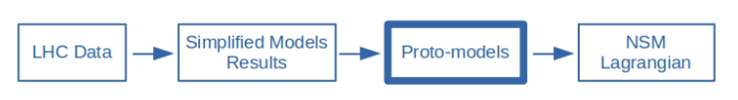
Differentiably if possible
If we had gradients we could perform gradient descent to find the best model, and we could use e.g. the Fisher information to infer the error on its parameters (or, alternatively we can then MCMC-sample).
SModelS is – in principle -- differentiable
for individual candidates we can make this differentiable w.r.t fundamental parameters Θ_{l}, via neural networks
described as likelihoods L that are differentiable with respect to the yields y_{i}
that’s just a sum of
simplified models →
differentiable!
.
.
.
Not yet required (theory space as well as space of measurements are still low-dimensional enough). Action item for now: keep choosing, supporting, developing technologies that support autograd

Slide 24
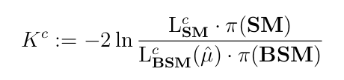
The Test Statistic
The test statistic K^{c} is a likelihood-ratio test that quantifies how much better the proto-model describes the data than the Standard-Model (plus a penalty for model complexity).
Quantifies violation of Standard Model hypothesis
Penalizes for model complexity
We search for proto-models and combinations of results / likelihoods that maximize K^{c} while remaining compatible with all negative results in our database.

