Slide 1
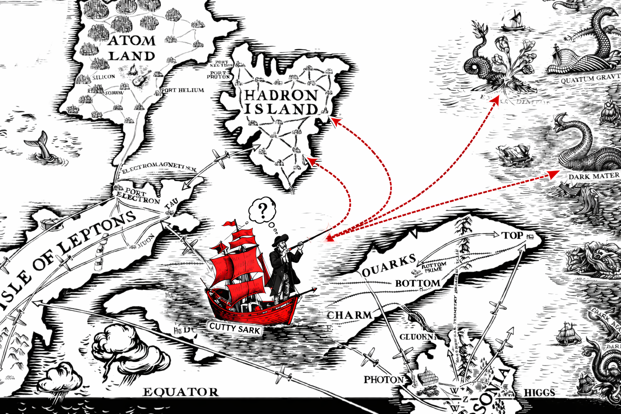
LHC Searches and the Next Standard Model:
A Meta-Statistical View
Wolfgang Waltenberger (MBI and Uni Wien)
For the SModelS / protomodels collaborations
BSM Workshop @ CERN
October 2026
image courtesy of Jon Butterworth, Chris Wormell
and chatgpt

Slide 2

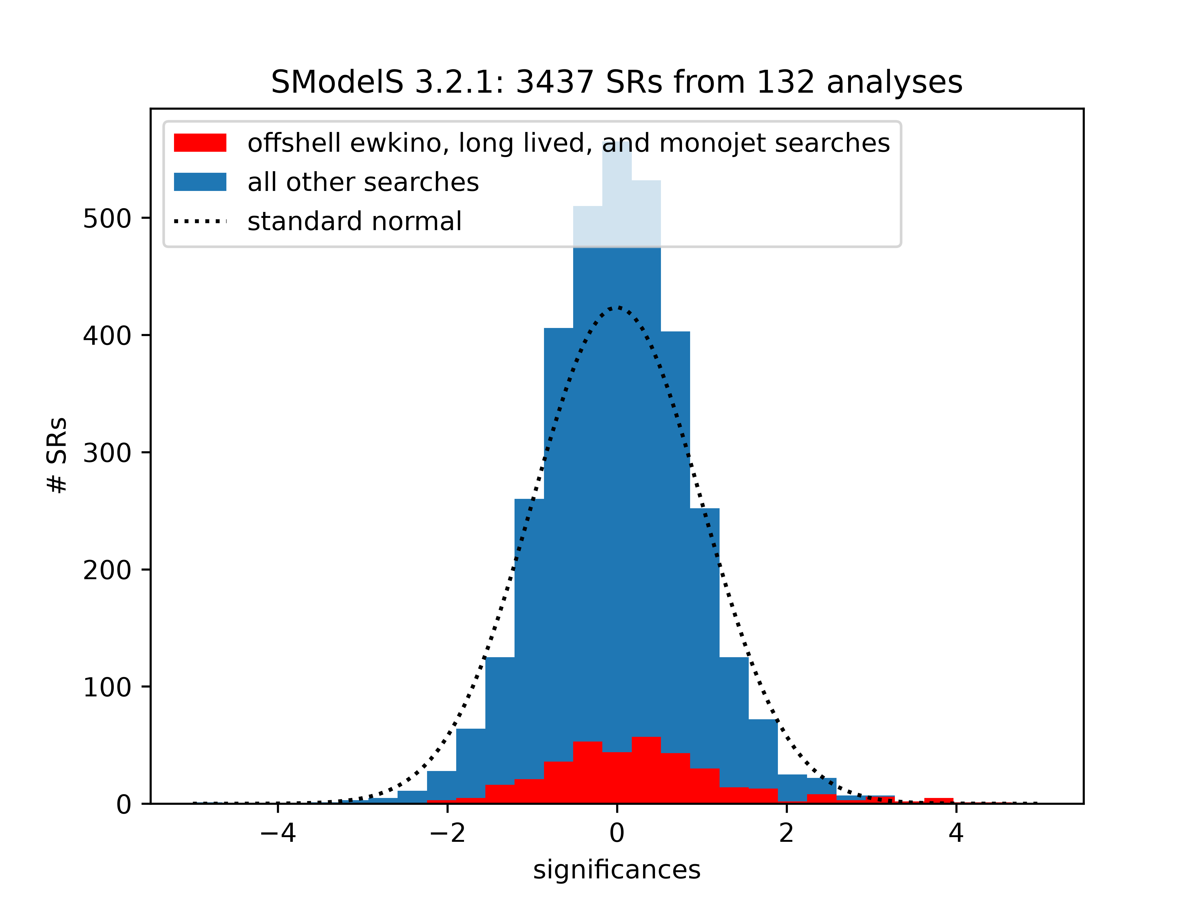
We, the SModelS collaboration have been collecting the published search results of CMS and ATLAS since the dawn of the LHC. Here is v3.2.1 of our database:
Distribution of significances of all the signal regions we have in our database, Standard Model hypothesis.
If no new physics is in the data, it should follow a standard normal (dashed black).
New pyhsics would be at Z → +∞, obs == exp are at Z ~ 0.

Slide 3

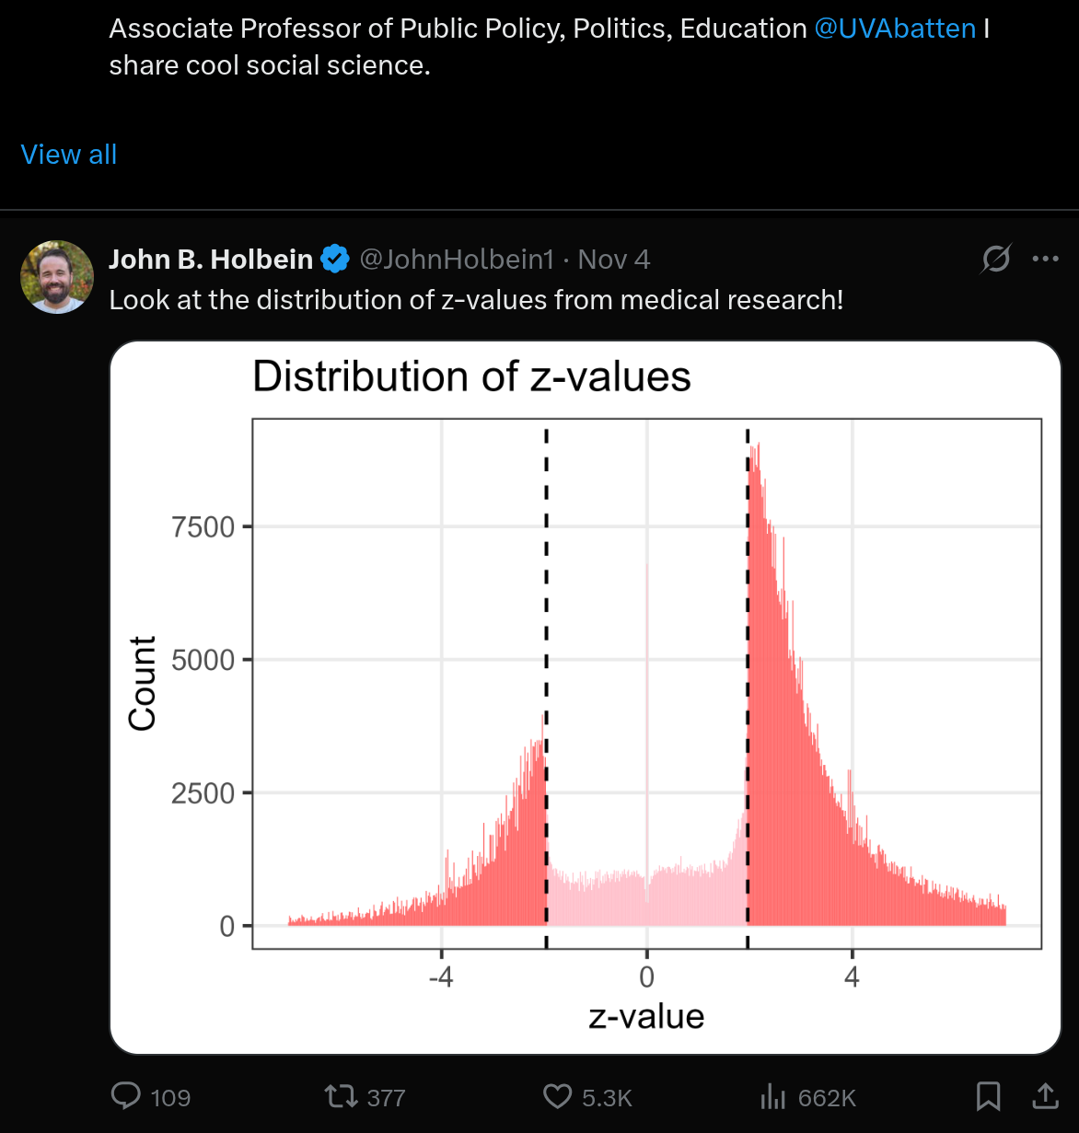
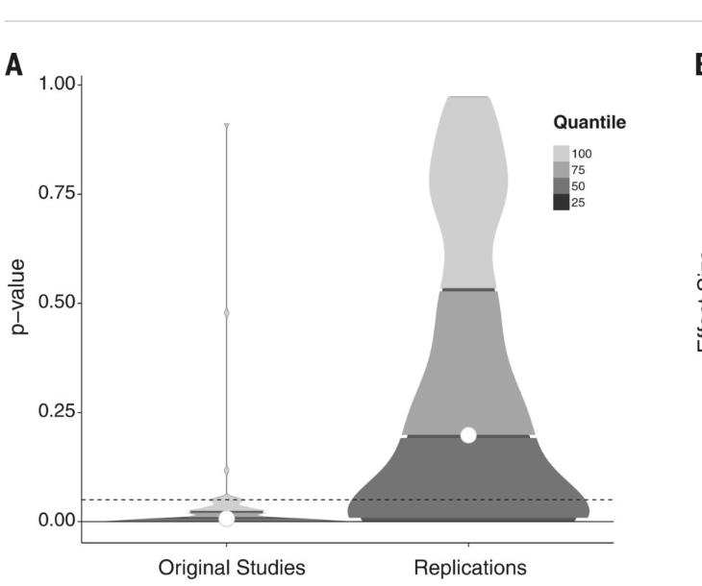
“Estimating the reproducibility of psychological science”
https://medianwatch.netlify.app/post/z_values/
No offense meant, medical researchers, we are very happy you are doing all the hard research )
We have our own problems.
We do however not have these problems.
https://www.science.org/doi/10.1126/science.aac4716

Slide 4
Similar information but p-values instead of significances. New physics would
manifest at p ~ 0, but only in some classes of results. If observation == expectation,
then p ~ 0.5, underfluctuations are at p ~ 1. Red: offshell electroweakino, long-lived, dark matter searches only.

Slide 5
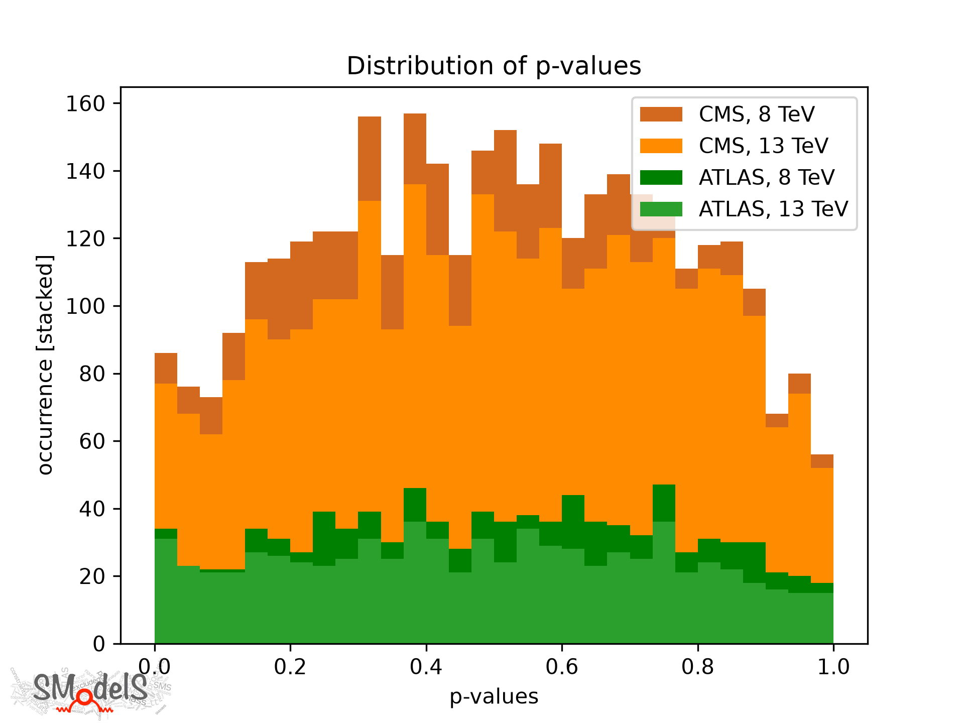

Conservativeness effect
Systematic errors are systematically overestimated (as they should!):
p-values tend towards 0.5

Slide 6
Conservativeness: CMS versus ATLAS
Systematic errors are conservatively estimated
CMS:
more fine grained SRs
→ more regions
→ more systematics dominated
→ more sensitive to
conservativeness effect
ATLAS:
More inclusive SRs
→ fewer regions
→ more statistcs dominated
→ less affected by
Conservativness effect

Slide 7
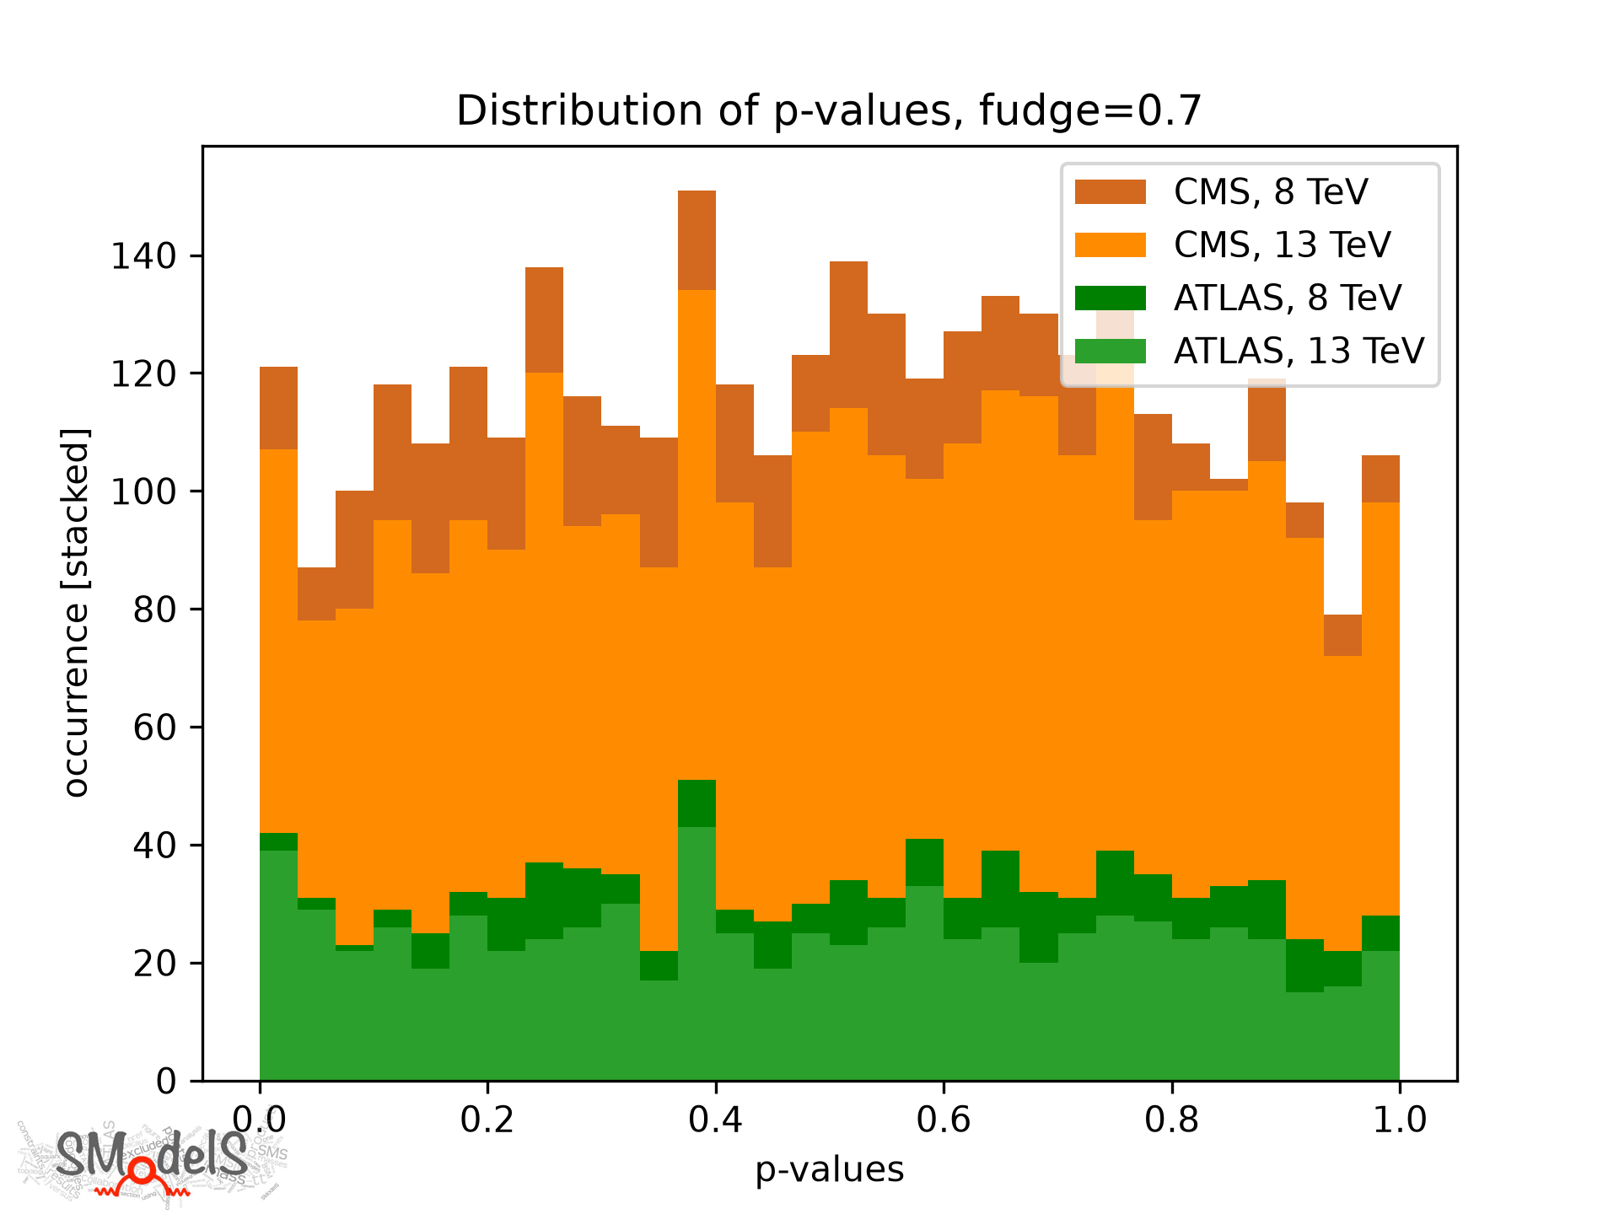
Correcting for conservativeness
Assuming that all systematic errors are roughly 40% overestimated – and “globally” correcting for it -- results in an approximately flat distribution of p-values.

Slide 8
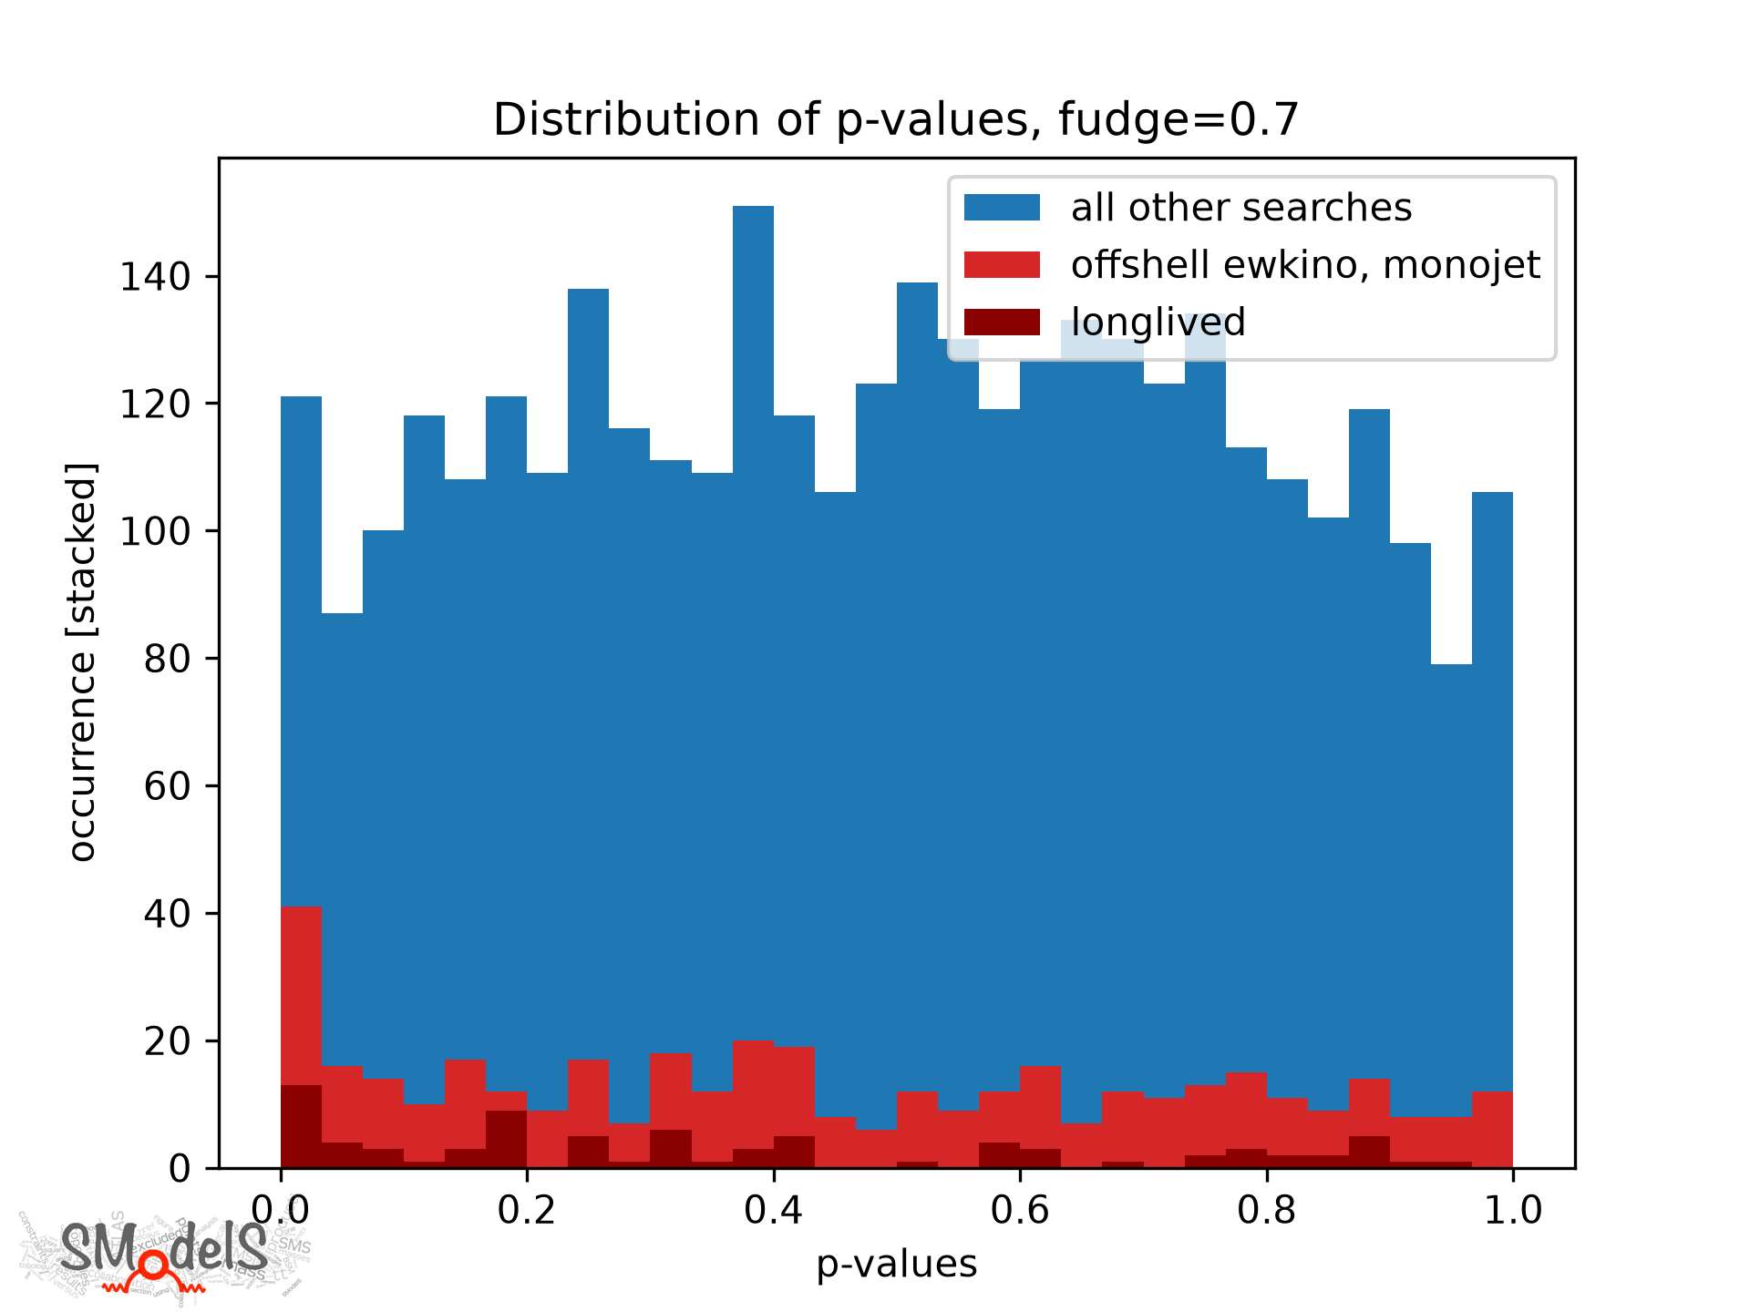
Looking great, all explained?
Assuming 40% Overestimated Syst. errors
Red: “searches for dark matter plus things with small mass gaps to the dark matter mass”

Slide 9
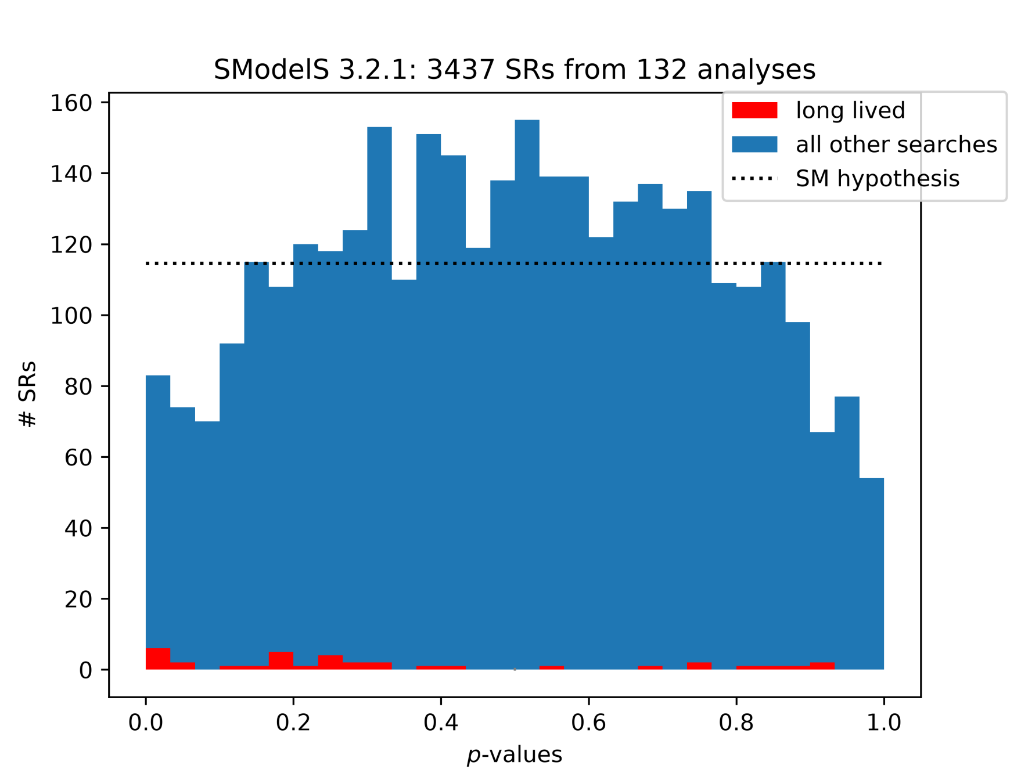
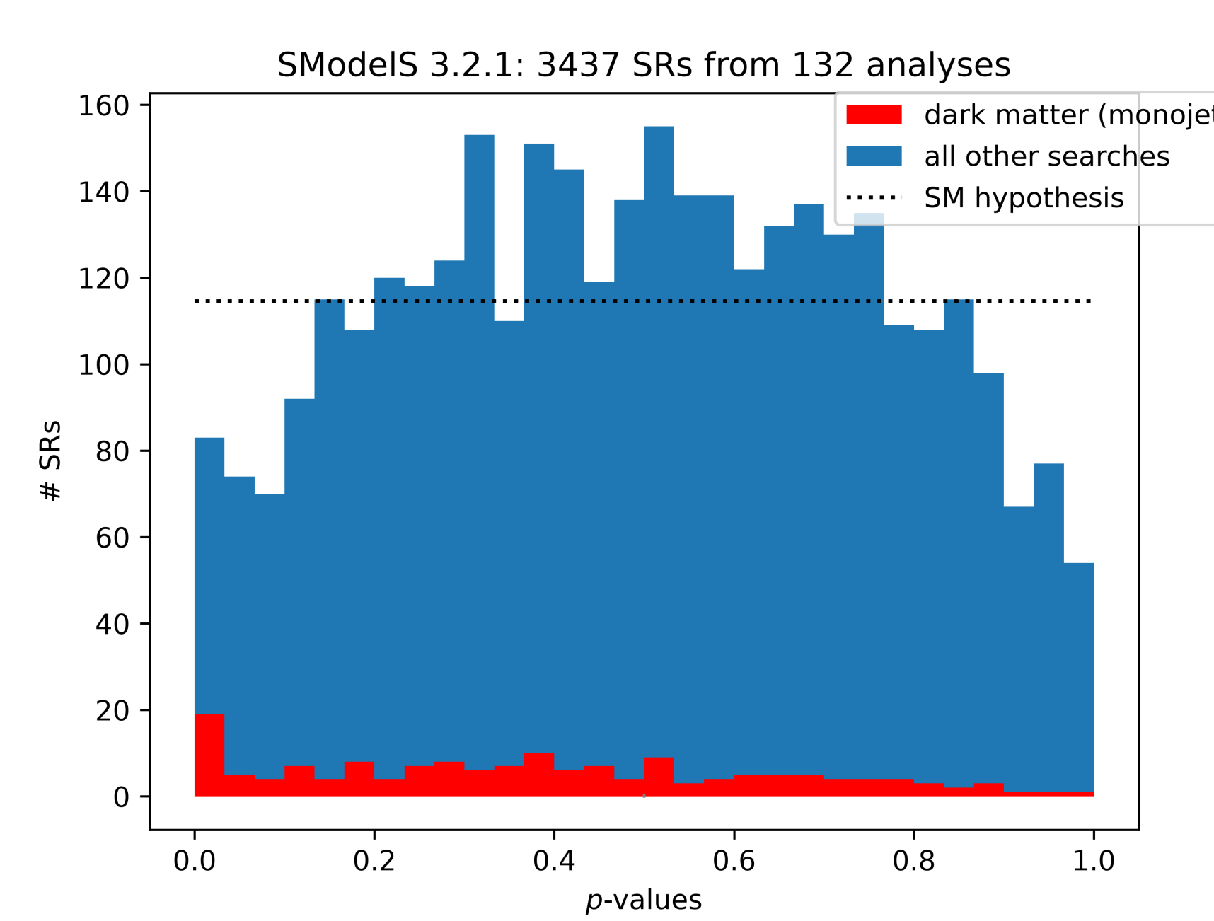
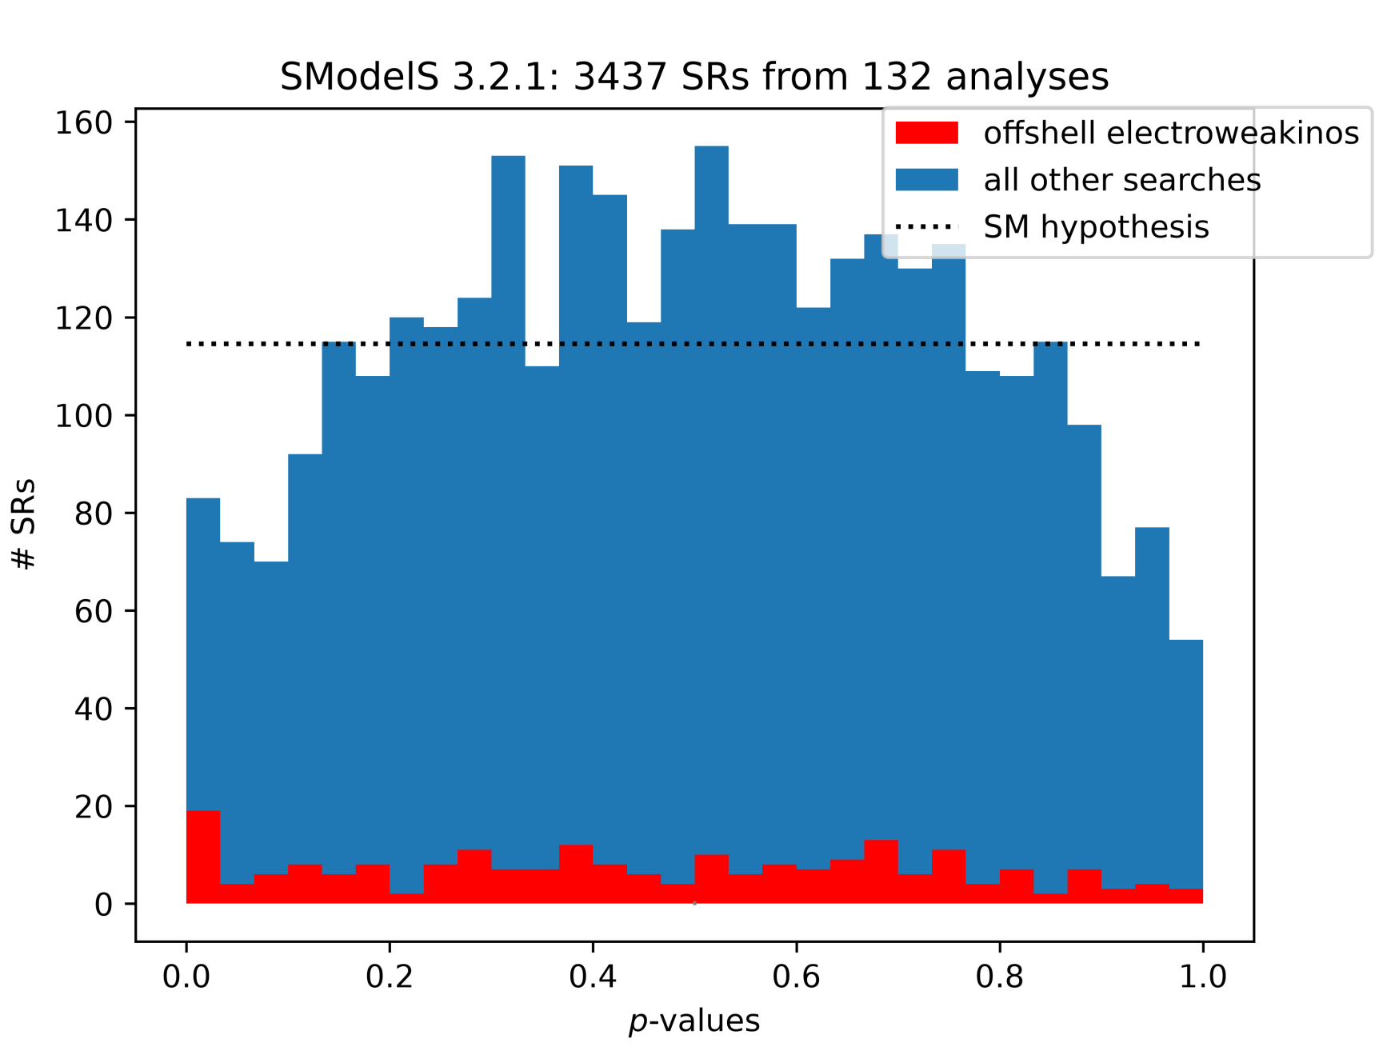
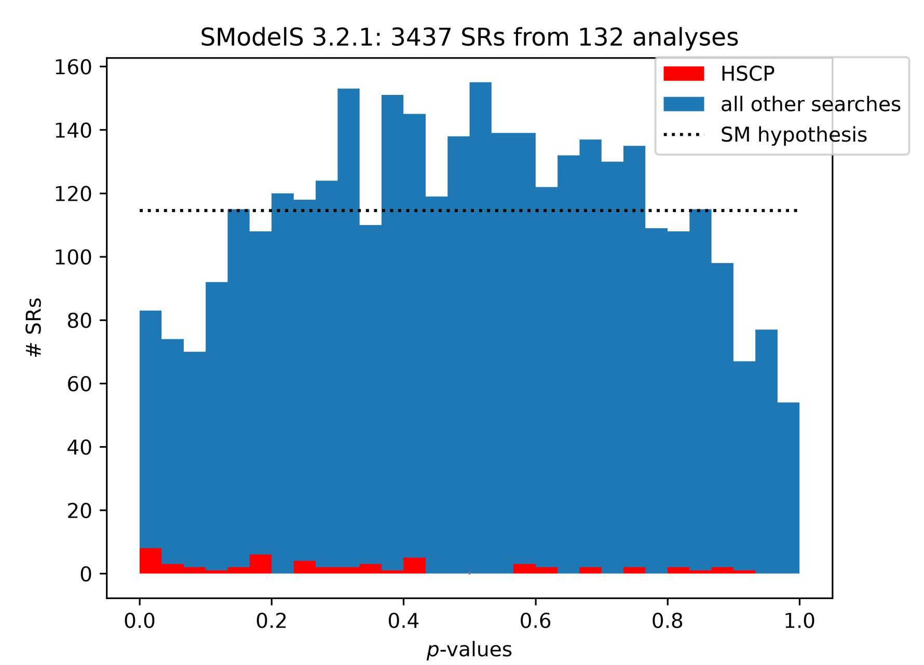
More detailed decomposition (and this time NOT correcting for conservatism)
Monojet
Long-lived particles
Offshell electroweakinos
Heavy stable charged
particles

Slide 10
More detailed decomposition (and this time NOT correcting for conservatism)
Monojet
Long-lived particles
These three categories nicely fit
the higgsino DM hypothesis
(but more on this later)
Heavy stable charged
particles

Slide 11
So the meta-statistics of almost all classes of results seem to look as expected (congratulations, LHC community!) except for electroweakino, dark matter searches.
Results of about 50% of electroweakino/dark matter searches are not In the database (either not yet, or technical obstacles).
So what about missing, or more recent mono-X and electroweakino searches?

Slide 12
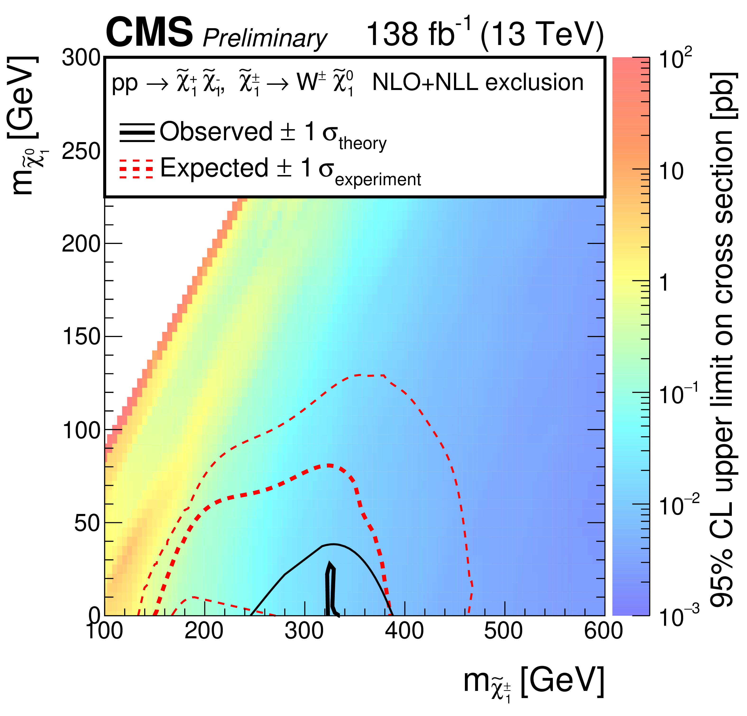
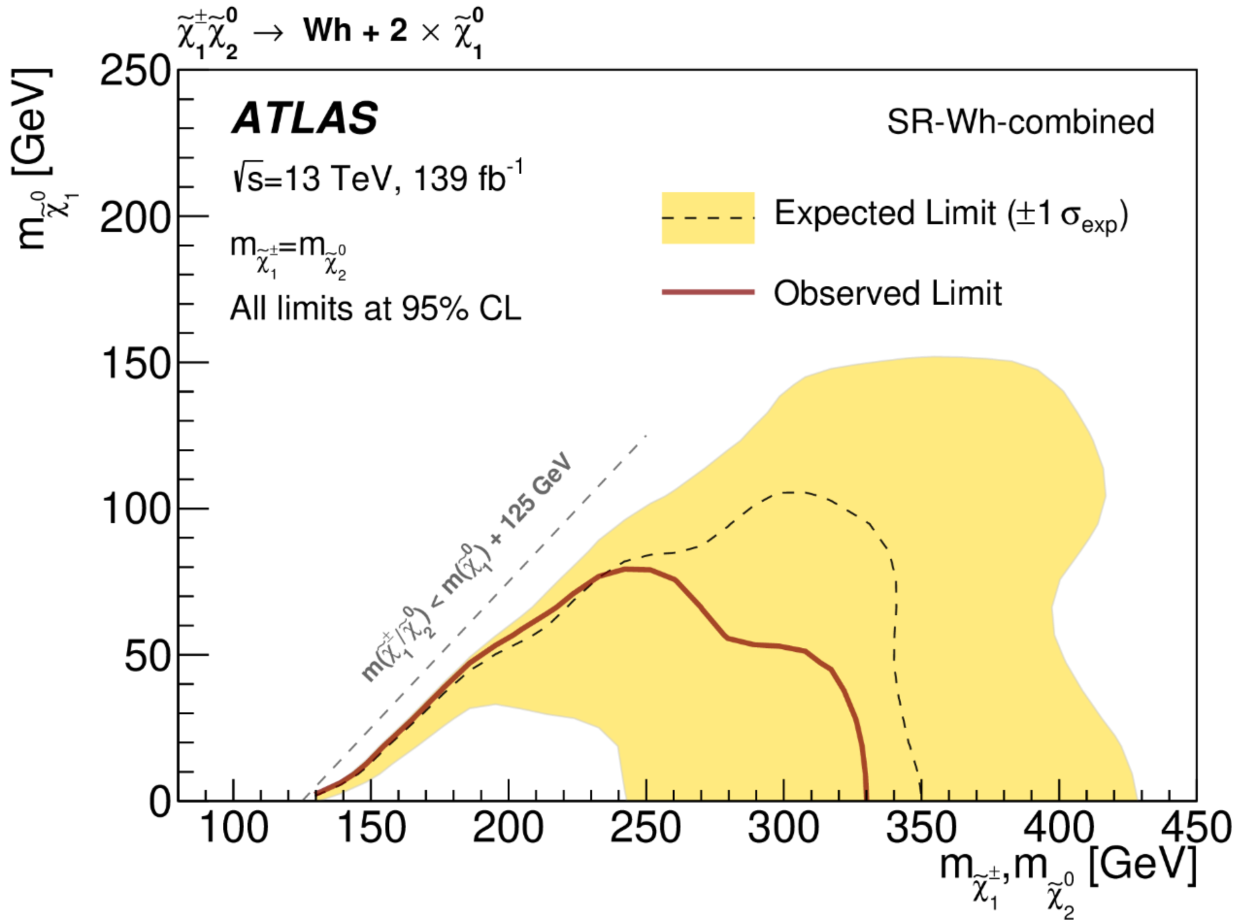
Results Not (yet) in SModelS
CMS-SUS-23-002, chargino pair production
ATLAS-SUSY-2023-03,
Charginos + neutralinos

Slide 13
Results Not (yet) in SModelS
CMS-SUS-23-008, MET+bb
CMS-SUS-23-004, mono-top

Slide 14
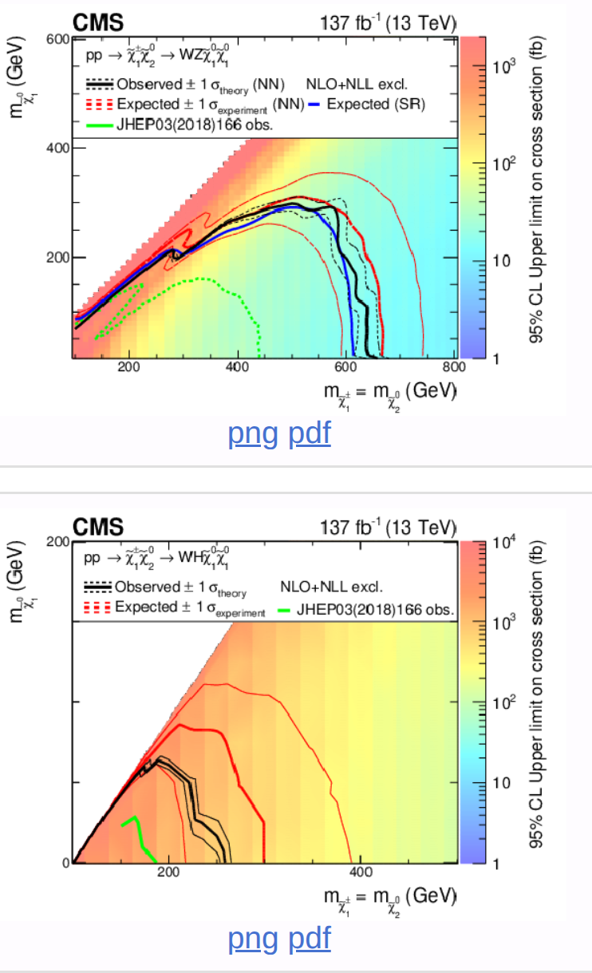
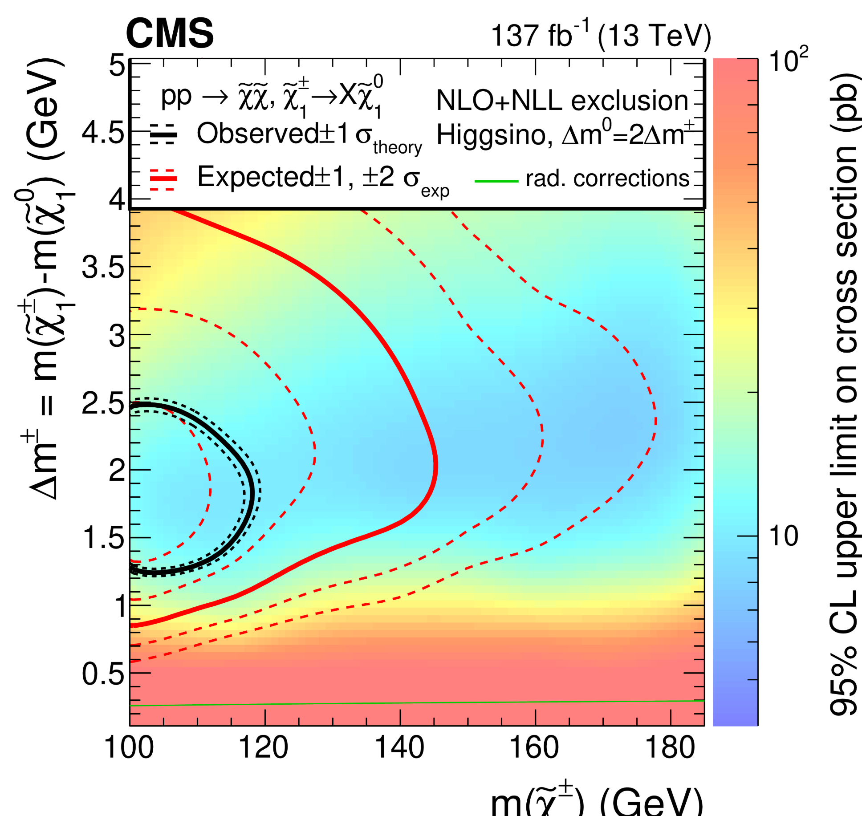
Results Not (yet) in SModelS
CMS-SUS-24-003
Ewkinos, small mass splitting
CMS-SUS-19-012,
ewkinos

Slide 15
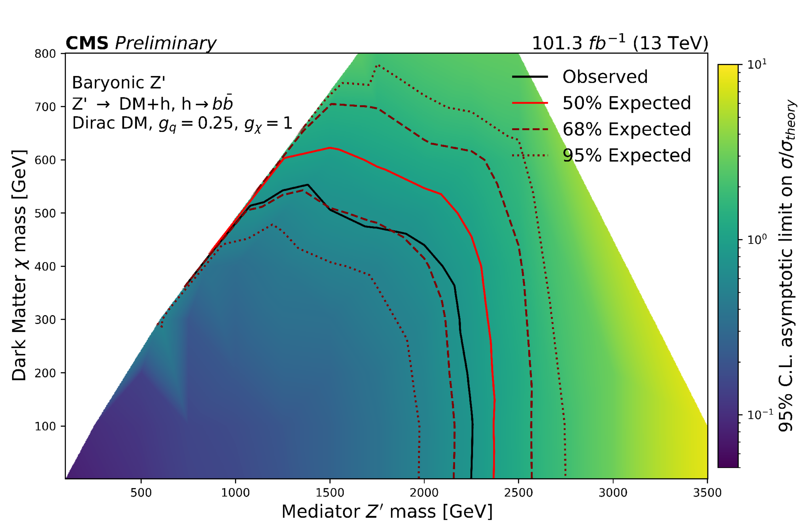
Results Not (yet) in SModelS
CMS-SUS-24-007
MET + higgs

Slide 16
So overall:
*) too many small excesses for these classes of searches
*) not enough underfluctuations
Surely we cannot be the only ones who have
noticed this?

Slide 17
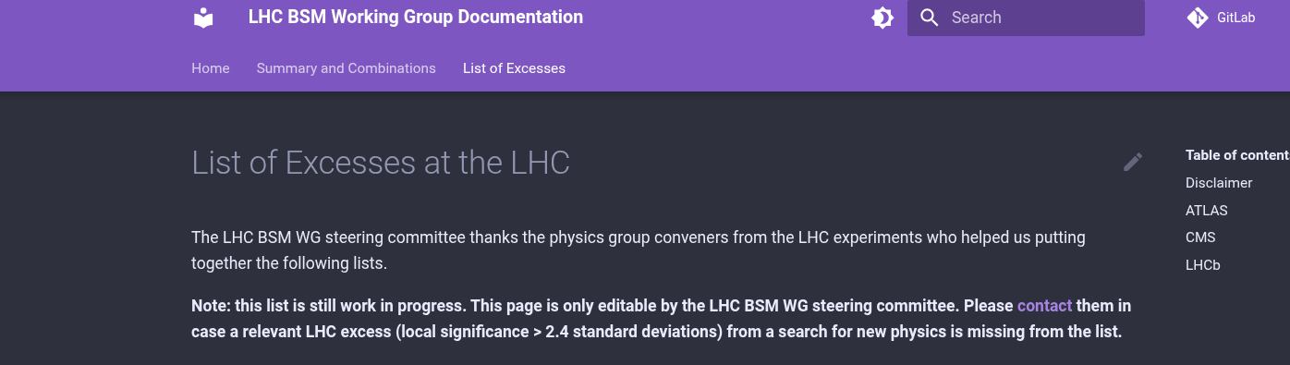
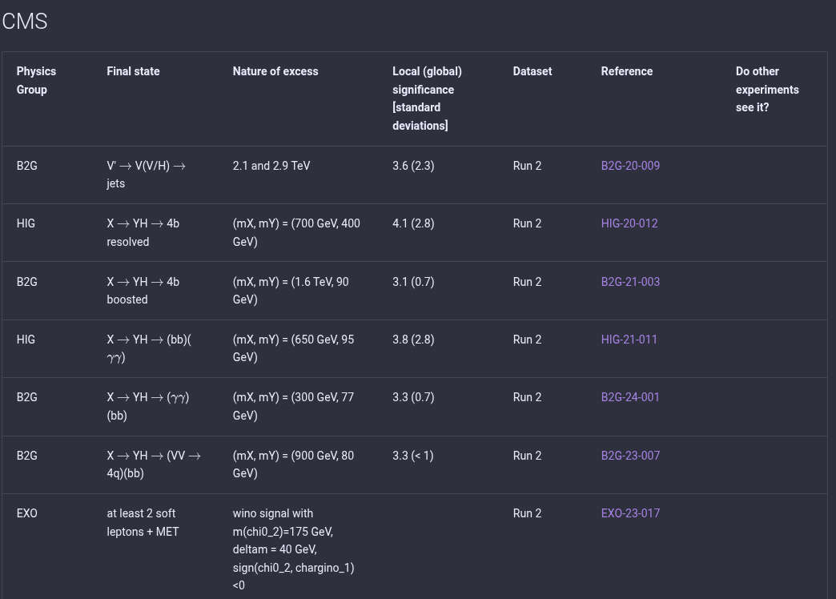
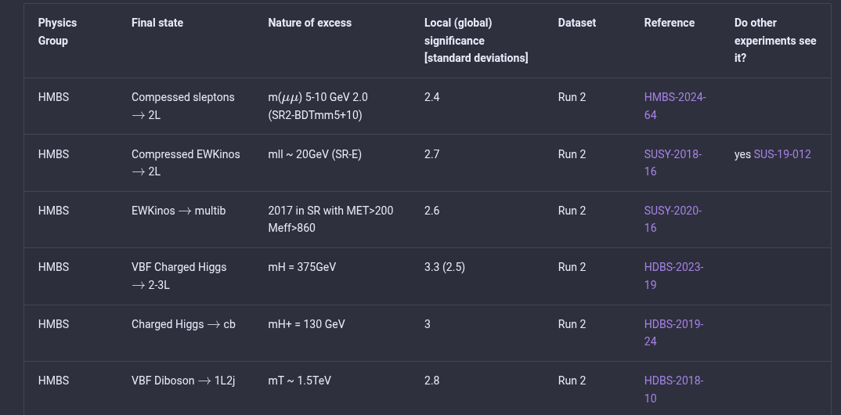
https://lhc-bsm-wg.docs.cern.ch/excesses/

Slide 18
Whither now?
Where do we take things from here?

Slide 19
We find it imperative for experimentalists to
be radically conservative:
*) how can we argue this away?
e.g.: Can it be a problem with our MET? (But then it is odd that things are fine as soon as we add colored production)
e.g.: Can it be a problem with our ISR jets? (But then why do the electroweakino excesses nicely fit the dark matter excecsses)
*) can we really draw a consistent picture or are there
inconsistencies between all these excesses?
*) and in case we cannot “argue this away”, let’s make sure all tools, all infrastructure that is needed for evidence/discovery of new physics, is in fact there

Slide 20

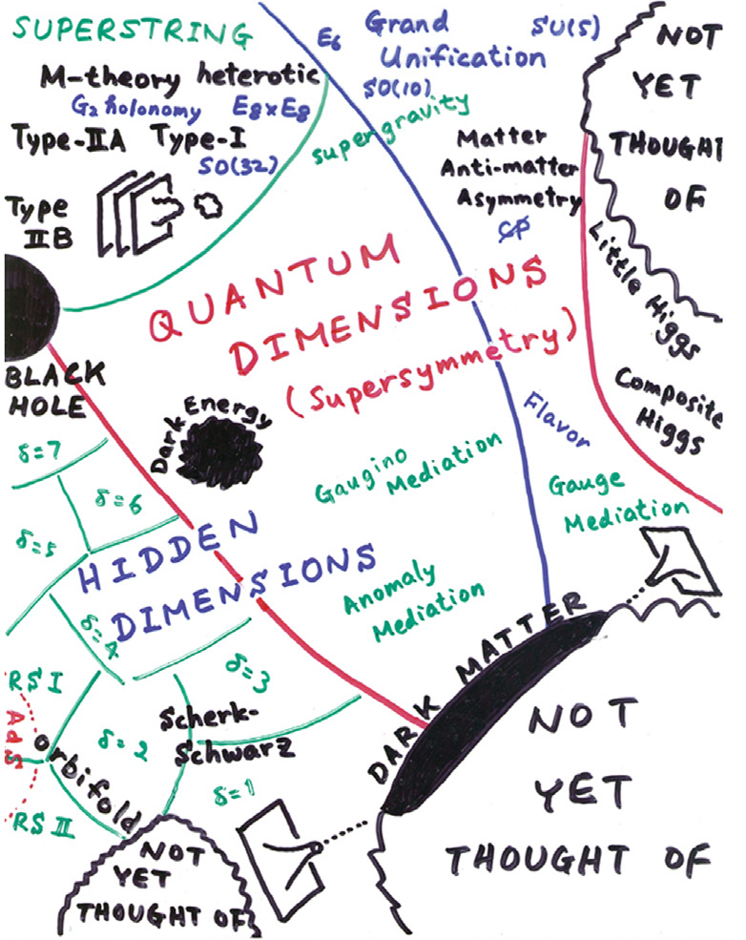
It is crucial for theorists to be conservatively radical:
*) can we really draw a consistent picture or are there
inconsistencies between all these excesses?
*) if it really is due to new physics,
what’s the big picture,
what do we infer globally?
*) how would we construct a
Next Standard Model from
such experimental evidence?
A situation very much unlike that
of the Higgs discovery!

Slide 21
Let’s try and find a simple prototype
BSM theory that explains the excessive number of excesses!
Apart from it being interesting in its own right,
such an attempt may help us also answering the radically conservatives’ questions of where the problem might lie (if there is a problem)

Slide 22
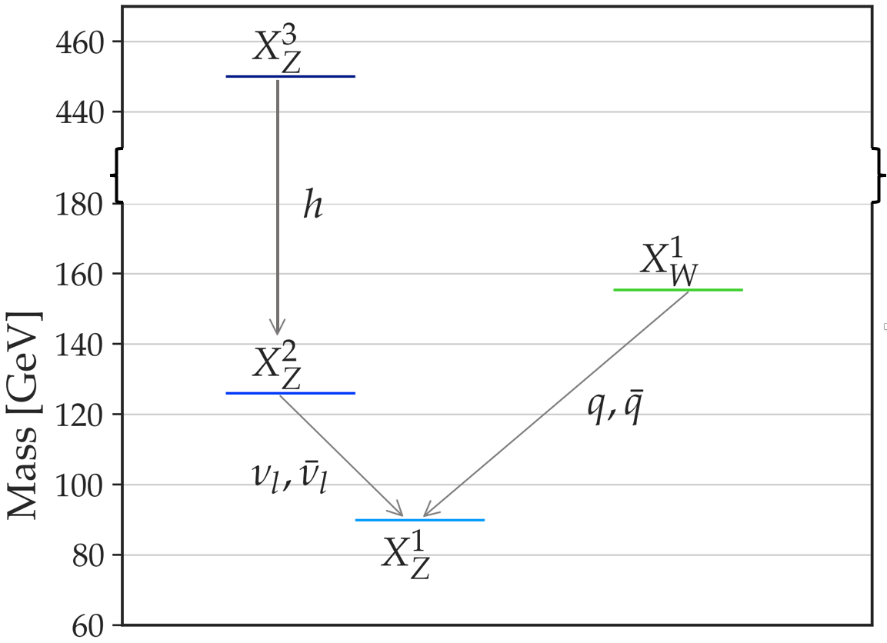
Here is such a prototype model, a “protomodel”
(We introduced this notion of a “protomodel”. It’s an incomplete BSM model, driven by data, not by theory considerations. LHC production cross sections are free parameters, BSM particle spins are left unspecified)
X^{i}Z = “neutralino-like”
X^{i}W = “chargino-like”
Why do we consider this to be an interesting protomodel?

Slide 23
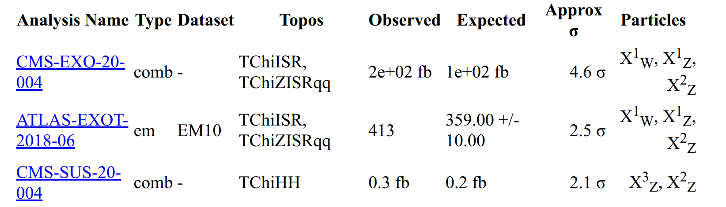
*) It contextualizes three of the biggest excesses we are
seeing in the databases, that are considered mutually independent.
*) we can thus approximately combine the likelihoods of these three analyses – by multiplying them.
*) Another result exists, but is correlated, so we cannot add it in that fashion (but it would also exhibit an excess)
“local 5.8 sigma” (if ndf=1) – with a GIGANTIC look elsewhere effect!

Slide 24
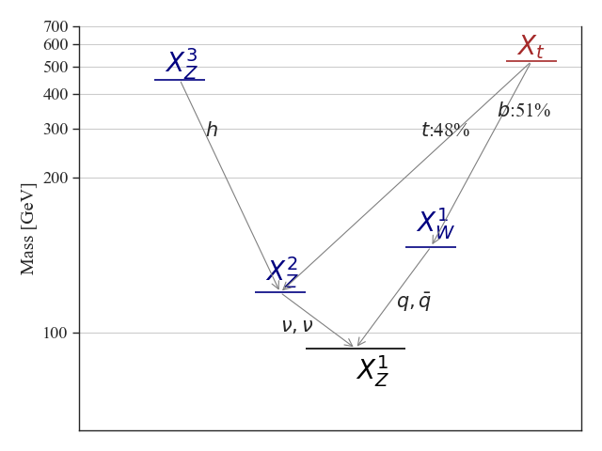
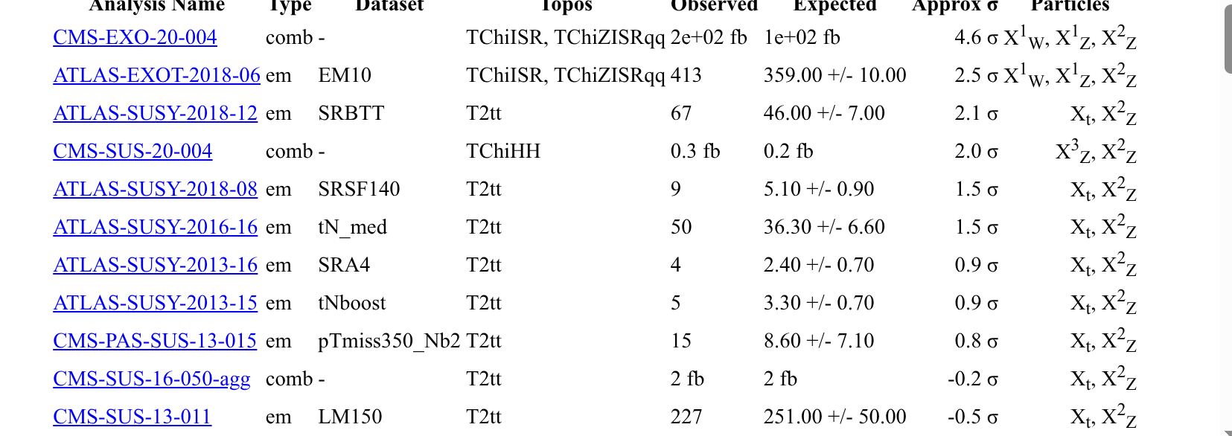
Here is another such protomodel

Slide 25
But let’s focus on the
simpler protomodel
Do we consider these excesses to be mutually compatible?

Slide 26
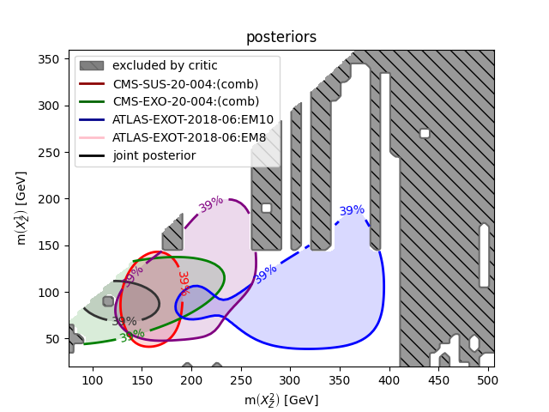
Combining Likelihoods
Likelihoods as
functions of particle
masses

Slide 27
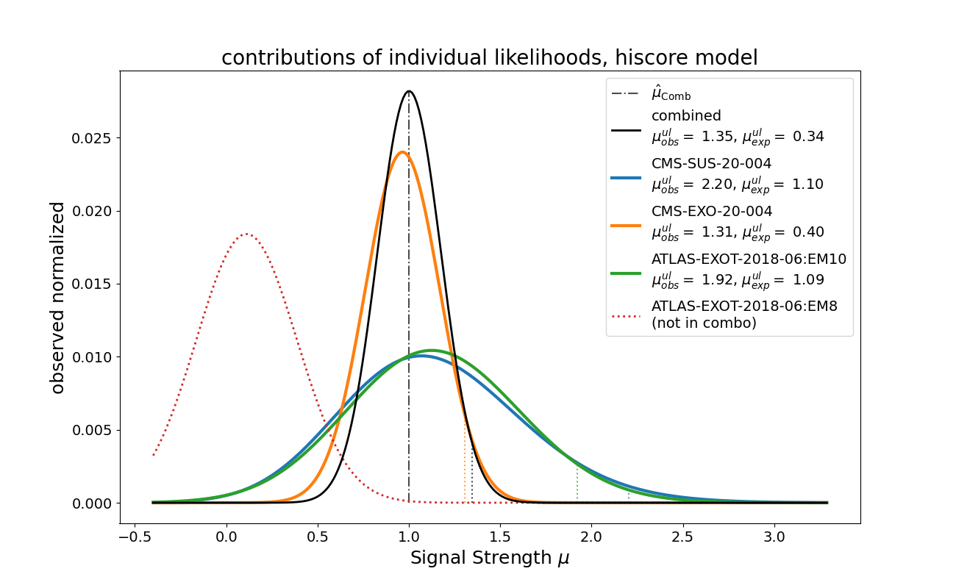
Combining Likelihoods
Likelihoods as
functions of an overall signal strength multiplier
Taking this model with mu as the only free parameter, we could formulate a likelihood ratio test:

Slide 28
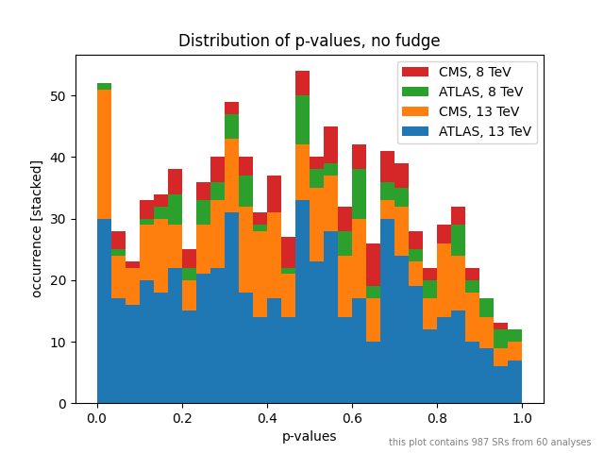
Now that we have a protomodel, what about the meta-statistics plots that I showed you earlier? We have a new hypothesis, so we can compute the p-values for that!
For the SM hypothesis:

Slide 29
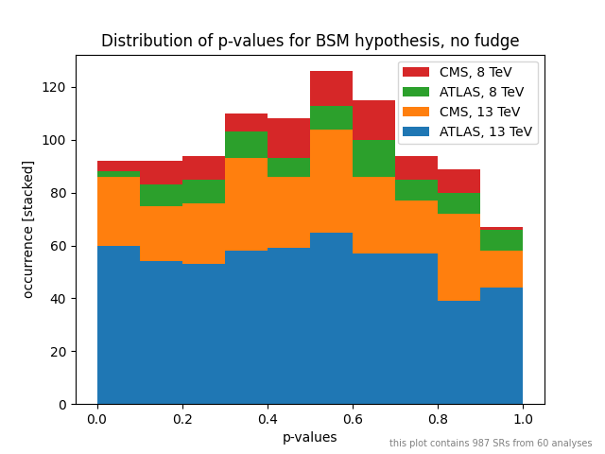
p-values for
The SM hypothesis
Instead of the SM, let’s compute the p-values for the BSM hypothesis:

Slide 30
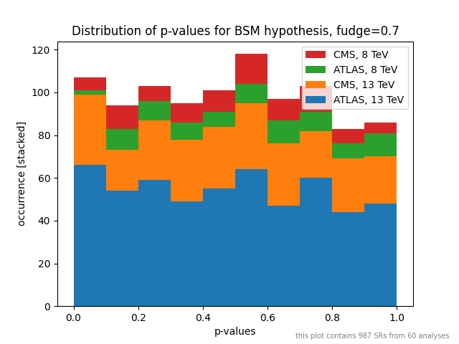
Instead of the SM, let’s compute the p-values for the BSM hypothesis:
The convex shape makes sense
if we assume the systematic
errors to be conservatively estimated (as they should).
Here is the distribution of the
P-values for the protomodel hypothesis, assuming all systematic errors to be ~ 40 % overestimated

Slide 31
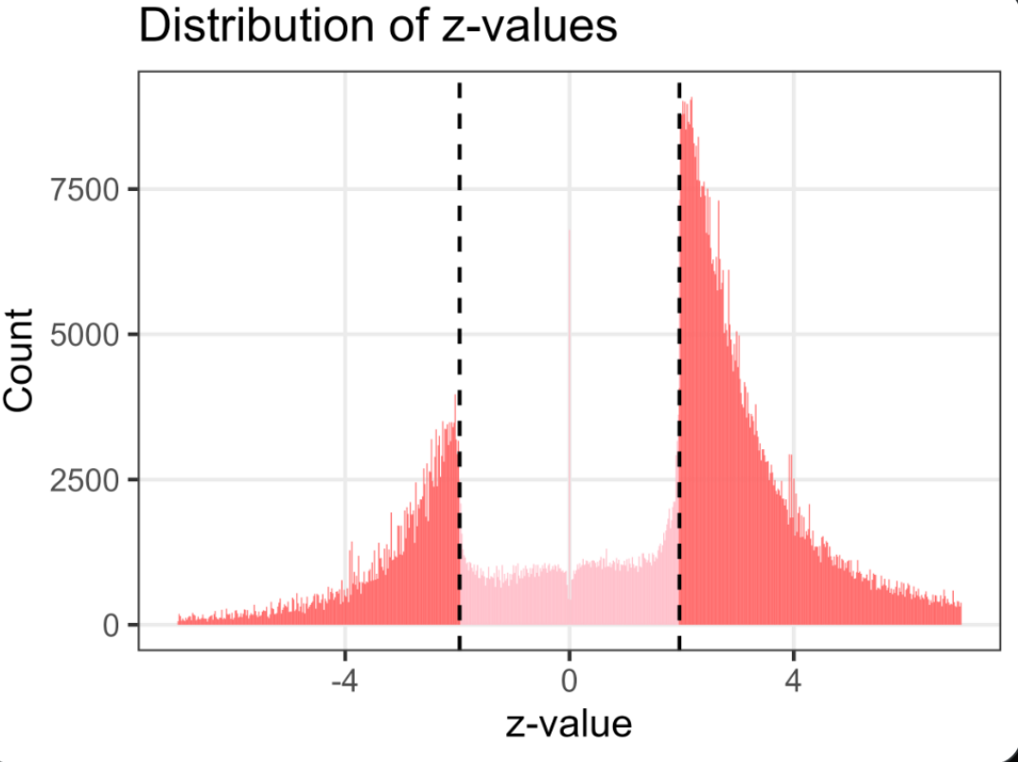
Here is the distribution of the
p-values for the protomodel hypothesis, assuming all systematic errors to be ~ 40 % overestimated
(This feels like nothing short of a miracle.
Remember the medical research plot?)

Slide 32
Did anyone say LZ?

Slide 33
But how did we obtain that protomodel?

Slide 34
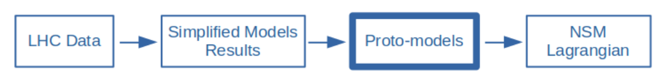
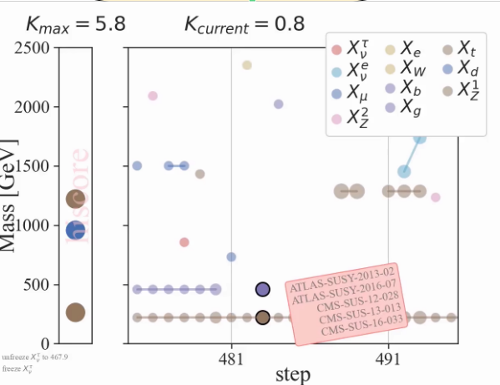
Protomodels
“Likelihood-based automated model building” (in a wider sense of the word ‘model building’)

Slide 35
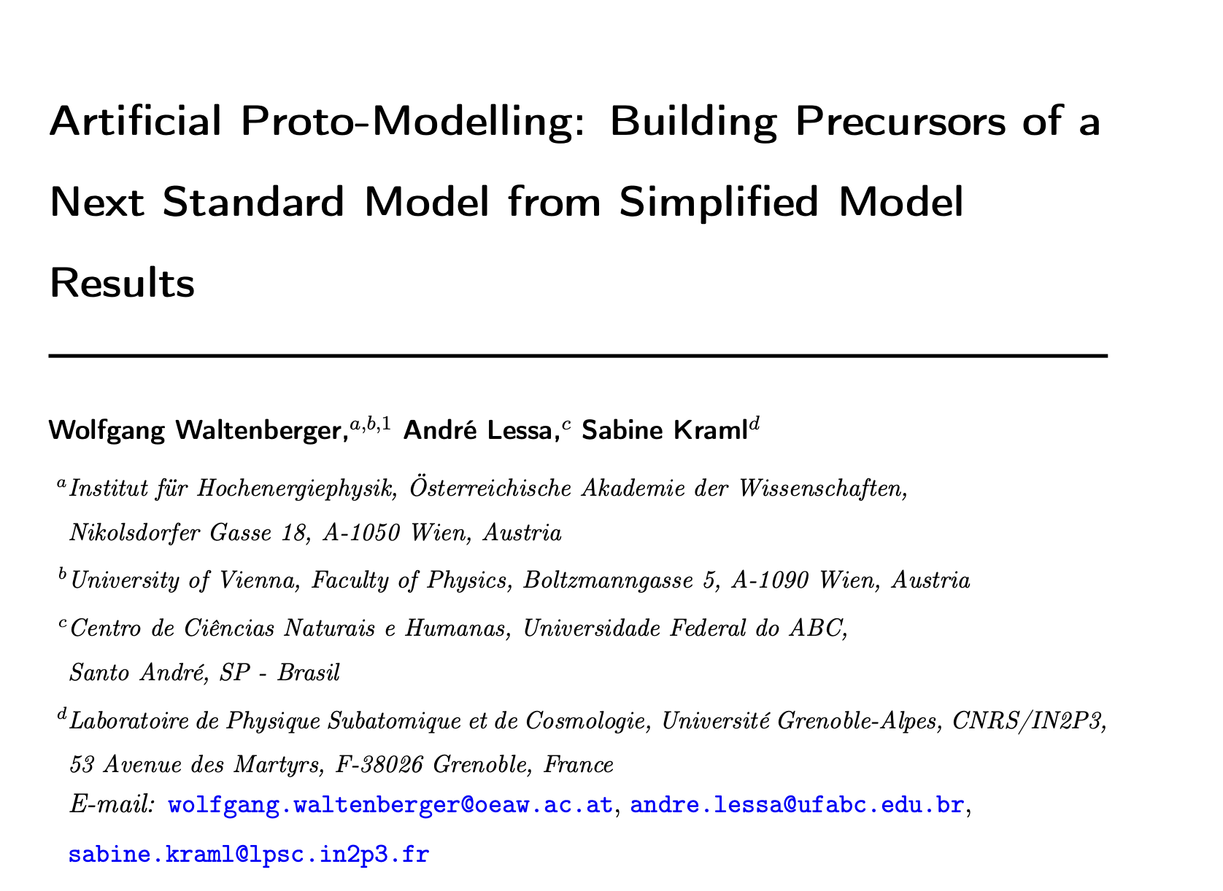
Protomodels
It’s like an MCMC walk as used for e.g. Bayesian
inference, except:
*) we allow the machine to add / remove particles,
decay channels, production mechanisms (variable
dimensionality)
*) the machine combines analysis results depending
on a notion of “combinability” and “completeness”
*) we look at likelihood ratios – L(BSM)/L(SM) – not likelihoods
*) we thus look for that legal combination that maximally violates
The SM hypothesis
*) we added the notion of “critics” that
ensure we remain consisent with all negative
results in our database
*) we think of production cross sections as free parameters
*) we published a prototype v1 in 2020:
https://arxiv.org/pdf/2012.12246

Slide 36
Algorithm Flowchart
Start
Stop
Yes
Proto-model
Builder
Chain
Converged?
No
Analyses
Combiner
No
Yes
Constraint
Compatibility?
No
Accept Proto-model?
Yes

Slide 37
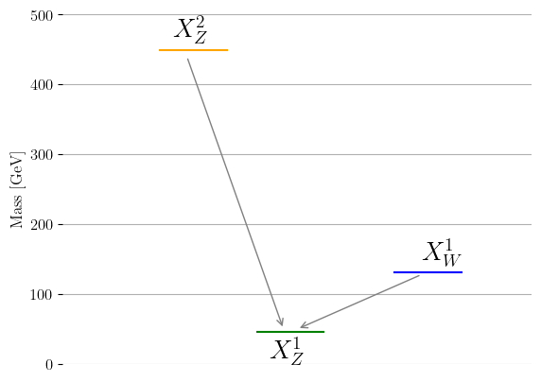
Algorithm Flowchart
Start
Stop
Yes
Proto-model
Builder
Chain
Converged?
No
Analyses
Combiner
No
Yes
Proto-model Builder
Creates proto-models, randomly
adding or removing new particles and changing any of the proto-model parameters.
Constraint
Compatibility?
No
Accept proto-model?
Yes

Slide 38
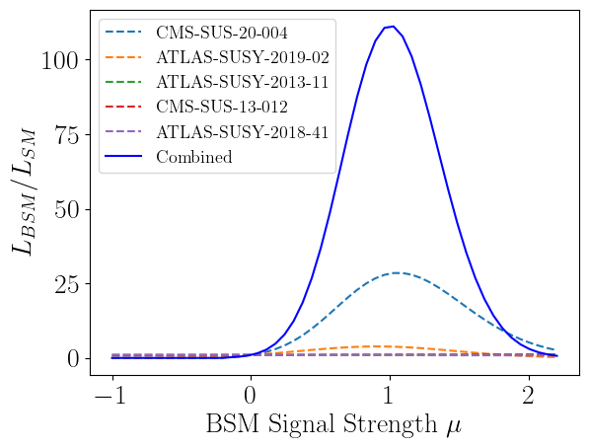
Algorithm Flowchart
Start
Stop
Yes
Proto-model
Builder
Chain
Converged?
No
Analyses
Combiner
No
Yes
Analyses Combiner
Identifies the best possible combination of experimental results and constructs a combined likelihood for the proto-model
Constraint
Compatibility?
No
Accept proto-model?
Yes

Slide 39
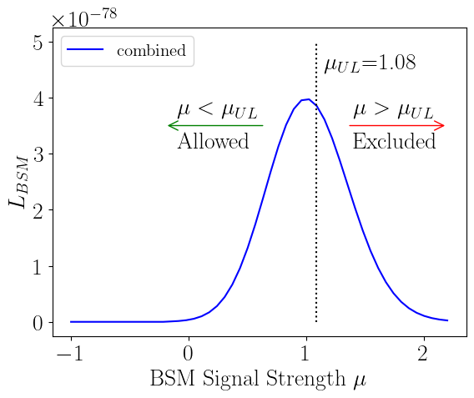
Algorithm Flowchart
Start
Stop
Yes
Proto-model
Builder
Chain
Converged?
No
Analyses
Combiner
No
“Critic”
Constraint Compatibility
Checks the compatibility of the
proto-model against the
extensive database of results
Yes
Constraint
Compatibility?
No
Accept proto-model?
Yes

Slide 40
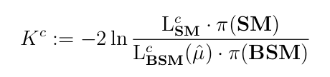

The Test Statistic
The test statistic K^{c} is a likelihood-ratio test that quantifies how much better the proto-model describes the data than the Standard-Model (plus a penalty for model complexity).
Quantifies violation of Standard Model hypothesis
Penalizes for model complexity (among
other things)
Main penalty is similar to
Akaike Information Criterion:
We search for proto-models and combinations of results / likelihoods that maximize K^{c} while remaining compatible with all negative results (and the most sensitive combination thereof) in our database.

Slide 41
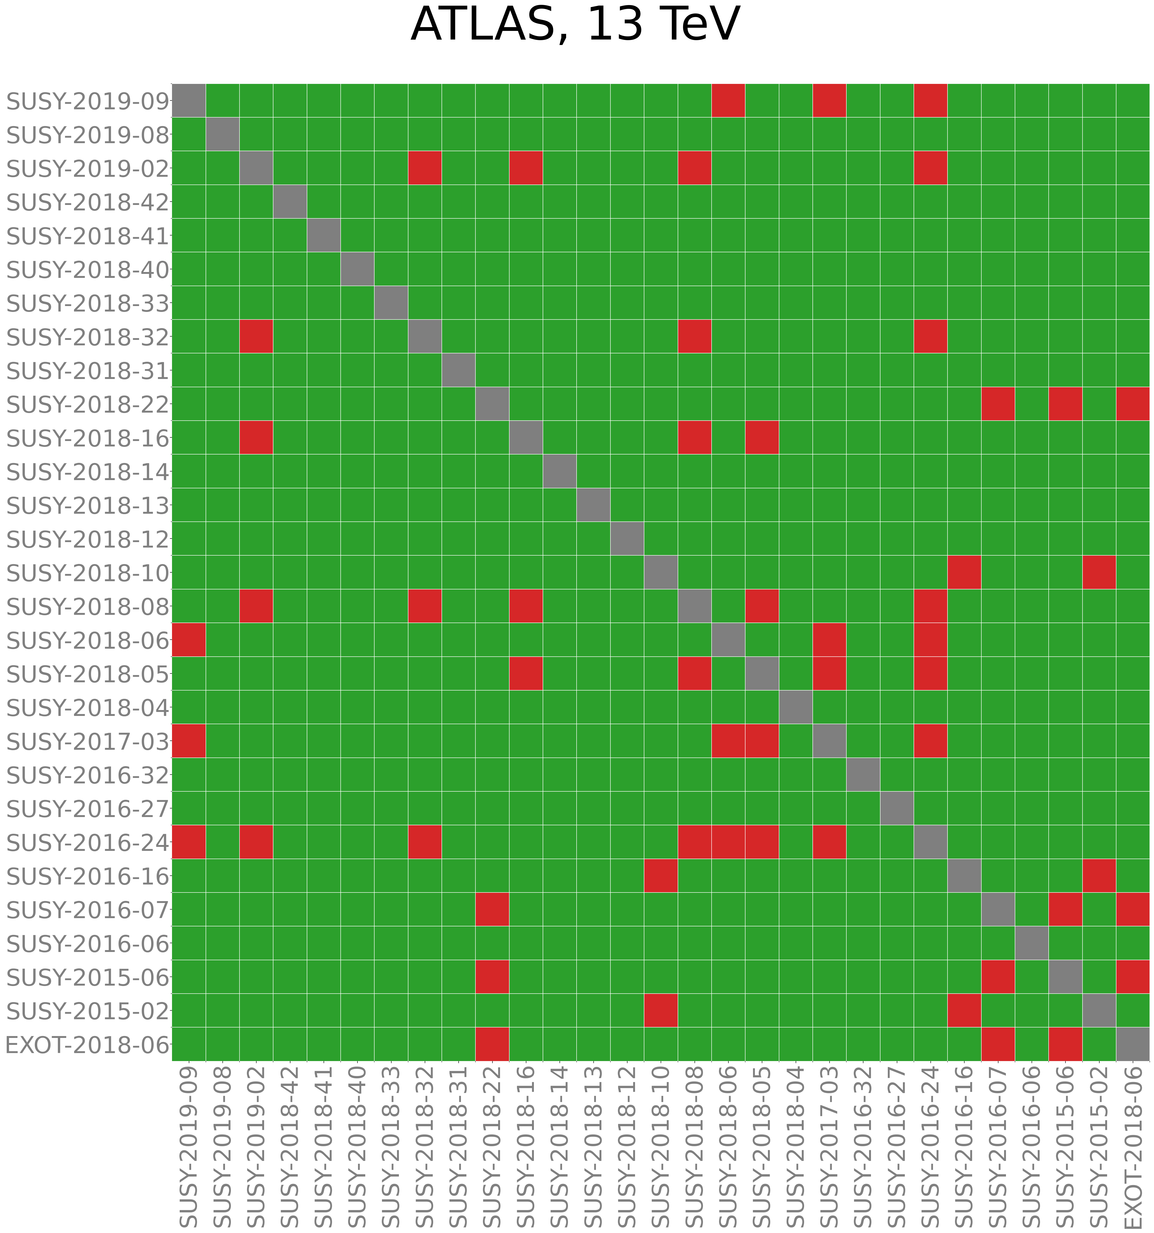
Combinabilities
Green: can combine
Red: cannot combine
*) Only 11 (ATLAS: 29) Run-2 CMS analyses published with all material needed to be usable for protomodels, though situation has been greatly improving recently
*) Longer term vision: full stats model for all analyses, naming conventions for nuisances. Correct combinations, taking into account correlations.

Slide 42
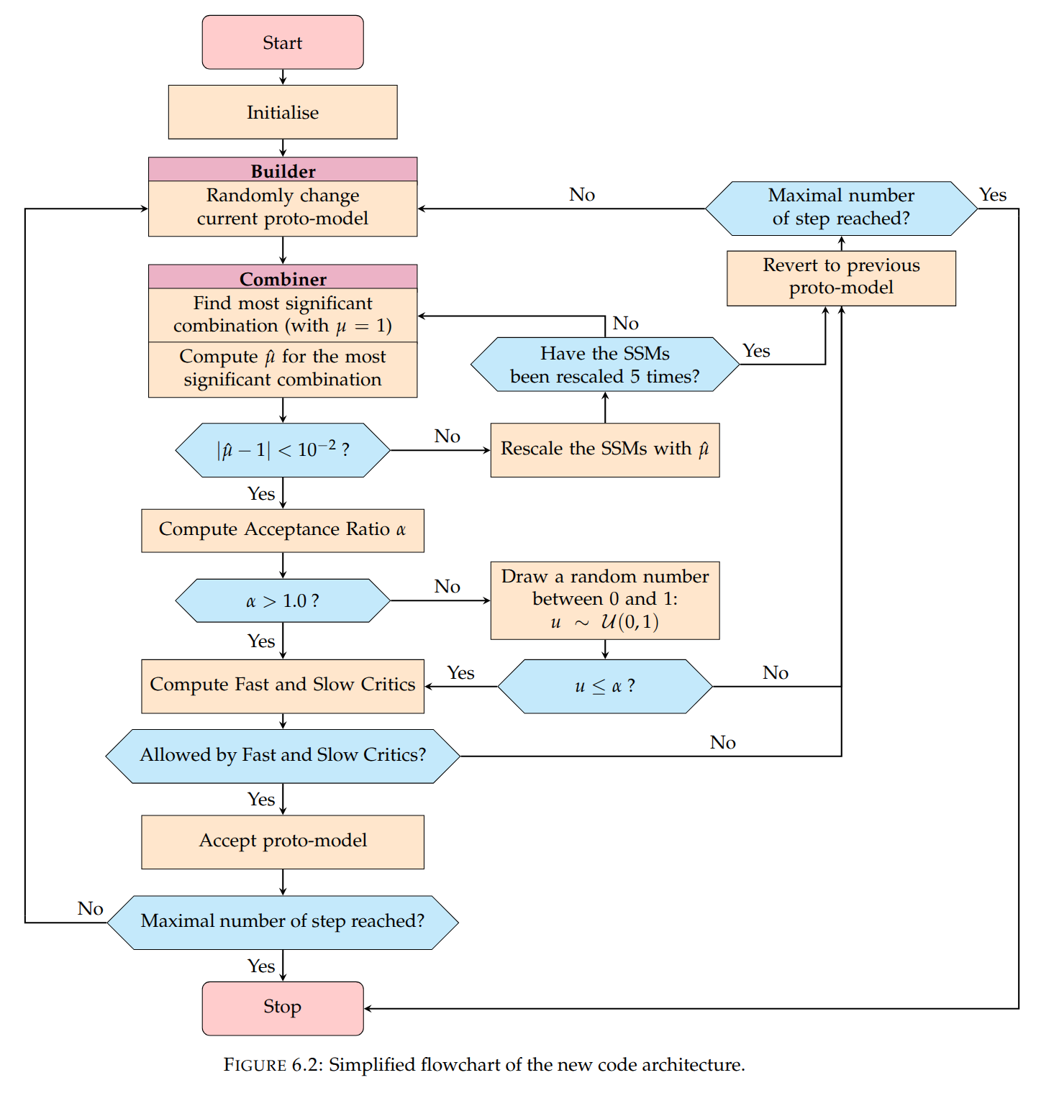
ProtoModels v2
Here is a flow chart of our much refined v2 of the machinery

Slide 43
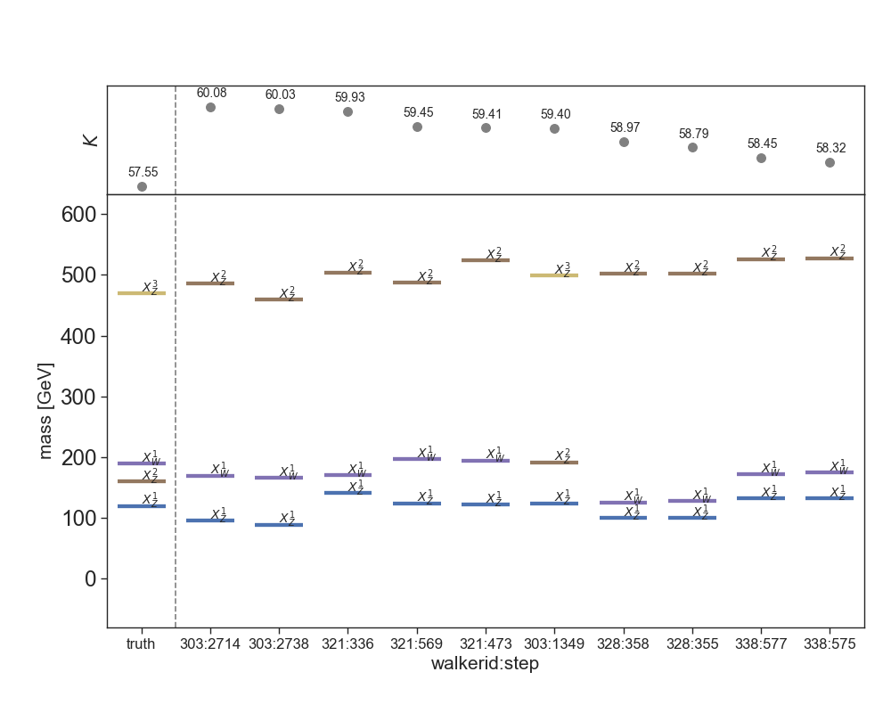
Closure test
If we create fake data with an injected signal, then run our algorithm over it, do we get the truth back out?
For protomodels similar to our hiscore model, we do.

Slide 44
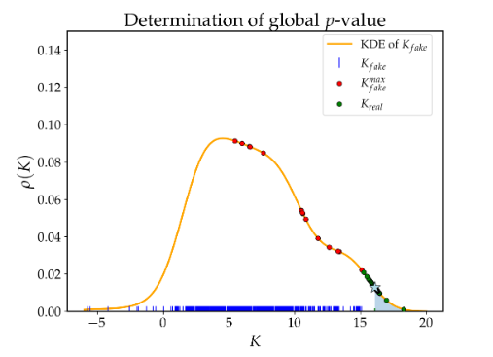
global p-value
If we synthesize SM-only versions of our database, and run our algorithm on these
synthetic data, we can compute a p-values for the SM-hypothesis
Extremely costly computation (1 – 100 millions of CPU hours), so only very rough estimate of global p-value (though the estimate is likely conservative). We currently
end up at p ~ 0.01 (very rough estimate!)

Slide 45
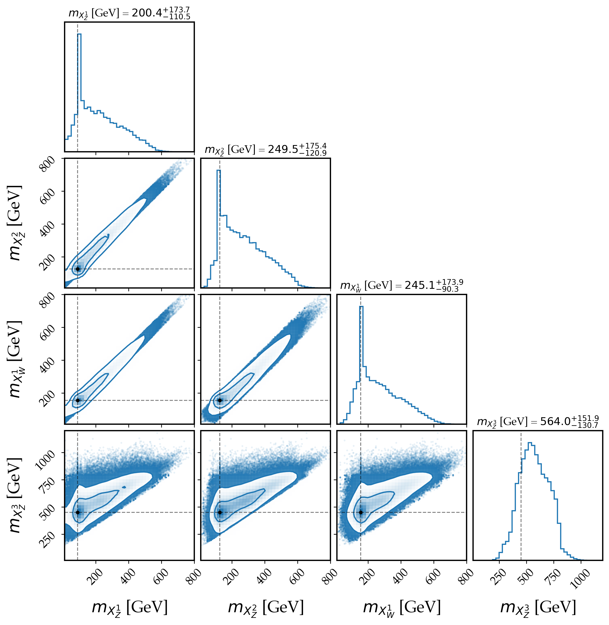
Very first estimates of errors
Here is a first estimate of e.g. errors on particle masses. Remember, we do not fixate
the spins / production cross sections of our model, so the errors are huge. If we asssume e.g. the MSSM, then spins, productions cross sections etc are (more) fixed and the errors become much smaller

Slide 46
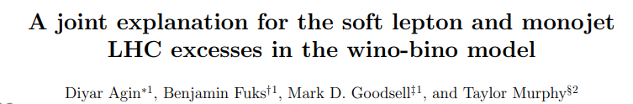
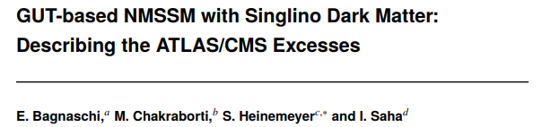
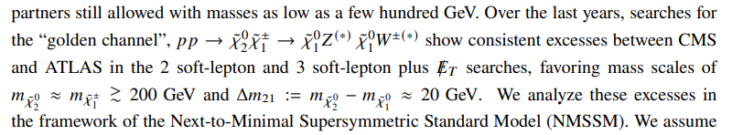
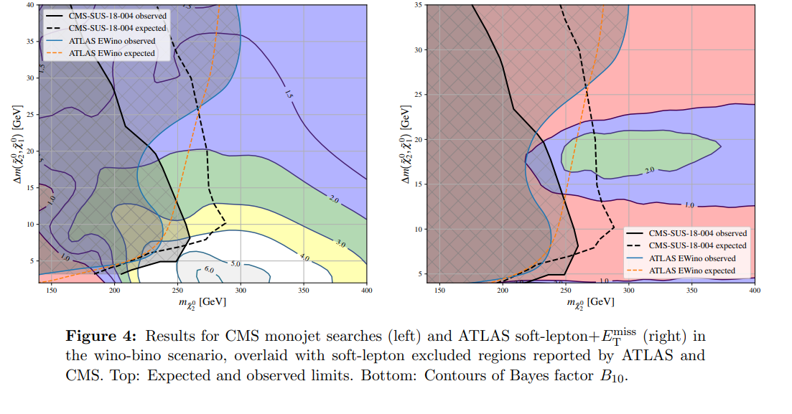
Other pheno groups
Have other pheno groups noticed / noted on these similar compatibilities between excesses?
Soft dilepton excess wants ~ 200, 250 GeV neutralinos with ~ 20 GeV mass gap.
Compatible with our findings (and we didn’t have dileptons result)

Slide 47
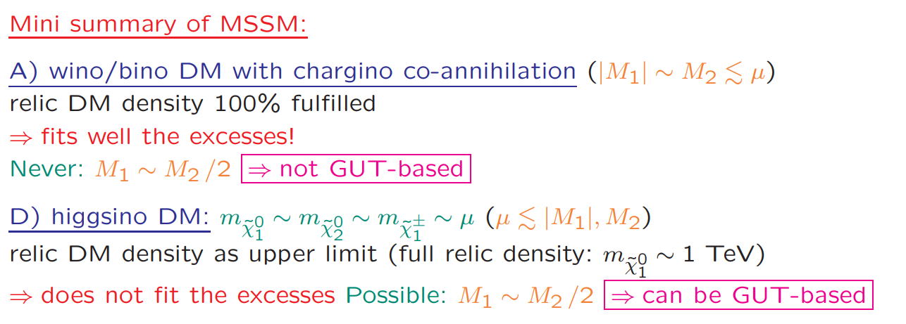
Other pheno groups
S. Heinemeyer, SUSY2026

Slide 48
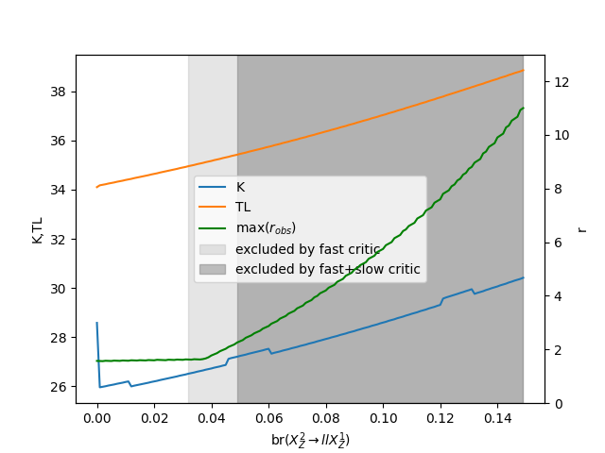
They added dileptons to the X2Z decays. We could, too.
The biggest excesses in soft dileptons + MET are not (yet) in the SModelS database.
But even the older ones that we have, would actually fit the picture – the excesses
are just not big enough yet.

Slide 49
Protomodels – what will we do with them?
(apart from them serving as a high-level summary of what we are seeing, possibly informing the search programmes about
where to look next)

Slide 50
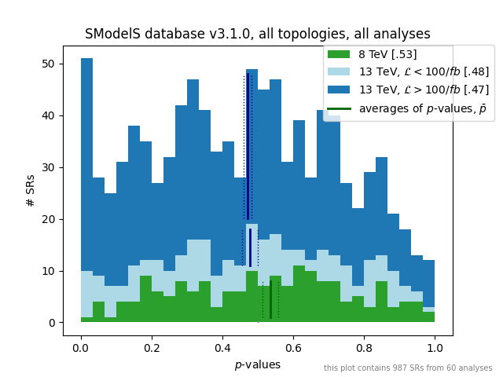
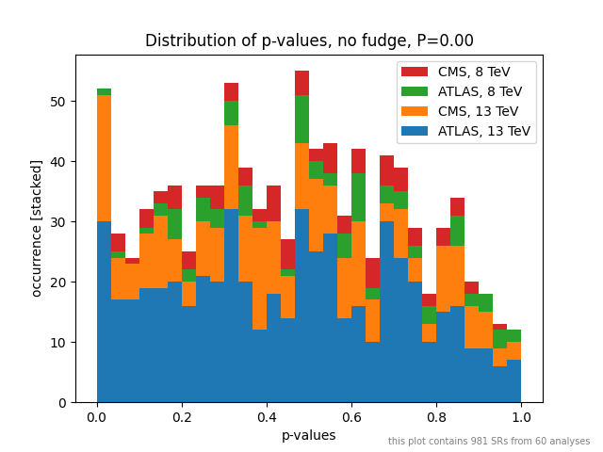
If this peak is due to new physics at the right energy scales, it’s plausible that we didn’t see anything at run-1 yet, we should starting seeing something at run-2 low-lumi, then things should get more pronounced at run-2 high-lumi.
Given that the ATLAS and CMS physics programmes are very similar, we should
be seeing similar behavior for both experiments.

Slide 51

NSM Lagrangian from the proto-models, work in progress
Work in progress. Lots of combinatorics:
we cannot differentiate between light quark flavors. Observed particles might be degenerate.
From particles to fields.
Singlets versus doublets versus multiplets. From broken to unbroken Lagrangians.

Slide 52
Informing the next Searches
Example:
Say you are taking the protomodel to the left
seriously. But also the excess
In the charges Higgs search at H⁺ ~ 600 GeV. An obvious question would then immediately be:
What about H⁺ → X¹W X²Z?
H⁺
(I havent yet thought carefully about such matters though. @Jonas?)

Slide 53
Wanna Collaborate?
v1 was a feasibility study
v2 will (soon) be the first version producing protomodels that are of physics relevance
v3 should give a comprehensive summary of much of the LHC programme
(especially SUSY)
We have started to plan a v3 of the project
There is more than plenty to do, from curating the inputs to speeding things up with ML and gradients to connecting the output protomodels with UV complete models.
Make connection with dark matter physics, flavor physics.
Full scale combinations within the collaborations, etc etc.

Slide 54
Wanna collaborate?
TODO
Implement more analyses in our database
machine learn surrogate statistical models to speed up evaluation
work on hs3/combine support in our software
work on code that can simplify statistical models, to speed things up
combinations within the MSSM, NMSSM, etc
introduce gradients in our inference chain
extend the space of theories we can cover
Refine LHC searches with specific protomodels in mind
Recast older analyses, recast for new simplified models
Compare with e.g. dark matter relic density, XENONnT, flavor physics
Connect with LHC measurements, EFTS
Protomodels but full-scale combinations (possibly within the experimental collaborations?)
Run interesting models with full recasts
Identicification of compatible UV complete theories

Slide 55
Thank you!

Slide 56








Naively: (without assuming conservatism) we would expect
<= 960 * Φ(2.40) ≈ 8 SRs.
We have 28 SRs with Z > 2.40, 4 SRs with Z < - 2.40
List Of SRs with Z > 2.40
TRS1
TRV1
TDTM2F
TChiWZ(off)
TDTM1F
*) CMS-EXO-20-004 is yes overrepresented
(simplified likelihood fit possible culprit?)
*) “small mass gap + MET” topologies are dominant

Slide 58


Algorithm Flowchart
Start
Stop
Yes
Proto-model
Builder
Chain
Converged?
No
Analyses
Combiner
No
Yes
Constraint
Compatibility?
No
Accept proto-model?
Yes
13

Slide 59
Our Inverse Problem
To connect our observations with contender theories for the Next Standard Model,
In addition to lots of other information, we need statistical models (in one way or another)
we can either start by:
postulating a theory, then fit its parameters
(“top-down”)
or:
try to build our model directly from data
(“bottom-up”)

Slide 60

Top-down versus bottom-up
Top-
Down:
Start here: You have a
great idea for a new model.
You write down the
model’s Lagrangian
You calculate all observables.
Comparing with data you
compute p(data|theory).
From this you compute
a test statistic T.
T
is “good”?
Come up with a better idea.
no
yes
Congratulations! Fly to Stockholm.
Claim your prize.

Slide 61

Top-down versus bottom-up
Only now do you think about symmetries, gauge groups, etc that
may underlie all observations. Construct your Lagrangian.
From the descriptions you try and construct precursor theories to the NSM
that describe everything you really know about
TeV-scale (and below) physics
Bottom-Up:
Start here: You describe your experimental findings in a language
amenable to theoretical physics, e.g. simplified models for on-shell
effects (“searches”), effective field theories for off-shell
effects (“measurements”).

Slide 62

Top-down: example
“Global LHC constraints on electroweakinos with SModelS v2.3”
Model: MSSM, but looking at its charginos and neutralinos only
Excluded
Model points
gain in exclusion reach by combining (CMS and ATLAS)
results
https://arxiv.org/abs/2312.16635

Slide 63

Top-down: example
Combination at work, for one model point. Likelihoods here are functions of a single parameter (the overall “signal strength”). Combining several likelihoods (colored lines)
results in a narrower combined likelihood (dashed line).
https://arxiv.org/abs/2312.16635

Slide 64

Statistical Models in the
SModelS Database
ATLAS, Run-2, Full Lumi only:
Type of statistical model

Slide 65

Statistical Models
Only exclusions for particular models
If only “exclusion lines” are given, without upper limits, we can do nothing
Observed 95% CL upper limits on production cross sections only:
cannot construct likelihood, binary decision “excluded” / “not-excluded” only (“critic”)
Expected and observed 95% CL upper limits
can construct an approximate likelihood with truncated Gaussian,
cannot combine topologies, very crude approximation
Signal Efficiency “maps” for “simplified models”
can construct a likelihood as Gaussian (for the nuisances) * Poissonian
(for yields), can work per SR, and combine topologies in each SR [*]
Efficiency maps + correlation matrices
can combine signal regions via multivariate Gaussian * Poissonians
Efficiency maps + full likelihoods
full realism, correct statistical model
Efficiency maps + full likelihoods + naming convention
+ knowledge about “data overlaps”
can combine publications at full realism
better
Likelihoods
Combos
[*] if efficiency maps are not supplied, we can try to produce them with recasting frameworks

Slide 66

Serialized Statistical Models
pyhf serializes the models into json files:
Posterior distributions on nuisance parameters (such as jet energy scales, pdf uncertainties, reconstruction ineffciencies, etc etc) are described via “auxiliary measurements” –> keeping things frequentist (if we wish)!
Statistics Standardization comittee formed: HS3
https://github.com/hep-statistics-serialization-standard/hep-statistics-serialization-standard
These “closed world” approaches are general enough for users!

Slide 67
Simplifications and Interoperability
An ecosystem of tools around serialized statistical models will be crucial:
Currently we have:
Simplify: simplifies pyhf likelihoods, collapses nuisances.
https://pypi.org/project/simplify/
Seems to be working with only minor quirks, we are making use of it.
Combine2pyhf: converts combine datacards to pyhf and back
https://github.com/kskovpen/combine2pyhf
Orphaned, does not handle all cases.
Pyhf-to-combine converter:
https://github.com/peterridolfi/Pyhf-to-Combine-converter
Student project. Promising but incomplete.

Slide 68



In “User Space”: Machine Learning Surrogate Models
We are in the process of using surrogate models in SModelS (scheduled for SModelS v3.2.0)
If only likelihood is needed: simple, fully
connected neural networks (Bayesian neural networks
for adding errors on the estimates), e.g.:
If full statistical model including toys is needed as well: generative network such as normalizing flows. e.g:

Slide 69


Combinability Matrix, and “recasts”
We keep track of which pairs of analyses have no overlaps in what LHC collision events enter the signal regions. In the “pheno community”, we combine only if no overlap.
Currently most reliable source for the combinations matrix: analysis recast frameworks: generating events, track which signal regions are populated by which events
Requires detailed documentation about
the analysis
Experimental collaborations could in principle produce this information as well
(and better)
Long term vision: a naming convention is established, making it possible to correctly combine stats models!

Slide 70
Reproducing an Analysis
In order to facilitate reproduction of an entire analysis – to e.g. apply it to a new model, or to study analysis overap (previous slide), the analysis needs to be documented in great detail:
Cutflow tables of the analysis cuts, reconstruction object efficiencies, machine-learning models (e.g. as onnx files) need to be given in digitized form, for e.g. recasts, studies of analysis overlaps.
Implementation in a simple framework / language: e.g. SimpleAnalysis or Analysis Description Language (ADL)
For Monte Carlo samples used in publication: generator datacards, etc
Upper limit plots, signal efficiency maps (of simplified models) in digitized form
Statistical models in reusable digitized form

Slide 71
Experimental Results →
Protomodels
the test statistic
Particle
spectra
A hiscore
protomodel
potential
dispersed
signals
Random modifications
an MCMC-like walk
https://smodels.github.io/protomodels/videos

Slide 72
ProtoModels → Next Standard Model
Work from protomodels to UV complete theories has begun
(John Gargalionis, PostDoc in Valencia) – lot’s of combinatorics!
Protomodel
X
X
Operators Mapping
Z
Consistent lagrangian
X
X
Y
Y
Z
LHC data
non-LHC data
X₀
Z
...
...
dark matter observables, low energy observables, ...

Slide 73
Summary
Ideally, all important aspects of a physics result get published: cutflow tables, reconstruction object efficiencies, machine learned models, generator datacards, for SModelS: efficiency maps and: serialized statistical models!
HEPdata is the collider physics results platform of choice
DOIs for all digital objects
Global fits are still an indispensible tool to obtain a “big picture” (see also gambit’s talk)
The SModelS collaboration recently started to automate model building based on the statistical models

Slide 74

Differentiably if possible
If we had gradients we could perform gradient descent to find the best model, and we could use e.g. the Fisher information to infer the error on its parameters (or, alternatively we can then MCMC-sample).
SModelS is – in principle -- differentiable
for individual candidates we can make this differentiable w.r.t fundamental parameters Θ_{l}, via neural networks
described as likelihoods L that are differentiable with respect to the yields y_{i}
that’s just a sum of
simplified models →
differentiable!
.
.
.
Not yet required (theory space as well as space of measurements are still low-dimensional enough). Action item for now: keep choosing, supporting, developing technologies that support autograd

