Slide 1
SModelS 3.0
Guide for a new Database Entry

Slide 2
Database – Constraints and Conditions
The constraints and conditions are string expressions for the SMS weights:
constraint: 2*({(PV > …} + { (PV > …)})
condition: Csim({(PV > …},{ (PV > …)})
Example: constraint: {(PV > anyBSM(1),anyBSM(2)), (anyBSM(1) > jet,jet,jet), (anyBSM(2) > jet,jet,jet)}
The labels appearing in constraint and conditions must match one of the particles defined in databaseParticles.py
The SMS appearing in the constraints are required to be unique, which means that distinct ExpSMS belonging to the same TxName can not match.
Note that the strings representing SMS are delimited by curly brackets: {(PV > …} = {ExpSMS}
All BSM nodes appearing in the SMS description should be numbered!

Slide 3
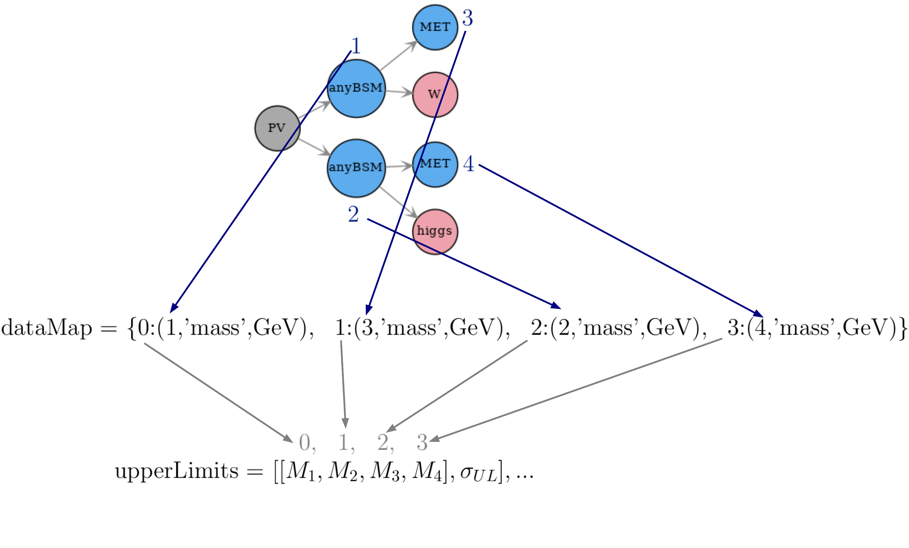
Database – DataMap
The dataMap stores the mapping between the node numbers appearing in the constraint (e.g. anyBSM(1),…) to the entries in the flat array of the data grid.
dataMap = {<data grid index> : (<node index>, <attribute>,<unit>)}
Example:

Slide 4
Database – AxesMap
The axesMap stores the mapping between the data grid indices and the axes labels for plotting validation.
axesMap = [{<data grid index> : <axes label>}]
Example:
0, 1, 2, 3

Slide 5
Database – addMassPlane
When adding a new mass plane a dictionary must be given defining the mapping between the data grid indices and variables. This mapping can be used to define constraints between the data grid values.
TxName.addMassPlane({<data grid index> : <variable label>})
Example:
0, 1, 2, 3
(setting “2” and “3” to the same variable ‘z’ imposes that the entries 2 and 3 are equal)

Slide 6
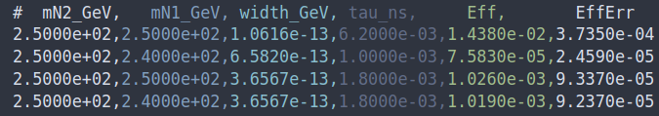
Database – Coordinates
The coordinates argument in setSources defines the mapping between the variables previously defined in addMassPlane to the columns in the input data file.
MassPlane.setSources(coordinates = [{<variable> : <column index in data file>}]
The upper limit or efficiency value is defined by the “value” string.
Example:
0 1 2 3 4 5

