Slide 1
SModelS 3.0
Generalized Topologies
With Graphs
André Lessa

Slide 2
Goal
Describe signal topologies with arbitrary shapes, such as:
Ressonant production
Associated Production
R-Parity Violating Decays
Non-Z₂ decays
...

Slide 3
Current Status – SModelS 2.0
Signal topologies (simplified models) are described by Elements:
.branches
list
Branch
Element
.weight
list
Particle
.oddParticles
.evenParticles
.Z2parity
list
.mass
list
ParticleList
...
.particles

Slide 4
Current Status – SModelS 2.0
Overall structure:
.branches = [Branch1, Branch2]
Element
.weight
Branch
.oddParticles = [Particle1, Particle2,...]
.evenParticles = [ParticleList1, ParticleList2,...]
ParticleList
.particles = [Particle1, Particle2,...]

Slide 5
Current Status – SModelS 2.0
Inclusive objects:
.branches
Branch
Element
.weight
Particle
.oddParticles
.evenParticles
.Z2parity
InclusiveBranch
.mass
...
.oddParticles = * (optional)
MultiParticle
.evenParticles = *
.particles
When comparing against branches:
Checks if last BSM particle matches (if defined)
Checks if intermediate BSM particles matches (if defined)
Ignores evenParticles
Ignores branch topology (number of vertices,...)
When comparing against particles:
Checks if any particle in .particles matches

Slide 6
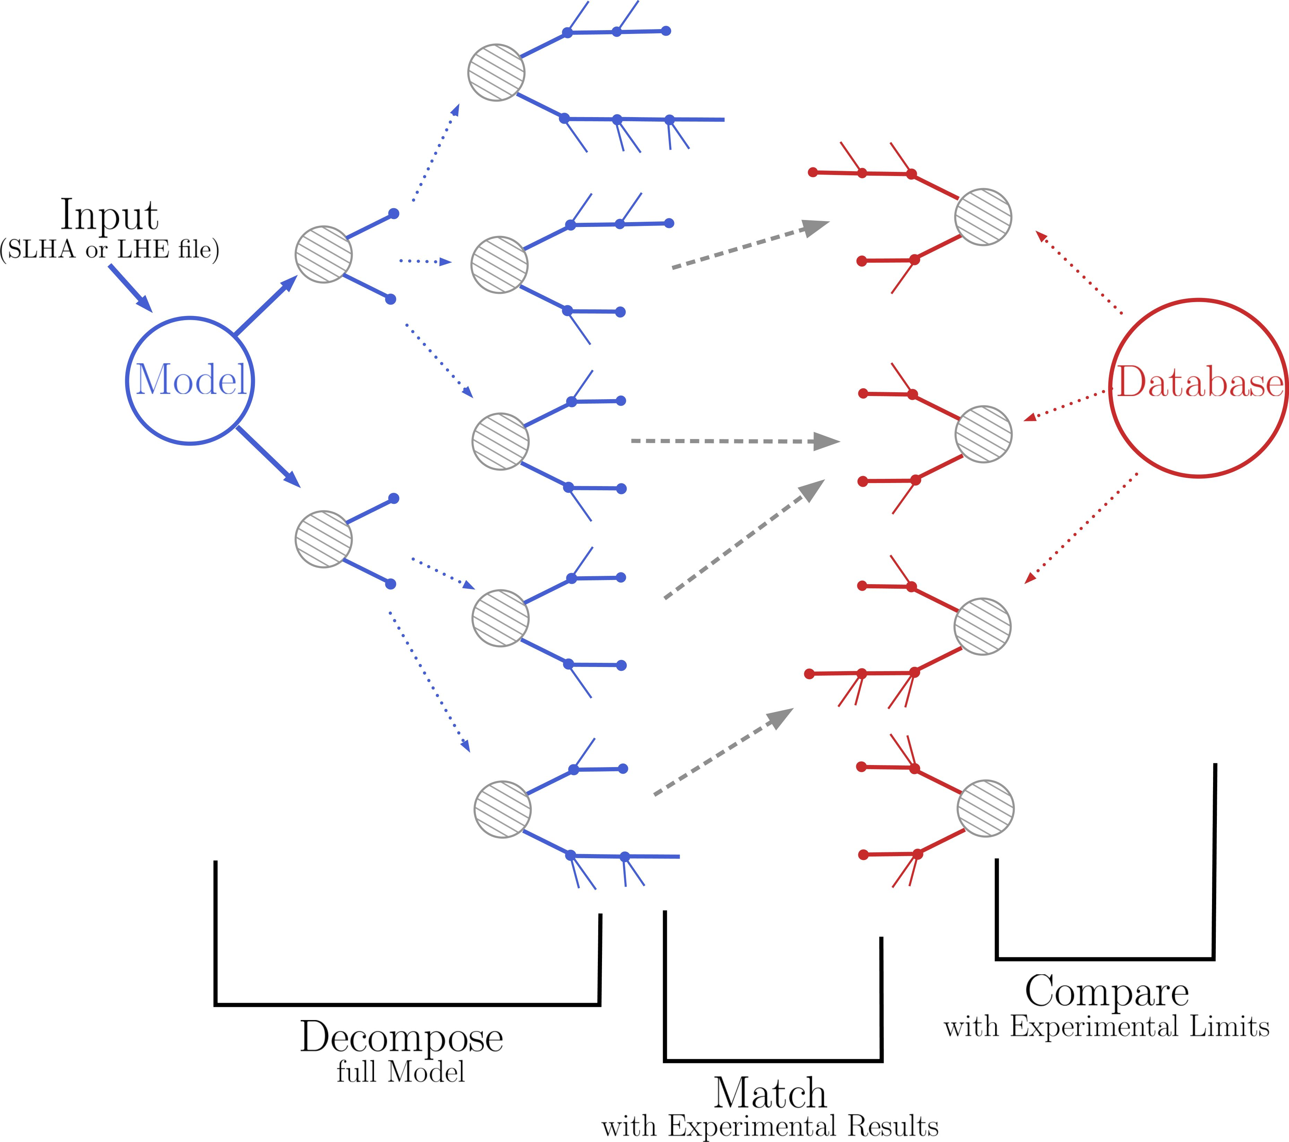
Current Status – SModelS 2.0
Element comparison takes place when:
Decomposing the model
(equal elements have their weights combined)
Matching against the database
(uses inclusive objects)

Slide 7
Current Status – SModelS 2.0
Element comparison: Element_{A} = Element_{B}?
.branches
Branch_{A}
Element_{A}
Particle_{A}
.weight
.oddParticles
.evenParticles
ParticleList_{A}
(any branch ordering)
(any particle ordering)
.branches
Branch_{B}
Element_{B}
Particle_{B}
.weight
.oddParticles
.evenParticles
ParticleList_{B}

Slide 8
Current Status – SModelS 2.0
A lot of the SmodelS structure is based on the 2-branch/Z₂ assumption
However, it only affects the inner layers (Element class and its methods)
How to move towards general topologies? → Graphs

Slide 9
Using Graphs to Describe Topologies
Nodes = Particles
PV
Directed Graph
(Directed Rooted Tree)
Edges = “Decay”
Can describe any topology
Well stablished libraries (networkx, ...)

Slide 10
Implementation
Main steps:
Text description ↔ graph ✓
Graph comparison ✓
Element compression ✓
Decomposition ✓
Inclusive objects ✓
Extracting relevant information from graphs (database) ✓
New database format (how to store data) ✓
Simplified missing topologies ✓
Printers ✓
...

Slide 11
Strings ↔ Graphs
We can use MadGraph-like language to convert the graphs to text and vice-versa:
(PV → anyBSM(1), anyBSM(2)), (anyBSM(1) → e+, anyBSM(3), anyBSM(4) ), (anyBSM (2) → e-, nu, anyBSM(5) ) , (anyBSM(3) → nu,MET), ....
We can use particle labels if we want to specify quantum numbers (as it is currently being done)
We would like to keep some backward compatibility → convertion to/from bracket notation (for 2-branch/Z₂ elements)

Slide 12
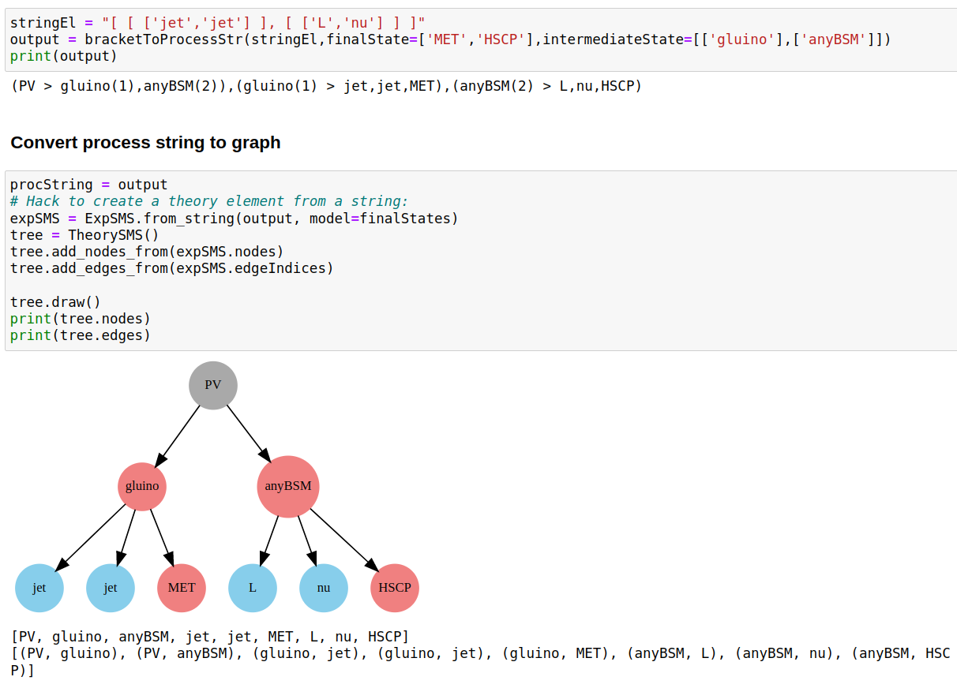
Strings ↔ Graphs

Slide 13
SModelS 3.0 – Simplified Model Topologies
In v3 “Elements” are renamed SMS (simplfied model spectra).
Three types of SMS are defined:
GenericSMS
a base class implementing common features of graphs
TheorySMS
class derived from GenericSMS and is used to describe SMS from the BSM model (generated by decomposition)
ExpSMS
class derived from GenericSMS and used to describe database simplified models

Slide 14
SModelS 3.0 – Simplified Model Topologies
The main differences between TheorySMS and ExpSMS are:
TheorySMS objects have a well defined comparison, so a sorted list can be built.
ExpSMS objects do not have a well defined comparison, since they can contain inclusive nodes.
Nonetheless a matching (equal/not equal) between ExpSMS and other SMS objects can be defined and has to allow for any node ordering.
Both TheorySMS and ExpSMS objects can have their structured sorted.

Slide 15
SModelS 3.0 - TheorySMS
Signal topologies from the BSM decomposition are described by TheorySMS topologies:
PV
P
P
Particle
ParticleNode
.mass
.nodes
.particle
.totalwidth
.nodeIndices
._isSM
...
TheorySMS
.isFinal
.canonName
(derived from GenericSMS)
.weightList
...
Used to identify SM particles

Slide 16
TheorySMS Comparison
Comparing SMS is no longer simple, since we have arbitrary shapes (topologies).
But it can still be done in 2 steps:
Shape (topology) matching
Particle comparison
=?

Slide 17
TheorySMS Comparison
Shape (topology) matching:
=?
The above shapes are equivalent, since the ordering of the nodes in each decay is irrevalant.
Easy using canonical labels (names)!

Slide 18
Canonical Name
We define the canonical (topology) label as:
i) For each final node (leaf):
Similar to a nested bracket notation! (1 → left bracket, 0 → right bracket)
Name → 10
ii) For each decayed node:
Name → 1 (sorted daughters name) 0
iii) Build name recursively → Graph name = PV name
Examples:
1 10 10 110100 0
1 10 10 0
1 10 10 0
10
10
10
10
10
10

Slide 19
Canonical Name
Example:
10
10
10
10
10
10
1 10 11010100 0
1 10 10 110100 0
10
1 10 10 0
=?
1 10 10 10 0
10
10
10
1 10 10 110100 0
1 10 11010100 0
10
1 10 10 0
1 10 10 10 0
10
10
10
10
10
Name 1:
1 110101101000 110110101000 0
Name 2:
1 110101101000 110110101000 0
Name 1 = Name 2

Slide 20
Canonical Name
The canonical name can also be used to sort the nodes from the same parent and structure the tree in a default format
1 10 10 0
1 10 10 0
1 10 10 110100 0
→
1 10 10 110100 0
1 1010 0
1 1010 0
10
10
10
10
10
10
10
10
10
10
10
10
For equivalent nodes (same name) we sort according to particle and then daughter nodes

Slide 21
Compressing TheorySMS
How to define mass and invisible compression?
It has to be applied node by node!
Invisible Compression
Node X is compressed if:
All its daughters are invisible
All its daughters are “final states”
X decays promptly or is invisible
→
X
X

Slide 22
Compressing TheorySMS
Mass Compression
Y
Node X is compressed if:
decays promptly
decays to a single BSM particle
and
X
→
Y
A
A

Slide 23
Decomposition
Decomposition follows a similar algorithm, but generalized to deal with arbitrary graphs.
First, starting with the model (production cross-sections and particles), create all simple SMS of the form:
PV
PV
PV
...
A
B
X
Y
A
A
Only SMS with cross-sections larger than sigmacut are kept

Slide 24
Decomposition
For a given initial SMS:
Iterate over the “final states”
For each final state construct all possible decays (including possible stable state)
Add all decays to original SMS
Apply step 1) to all SMS created by the last step
...
...

Slide 25
Decomposition
Nodes can be tagged with the attribute “.isFinalState = True” to avoid further decays
The SMS has the attributes:
prodXSec = list of production cross-sections (distinct sqrts) for PV
maxWeight = maximum weight (largest production cross-section times BRs)
decayBRs = total BR (product of BRs appearing in the SMS)
PV
A
B

Slide 26
Decomposition
During step 3) any SMS with maxWeight smaller than sigmacut is ignored
...
In the end only SMS where all final state nodes have finalStates = True are kept (avoids intermediate undecayed trees generated by failing to pass sigmacut)
There is a lot of duplicated steps in the decompositon, since everytime a particle appears all of its possible decay trees have to be generated again. For instance, pair production of the same particle will generate exactly the same decay branches twice. However, since the possible decays are filtered by sigmacut, it depends on which position the particle appears (how small is the weight leading to the particle). Therefore previously generated cascade decays (under some effective sigmacut assumption), can not be easily recycled.
→ A better solution still to be found?

Slide 27
SModelS 3.0 - ExpSMS
Simplified model topologies used for defining experimental results are described by ExpSMS topologies:
P
P
PV
Particle/
MultiParticle
ParticleNode/
InclusiveParticleNode
.eCharge
.colordim
.nodes
.particle
._isSM
...
ExpSMS
.nodeIndices
.canonName
.isInclusive
(derived from GenericSMS)
.inclusiveList
No mass and totalwidth is defined for database particles
Used to tag inclusive nodes

Slide 28
SModelS 3.0 - ExpSMS
Unlike TheorySMS topologies, ExpSMS topologies can hold inclusive nodes and inclusive particle definitions (multiparticles).
ExpSMS can be generated from strings (as appearing in TxNames constraints and conditions)
Experimental topologies can be matched to other (ExpSMS or TheorySMS) topologies.
The matching has to take into account inclusive node and particle definitions and all possible node orderings.
The matching is done in two steps:
Shape (topology) matching (for ExpSMS containing inclusive nodes, the shape is not defined and will match any other shape)
Particle matching (must take into account any node ordering and inclusive nodes)

Slide 29
ExpSMS Matching
Shape (topology) matching:
Simple comparison of canonical names
If the ExpSMS contains an inclusive node, its canonical name is defined as “*” and will match any canonical name.

Slide 30
ExpSMS Matching
Particle/Node Matching
=?
Two nodes match if:
Their particles and canonical names match
Their daughter nodes match
Two SMS match if their root nodes match, which means the SMS have matching canonical names and all nodes have matching nodes.

Slide 31
ExpSMS Matching
Particle/Node Matching
When matching two sets of daughters from the nodes being compared, the following procedure is adopted:
SMS A
SMS B
Node 2 =? Node a
Node 2
Node a
6
7
8
c
d
e
All possible pairs of daughters are compared:
6
c
7
d
(to improve perfomance, it is only necessary to compare nodes with the same canonical name)
8
e

Slide 32
ExpSMS Matching
Particle/Node Matching
A bipartite graph is constructed where the left nodes are the daughters for SMS “A”, the right nodes the daughters from SMS “B” and the edges connect the pairs of daughter nodes which have matched.
6
c
7
d
8
e
A maximal matching algorithm is used to determine the maximal number of matchings (edges which do not share common nodes)
6
c
6
c
7
d
7
d
8
e
8
e
maximal matching = {6 : c, 7 : d, 8 : e}

Slide 33
ExpSMS Matching
Particle/Node Matching
If all left nodes and right nodes have had matches, the daughter nodes are considered as matched and the matching dictionary is kept
6
c
7
d
Daughters match
8
e
maximal matching
Otherwise the daughters are NOT matched:
6
c
7
d
Daughters do not match
8
e
maximal matching
With this procedure, the SMS matching checks for any possible node ordering.

Slide 34
ExpSMS Matching
If more than one ordering matches we keep the “first one” (arbitrary)
In v2 we already have this issue, but it is simpler:
only two possible branch orderings (we always check both)
in a given vertex we compare ParticleLists (SM particles) and cache the comparison result
In order to “reproduce” the v2 results, in v3 we check the matching for 2 possible branching orderings (if the TheorySMS has a 2-branch structure):
SMS A
SMS A’
?= SMS B
or
?= SMS B

Slide 35
ExpSMS Matching
Note that if only one ordering matches SMS B, comparing both orderings will return the same result (since all possibilities are checked).
However, if both match, we get two possible matching orderings. In this case:
In order to always select a unique ordering, the two orderings are sorted according to their respective dataPoints (which holds all the information required for interpolation of the TxName grid) and their reweighting factor.
This way a specific branch ordering is singled out.
The above result, however, is limited to the Z2 case, not very efficient (since we need to do two very similar comparisons)
The general case would require to compute all possible matchings, sort them and select one. However this is technically much more challenging and might reduce the performance quite a bit.

Slide 36
Inclusive Objects – SModelS v2
In SModelS v2 we make use of
Inclusive Particles: matches any particle
Inclusive Branches: matches other branches (may or may not include comparison of intermediate and final BSM states)
Any (single) SM final state:
(InclusiveParticle → [[‘*’]])
*
X
Y
Any arbitrary number of SM particles:
(InclusiveBranch→ [‘*’] + intermediate and final states defined)
*
X
Y
Arbitrary SM final states and BSM intermediate states:
(InclusiveBranch→ [‘*’] + final states defined)
*
Z
Arbitrary SM final states and BSM states
(InclusiveBranch→ [‘*’])
*

Slide 37
Inclusive Objects – SModelS v3
In v3 inclusive objects are handled using three new definitions:
Final States of a Node:
particles appearing as a final state (undecayed) generated by the cascade decay of the node
Final states of X = A,B,a,b
X
A
B
C
a
b

Slide 38
Inclusive Objects – SModelS v3
Inclusive Node:
Its canonName is an inclusive value (*), which matches any int
If a tree contains an InclusiveNode, all of its antecessors also have their canonNames set to *
It is represented in string form by “Inclusive > ...” or by [‘*’] (old bracked notation)
When comparing to another node, only the final states of the InclusiveNode and of the other node are compared:
~
X
InclusiveNode
a
B
C
a
b
c
c
b

Slide 39
Inclusive Objects – SModelS v3
InclusiveList Node:
Behaves as a regular ParticleNode, however it represents any repeated number of the same particle
It is represented in string form by *particleLabel (e.g. *q) → can only be implemented using the new string format
When matching to another list of nodes, it will match all the nodes which match its particle:
X
A
B
*C
=
X
X
A
*C
A
C
C
C

Slide 40
Inclusive Objects – SModelS v3
Examples:
PV
canonName = *
Matches any node/branch which cascade decays to (any number of) SM final states and one MET final state
canonName = *
Inclusive
...
*anySM
finalStates = [*anySM,MET]
MET
PV
canonName = *
Matches any node which cascade decays to (any number of) SM final states
...
canonName = *
Inclusive
*anySM
finalStates = [*anySM]
PV
canonName = *
Matches any node which decays to X plus any number of SM particles
...
X
*anySM

Slide 41
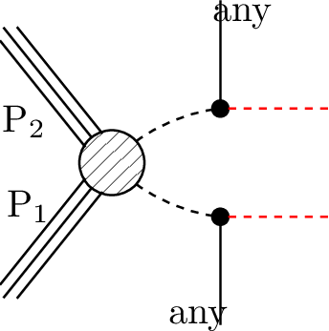
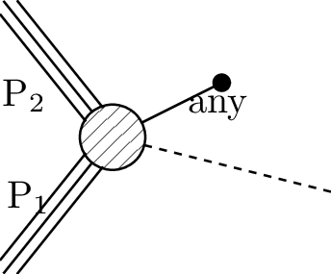
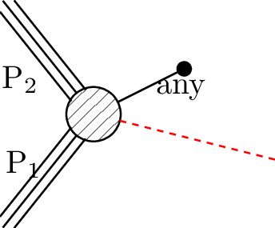
Inclusive Objects – SModelS v3
The inclusive objects in v2 correspond to:
V2
V3
Example
*
X
Y
X
Y
anySM
(THSCPM3)
*
X
Y
X
Y
*anySM
(TDTM2F)
Inclusive
*
Z
Z
*anySM
Inclusive
(THSCPM2b)
*
*anyBSM
*anySM
(None)

Slide 42
Database Topologies
How to store information (effs, ULs) for arbitrary topologies?
Numbered nodes
dataMap → maps the nodes attributes to a flat array
TxName.dataMap = {arrayIndex : (node number, attribute, unit),...}
flat array index
1
6
3
8
DataMap = {0 : (1, ‘mass’, GeV), 1 : (3, ‘mass’,GeV), …
…, 6 : (12, ‘mass’, GeV),
7 : (12, ‘totalwidth’, GeV)}
None
2
None
7
4
5
9
10
11
12
BSM nodes: 1,3,4,6,7,8,12

Slide 43
Database - dataMap
The dataMap holds all the information for extracting the relevant data from a TheorySMS.
Inclusive nodes are ignored (do not appear in a dataMap)
When creating a database entry, the dataMap can be directly defined in the TxName.txt file, as well as the flat data points:
constraint : {(PV > anyBSM(1),anyBSM(2)), ...}
dataMap : {arrayIndex : (node number, attribute, unit),…}
efficencyMap: [ [[m1,m2,…],eff], [[m1’,m2’,…],eff’, …]
or
upperLimits : [ [[m1,m2,…],ul], [[m1’,m2’,…],ul’, …]
flat mass/width data array
of floats (without units)
The node numbers are defined by the particle indices appearing in the constraint:
constraint : {(PV > anyBSM(1),anyBSM(2)), ...}
node = 1
node = 2

Slide 44
Database - dataMap
For the old format (nested brackets) an intermediate map is constructed, which maps the nested bracket indices to a flat array:
arrayMap : {arrayIndex : ((i,j,k), attribute, unit, node number),…}
flat array index
i,j → indices of nested array
k → 0 for mass, 1 for width (if present in data)
Example:
[ [m0,(m1,w1)], [m2,(m3,w3)] ]
1
2
(SM)
(SM)
3
5
4
6
arrayMap : {0 : ((0,0,0), ‘mass’, GeV, 1), 1 : ((0,1,0), ‘mass’, GeV, 3),
2 : ((1,0,0),’mass’, GeV, 2), 3 : ((1,1,0), ‘mass’, GeV, 4),
4 : ((0,1,1), ‘totalwidth’, GeV, 3), 5 : ((1,1,1), ‘totalwidth’, GeV, 4) }

Slide 45
Database - dataMap
The arrayMap is used to convert the old data format to a flat array and construct the dataMap:
[ [m0,(m1,w1)], [m2,(m3,w3)] ]
arrayMap
[m0,m1,m2,m3, w1, w3 ]
dataMap : {... }
Hence the old format can be (internally) converted to a new flat array format with a well defined dataMap

Slide 46
Database - dataMap
Finally the dataMap can be used for extracting the required information from TheorySMS objects (from the decomposition):
TheorySMS
ExpSMS
matching
1
2
X
Y
(SM)
(SM)
Z
e⁻
Z
e⁺
3
5
4
6
Matched TheorySMS:
(When the ExpSMS constaints Inclusive nodes, these are used as replacements for the original TheorySMS nodes)
The matched SMS has its nodes numbered according to the ExpSMS numbering
X (1)
Y (2)
Z (3)
e⁻
Z (4)
e⁺
dataMap : {... }
[mX,mZ,mY,mZ, wZ, wZ ]

Slide 47
Database – matching
When matching TxNames with TheorySMS from decomposition:
The matching returns the SMS with the same shape and the daugthers ordered in the way they have matched the txname SMS (ExpSMS)
The matched SMS nodes are numbered according to the txname SMS numbering
The matched SMS receives a label matching the label used for evaluating constraints.
Matched SMS (TheorySMS)
TheorySMS
ExpSMS
match
X (1)
1
2
Y (2)
Y
X
(SM)
(SM)
3
5
4
6
Z (3)
e⁻
Z (4)
e⁺
e⁺
Z
e⁻
Z
sms_1
sms_1

Slide 48
Database – Constraints and Conditions
The constraints and conditions are string expressions for the SMS weights:
constraint: 2*({(PV > …} + { (PV > …)})
v3 format
or
constraint: 2*([[[...]]]+ [[[...]]])
v2 format
condition: Csim({(PV > …},{ (PV > …)})
v3 format
or
condition: Csim([[[…]]], [[[...]]])
v2 format
Note that in v3 strings representing SMS are delimited by curly brackets: {(PV > …} = {ExpSMS}
All nodes appearing in the SMS description should be numbered and match the dataMap

Slide 49
Database – Constraints
In v3 the SMS appearing within the constraints are converted to ExpSMS objects and receive labels, which are used as replacements in the string expressions. The constraint function (string) is also created using the labels:
constraint: 2*({(PV > …} + { (PV > …)})
or
constraint: 2*([[[...]]]+ [[[...]]])
sms_1
sms_2
constraintFunc = 2*(sms_1 + sms_2)
The SMS appearing in the constraints are required to be unique, which means that distinct ExpSMS belonging to the same TxName can not mach:
This restriction is needed in order to make sure that the same TheorySMS will not match more than one ExpSMS in the same constraint (to avoid double counting)
sms_1
sms_2

Slide 50
Database – Constraints
The SMS and respective labels appearing in constraints are stored in the TxName.smsMap:
smsMap = { : sms_1, : sms_2, ...
constraint
When checking if a TheorySMS appears in the TxName, the ExpSMS objects from smsMap are used for comparison. Since the TheorySMS has to match a single ExpSMS, it is “tagged” with the ExpSMS label:
TheorySMS
ExpSMS
the txlabel is then used to evaluate the constraints using the constraintFunc
X
Y
X
Y
matching
sms_2
Z
e⁻
Z
e⁺
Z
e⁻
Z
e⁺
Txlabel = sms_2

Slide 51
Database – Constraints
The constraints can then be evaluated using a dictionary mapping the TheorySMS weights to their txlabels.
In summary:
constraint: 2*({(PV > …} + { (PV > …)})
smsMap = {ExpSMS : sms_1,
ExpSMS : sms_2, ...}
match
TheorySMS
constraintFunc = 2*(sms_1 + sms_2)
.txlabel = sms_1
.weight = w1
smsDict = {sms_1 : w1, sms_2 : w2}
eval(constraintFunc, smsDict)
value

Slide 52
Database – Conditions
Evaluating conditions are less straightforward, since they may contain overlapping SMS. For instance, in the example below the first SMS ([[[L,L]],[[L,nu]]]) contains the second:
conditions: Cgtr([[[L,L]],[[L,nu]]], 3*[[[L,L]],[[ta,nu]]]); Csim([[[L,L]],[[e,nu]]], [[[L,L]],[[mu,nu]]])
Therefore, for conditions, a smsMap is defined for each condition and the map can contain overlapping SMS.
In this case the TheorySMS can match multiple SMS and the ordering of each matched SMS does not have to be the same.
Therefore, when evaluating conditions, the SMS matched by the constraints are compared to the ones contained in conditions. If it matches, its weight is added to the matched sms label.

Slide 53
Database – ExpSMSDict
In order to enhance the performance for the calculation of theory predictions and avoid duplicated comparisons, the matching between TheorySMS and ExpSMS is done in a centralized fashion.
First, all the ExpSMS in the database are collected and a unique list of (sorted) ExpSMS objects is built using the ExpSMSDict class. This class holds a mapping between the unique SMS and the TxNames they belong to:
sms_1
Unique SMS:
Database
TxName1
a
sms_2
...
ExpSMSDict
b
sms_1
TxName2
c
...
...
sms_2
...

Slide 54
Database – ExpSMSDict
Since the unique SMS are sorted, the ExpSMSDict object also holds the mapping between the numbering of the sorted nodes in the unique SMS and the node numbering in the (original) txname SMS:
TxName SMS
ExpSMSDict SMS
sort
1
2
1
2
Database
3
5
4
6
3
4
5
6
NodesDict = {1 : 2, 2 : 1, 5 : 5, 6 : 3, 3 : 4, 4 : 5}
ExpSMSDict
new index
(unique SMS)
old index
(txname SMS)

Slide 55
Database – ExpSMSDict
The list of unique SMS are then used to match the ExpSMS to the TheorySMS from decomposition. Since the number of unique SMS is much smaller than the (duplicated) txname SMS the number of comparisons between TheorySMS and ExpSMS are greatly reduced.
TheorySMS
(from decomposition)
ExpSMS
(from ExpSMSDict)
A
a
A
B
B
b
C
...
C
...

Slide 56
Database – ExpSMSDict
Finally, when computing predictions for a specific dataset/TxName, the following steps are taken:
The ExpSMSDict is used to fetch the unique SMS corresponding to a given TxName SMS
The TheorySMS which were previously matched to the unique SMS are then copied and passed on to the TxName SMS
The TheorySMS nodes are relabeled to correspond to the TxName SMS labeling (using the nodesDict from ExpSMSDict)
ExpSMS
(from ExpSMSDict)
ExpSMS
(from TxName)
TheorySMS
(from decomposition)
A
B
a
sms_1
A’
B’
(relabeled nodes)
C
b
sms_2
A’’
B’’
...
...
(relabeled nodes)

Slide 57
Database – ExpSMSDict
In summary, the matching between decomposition (TheorySMS) SMS and the database (ExpSMS) is done through the unique SMS stored in ExpSMSDict:
TheorySMS
(from decomposition)
ExpSMS
(from ExpSMSDict)
ExpSMS
(from TxName)
A
a
sms_1
A’
B’
(relabeled nodes)
B
b
sms_2
A’’
B’’
...
...
(relabeled nodes)
C
...

Slide 58
Conclusions
The implementation is somewhat encapsulated (it does not affect the higher levels of the code)
Graphs can be an useful tool
The main reamining issue is how to resolve ambiguities for equivalent nodes
Some functionality is already in place in smodels:graphs

