Slide 1
SModelS 3.0
Generalized Topologies
With Graphs
André Lessa

Slide 2
Goal
Describe signal topologies with arbitrary shapes, such as:
Ressonant production
Associated Production
R-Parity Violating Decays
Non-Z₂ decays
...

Slide 3
Current Status – SModelS 2.0
Signal topologies (simplified models) are described by Elements:
.branches
list
Branch
Element
.weight
list
Particle
.oddParticles
.evenParticles
.Z2parity
list
.mass
list
ParticleList
...
.particles

Slide 4
Current Status – SModelS 2.0
Overall structure:
.branches = [Branch1, Branch2]
Element
.weight
Branch
.oddParticles = [Particle1, Particle2,...]
.evenParticles = [ParticleList1, ParticleList2,...]
ParticleList
.particles = [Particle1, Particle2,...]

Slide 5
Current Status – SModelS 2.0
Inclusive objects:
.branches
Branch
Element
.weight
Particle
.oddParticles
.evenParticles
.Z2parity
InclusiveBranch
.mass
...
.oddParticles = * (optional)
MultiParticle
.evenParticles = *
.particles
When comparing against branches:
Checks if last BSM particle matches (if defined)
Checks if intermediate BSM particles matches (if defined)
Ignores evenParticles
Ignores branch topology (number of vertices,...)
When comparing against particles:
Checks if any particle in .particles matches

Slide 6
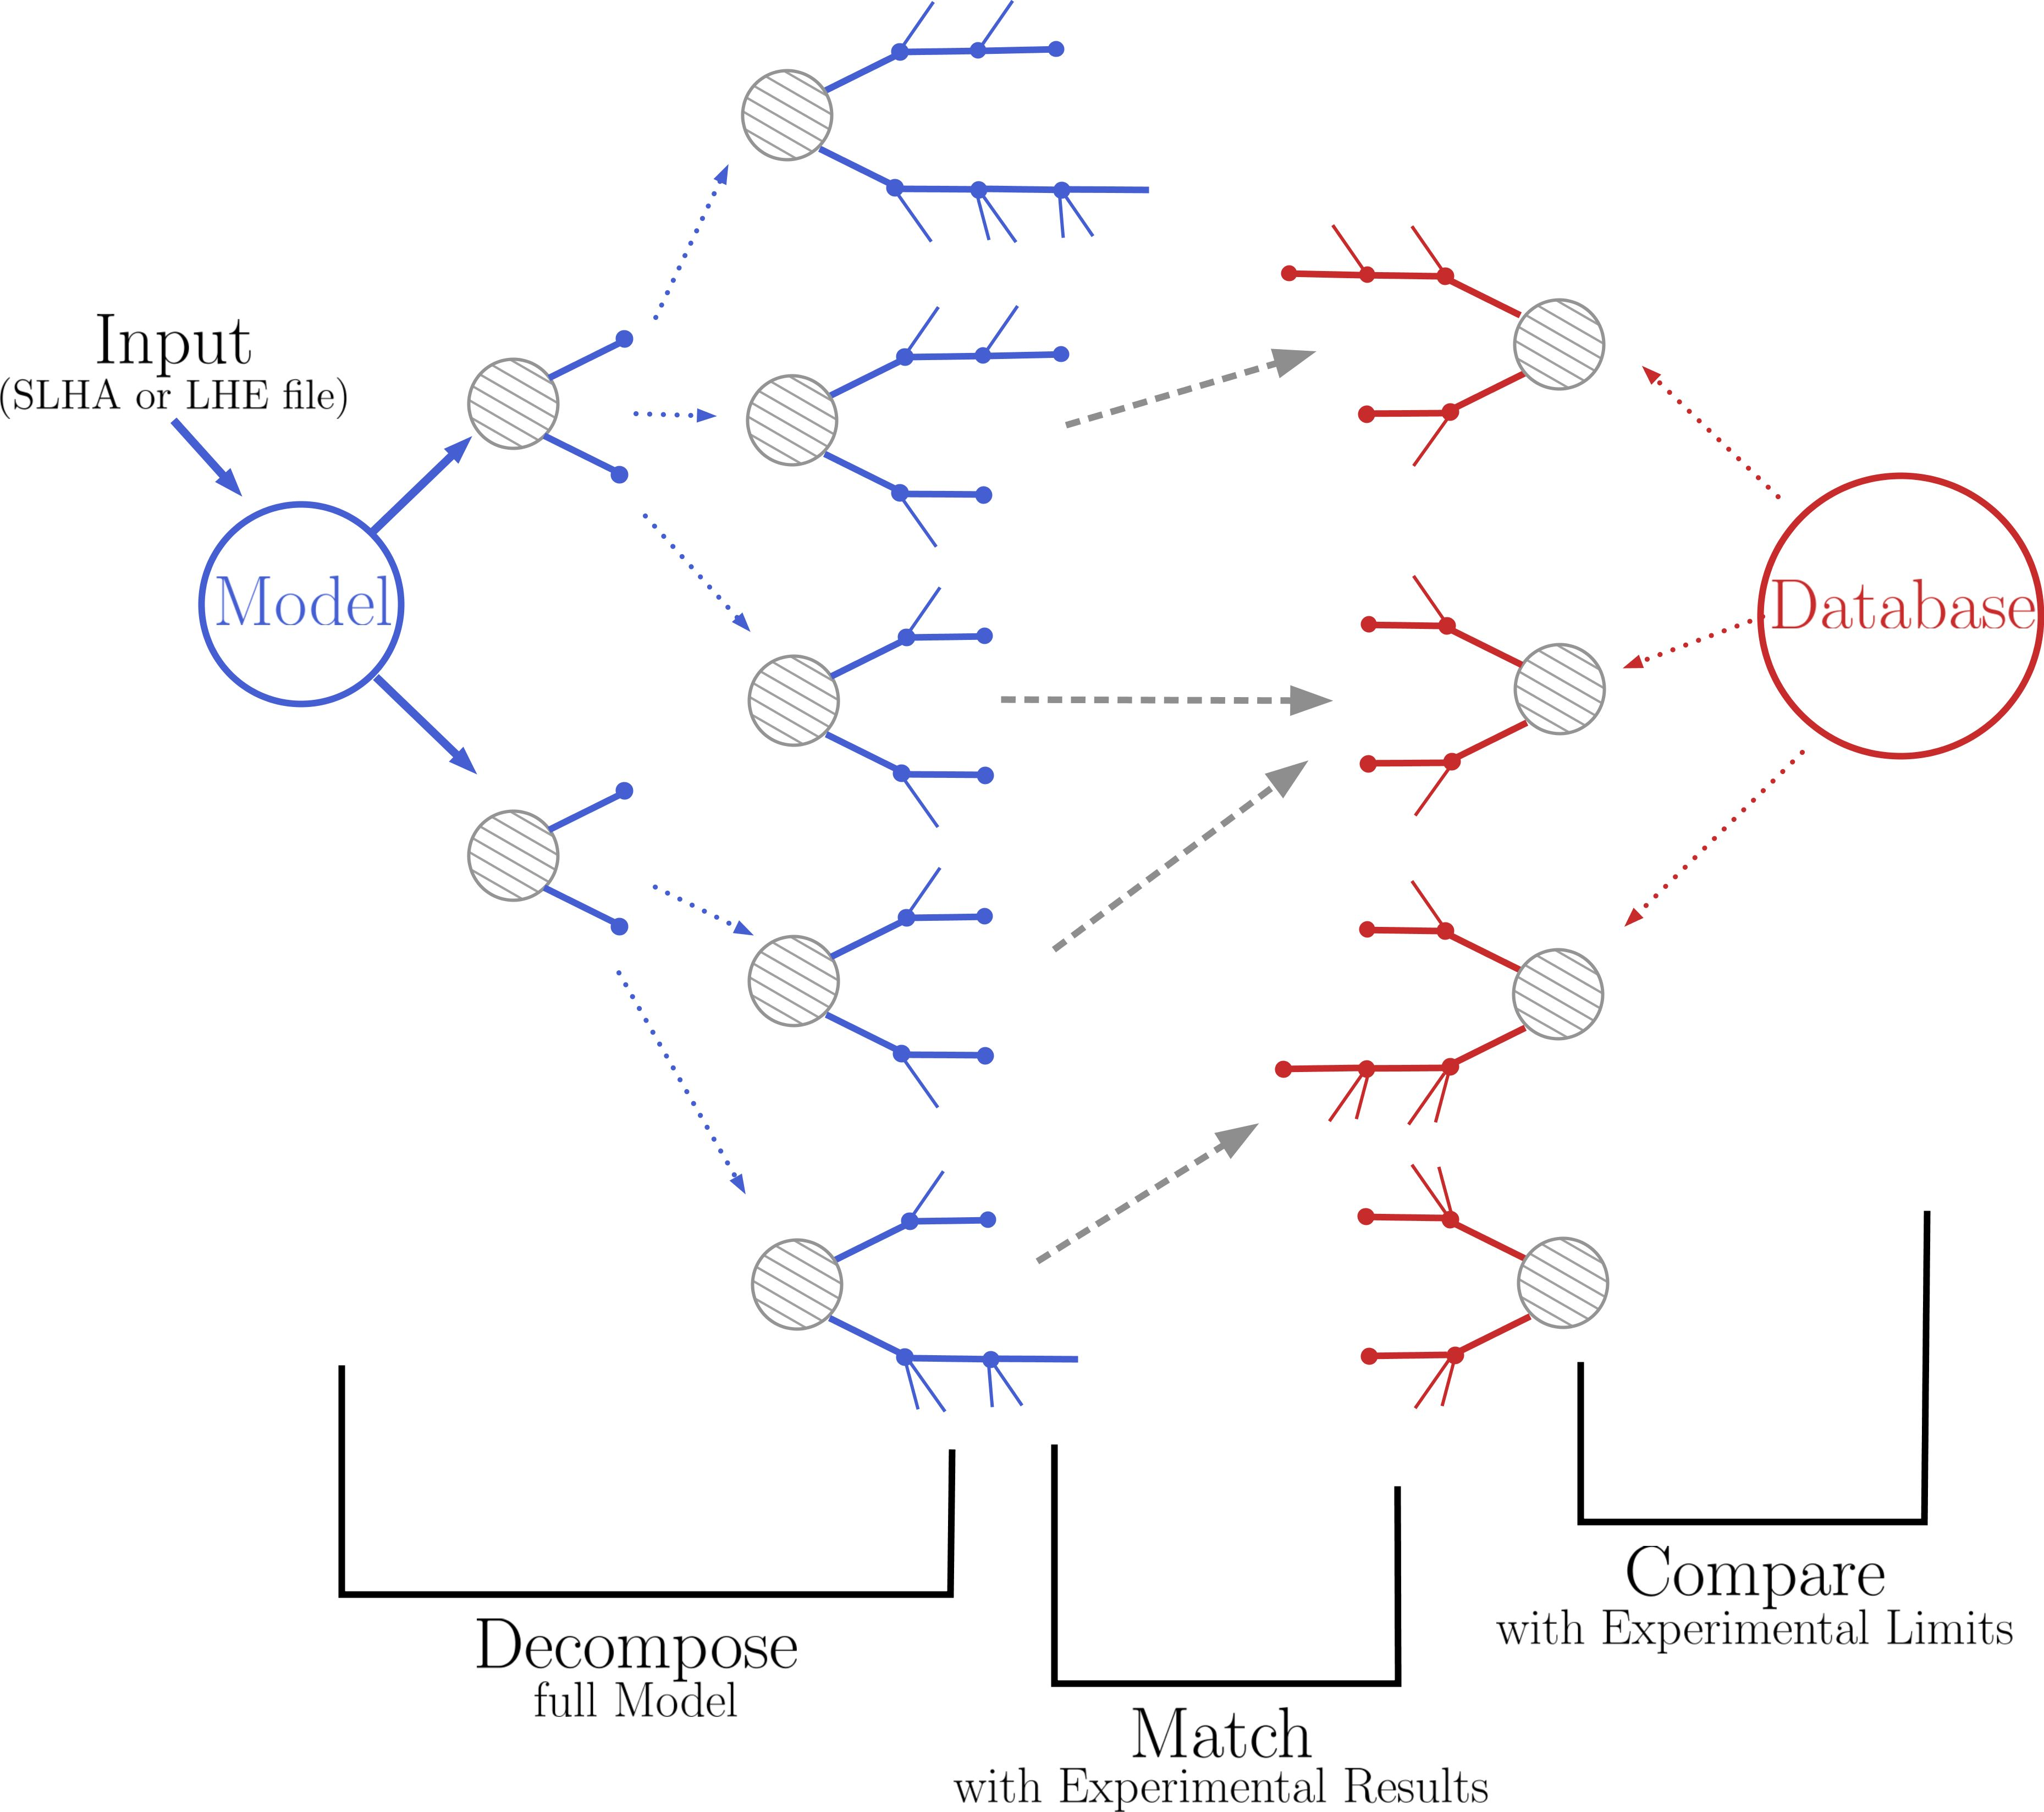
Current Status – SModelS 2.0
Element comparison takes place when:
Decomposing the model
(equal elements have their weights combined)
Matching against the database
(uses inclusive objects)

Slide 7
Current Status – SModelS 2.0
Element comparison: Element_{A} = Element_{B}?
.branches
Branch_{A}
Element_{A}
Particle_{A}
.weight
.oddParticles
=
.evenParticles
ParticleList_{A}
=
(any branch ordering)
(any particle ordering)
.branches
Branch_{B}
Element_{B}
Particle_{B}
.weight
.oddParticles
.evenParticles
ParticleList_{B}

Slide 8
Current Status – SModelS 2.0
A lot of the SmodelS structure is based on the 2-branch/Z₂ assumption
However, it only affects the inner layers (Element class and its methods)
How to move towards general topologies? → Graphs

Slide 9
Using Graphs to Describe Topologies
Nodes = Particles
PV
Directed Graph
(Directed Rooted Tree)
Edges = “Decay”
Can describe any topology
Well stablished libraries (networkx)

Slide 10
Implementation
Not impossible, because only affects how Elements are described and compared
Main steps:
Text description ↔ graph
New database format (how to store data)
Graph comparison
Element compression
Decomposition
Extracting relevant information from graphs (database)
...

Slide 11
SModelS 3.0
Signal topologies are described by Elements/trees:
PV
Particle
(DiGraph)
ParticleNode
Tree
.particle
.mass
.tree
._isSM
Element
.canonName
.node
.weight
.canonName
rename to SMSTopology?
Used to identify SM particles
.nodeWeight
* Node objects within a tree have to be unique, so we can not directly use Particle objects, since two identical particles (say “jet”) appearing twice in a tree would not be allowed

Slide 12
Element Comparison
Comparing elements it is no longer simple, since we have arbitrary shapes (topologies).
But it can still be done in 2 steps:
Shape (topology) matching
Particle comparison
=?

Slide 13
Element Comparison
Shape (topology) matching:
=?
The above shapes are equivalent, since the ordering of the nodes in each decay is irrevalant.
Easy using canonical labels (names)!

Slide 14
Canonical Name
We define the canonical (topology) label as:
i) For each final node (no daughters):
Similar to a nested bracket notation! (1 → left bracket, 0 → right bracket)
Name → 10
ii) For each non-final node:
Name → 1 (sorted daughters name) 0
iii) Build name recursively → Graph name = PV name
Examples:
1 10 10 110100 0
1 10 10 0
1 10 10 0
10
10
10
10
10
10

Slide 15
Canonical Name
Example:
10
10
10
10
10
10
1 10 11010100 0
1 10 10 110100 0
10
1 10 10 0
=?
1 10 10 10 0
10
10
10
1 10 10 110100 0
1 10 11010100 0
10
1 10 10 0
1 10 10 10 0
10
10
10
10
10
Name 1:
1 110101101000 110110101000 0
Name 2:
1 110101101000 110110101000 0
Name 1 = Name 2

Slide 16
Canonical Name
The canonical name can also be used to sort the nodes from the same parent and structure the tree in a default format
1 10 10 0
1 10 10 0
1 10 10 110100 0
→
1 10 10 110100 0
1 1010 0
1 1010 0
10
10
10
10
10
10
10
10
10
10
10
10

Slide 17
Comparing Particles/Nodes
Comparing particles
=?
In principle, after sorting the nodes, we could traverse the tree starting at PV (breadth first search) and check if every node matches.
However everytime there are equivalent nodes (same color in the figure above), we have to compare against the possible permutations.
If more than one permutation gives a match, we have to keep each possibility when moving further down the tree → combinatorics can easily blow up!

Slide 18
Comparing Particles/Nodes
Example:
=?
Number of possible orderings for comparison:
(particle comparisons are expensive)
j ↔ j
W ↔ MET
X_{a} ↔ X_{b}
* ↔ MET
h ↔ MET

Slide 19
Comparing Particles/Nodes
Current implementation:
A
B
Node A = Node B if:
same canonical name (same shape)
the daughters nodes are equal
for daughters with the same canonical name all permutations are tried

Slide 20
Comparing Particles/Nodes
Inclusive labels (MultiParticles) can match several particles.
And we also have the possibility of Inclusive Branches
The current “brute force” approach is to check all combinations, but it can be very inefficient
If more than one ordering matches we keep the “first one” (but it is not general)
Currently we already have this issue, but it is simpler:
only two possible branch orderings
in a given vertex we compare ParticleLists (SM particles) and cache the comparison result
Maybe build a centralized list of unique database graphs to reduce the number of graph comparisons?
→ A better solution still has to be found

Slide 21
Inclusive Objects – SModelS v2
In SModelS v2 we make use of
Inclusive Particles: matches any particle
Inclusive Branches: matches other branches (may or may not include comparison of intermediate and final BSM states)
Arbitrary SM final states
Defined BSM states
*
*
Y
Z
X
Arbitrary SM final states and BSM intermediate states
Defined BSM final state
*
Z
Arbitrary SM final states and BSM states
*

Slide 22
Inclusive Objects – SModelS v3
Inclusive Node:
X
*
*
Y
?
*
Y
Z
Z
*
X
*
How to define an arbitrary number of “N-1” nodes?
*
*
?
*
Z
Z
PV
matches any node (irrespective of edges)
X
*
*
...

Slide 23
Compressing Elements
How to define mass and invisible compression?
It has to be applied node by node!
Invisible Compression
Node X is compressed if:
All its daughters are invisible
All its daughters are “final states”
X decays promptly or is invisible
→
X
X

Slide 24
Compressing Elements
Mass Compression
Y
Node X is compressed if:
decays promptly
decays to a single BSM particle
and
X
→
Y
A
A
→ Possible to generalize to other cases?

Slide 25
Decomposition
Decomposition follows a similar algorithm, but generalized to deal with arbitrary graphs. Given an initial tree:
First, starting with the model (production cross-sections and particles), create all simple trees of the form:
PV
PV
PV
...
A
B
X
Y
A
A
Only trees with cross-sections larger than sigmacut are kept

Slide 26
Decomposition
For a given initial tree:
Iterate over the “final states”
For each final state construct all possible decays (including possible stable state)
Add all decays to original tree
Apply step 1) to all trees created by the last step
...
...

Slide 27
Decomposition
Nodes can be tagged with the attribute “.finalState = True” to avoid further decays
Each node carries a nodeWeight defined as:
nodeWeight = production cross-section for root node (PV)
nodeWeight = BR for decayed particle
nodeWeight = 1 for undecayed particle
PV
A
B
This way the total tree weight can be computed as the product of nodeWeights:
1
1
1
1
1

Slide 28
Decomposition
During step 3) any tree with weight smaller than sigmacut is ignored
...
In the end only trees where all final state nodes have finalStates = True are kept (avoids intermediate undecayed trees generated by failing to pass sigmacut)

Slide 29
Database Topologies
How to store information (effs, Uls) for arbitrary topologies? (in practice it might not be an issue)
Sort topologies
Identify the BSM nodes
Enumerate them (based on canonical naming)
For nodes with the same name, define an additional (arbitrary) sorting
Define a list of parameters: [(M0,T0), (M1,T1),...] according to this ordering
1
6
3
8
None
2
None
7
4
5
9
10
11
12
(arbitrary)

Slide 30
Database Topologies
When matching with elements from decomposition:
The matching returns the element with the same shape (sorted) and the daugthers ordered in the way they have matched the database topology
So we can simply fetch the information node by node following the database element numbering
1
6
3
8
None
2
None
7
4
5
9
10
11
12
→ More robust solution?

Slide 31
Strings ↔ Graphs
We can use MadGraph-like language to convert the graphs to text and vice-versa:
(PV → anyOdd(1), anyOdd(2)), (anyOdd(1) → e+, anyOdd(3), anyOdd(4) ), (anyOdd (2) → e-, nu, anyOdd(5) ) , (anyOdd(3) → nu,MET), ....
We can use particle labels if we want to specify quantum numbers (as it is currently being done)
We would like to keep some backward compatibility → convertion to/from bracket notation (for 2-branch/Z₂ elements)

Slide 32
Conclusions
The implementation is somewhat encapsulated (it does not affect the higher levels of the code)
Graphs can be an useful tool
The main reamining issue is how to resolve ambiguities for equivalent nodes
Some functionality is already in place in smodels:graphs

Slide 33
Backup
NetworkX Conventions:
Undirected Forest:
Undirected Tree:
Directed Forest:
Directed Tree:

Slide 34
Backup
NetworkX Conventions:
Branching (direct forest with each node has at most 1 parent):
Arborescence (direct tree with each node has at most 1 parent):

