Slide 1


ADVENTURE WORKS
C Y C L E S
S A L E S A N A L Y S I S & B U S I N E S S I N T E L L I G E N C E P R O J E C T
Final Round Presentation

Slide 2









CONTENTS
Agenda
01
Group Details
06
Tableau Dashboards
02
Project Summary
07
SQL Scripts
03
KPI Overview
08
Key Insights & Recommendations
04
Excel Dashboard
09
Key Takeaways
05
Power BI Dashboard
ADVENTURE WORKS
02

Slide 3
OUR TEAM
Group Details
01
Drishya K
02
Kota Sruthi Keerthi
03
Kaluva Srikanth
04
Namrata B Yadav
05
Manish Kumar Sahu
06
Shashank S M
07
Mohamed Yasin Bekinalkar
ADVENTURE WORKS
03

Slide 4
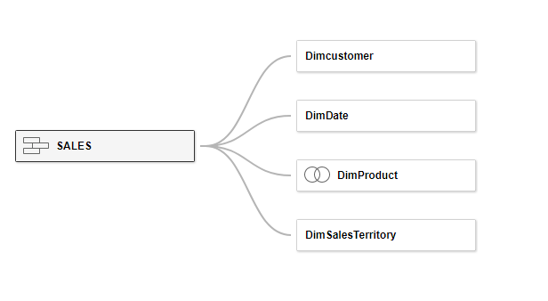
OVERVIEW
Project Summary
Adventure Works Cycles is a large, multinational manufacturer of metal and composite bicycles serving North American, European and Asian commercial markets, headquartered in Bothell, Washington.
DATA MODEL
Business goal: broaden market share by targeting top customers, extending product availability online, and reducing cost of sales through lower production costs.
What our team delivered:
Built a unified sales data model from raw Internet Sales data
Engineered date, sales, cost & profit calculations end-to-end
Delivered parallel dashboards in Excel, Power BI, Tableau & SQL
Designed KPIs for sales, profit, orders and customer performance
Sales, Product, Customer & Date tables related into a single analytical model, powering every dashboard.
ADVENTURE WORKS
04

Slide 5







METRICS THAT MATTER
KPI Overview
Total Sales
Total Profit
Total Orders
Profit Margin %
Every KPI above is broken down by Year, Quarter, Month, Country & Region across all four tools.
Average Order Value
Total Production Cost
Total Customers
ADVENTURE WORKS
05

Slide 6
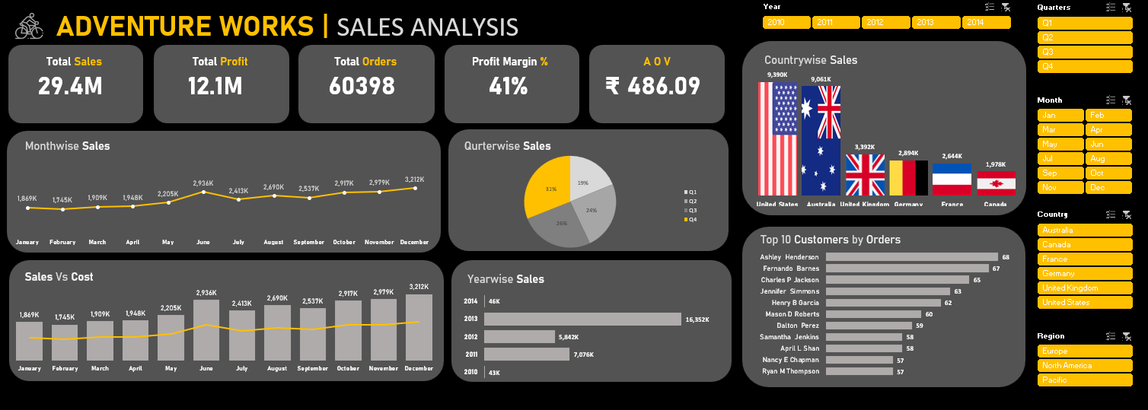
TOOL 01 / 04
Excel Dashboard
BUILT WITH FORMULAS, PIVOTS & CHARTS
Union of Fact Internet Sales tables into one master sheet
XLOOKUP for Product, Customer & Unit Price
Date table: Year, Month, Quarter, Weekday, Financial period
Calculated Sales Amount, Production Cost & Profit
Pivot table with Year filter for month-wise sales
Bar, Line, Pie & combo (Sales vs Cost) charts
KPI cards for Sales, Profit, Orders, Margin & AOV
ADVENTURE WORKS
06

Slide 7
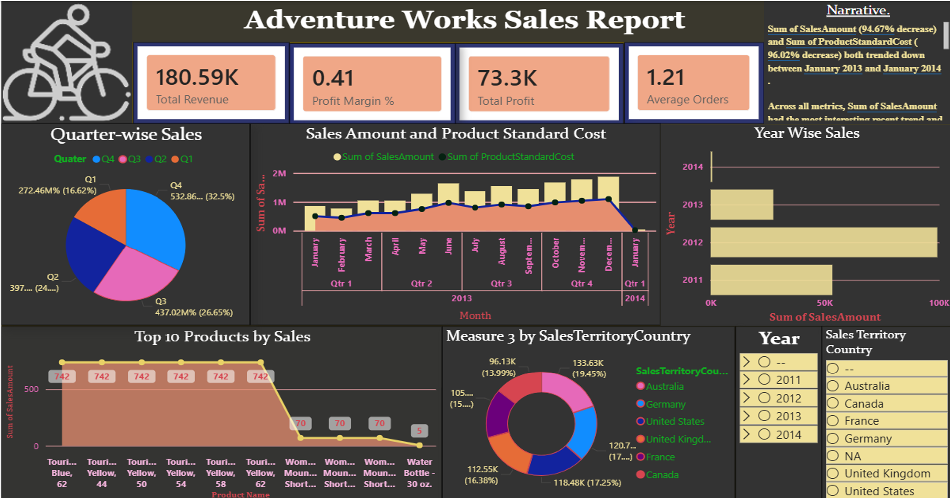
TOOL 02 / 04
Power BI Dashboard
MODELED WITH POWER QUERY & DAX
Star-schema data model built in Power Query
DAX measures for Sales, Profit, Margin & AOV
Interactive slicers: Year, Quarter, Month & Country
Country-wise sales & customer map visuals
Drill-through: Sales Analysis to Customer & Orders
Top 10 customers by orders & by sales
Bookmark-based navigation across report pages
ADVENTURE WORKS
07

Slide 8
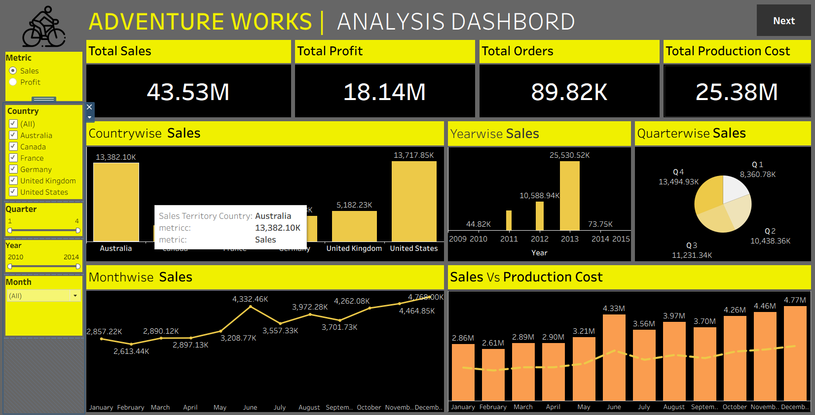
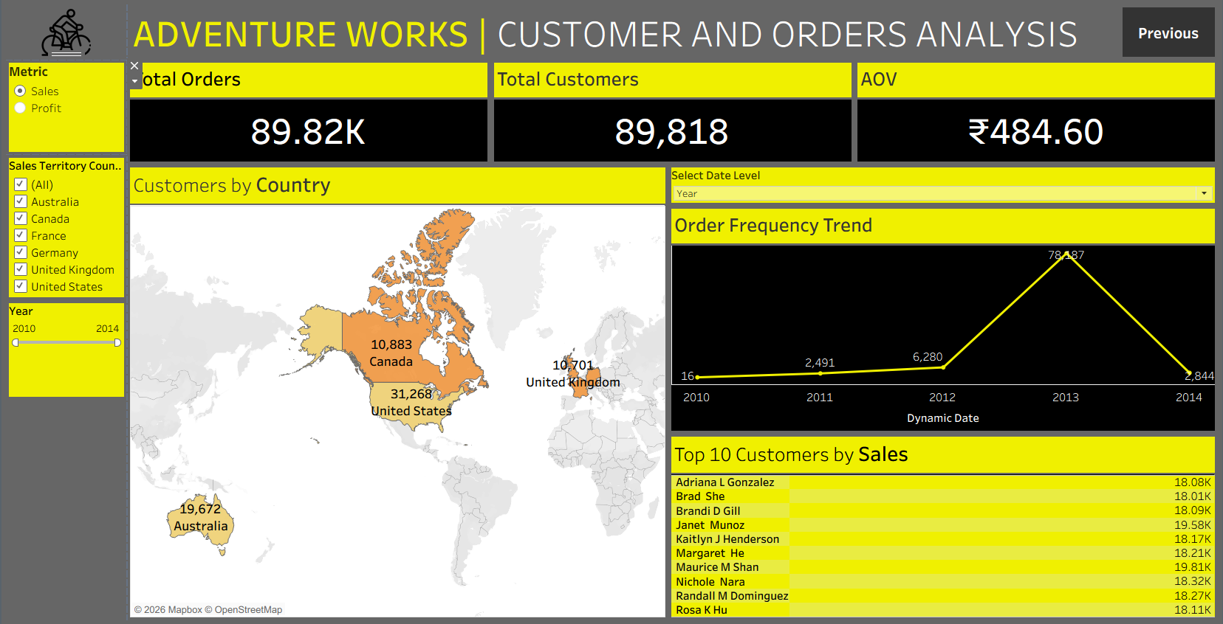
TOOL 03 / 04
Tableau Dashboards
Sales & Profit Analysis
Customer & Orders Analysis
Calculated fields for Sales, Profit & Margin • Country map & Top-10 customer ranking • Filter actions across Year, Quarter, Month & Country • Dashboard navigation actions
ADVENTURE WORKS
08

Slide 9
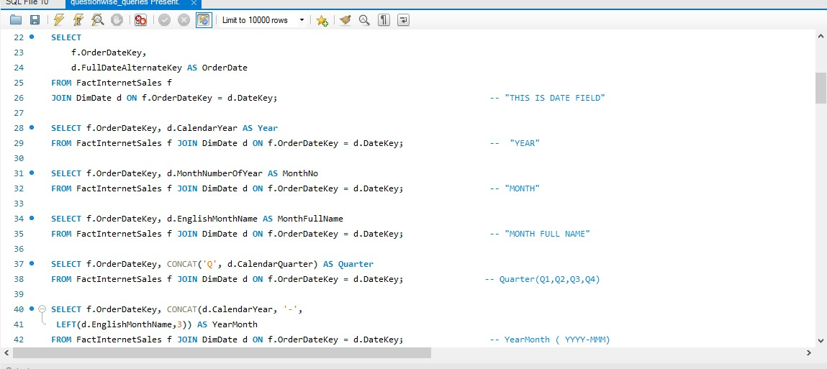
TOOL 04 / 04
SQL Scripts
ADVENTURE WORKS
09

Slide 10

WHAT THE NUMBERS SAY
Key Insights & Recommendations
INSIGHTS
RECOMMENDATIONS
United States & Australia together drive over 45% of total sales
Q4 consistently records the strongest quarter-on-quarter sales
Profit margin holds steady around 41% across most regions
Top 10 customers contribute a disproportionate share of revenue
Order volume peaks mid-year, easing in early Q1
Prioritize marketing spend in the US & Australia markets
Launch loyalty offers for the Top 10 customer segment
Plan inventory & staffing ahead of the Q4 sales surge
Investigate production cost drivers to lift margin further
Extend online store reach into under-performing regions
ADVENTURE WORKS
10

Slide 11


WRAPPING UP
Key Takeaways
One Data Story, Four Tools
KPI-First Thinking
The same Adventure Works sales model was built and validated independently in Excel, Power BI, Tableau & SQL.
Every dashboard was designed around the same core KPIs, making results directly comparable across platforms.
Team Collaboration
Deployment-Ready Dashboards
Seven team members split cleanly across data prep, development and analysis for an efficient sprint.
Interactive, filterable dashboards are ready to support real sales & customer decisions.
ADVENTURE WORKS
11

Slide 12
THANK YOU
ADVENTURE WORKS | SALES ANALYSIS PROJECT
Questions & Discussion

