Slide 1

FRSS
Presenter name:-
Vinod Meena (20CS10074)
Sonu KumarYadav (20CS10061)
Nirbhay Kumar (20CS10040)

Slide 2



Index
Problem statement
Solution
Importance of the project
Tools used
Features and Functionalities for Admin
Features and Functionalities for Customer
Customer
Implementation Challenges
Why We Choose Python
Price Calculation while Buying Furniture
Scope For Improvement

Slide 3

Problem Statement
When people relocate to a new city for a limited period of time, they find it more economically viable to rent the furniture than to buy them permanently.
There is a shop which is providing furniture of various types for rent. A Furniture Rental Store System helps to maintain all the information related to the rental operations. FRSS stores the data of furniture like the type, relevant images, rental price, cost price, age, etc. There are two types of users for FRSS viz. Admin and customer. Customers need to create an account in order to get services from FRSS. Admin can also create accounts for any customer or can also be able to delete accounts from the system.

Slide 4
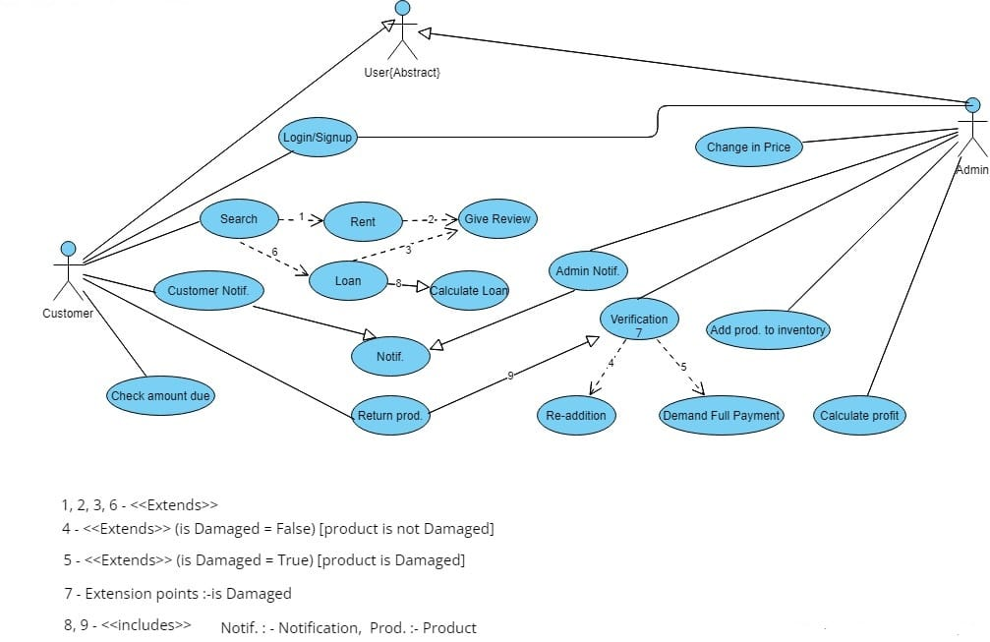
Solution :-

Slide 5

Importance of the project
By computerising the consignment entry process, we ensure the presence of digital records of our transactions.
We provide an admin interface to the manager. This aid’s in high level decision making and smooth functioning of the company like it will notify the requirements of new furniture.
Customer can easily select the items which he or she wants to buy.

Slide 6
Tools used

Slide 7
Features and Functionalities for Admin
Addition/ removal of furniture
Maintaining inventory
Admin
Sign up/login
Verifying returns
Maintaining user database

Slide 8
Features and Functionalities for Customer
Searching & Checking price
Rents / loans
Customer
Sign up/login
Payments
Return products

Slide 9
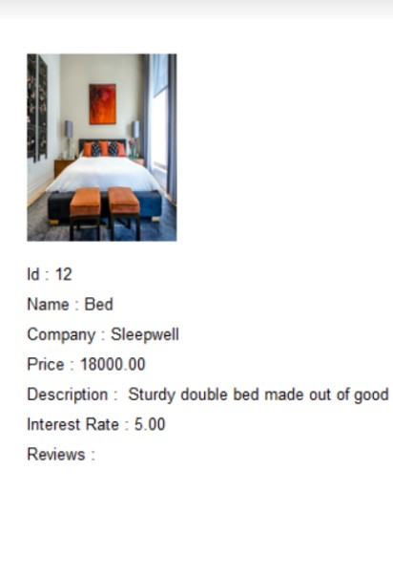
Customer page
Furniture id , image , description
Substring Search
Non-rented items
Sign up/login
Distinct items
Past reviews , price
Search based on name
9

Slide 10
Implementation Challenges
Abstract Base Classes
Display of graph
SQL queries from python
Database Management
MySQL syntax
Images in text - boxes
Functions inside functions

Slide 11
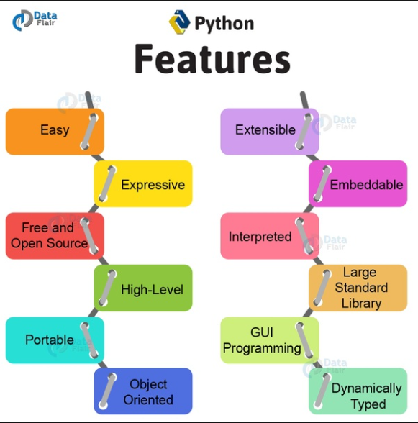
Why We Choose Python
Syntax simplification and resemblance to natural language
● Excellent libraries that decrease development time and effort.
The ultimate tool for graphing and data research.
● MySQL as a database management tool is well integrated.
● Tkinter provides an easy-to-use graphical user interface.
● VSCode editor provides extensive error detection support.

Slide 12
Price Calculation while Buying Furniture
New interest rate = current interest rate / count
count = number of past orders
Price when customer buys on loan :
New price = old price ( 1 +( new interest rate ) . (number of days )/(365 * 1000 ))
Price when customer buys on rent:
Rented Price = ( new interest rate ) . (number of days )/(365 * 100 )

Slide 13
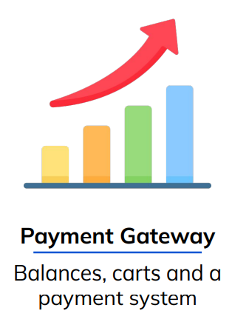

Scope For Improvement

Slide 14




Team
Team
Vinod Meena
Sonu Kumar Yadav
Nirbhay Kumar
Dakshana
20CS10074
20CS10061
20CS10040

Slide 15

Thank you
To;-
Prof Sourangshu bhattacharya
Prof Abir Das
Mr. Karanam Tejendhar

