Slide 1
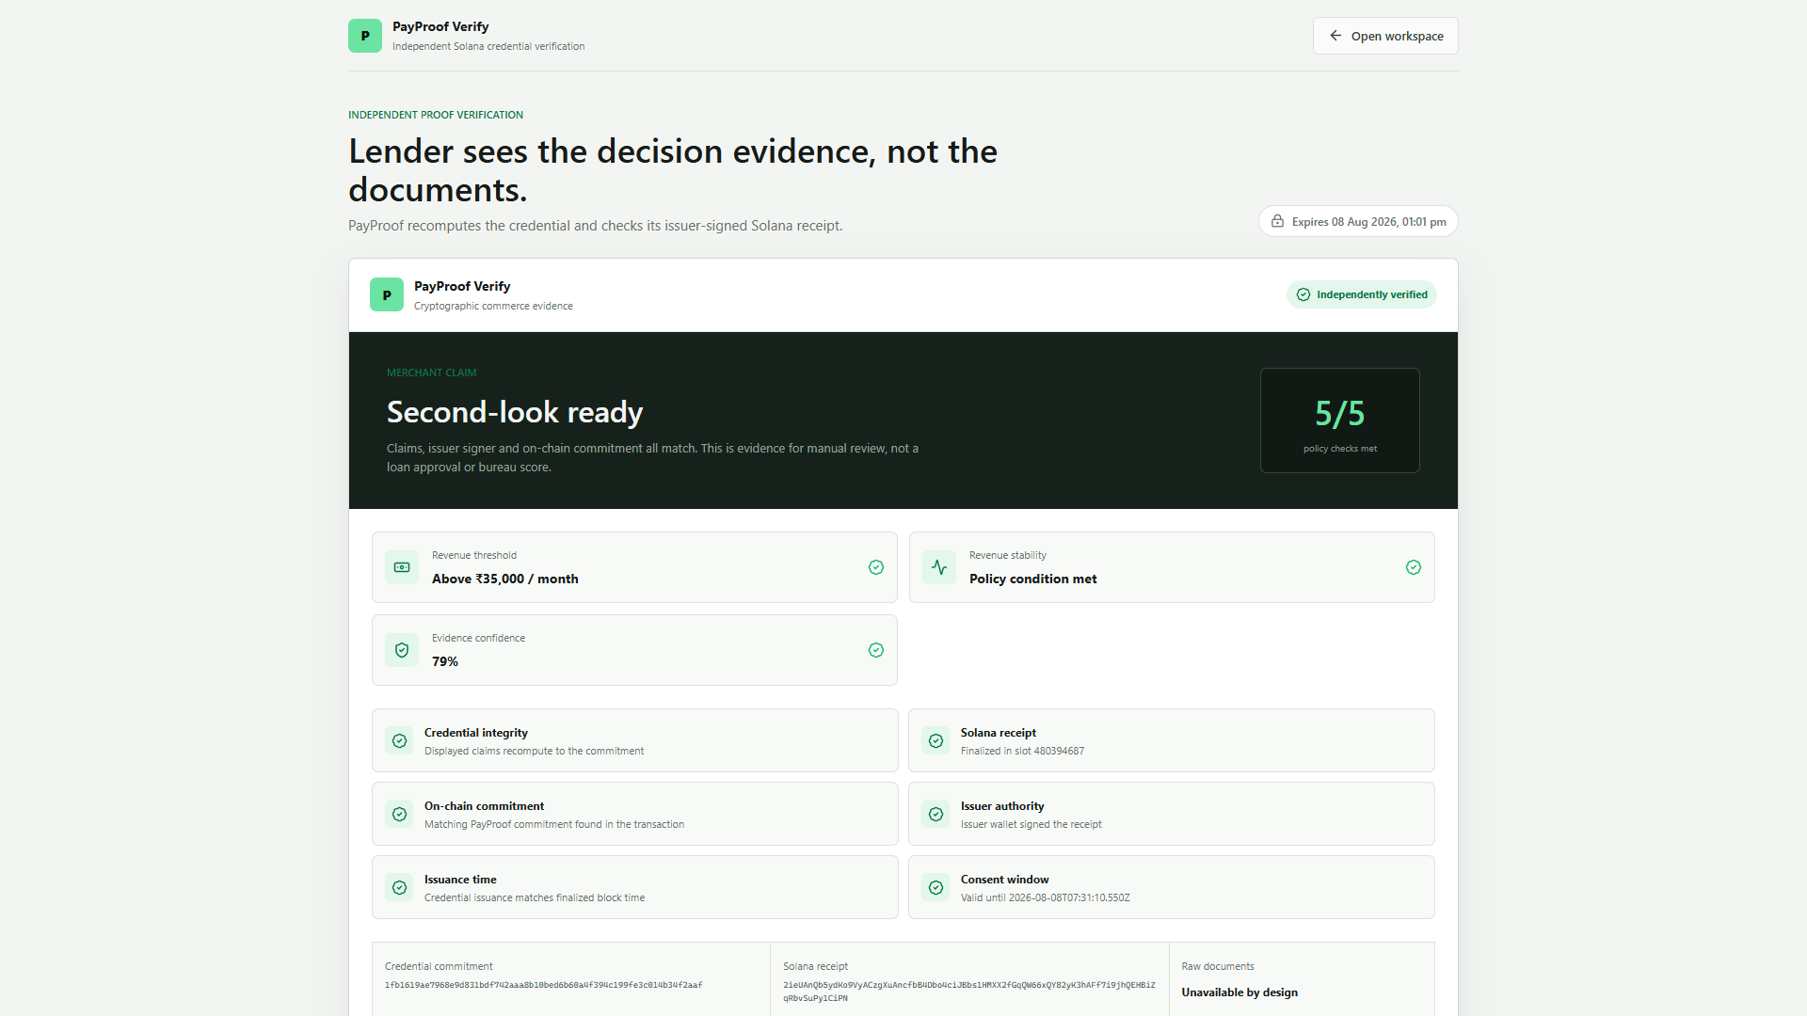
SOLANA COMMERCE EVIDENCE NETWORK
Invisible commerce,
verified.
PayProof turns fragmented merchant records into a consent-bound claim a lender can verify.
28 records
13 events
92% cross-source
Working product on Solana devnet
PAYPROOF
01
Notes:
[Sources]
- https://snakbillion.github.io/payproof-solana-prototype/
- https://github.com/SNAKBILLION/payproof-solana-prototype
[/Sources]

Slide 2
THE UNDERWRITING GAP
The commerce is real.
The evidence is disconnected.
A WhatsApp order, invoice, UPI settlement and bank credit may describe one sale. Today a lender must reconstruct that chain manually.
01
02
03
04
Order
Invoice
UPI
Bank
intent
obligation
settlement
receipt
PAYPROOF
02
Notes:
[Sources]
- Product problem statement and import schema: https://github.com/SNAKBILLION/payproof-solana-prototype
[/Sources]

Slide 3
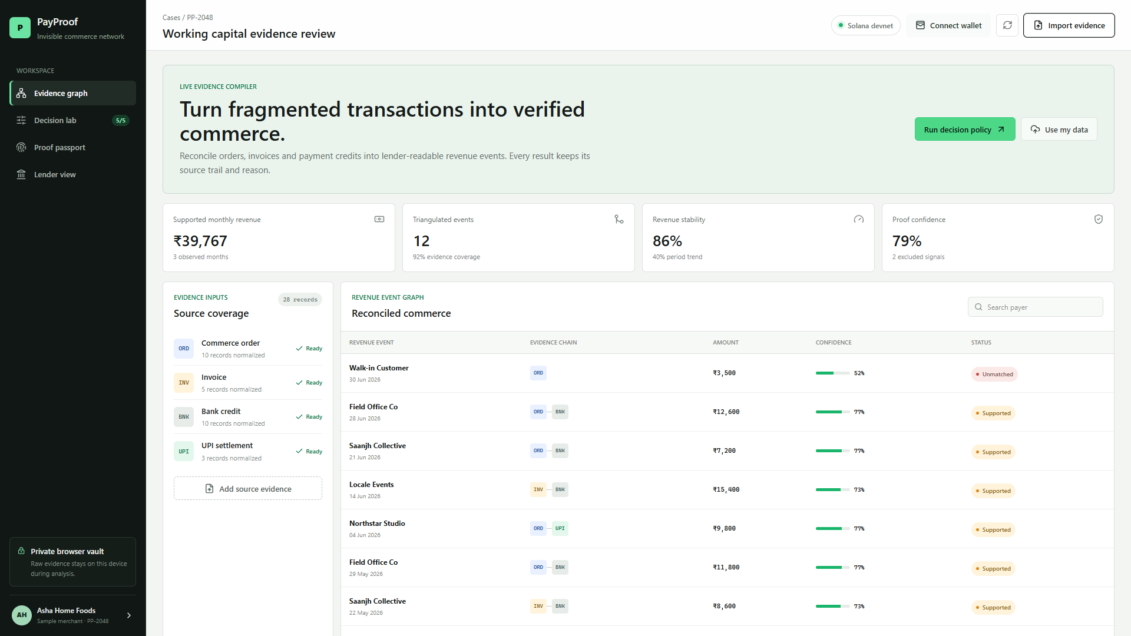
WORKING PRODUCT
Reconciliation creates a traceable revenue graph.
28 to 13
records to events
Every event keeps source provenance, confidence and exceptions.
92% cross-source coverage
PAYPROOF
03
Notes:
[Sources]
- Screenshot captured from local working product using the downloadable sample CSV bundle.
- https://snakbillion.github.io/payproof-solana-prototype/
[/Sources]

Slide 4
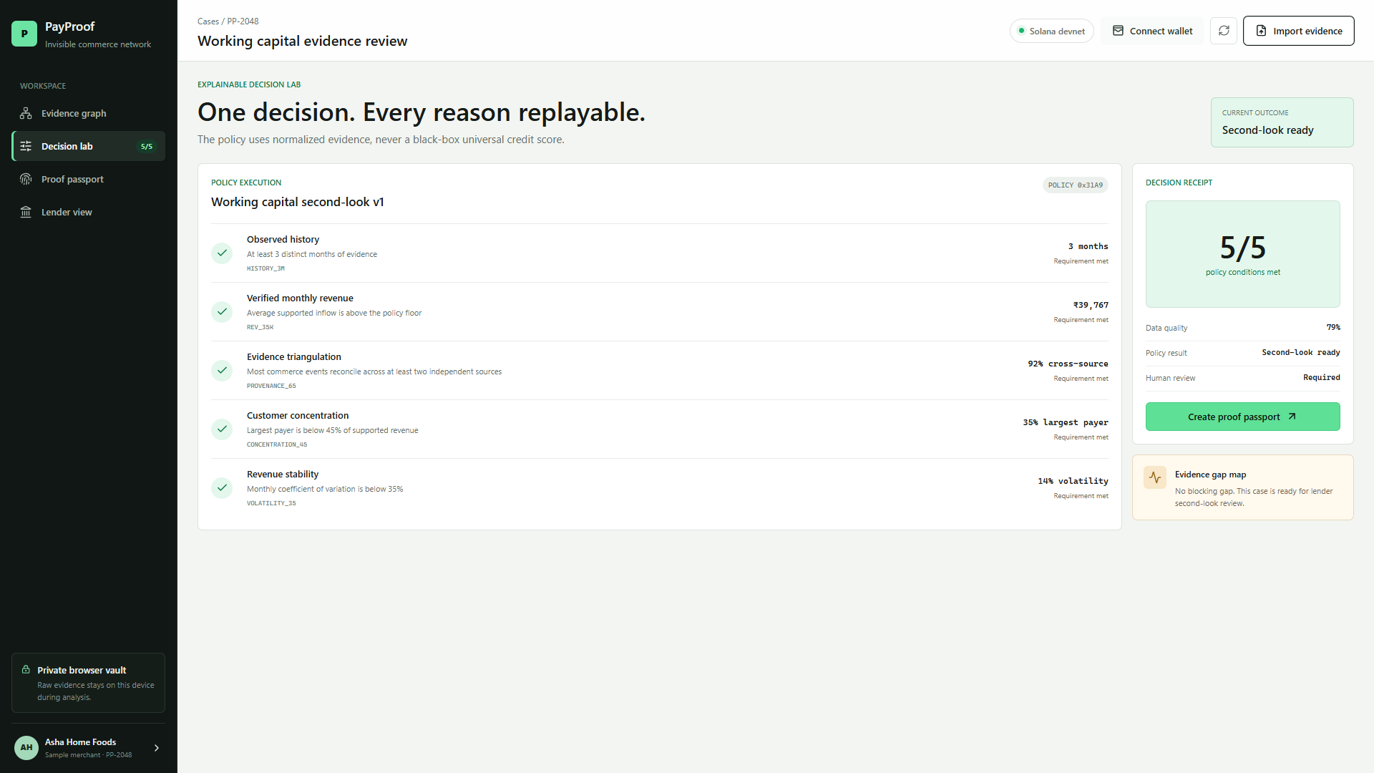
DECISION INFRASTRUCTURE
A lender can replay every reason.
No universal credit score. One purpose-specific policy, five explicit checks, and mandatory human review.
5/5
policy checks
Rs 39,767
supported monthly revenue
14%
revenue volatility
PAYPROOF
04
Notes:
[Sources]
- Screenshot captured from the working policy engine and sample evidence bundle.
- https://github.com/SNAKBILLION/payproof-solana-prototype/blob/main/SUBMISSION.md
[/Sources]

Slide 5
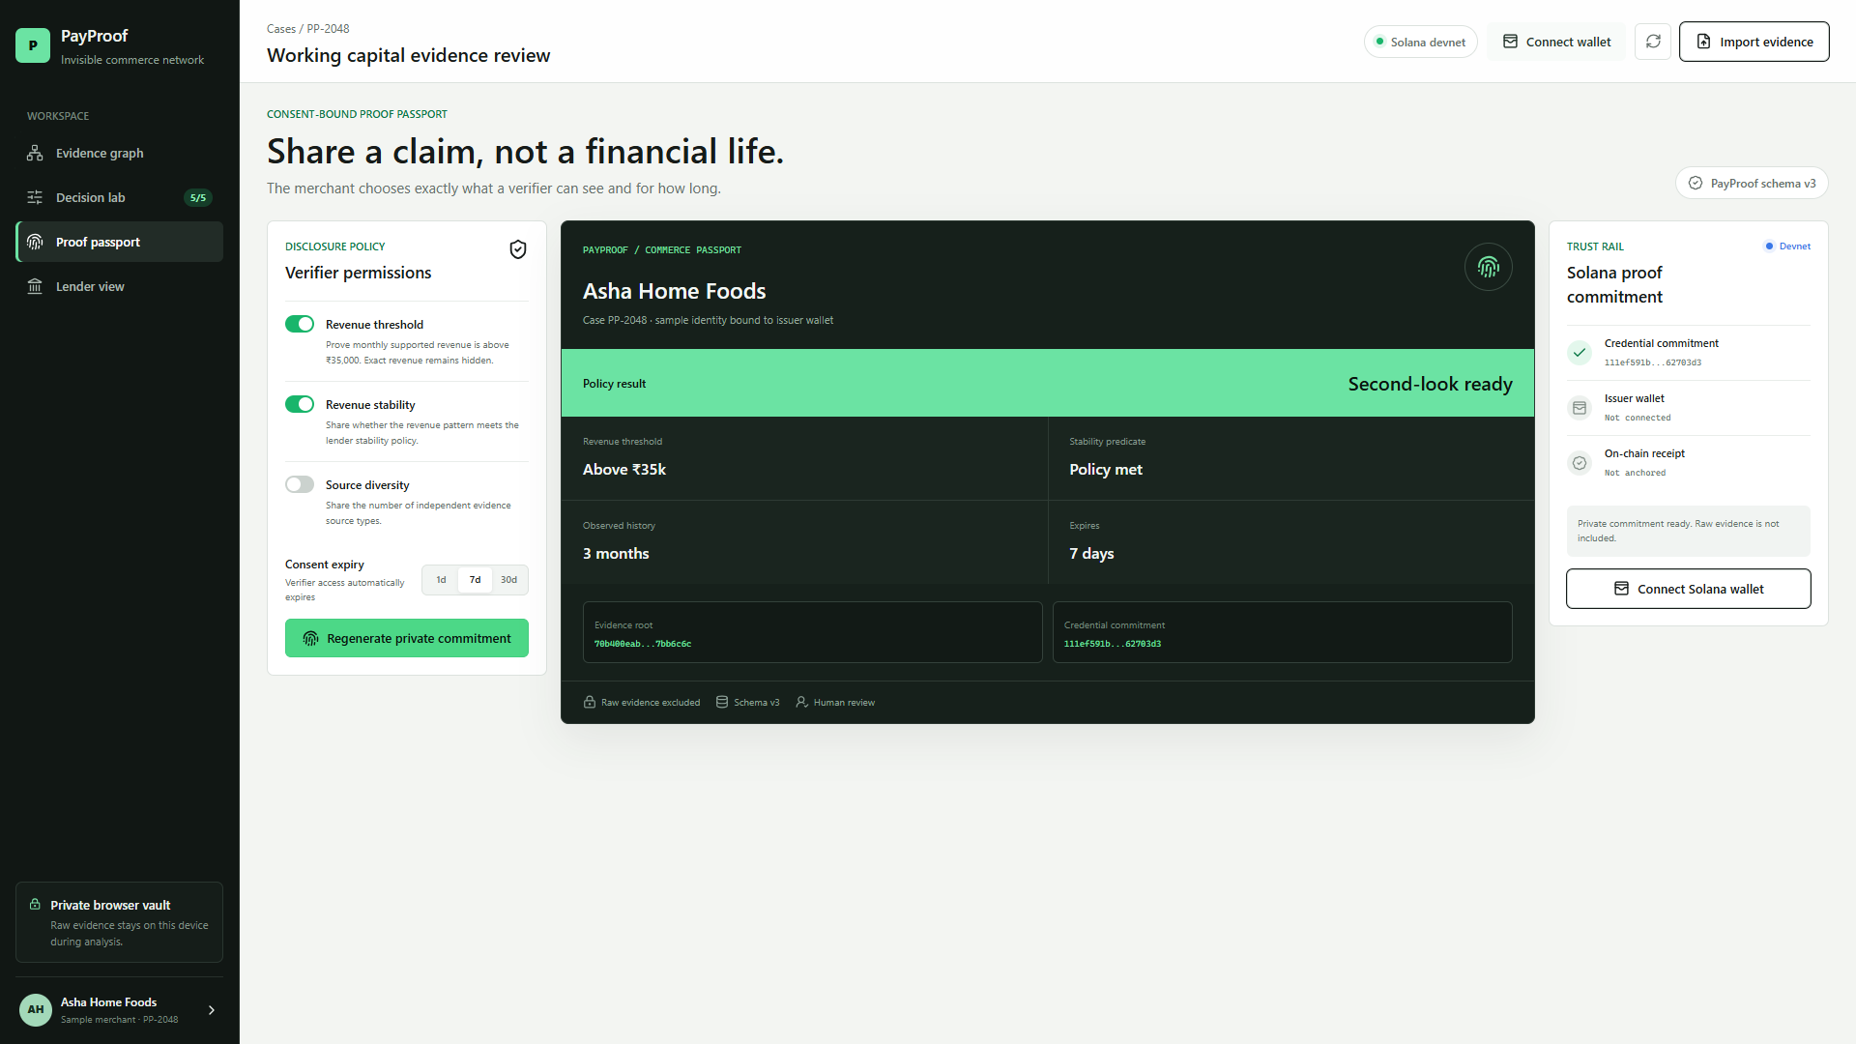
PRIVACY-SAFE TRUST RAIL
Share a claim, not a financial life.
Raw records stay off-chain. The merchant selects claims and expiry; Solana carries the verifiable commitment.
MERCHANT CONTROLS
VERIFIER RECEIVES
claims + expiry
predicate + receipt
PAYPROOF
05
Notes:
[Sources]
- https://solana.com/docs/tools/attestations/instructions/create-attestation
- Screenshots captured from the working PayProof product.
[/Sources]

Slide 6
THE 12-WEEK PILOT
Fund the step from proof to operating network.
01
02
03
04
Issuer
Attestation
Pilot
Evidence
Authenticated case vault
and issuer-controlled keys
SAS schema, expiry,
verification and revocation
10 merchants and one
lender design partner
Publish verification time,
exceptions and learnings
$5,000
10
1
12 weeks
grant ask
merchant cases
lender design partner
to measured pilot
PAYPROOF
06
Notes:
[Sources]
- https://superteam.fun/earn/grants/solana-foundation-india-grants
- https://solana.org/grants-funding
- https://colosseum.com/eternal
[/Sources]

