Slide 1
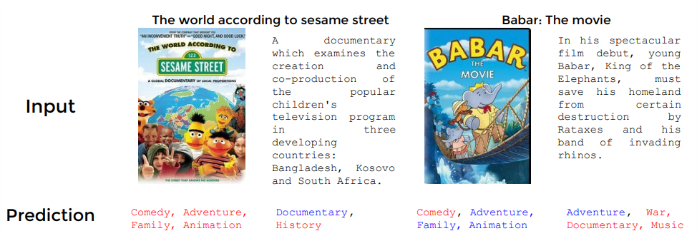
Applied Deep Learning Final Project¶ Movie Genre Classification TEAM
Rafael Antonio Niño Vargas
Santiago Nicolás Barco Gómez
Julio, 2018

Slide 2
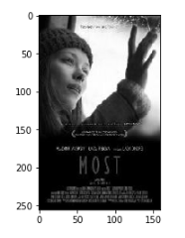
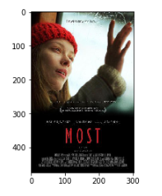
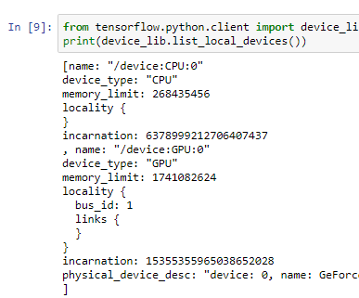


Data Analytics
Output:
1. Probability of the movie belong to each genre.
Issue:
1. Computer capacity CPU / GPU / RAM.
2. Machine Learning algorithm
3. Deep Learning algorithm
vs
How?:
Use GPU, limited by the laptop RAM.
Use COLAB, limited by many users.

Slide 3
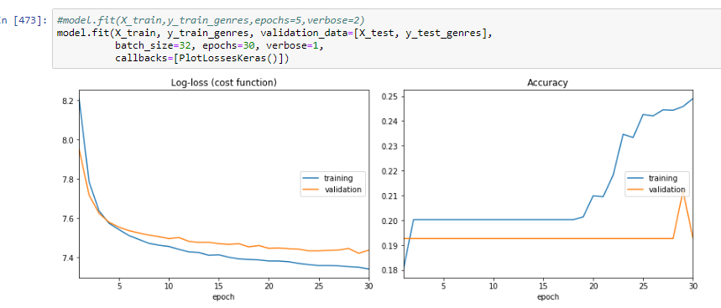
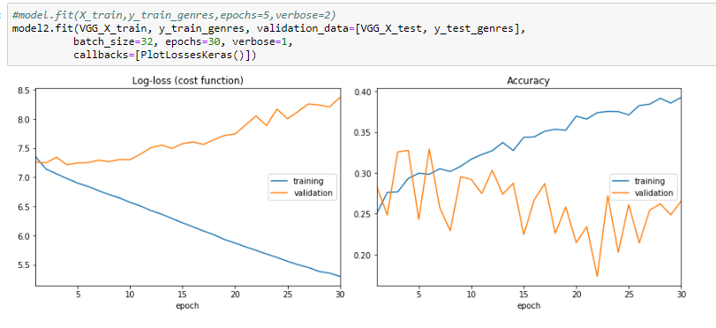
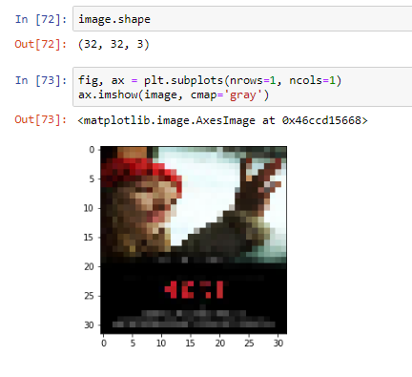
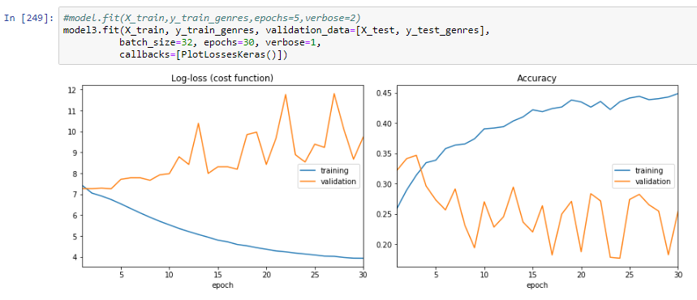
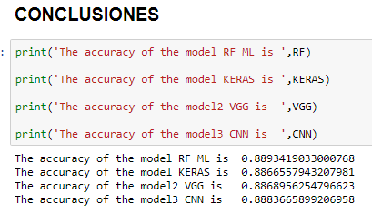
How we do?
Color Image Reshape 32,32,3
ML: Random Forest.
DL: Neuronal Network – Keras.
DL: VGG.
DL: Transfer Learning con CNN

Slide 4
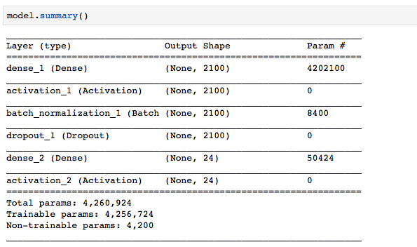
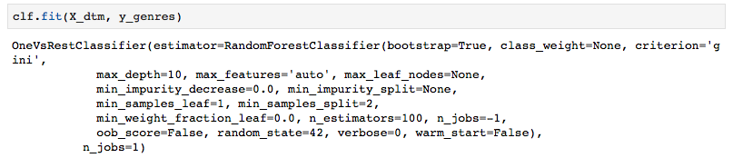
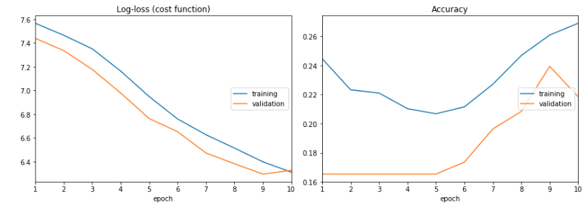
Text Analytics
Deep Learning: Neuronal Network – Keras.
Machine Learning: Random Forest.
Accuracy: 0.4976
Accuracy: 0.9370
Deep Learning: Transfer Learning con word2vec
Accuracy: 0.2184

Slide 5
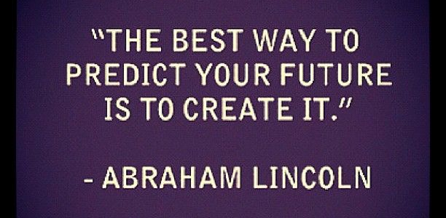
GRACIAS

