Slide 1
Dynamic-developers

Slide 2
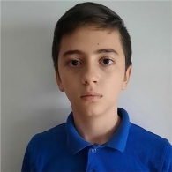


About Us
Стефан Чапкънов Раян Христов Йордан Жечев
SCRUM Trainer Backend Developer and Frontend Developer Designer

Slide 3





Used apps throughout the project
Communication –Discord
App work – Visual Studio Code
Documentation – Word
Presentation – PowerPoint
Submission - GitHub

Slide 4
link to our repository
Repository

Slide 5


Thank you for your attention !!!

