Slide 1


sndsTools
An R package to simplify SNDS data extraction
Matthieu Doutreligne
Insee
2026-01-26
Some slides from Antoine Belloir and Marc Dibbling
24/03/2025

Slide 2
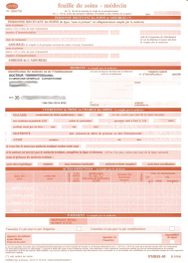


SNDS sources
January 2016 : created by law « modernisation de notre système de santé »
CNAM
National fund
Primary funds (caisses primaires)
Claims
Controls and anonymisation : NIR encryption
DCIR
Counting
Data on healthcare providers
encrypted NIR
Reimbursement of healthcare providers
PMSI
Causes de décès
ATIH
encrypted NIR
encrypted NIR
CépiDc
Local nominative databases
Reimbursement, possible identification, specific to each regime (three main regimes) and local fund.
Système National des Données de Santé (SNDS)
Anonymous national data warehouse
All regimes
Chained with hospital data (PMSI, programme de médicalisation des systèmes d’information)
Chained with death certificates (CépiDc)
🚀 2021: Permanent access to research organisms (INRIA, INSERM, hospitals…) : profil 108 and formation

Slide 3






In summary, SNDS is a rich database…
In-town healthcare data (DCIR)
Populational data base
Consultations
Medical acts
Biological exams
Drugs and medical devices dispenses (reimbursed ones)
≃ 68 millions individuals
Hospital care data (PMSI)
…but a claim database
Inpatient hospital stay dates
Medical acts and diagnostics
Outpatient visits (consultations externes)
Information not available
Death causes
Clinical exam results
Basic clinical data (BMI, blood pressure, …)
Environmental exposures or risk factors (smoking, drinking, nutrition habits)
Socioeconomic status (education, income, …)
Clinical data for hospital stays (beyond diagnostic codes) : eg. cheap medication during stays, biology, …
No reason for consultation or prescription not reimbursed
Medical diagnostics mentioned on the death certificate
Patient data
Basic demographic variables (age, sex, department of residence, date of birth and death, geographical social deprivation index)
Long Term Disease status with associated diagnostic codes
Antecedents identified by the Cnam mapping system (“cartographie des pathologies”)

Slide 4
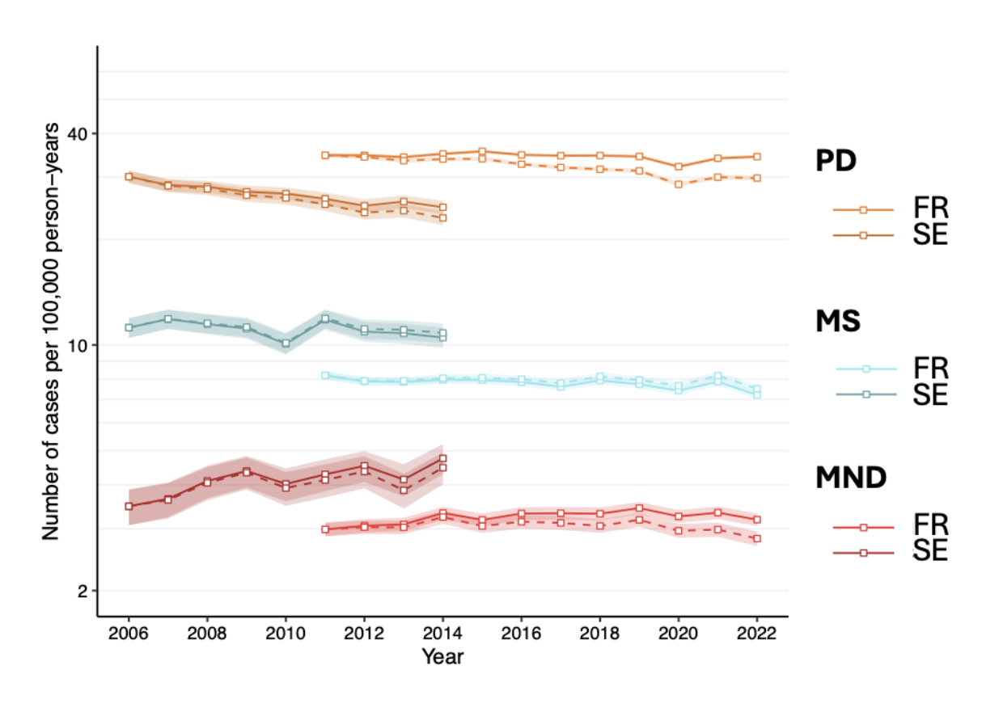
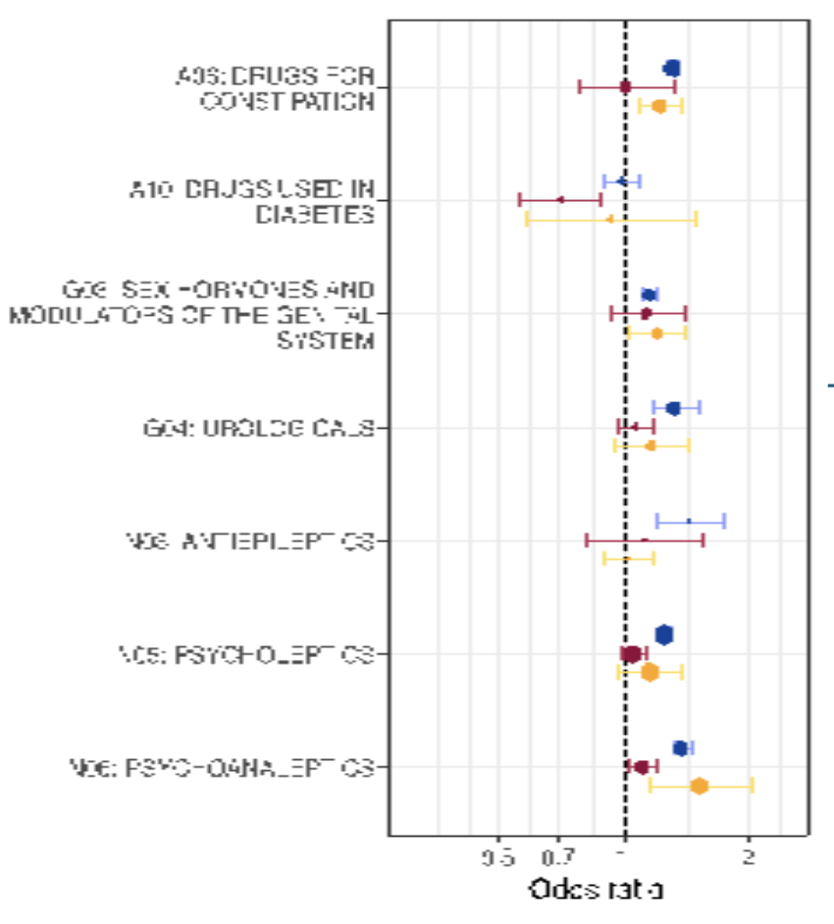
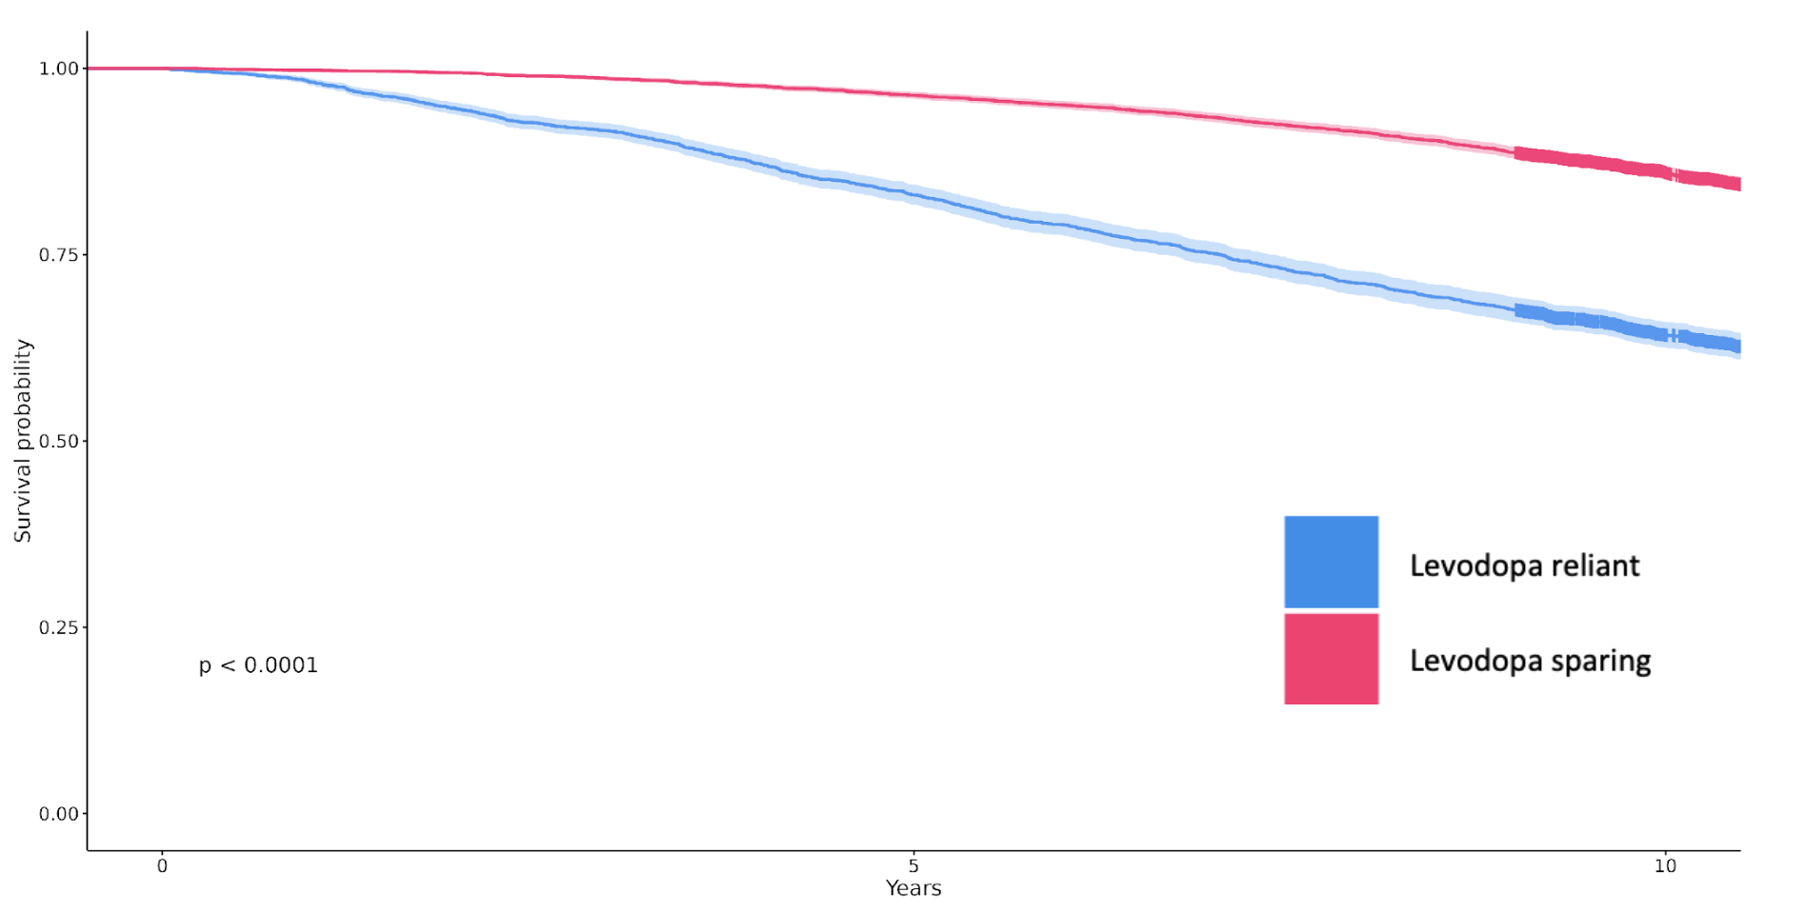
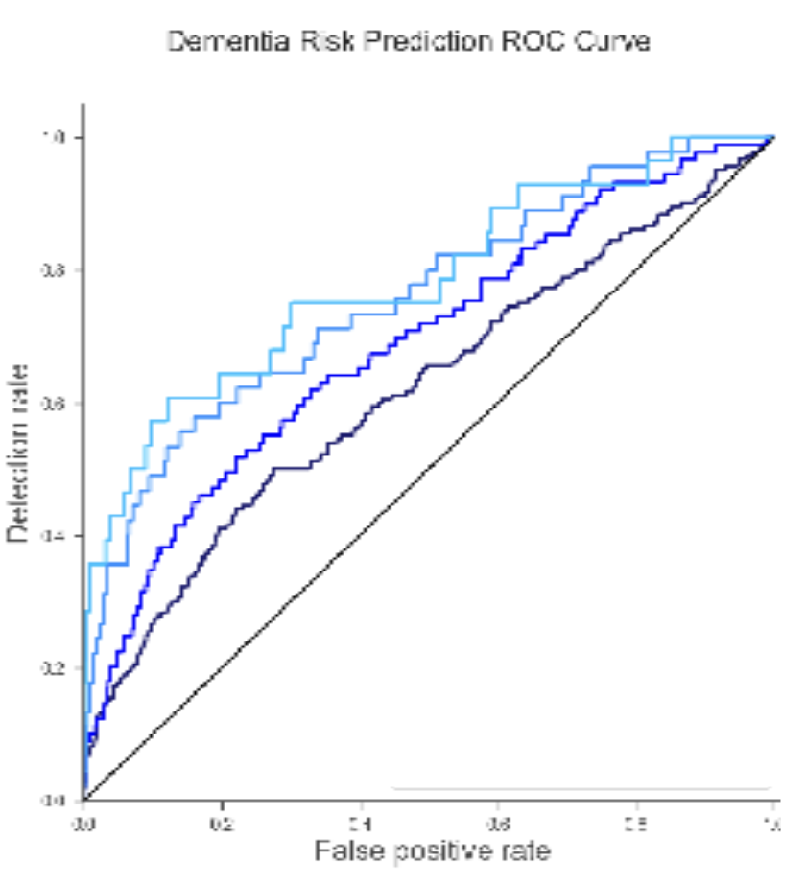
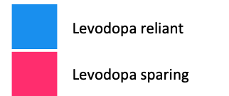
Overview of clinical research studies based on the SNDS database
Epidemiological studies
Therapeutic studies
Prognostic studies
Predict disease progression based on individual patient characteristics
Compare the effectiveness of different treatments
Describe the health status of a population…
..and identify factors that influence it
Incidence of Parkinson’s disease in France over 10 years
Health conditions associated with Alzheimer's disease
Survival for two treatment options for 20 000 patients with Parkinson’s disease
ROC curves for dementia onset prediction at 2, 5 and 10 years

Slide 5
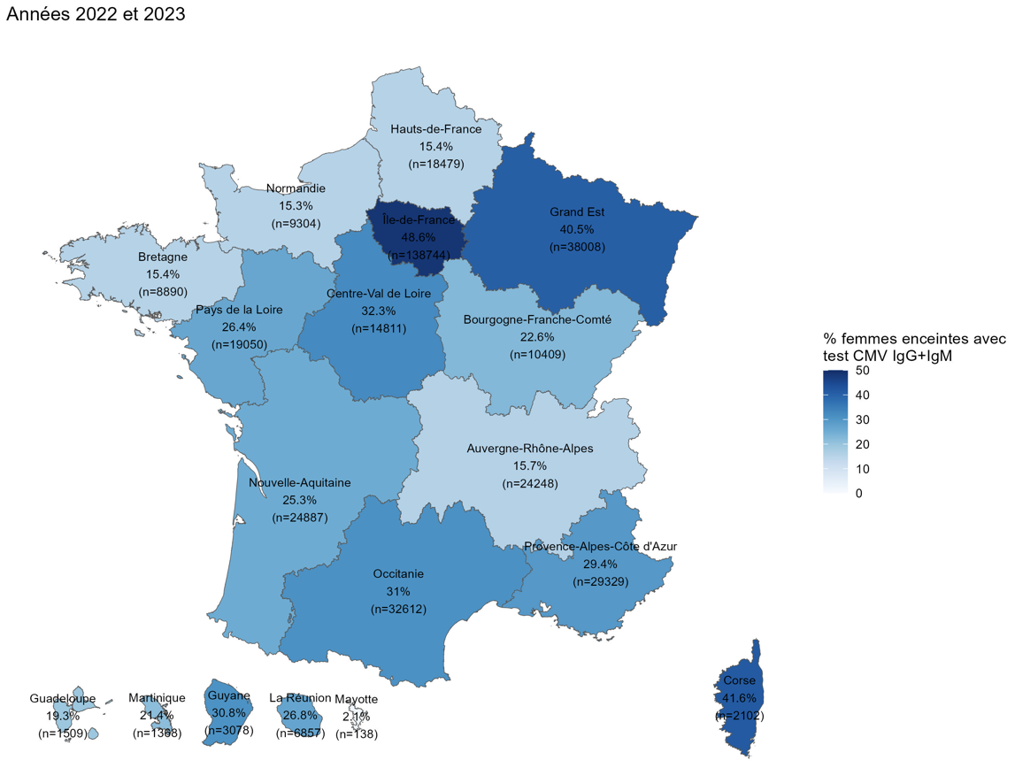
Description of healthcare practices Eg. Practice of screening pregnant women for CMV infection (2022-2023)
NABM 1260 : IgG and IgM anti-CMV
Heterogeneity of practices on the french territory
Frequent use (> 40%) :
Île-de-France, Corse, Grand Est
Much less common (≈ 15%) :
Bretagne, Normandie, Hauts-de-France, Auvergne-Rhône-Alpes

Slide 6
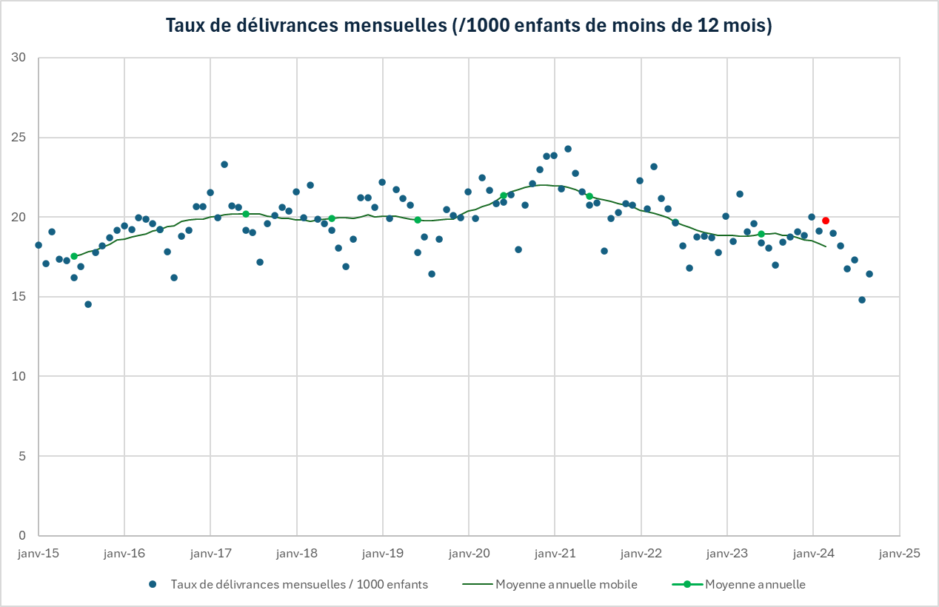
Impact of institutional recommendations Eg. Proton pump inhibitor dispensing trends in children under 1 year of age since 2015 (⚠ WIP)
Mars 2024

Slide 7
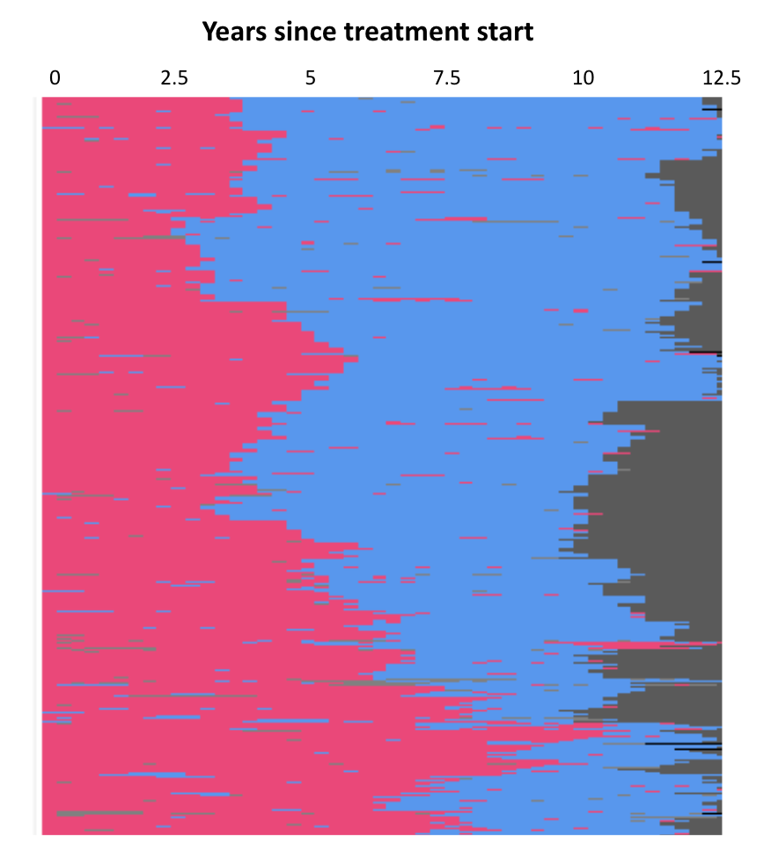
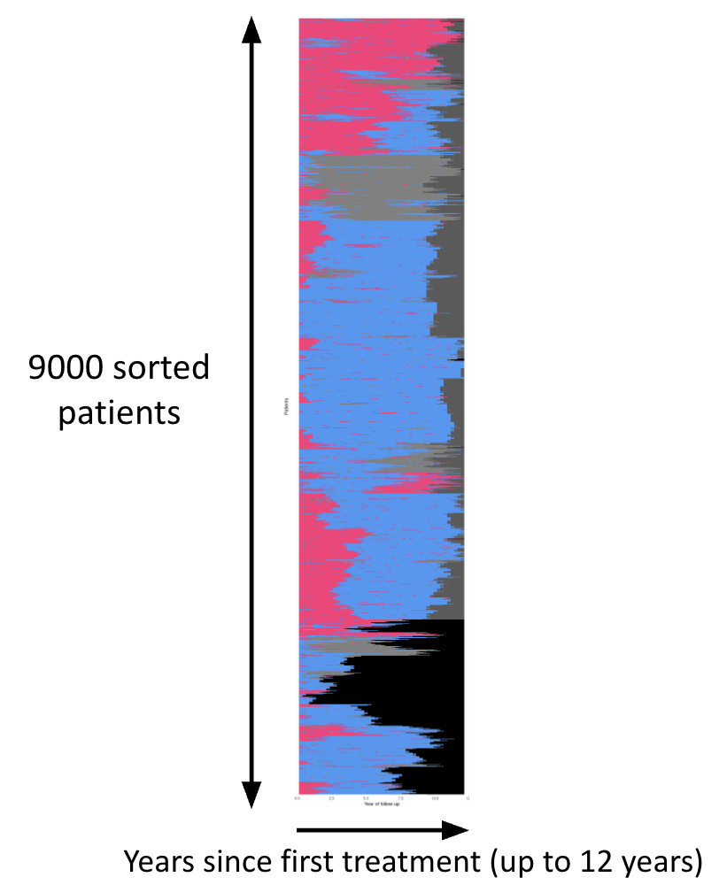

A sanity check in SNDS clinical studies : visualize individual treatment pathways
Patient treatment status during quarter
Levodopa reliant
Levodopa sparing
No treatment dispensed
Not yet observed
Death

Slide 8
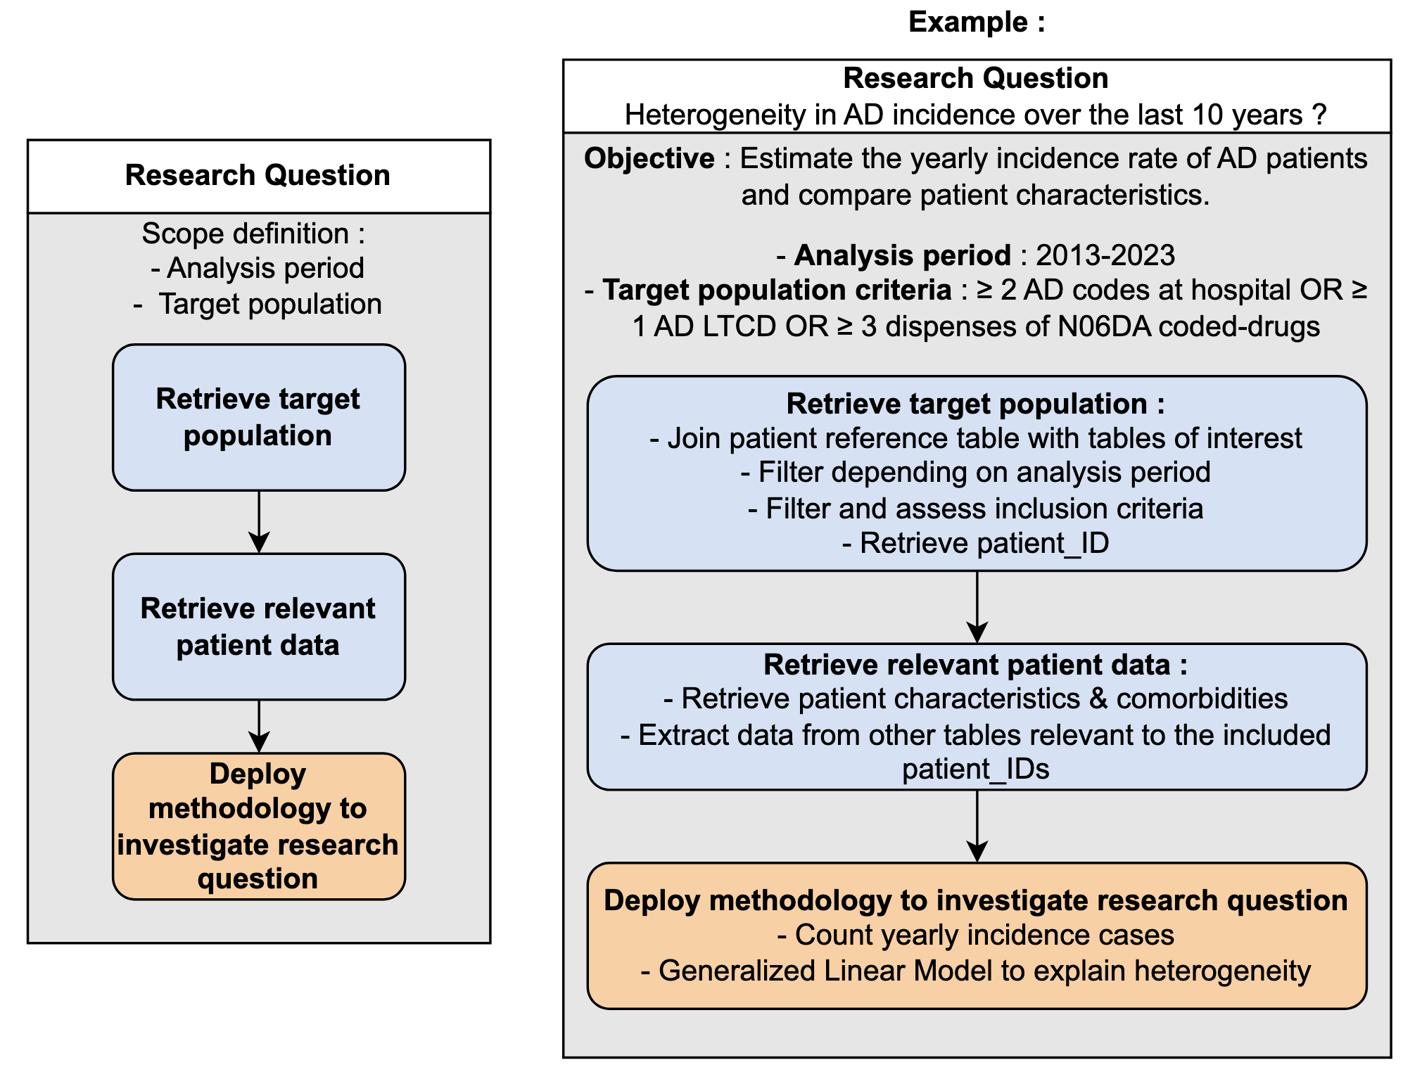
Typical workflow

Slide 9
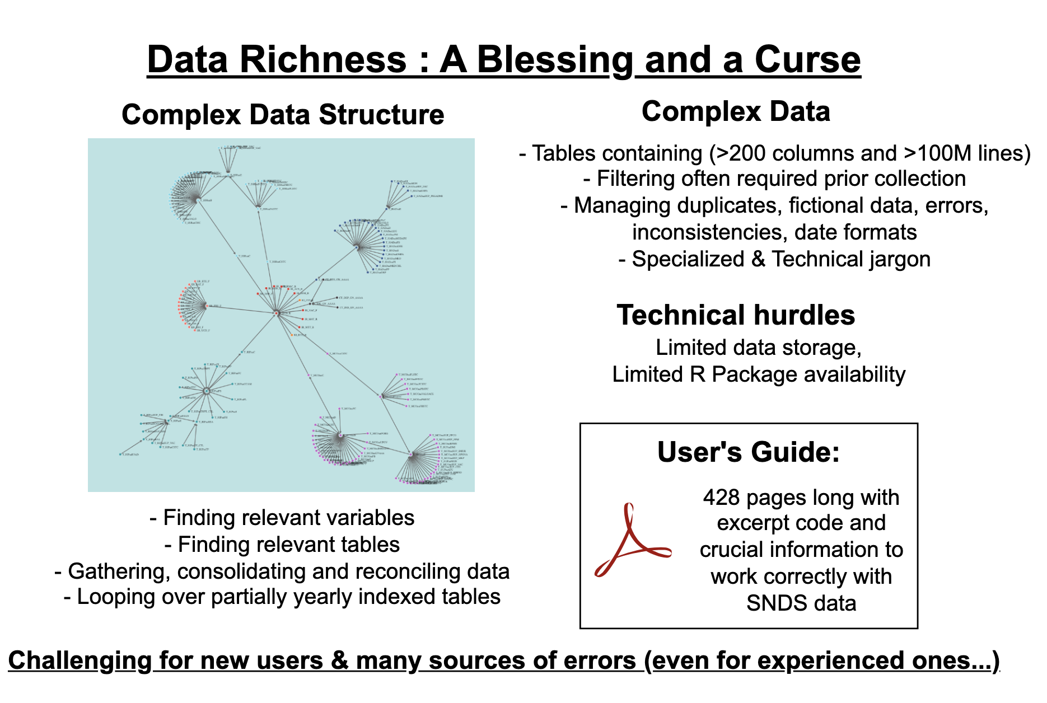
Typical workflow in practice

Slide 10
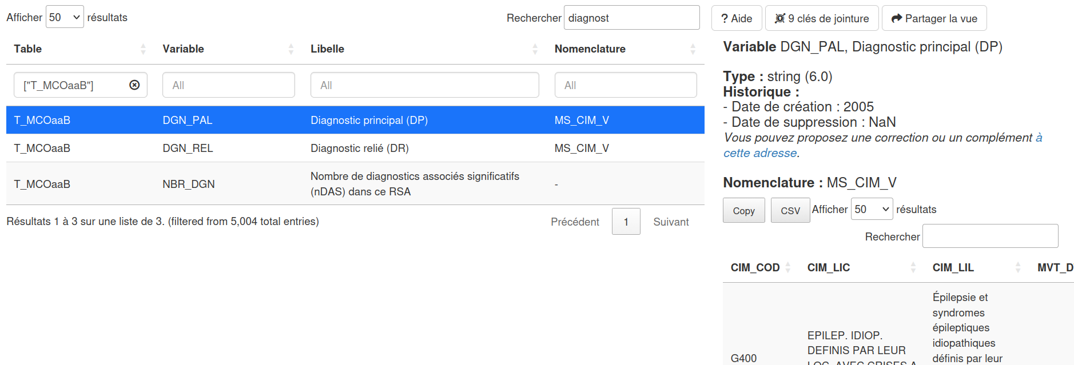
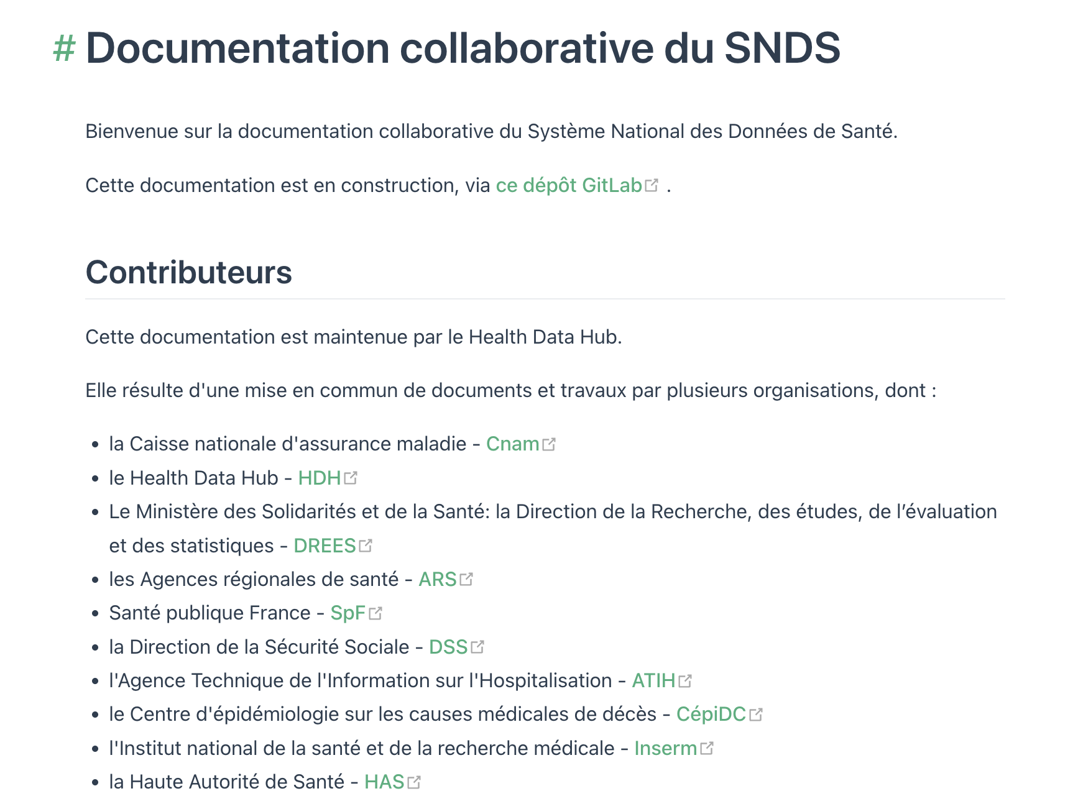
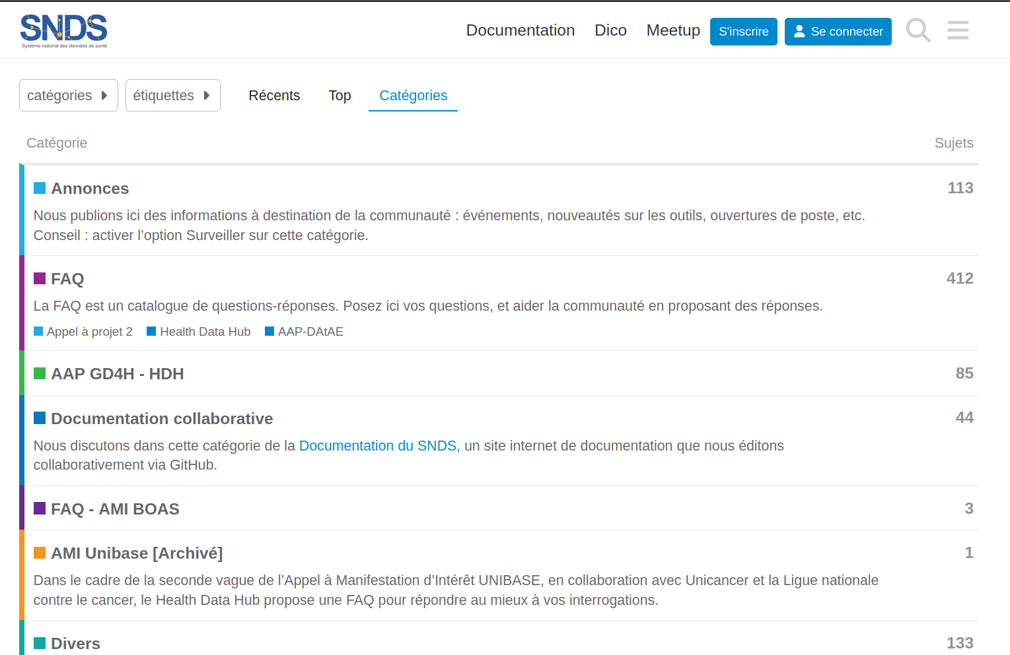
Resources for using the SNDS in clinical research
Interactive data dictionary : https://health-data-hub.shinyapps.io/dico-snds/
A helpful collaborative documentation
A forum
https://documentation-snds.health-data-hub.fr/snds/
https://entraide.health-data-hub.fr/categories

Slide 11



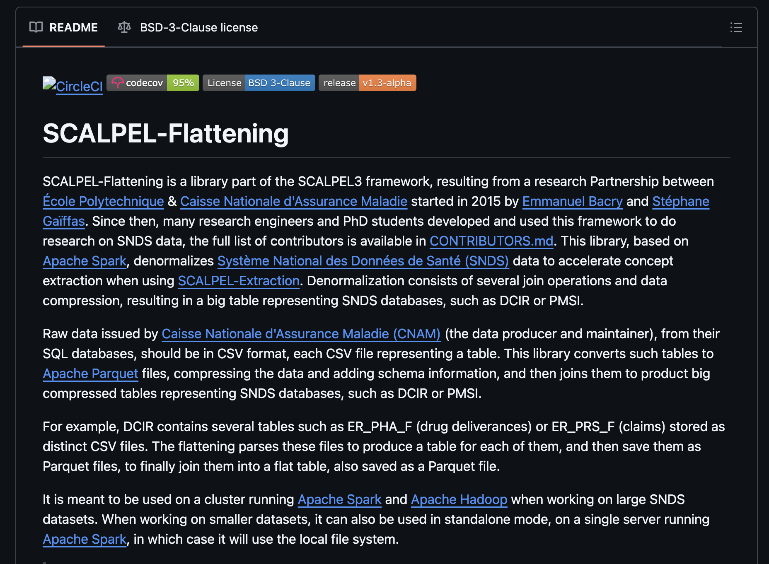
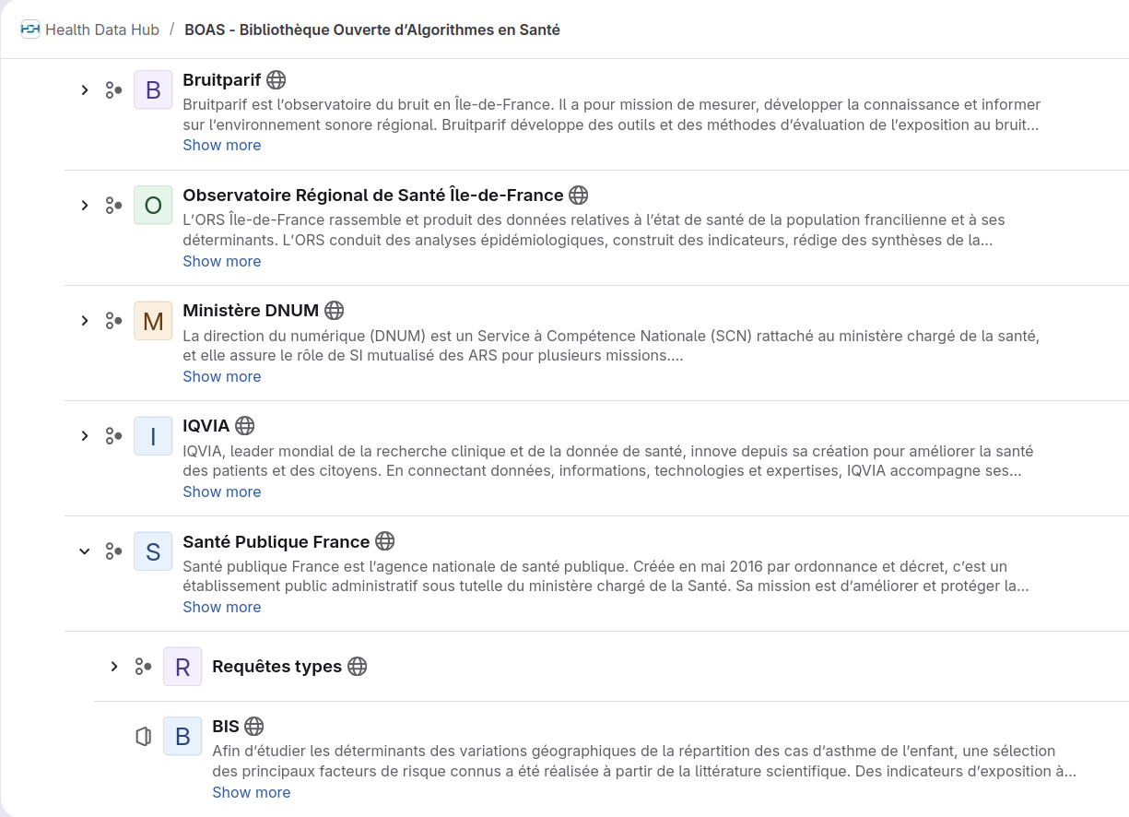
Resources for coding with the SNDS
Several institutions use the SNDS database “at scale”, leveraging large internal code bases built over the years that are not public.
HDH BOAS: useful references of studies
Mainly ad-hoc SAS code hard to adapt or configure
Open initiatives for a shared code base
Not adapted to shared infra and hard for collaboration
https://gitlab.com/healthdatahub/boas/
https://github.com/X-DataInitiative/SCALPEL-Flattening

Slide 12

Resources for using the SNDS in clinical research
To this day : no comprehensive code base for “new SNDS actors” to leverage the SNDS database with the existing CNAM platform
Consequences
for individual researchers
Re-invent the wheel by re-implementing basic functions
Re-implementation is typically :
compromise between quality and time
under-optimized
prone to errors or approximations
Time spent building a dataset >> time left for data analysis

Slide 13
Resources for using the SNDS in clinical research
To this day : no comprehensive code base for “new SNDS actors” to leverage the SNDS database with the existing CNAM platform
Consequences
for research labs, public sector and research community
Unnecessary “barriers to entry” ⇒ less research actors
Duplicated work ⇒ waste of time and money
Lack of uniformity and reproducibility when building SNDS datasets ⇒ improvable research quality

Slide 14
The sndsTools R package
Objectives
🔁 Enhance reproducibility across studies
📄 Improve readability
🤗 Facilitate onboarding for new users
🚀 Accelerate population extraction for all
🤝 Encourage code sharing and transparency
🌐 Community-driven

Slide 15
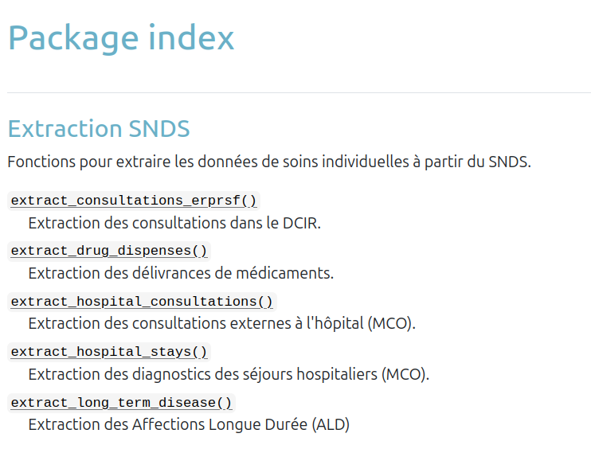
What is there right now in sndsTools?
Function references
https://sndstoolers.github.io/sndsTools/reference/index.html
✅ All functions are unit tested
🚧 Ongoing
🧐 Waiting review
PR69 - Example study
⏳In review PR64 - Extract MCO consultations with CCAM codes

Slide 16
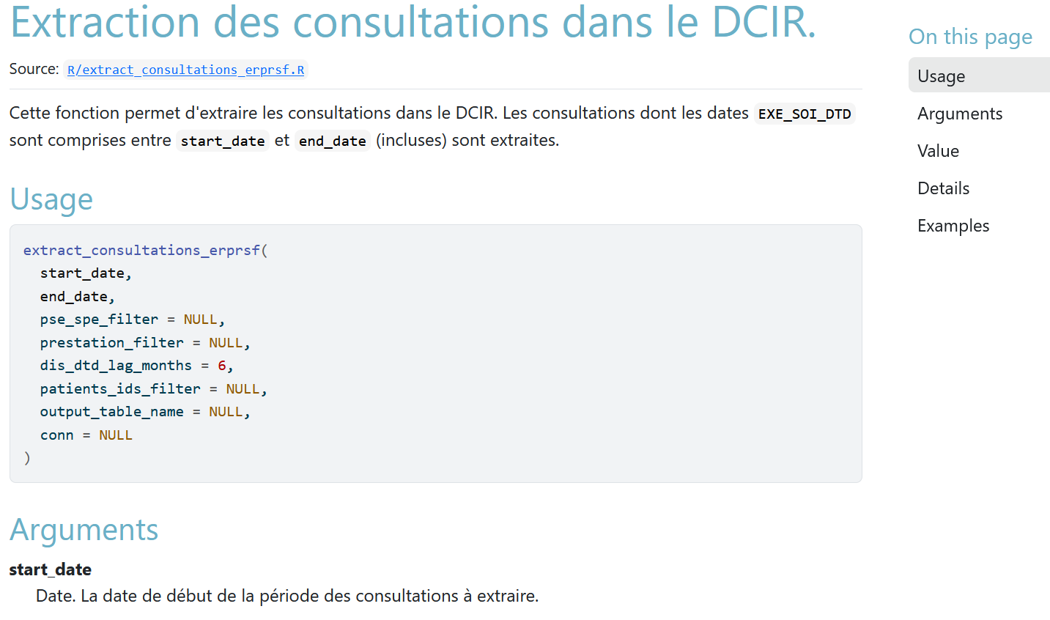
📚 Strong focus on documentation
Consistent API for extraction functions
Documentation of :
Parameters
Outputs
Filter or SNDS choices
Link to original sources of documentation if existing
Using roxygen2 to have the doc and the code both in the same R file.
https://sndstoolers.github.io/sndsTools/reference/extract_consultations_erprsf.html

Slide 17
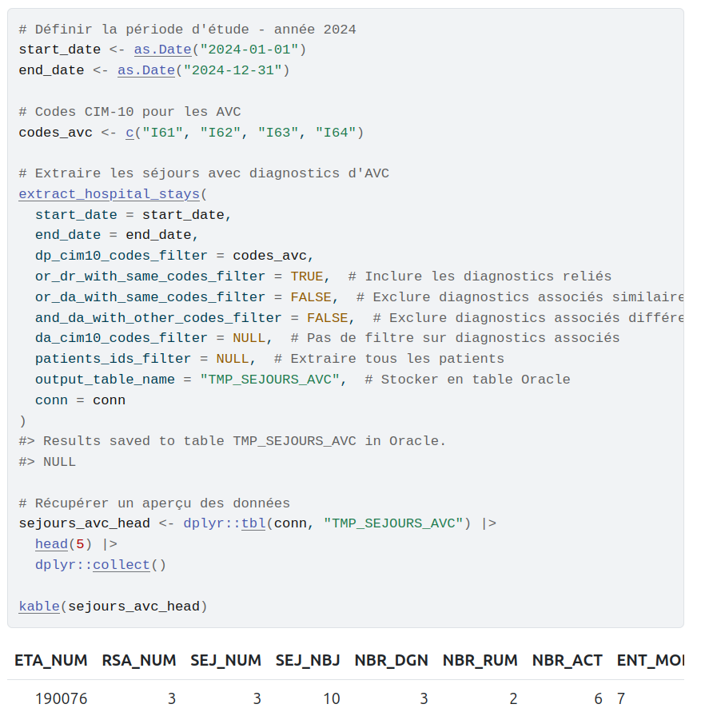
🐣 A simple case study as a tutorial
Fictive case : hospitalized AVC in MCO
Demo of extraction functions
Same code running :
Inside the CNAM server
Outside with fictive data
Consistent documentation and code !
Not merged yet ideas for improvement ?
https://sndstoolers.github.io/sndsTools/pr-preview/pr-69/articles/tutoriel_avc.html

Slide 18
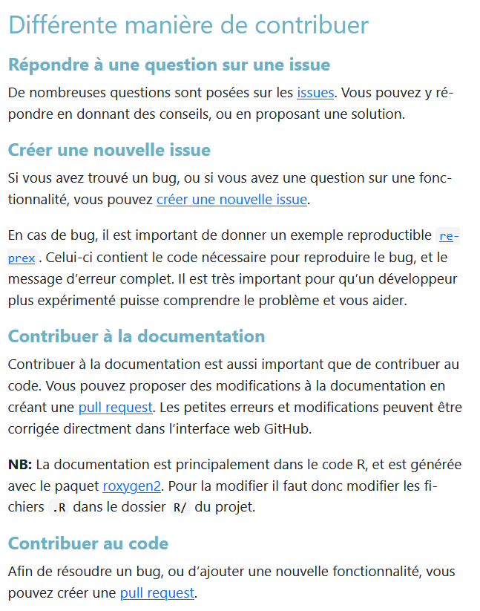
📌 Next steps ?
Extraction of top pathologies
Extension to other PMSI fields : HAD, SMR
Extension to other SNDS fields : sick leaves, expensive drugs in ER_UCD_F, …
🤗 Search for contributors : https://github.com/SNDStoolers/sndsTools/issues
Ideas
Review
Code

Slide 19
Thanks to all contributors :
Antoine Belloir (ICM)
Thomas Soeiro (AP-HM)
Marc Dibbling (ICM)
Leo Guillon (ICM)
Catherine Bisquet (HAS)
Nelly Leguen (HAS)

Slide 20
Supplementary slides

Slide 21
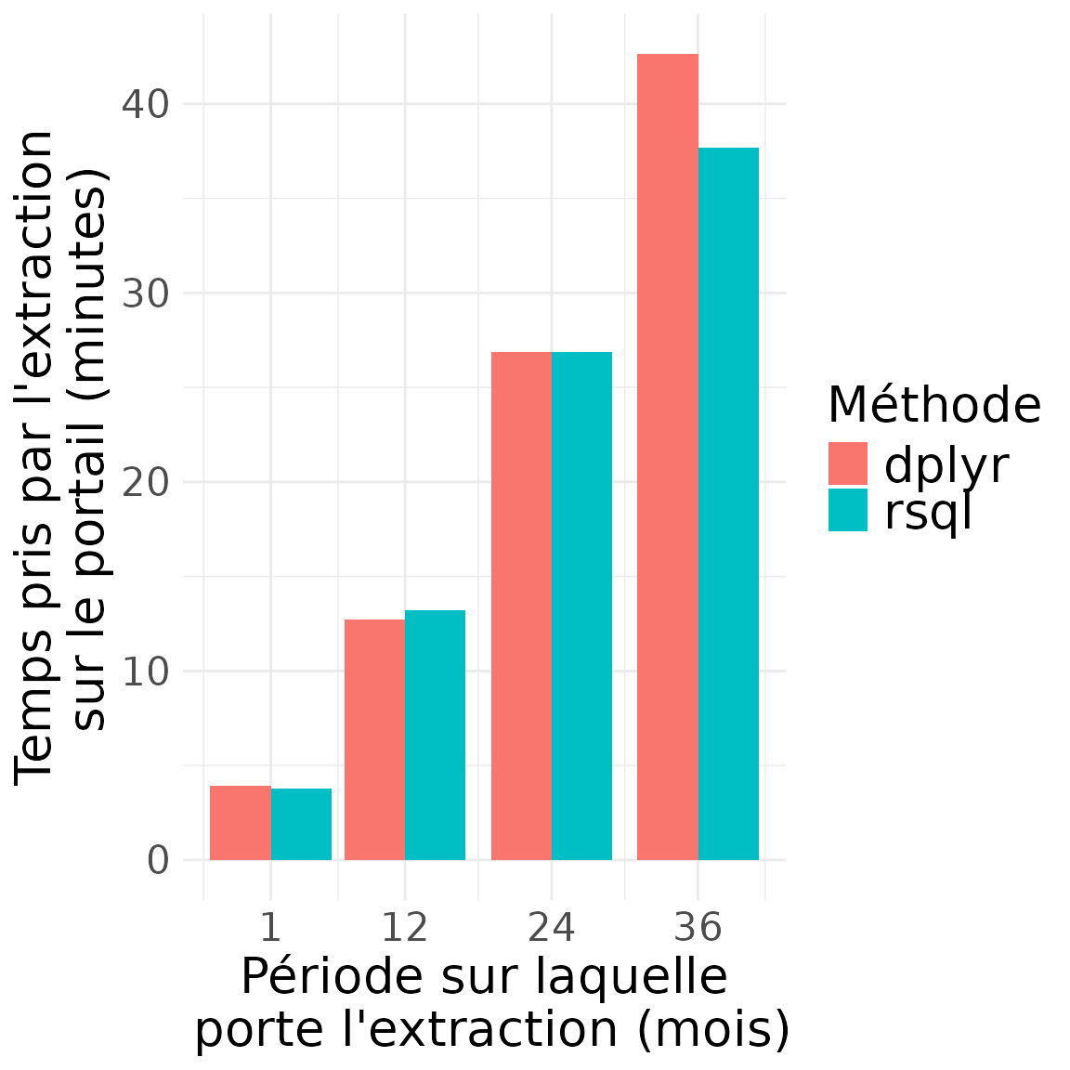
An example of case study used as benchmark https://sndstoolers.github.io/sndsTools/articles/benchmark_dplyr_vs_rsql.html
Is there a speed difference between dplyr syntax and direct sql queries?
Simple yet big query on ER_PRS_F, ER_PHA_F and ER_ETE_F
Case study: C vitamin drugs on different period of times
CCL: No big differences!

