Slide 1


Optimized Name Matching API: Advanced Techniques & Customizable Parameters
by Ashley

Slide 2

Overview
1
Compares farmer names across multiple sources
2
Uses FastAPI for REST endpoints & SQLAlchemy for DB interactions
3
Incorporates advanced normalization, phonetic matching, TF-IDF, and fuzzy matching
4
Tunable parameters to optimize matching accuracy

Slide 3
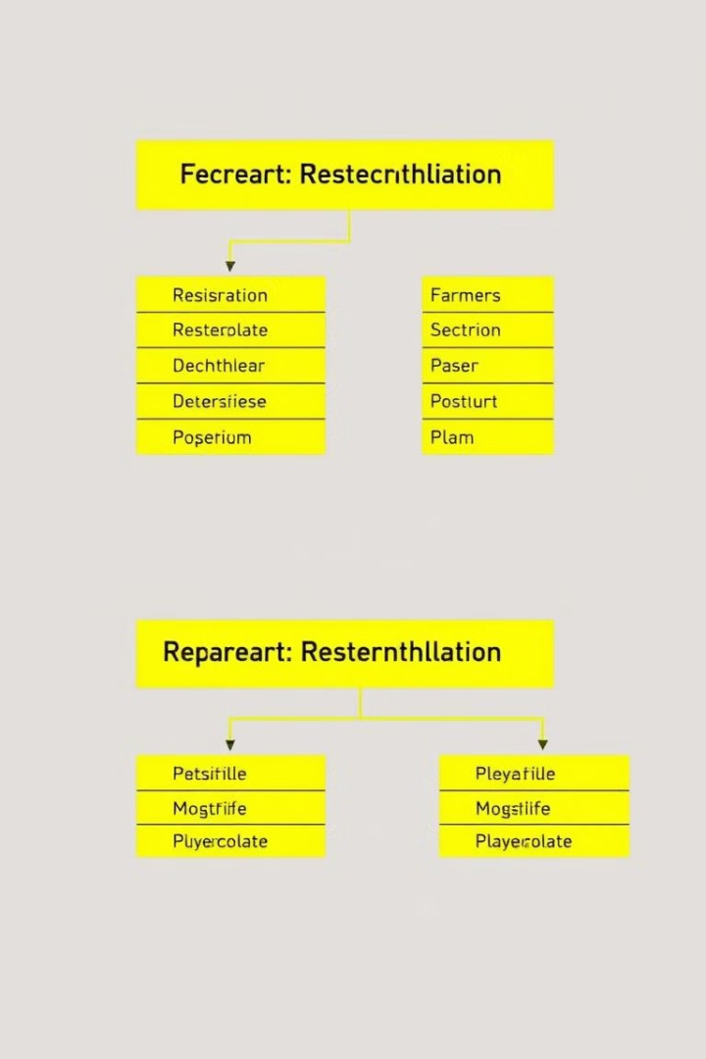
Database Models
1
Two tables:
2
Columns include various name fields (registration, aadhaar, kb, bank)
farmer_registration
farmer_details
3
Additional flags & accuracy scores to track AI matching results

Slide 4
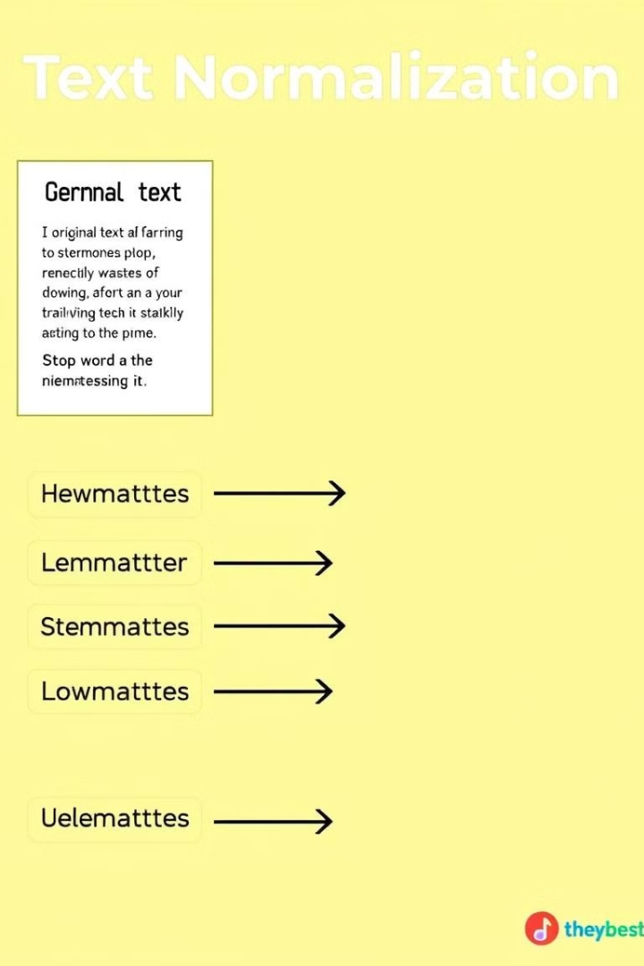
Advanced Normalization
1
Converts names to lowercase and trims whitespace
2
Removes punctuation & extra spaces
3
Applies regex-based substitutions for Bengali phonetics:
e.g., "mohammad" becomes "md", 'v' to 'bh', 'a' to 'o', etc.

Slide 5

Phonetic Code Generation
1
Uses double metaphone to generate phonetic codes
2
Example: Generates a code like "P0:NULL" for names
3
Helps in comparing names based on pronunciation rather than spelling
4
Example:
'John' → 'JN'
'Jon' → 'JN' (Same phonetic code as 'John')
'Ashleigh' → 'Ashley' (Same phonetic representation)

Slide 6

TF-IDF Vectorization
1
TF-IDF vectorizer is trained on phonetic codes
2
Configured with:
3
Cosine similarity is used to compare the TF-IDF vectors
Analyzer: char_wb
ngram_range: (2, 4)
min_df: 2
4
Example:
'Rahul' vs 'Raul' → Cosine similarity: 0.78
'Pritam' vs 'Preetam' → Cosine similarity: 0.85

Slide 7
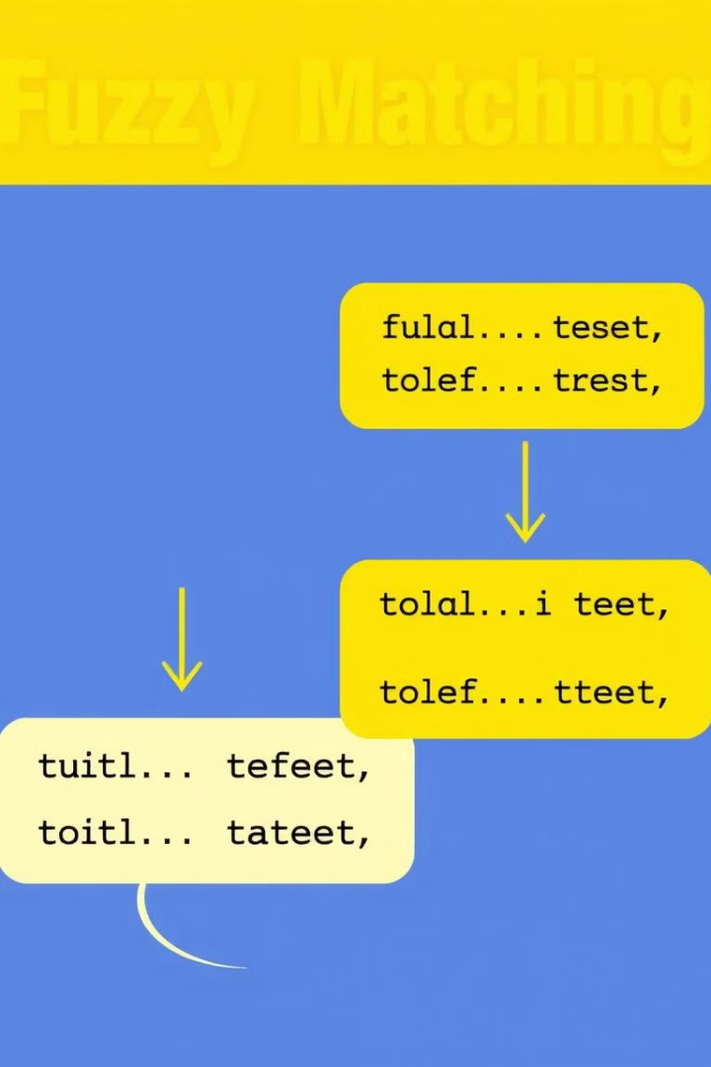
Fuzzy Matching
1
Uses RapidFuzz library methods:
2
Provides a similarity score based on edit distances
token_sort_ratio, partial_ratio, QRatio, WRatio
3
Compensates for typos and ordering differences
4
Example:
'Sanjay Kumar' vs 'Sanjay K.' → Fuzzy score: 92
'Mohammed' vs 'Md' → Fuzzy score: 89
'Rohit' vs 'Rohith' → Fuzzy score: 94

Slide 8
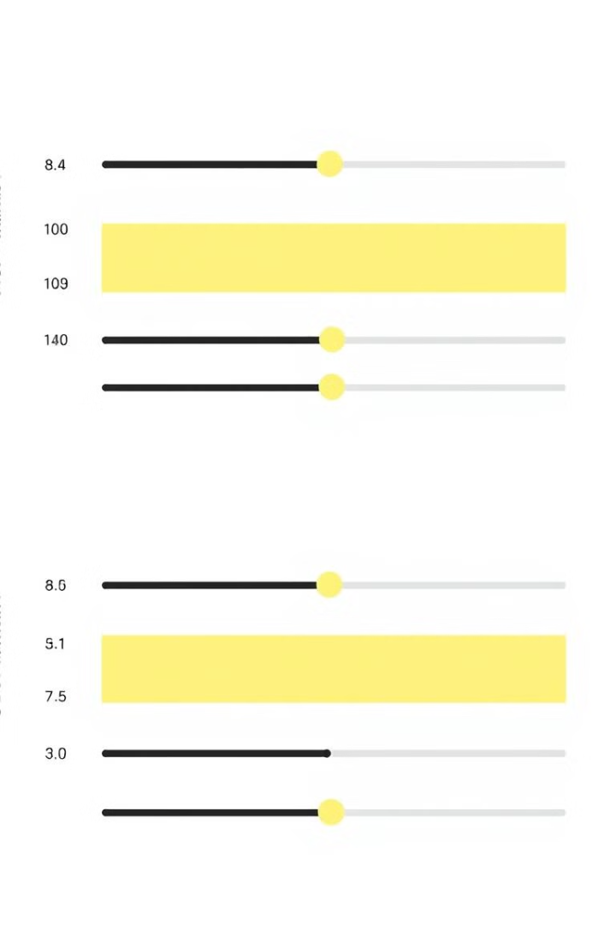
Hybrid Similarity Calculation
1
Combined score = (TF-IDF score * tfidf_weight) + (Fuzzy score * fuzzy_weight)
2
Tunable weights (must sum to 1.0):
e.g., tfidf_weight=0.6 & fuzzy_weight=0.4 or tfidf=0.25 & fuzzy=0.75
3
Minimum matching threshold set at 0.45 for a positive match
Example:
'Amit Kumar' vs 'Amith Kumar' → (TF-IDF 0.7 * 0.6) + (Fuzzy 0.9 * 0.4) = 0.78
'Suresh Raina' vs 'Suresh Kumar Raina' → (TF-IDF 0.65 * 0.6) + (Fuzzy 0.85 * 0.4) = 0.72

Slide 9

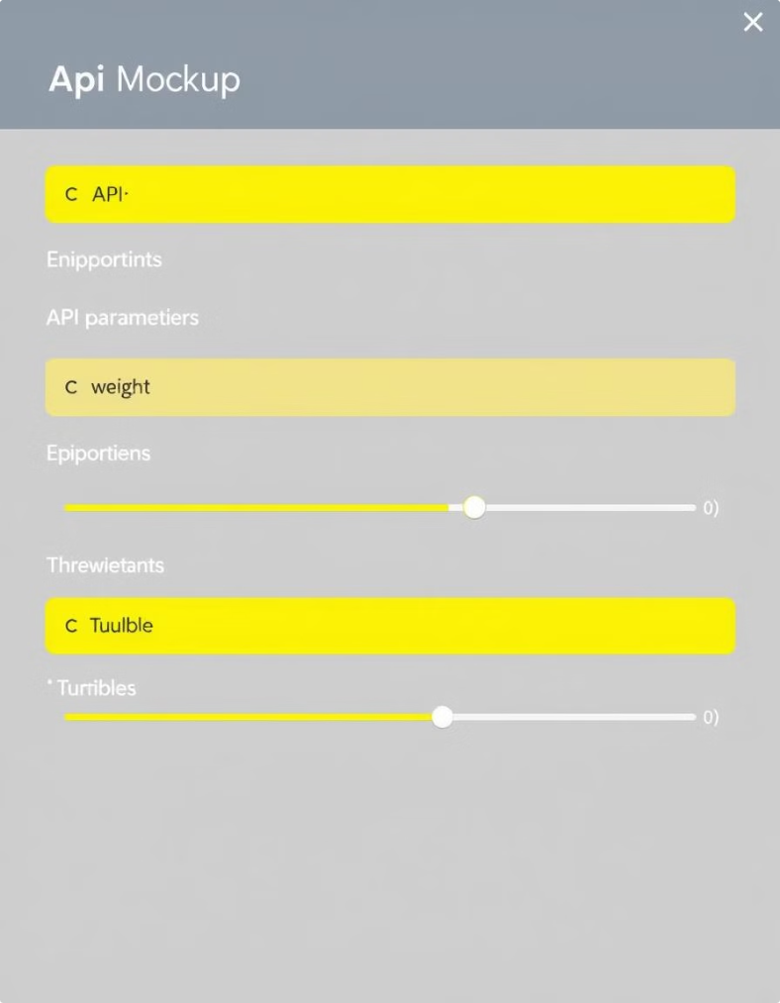
Tunable Parameters & Endpoints
1
Tunable Parameters:
2
Two POST Endpoints:
tfidf_weight & fuzzy_weight (configurable via URL query parameters)
/update_farmer_registration: processes farmer_registration table
Example Usage:
/update_farmer_details: processes farmer_details table
API Call: /update_farmer_registration?tfidf_weight=0.5&fuzzy_weight=0.5
3
Minimum matching threshold: 0.45 (Adjustable)
Different weights improve accuracy for various datasets
Batch processing with commit intervals for efficiency

Slide 10
API Workflow
1. Retrieve names from DB and normalize them
2. Generate phonetic codes using double metaphone
3. Transform codes into vectors with TF-IDF
4. Compute cosine similarity and fuzzy similarity scores
5. Combine scores using tunable weights
6. Update DB with match flags and accuracy scores

Slide 11
Benefits & Customer Value
1
High accuracy in matching names with spelling variations and typos
2
Fully customizable parameters to suit different business needs
3
Scalable and efficient batch processing
4
Flexible endpoints for different datasets

Slide 12
Conclusion & Next Steps
Our API combines advanced normalization, phonetic matching, TF-IDF, and fuzzy matching
Tunable parameters allow fine-tuning for optimal performance
Ready for deployment to improve data quality and customer satisfaction
Q&A and further customization discussions are welcome!

