Slide 1

HALO SNEWS report at Neutrino 2012
June 8, 2012
Clarence J. Virtue

Slide 2
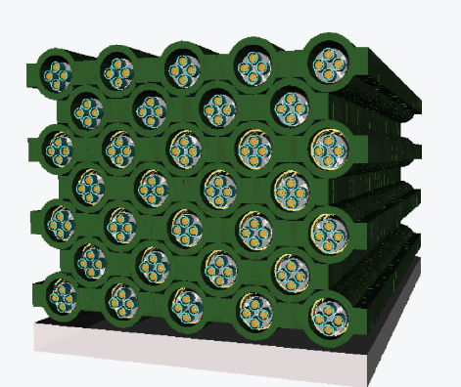
HALO - a Helium and Lead Observatory
A “SN detector of opportunity” / An evolution of
LAND – the Lead Astronomical Neutrino Detector,
C.K. Hargrove et al., Astropart. Phys. 5 183, 1996.
“Helium” – because of the availability of the ³He neutron detectors from the final phase of SNO
+
“Lead” – because of high ν-Pb cross-sections, low n-capture cross-sections, complementary sensitivity to water Cerenkov and liquid scintillator SN detectors
HALO is using lead blocks from a decommissioned cosmic ray monitoring station

Slide 3
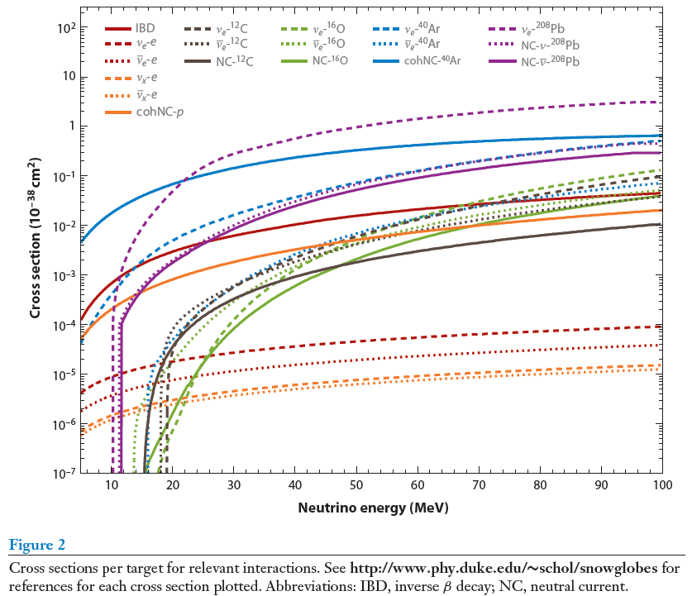
Comparative ν-nuclear cross-sections
Kate Scholberg
SNOwGLoBES

Slide 4
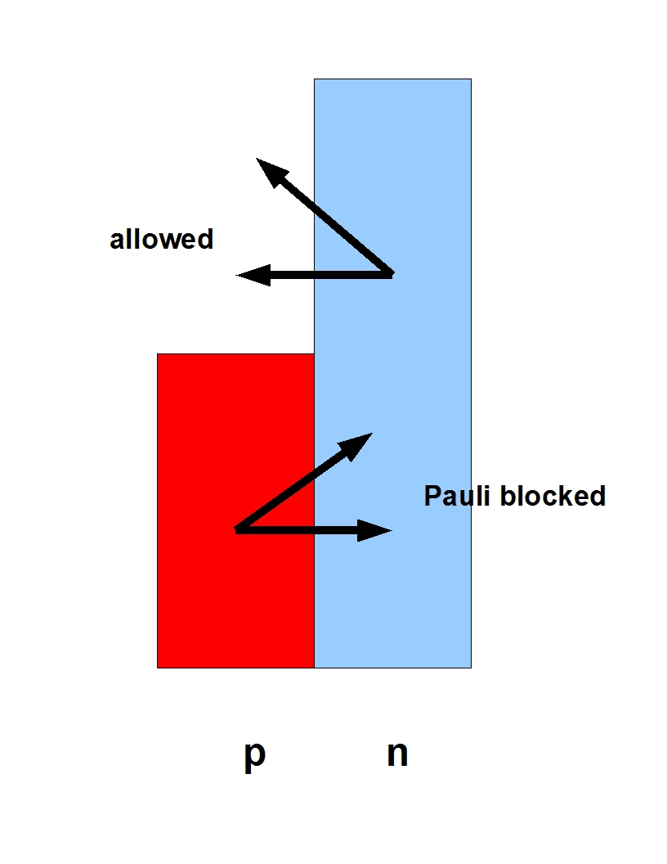

Pb nuclear physics
High Z increases ν_{e} CC cross-sections relative to ν_{e} CC and NC due to Coulomb enhancement.
CC and NC cross-sections are the largest of any reasonable material though thresholds are high ( CC-1n: 10.3 MeV, CC-2n: 18.4 MeV, NC-1n: 7.4 MeV, NC-2n: 14.1 MeV)
Neutron excess (N > Z) Pauli blocks
further suppressing the ν_{e} CC channel
Results in flavour sensitivity complimentary to water Cerenkov and liquid scintillator detectors
Other Advantages
High Coulomb barrier → no (α, n)
Low neutron absorption cross-section (one of the lowest in the table of the isotopes) → a good medium for moderating neutrons down to epithermal energies

Slide 5
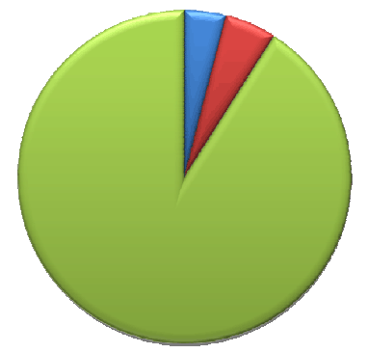
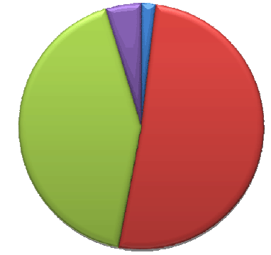
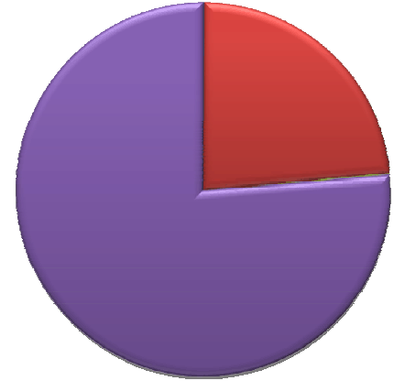
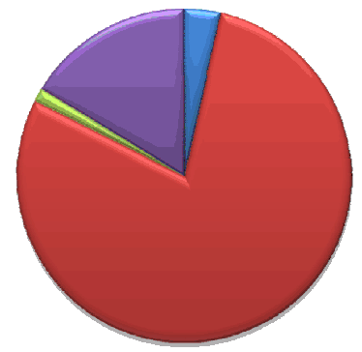
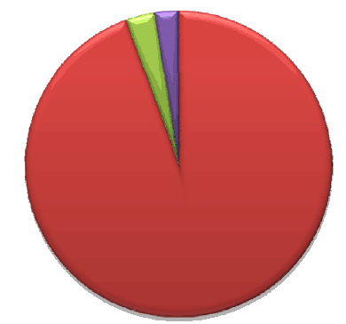
Flavour Sensitivities
Water
Cherenkov
Liquid
Scintillator
νe CC
NC
νe CC
NC
ES
ν_{e} CC
ν_{e} CC
Lead
Liquid
Argon
(needs updating
for large θ₁₃)
NC
NC
Iron

Slide 6
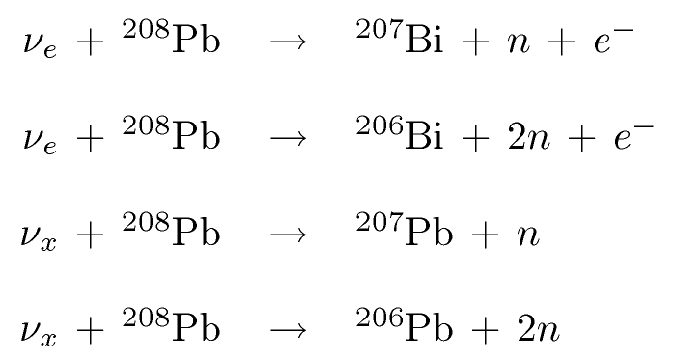
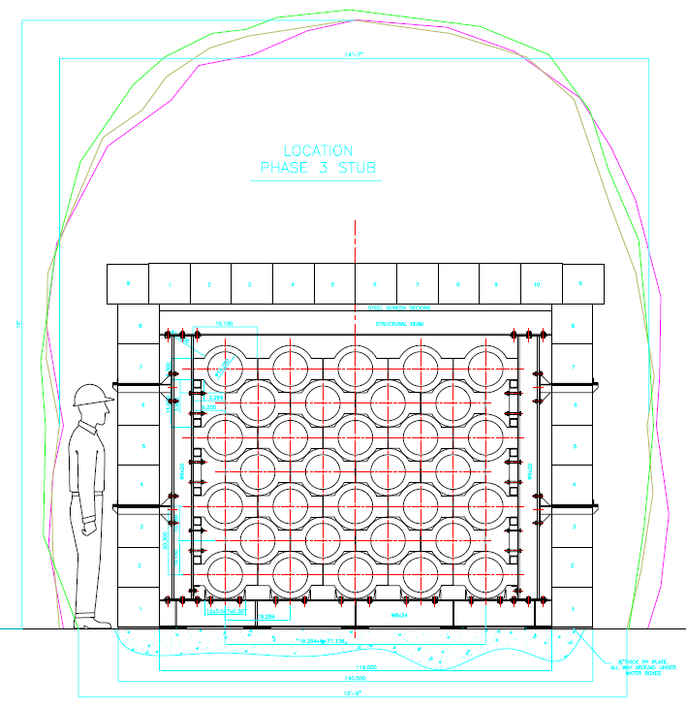
Supernova signal
CC:
NC:
In 79 tonnes of lead for a SN @ 10kpc†,
Assuming FD distribution with T=8 MeV for ν_{μ}’s, ν_{τ}’s.
68 neutrons through ν_{e} charged current channels
30 single neutrons
19 double neutrons (38 total)
20 neutrons through ν_{x} neutral current channels
8 single neutrons
6 double neutrons (12 total)
~ 88 neutrons liberated; ie. ~1.1 n/tonne of Pb
†- cross-sections from Engel, McLaughlin, Volpe, Phys. Rev. D 67, 013005 (2003)
For HALO neutron detection efficiencies of 50% have been obtained in MC studies optimizing the detector geometry, the mass and location of neutron moderator, and enveloping the detector in a neutron reflector.

Slide 7
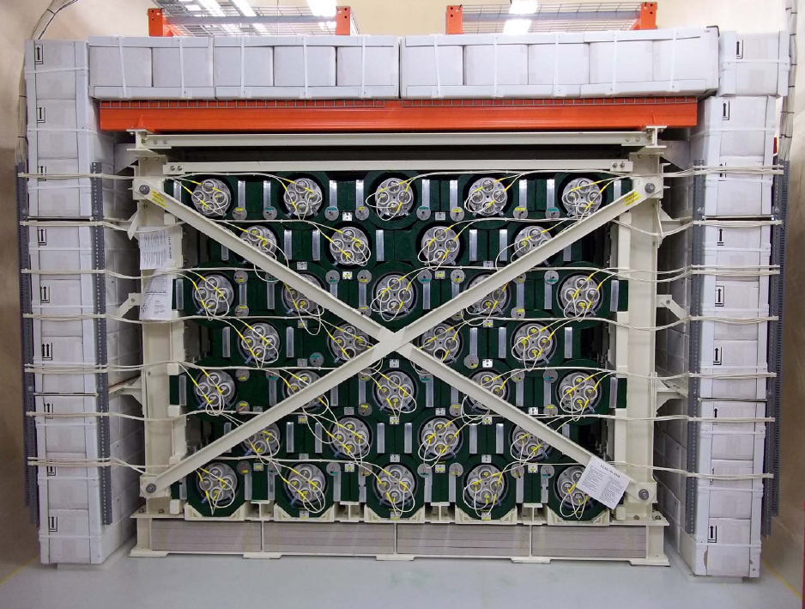
Status today
4/5th of shielding in place
Cabling complete
Readout complete
HV on all channels and full detector being read-out since May 8th 2012.
Upgrade of electronics pending
Calibration / characterization started
Plans
shielding compete in June
Participate in SNEWS by year end

Slide 8
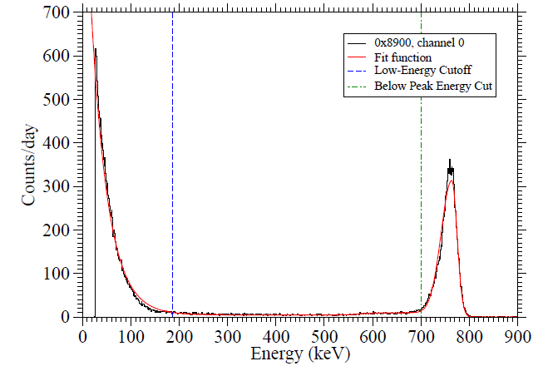
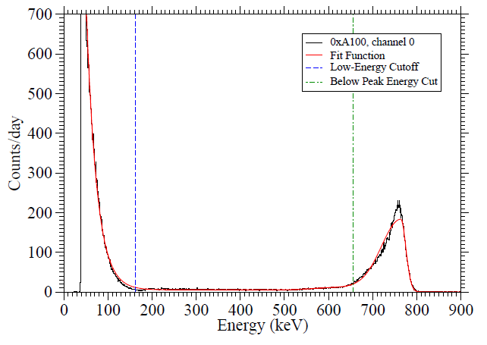
Performance
Preamp / ADC pairing with best resolution (left)
Preamp / ADC pairing with best γ / n separation (right)

Slide 9
Backgrounds and SNEWS
A trigger condition of 6 neutrons in a 2 second window gives sensitivity out to ~20 kpc (for T=8 MeV for ν_{”μ”} )
Fast and thermal neutrons in SNOLAB occur at 4000 and 4100 neutrons/m²/day respectively
A background event rate of 150 mHz from all sources will randomly satisfy the trigger condition once per month. We take this as the target false alert rate for SNEWS (presently at 170 mHz with partial shielding)
Bulk α contamination in the CVD nickel tubes gives a negligible 22 +/- 1 events in neutron window per day for the whole array
(α, n) reactions not simulated in the HALO GEANT MC but the threshold in Pb is 15.2 MeV
Cosmic ray muon rate is < 2 per day. Rate of spallation events not yet calculated.

Slide 10
Summary
HALO is effectively complete and continuous operation of the full detector began on May 8th providing sensitivity to the ν_{e} and ν_{x} components of a supernova
HALO will participate in SNEWS once the behaviour of the detector is well understood
Experience gained will feed into the design of a next generation detector taking advantage of the scalability of the lead plus neutron detector technology

Slide 11

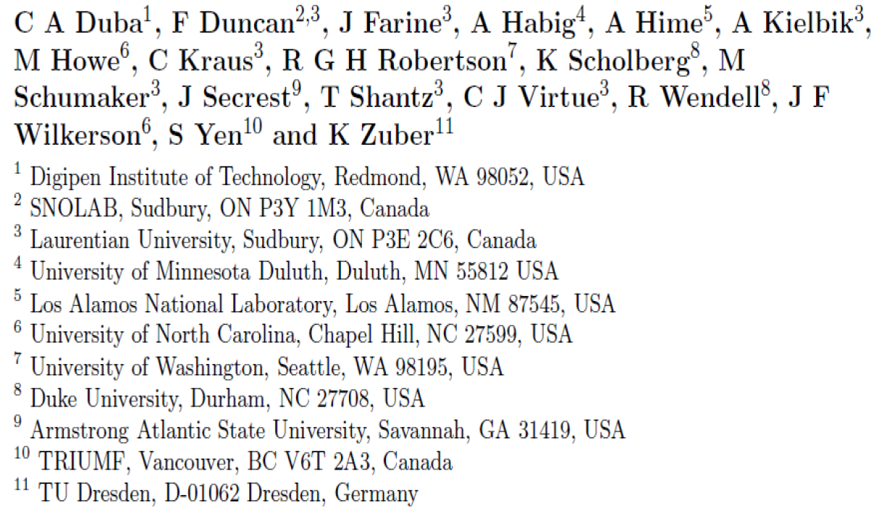







The HALO Collaboration
With assistance this past year from:
Kurt Nicholson – Guelph U.
Axel Boeltzig – TU Dresden
Ben Bellis, Leigh Schaefer, Zander Moss – Duke U.
Victor Buza, Olivia Zigler – U. Minnesota Duluth
Brian Redden – Armstrong Atlantic State U
Thomas Corona – U. North Carolina
Andre-Philippe Olds – Laurentian U.

