Slide 1
LVD
Status Report
C. Vigorito
on behalf of the LVD Collaboration
University and INFN Torino, Italy
SNEWS General Meeting, Neutrino 2006 Santa FE
C. Vigorito, University & INFN Torino, Italy

Slide 2
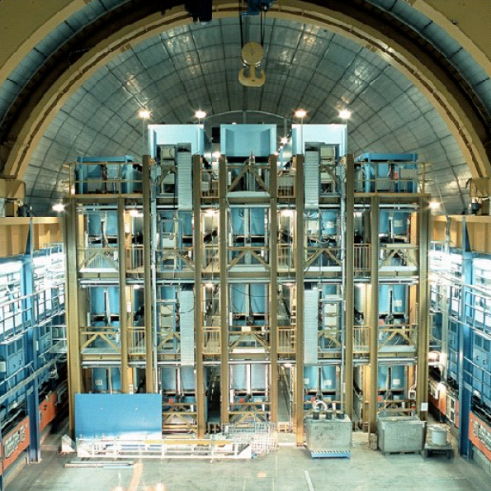
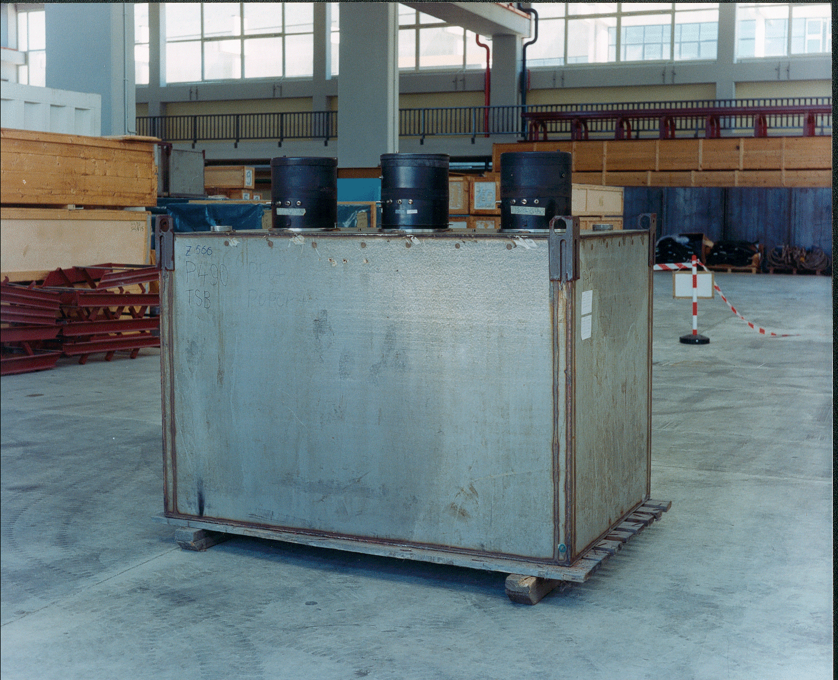
1 kton scintillator detector for ν astronomy
15 years 1992-2006
840 Counters x 3 PMTs
Structure 0.7 kton of iron
Trigger: 3-fold coincidence of counter PMTs
Energy Threshold: ~5 MeV + 1 ms active gate at ~1 MeV
Resolution: 15% at 10 MeV
External dimensions: 1.5 x 1 x 1 m³
Scintillator composition:
C_{n}H_{2n+2} <n>=9.6 +1 g/l PPO + 0.03 g/l POPOP
Density: ~ 0.8 g/cm³
Attenuation lenght: > 15m @ λ=420 nm
SNEWS General Meeting, Neutrino 2006 Santa FE
C. Vigorito, University & INFN Torino, Italy

Slide 3
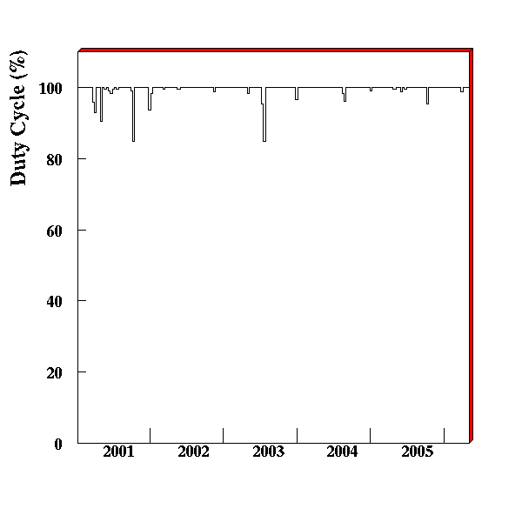
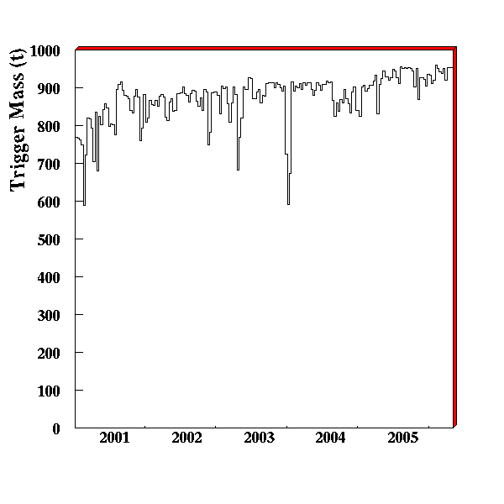
Data Acquisition Uptime
Last LVD run
5 Feb 2005 -13 Apr 2006
Uptime: 99.98 %
Trigger Mass: 940 tons
LVD Recalibration
Year 2004
Uptime: 99.6 %
Trigger Mass: 880 tons
Trigger Mass
SNEWS General Meeting, Neutrino 2006 Santa FE
C. Vigorito, University & INFN Torino, Italy

Slide 4
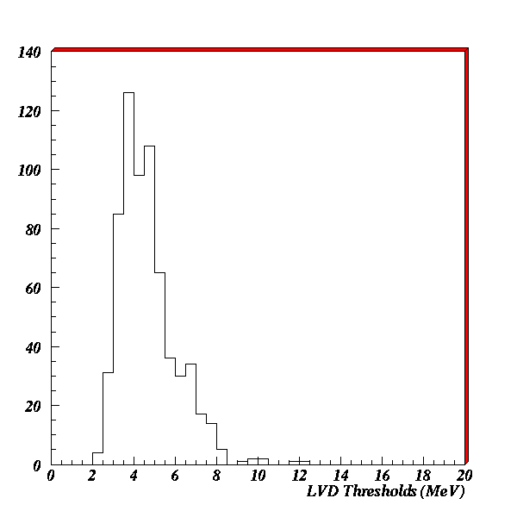
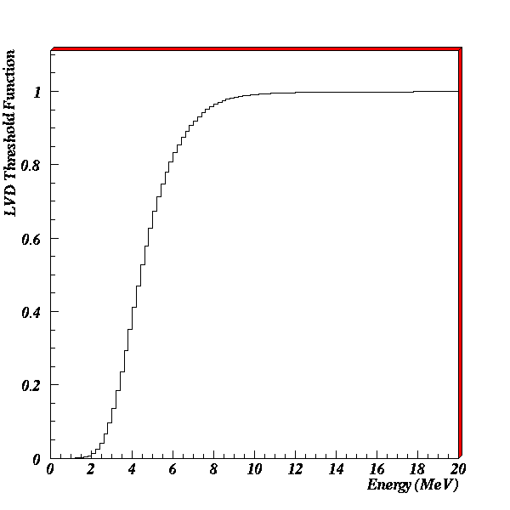
LVD Energy Threshold
By processing single counter spectrum
LVD Mean Threshold: 5 MeV @ 50 %
SNEWS General Meeting, Neutrino 2006 Santa FE
C. Vigorito, University & INFN Torino, Italy

Slide 5
Search for SN burst (Poster on this subject)
Performed twice:
on-line: to generate prompt alert to SNEWS
off-line: to check LVD data
Input: trigger sequence in the 7-100 MeV range
STEP 1 Candidates Selection
Statistical analysis of clusters / Imitation Frequency IMF estimated from background rate
Candidates thresholds:
IMF<1 event/day Monitor purposes
IMF<1 event/month Alert to SNEWS
IMF<1 event/year Burst to be checked
IMF<0.01 event/year LVD standalone Alert
SNEWS General Meeting, Neutrino 2006 Santa FE
C. Vigorito, University & INFN Torino, Italy

Slide 6
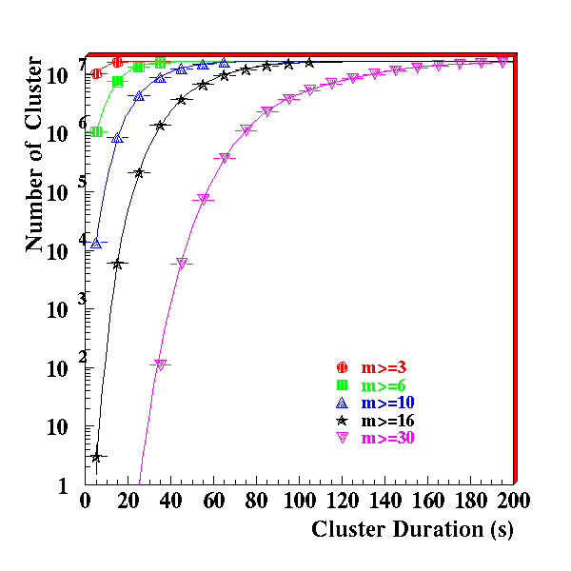
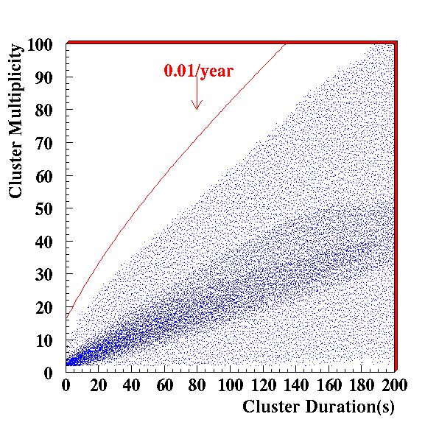
Last LVD Run / 430 days
Poissonian behaviuor of LVD rate
Last LVD RUN
3 Burst candidates, IMF ranging from 0.5 to 0.8 event/year
SNEWS General Meeting, Neutrino 2006 Santa FE
C. Vigorito, University & INFN Torino, Italy

Slide 7
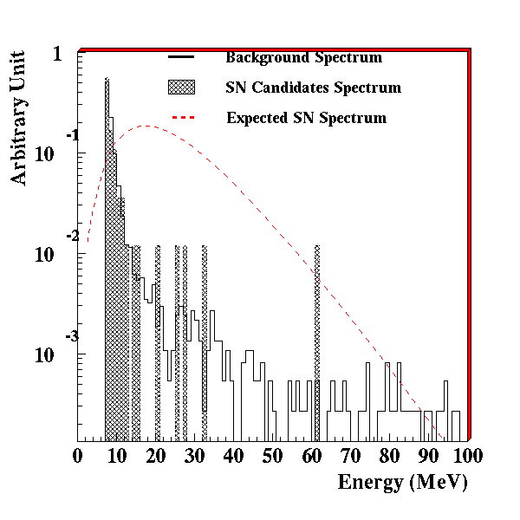
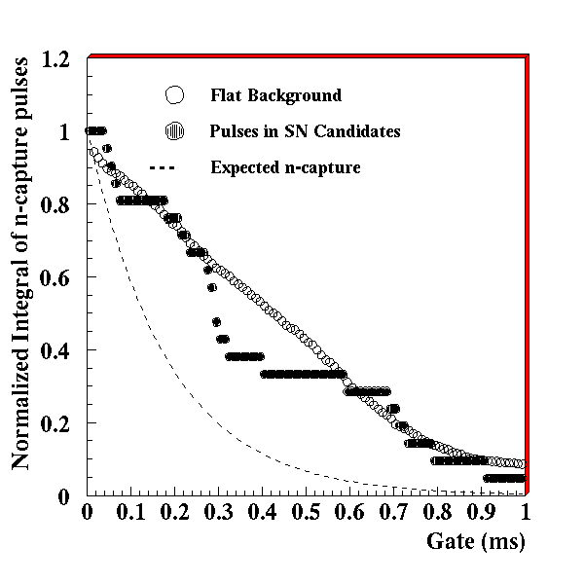
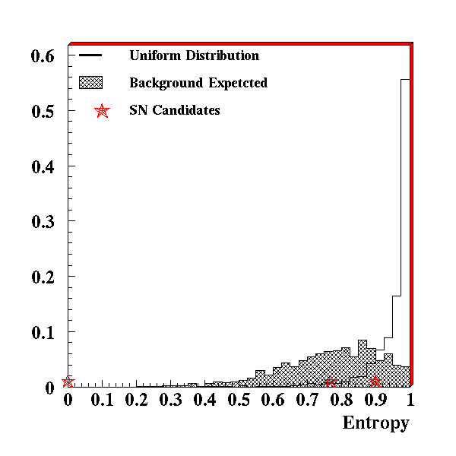
STEP 2 Candidates Analysis
By:
energy spectrum,
time distribution of delayed γ-pulses due to n-capture,
topological distribution of pulses in inner counters (57%) and outer shell (43%).
No candidate survives the selection in the shown data sample
No SN signal has been detected so far: 4503 days of observation
Upper Limit to the SN rate in the galaxy is
0.18/year (90% c.l.).
SNEWS General Meeting, Neutrino 2006 Santa FE
C. Vigorito, University & INFN Torino, Italy

Slide 8
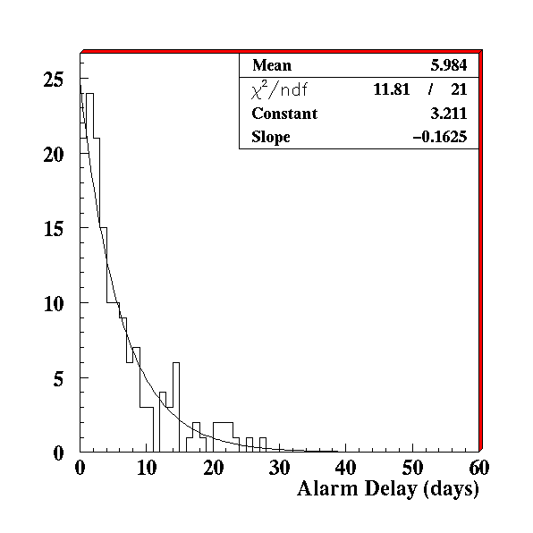
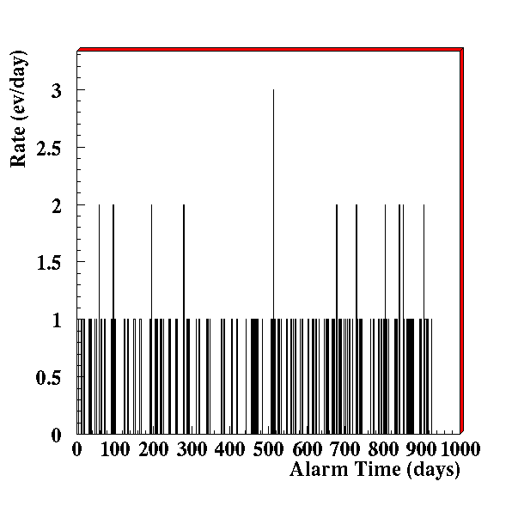
LVD Alerts TO SNEWS
Continuous sending over almost 3 years (Jul. 2002, Feb. 2005)
Stable alert selection at ~1/week threshold
Since Feb 2005 @ 1ev/month
17 Alerts sent
SNEWS General Meeting, Neutrino 2006 Santa FE
C. Vigorito, University & INFN Torino, Italy

Slide 9
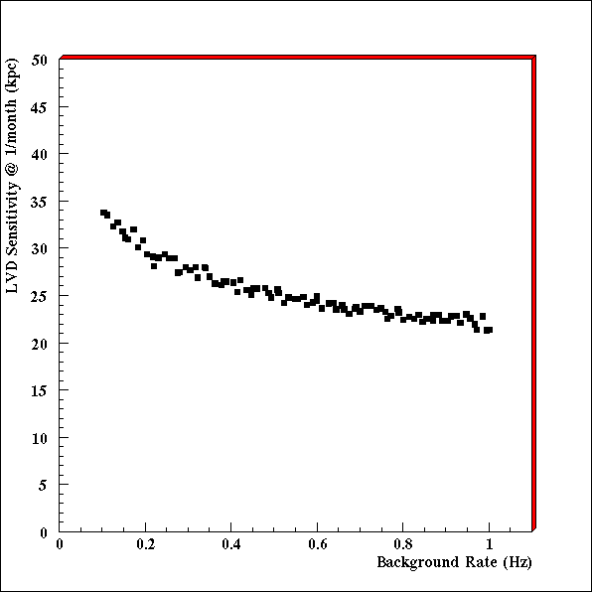
Sensitivity of LVD SN monitor
Depends on:
Selection Technique - study of event multiplicity (m) in fixed time windows Δt=20 s starting at t_{o} (and t_{o}+10 s, over sampling)
LVD Features - background rate and trigger mass
Expected events from SN - 150 events @ 10 kpc / 1 kton (normalized to SN1987A observation)
Alert threshold – 1ev/month
1 kton
90% c.l.
All trigger in 7-100 MeV range
SNEWS General Meeting, Neutrino 2006 Santa FE
C. Vigorito, University & INFN Torino, Italy

Slide 10
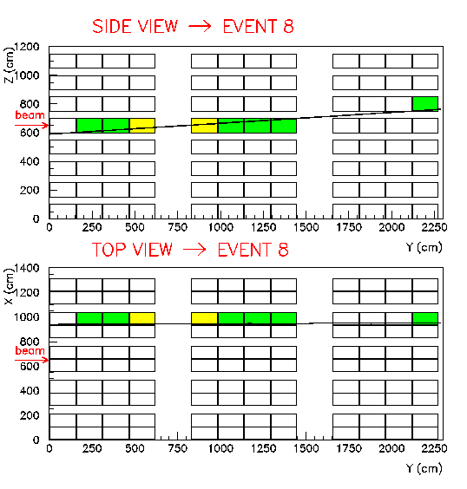
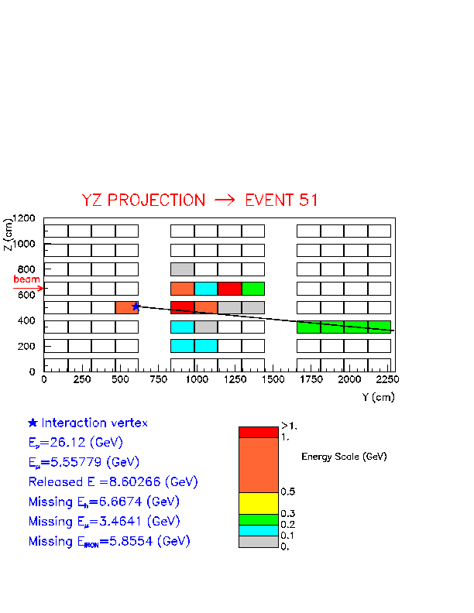
FUTURE-CNGS Beam Monitor
Beam commissioning delayed 1 month / First events expected end of July
LVD monitor almost ready /Simulation & Monitor
Detected muons from the rock | ~ 120 / day
Detected internal events in LVD | ~ 30 / day
Detected CNGS events in LVD (rock muons + internal neutrinos) | ~ 150 / day
μ from rock
Internal ν CC
SNEWS General Meeting, Neutrino 2006 Santa FE
C. Vigorito, University & INFN Torino, Italy

Slide 11
SNEWS General Meeting, Neutrino 2006 Santa FE
C. Vigorito, University & INFN Torino, Italy

