Slide 1
SNO & SNEWS
SN signal in SNO during NCD phase
SNO’s Supernova Trigger
SNO’s response to a Supernova Trigger
SNO’s interaction with SNEWS - current
Operational Mode

Slide 2
Monte Carlo Results for SN @8.5kpc
In 1.4K tonnes of H₂O
Reaction | #Events (NCD phase) | Energy | Time | Pointing
CC: ν_{e}+p→n+e⁺ | 443 | Y | Y | *
ES: ν_{e}+e⁻→ν_{e}+e⁻ | 15 | ~ | Y | Y
ES: ν_{e}+e⁻→ν_{e}+e⁻ | 4 | ~ | Y | Y
ES: ν_{μ,τ}+e⁻→ν_{μ,τ}+e⁻ | 8 | ~ | Y | Y
_
* - weak, energy
dependent, changes
sign, sums to ~
isotropic
_
_
In 1.0K tonnes of D₂O
Reaction | #Events (NCD phase) | Energy | Time | Pointing
CC: ν_{e}+d→p+p+e⁻ | 112 | Y | Y | *
CC: ν_{e}+d→n+n+e⁺ | 134 | Y | Y | *
NC: ν_{e}+d→ν_{e}+p+n | 24 | N | ~Y | N
NC: ν_{e}+d→ν_{e}+p+n | 24 | N | ~Y | N
NC: ν_{μ,τ}+d→ν_{μ,τ}+p+n | 116 | N | ~Y | N
ES: ν_{e}+e⁻→ν_{e}+e⁻ | 10 | ~ | Y | Y
ES: ν_{e}+e⁻→ν_{e}+e⁻ | 3 | ~ | Y | Y
ES: ν_{μ,τ}+e⁻→ν_{μ,τ}+e⁻ | 4 | ~ | Y | Y
_
Note:
ν_{μ,τ}= “ν_{μ,τ}”
= ν_{μ} + ν_{μ} + ν_{τ}+ ν_{τ}
_
_
_
_
_
_
_

Slide 3
SNO’s Supernova Trigger
SNO’s SN trigger has 3 levels
- level 1 is the online “burst” detection
- level 2 is a fast offline analysis applying data cleaning cuts
- level 3 is an offline analysis with full reconstruction
A “burst” is defined as a group of events which satisfies
the burst criteria of at least 30 events in a sliding
2 second window with NHIT > 35 PMTs (Energy > ~4MeV).
If >35% of burst events remain after the level 2 data cleaning cuts
the burst is considered “significant” and several additional
automated actions are launched including the level 3 analysis.
→ The SNO Burst Response Team becomes involved.

Slide 4
Significant Bursts – what happens
Automated Actions
e-mail to entire burst response team
e-mail to “Supernova logbook” on collaboration webserver
Burst Response team list passed to “dialout” computer
generation of wml and html pages with info on webserver
e-mails sent to cellphones with url to either wml or html pages
alert to SIC and SAC pagers (Detector experts)
level 3 analysis launched (includes data reconstruction)
Burst Response Team initiates a conference call
→ human intervention
This happens ~8 times per year due to large
spallation events plus a few times per year due
to operator error.

Slide 5
Burst Response Team
Objective: to get quorum on a conference call as quickly as possible
Group: SNTrigger: Fabrice Fleurot Mike Schwendener Jaret Heise Clarence Virtue
SNResponse: Fraser Duncan Art McDonald
Joe Formaggio Simon Peeters
Nick Jelley Alan Poon
Josh Klein Keith Rielage
Neil McCauley Peter Skensved
SIC/SAC Naeem Ahmed Noel Gagnon
Quorum: 2 from SN Trigger group, 2 from SNResponse group, SIC or SAC (5 people total)

Slide 6
Expected response from team -
“Manual” or “human intervention”
if possible get to computer and land phone line
dial into conference call which will include current detector operator
browse to burst analysis page in Supernova logbook
achieve quorum on call and start checklist
as level 3 analysis completes…
  e-mail analysis results to webserver
  e-mail to entire burst response team
  Decision – was this a supernova?

Slide 7
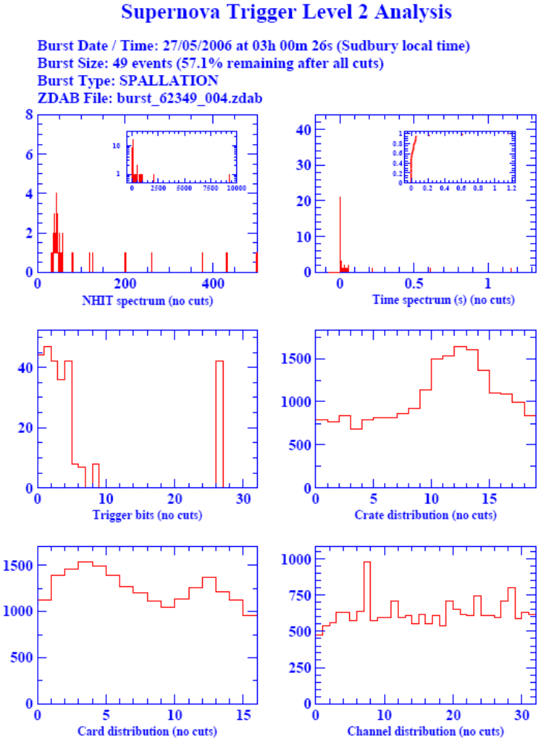
Level 2 analysis example

Slide 8
Conditions for Automated Alarm
Runtype = NEUTRINO
Muon Tag = NOT SET
NHIT>5000 Tag = NOT SET
UC Bit = OFF
CAST info = no source below z=1500
Bubbler Bit = OFF
% remaining > 35%
CCC Flatness cut = PASSED
D2O / H2O ratio cut = PASSED
Width / Mean cut = FAILED
Last Burst > ( 9 hours ago)

Slide 9
Interaction with SNEWS
In the event of a burst satisfying our SN criteria
SNO would automatically send a “GOOD” datagram to SNEWS
The entire “normal” manual response would be initiated in parallel (ie. e-mails, text messaging, pagers, dialout calls, and conference call)
IF the manual process concludes the burst is a supernova, THEN SNO sends an “CONFIRMED” datagram
IF the manual process concludes the burst is not a supernova, THEN SNO sends a “RETRACT” datagram

