Slide 1
NOvA Supernova Status
and SNEWS plans
Alec Habig, Andrey Sheshukov, Justin Vasel
SNEWS meeting
Heidelberg, June 8 2018

Slide 2
NOvA & SNEWS
NOvA has been triggering on SNEWS output for a couple years now
Will read out 45s of data if a SNEWS coincidence is found: a script is run on bnlboom after SNEWS emails are sent
Cronjob on bnlboom sends a short test trigger every minute, and a full length test trigger once per day
Triggering on a high-rate queue would be a far more robust test

Slide 3
NOvA Self Triggering
Since last November, NOvA has been self-triggering for SNe
See poster by Andrey Sheshukov & Justin Vasel https://indico.desy.de/indico/event/18342/session/35/contribution/326/material/poster/0.pdf
Has run stably, average of less than one trigger per week as desired
Next most common “false” mode now known, will be trapped this summer

Slide 4
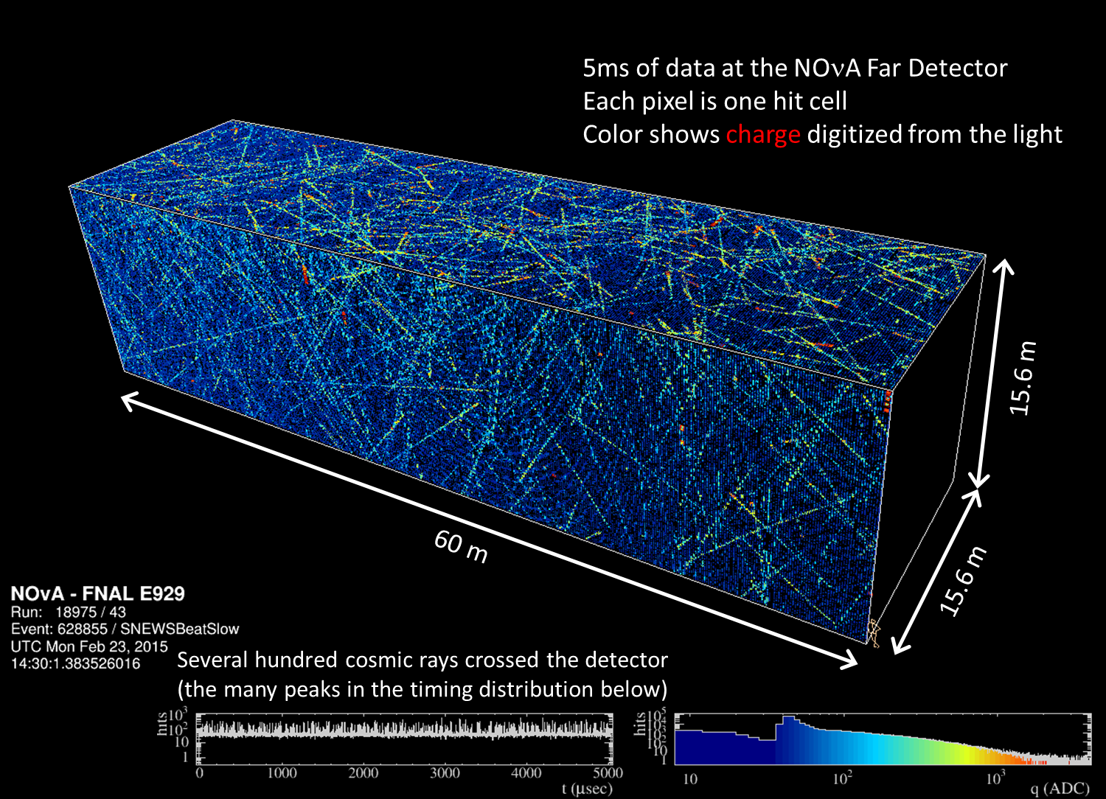
A 5ms block of Far Detector data

Slide 5
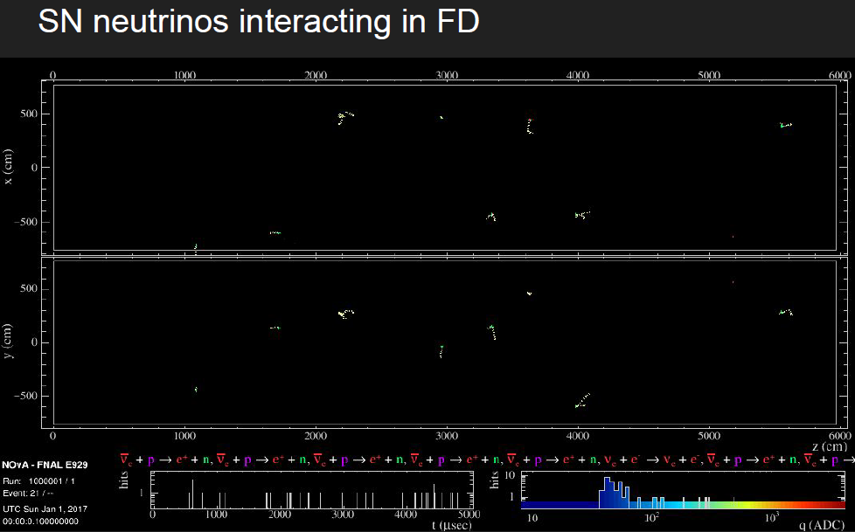
5ms of SN ν interactions
(Truth hits, not light)

Slide 6
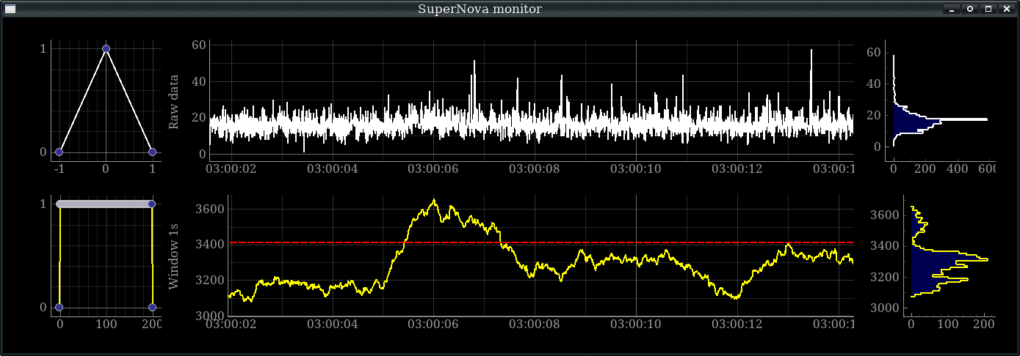
SN trigger
A central program keeps track of the time series of 5ms SN candidate rates
A 1s rolling average does a decent job of picking up a simulated SN, despite S/N per point of ~0.1
More sophisticated template will help, as will better calibrations in the trigger

Slide 7
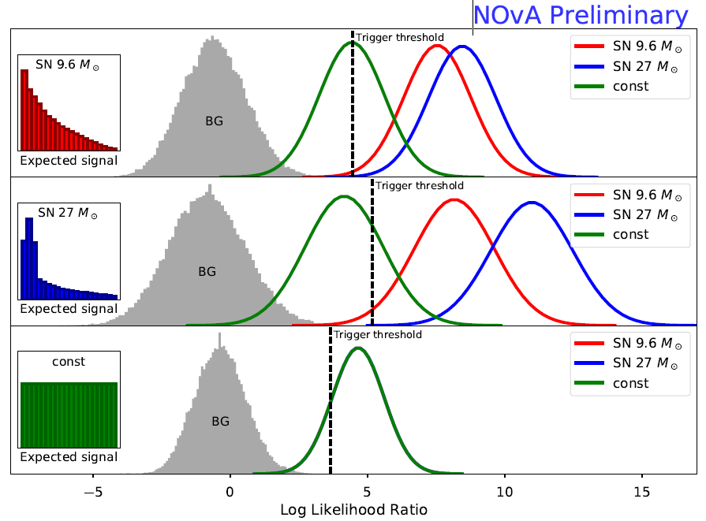
Shape of signal
Testing different “light curve” templates gives us more sensitivity at the cost of little extra noise

Slide 8
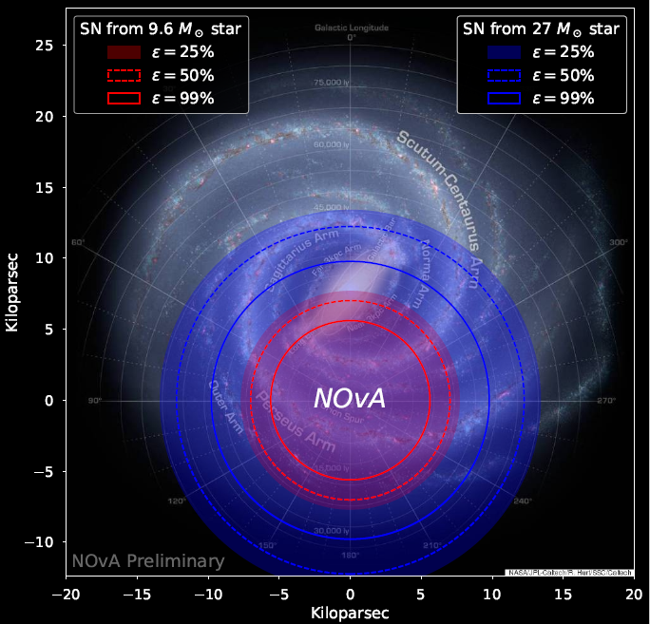
SN Sensitivity
Currently not sensitive to whole galaxy, but a decent chunk
Will read out all data in a [-5s,40s] window
Also triggered by external SNEWS coincidence
Improvements to be deployed this summer will further improve reach
This figure

Slide 9
Sending to SNEWS?
We will add the SNEWS code to the NOvA trigger this summer and test with the test server
After some time of stability doing that, NOvA would like to contribute to SNEWS for real

