Slide 1


Department of Mechanical Engineering
MECH 609 — Masters Seminar
Comparing Compliant Fin-Ray Fingers with Rigid Parallel-Jaw Grippers for Cloth Grasping under Depth and Tilt Variation
Shiyao Ni
M.Sc. Thesis · Supervisor: Prof. Audrey Sedal August 12, 2026

Slide 2
Context and Motivation
Who needs robots to pick up fabric?
Why it is still unsolved
• Garment manufacturing — still largely manual
• Commercial laundry, hospital bedding
• Assistive robots — dressing, household tasks
• Demos often start with a person handing over the object
• Picking flat cloth off a table = the skipped hard step
Context
2 / 19

Slide 3
Why Flat Cloth Defeats a Standard Gripper
• A flat ply presents no fixed shape to close a gripper around.
• Near-zero bending stiffness lets the fabric slip out of a misplaced jaw.
• A rigid jaw has roughly 1 mm of placement margin between missing the cloth and triggering the robot's safety stop.
• A flexible finger is the proposed fix — but when does flexibility actually help?
Problem Statement
3 / 19

Slide 4
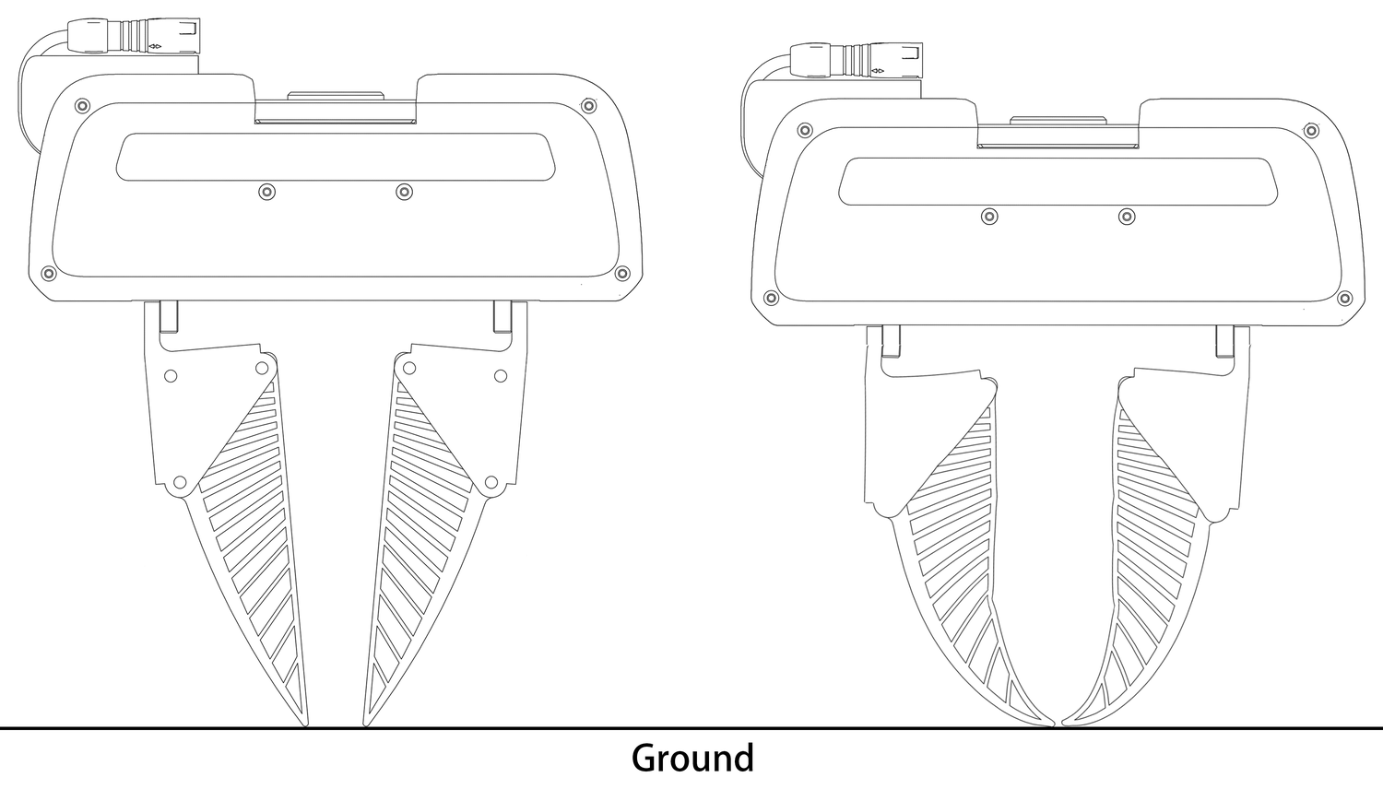
The Fin-Ray Finger
• A compliant structure inspired by fish-fin anatomy: flexible side walls connected by internal ribs — entirely passive, 3D-printed in a flexible thermoplastic (TPU).
• When pressed, it bends toward the load and wraps the contact surface — the opposite of a stiff beam.
At first contact the blades are straight (left); pressed deeper, they bend toward the load and wrap the ground (right).
Background
4 / 19

Slide 5
Prior Approaches: Make the Cloth Graspable First
• Wrinkle-directed grasping — detect and rank wrinkles in depth images of crumpled laundry, and send the gripper to the most graspable bump. (Ramisa et al., ICRA 2012)
• Edge and corner detection — segment cloth edges and corners, then execute a sliding grasp along the estimated direction. (Qian et al., IROS 2020)
• Dynamic state reset — a high-speed fling unfolds a crumpled cloth in a few actions, producing a flatter state before the pick. (Ha and Song, CoRL 2021)
• Feature-defined benchmarks — a household clothing set defining graspable textile features (edges, hems), with end-effectors scored on grasping them. (Clark et al., ICRA 2023)
All spend extra actions and sensing to create a feature — and offer no help when the cloth is already lying flat.
Literature Review
5 / 19

Slide 6
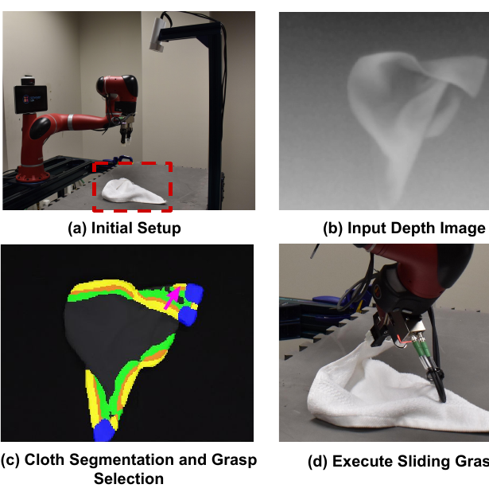
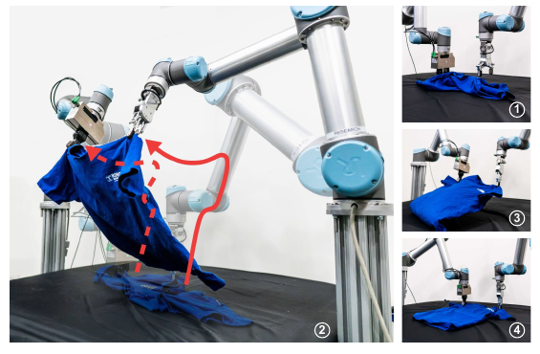
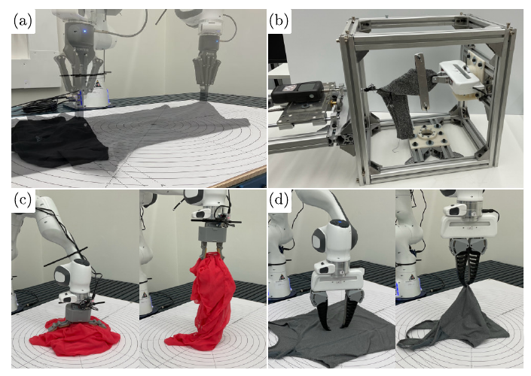
Make the Cloth Graspable — in Practice
Edge/corner segmentation, then a sliding grasp. Qian et al., IROS 2020.
A fling resets crumpled cloth to flat. Ha and Song, CoRL 2021.
Feature-defined cloth benchmarks. Clark et al., ICRA 2023.
Literature Review
6 / 19

Slide 7
Specialised End-Effectors: A Summary
• Needle and electrostatic textile grippers — industrial devices from garment manufacturing that pierce or electrostatically hold the top ply. (Monkman, IJRR 1995)
• Non-contact airflow handling — a Bernoulli-principle end-effector suspends a single garment ply on a radial air film. (Ozcelik and Erzincanli, Robotica 2002)
• Electroadhesion — electrically switchable adhesion; effective on delicate, flexible materials at low energy cost. (Guo, Leng, and Rossiter, IEEE T-RO 2020)
• Variable-friction fingertips — switch between high- and low-friction states to slide, pinch, and unfold fabric in-hand. (Jiang et al., IEEE RA-L 2022)
• Compliant-hand precedent — the Harvard SDM hand grasps despite positioning errors exceeding 100% of object size; success-range maps over an offset grid, on rigid objects. (Dollar and Howe, IJRR 2010)
Remaining gap: gripper comparisons on cloth are scored at the task level — still no map of grasp quality versus placement error (depth, tilt) across finger designs.
Literature Review
7 / 19

Slide 8
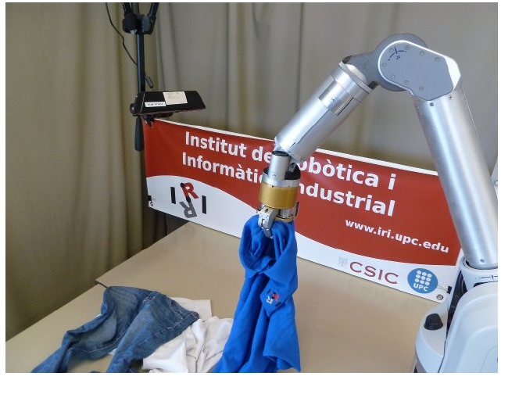
Specialised End-Effectors — and the Remaining Gap
Replace the gripper entirely
• Needles, electroadhesion, air jets, variable-friction fingertips
• Cost: single-purpose hardware, fabric damage risk
What is missing
• Gripper treated as fixed; effort goes to cameras & software
• Gripper comparisons: task-scored on cloth, or on rigid objects
• No map of grasp quality vs. placement error across finger designs
Wrinkle/collar-directed grasping of deformed clothes. Ramisa et al., ICRA 2012.
This work: keep the robot, the control policy, and the cloth identical — change only the finger, and map the result.
Literature Review
8 / 19

Slide 9
Questions This Work Answers
1. How does the contact force vary with press depth, for each finger design?
2. How much can the gripper be tilted before the grasp becomes unreliable?
3. Does tilt tolerance depend on the press depth?
4. Is the response to tilt symmetric — is tilting one way the same as tilting the other?
Objectives
9 / 19

Slide 10
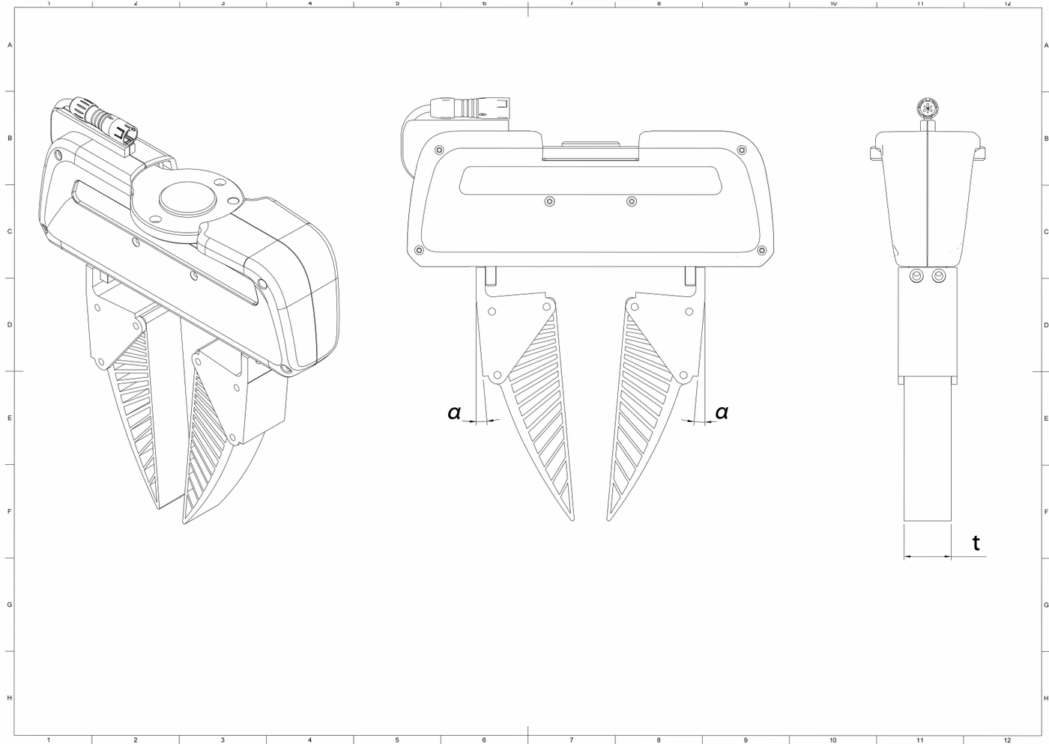
Test Platform: Six Fingers, One Robot
• Franka FR3 arm — force sensing via joint motors
• Rigid: stock metal jaws, ± thin rubber pad
• Fin-ray: thickness 18 / 26 mm; mount angle 2.5° / 5°
• + a second print of one finger (print variability)
• Same routine, cloth, and table for all six
Design variables: finger thickness t (side view) and mounting angle α (front view).
Methodology
10 / 19

Slide 11
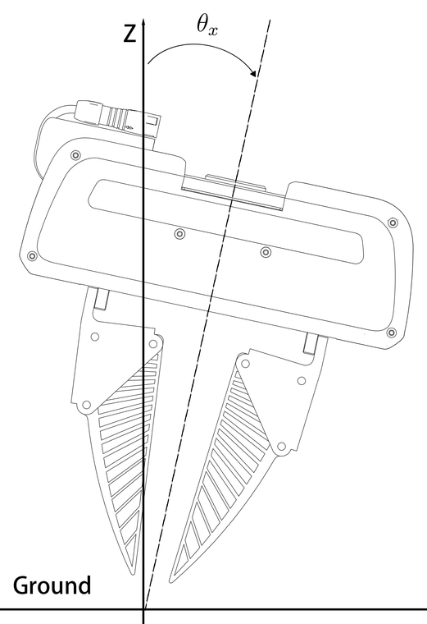
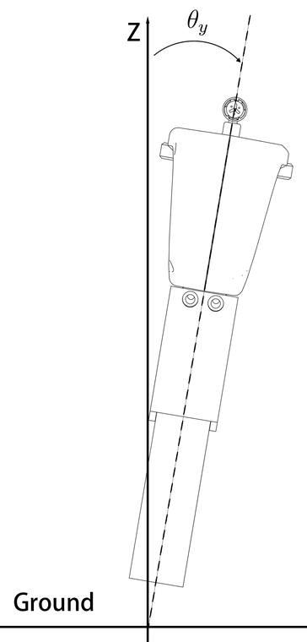
What We Vary: Press Depth and Tilt
• Depth d — fingertip driven below the surface (surface found by force touch-off, ±0.1 mm)
• Tilt — arm leaned ±2.5° from perpendicular; 0° = perpendicular to the table
• Measured — steady contact force F + held / not held
Tilt θx: leaning the arm sideways (front view).
Tilt θy: leaning along the gripping direction (side view).
Methodology
11 / 19

Slide 12
Trial Procedure and Data Set
1. Descend to 5 mm above the surface.
2. Slow final descent to the target depth.
3. Close the gripper on the cloth.
4. Hold still 1 s; record the contact force (30 samples).
5. Lift and record whether the cloth is held.
Data set
Gripper variants | 6
Curated benchmark trials | 204 (75 sessions)
Confirmed successful grasps | 139
Total trials on record | > 940
Tools: Franka FR3 arm, ROS 2, Python, Bambu Lab X1C printer. Experiment design, calibration, data collection, and analysis by the author.
Same arm, policy, cloth, surface — only the finger design changes.
Methodology
12 / 19

Slide 13
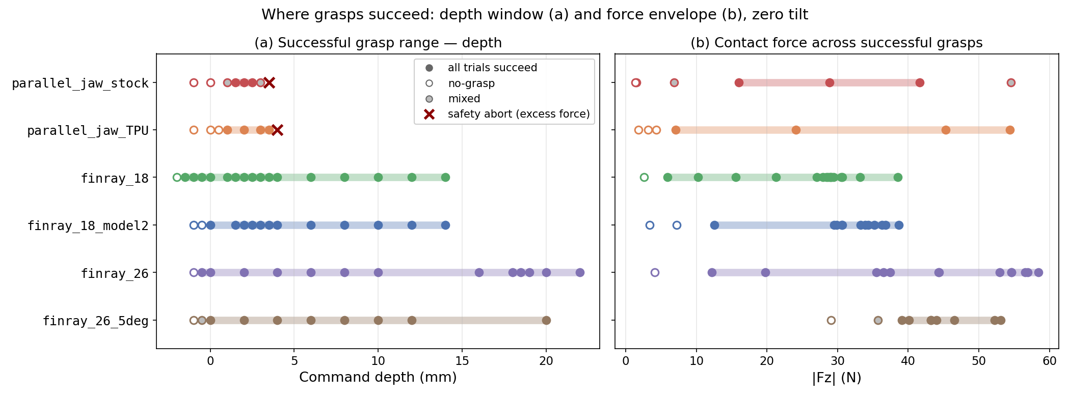
Result 1 — Where Grasps Succeed: Depth and Force
Per variant: (a) depths at which grasps succeed; (b) contact forces measured across those successful grasps.
Answer 1: rigid jaws succeed inside ≈ 1 mm and only at high force; fin-rays succeed across ≥ 12 mm — and from forces as low as ≈ 10 N.
Results
13 / 19

Slide 14
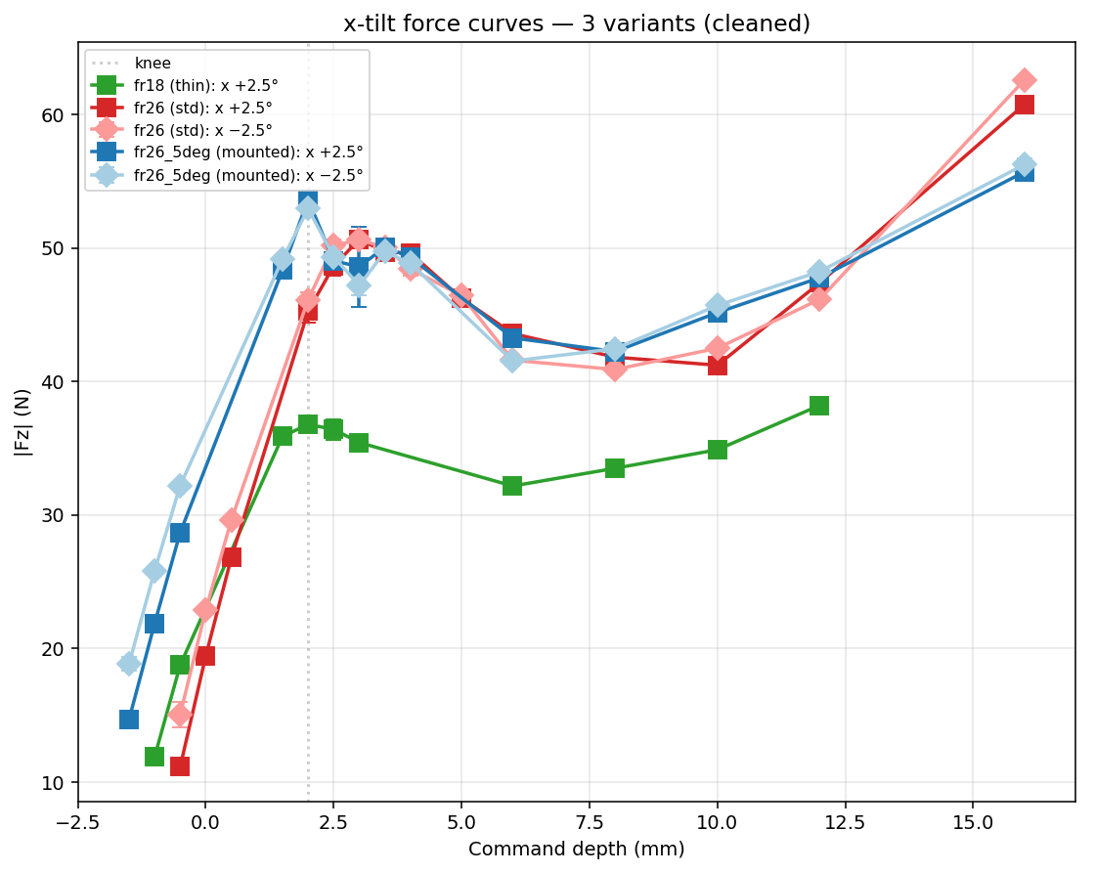
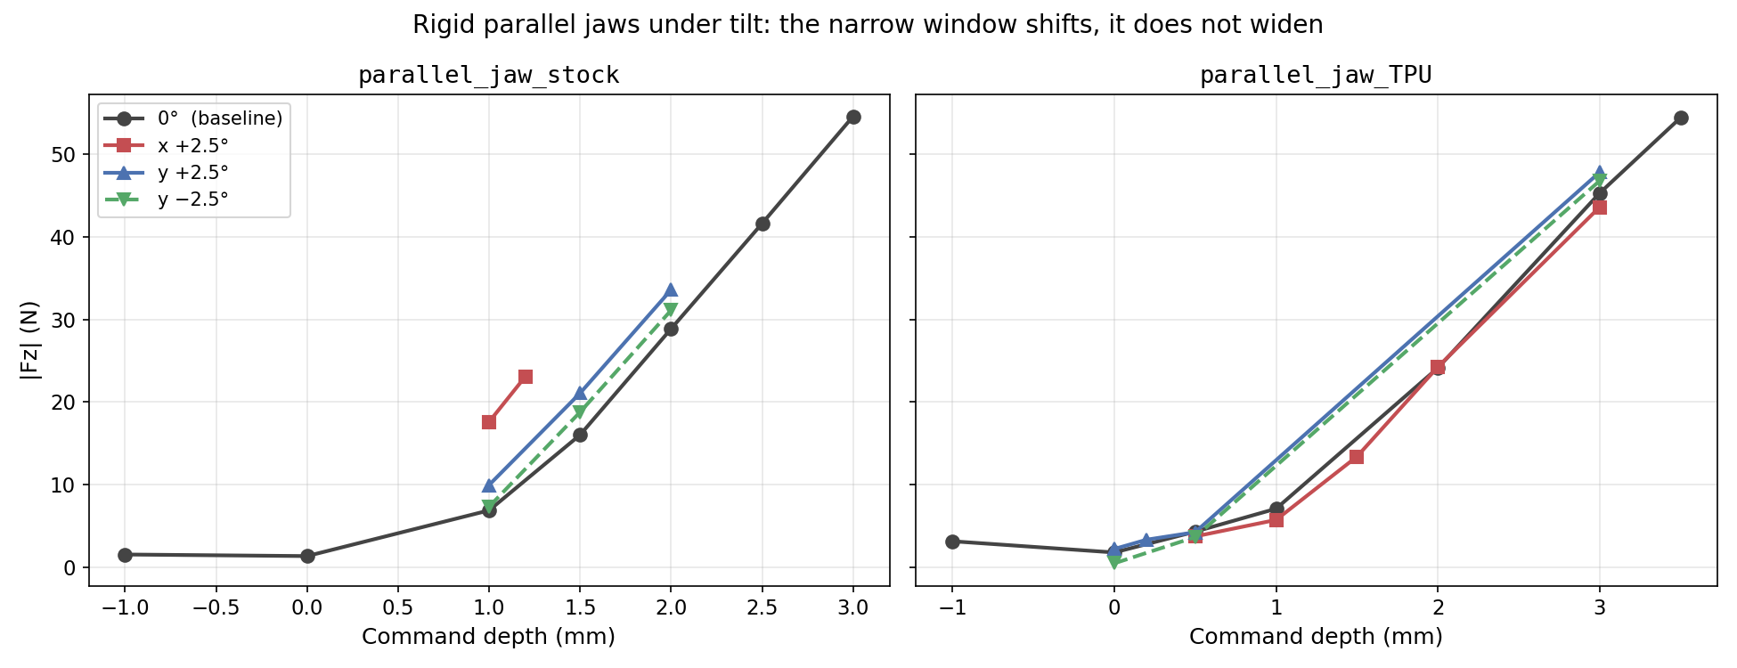
Result 2 — Working Range under Tilt
Rigid jaws under the same tilts: slope unchanged — the ≈1 mm window shifts, it does not widen.
Fin-rays under ±2.5° tilt: curves separate at shallow depth, converge at depth. Shallow: 5° tilt cuts force 58%; deep: 1%. Sign flip changes force 2.4× at shallow press only.
Answers 2–4: press deep enough and tilt sensitivity — including its direction dependence — essentially disappears.
Results
14 / 19

Slide 15
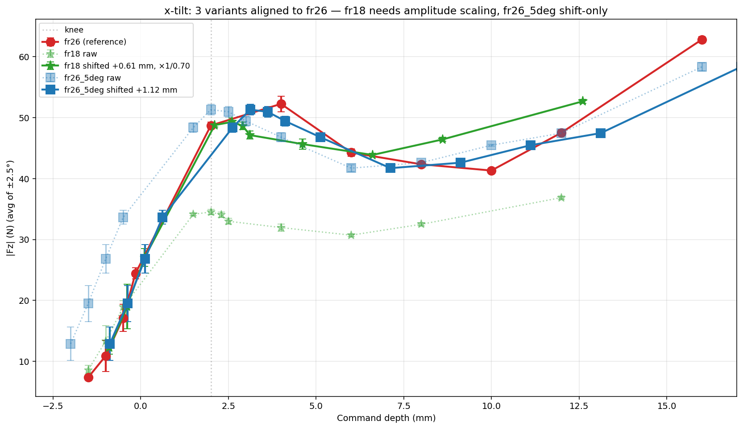
Result 3 — One Curve Shape for Every Fin-Ray
• Steep rise to a small peak (≈50 N near +2–4 mm) while the straight blades load at their tips
• Then the blades buckle outward — force dips into a shallow valley
• Deeper still, the wrapped blades re-engage and force climbs again
• The same peak–valley–rise shape appears on every fin-ray variant
All fin-ray variants aligned onto the 26 mm reference.
The curve shape is a property of the fin-ray architecture — thickness, seat angle, and print copy only shift and scale it.
Results
15 / 19

Slide 16
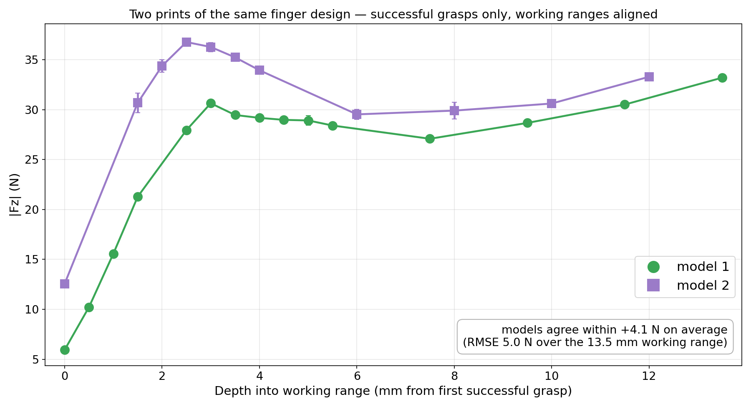
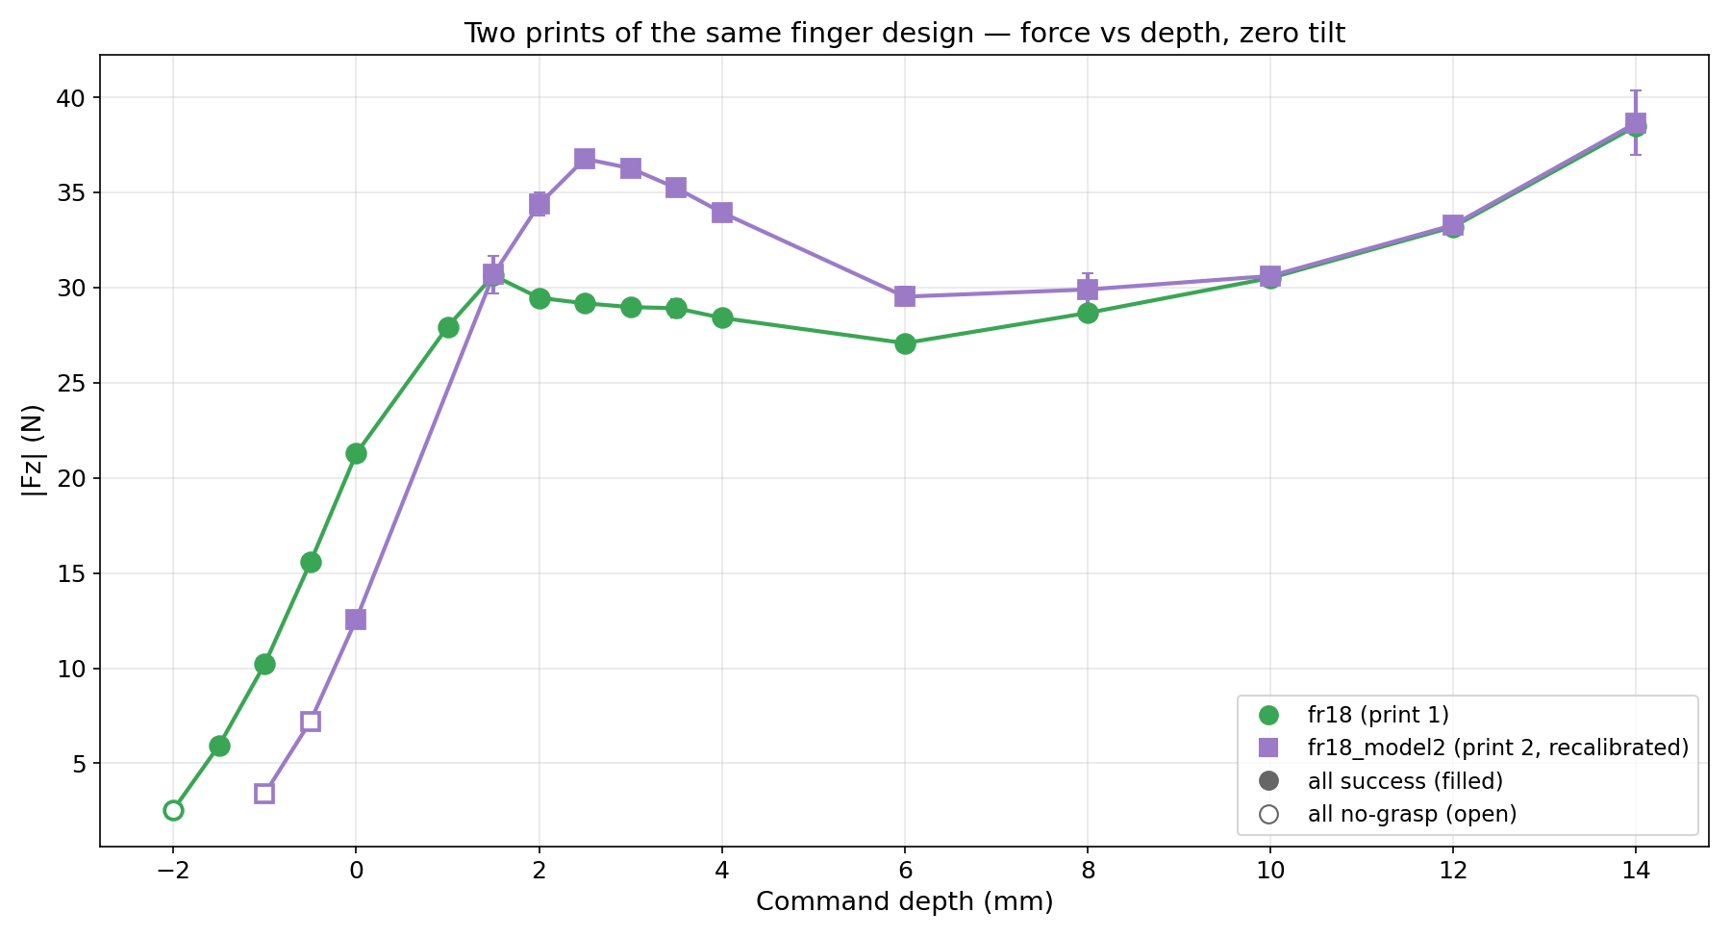
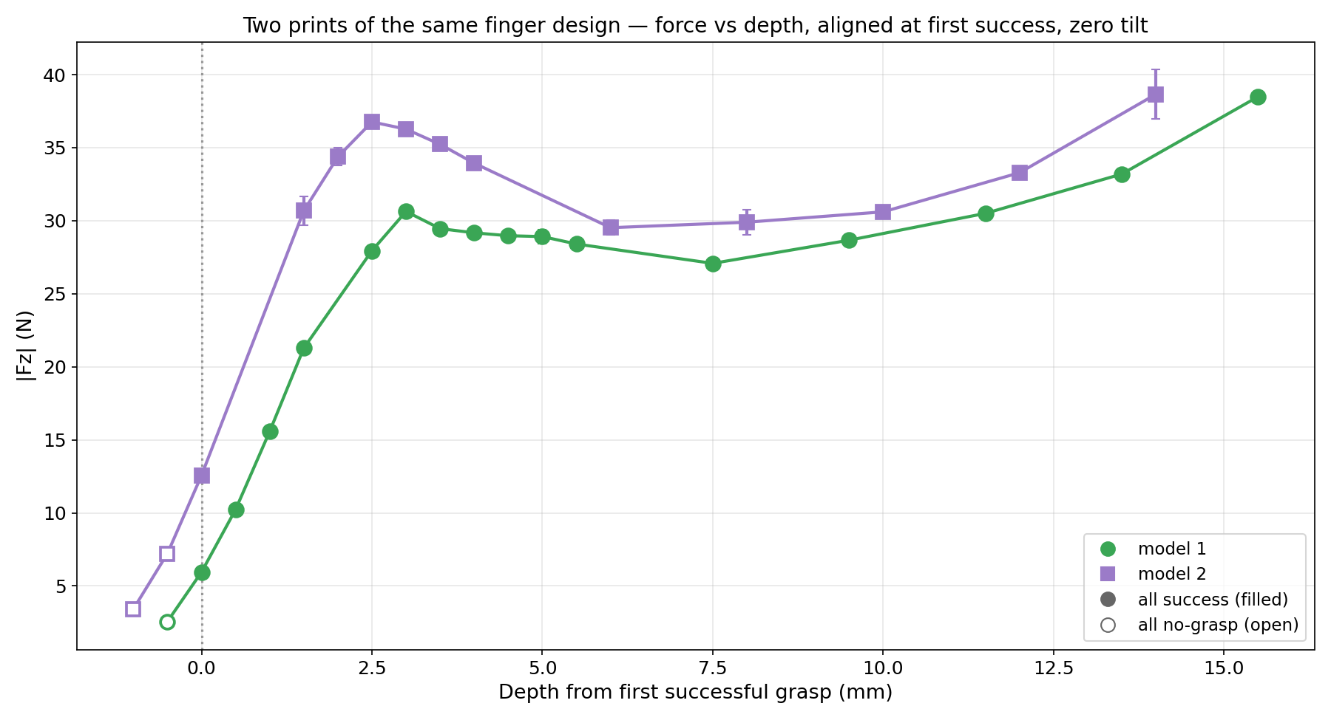
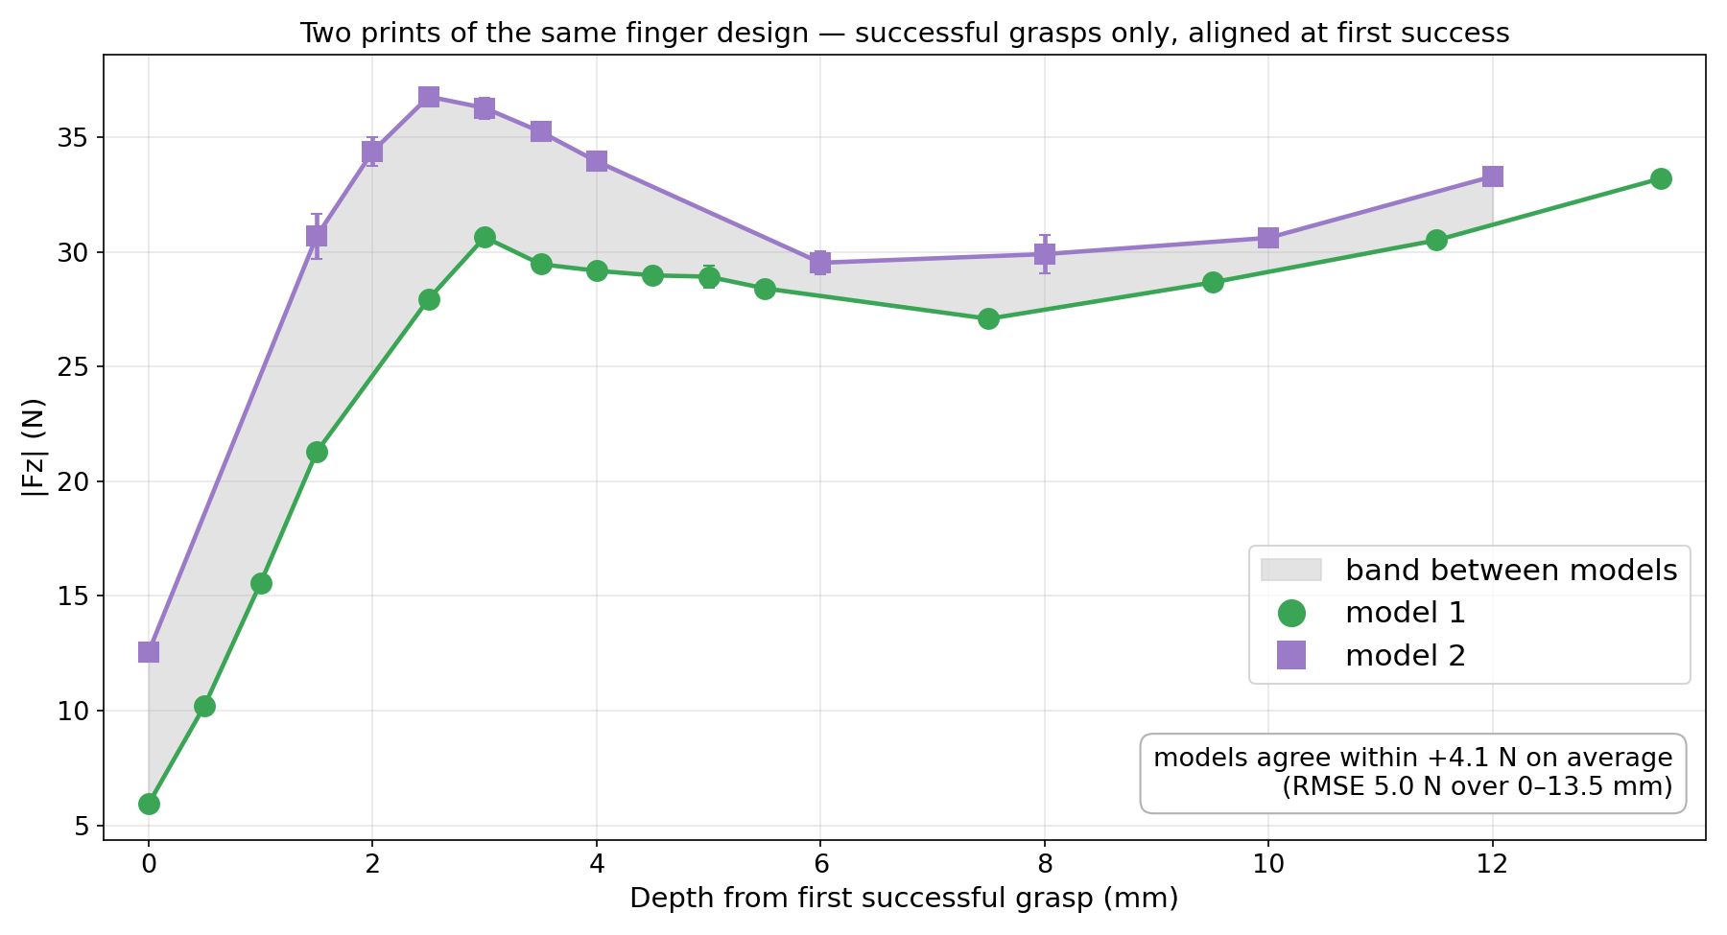
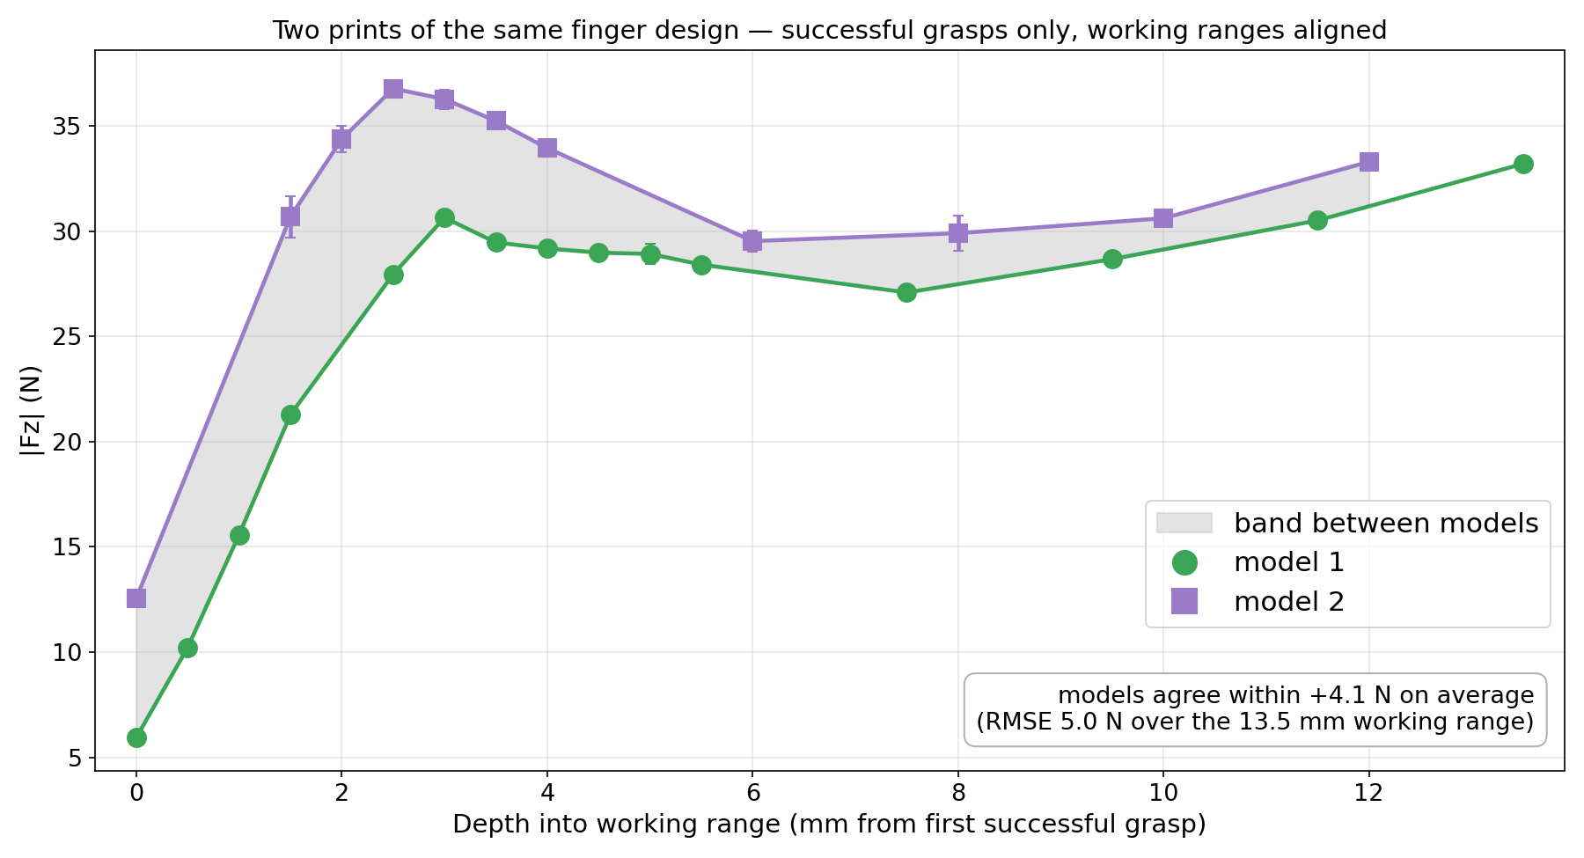
Result 4 — Print-to-Print, the Fin-Rays Are Nearly Identical
• Each model's working range aligned to start at 0
• Same peak–valley–rise shape; the two agree within +4.1 N on average (RMSE 5.0 N)
• Comparable to day-to-day sensor drift — small next to the depth effects (Results 1–3)
Successful grasps only; each model's working range aligned to start at 0.
Two prints of the same design behave nearly identically — manufacturing error does not change any conclusion of this study.
Results
16 / 19

Slide 17
What This Means in Practice
• A flexible finger buys a tenfold gain in placement tolerance from hardware alone — before any investment in cameras, sensing, or machine learning.
• But the benefit is conditional: the finger must be pressed past a threshold depth. Compliance is not a free pass at light contact.
• Systems that must touch delicately — near the contact boundary — still need to account for the finger's direction-dependent behaviour.
Discussion
17 / 19

Slide 18
Conclusions and Future Work
Conclusions
Future work
• Benchmark with finger design as the variable
• ≈ 10× wider depth window at half the force
• Tilt tolerance is depth-gated — incl. the direction asymmetry
• Task-level tests: fold, place, drag
• Mechanical model of the depth threshold
• Independent force-sensor cross-check
Conclusions
18 / 19

Slide 19
Department of Mechanical Engineering · MECH 609 — Masters Seminar
Thank you
Acknowledgements
Prof. Audrey Sedal — supervision · MACRObotics Lab
McGill Applied Dynamics Lab — in-house fr3_pose_controller (adl-ros2)
Shiyao Ni · MECH 609 Masters Seminar

