Slide 1


System Call Trace Record/Replay Project
Shubhi Rani - Stony Brook University Nina Brown - Harvey Mudd College
July 26, 2016
July 26, 2015
System Call Trace Record/Replay Project
<number>

Slide 2
Agenda
Introduction
Workflow
Trace Recording
Strace
Strace2ds library
Trace Replaying
System Calls Supported
Replayer Results
Changes to SNIA document
Issues not yet addressed
What’s next?
July 26, 2015
System Call Trace Record/Replay Project
<number>

Slide 3
Introduction
July 26, 2015
System Call Trace Record/Replay Project
<number>

Slide 4
Overview
Tracing and Replaying tool
Intended for
extracting system call traces from running any program or application
replaying their I/O behavior
Uses DataSeries
Fast and efficient format in which to store traces
Follows SNIA specification documents
POSIX System-Call Trace Common Semantics
I/O Trace Common Semantics
July 26, 2015
System Call Trace Record/Replay Project
<number>

Slide 5
Motivation
To be able to accurately record and replay workloads using Linux system calls
Possible uses:
Simulate I/O behavior of an application or a program
Benchmark operating system features or alterations
Analyze program security and other characteristics
Ultimate goal:
Record and replay large server apps (i.e. apache, mysql)
July 26, 2015
System Call Trace Record/Replay Project
<number>

Slide 6
Workflow
July 26, 2015
System Call Trace Record/Replay Project
<number>

Slide 7
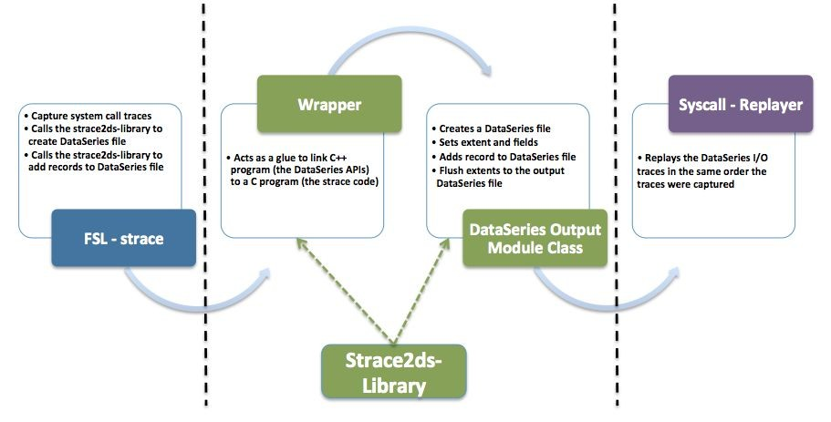
High - level diagram
July 26, 2015
System Call Trace Record/Replay Project
<number>

Slide 8
Trace Recording (FSL - strace)
July 26, 2015
System Call Trace Record/Replay Project
<number>

Slide 9
Approach
Minimize changes to strace code
Every change is wrapped in #ifdef ENABLE_DATASERIES
Enabled with ./configure --enable-dataseries
Run-time option “-X ds-filename” to enable functionality
When writing to a DataSeries file, strace’s normal (human-readable) output is turned off
Prints warning message if an unsupported system call is traced
strace2ds-library also uses autoconf
July 26, 2015
System Call Trace Record/Replay Project
<number>

Slide 10
Why this approach?
Previous attempt failed
Parse strace’s human-readable output and convert it to a CSV file
Convert the CSV file to a DataSeries file
Issues
Parsing the output of certain system calls was very difficult (e.g., stat)
Required multiple distinct steps
Binary information (buffer contents) not always available
This new approach
Easy to run
We have access to all of the information strace collects about each traced system call
Uses strace’s code to our advantage
July 26, 2015
System Call Trace Record/Replay Project
10

Slide 11
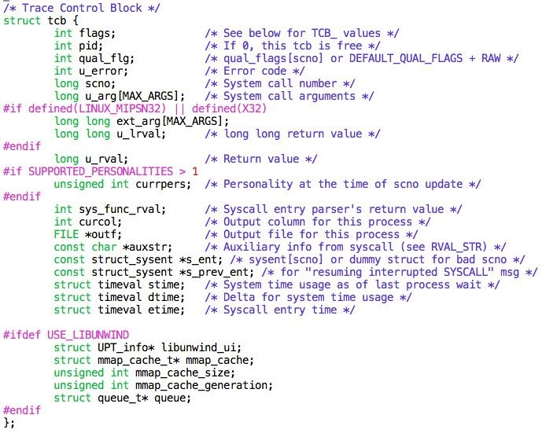
Trace Control Block (Strace: struct tcb)
July 26, 2015
System Call Trace Record/Replay Project
<number>

Slide 12
Strace: Common Fields and Virtual Arguments
Void * arrays
Used to pass system call arguments, information to strace2ds-library functions
Common Fields:
Time called, time returned, return value, errno number, pid
Virtual Arguments (v_args):
Pathnames, read/write buffers, struct stat, etc. as needed
Memory copied from the traced process’s address space to strace’s address space
July 26, 2015
System Call Trace Record/Replay Project
<number>

Slide 13
Strace: Utility functions
ds_get_* (path, buffer, etc.)
Located in util.c
These functions call umoven() or umovestr() which are strace’s own utility functions
Copy data from a traced process’s address space to strace’s address space
July 26, 2015
System Call Trace Record/Replay Project
<number>

Slide 14
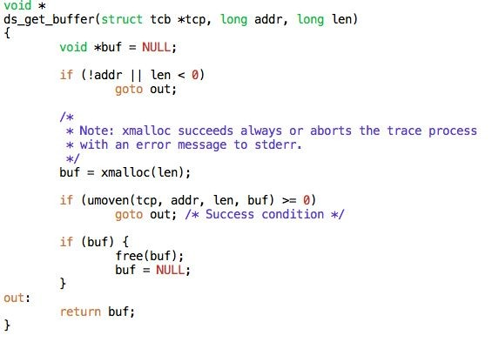
Strace : Utility function example
July 26, 2015
System Call Trace Record/Replay Project
<number>

Slide 15
How We Get Information from Strace: syscall.c
SEN_*: strace’s own identification numbers for system calls
Ex: SEN_open, SEN_close
Primarily in trace_syscall_exiting(), an strace function called just after a system call is executed
Switch statement with a case for each supported system call
Switch block is defined in trace_syscall_exiting() function
In each case, get any virtual arguments and call ds_write_record(), an strace2ds-library function, to add a record in the DataSeries output file
Non-terminating system calls (i.e., exit, execve) are recorded from trace_syscall_entering(), which is called just before a system call is executed
July 26, 2015
System Call Trace Record/Replay Project
<number>

Slide 16
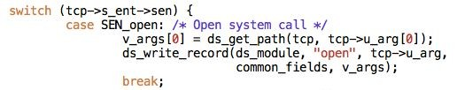
Simple Use Case for trace recording
tcp->s_ent->sen : unique for each system call (SEN_* numbers)
ds_get_path(): returns the actual pathname passed to open system call.
ds_write_record(): adds the captured trace to the DataSeries file.
July 26, 2015
System Call Trace Record/Replay Project
<number>

Slide 17
Trace Recording (strace2ds-library)
July 26, 2015
System Call Trace Record/Replay Project
<number>

Slide 18
Fields Table and XML Files
Table format
Delimited by ‘\t’
Four fields
Extent (system call) name
Field name
Nullable (1) or non-nullable (0)
Field type (int32, int64, bool, byte, variable32)
XML files
One for each system call
Created using script generate-xml.sh <table-filename>
Table and XML must exist prior to running strace -X <ds-filename>
July 26, 2015
System Call Trace Record/Replay Project
<number>

Slide 19
Wrapper code (strace2ds.h, strace2ds.cpp)
Three major functions:
ds_create_module():
Calls DataSeriesOutputModule constructor to create a new DataSeries file
Called once when strace starts
ds_write_record():
Calls DataSeries APIs to add new records in the DataSeries file
Called each time a (supported) system call is traced.
ds_destroy_module():
Calls DataSeriesOutputModule destructor to flush all the records to the DataSeries output file.
Called once when strace ends
July 26, 2015
System Call Trace Record/Replay Project
<number>

Slide 20
DataSeriesOutputModule Class
One DataSeriesOutputModule object is created per trace
When initialized, creates configuration table from the XML files with extent names and the relevant fields
Variables
OutputModuleMap modules_
map<extent name, OutputModule>
ExtentMap extents_
map<extent name, FieldMap>
FieldMap: map<field name, <DS field, DS field type>>
DataSeriesSink
Wrapper for DataSeries output file
config_table_
u_int record_num
July 26, 2015
System Call Trace Record/Replay Project
20

Slide 21
DataSeriesOutputModule : Major functions
Three major functions
Constructor():
Initializes configuration table (tables/snia_syscall_fields.table)
Register extent types to the library
Loop through each extent to
Create its fields from xmls
Create Extent series, Output Module and fields
writeRecord():
Add a new record to the DataSeries file
Register the record and field values into DataSeries fields
~Destructor():
Flush all the records to the output file
Destroy the DataSeriesOutputModule object
July 26, 2015
System Call Trace Record/Replay Project
<number>

Slide 22
DataSeriesOutputModule : Helper functions
Three major helper functions
addExtent()
Add a new extent (system call) to the DataSeries file
setField()
Sets the DataSeries field with its corresponding values
make[system call name]ArgsMap(....)
Creates a mapping between system call field names and their corresponding values
This map is used later, with setField(), to set each field in the DataSeries record
July 26, 2015
System Call Trace Record/Replay Project
<number>

Slide 23
Workflow
Run strace with ‘-X’ option
Each system call is caught inside switch block
From switch block, call ds_write_record() [wrapper code]
ds_write_record() calls DataSeriesOutputModule::writeRecord()
Creates map<string, void *> of field names to field values
Stores the common fields in the map if present
Checks if the system call name matches a supported system call
Make[system call name]ArgsMap (...)
Stores system call specific arguments in the map
Iterate through field names, set values, and write to DataSeries record
July 26, 2015
System Call Trace Record/Replay Project
<number>

Slide 24
How to run strace
strace [-X ds_filename] program_name
July 26, 2015
System Call Trace Record/Replay Project
<number>

Slide 25
Trace Replaying
July 26, 2015
System Call Trace Record/Replay Project
<number>

Slide 26
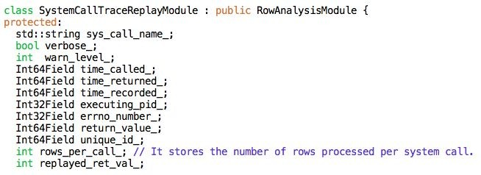
Base SystemCallTraceReplayModule Class
July 26, 2015
System Call Trace Record/Replay Project
<number>

Slide 27
Individual System Call Module Classes
Each system call has its own module class derived from SystemCallTraceReplayModule
Variables
arguments specific to that system call
Methods
print_specific_fields()
processRow()
July 26, 2015
System Call Trace Record/Replay Project
<number>

Slide 28
Priority Queue
Min heap is defined that stores each system call module.
Modules are processed in the order of minimum unique_id number
July 26, 2015
System Call Trace Record/Replay Project
<number>

Slide 29
Workflow
Initialize a module object for each supported system call
Replay system calls in order of unique_id number
processRow() defined in each system call’s module class
Gets argument values from the ExtentSeries
Actually replays the system call
completeProcessing()
Compares traced and replayed return values and errno numbers
Prints system call arguments if in verbose mode
Adjusts location in ExtentSeries appropriately
July 26, 2015
System Call Trace Record/Replay Project
<number>

Slide 30
Replayer Design Decisions - I
File Descriptor Map
System calls may not replay with the same file descriptors as were traced
Maintain a map<int, int> of traced file descriptor to replayed file descriptor
Map certain standard values (stdin, stdout, stderr, AT_FDCWD) to themselves before replay begins
Integer encoding of flag/mode arguments
The SNIA document specifies that individual flags/modes bit should be recorded as boolean fields, so we do record them
However, it is faster when replaying a trace to simply pass the traced integer encoding to the system call
July 26, 2015
System Call Trace Record/Replay Project
30

Slide 31
Replayer Design Decisions - II
Rows per call
Most system calls can be fully encoded in a single record and take up one row in an extent
rows_per_call_ is a member variable of the base SystemCallTraceReplayModule class
The default value of the rows_per_call_ variable is 1
Some require more than one record (e.g., readv, writev, execve)
For these system calls, rows_per_call_ is set accordingly in processRow()
It doesn’t make sense to replay some system calls
E.g., _exit, execve, mmap
We record them in trace, and identify that they were traced when replaying, but don’t actually replay them
July 26, 2015
System Call Trace Record/Replay Project
<number>

Slide 32
How to run replayer
system-call-replayer [-vV] [--verify] [-p ARG] [-w N] ds_filename
July 26, 2015
System Call Trace Record/Replay Project
<number>

Slide 33
Replaying Options - I
Default (-w 0)
July 26, 2015
System Call Trace Record/Replay Project
<number>

Slide 34
Replaying Options - II
Verify (--verify)
Verifies that traced and replayed data in read/write buffers, struct stat, etc. is the same.
Default: no verify
Warn mode: displays contents of both traced and replayed data and continue to replay
Abort mode: displays contents of both traced and replayed data and then aborts the replayer program
Write Pattern data (-p ARG)
If ARG is specified, fills write buffers with
0: write zeros, e.g., -p 0 (default mode)
pattern: write a repeated patterns (e.g., -p 0x5)
random: generate random data using rand()
urandom: generate random data from /dev/urandom
Multiple options can be used at the same time
Abort mode and warn mode cannot be used together
July 26, 2015
System Call Trace Record/Replay Project
<number>

Slide 35
System Calls Supported
July 26, 2015
System Call Trace Record/Replay Project
<number>

Slide 36
List of Supported System Calls
1. open | 12. stat | 23. | unlink | 34. | pipe
2. openat | 13. fstat | 24. | unlinkat | 35. | rename
3. close | 14. lstat | 25. | symlink | 36. | getdents
4. read | 15. fcntl | 26. | readlink | 37. | execve
5. pread | 16. access | 27. | chmod | 38. | _exit
6. readv | 17. truncate | 28. | chown | 39. | mmap
7. write | 18. chdir | 29. | fsync | 40. | munmap
8. pwrite | 19. mkdir | 30. | utime
writev lseek mknod | rmdir creat link | 31. 32. | utimes dup 33. dup2 | Not in original SNIA document Non-replayed system call
July 26, 2015
System Call Trace Record/Replay Project
<number>

Slide 37
Replayer Results
July 26, 2015
System Call Trace Record/Replay Project
<number>

Slide 38
Utilities Replayed Successfully
cp
mv
rm, rm -r
ls
mkdir
July 26, 2015
System Call Trace Record/Replay Project
<number>

Slide 39
SNIA document
July 26, 2015
System Call Trace Record/Replay Project
<number>

Slide 40
Suggested Changes to SNIA Posix System Call Trace Semantics Document
All changes are redlined in the .doc file
Added system calls rename, getdents, openat, unlinkat
Added/removed fields due to relevance/redundancy
Made certain fields nullable or non-nullable
Fixed typos and inconsistencies
July 26, 2015
System Call Trace Record/Replay Project
40

Slide 41
Issues Not Yet Addressed
July 26, 2015
System Call Trace Record/Replay Project
<number>

Slide 42
Testing Protocol
We’ve been testing individual system calls with simple test programs centered around one system call
Some tests depend on others (e.g., read(2) needs open(2))
To do:
Design a test script aligned with current approach to replay system calls.
July 26, 2015
System Call Trace Record/Replay Project
<number>

Slide 43
Necessary Statistics
We will need to add support to collect statistics about trace replay
For benchmarking the replayer itself
For the replayer to be used as a benchmarking tool
Ex: Timing replayed system calls
July 26, 2015
System Call Trace Record/Replay Project
<number>

Slide 44
Unsupported System Calls
mremap, mprotect, madvise, mlock, msync
exec, execl, etc.
clone, fork
ioctl
Work in progress: hard to tell how many bytes to record by ioctl type
July 26, 2015
System Call Trace Record/Replay Project
<number>

Slide 45
Trouble Replaying ls -l
When the command ls -l is used, a socket is created and connected to
/var/run/nscd/socket to look up uid/gid values
Since we aren’t tracing or replaying socket() and related system calls, other system calls that rely on the existence of the socket (i.e., some read and close calls) fail upon replay
July 26, 2015
System Call Trace Record/Replay Project
<number>

Slide 46
What’s next?
July 26, 2015
System Call Trace Record/Replay Project
<number>

Slide 47
Replay Larger Applications
Our strace will warn us if it traces a system call we don’t support
We can add support for more system calls as needed
Replay bigger and bigger applications
E.g., /bin/ls and /bin/cp in various modes
Ultimate goal
Replay server apps (mysql, apache, etc.)
Focus on storage and file system replaying first
Submit a paper (where/when?)
Release code (SNIA?)
How to release updated spec to SNIA?
July 26, 2015
System Call Trace Record/Replay Project
<number>

Slide 48
Questions ?
July 26, 2015
System Call Trace Record/Replay Project
<number>

