Slide 1
Machine Learning for Networking
Nick Feamster University of Chicago Principal Component Analysis (PCA)

Slide 2
What is Principal Component Analysis (PCA)?
Each data point can be represented as a linear combination of vectors/features.
PCA changes the set of component vectors to align in the directions that capture the most variance.
Principal components are linear combinations of the original vectors
Importance of principal components represented by “loading” vector.
In linear algebra terms, it is a “change in basis”.

Slide 3
Why Principal Component Analysis (PCA)?
Goal: Represent data in higher dimensions in a smaller number of dimensions.
Motivation: Why is Principal Component Analysis helpful?
Simplification: Reduce the dimension/complexity of the data while preserving variance (“interesting” properties of the data)
Visualization: Easiest to visualize data in two dimensions, but visualizing all pairs may be prohibitive.
Noise reduction: Keeping principal components that capture variance and removing the rest effectively filters noise.
Clustering: Spectral clustering attempts to map data points into principal components with the highest contributions.

Slide 4
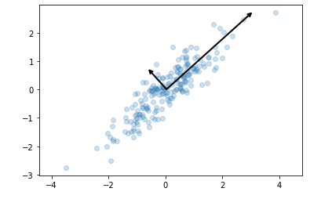
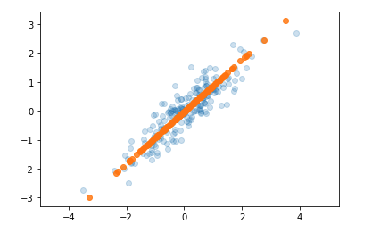
Two Views of Principal Component Analysis
Capturing Maximum Variance
Minimizing Distance to Projection
Principal component is the vector that captures the most variance in the dataset.
Principal component is the vector that is closest to the data points. (Minimize squared error to projection.)
Notes:
These vectors represent the principal axes of the data, and the length shown in Figure 5-81 is an indication of how “important” that axis is in describing the distribu‐ tion of the data—more precisely, it is a measure of the variance of the data when pro‐ jected onto that axis. The projection of each data point onto the principal axes are the “principal components” of the data.

Slide 5
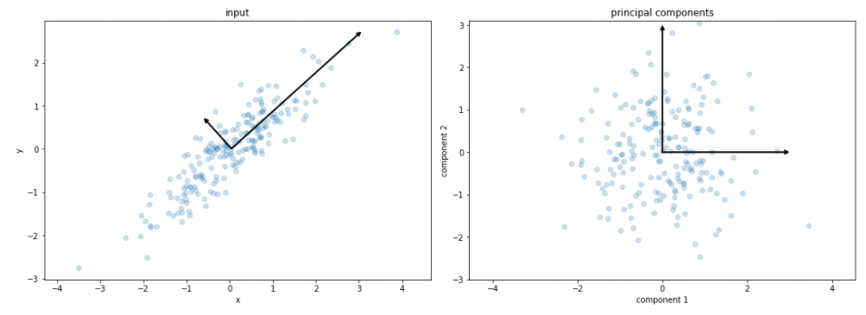
Interpreting Principal Component Projections
Projecting the data points onto the principal component yields the principal components themselves.

Slide 6

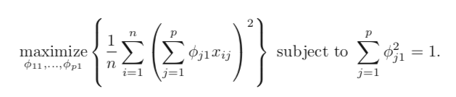
How to Compute Principal Components?
Given: An n x p dataset, X.
Want: n x m vectors where m << p, that capture most variance in X.
How: Project onto the sorted eigenvectors of the covariance matrix of X.
Notes:
https://towardsdatascience.com/pca-and-svd-explained-with-numpy-5d13b0d2a4d8

Slide 7
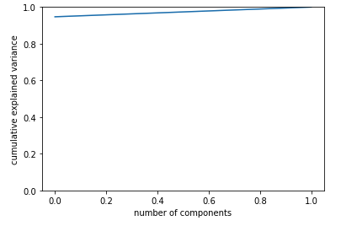
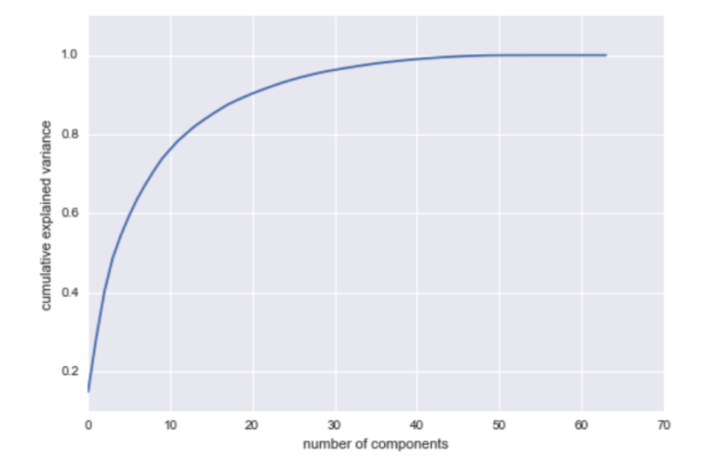
How Many Principal Components?
Scree plot shows the distribution of explained variance for the number of principal components (typically shown with eigenvalues).
Aim is to find a small number of principal components that capture the most variance.

Slide 8
Summary
Principal Component Analysis (PCA) is a way of representing high-dimensional data in lower dimensions.
Method: Projection of the data points onto the eigenvectors of the covariance matrix.
Useful for dimensionality reduction (simplification, visualization, noise reduction)

Slide 9
Applying PCA to Network Anomaly Detection

Slide 10
Traffic Anomaly Detection: Motivation
Many “actionable” changes to traffic patterns
DDoS attacks
Routing anomalies
Link failures
Flash crowds
…

Slide 11
Traditional Network Traffic Analysis
Gap between Capabilities and Goals
What ISPs Care About
Focus on
Long, nonstationary timescales
Traffic on all links simultaneously
Principal goals
Anomaly detection
Traffic engineering
Capacity planning
Focus on
Short ‘stationary’ timescales
Traffic on a single link in isolation
Principal results
Scaling properties
Packet delays and losses

Slide 12
Network-Wide Traffic Analysis
Anomaly Detection: Which links show unusual traffic?
Traffic Engineering: How does traffic move throughout the network?
Capacity planning: How much and where in network to upgrade?

Slide 13
This is Complicated
Measuring and modeling traffic on all links simultaneously is challenging.
Even single link modeling is difficult
100s of links in large IP networks
High-Dimensional timeseries
Significant correlation in link traffic

Slide 14

Origin-Destination Flows
total traffic on the link
traffic
time
Link traffic arises from the superposition of Origin-Destination (OD) flows
A fundamental primitive for whole-network analysis
Notes:
OD flows account for routing and link failures. A fundamental primitive to study
MARK: I will replace that cartoon plot with a real data plot.

Slide 15
How to Analyze OD Flows?
Even more OD flows than links
Still a high dimensional, multivariate timeseries
How do we extract meaning from this high dimensional structure in a systematic manner?

Slide 16
Dimensionality Reduction
Look for good low-dimensional representations
A high-dimensional structure can be explained by a small number of independent variables
A commonly used technique: Principal Component Analysis (PCA) (aka KL-Transform, SVD, …)

Slide 17
Summary
Measure complete sets of OD flow timeseries from two backbone networks
Use PCA to understand their structure
Decompose OD flows into simpler features
Characterize individual features
Reconstruct OD flows as sum of features
Call this structural analysis
Notes:
Our work is the first to study the properties of OD flows. We collect data from two backbone networks, the European portion of the Sprint Tier-1 backbone network and the Abilene backbone network. We then use a technique called Principal Component Analysis to understand the structure of OD flows.
To give some intuition here, our general strategy is to take the set of all OD flows from a network and decompose it systematically into a smaller set of primitive features, which are easier to understand. And then, armed with an understanding of these features, to re-assemble all the OD flows. Such a methodology can actually yield significant insight into the structure of all OD flows, which number in the hundreds.

Slide 18
Example OD Flows
Some have visible structure, some less so…
Notes:
So having done all this data processing, here are example of some sample OD flows.

Slide 19
Structural Analysis
Are there low dimensional representations for a set of OD flows?
Do OD flows share common features?
What do the features look like?
Can we get a high-level understanding of a set of OD flows in terms of these features?
Notes:
netflow

Slide 20
Principal Component Analysis
Coordinate transformation method
Original Data
Transformed Data
PC2
PC1
x2
PC2
x2
u2
u1
u2
PC1
u1
x1
x1
x1 , x2
u1 , u2
Notes:
At its heart PCA is a coordinate transformation method, best shown by an example.
On the left we have some data in their original axis representation, an XY axis. The data is a set of correlated rv as defined by this ellipse here.
PCA works by finding a new set of axis to describe this data, called the pc axis.
These axis have two special properties:
First, each PC axis captured the max energy in the data. And second, they are orthogonal to each other.
Ex, PC1 here basically amounts to a linear regression of the 2d data.
Once these axis are formed, each ponit x1 x2 in the original data can be now described in the new coordinate space, formed by the pc axis, as u1 u2.
All we’ve done therefore is to find a new set of axis and map the original data in the new axis.

Slide 21
Properties of Principle Components
Each PC in the direction of maximum (remaining) energy in the set of OD flows
Ordered by amount of energy they capture
Eigenflow: set of OD flows mapped onto a PC; a common trend
Ordered by most common to least common
Notes:
Generalizinig this to OD flows is as follows.
Each PC captures the maximum energy in the data.
In this way, the PCs are ordered by the amount of energy they capture.
The transformed points, the u1 u2 in the last slide, are what we call eigenflows now. Each eigenflow is a mapping of the OD flows onto a PC. Therefore, each eigenflow is a timeseries that captures a trend common across all OD flows.
Because the PCs are ordered by their energy, the eigenflows are also ordered by importance – from the trend that’s most common to the trend that is least common in all the OD flows.

Slide 22
PCA on OD flows
# OD pairs
# OD pairs
# OD pairs
time
time
# OD pairs
OD flow
Eigenflow
PC
X:
V:
Principal matrix
OD flow
matrix
U:
Eigenflow matrix

Slide 23
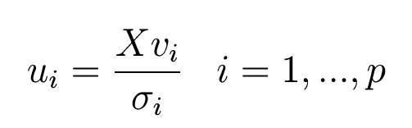



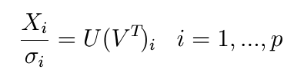
PCA on OD flows (2)
Each eigenflow is a weighted sum of all OD flows
Eigenflows are orthonormal
=
Singular values indicate the energy attributable to a principal component
;
Each OD flow is weighted sum of all eigenflows
=
+
+

Slide 24
An Example Eigenflow and PC
OD Flow 167
OD Flow 94

Slide 25
Low Dimensionality of OD Flows
Small number of PCs capture most of signal’s structure
Plot of OD flow energy captured by each dimension.
Energy captured
Principal Components
Notes:
Recall that each principal component captures the maximum remainng energy in the data.
Therefore by inspecting how much energy is captured y each pc, we can gauge the true dimension of the OD flows.
Here, on the xaxis are the principalc omponents.
On the yaxis, the energy captured by them.
Whats surprising here is that evevn though there are so many od flows with such varied structure, about 10 dimensions capture all the energy of the data.

Slide 26
Structure of OD Flows
Most OD flows have less than 20 significant eigenflows
Can think of each OD flow as having only a small set of “features”
Notes:
Transition: What do these common features or eigenflows look like?

Slide 27
Reasons for Low Dimensionality
Generally, traffic on different links is dependent
Link traffic is the superposition of origin-destination flows (OD flows)
The same OD flow passes over multiple links, inducing correlation among links
All OD flows tend to vary according to common daily and weekly cycles, and so are themselves correlated
Notes:
But, even though there are hundreds of links, each with their own varied structure, there is a case to be made that link traffic really can be well described by fewer dimensions.
Two reasons
1) flows induced correlation.
2) OD flows

Slide 28
Approximating With Top 5 Eigenflows

Slide 29
Kinds of Eigenflows
Deterministic
d-eigenflows
Spike
s-eigenflows
Noise
n-eigenflows
Periodic trends
Sudden, isolated spikes and drops
Roughly stationary and Gaussian

Slide 30
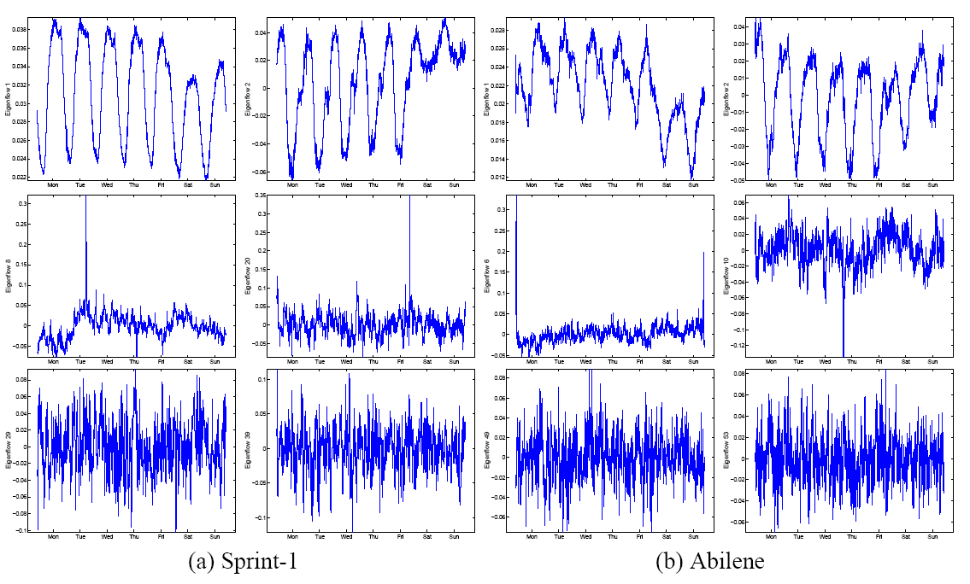
Hundreds of Eigenflows But Only Three Basic Types
Notes:
Here is an example of eigenflows. After visually inspecting the set of all eigenflows, three clear patterns emerged.
We have some eigenflows here that are periodic.
Some that have sharp sikes.
And these look roughly like noise.

Slide 31
An OD Flow, Reconstructed
OD flow
D-components
S-components
N-components

Slide 32
Application: Anomaly Detection
Is my network experiencing unusual conditions?
Then, adopt the following framework
Detection Is there an unusual event?
Identification Which of the possible explanations fits best?
Quantification How serious is the problem?
Notes:
Our work begins with the observation that the problems I just mentioned are all really special cases of the more basic and general question: is my network experiencing an unusual condition.
This is a pretty broad and difficult question and so to answer it, we separated it into 3-steps:
The first step is to detect when something has gone wrong.
The next step is to identify what exactly it is, perhaps an attack or an outage.
And the final step is to quantify its impact, and if its great, to alert operators so that the necessary mitigation steps can be taken.

Slide 33
Statistical Approach
The advantage of such a framework is that it lends itself to a statistical approach:
Detection: Outlier detection
Identification: Hypothesis testing
Quantification: Estimation
Anomaly Diagnosis
Notes:
The advantage of this 3 step framework is that it naturally lends itself to a statistical approach to this problem.
Specifically, the problem of detecting when something unusual has happened translates to a problem of detecting statistical outliers.
Identification translates to the problem of finding the best hypothesis from a candidate set that describe the detected anomaly.
And finally, quantification becomes a problem of statistical estimation of an unknown quantity.
Together, these three steps constitute what we call anomaly diagnosis. So, successful diagnosing an anomaly requires correct detection and identification and accurate quantification.

Slide 34
State of the Art
Much previous work in anomaly detection, attack detection, and traffic characterization
Previous work has
Relied on rules and heuristics
Not taken a general approach
Almost exclusively concentrated on measurements from individual links
Notes:
But this is a pretty slippery slope because heuristics and models are brittle and not always very flexible. And they can’t be easily applied from network to network.
The state of the art has really been limited to dealing with each of the specific problems in piece.
For instance, there has been work done on intrusion detection at edges, and some recent work on detecting routing loops.
So far, there hasn’t been a general approach and something that can diagnose anomalies of the entire range as exemplified in the earlier slide. SPECIFIC kinds of anomalies.
Detect/Identify/Quantify paradigm.
most of this work has relied on heuristics and models of normal behavior.
Perhaps the theme most common to prior work is that previous work has relied on traffic measurements from single links… (to next slide)

Slide 35
Whole-Network Diagnosis
Effective diagnosis of network anomalies requires a whole-network approach
For example, diagnosing traffic anomalies requires analyzing traffic from all links
Notes:
We take a different approach, a whole-network approach, to diagnose network anomalies.
Our thesis is that in order to be able to diagnose network anomalies effectively, we in fact need to look at the network as a whole, instead of focusing on single links.
So, for instance, since our focus is on diagnosing traffic anomalies, we would need to analyze traffic on all links and not on individual links in isolation of other links.
# traffic anomalies which may constitute a subset of all network anomalies. But the techniques proposed are not restricted to traffic measurements and
# maybe effective when dealing with other types of network data.

Slide 36
Complicated!
Need to study traffic from all links in a network simultaneously
Large amount of data
Traffic is nonstationary
Varying link utilization levels
100s of links → High dimensionality
How to extract meaning from such a high-dimensional data in a systematic manner?
Notes:
High apparent dimensionality
Transition: when confronted with high dimensional structures such as this, one strategy is to look for accurate low dimensional representations…

Slide 37
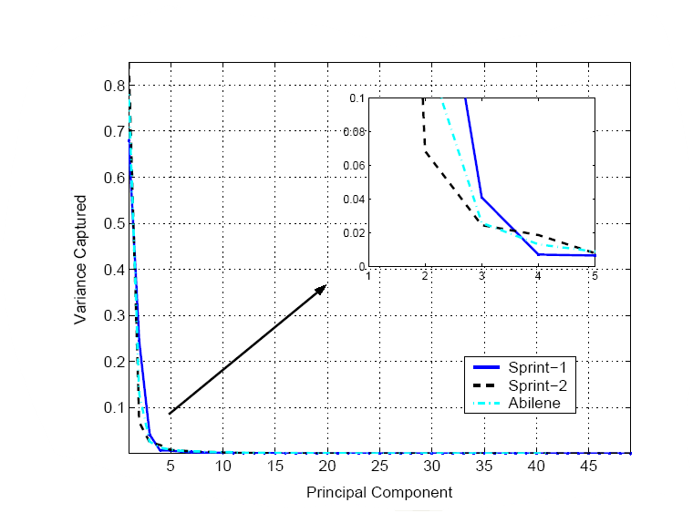
Low Intrinsic Dimensionality of Link Traffic
Key result:
Normal traffic is well approximated by a low dimensional space
For example:
Traffic on 40+ links is well approximated in space of only 4 dimensions
Notes:
So its not surprising that link traffic occupies a low dimensional subspace. And here is evidence for low intrinsic dimensionality.
We studied link traffic of Sprint Europe and Abilene Internet 2 backbone networks using a dimension analysis technique called principal component analysis.
What PCA does is basically the following. It finds a new set of axis, called the principal components, to describe our multivariate timeseries of link traffic such that each new axis captures the maximum variance in the data.
Our results from PCA are shown in this plot.
..

Slide 38
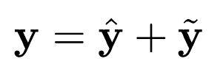
Anomaly Detection: Subspace Method
An approach to separate normal from anomalous traffic
Define as the space spanned by the first k principal components
Define as the space spanned by the remaining principal components
Then, decompose traffic on all links by projecting onto and to obtain:
Traffic vector of all links at a particular point in time
Residual traffic vector
Normal traffic vector
Notes:
The subspace method exploits this low dimensionality to separate traffic on all links into normal and anomalous components.
So let S denote the normal subspace, which is spanned by the first k principal components.
And, let S-tilde denote the anomalous subspace spanned the remaining PCs.
Then, we can decompose traffic on all links by projecting onto S and S-tilde to obtain the vector of normal and anomalous traffic.
So if we let y denote the traffic on all links at a particular point in time, we can write it as the sum of the normal traffic vector and anomalous traffic vector.
Because link traffic has low intrinsic dimensionality, the first k PCs capture most of the variability in all link traffic and
y-hat will contain the temporal patterns most common to the links.
Let me pause for a moment and remark that the ideas similar to the subspace method were developed in the multivariate SPC literature have been successfully applied in industrial process control settings.

Slide 39
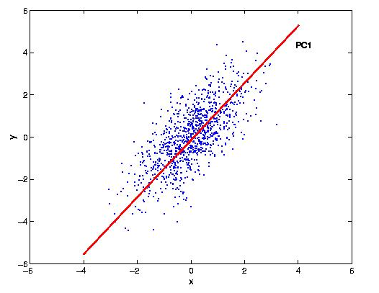

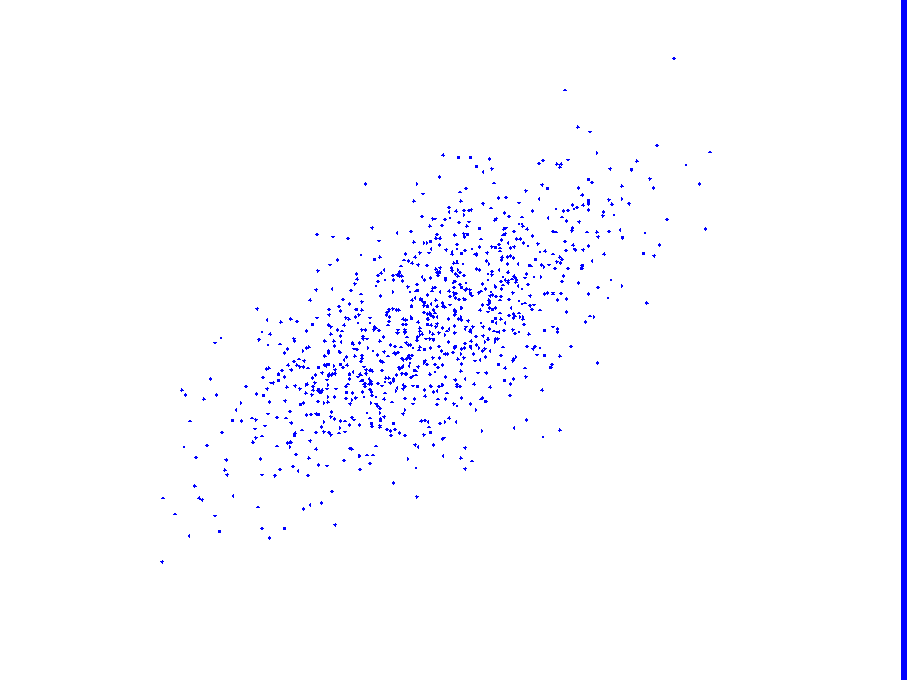




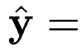
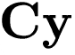
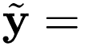
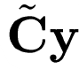
The Subspace Method, Geometrically
In general, anomalous traffic results in a large value of
Traffic on Link 2
y
Traffic on Link 1
Notes:
So here is a geometric illustration of how the subspace method works. Simplest possible case, 2 links. Each point on the picture bytes falling on link 1 and link 2 at some instance. Look they are correlated because if one is high, the other is high. And this is why its ellipsoid. If we had to approximate this using 1 dimension, here is: S. So we would treat S as the best one dimensional representation of network-wide traffic. OK then put up y. Why is it anomalous because its far from some time. And how can we capture this? (Bring up text). This plot here shows the traffic on links plotted against one another. So on the x-axis you have traffic on link 1 and on the y-axis, traffic on link 2. Now, the green and red lines corresponds to the principal axis as obtained from PCA. What PCA basically does is find a new coordinate space to describe this data so that the maximum variability in the data is captured in the minimum set of axis. So for instance, the green line corresponds to the first principal axis, which captures the maximum energy in this data. And the red line, is orthogonal to the green and captures the remaining energy. So the subspace method, in this 2D example, would take S to be the normal subspace spanned by the first PC and S-tilde as the anomalous subspace, spanned by the second PCs. Now lets look at this yellow point, which we denote by y. It is the traffic on both links at a specific time. Note that by combining information from both links, this point becomes an outlier. So we can write y as the sum of the projections on the two subspaces, i.e. y-hat and y-tilde. And in general, we will see that anomalous values will result in large values of y-tilde. Therefore, by examining y-tilde for large values, we will be able to detect such outliers.

Slide 40
Diagnosing Volume Anomalies
A volume anomaly is a sudden change in an OD flow’s traffic (i.e., point to point traffic)
Problem: Given link traffic measurements, diagnose the volume anomalies
Notes:
So let me begin by introducing volume anomalies and the problem of diagnosing volume anomalies.
Now given that OD flows are not easily available, we want to actually diagnose anomalies in OD flows by inspecting link traffic alone.
If it helps, you can think of this as the problem of finding aberrations in the traffic matrix, from link traffic measurements.
I should point out here that the subspace method is not specific to volume anomalies, and this problem really serves as a first application of the subspace method.

Slide 41
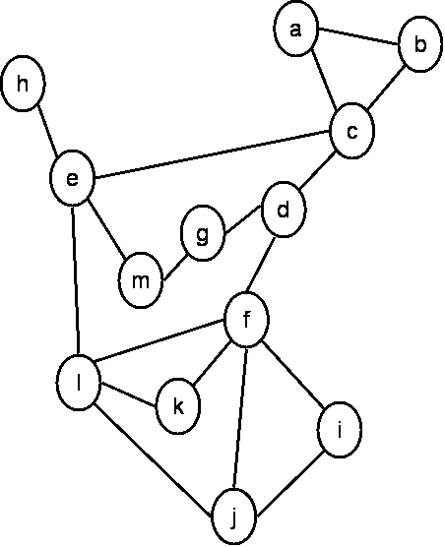
An Illustration
Sprint-Europe Backbone Network
The Diagnosis Problem requires analyzing traffic on all links to:
1) Detect the time of the anomaly
2) Identify the source & destination
3) Quantify the size of the anomaly

Slide 42
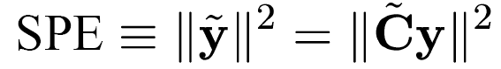
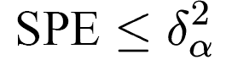
Subspace Method: Detection
Error Bounds on Squared Prediction Error:
Assuming multivariate Gaussian data, traffic is normal when,
Result due to [Jackson and Mudholkar, 1979]
Traffic on Link 2
Traffic on Link 1
Notes:
Detection involves finding the points in time when an unusual event has occurred. As I mentioned before, detection is really a problem of finding outliers. And I’ve also shown you before that an anomaly will tend to cause a large change in ytilde. So really what we want to be able to do is find large values in y-tilde. A useful statistic to detect unusual changes is to examine the squared prediction error, which is basically the squared L2 norm of y-tilde as shown here.
Jackson and Mudholkar derived thresholds for the residual vector, as captured by the SPE. This is given by delta squared alpha. Here delta-squared alpha denotes the threshold for the 1-alpha level confidence in the multivariate normal distribution. So if you chose alpha to be 0.1%, then points outside this threshold will correspond to points that lie outside the 99.9% of the multivariate mean. So essentially this is our false alarm rate under the assumption of normal traffic data. Their result basically puts bounds on values on the residual vector, as shown in this plot for the 2dimensional case. Any point outside these green lines, will correspond to an anomaly. What I’ve not shown here and whats important about this test is that it does not depend on the amount of traffic in the network, and so one can apply the same test on networks of different sizes and different utilization results. Now lets see how well this test works in practice.

Slide 43
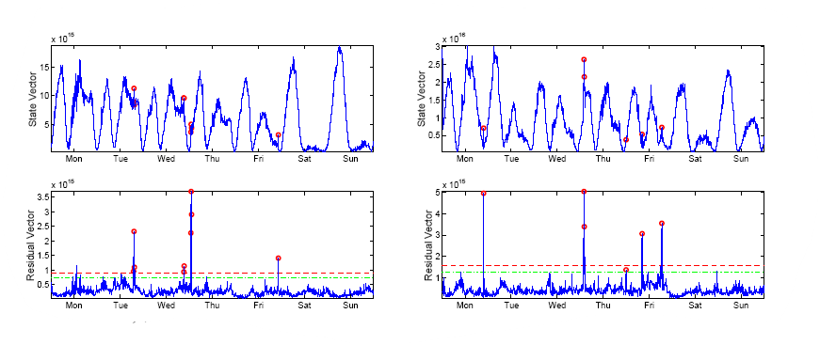

SPE vs. All Traffic
Value of
over time
Value of
over time
SPE ( ) at anomaly time points clearly stand out
Notes:
So here I’m showing you link traffic from two different weeks of sprint data.
On the top plot, I have the time series of squared norm of all all link traffic.
The points in red correspond to actual anomalies. I’ll discuss how we obtained these later on in the talk. But for now, lets agree that these are in a sense, our true anomalies.
OK, now on the bottom plots, I’ve shown the squared norm of only the residual vector, that is, the timeseries of the SPE. The dotted red and green lines correspond to the Jacskon Mudholkar threshold at the 99.9% and 99.5% confidence limit. Any point that exceeds this threshold will lead to a subspace detection.
What we see here is that the true anomalies are difficult to detect in the top plots, that is, the plots of all link traffic.
But, these anomalies clearly stand out in the residual vector timeseries. Thus, we see here that the SPE is an effective metric to expose anomalies.

Slide 44
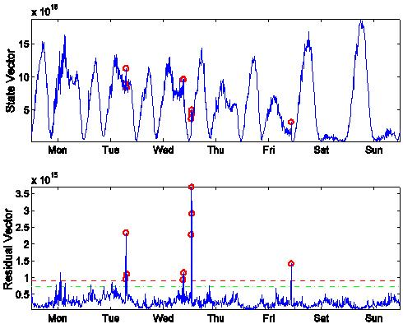
Subspace Method: Identification
An anomaly causes a displacement of the state vector away from
The direction of the displacement gives information about the nature of the anomaly
Intuition: find the hypothesis that best describes a detected anomaly
Select the OD flow that accounts for maximum residual traffic
Notes:
NOW THAT I”VE TOLD YOU ABOUT DETECTION, Lets now turn to identification step. Recall that our objective here is to identify which single OD flow is responsible for the anomaly that we have detected in link traffic.
The way we proceed is as follows.
Now we know that an anomaly will cause a displacement of our link traffic vector away from the normal subspace, and towards the anomalous subspace. In fact, we detected it.
To identify, we exploit the direction of this displacement. Because the direction of this anomaly displacement has information about which OD flow is responsible for the link traffic anomaly.
So the intuition here is that we want to find the OD flow that best describes the anomaly that we have detected.
And by best describes, I mean we want the OD flow that accounts for the maximum residual traffic.

Slide 45
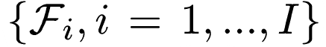





Identification: Hypothesis Testing
Denote the set of all anomalies
Each anomaly adds traffic in some way
So in the presence of anomaly :
And the best estimate of is found by minimizing the distance to in the direction of the anomaly
Notes:
To identify the OD flow which exhibits the anomaly at the detected time, we rely on a hypothesis-based strategy.
First, lets denote the set of all anomalies by F. Now, each of these adds link traffic in a specific way, which we represent by a vector Theta_i. Indeed, the Theta_i, for the case of volume anomalies, are simply the column of the routing matrix corresponding to the OD flow.
Then, in the presence of an anomaly F_i, the traffic on all links, y, is given by the sum of y* and theta_i times f_i. Here, f_i is a scalar quantity, representing the magnitude of the anomaly, and y* represents the usual traffic, without the traffic of F_i. And theta_i is links that F_i causes a spike in. Now, we do not know what y* is, nor do we know what f_i is. The only thing here that we do know is y and theta_i. What we’d like to do is find y*, the non-anomalous traffic, because then, we can find out which OD flow is responsible.
In fact, the best estimate of y* can be found by minimizing the distance to the normal subspace, in the direction of the anomaly, ie theta_i.

Slide 46


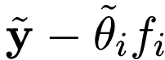


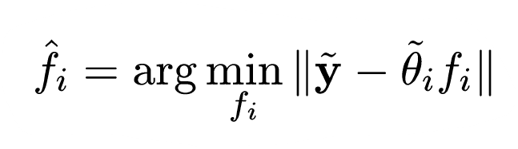
A Geometric Illustration
Normal
Subspace
Notes:
So lets look at this geometrically.
Here is our vector of all link traffic at a specific time, in some high dimensional space.
And here is the projection of that vector onto the anomalous subspace.
And orthogonal to this is the normal subspace.
Now lets assume that anomaly i was responsible for the anomaly, in the direction theta_i.
Now what we want to do is find y_i*, which is the amount of normal traffic, assuming OD flow i was responsible.
And here is the corresponding projection of y_i* onto the anomalous subspace.
Now, the best estimate for y_i* will be the one that brings us closest to the normal subspace, and this involves finding the f_i that minimizes this distance here.
And once we have f_i-hat, we have y_i*. We thus have the normal traffic on all links assuming anomaly Fi.

Slide 47



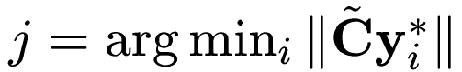
Selecting the Best Hypothesis
1. For each hypothesized anomaly
compute as:
2. Select anomaly as
In this manner, select the anomaly that accounts for maximum residual traffic
Notes:
So, selecting the best hypothesis is really a 2-step procedure.
First, we compute y_i* for each anomaly for each candidate anomaly in our hypothesis set, as I’ve just illustrated.
Second, we select the hypothesis that minimizes the size of the residual vector assuming that anomaly.
That is, we select the anomaly that accounts for the maximum residual traffic.
Fi -> anomaly i.

Slide 48


Subspace Method: Quantification
Given hypothesized anomaly , quantification is straightforward
Estimated per-link anomaly traffic is
And the portion due to the anomaly is
Notes:
OK, so now that we know which hypothesis explains the anomaly, we can quantify the size of the anomaly.
Actually this is pretty straightforward.
We’ve already identified the OD flow or more generally, the hypothesis that caused the link traffic anomaly. So suppose this was anomaly i.
Then, the per-link anomaly traffic size is simply the difference between the vector of all link traffic and the vector of normal traffic, assuming anomaly i.
And finally, the actual number of bytes in the OD flow anomaly is given by this inner product, where theta_i is the column of the routing matrix corresponding to the OD flow.
So basically what we’re doing here is summing over the portions of y_i that are used by the OD flow.
OK, now that we’ve seen how to do detection, identification and quantification, lets see how the subspace method performs in practice.

