Slide 1
Machine Learning for Computer Networking
Nick Feamster University of Chicago Lecture 1: Data Science, Data, and Basics

Slide 2
Data Science = Modeling (“ML”) + Preparation + Deployment

Slide 3
Modeling: Types of Machine Learning Problems
Supervised Learning
Regression: What is the value of something I’m trying to predict?
Classification: What class/type does this data point belong to?
Prediction: What is going to happen? What will happen if…?
Unsupervised Learning
Clustering: What are natural groups for this data?
Dimensionality Reduction: What are the most important aspects of the data?
Recommendation: “You might also like…”

Slide 4
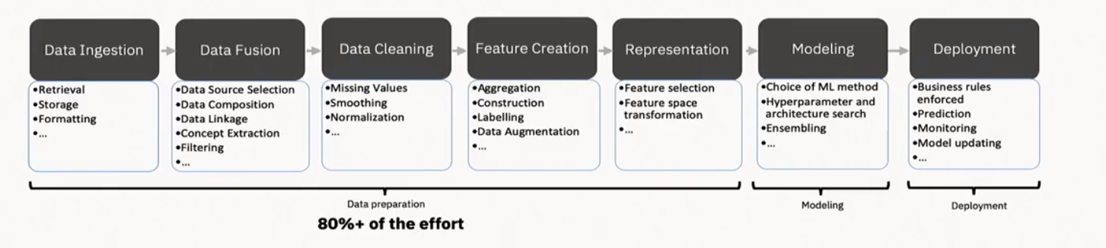
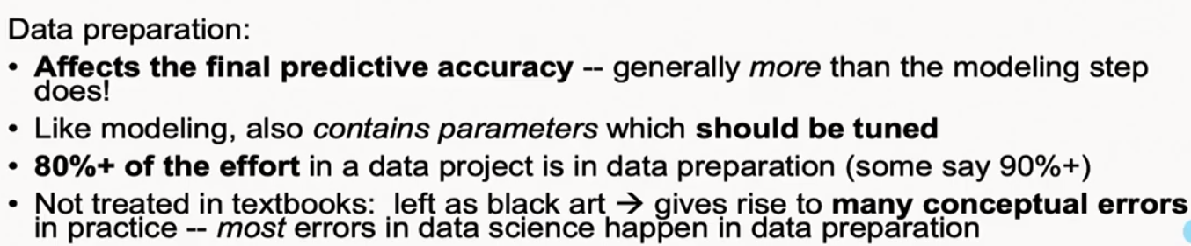
Steps in the ML/Data Science Pipeline
Credit: Alex Gray

Slide 5
Data Ingestion/Fusion/Exploration
Outliers (zero values, etc.): May indicate errors
Distributions: What stands out about the data?
Separators: Are there features that naturally separate classes you are interested in?
Correlations: Are certain features correlated with one another?
Temporal patterns: Hourly? Daily? Weekly? Seasonal?
Very important for understanding whether a model trained today will be valid tomorrow!

Slide 6
Data Cleaning
Sanity checks
Missing values
Zero values
Negative values
Data of the wrong type
Smoothing
Normalization

Slide 7
Feature Engineering: Creation and Representation
Discretization
Map continuous-valued feature into ”buckets”
Sampling
Random, periodic, …
Transformations
Fourier transform
Encodings (e.g., one-hot encoding)
Aggregation
Temporal: ”Binning” quantitative values into discrete time bins
Spatial

Slide 8
Modeling (Supervised Learning)
Model Selection and Training
Considerations: Accuracy, complexity, training cost, assumptions about underlying data, …
Parameter Tuning
Training
Features
Training
Learned Model
Training Data
Labels/Outcomes
Testing
Apply Model
Evaluate
Features
Predictions
Metrics
Test Data
Labels

Slide 9
Evaluation and Testing
Common: Using Historical Data
Training and testing: Cross-validation
Accuracy metrics:
Accuracy, F1 Score, Receiver Operating Characteristic (FP/FN), Precision/Recall
Challenge: Doing better than just relearning the labeled dataset
Also: Deployment/Field Approach
Harder!
Need deployment
Streaming model, real-time constraints, …

Slide 10

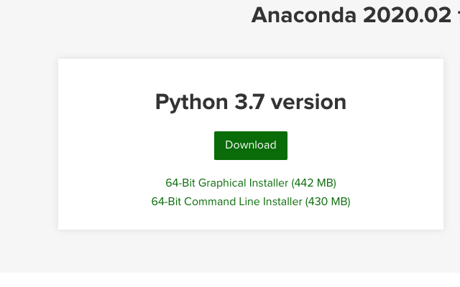
Anaconda Installation

Slide 11
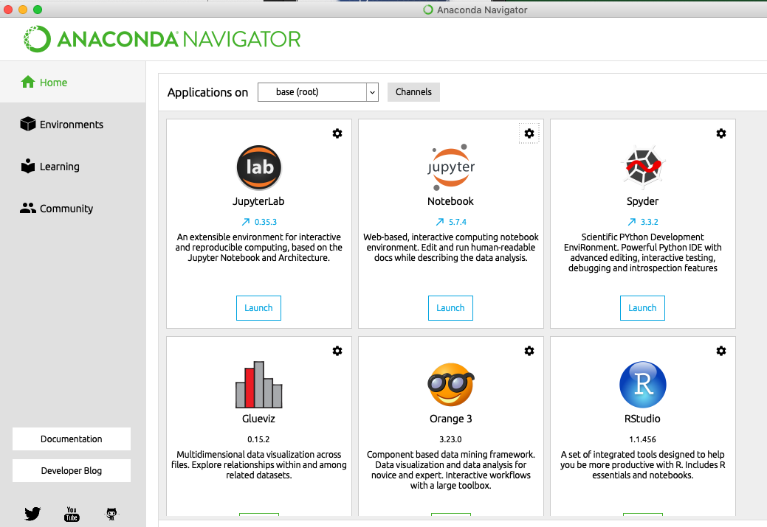
Jupyter Notebooks

Slide 12
Data Ingestion/Exploration
Python Data Libraries
NumPy: multi-dimensional arrays, matrices, mathematical operations
SciPy: linear algebra, differential equations, optimization, statistics
Pandas: data structures and tools for table-line data (reshaping, merging, sorting, slicing, etc.)
SciKit-Learn: machine learning algorithms
Visualization and Plotting Libraries
Matplotlib: 2D plotting library, similar to matlab-style plotting
Seaborn: based on matplotlib, higher-level interface

Slide 13
NumPy Examples
Creating vectors and matrices
Describing a matrix
Calculating average, variance, and standard deviation

Slide 14
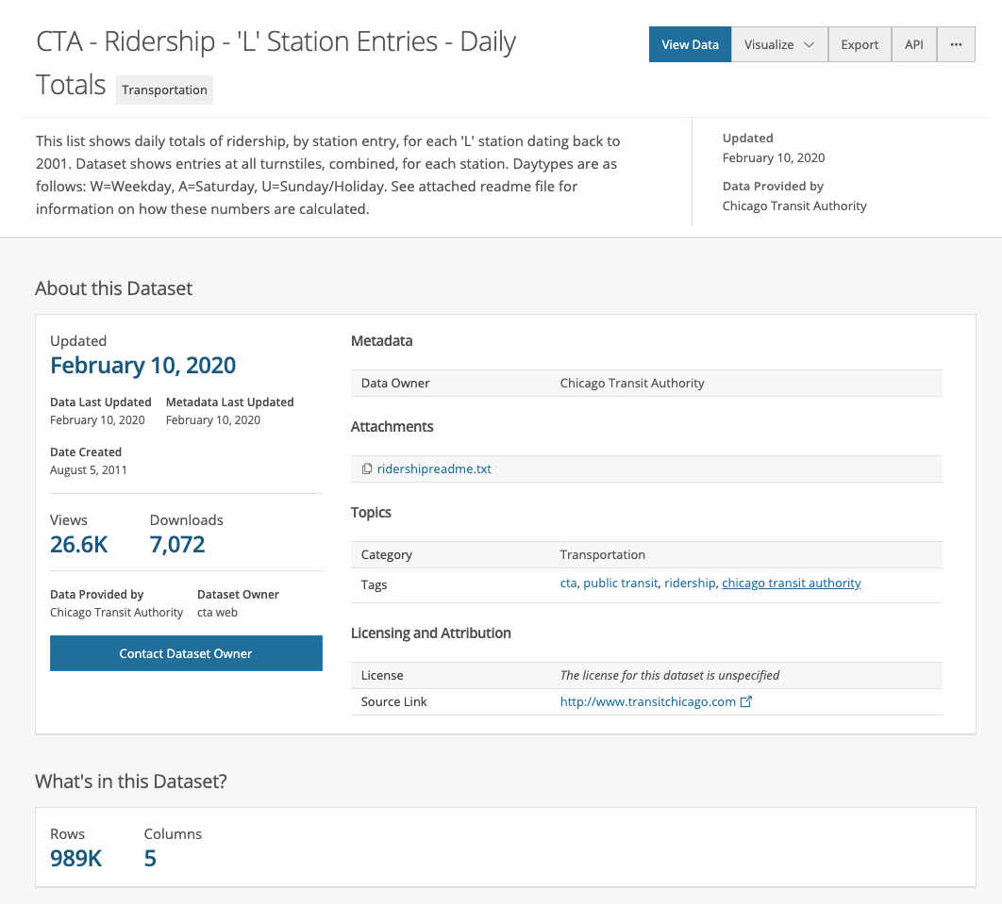
Pandas Examples
Loading data
From CSV
From JSON
Wrangling Data
Describing the data
Selecting based on conditionals
Grouping rows by values

