Slide 1

Closed-Loop “ML for Networks” Pipelines ACM SIGCOMM Tutorial Sep 10, 2023
https://github.com/SNL-UCSB/sigcomm-tutorial
Notes:
\

Slide 2
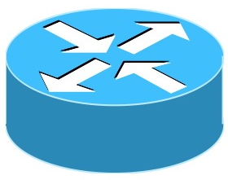
What is ML for Networks?
Monitor
Control

Slide 3
What is ML for Networks for you?
Learning problems
…

Slide 4
Learning Problems for Networks
Learning for networks is not new
Learning is intrinsic to networking
Attributable to inherent partial visibility into network’s state
Entails multiple complex closed-loops across different spatial and temporal granularities
Examples
For TCP, end-hosts need to infer capacity of bottleneck link and round-trip time
For video streaming, client needs to infer future network bandwidth
…

Slide 5
Approaches to Solve Learning Problems
Simple (transparent, explainable) heuristics
E.g., current breed of congestion control and ABR algorithms employ simple rule-based approach to infer network state
Machine Learning for Networks
Recent works have shown ML-based solutions can better detect subtle and complex patterns in data → better decisions
E.g., Aurora (TCP), Pensieve (ABR), …

Slide 6
How are we doing as a Community?
Past Decade
Academia
1000+ research publications
Industry
multiple prominent ML-based networking products and companies
VCs/private equity/government
hundreds of billions of dollars invested
Expected Outcome
We should expect successful adoption of ML-based solutions
Reality
Reluctance to deploy/adopt ML-based networking solutions
Why do we see this reluctance?

Slide 7
Standard ML Pipeline/Workflow
Data
Preprocessing +
Model selection
Model
Deployment
Training
Evaluation
Train high-performing learning models (e.g., ones with high F1-scores)

Slide 8
Resulting Artifacts
HTTP Bruteforce Attack Detection Problem
Data
Preprocessing +
Model selection
Model
Deployment
Training
Evaluation
CIC-IDS
CICFlowmeter
+ Random Forest
0.9+
F1-Score
A high F1 score is desired but not sufficient
Notes:
Can we trust ML models with just high F1-scores trained using some data?

Slide 9
Underspecification Issues
Shortcut Learning
Model takes shortcuts to classify data
OOD Issues
Model does not generalize to out-of-distribution samples
Spurious Correlations
Model picks up wrong correlations in the data
Underspecification negatively affects learning models’ generalizability

Slide 10
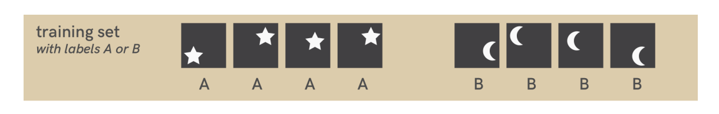
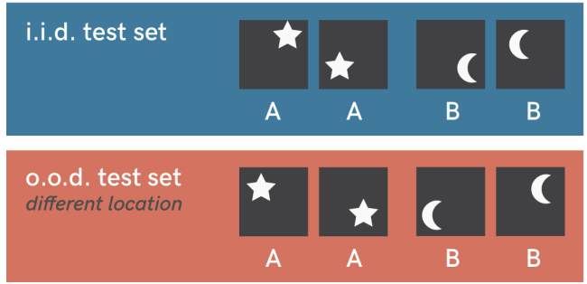
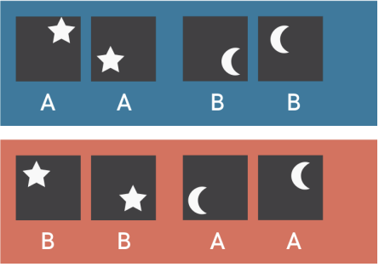
Shortcut Learning (Toy Example)
Expected Decisions
ML Model’s Decisions
Model learns a shortcut (image’s location)

Slide 11
Shortcut Learning (Real Example)
Learning Problem: Detect Bruteforce Attack
Data: CIC-IDS-2017 Dataset
Model: Random Forest
F1-score: 0.99
Observations
All nodes sending benign traffic have the same TTL
Artifact of how the data was curated
Model learns a shortcut

Slide 12
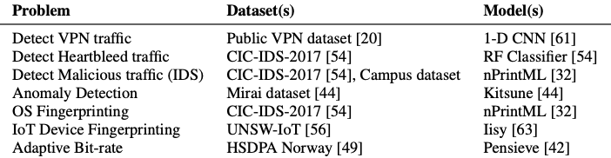
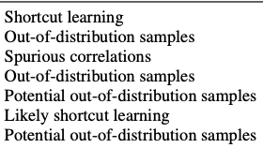
Prevalence of Underspecification Issues
Underspecification
Issues
How can we trust any ML model trained using the existing standard ML pipeline

Slide 13
How can we establish “Trust”?
By answering additional questions
Why is model exhibiting high F1-score?
How is this model making its decisions?
Under what conditions will the model work?
When should we expect it to fail?
Is the training data representative of deployment settings?
How can I collect more representative data?
…
Can we answer these questions with our existing ML pipeline/workflow?

Slide 14

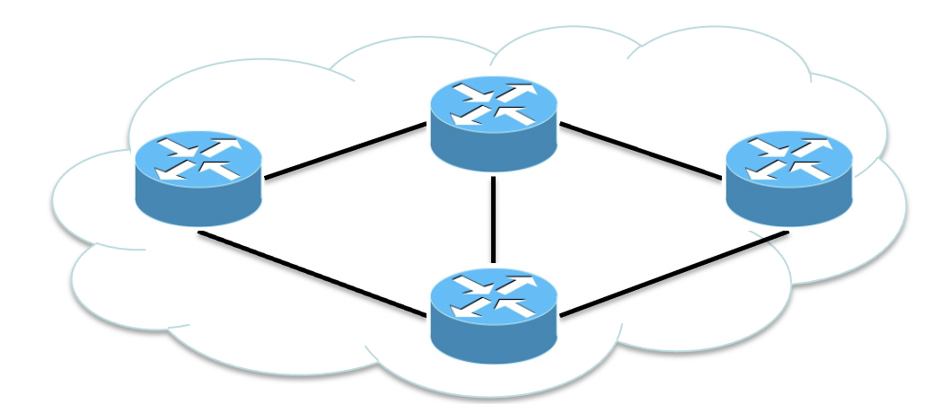
How to Look Beyond F1-Scores?
Data-collection intents
Analysis results
Data Collection
Domain Expert
Explain
Analyze
Data
Preprocessing +
Model selection
Training
Evaluation
Deployment
Standard → Closed-loop ML Pipelines

Slide 15
How to Realize Closed-loop ML Pipeline?
Data-collection intents
Analysis results
netUnicorn
Domain Expert
Trustee
Data
Preprocessing +
Model selection
Training
Evaluation
Deployment

Slide 16
Objectives
Session 1 (This session)
Illustrative overview of standard ML pipeline/workflow for networks
Session 2 (10:30 am -12 pm)
A deep dive into two key building blocks for closed-loop ML pipelines
Trustee https://trusteeml.github.io
Learn how it detects underspecification problems (detect)
netUnicorn https://netunicorn.cs.ucsb.edu
Learn how it enables iteratively collecting the “right” data to address underspecification problems (rectify)

Slide 17
Objectives
Session 3 (1-3:30 pm)
Learn how to use closed-loop ML pipeline to develop generalizable ML models
Session 4 (4-5:30 pm)
Learn about
New tools to develop ML models (NetAIGym)
Past, present, and future of xAI tools for (network) security
NetAI Manifesto
Brainstorm on
Open challenges in developing deployment-ready ML artifacts
Recommendations for the networking community

Slide 18
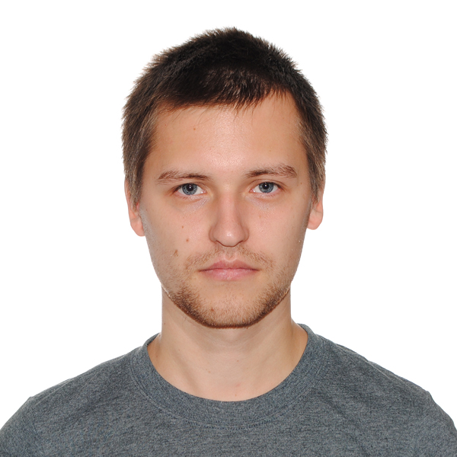
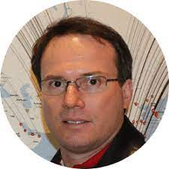
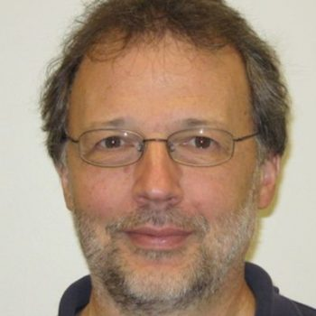
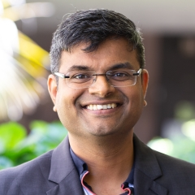



Instructors
Roman Beltiukov
Ronaldo Ferreira
Walter
Willinger
Arpit
Gupta

Slide 19
Special Thanks!
Co-organizers
Arthur Selle Jacobs (UFRGS)
Lisandro Granville (UFRGS)
Wenbo Guo (Purdue)
Hooman Mohajeri (UCSB)
Panelists
Wenbo Guo (Purdue)
Menglei Zhang (Intel)
TAs
Punnal Ismail Khan, Satyandra Guthula (UCSB)

