Slide 1

In Search of a Networking Unicorn A “Thin Waist” Data-Collection Platform to Develop Generalizable ML Models for Networking Problems
Session 2
ML4Nets Tutorial, SIGCOMM’23
https://github.com/SNL-UCSB/sigcomm-tutorial
Notes:
\

Slide 2

How to Look Beyond F1-Scores?
Data-collection intents
Analysis results
Data Collection
Domain Expert
Explain
Analyze
Data
Preprocessing +
Model selection
Deployment
Training
Evaluation
Augment existing ML Pipeline to develop
closed-loop ML pipeline

Slide 3
How to Realize Closed-loop ML Pipeline?
Data-collection intents
Analysis results
netUnicorn
Domain Expert
Trustee
Data
Preprocessing +
Model selection
Deployment
Training
Evaluation
Trustee
Explain and analyze ML model’s decision making
netUnicorn
Iteratively collect the “right” data for a learning problem

Slide 4
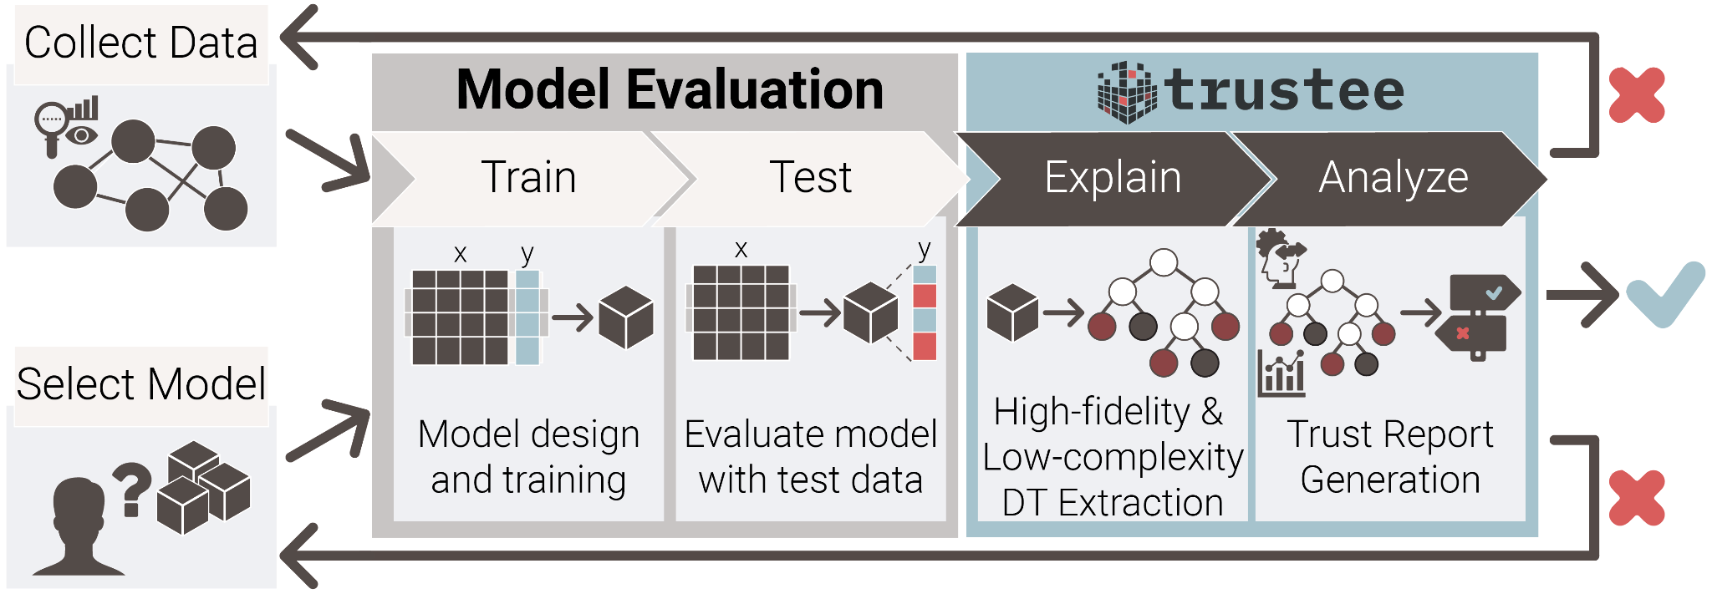
Trustee --- A Model Analysis Framework
Augments ML pipeline to explain and analyze model’s decision making

Slide 5
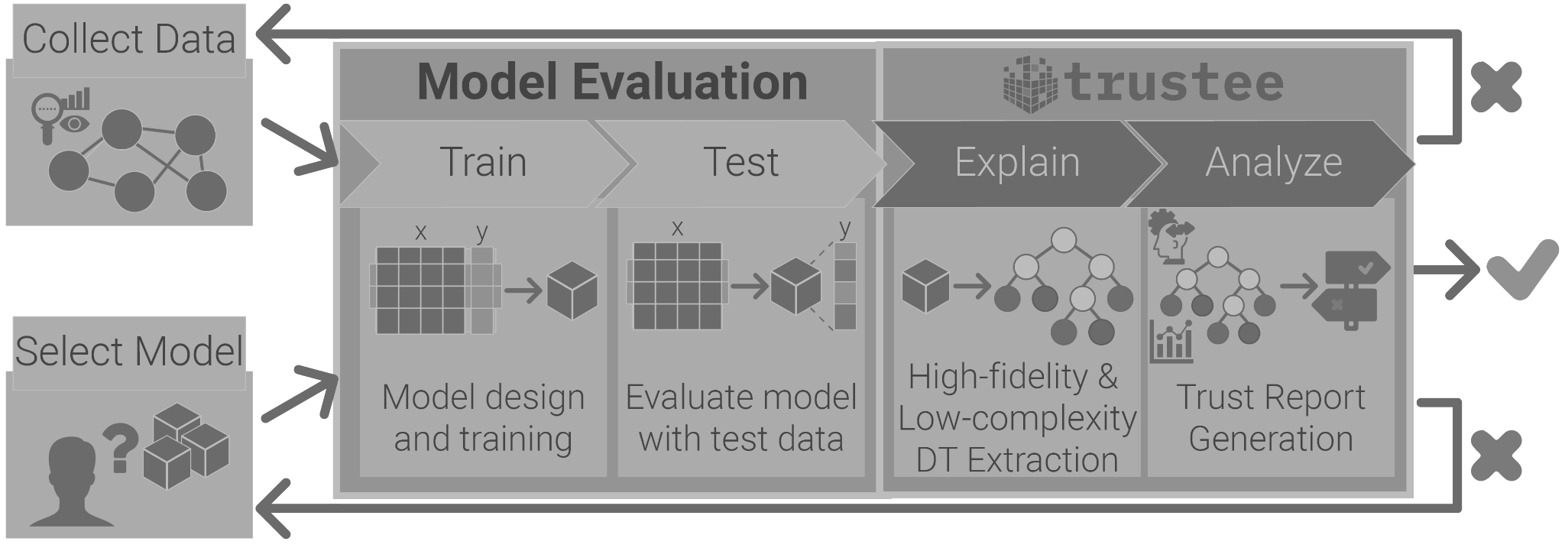
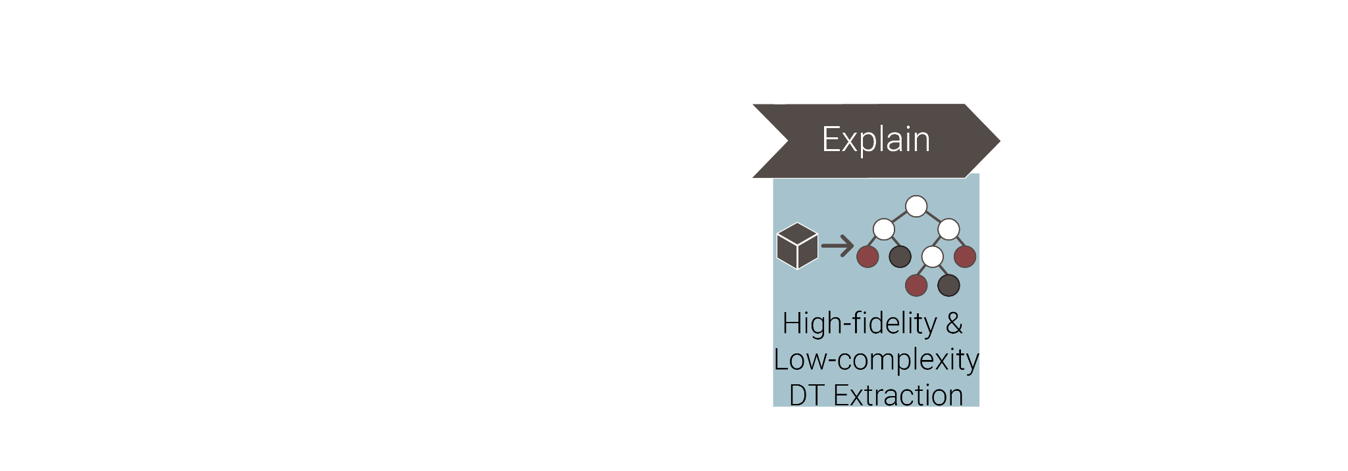
Step 1: Crack Open the Blackbox Model
Synthesize easy-to-interpret
Decision Trees

Slide 6
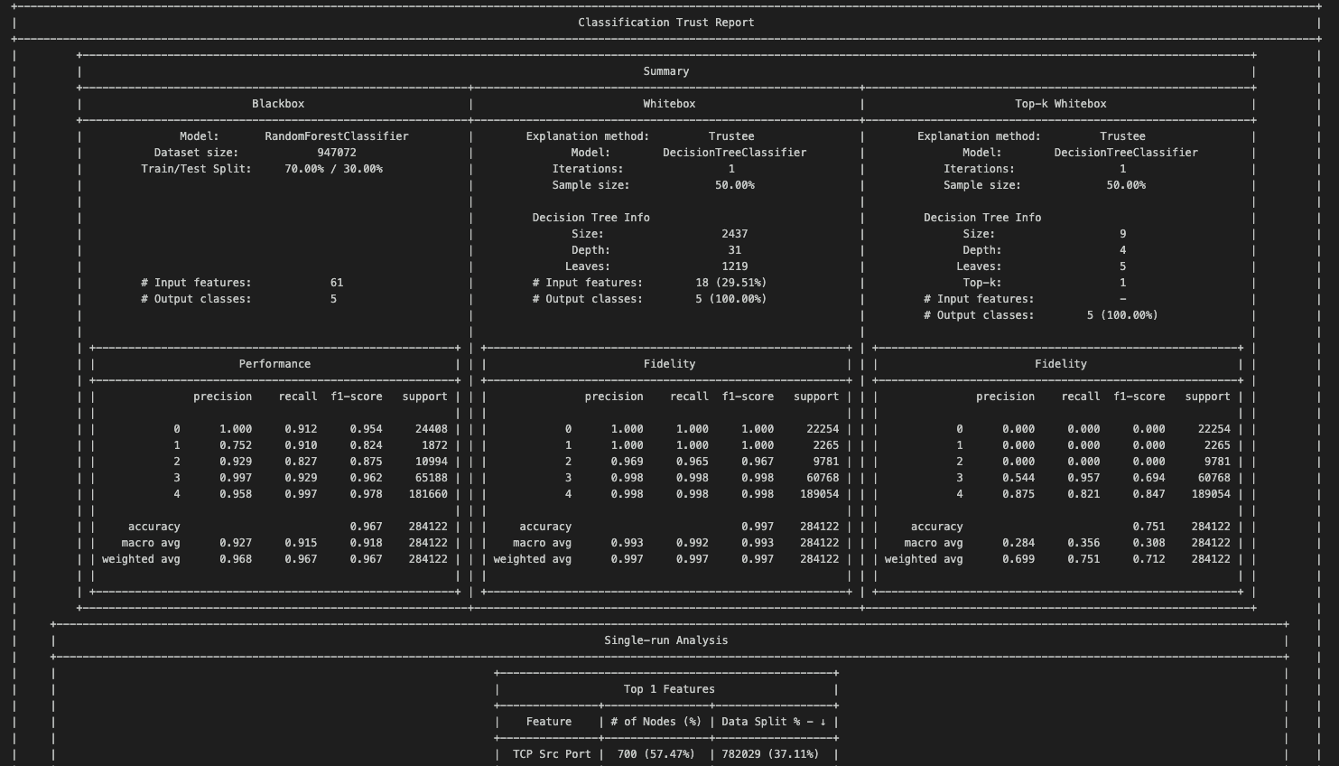
Step 2: Generate Trust Report
Helps identify underspecification issues

Slide 7
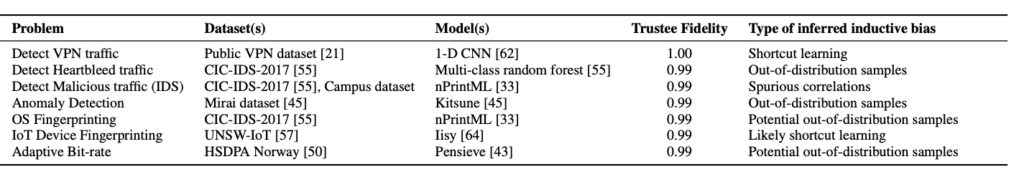
Trustee in Action
Underspecification issues negatively affect learning models’ generalizability

Slide 8
Detecting HTTP Bruteforce Attacks (Recall)
Data: CIC-IDS-2017 Dataset
Model: Random Forest
F1-score: 0.99
Observations
All nodes sending benign traffic have the same TTL
Model learns a shortcut---underspecification issue
What would you do to rectify this issue?

Slide 9
How to Address Underspecification Issues?
Existing Approaches
New data representation, model selection, training and evaluation algorithms
New training dataset (using data augmentation)
Missed opportunities
Leverage newly-developed explainable ML techniques
Ensure realism in collected training dataset
exogenous vs. endogenous data generation

Slide 10
Our Approach
Iterative
data-collection intents
Analysis results
Data Collection
Domain Expert
Trustee
Data
Preprocessing +
Model selection
Deployment
Training
Evaluation
Use Trustee’s report to iteratively collect new data → close the loop

Slide 11
Existing Data Collection Efforts
Entails three distinct operations
Specification
Express intents that specify what data to collect or generate for the experiment
Deployment
Translate high-level intents into target-specific commands and configurations (mechanism)
Execution
Orchestrate data collection while handling different runtime events (mechanism)

Slide 12
Existing Data Collection Efforts
Key (problematic) attributes
Fragmented
Designed for specific learning problems and network environments
Monolithic
Lack modularity, no clear separation between intents and mechanisms
One-off
Not suited for iterative data collection

Slide 13
A New Data-Collection Platform-- netUnicorn
Key (desired) attributes
Fragmented → Unified
Enables data collection for any learning problem from any network environment
Monolithic → Modular
Decouples data-collection intents from mechanisms
Disaggregates intents into independent and reusable pipelines and tasks
Disaggregates mechanisms into independent services
One-off → Iterative
Simplifies iterative data collection for a given learning problem and environment

Slide 14
A New Data-Collection Platform-- netUnicorn
Key (desired) attributes
Fragmented → Unified
Enables data collection for any learning problem from any network environment
Monolithic → Modular
Decouples data-collection intents from mechanisms
Disaggregates intents into independent and reusable pipelines and tasks
Disaggregates mechanisms into independent services
One-off → Iterative
Simplifies iterative data collection for a given learning problem and environment

Slide 15
Existing Data Collection Efforts
Bruteforce
Attack
Video
Fingerprinting
QoE
Inference
Learning Problems
HTTP
SSH
Fragmented
data collection
Network environments
Physical/virtual Network infrastructures
AWS
Netrics
UCSB

Slide 16
Embrace an Hourglass Model
Learning Problems
Unified
data collection
Network environments
Physical/virtual Network infrastructures
Notes:
Trustee is a novel XAI technique to produce global explanations from black-box in the form a high-fidelity and low-complexity decision tree.
Our idea behind Trustee is too augment the traditional ML development pipeline with 2 extra steps, that consist in extracting a decision tree explanation from the model, and analyze it looking for issues that maybe cause the ML model to fail.
To aid domain experts in that last, Trustee also produces a Trust Report, which summarizes some key insights from the produced explanation, which the experts can use to decide whether they trust the models decisions or not.

Slide 17
Embrace an Hourglass Model
Learning Problems
Unified
data collection
Network environments
Data collection “thin waist” addresses the fragmentation issue
Physical/virtual Network infrastructures

Slide 18
A New Data-Collection Platform-- netUnicorn
Key (desired) attributes
Fragmented → Unified
Enables data collection for any learning problem from any network environment
Monolithic → Modular
Decouples data-collection intents from mechanisms
Disaggregates intents into independent and reusable pipelines and tasks
Disaggregates mechanisms into independent services
One-off → Iterative
Simplifies iterative data collection for a given learning problem and environment

Slide 19
Disaggregate Intents (Modular)
Key Stakeholders
Experimenters (intents) vs. Developers (mechanisms)
Programming Abstractions for Experimenters
Tasks: independent and reusable data-collection operations
Pipelines: ordered collection of tasks
Nodes: abstract data collection targets with disparate attributes
Experiments: Ordered collection of (Pipeline, node) pairs
Notes:
Experimenter: express data-collection intents
Developers: translate intents to mechanisms

Slide 20
Disaggregate Intents (Modular)
Key Stakeholders
Experimenters (intents) vs. Developers (mechanisms)
Programming Abstractions for Experimenters
Tasks: independent and reusable data-collection operations
Pipelines: ordered collection of tasks
Nodes: abstract data collection targets with disparate attributes
Experiments: Ordered collection of (Pipeline, node) pairs
Disaggregates intents into smaller reusable pipelines and tasks
Notes:
Experimenter: express data-collection intents
Developers: translate intents to mechanisms

Slide 21
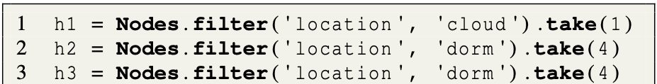
Illustrative Example – HTTP Bruteforce
Server
Benign hosts
Malicious hosts
Select nodes from two different network infrastructures: cloud, dorm

Slide 22
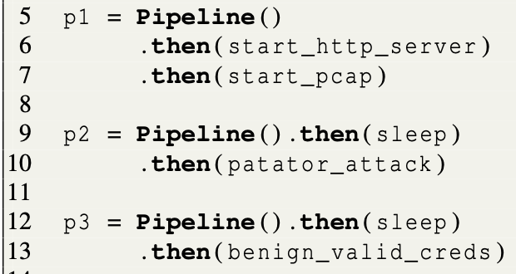
Illustrative Example – HTTP Bruteforce
Victim
Malicious
Benign
Define workflow for three node types

Slide 23
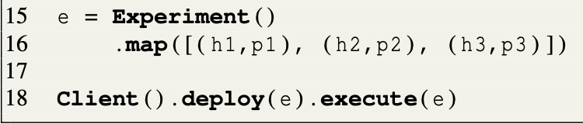
Illustrative Example – HTTP Bruteforce
Map pipelines to nodes to complete expressing the data collection experiment

Slide 24
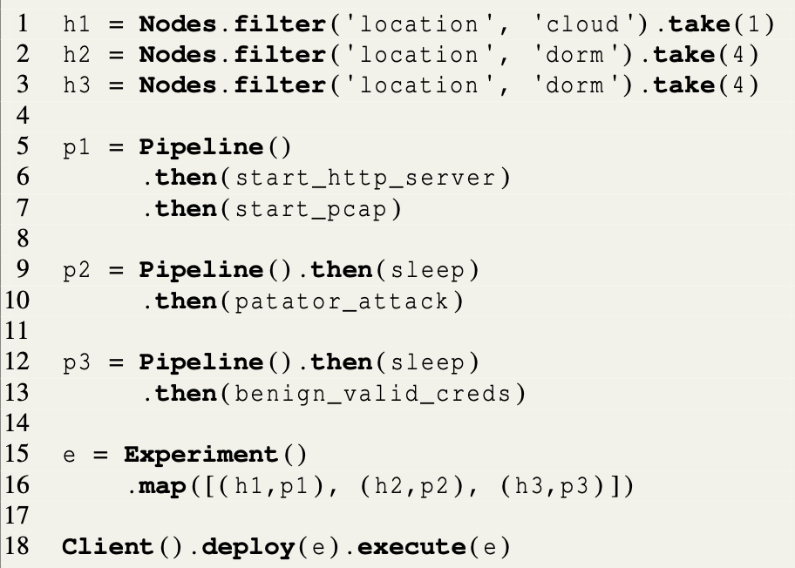
Illustrative Example – HTTP Bruteforce
Disaggregation simplifies expressing (new) data-collection intents

Slide 25
A New Data-Collection Platform-- netUnicorn
Key (desired) attributes
Fragmented → Unified
Enables data collection for any learning problem from any network environment
Monolithic → Modular
Decouples data-collection intents from mechanisms
Disaggregates intents into independent and reusable pipelines and tasks
Disaggregates mechanisms into independent services
One-off → Iterative
Simplifies iterative data collection for a given learning problem and environment

Slide 26

Disaggregate Mechanisms (Modular)
Client(s)
Experiments (Intents)
Mechanisms
Mediation Service
Deployment Services
Execution Services
Processor
Gateway
Datastore
Instructions
Results
Deployment Systems
Instructions
Nodes

Slide 27
Disaggregate Mechanisms (Modular)
Client(s)
Experiments (Intents)
Mediation Service
Deployment Services
Execution Services
Compiler
Connectivity
Manager
Processor
Gateway
Datastore
Instructions
Results
Disaggregates mechanisms into smaller independent microservices
Deployment Systems
Instructions
Nodes

Slide 28
Disaggregate Mechanisms (Modular)
Client(s)
Experiments (Intents)
Disaggregation simplifies adding new infrastructures
Mediation Service
Deployment Services
Execution Services
Compiler
Connectivity
Manager
Processor
Gateway
Datastore
Instructions
Results
Deployment Systems
Instructions
Nodes

Slide 29
Evaluation Questions
Does netUnicorn simplify collecting data for different learning problems from a given environment?
Does netUnicorn simplify collecting data for a given learning problem from different network environments?
Does our closed-loop ML pipeline helps address the underspecification issues?
…

Slide 30
Evaluation Setup
Data-collection Infrastructures
Infrastructures: campus network (UCSB), cloud (AWS, Azure, Digital Ocean)
Deployment systems: SaltStack and Azure Containers (200 LLoCs)
Tasks
Implemented 20+ data-collection tasks (900 LLoCs)
ML Pipelines
Pre-processing: CICFlowMeter
Models: Multi-layer perceptron (MLP), Gradient Boosting (GB), and Random Forest (RF)

Slide 31
Key Results
Does netUnicorn simplify collecting data for different learning problems from a given environment?
Expressing data-collection experiments for three different learning problems required < 40 LLoCs each
Does netUnicorn simplify collecting data for a given learning problem from different network environments?
Does our closed-loop ML pipeline helps address the underspecification issues?

Slide 32
Key Results
Does netUnicorn simplify collecting data for different learning problems from a given environment?
Does netUnicorn simplify collecting data for a given learning problem from different network environments?
Changing the environment for existing pipeline required < 5 LLoCs
Does our closed-loop ML pipeline helps address the underspecification issues?

Slide 33
Key Results
Does netUnicorn simplify collecting data for different learning problems from a given environment?
Does netUnicorn simplify collecting data for a given learning problem from different network environments?
Does our closed-loop ML pipeline helps address the underspecification issues?
For a given use case (HTTP Bruteforce Attack), iterative data collection required < 10 LLoCs and new data eliminated obvious model shortcuts

Slide 34
Detecting HTTP Bruteforce Attacks (Recall)
Data: CIC-IDS-2017 Dataset
Model: Random Forest
F1-score: 0.99
Observations
All nodes sending benign traffic have the same TTL
Model learns a shortcut---underspecification issue

Slide 35
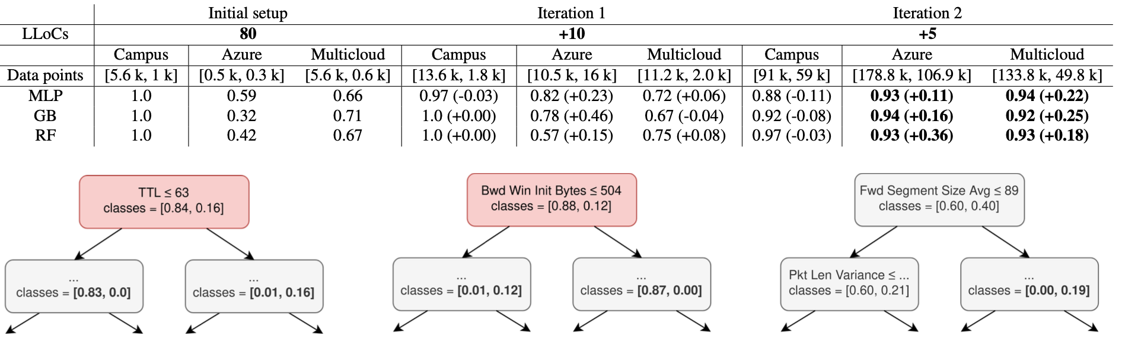
Iterative Data Collection
Replicates issue with CIC-IDS dataset

Slide 36
Iterative Data Collection
Model learns a new shortcut

Slide 37
Iterative Data Collection
netUnicorn’s iterative data collection helps eliminate underspecification issues

Slide 38
netUnicorn realizes Data Collection “Thin Waist”
Learning Problems
netUnicorn
Network environments
Physical/virtual Network infrastructures

Slide 39
“Thin Waist” enables Closed-loop ML Pipeline
Data-collection intents
Analysis results
netUnicorn
Domain Expert
Trustee
Data
Preprocessing +
Model selection
Deployment
Training
Evaluation
netUnicorn
Collect the “right” data for a learning problem

Slide 40
Closed-loop Pipeline helps Establish Trust
Data-collection intents
Analysis results
netUnicorn
Domain Expert
Trustee
Data
Preprocessing +
Model selection
Deployment
Training
Evaluation
Trustee
Explain and analyze ML model’s decision making
netUnicorn
Iteratively collect the “right” data for a learning problem

Slide 41
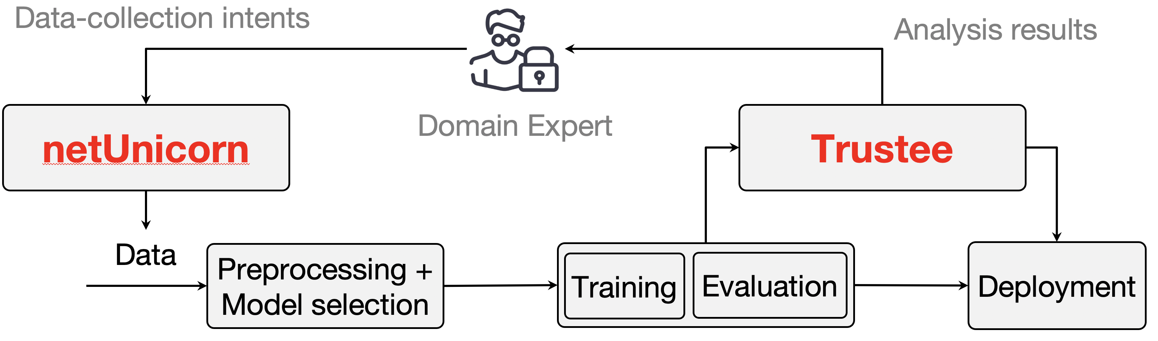
Takeaways
Establishing Trust in ML model requires looking beyond F1-scores
We propose augmenting the standard ML pipeline with
Trustee: explain and analyze model’s decision making
netUnicorn: iteratively collect the “right” data
Public release
Trustee: https://trusteeml.github.io
netUnicorn: https://netunicorn.cs.ucsb.edu

Slide 42
Backup

Slide 43
Limitations
Proposed Approach
Only focuses on endogenous data generation
Assumes sufficient disaggregation and decoupling opportunities
Significant bootstrapping overheads (for developers)
Prototype Implementation
Supports a restricted set of data-collection nodes
Lacks inherent synchronization primitives

Slide 44
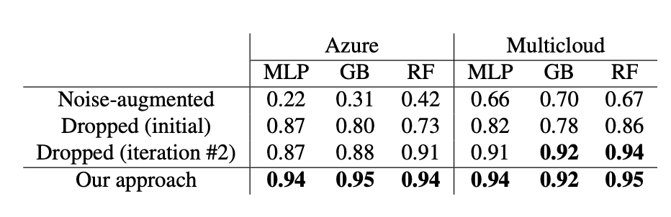
Endogenous vs. Exogenous Methods
netUnicorn’s endogenous data generation is highly desired for networking problems

