Slide 1
World happiness
Badrija Khalifa
Farah Hayat
Nandhini Nallathambi
Kazimierz Lubas

Slide 2

Table of contents
DATA CLEANING
DASHBOARD -BRAINSTORM
INTRODUCTION
LEAFLET MAP CREATION
PLOTLY AND CHARTS
PYTHON FLASK
INTEGRATION
Notes:
Insert a map of your country.

Slide 3
Introduction
The point of our project is to work out what country of the world can be classed as the happiest nation. We are doing this through a series of different evaluations and analysis of data extracted from World Happiness Report up to 2022 | Kaggle.
We will be analysing selected CSVs part of that dataset and manipulating and creating interactive dashboards and maps for selected years.
End result will be fully interactive HTML web page with interactive Map.

Slide 4
Data Cleaning and creating engine
We obtained our data from https://www.kaggle.com/datasets/mathurinache/world-happiness-report and https://gist.github.com/metal3d/5b925077e66194551df949de64e910f6
We downloaded 4 CSV files for 4 years and CSV file with country coordinates
We decided to focus on 4 years: 2022 - 12 columns, 147 rows 2021 - 20 columns, 150 rows 2020 - 20 columns, 154 rows 2019 - 9 columns, 157 rows
Data frames for all years had been cleaned and reduced to 6 columns (country ,happiness_score, gpd_per_capita, social_support, healthy_life_expectancy, freedom_to_make_life_choices) which we though might impact happiness score most.
SQL Database with corresponding tables had been created and loaded with table contents from ipynb file.
Notes:
Insert a picture of one of the geographical features of your country.

Slide 5
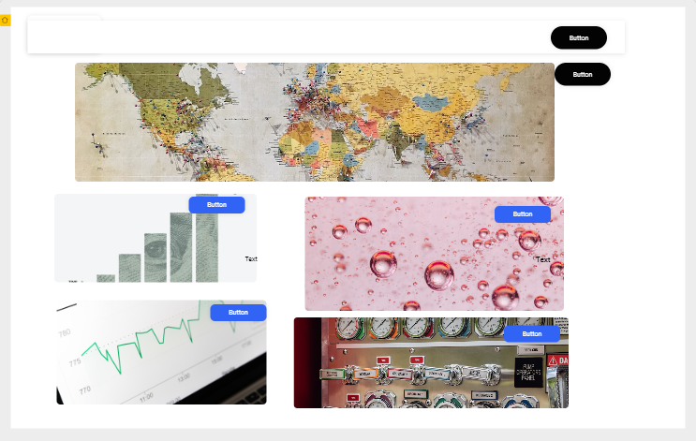
Designing a dashboard and creating index.html.
Wireframe and web concept

Slide 6
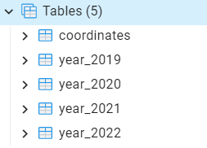
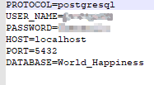
Python Flask
Connection between pgAdmin 4 – app.py
.env file to authenticate login for pgAdmin 4

Slide 7
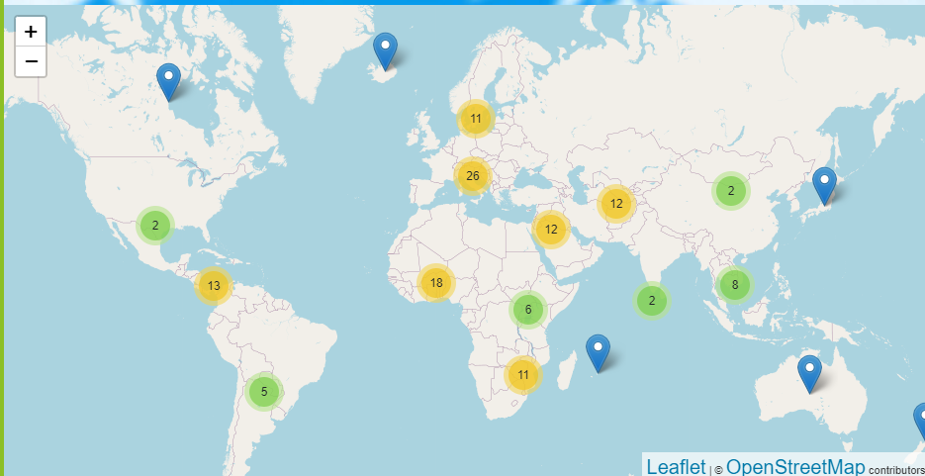
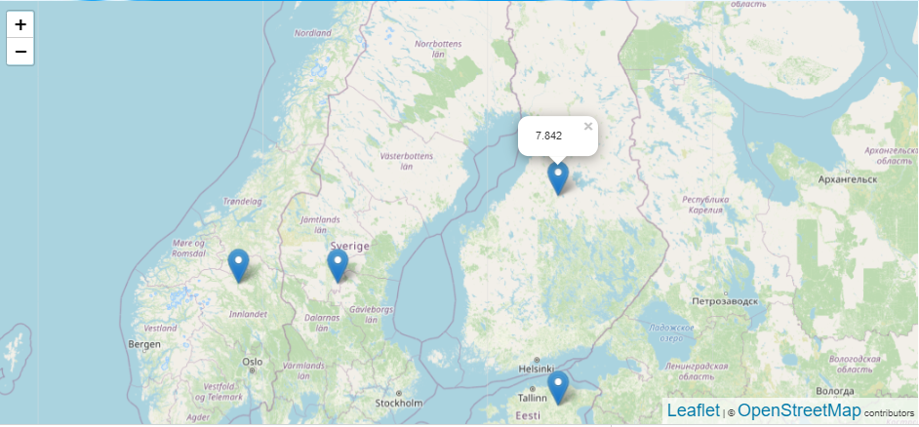
Leaflet map creation
Colour depends on density of the countries and zoom used.
Markers attached to every country with Happiness score for selected year

Slide 8
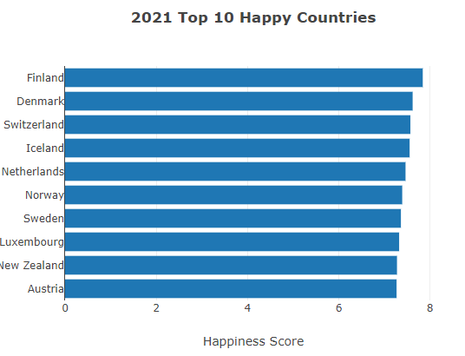
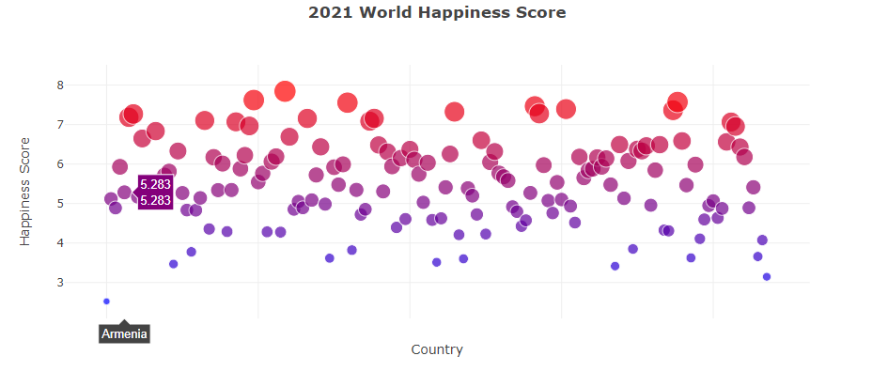
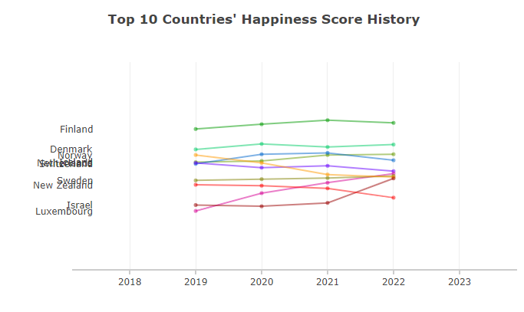
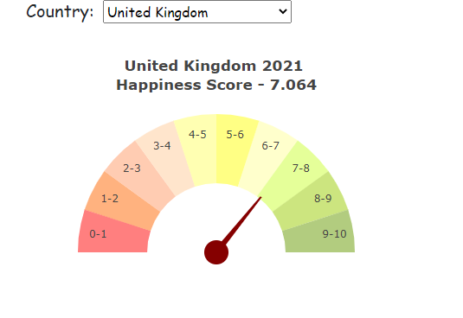
Plotly and chart creations
App.js
Bar.js
Bubble.js
Gauge.js
Line.js

Slide 9
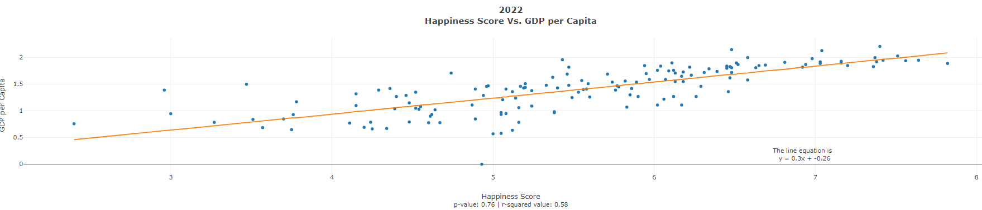
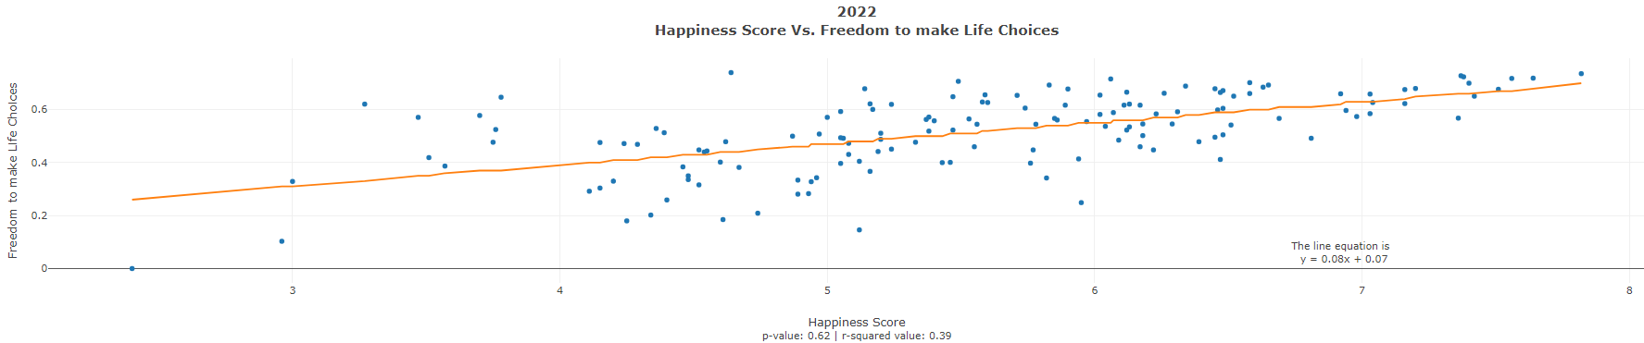
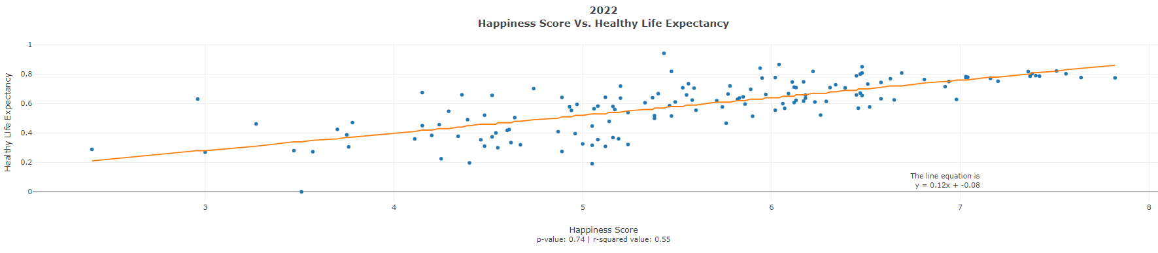
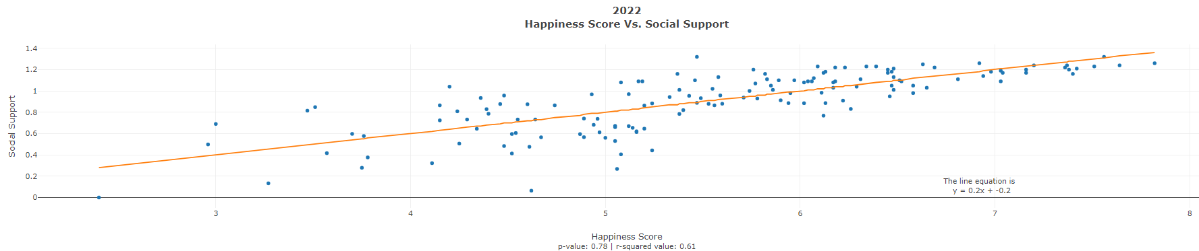
New js library – regression.js
To find out relationship between total score and different factors that can affect it (gpd per capita, social support, healthy life expectancy, freedom to make life choices)

Slide 10
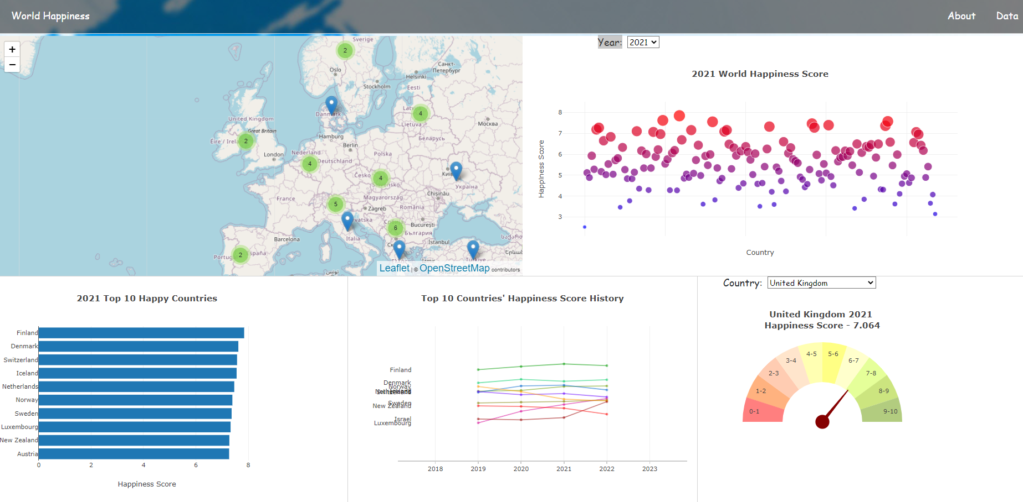
Integration – finalising dashboard

Slide 11
Conclusions
Finland is happiest country on all analysed datasets 2019-2022
UK – 2022 worst score from all years
Afghanistan took last place in 2022 with score 2.4
Top 10 dominated by European countries (8-9 places)
Only non-European country placed in top 10 in all years : New Zealand
Social support has highest impact on the total score of happiness in 2022, however GDP per Capita had a higher impact on total score of happiness in the other years.

Slide 12
Project timelapse
07/12/2022 | 08/12/2022 | 12/12/2022 | 14/12/2022 | 15/12/2022 | 19/12/2022 | 21/12/2022 | 30/12/2022
Team assembly meeting and discussion about potential topic. | Picking up subject of the project and data set. Creating repository and pushing resources. | Initial data cleaning, creating ipynb with engine and SQL file with table. | Designing a dashboard- WIREFRAME and creating index.html. | Python Flask creation | Leaflet map creation | Plotly and chart creation | Integration – finalising dashboard
Notes:
Add key points in the history of your country to the timeline.

