Slide 1

Astha Nayak
Badrija Khalifa
Hibaa Aldubai
Nandhini Nallathambi
Kazimierz Lubas

Slide 2

Table of contents
DATA CLEANING
TABLEAU
INTRODUCTION
Notes:
Insert a map of your country.

Slide 3
Introduction
Glassdoor is one the fastest growing jobs and recruiting sites. Glassdoor holds a growing database of millions of company reviews, CEO approval ratings, salary reports, interview reviews and questions, benefits reviews, office photos and more. We will take a deeper look in some of the job reviews to see if we can identify any trends and interpret the reviews. Our aim is to build a machine learning model using Natural Language Processing to predict how helpful the Glassdoor reviews are.
We are doing this through a series of different evaluations and analysis of data extracted from https://www.kaggle.com/datasets/davidgauthier/glassdoor-job-reviews
End result will be presented in form of various charts and graphs which will be created using Matplotlib library in Python

Slide 4
Data Cleaning and creating engine
We obtained our data from: https://www.kaggle.com/datasets/davidgauthier/glassdoor-job-reviews?resource=download
We downloaded 1 CSV file with glassdoor reviews.
Original file had 838567 rows, due to size (270MB) it was difficult to work with (push to repository, open excel file).
Data frames has been created and after dropping rows with empty cells we get file down to 108628 rows and reduced size of file itselt
SQL Database with corresponding tables had been created and loaded with table contents from ipynb file.
Notes:
Insert a picture of one of the geographical features of your country.

Slide 5
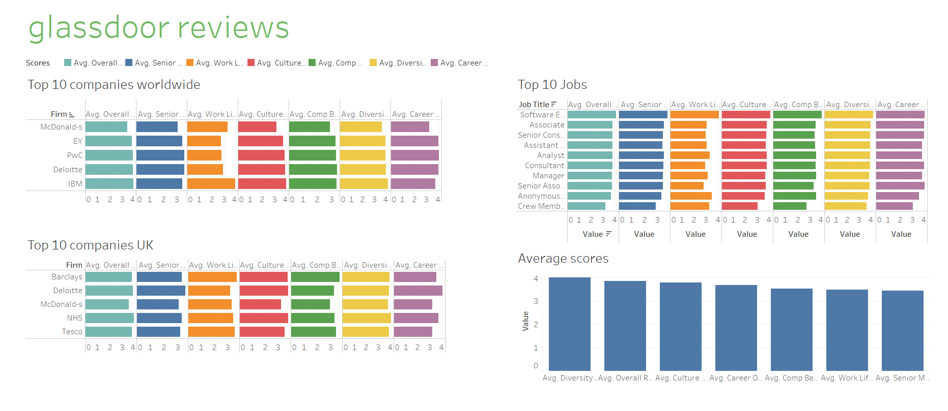
Tableau
https://tinyurl.com/32rbwkkx

Slide 6
Something

Slide 7
Something

Slide 8
Something

Slide 9
Something

Slide 10
Something

Slide 11
Conclusions

Slide 12
PROJECT TIMELAPSE
09/02/2023 | 12/02/2023 | 13/02/2023 | 15/02/2023 | 16/02/2023 | 20/02/2022
Project ideas, brainstorming and picking up dataset | Creating project proposal, data cleaning | Creating visualisations in Tableau

