Slide 1

Astha Nayak
Badrija Khalifa
Hibaa Aldubai
Nandhini Nallathambi
Kazimierz Lubas
Notes:
A - Welcome to group ones project 4. Our project is using machine learning and deep learning models to analyse glassdoor reviews.

Slide 2

Table of contents
DATA CLEANING
SUPERVISED MACHINE LEARNING MODELS
INTRODUCTION
UNSUPERVISED MACHINE LEARNING MODELS
TABLEAU
NEURAL NETWORK MODELS
CONCLUSIONS & LIMITATIONS
Notes:
A – we will be going through …….

Slide 3

Introduction
Glassdoor is one the fastest growing jobs and recruiting sites. Glassdoor holds a growing database of millions of company reviews, CEO approval ratings, salary reports, interview reviews and questions, benefits reviews, office photos and more.
We will take a deeper look in to some of the job reviews to see if we can identify any trends and interpret the reviews. Our aim is to build a machine learning model to predict how helpful the Glassdoor reviews are.
Notes:
A - Glassdoor is one the fastest growing jobs and recruiting sites which is commonly used by the public to post job reviews.
Our project will be to look at the job reviews and try to identify any trends using machine learning methods.

Slide 4
Data Cleaning and creating engine
We obtained our data from: https://www.kaggle.com/datasets/davidgauthier/glassdoor-job-reviews?resource=download
We downloaded 1 CSV file with glassdoor reviews.
Original file had 838567 rows, due to size (270MB) it was difficult to work with (push to repository, open excel file).
Data frames has been created and after dropping rows with empty cells we get file down to 108628 rows and reduced size of file itself.
SQL Database with corresponding tables had been created and loaded with table contents from a jupyter file.
Notes:
K - Our dataset was obtained from Kaggle and contained one CSV file containing thousands of glassdoor reviews.
Due to the dataset being larger than 100MB we were unable to push it onto the repository or open using excel.
We cleaned the data by removing empty cells and null values and we ended up with just over 100,000 rows and it reduced the datafile to a manageable size.
We then established the connection with PostgreSQL using a SQLAlchemy engine and uploaded the cleaned dataset into the table.

Slide 5
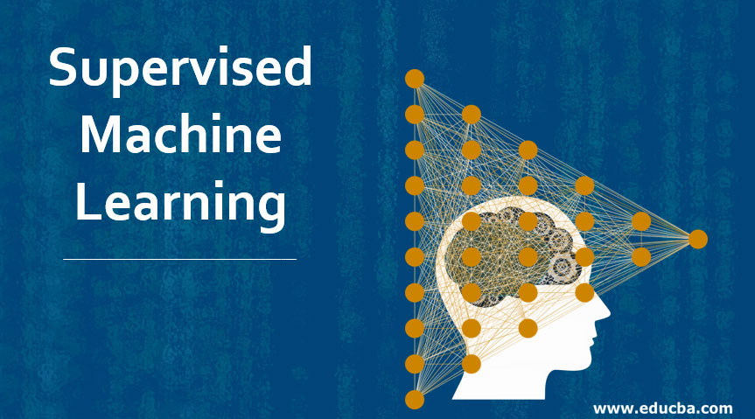
Supervised Machine Learning
Decision Tree
Bagging
Extremely Random Trees
Random Forest
K-nearest neighbors
Notes:
A - We created and trained the following models:
Decision Tree, Bagging, Extremely Random Trees, Random Forest, K-nearest neighbors
We connected to the PostgreSQL using SQLAlchemy engine instance and loaded the data onto a dataframe to create the models. We considered only the numeric columns for the models.

Slide 6
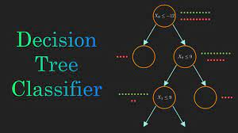

Decision tree
A decision tree is one of the supervised machine learning algorithms. This algorithm can be used for regression and classification problems.
Notes:
H - The first model was the Decision Tree algorithm which is used on regression and classification problems. Here, the field Overall Rating has 5 values (1 to 5) and so this is a classification problem. The training and testing scores were 0.71 and 0.63 respectively.

Slide 7
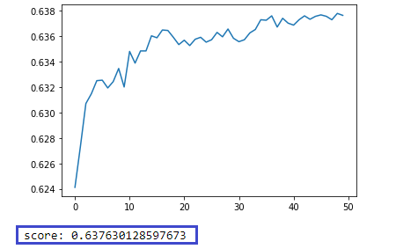
Bagging
Apply Bagging instead of having one decision tree, we make 50 random trees and average their output.
Decision trees try to make the best decision possible at every point where my score: 0.637630128597673.
Notes:
B - As the accuracy score from the decision tree model doesn't hit the target of 75% accuracy, we decided to create a random ensemble known as bootstrap aggregating, or bagging. By doing this instead of having one decision tree, we make 50 random trees and average their output.
Doing this took the score further down to 0.64.

Slide 8


Extremely Random Trees
Extremely Randomized Trees (ET) construct multiple trees like RF (Random Forest) algorithms during training time over the entire dataset.
Random Forest
A random forest can perform both regression and classification tasks. It can handle large datasets efficiently and works well with non-linear data.
Notes:
H - Extremely Randomized Trees (ET) construct multiple trees like RF (Random Forest) algorithms during training time over the entire dataset. During training, the ET will construct trees over every observation in the dataset but with different subsets of features.
Applying Extremely Random Trees, the training and testing scores were 0.71 and 0.63 respectively.
Another model was random forest which can perform both regression and classification tasks. It can handle large datasets efficiently and works well with non-linear data. The random forest algorithm provides a higher level of accuracy in predicting outcomes and has better accuracy than other classification algorithms.
Applying Random Forest, the training and testing scores are 0.71and 0.64 respectively.

Slide 9
K-nearest neighbours
The k-nearest neighbors algorithm, also known as KNN or k-NN, is a non-parametric, supervised learning classifier, which uses proximity to make classifications or predictions about the grouping of an individual data point.
Applying the K-nearest neighbors, we got an accuracy score of 0.626
As none of the models hit the target of 75%, we went for second iteration. For this, in addition to the input features we had already, we included the columns recommend, ceo_approval, outlook and firm. Though there was a huge improvement with the training scores, the test scores improved only slightly.
Notes:
N - The k-nearest neighbors algorithm, is a non-parametric, supervised learning classifier, which uses proximity to make classifications or predictions about the grouping of an individual data point.
In k-NN, the number "k" refers to the number of nearest neighbors to consider when classifying a new instance. The k nearest neighbors are the k instances in the training dataset that are closest to the new instance based on a similarity measure, such as Euclidean distance.
Applying the K-nearest neighbors, we got an accuracy score of 0.626
As none of the models hit the target of 75%, we went for second iteration. For this, in addition to the input features we had already, we included the columns recommend, ceo_approval, outlook and firm. Though there was a huge improvement with the training scores, the test scores improved only slightly.

Slide 10
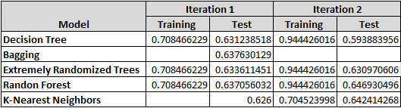
Notes:
K - These are all the scores together for both iterations. Decision tree, extremely randomized trees and random forest created better training scores and so further analysis can be done with them.

Slide 11
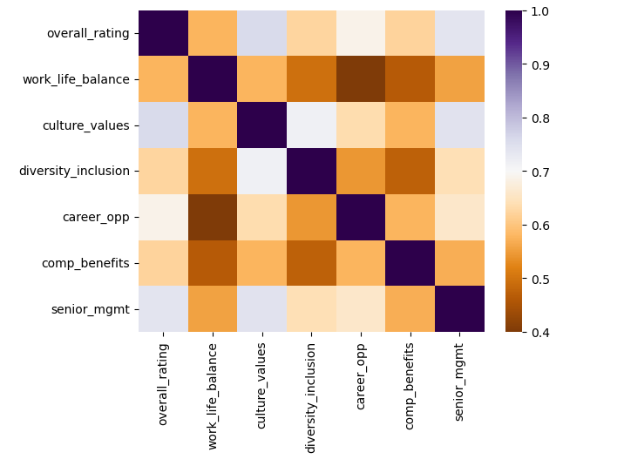
NEURAL NETWORKS
PRE-PROCESSING
We used the Seaborn Heatmap to determine the correlation between all the numeric columns in the dataset.
Notes:
N – Neural networks was the next model we used.
We used the Seaborn Heatmap to determine the correlation between all the numeric columns in the dataset.
The heatmap shows that work-life balance, career opportunities and senior management have strong relationships with overall ranking. So we decided to include these attributes to the input features.

Slide 12
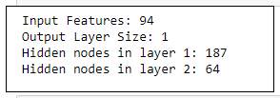
Compiling, training and evaluating the model
Keras sequential model
Notes:
B – after deciding on the input features, we converted the categorical data into numerical data and binned a couple of variables so that the resulting database contained 94 columns.
The Input Features is 94.
The overall rating is the target so the Output Layer size is 1.
To determine the number of hidden nodes in layer 1, we used a rule of thumb that the number of hidden neurons must be less than twice the size of the input layer
To determine the number of hidden nodes in layer 2, we used another rule of thumb that the number of hidden neurons must be 2/3 the size of the input layer, plus the size of the output layer
The activation functions relu and softmax were used on the hidden and output layers respectively.
The model based on these parameters gave an accuracy score of 5.7% which is way below the target of 75%.

Slide 13
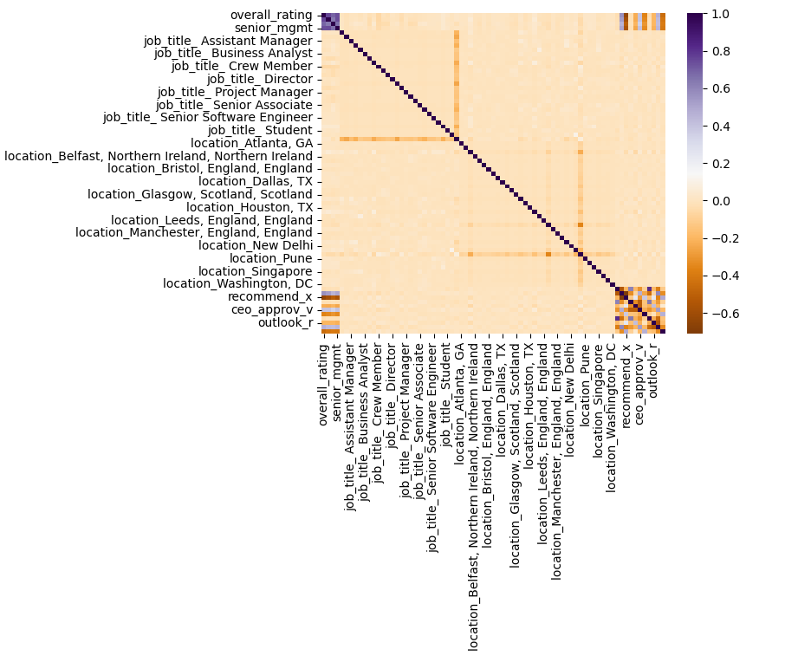
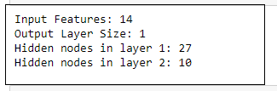
Optimisation 1
Notes:
H - To be sure that the correct input features are used, a seaborn heatmap was created on the dataset created while converting categorical data to numeric.
Following this, the location and job_title columns were removed, and the resulting dataset had 15 columns.
The input features and hidden nodes following the optimization are input features: 14, output layer size: 1, hidden nodes in layer 1: 27, hidden nodes in layer 2: 10.
However There was no improvement and the model still gave an accuracy score of 5.7%.

Slide 14
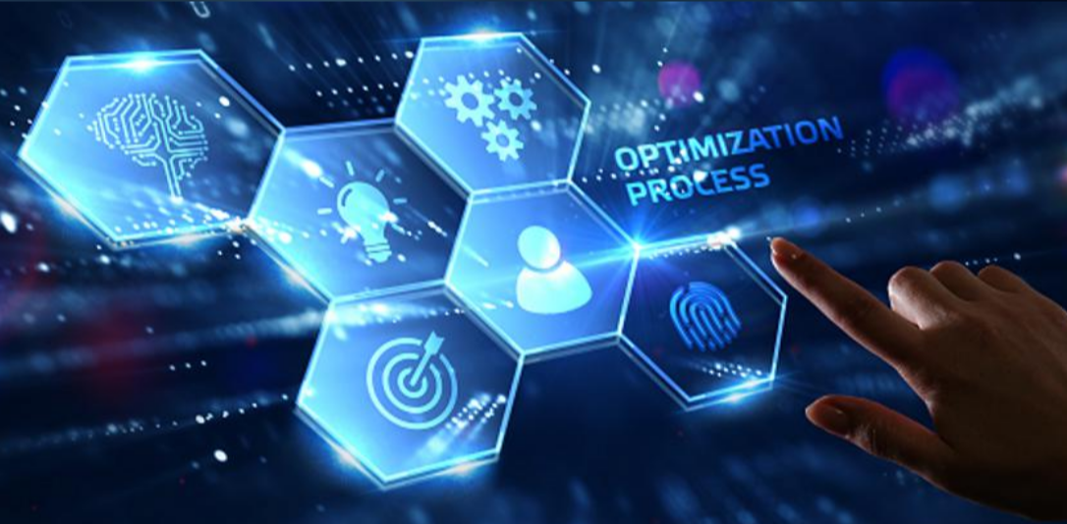
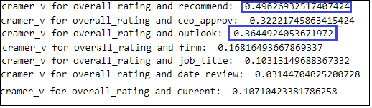
Further optimisations
Notes:
N – we did further optimisations and a number of modifications were performed on the input features, hidden nodes and layers with no improvement on the accuracy score which continued to stay on 5.7%
In the final optimisation, In addition to the seaborn heatmap, Cramer's V statistic was used to compute the correlation between the numerical and categorical columns and the highlighted columns were added back to the features list.
The keras tuner was automated to choose the best of activation models, hidden neuron and layers.
However, there was no change in the accuracy score.

Slide 15
Unsupervised machine learning
The target column (overall_rating) was removed, as it will make an unsupervised model biased.
A number of columns like headline, pros, cons, job_title, date_review, location and current were removed as we thought these might have little or no impact on the model.
The categorical data were converted to numeric, and the resulting dataset had 438 columns.
Dimensionality reduction was performed with PCA which reduced the number of features to 385, preserving 90.1% of the explained variance.
Notes:
B – As we weren’t reaching the target accuracy score of 75% in the previous models, we moved onto unsupervised machine learning the target column (overall_rating) was removed, as it will make an unsupervised model biased.
A number of columns like headline, pros, cons, job_title, date_review, location and current were removed as we thought these might have little or no impact on the model.
The categorical data were converted to numeric, and the resulting dataset had 438 columns.
We then performed dimensionality reduction with PCA which reduced the number of features to 385, preserving 90.1% of the explained variance.

Slide 16
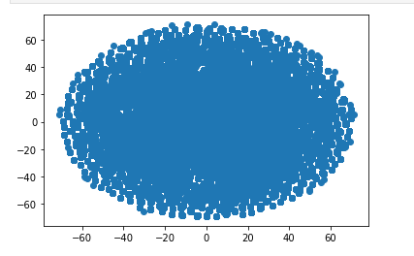
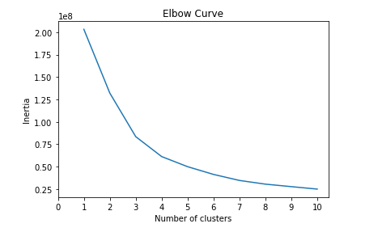
Unsupervised machine learning
T-sne
Elbow curve
Notes:
K - t-SNE was ran to further reduce the dataset dimensions wee then plotted a scatter plot on the t-SNE output.
There are no distinct clusters visible. So, an elbow plot was created to identify the best number of clusters.
Looking at the plot, the elbow seems to appear at k=4.

Slide 17
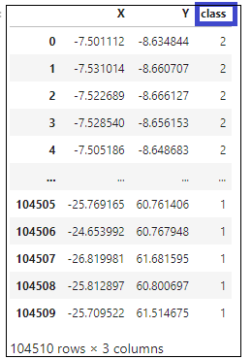
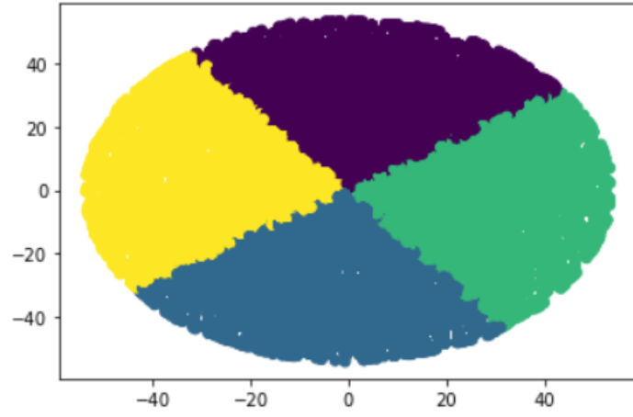
Notes:
H - We further analysed the clusters with the best value of k. The following is the dataframe that includes a new column containing the clusters found.
Based on the tSNE scatter plot, elbow curve and K-Means Clustering, it can be seen that the reviews can be placed into 4 distinct groups. However, the data will have to be analysed further to understand what these 4 clusters are and how effectively these can be used to predict the helpfulness of reviews.

Slide 18
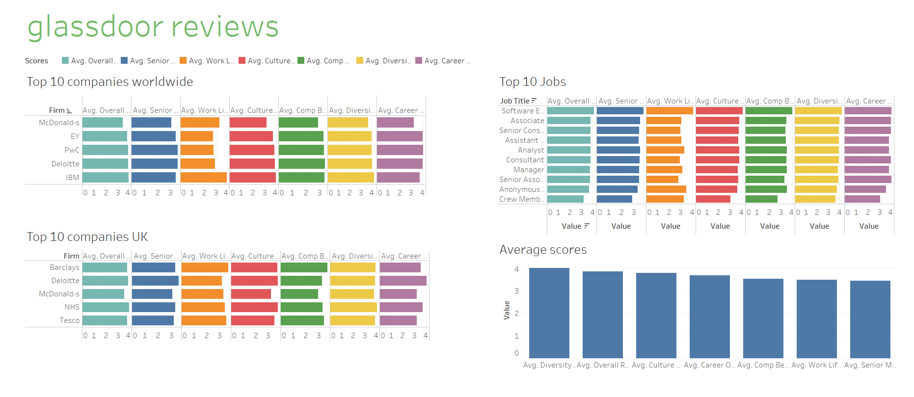
Tableau
https://tinyurl.com/32rbwkkx
Notes:
Kaz

Slide 19

limitations
Only the accuracy scores across different models were examined which may be a very basic evaluation of the models. Looking at additional metrics like the classification report or confusion matrix could provide a broader point of view and help with better interpretation.
The free text columns for Review Headlines, Pros and Cons were not used as input features in any of the models. NLP techniques could have been used to convert the text columns into a numeric representation that could then be fed to the models like neural network. This would have given us a wider list of input features to build the models on.
Notes:
nandhini

Slide 20
Conclusions
The Supervised Machine Learning Models performed better than all models that we created. Decision Tree, Extremely Randomized Trees and Random Forest models created a training score of 94%. However, the testing scores were only around 63%. Further analysis could be done around these models to create a better model that analyses the reviews.
Based on K-Means Clustering, it can be seen that the reviews can be placed into 4 distinct groups. However, the data will have to be analysed further to understand what these 4 clusters are and how effectively these can be used to predict the helpfulness of reviews.
Notes:
nandhini

