Slide 1

Astha Nayak
Badrija Khalifa
Hibaa Aldubai
Nandhini Nallathambi
Kazimierz Lubas

Slide 2

Table of contents
DATA CLEANING
TABLEAU
INTRODUCTION
Notes:
Insert a map of your country.

Slide 3
Introduction
Glassdoor is one the fastest growing jobs and recruiting sites. Glassdoor holds a growing database of millions of company reviews, CEO approval ratings, salary reports, interview reviews and questions, benefits reviews, office photos and more. We will take a deeper look in some of the job reviews to see if we can identify any trends and interpret the reviews. Our aim is to build a machine learning model using Natural Language Processing to predict how helpful the Glassdoor reviews are.
We are doing this through a series of different evaluations and analysis of data extracted from https://www.kaggle.com/datasets/davidgauthier/glassdoor-job-reviews
End result will be presented in form of various charts and graphs which will be created using Matplotlib library in Python

Slide 4
Data Cleaning and creating engine
We obtained our data from: https://www.kaggle.com/datasets/davidgauthier/glassdoor-job-reviews?resource=download
We downloaded 1 CSV file with glassdoor reviews.
Original file had 838567 rows, due to size (270MB) it was difficult to work with (push to repository, open excel file).
Data frames has been created and after dropping rows with empty cells we get file down to 108628 rows and reduced size of file itselt
SQL Database with corresponding tables had been created and loaded with table contents from ipynb file.
Notes:
Insert a picture of one of the geographical features of your country.

Slide 5
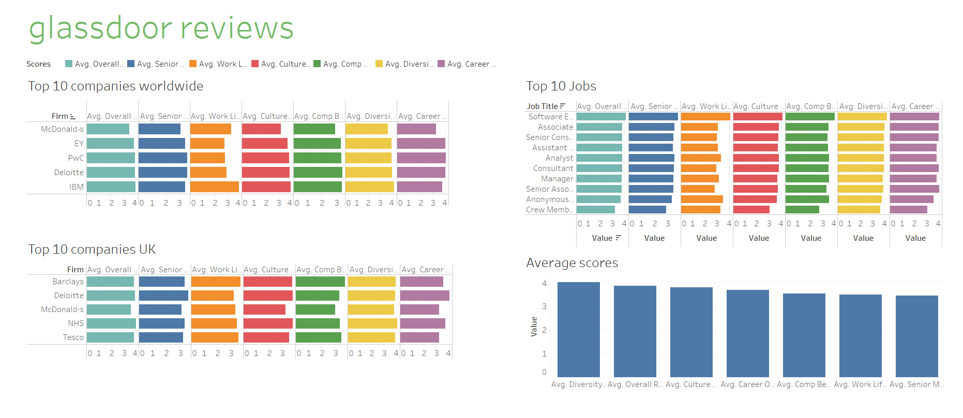
Tableau
https://tinyurl.com/32rbwkkx

Slide 6
Supervised Machine Learning
Creating a connection string for the Glassdoor database. Create an engine instance Connect to PostgreSQL server. Read data from PostgreSQL database table and load into a DataFrame instance. Close the database connection. Next is Appling different Models.

Slide 7
Decision tree
A decision tree is one of the supervised machine learning algorithms. This algorithm can be used for regression and classification problems.
Training score is: 0.7084662294914649
Testing score is: 0.6312385180649112

Slide 8
Bagging
Apply Bagging Instead of having one decision tree, we make 50 random trees and average their output.
Decision trees try to make the best decision possible at every point where my score: 0.637630128597673.

Slide 9
Extremely Random Trees
Applying Extremely Random Trees where:
Training Score is: 0.7084662294914649
Testing Score is: 0.6336114513165952

Slide 10
Random Forest
Applying Random Forest where:
Training Score: 0.7084662294914649
Testing Score: 0.6370560318432333

Slide 11
K-nearest neighbours
Applying K-nearest neighbors where: Acc is: 0.626 .
Because score is not very good so we try 2nd lteration where our score improve to: 1%

Slide 12
Conclusions
Features The columns correspond to the date of the review, the job name, the job location, the status of the reviewers, and the reviews. Reviews are divided in s sub-categories Career Opportunities, Comp & Benefits, Culture & Values, Senior Management, and Work/Life Balance. In addition, employees can add recommendations on the firm, the CEO, and the outlook.
Other information Ranking for the recommendation of the firm, CEO approval, and outlook are allocated categories v, r, x, and o, with the following meanings: v - Positive, r - Mild, x - Negative, o - No opinion

Slide 13
PROJECT TIMELAPSE
09/02/2023 | 12/02/2023 | 13/02/2023 | 15/02/2023 | 16/02/2023 | 20/02/2022
Project ideas, brainstorming and picking up dataset | Creating project proposal, data cleaning | Creating visualisations in Tableau

