Slide 1
SSIG 3
Dennis Pipenbring, 16. 09. 2026

Slide 2
Understanding
Key for legal ownership
Business segments?
Market segments?
Business register
Domain register
Web
Legal owner
Company A
Domains
accessible
What is the purpose of the webpage?
Webpage
Company B
Domains
inaccessible
Company C
Who is the webpage referring to?
Beneficial owner
≠ legal owner
Alternative purpose / inactive / placeholder
Key for beneficial ownership
Company D
Our terminology: Webpage ⊂ domain (subset)
Webpages are scraped, domains are not
Received data
Extracted data

Slide 3
Use
Webshop
Booking
Login
Social media
20%
9 %
10 %
31 %

Slide 4
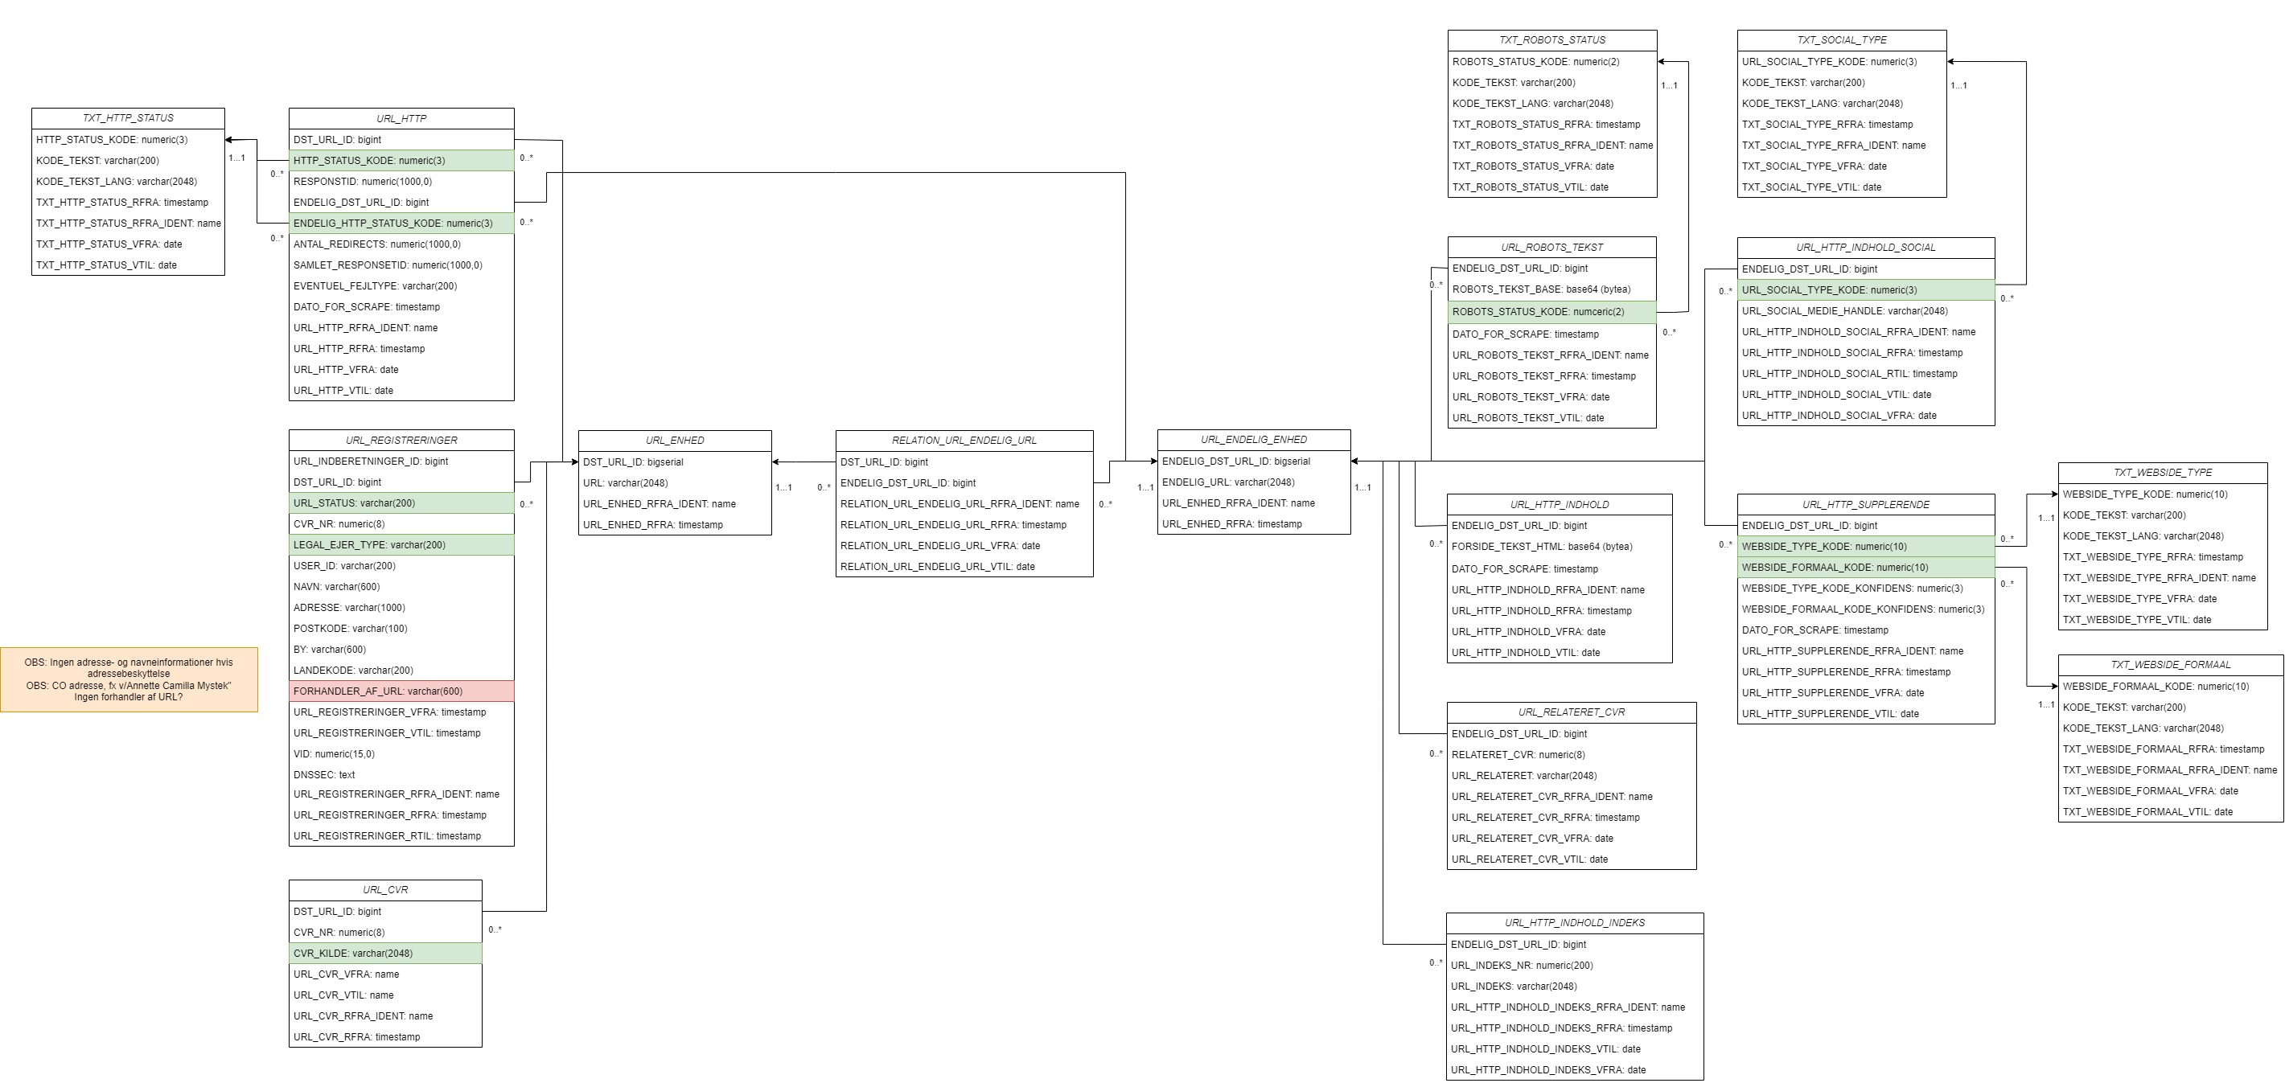
Tecnical

