Slide 1
An Atlas of Economic Activities in the UK
A fine-grained typology of economic activities from open, large-scale web archive data
Leonardo Castro-Gonzalez • Emmanouil Tranos • Levi Wolf • Rui Zhu • Emerald Dilworth
SCHOOL OF GEOGRAPHICAL SCIENCES, UNIVERSITY OF BRISTOL
Common Crawl web text → LLM-assisted taxonomy → postcode-level economic geography

Slide 2
ROADMAP
What we'll cover
01
The Problem
Why static industrial classifications fall short
02
The Atlas
A web-derived, LLM-assisted typology
03
The Pipeline
Collect, cluster, taxonomize, refine
04
Validation
Geography, FAME/SIC benchmarking, policy
05
Usage & Limits
How to use the Atlas — and where it falls short
The Atlas of Economic Activities in the UK
2

Slide 3
THE PROBLEM
Standard classifications can't keep up
SIC, NAICS and NACE structure the economy — but each carries the same three limitations.
◐
↻
✎
Coarse resolution
Slow to update
Self-reported
Broad categories miss specialised or emerging activities.
Revision cycles lag years behind real firm activity.
Registered once, rarely revisited — codes drift over time.
The Atlas of Economic Activities in the UK
3

Slide 4
THE OPPORTUNITY
Websites describe activity in firms' own words
•
Rich detail
Business websites describe products, services and specialisation in far greater detail than conventional classifications.
Firms describe their own specialisation.
•
Timely
Updated by businesses, not fixed cycles.
•
Scalable
Common Crawl: hundreds of millions of pages.
A live, self-updating signal of what a business actually does.
•
Reproducible
Open data + open tools throughout.
The Atlas of Economic Activities in the UK
4

Slide 5
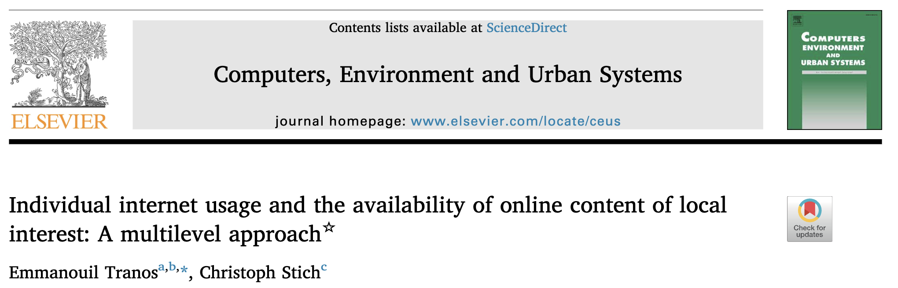
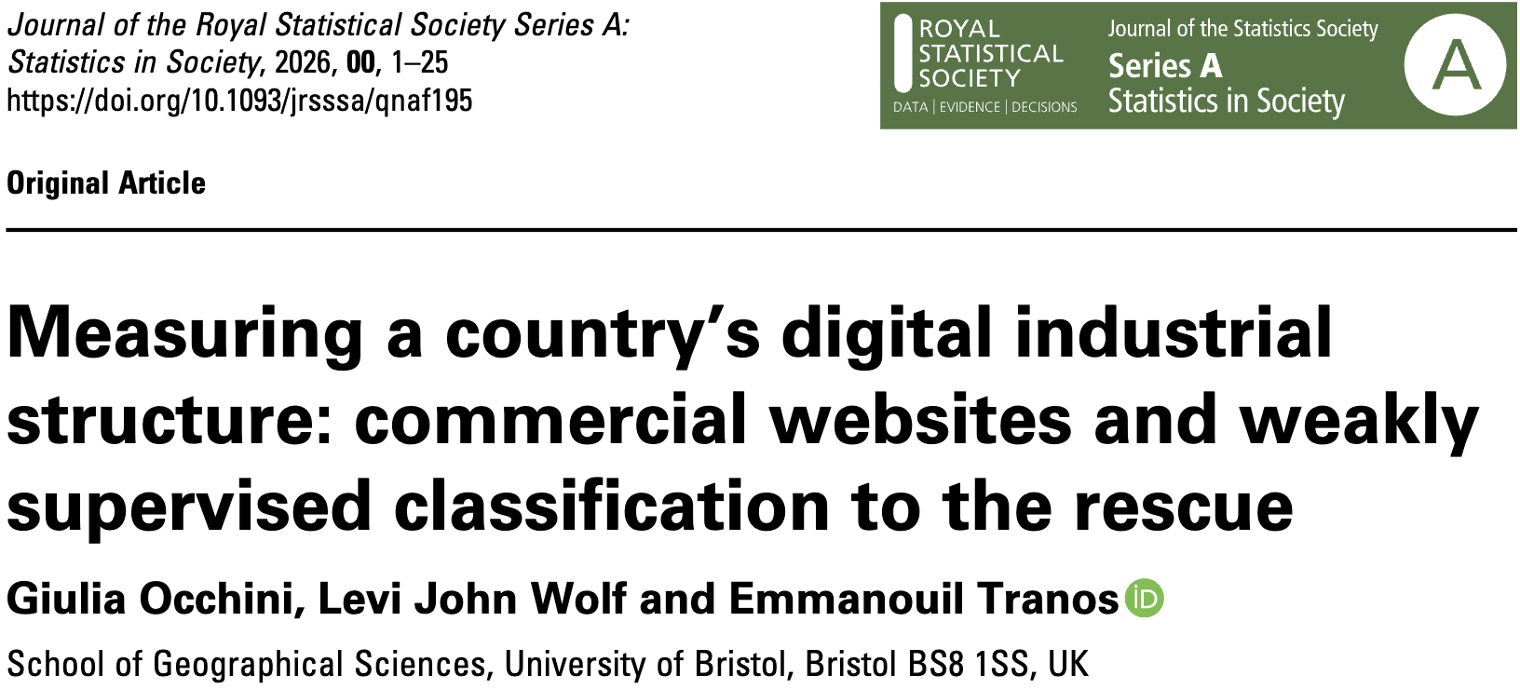



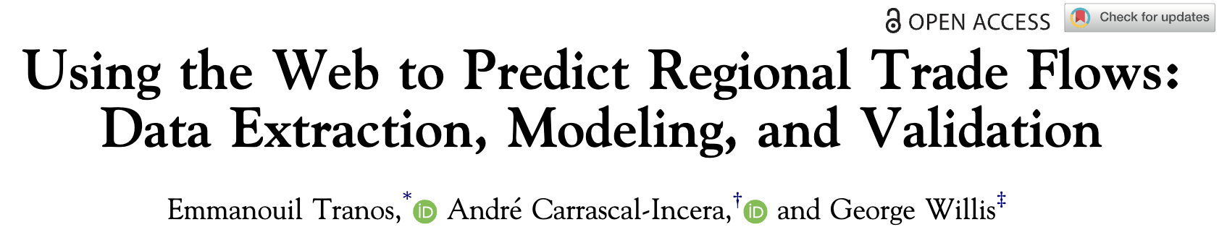

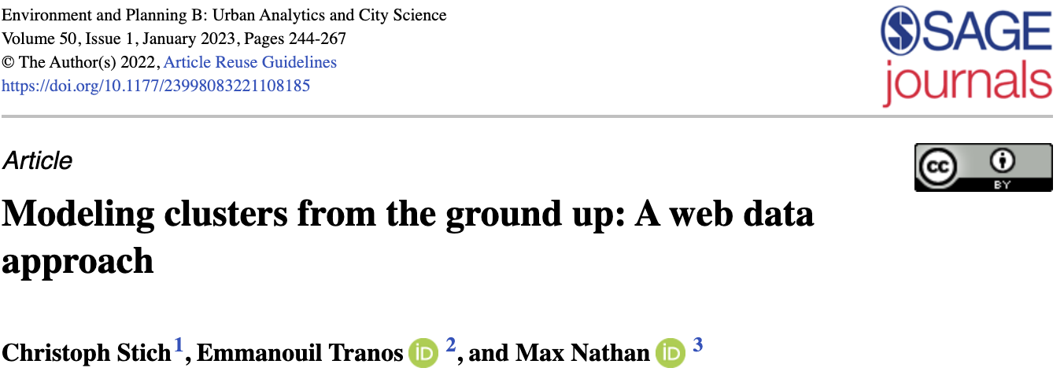

Slide 6
RESEARCH GAP
Prior web-based studies fall short
1
Narrow scope
Specific sectors or territories, not the whole economy.
2
Opaque data
Hard-to-inspect sources harm reproducibility.
3
No time-consistency
Years pooled together — can't isolate change.
→ An open, transparent, reusable framework — for the ‘whole’ economy, at a fixed point in time.
The Atlas of Economic Activities in the UK
5

Slide 7
OUR SOLUTION
Introducing the Atlas of Economic Activities
A granular, dynamic, geolocated typology of UK economic activity.
823k+
5,102
postcode
2
business websites
processed (2021+2024)
unified economic
activity labels
level geolocation
of businesses
time points
2021 & 2024
Supports research and policy needing fine-grained evidence — spatially, temporally, structurally.
The Atlas of Economic Activities in the UK
6

Slide 8
METHOD
A four-stage pipeline
1
2
3
4
Collect & Preprocess
Partition
Build Taxonomy
Refine & Validate
→
→
→
Common Crawl → filter, geocode, clean, summarise
Embed & cluster summaries with EVoC
Extract labels per partition (TnT-LLM)
Deduplicate, merge years, validate
The Atlas of Economic Activities in the UK
7

Slide 9
STAGE 1 · DATA COLLECTION
From ~294M webpages to a usable dataset
No open business register with website information – next project!
Common Crawl released 9–10 crawls per year (2021, 2024), ~150M pages/year at the start.
Raw webpages collected (in millions)
Websites kept after filtering (in thousands)
Filter: .co.uk domain, English text, contains a valid UK postcode, ≤10 distinct postcodes/site.
Final retention from raw archive to usable web text: ~0.3%.
The Atlas of Economic Activities in the UK
8

Slide 10
STAGE 1 · FILTERING LOGIC
Two deliberate design choices
.uk
Restrict to .co.uk domains
≤10
Drop sites with >10 postcodes
A tractable, reproducible national sampling frame — .com is dominated by global organisations, costly to filter by UK-relevance. Extendable to .io / .ai.
Removes large multi-site chains and directory websites — both add noise to postcode-level mapping.
The Atlas of Economic Activities in the UK
9

Slide 11
STAGE 1 · CLEANING & SUMMARISING
From raw web text to a clean signal
Raw WET text
LLM cleaning
LLM summary
Menus, banners and boilerplate mixed with prose.
LLaMA 4 (temp = 0) strips navigation & noise.
≤20-word, activity-focused summary.
→
→
Final dataset: 423,278 websites (2021) and 400,897 websites (2024) with a clean summary.
The Atlas of Economic Activities in the UK
10

Slide 12
STAGE 2 · PARTITIONING
Embedding and clustering summaries
Summaries embedded with all-MiniLM-L6-v2, then clustered with EVoC (UMAP + HDBSCAN-inspired).
●
Signature-based clusters
Resulting partitions
Documents sharing a signature form a cluster core.
879
999
●
Single-linkage for noise
Non-core points join their nearest labelled neighbour.
partitions, 2021
partitions, 2024
Parameters chosen by grid search to minimise noise and variance.
●
Size-bounded partitions
20–4,000 docs, tuned so TnT-LLM always converges.
The Atlas of Economic Activities in the UK
11

Slide 13
STAGE 3 · TAXONOMY GENERATION
TnT-LLM: taxonomy induction, iteratively
1
2
3
4
Split partition
into N samples
→
Generate taxonomy
for sample 1
→
Feed new samples,
refine taxonomy
→
Final taxonomy
for the partition
Applied per-partition (879 + 999 runs)
2021
2024
8,127 labels
9,893 labels
9.3 ± 3.3 / partition
9.9 ± 3.4 / partition
The Atlas of Economic Activities in the UK
12

Slide 14
WORKED EXAMPLE
Resolution adapts to the data
Two 2024 partitions — labels get as specific as the underlying diversity allows.
Partition 0
Partition 15
Business Services
Digital Services
Construction Services
Education Services
Financial Services
Healthcare Services
IT & Technology Services
Legal Services
…
Driving Lessons
Intensive Driving Courses
Learner Driving Services
Specialised Driving Services
Online Driving Services
Refresher Courses
Automatic Driving Lessons
Manual Driving Lessons
Pass Plus Courses
…
The Atlas of Economic Activities in the UK
13

Slide 15
STAGE 4 · REFINEMENT
Semantic deduplication merges look-alikes
Labels sharing only one common word can still describe the same activity.
Intensive Driving
Courses
Learner Driver
Services
How it works
Find each partition's exemplar document
Embed name + description + exemplar
Find cliques within cosine distance < 0.1
Keep the label with most documents
cosine distance < 0.1 ⇒ merge
Driving Lessons
Result: 8,127 → 6,057 labels (2021) | 9,893 → 7,088 labels (2024)
The Atlas of Economic Activities in the UK
14

Slide 16
STAGE 4 · REFINEMENT
From deduplicated labels to one taxonomy
Re-cluster & aggregate
Re-embed and merge overlapping labels via a modified TnT-LLM pass.
Linguistic dedup
Merge labels with indel similarity above 0.85.
Merge years
Human-reviewed alignment of 2021 & 2024 taxonomies.
Final: 5,102 unified labels — 99.99% of both years classified.
The Atlas of Economic Activities in the UK
15

Slide 17
THE DATASET
Three CSV files, openly available on OSF
2021 websites
2024 websites
Unified taxonomy
423,233 rows
400,871 rows
5,102 rows
url, summary, postcodes, labels
identical structure to 2021
label, description, docs/year
Data: osf.io/fxjzq/overview Code: public GitHub repos upon paper publication
The Atlas of Economic Activities in the UK
16

Slide 18
STAGE 4 · TECHNICAL VALIDATION
Geographic coverage is broad & consistent
363 / 363
How coverage was tested
Postcodes cross-checked against ONS databases
Choropleth maps: total vs. dataset postcodes
Consistent ratios across authorities
UK local authorities represented — no large spatial gaps.
12% ± 3%
mean postcode coverage ratio per authority — 80% fall in [9%, 15%].
The Atlas of Economic Activities in the UK
17

Slide 19
STAGE 4 · TECHNICAL VALIDATION
The Atlas of Economic Activities in the UK
17

Slide 20
STAGE 4 · TECHNICAL VALIDATION
Benchmarking against FAME company records
127,120
113,137
SIC-section coverage: FAME vs. our test set
2021 validation firms
2024 validation firms
Coverage drops most for primary/secondary sectors — fewer of those firms have websites.
The Atlas of Economic Activities in the UK
18

Slide 21
STAGE 4 · CASE STUDIES
Where the Atlas adds detail SIC can't
Company | Registered SIC code | Atlas label
Geschwender Interiors Ltd | Petroleum & gas extraction support | Furniture Design & Manufacturing
Aerial Exposure Ltd | Other transport equipment n.e.c. | Drone Services
One Stop Europe Ltd | Retail — motor vehicle parts | EV Charging Solutions
Companies stay incentivised to describe real activity accurately — even when SIC is outdated or wrong.
The Atlas of Economic Activities in the UK
19

Slide 22
STAGE 4 · POLICY BENCHMARK: UK INDUSTRIAL STRATEGY
Case 1 — Financial Services tracks SIC well
25 of 40 relevant SIC codes found: 1,761 (2021) / 2,273 (2024) companies.
SIC code | Top Atlas label
64999 — Other financial services | Financial Services, Investment Management, Bridging and Mortgage services
66220 — Insurance agents & brokers | Insurance Brokerage, Financial Services, Personal Insurance, Protection and Insurance
Takeaway
Labels align well with the sector — but the top label, “Financial Services”, stays fairly generic.
The Atlas of Economic Activities in the UK
20

Slide 23
STAGE 4 · POLICY BENCHMARK: UK INDUSTRIAL STRATEGY
Cases 2 & 3 — filling gaps where SIC can't
Life Sciences
Clean Energy
Partially represented by SIC
No dedicated SIC codes at all
5 SIC codes cover BioPharma & MedTech broadly
Labels reveal sub-specialisations (Genetic Screening, Medical Devices, AI Health)
No clear mislabelling found
Keyword search across labels finds candidate firms directly
Works for Heat Pumps, Wind, CCUS, Hydrogen
Nuclear terms return false positives — needs care
The Atlas of Economic Activities in the UK
21

Slide 24
USING THE ATLAS
How to use it — and where it doesn't reach
✓ Usage notes
⚠ Limitations
Define sectors at the label level, not a single label
Keyword-search labels, then group matches
Use spatially, temporally, or structurally
Not a census — only web-visible businesses
Sectoral bias: primary industries under-represented
Labels aren't a strict hierarchy
Complements SIC — isn't ground truth
The Atlas of Economic Activities in the UK
22

Slide 25
CONCLUSION
A transparent, reusable window on the economy
✓
Open & reproducible
Open web data, open-source tools, a locally deployable LLM.
✓
Granular & dynamic
5,102 labels at postcode resolution, across two years.
✓
Complements SIC
Adds detail where SIC is coarse, stale, or absent.
✓
Transferable
UK-focused today; the framework generalises readily.
The Atlas of Economic Activities in the UK
23

Slide 26


Thank you
Questions & discussion
leonardo.castrogonzalez@bristol.ac.uk • e.tranos@bristol.ac.uk
Data: osf.io/fxjzq/overview • School of Geographical Sciences, University of Bristol

